Slide 1
MCLS Linked Data for Libraries Users Group
“Linked Data: From Promise to Progress”
Andrew K. Pace
Executive Director for Technical Research

Slide 2
Problem statement
The library community’s foundational bibliographic standard is no longer sufficient to take advantage of the tremendous opportunities offered by the web.

Slide 3
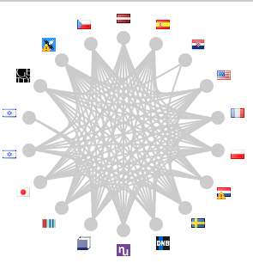
Linked Data and OCLC
WorldCat Works:
5 billion triples
ISNI: 10-50 million triples
WorldCat Catalog:
15 billion triples
VIAF: 2 billion triples
FAST:
23 million
triples
Notes:
Library of Congress (id.loc.gov)
Enables developers to interact with vocabularies found in data & standards promulgated by LC as linked data.
100,000+ requests/day; 100-500 million triples
Getty Art & Architecture Thesaurus
A structured vocabulary for generic concepts related to art and architecture.
100,000+ requests/day 100-500 million triples
Bibliothèque nationale de France (data.bnf.fr)
Data produced by the Bibliothèque nationale de France more useful on the Web.
10,000 – 50,000 requests/day; 100-500 million triples
Deutsche National Bibliothek
Publishes authority and bibliographic data in RDF to make the data accessible to the semantic Web community with no need to know library-specific metadata schemes.
100-500 million triples
Linked Data for Libraries!! (https://www.ld4l.org/)

Slide 4
oc.lc/linkeddatasummary
“While we believe that linked data representations will eventually become the de facto standard, we also believe that MARC will continue to be used by the library community for many years to come.”
Notes:
I hope you’ve seen OCLC’s more detailed statements about Linked Data
In September 2017, OCLC published the strongest public statement in support of linked data to date. Because of our experience, we understand some of the challenges and have learned some important lessons. But because of the technical successes we have already witnessed, plus the sense that the library community’s current standards are bumping up against intractable problems, OCLC is formally committed to the view that linked data will become the de-facto standard. And we are working to make it so.
We have a better understanding of the more nuanced environment required to move research to production. It’s much more complex than a set of legacy datasets that can be converted to a new format.
CLICK
That complexity includes the realization that MARC will be part of our data landscape for the foreseeable future.

Slide 5
A new Linked data prototype

Slide 6
An project vision statement
Work with OCLC members through a foundational shift in the collaborative work of libraries, communities of practice, and end-users—dramatically improving efficiency, embracing the inclusive, diverse, and earnest OCLC membership, and empowering a new and trusted knowledge work enabled by the web.

Slide 7
Who
Phase II Partners (May ‘18 – Sep ‘18)
American University
Brigham Young University
Cleveland Public Library
Harvard University
Michigan State University
National Library of Medicine
North Carolina State University
Northwestern University
Princeton University
Smithsonian Library
Temple University
University of Minnesota
University of New Hampshire
Yale University
Phase I Partners (Dec ’17 - Apr ‘18)
Cornell University
University of California, Davis
OCLC Research
OCLC Global Technolo-gies
OCLC Global Product Management
Notes:
Ran from December 2017 through September 2018
16 OCLC Member libraries participated
The objective was to evaluate a framework for creating and managing bibliographic and authority data as linked data entities and relationships
The internal objective: cross-divisional
The pilot Wikibase instance included 1.2M entities, mostly data representing overlaps between Wikidata, VIAF, and WorldCat

Slide 8
What & HOW?

Slide 9
Disambiguating Wiki*
Wikipedia – a multilingual web-based free-content encyclopedia
Wikidata.org - a collaboratively edited structured dataset used by Wikimedia sister projects and others

Slide 10
Disambiguating Wiki*
Wikipedia – a multilingual web-based free-content encyclopedia
MediaWiki - a free and open-source wiki software
Wikidata.org - a collaboratively edited structured dataset used by Wikimedia sister projects and others
Wikibase - a MediaWiki extension to store and manage structured data

Slide 11
MediaWiki Features
Search, Autosuggest, and APIs
Multilingual User Interface
Wikitext editor
Change history
Discussion pages
Users and rights
Watchlists
Maintenance reports
Etc.

Slide 12
MediaWiki+Wikibase Features
Search, Autosuggest, APIs, Linked Data, and SPARQL
Multilingual User Interface
Structured data editor
Change history
Discussion pages
Users and rights
Watchlists
Maintenance reports
Etc.

Slide 13
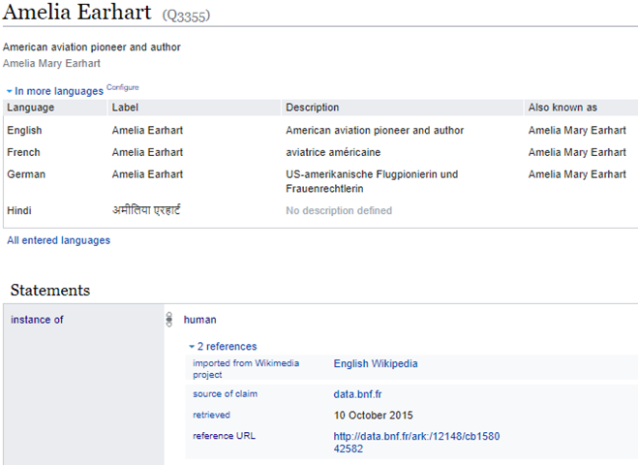
Item Identifier
Label
The “Fingerprint”, for text searching, disambiguation, selection, and duplicate detection.
Description
Aliases
Structured data describing the item and its relationship to other items.
Property
Rank
Value
Notes:
Wikibase and Wikidata gave us a platform to transition away from
Multiple, unranked assertions and Unlinked citations for different assertions so prevalent in MARC bib and authority records

Slide 14
USE CASES FROM AN OCLC WIKIBASE PILOT PROJECT

Slide 15
Use case: Manual Data Entry
The Wikibase UI supports data entry.
It has a powerful and well-tested set of features that speed the data entry process and assist with quality control and data integrity.
Notes:
People want the ability to edit manually

Slide 16
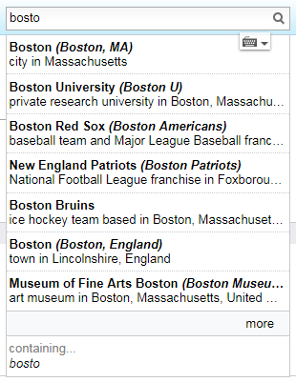
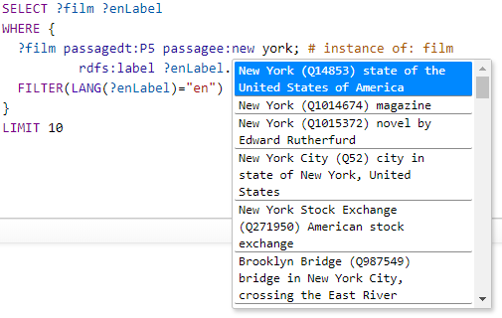
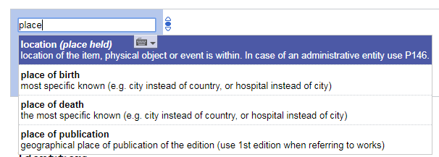
Use case: Autosuggest
Searching for entities as you type is supported by the Mediawiki API. This feature is found in both the Wikibase UI and in the SPARQL Query Service UI.

Slide 17
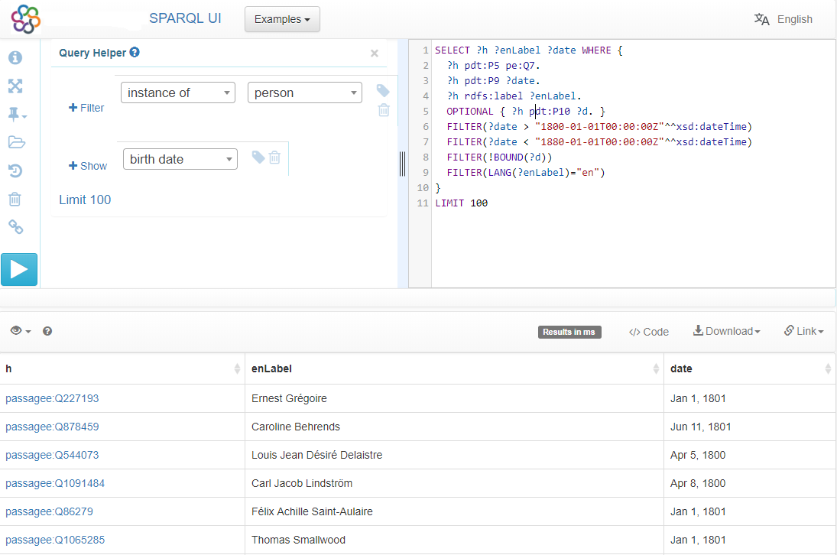
Use case: Complex Queries
SPARQL is a semantic query language for databases.
The ecosystem includes a SPARQL endpoint and a user-friendly interface for constructing queries.
In this example SPARQL query, items describing people born between 1800 and 1880, but without a specified death date, are listed.

Slide 18
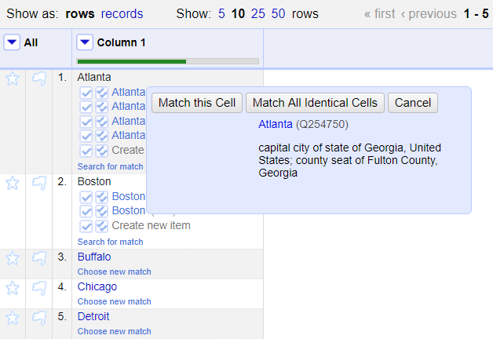
Use case: Reconciliation
Reconciling strings to a ranked list of potential entities is a key use case to be supported.
We used an OpenRefine-optimized Reconciliation API endpoint for this use case.
The Reconciliation API uses the ecosystem’s Mediawiki API and SPARQL endpoint in a hybrid tandem to find and rank matches.
Notes:
Why OpenRefine? Because it is popular, powerful, and ubiquitous. Though it might not be as commonly used with those managing MARC data? Something for us to learn more about.

Slide 19
Use case: Batch Loading Data
For batch loading new items and properties, and subsequent batch updates and deletions, OCLC staff use Pywikibot.
It is a Python library and collection of scripts that automate work on MediaWiki sites. Originally designed for Wikipedia, it is now used throughout the Wikimedia Foundation's projects and on many other wikis.
Wikidata Quickstatements is an interesting alternative.

Slide 20
Some take-aways
from the pilot project

Slide 21
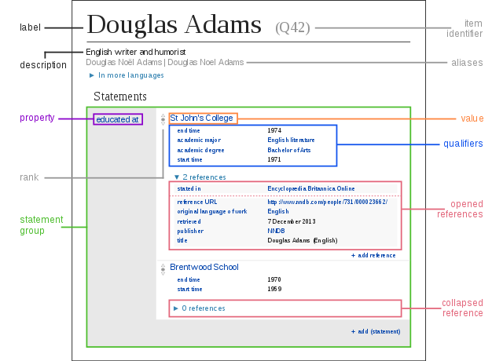
Wikibase allows for complexity without insisting on it.

Slide 22
Key Takeaways
Linked data notability, property, and reference requirements and guidelines are substantially different from authority work.
Partnership is key: community input will determine the path forward
Additional consideration of technical aspects including reconciliation and scalability
Wikibase was an ideal software stack for our pilot
Notes:
This is a lot different from authority work
Without the use cases provided by the library partners and their active participation, we could not have learned as much as we did in such a short time
There are several data ingest and output challenges ahead, and of course the prototype included datasets orders of magnitude smaller than the totality of library and 3rd party data.
4. Despite concerns of scale, wikibase was perfect for our prototype work
This is great software … well-designed and accessible to those inclined to extend it
There are many great MediaWiki community extensions available, far more than we had time to try out
The Wikidata data model, software framework, and community are enabling a paradigm shift in how the world records knowledge

Slide 23
NEXT STEPS
Notes:
Finally, just 3 slides on our next steps….

Slide 24
Product Planning
Currently in design phase: consultation and architecture
Initial priority on building entity ecosystem and services
Will continue to develop thinking on interfaces
Product Advisory group being formed to guide priorities
Guiding principles
Mixed environment
Persistence and quality
Input/output
Services paramount
Web visibility
Notes:
Even before the pilot ended, we engaged with our technical and development teams on how we could put this into broad use.
This work continues and we have milestones this fall.
Can't really announce details but the initial priorities are around building the entity ecosystem, including services for working with it
We will continue to work on interface design
----------------------
We believe the mixed MARC-Bibframe environment will continue for a while
Need to leverage OCLC's scale and structure to create high-quality entity descriptions
AND stand behind their URIs for the long term – infrastructure provider
Need to deal with even more heterogeneous input/output
Need to build services to allow 3rd-party/library-built to engage with Entity Environment
And lest we forget: Why do all of this – get discovered!!

Slide 25
oc.lc/linkeddatawikibase
Prepare to hear more!
Forthcoming Publications
Presentations
Linked data Survey: analysis of the “2018 International linked data Survey for Implementers,” published in Issue 42 of the Code4Lib Journal.
Linked data Prototype: a full technical and functional report on the linked data Wikibase prototype, published by OCLC Research.
Linked data Landscape in Europe and the U.S. an OCLC Research report synthesizing the last five years of linked data research—the state of linked data in libraries, challenges presented in the transition, and pragmatic observations regarding creating a production linked data service for libraries.
DEVCONNECT: Using Wikibase as a platform for library linked data management and discovery (October 16)
WikiConference North America: Creating a Linked Data Library Partnership Using Wikibase (October 21)
Works in Progress Webinar: Lessons Learned from a Linked Data Prototype for Managing Bibliographic Data (October 30)
OCLC Global Council Virtual meeting (November 7)
Midwest Collaborative for Library Services meeting (November 7)
MELA (November 13-15)
CNI: From Prototype to Production: turning good ideas into useful library services (December 10-11)
ALA Midwinter: OCLC LD Roundtable (January 26)

Slide 26
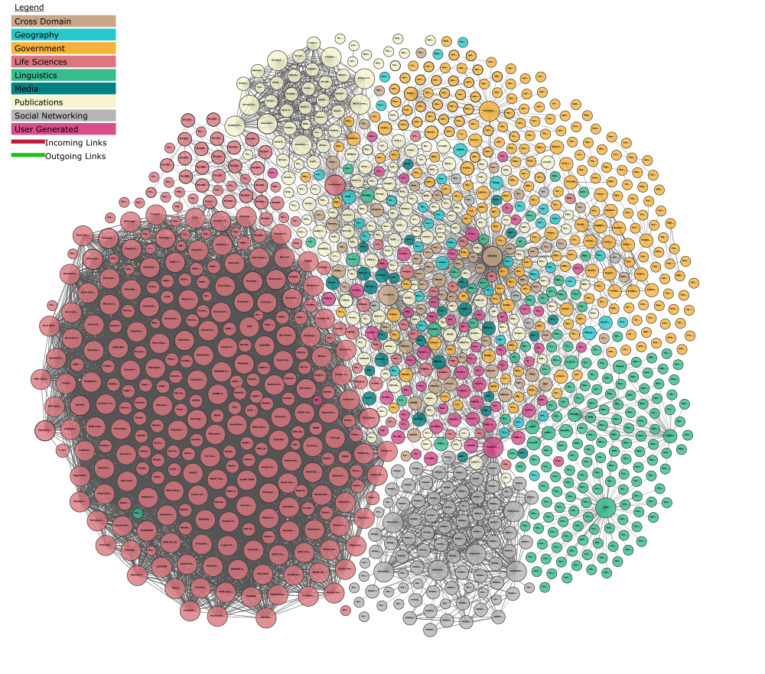
Questions?
Andrew K. Pace
pacea@oclc.org
@andrewkpace
Massive Linked Open Data Cloud (Reference Database), under-exploited by Publishers. (Linking Open Data cloud diagram 2017–08–22, CC-BY-SA by Andrejs Abele, John P. McCrae, Paul Buitelaar, Anja Jentzsch, and Richard Cyganiak. http://lod-cloud.net/)

