Slide 1
Applying Research Methods:
Opportunities for Engagement and Progress
Lynn Silipigni Connaway, PhD
Director of Library Trends and User Research, OCLC
connawal@oclc.org
@LynnConnaway

Slide 2

Image: https://www.flickr.com/photos/75279887@N05/6886478111 by luckey_sun / CC BY-SA 2.0
When put on the spot and asked to define “research,” what would you say?
Notes:
Image: https://www.flickr.com/photos/75279887@N05/6886478111 by luckey_sun / CC BY-SA 2.0

Slide 3

“Much of the library-related research has been applied research dealing with everything from evaluating e-collections, to assessment of reference services, to analyzing integrated library systems.”
(Connaway & Radford, 2017)
Image: https://www.flickr.com/photos/cuellar/370663920 by Jose Maria Cuellar / CC BY-NC 2.0
Notes:
Image: https://www.flickr.com/photos/cuellar/370663920 by Jose Maria Cuellar / CC BY-NC 2.0
Two types of research:
Basic:
“deriv[es] new knowledge and is at most only indirectly involved with how that knowledge will be applied to specific, practical, or real problems” (Connaway & Radford, 2017)
Produces generalizable findings; can be applied to a larger population than the sample
Applied:
Solves specific problems in real situations
Majority of LIS research
Basic and applied research are not dichotomous
Connaway, L. S., & Radford, M. L. (2017). Research Methods for Library and Information Science, 6th ed. Westport, CT: Libraries Unlimited.

Slide 4
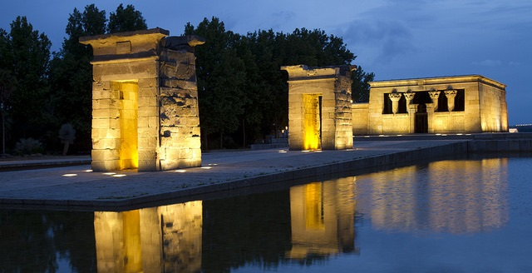
Method: “Any procedure employed to attain a certain end” (e.g., focus groups)
Methodology: “A study of the plans which are used to obtain knowledge”
(Runes, 2001, 346)
(Polkinghorne, 1983, 5)
Image: https://www.flickr.com/photos/nathaninsandiego/14200548378 by Nathan Rupert / CC BY-NC-ND 2.0
Notes:
Image: https://www.flickr.com/photos/nathaninsandiego/14200548378 by Nathan Rupert / CC BY-NC-ND 2.0
Methods and methodology:
Methods and methodology often used interchangeably when that’s not the case
Method:
“Any procedure employed to attain a certain end” (Runes, 2001, 346)
End is the data to be gathered and method is the means by which data is gathered
Quantitative (numbers), qualitative (participant accounts), mixed methods (e.g., combination of quant and qual)
Methodology:
Broader term than method
“A study of the plans which are used to obtain knowledge” as defined by (Polkinghorne, 1983, 5)
Strategies surrounding the use of multiple methods to achieve higher degrees of reliability and validity
Runes, D. D. (Ed.). (2001). The dictionary of philosophy. New York, NY: Citadel Press.
Polkinghorne, D. (1983). Methodology for the human sciences: Systems of inquiry. Albany, NY: State University of New York Press.
Connaway, L. S., & Radford, M. L. (2017). Research Methods for Library and Information Science, 6th ed. Westport, CT: Libraries Unlimited.

Slide 5
Most widely used research methods in LIS
Notes:
What do you think the most widely used data collection method was from 1950-1975?

Slide 6
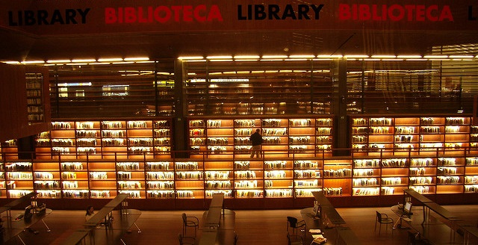
“The LIS field is maturing in terms of research method selection and application in that a greater number and wider variety of research methods are used in all the research publications this study examines…Scholars are no longer limited to the research methods traditionally applied in LIS explorations…"
(Chu, 2015, 40)
Image: https://www.flickr.com/photos/23256651@N00/347072854 by microlito / CC BY 2.0
Notes:
Image: https://www.flickr.com/photos/23256651@N00/347072854 by microlito / CC BY 2.0
Current landscape
“The LIS field is maturing in terms of research method selection and application in that a greater number and wider variety of research methods are used in all the research publications this study examines…Scholars are no longer limited to the research methods traditionally applied in LIS explorations (e.g., questionnaire and historical method)" (Chu, 2015, 40).
Chu, H. (2015). Research Methods in Library and Information Science: A Content Analysis. Library & Information Science Research 37(1), 36-41.

Slide 7
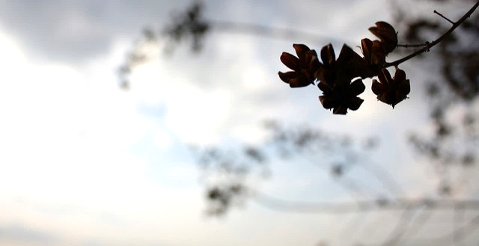
Survey research is one of the most popular methods used in the LIS literature.
(Case & Given, 2016)
Image: https://www.flickr.com/photos/courtneymcgough/3267225383 by Courtney McGough / CC BY-NC-ND 2.0
Notes:
Image: https://www.flickr.com/photos/courtneymcgough/3267225383 by Courtney McGough / CC BY-NC-ND 2.0
Case, D. O., & Given, L. S. (2016). Looking for information: A survey of research on information seeking, needs, and behaviour. Bingley, UK: Emerald.

Slide 8

Qualitative and mixed-method studies are not as prevalent in information behavior studies but demonstrate a greater variety of research strategies and data collection techniques.
(Matusiak, 2017; McKechnie et al., 2002)
Image: https://www.flickr.com/photos/stewdean/3801630111 by Stew Dean / CC BY-NC 2.0
Notes:
Image: https://www.flickr.com/photos/stewdean/3801630111 by Stew Dean / CC BY-NC 2.0
Matusiak, K. K. (2017). Studying information behavior of image users: An overview of research methodology in LIS literature, 2004-2015. Library and Information Science Research 39 (1), 53–60.
McKechnie, L. M., Baker, L., Greenwood, M., & Julien, H. (2002). Research method trends in human information behaviour literature. The New Review of Information Behaviour Research: Studies of Information Seeking in Context (Proceedings of ISIC 2002), 3, 113-125.

Slide 9
Research Papers by Methodology & Year
Methodology | 1950 | 1960 | 1965 | 1970 | 1975 | Total* | %*
Theoretical-analytical | 11 | 17 | 11 | 36 | 52 | 127 | 14
Information system design | 7 | 16 | 21 | 57 | 49 | 150 | 17
Surveys on the public | 3 | 2 | 9 | 20 | 19 | 53 | 3
Survey or experiment on libraries, etc. | 22 | 15 | 45 | 89 | 113 | 284 | 32
Bibliometric and similar studies | 0 | 1 | 7 | 14 | 16 | 38 | 4
Content analysis | 0 | 1 | 2 | 1 | 3 | 7 | 1
Secondary analysis | 6 | 15 | 15 | 13 | 27 | 76 | 8
Historical methodologies | 21 | 26 | 25 | 49 | 42 | 163 | 18
Descriptive bibliography | 7 | 4 | 6 | 4 | 9 | 30 | 3
Comparative studies | 0 | 2 | 6 | 4 | 7 | 19 | 2
Other and multiple | 3 | 1 | 7 | 9 | 10 | 30 | 3
All papers* | 76 | 96 | 139 | 274 | 315 | 900 | 100
(Powell, 1999)
Notes:
*Note: The figures add to more than the total number of papers (and the percentages add to more than 100), since a paper may have more than one methodology
Table (2) from Powell, 1999
Powell, R. (1999). Recent Trends in Research: A Methodological Essay. Library & Information Science Research 21(1), 91-119.

Slide 10
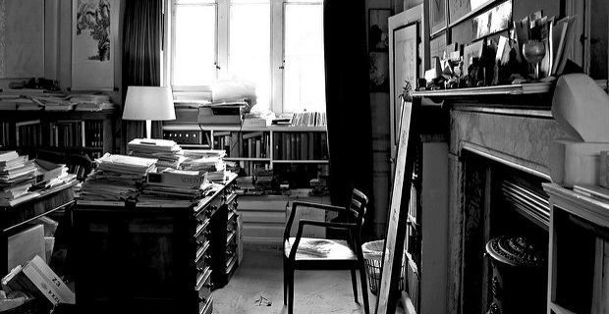
Research Methods: JDoc 2001-2010
N=367
Theoretical approach, 38%
Content analysis, 14%
Questionnaire, 13.8%
Experiment, 13.4%
Interview, 13.4%
(Chu, 2015)
Image: https://www.flickr.com/photos/jaypeg/3658793747 by Jaypeg / CC BY-NC 2.0
Notes:
Image: https://www.flickr.com/photos/jaypeg/3658793747 by Jaypeg / CC BY-NC 2.0
“The LIS field is maturing in terms of research method selection and application in that a greater number and wider variety of research methods are used in all the research publications this study examines. All the methods reported in the 1162 scholarly publications in a sense constitute a toolbox of research methods. Scholars are no longer limited to the research methods traditionally applied in LIS explorations (e.g., questionnaire and historical method). Researchers can instead choose research methods from this expanded toolbox according to their study objectives” (Chu, 2015, p. 40).
Chu, H. (2015). Research Methods in Library and Information Science: A Content Analysis. Library & Information Science Research 37(1), 36-41.

Slide 11
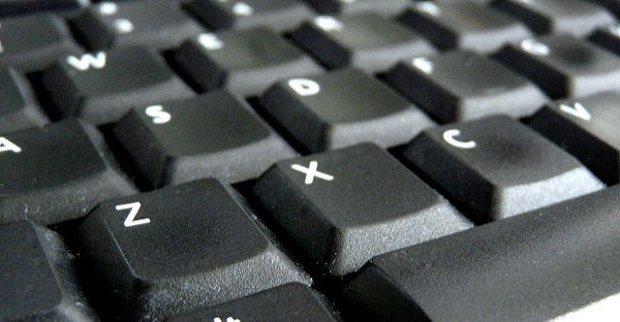
Research Methods:
JASIS&T 2001-2010
N=554
Experiment, 31%
Bibliometrics, 23%
Questionnaire, 14%
Content analysis, 13%
Theoretical approach, 12%
(Chu, 2015)
Image: https://www.flickr.com/photos/judy-van-der-velden/5588900332 by Judy van der Velden / CC BY-NC-ND 2.0
Notes:
Image: https://www.flickr.com/photos/judy-van-der-velden/5588900332 by Judy van der Velden / CC BY-NC-ND 2.0
Chu, H. (2015). Research Methods in Library and Information Science: A Content Analysis. Library & Information Science Research 37(1), 36-41.

Slide 12
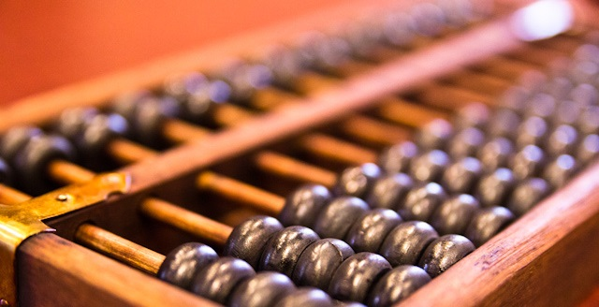
Research Methods: LISR 2001-2010
N=241
Content analysis, 30%
Questionnaire, 28%
Interview, 20%
Theoretical approach, 15%
Experiment, 9%
(Chu, 2015)
Image: https://www.flickr.com/photos/stevendepolo/6752594589 by Steven Depolo / CC BY 2.0
Notes:
Image: https://www.flickr.com/photos/stevendepolo/6752594589 by Steven Depolo / CC BY 2.0
Chu, H. (2015). Research Methods in Library and Information Science: A Content Analysis. Library & Information Science Research 37(1), 36-41.

Slide 13
Research Methods: JAL 2004-2013
Method | Percentage (n=346)
Questionnaire | 47.6
Test or Quiz | 2.6
Diary | 0.6
Content Analysis | 27.2
Semi-structured Interviews | 14.0
Analysis of existing statistics | 6.6
Citation Analysis | 6.3
Focus Group Interview | 5.7
Observation | 4.3
Log Analysis | 3.4
Task Analysis | 2.9
(Luo & McKinney, 2015)
Notes:
Questionnaire: a standard survey questionnaire, 47.6
A test or quiz in the questionnaire format, usually used in experimental or quasi-experimental deign, 2.6
Diary, a type of self-administered questionnaire often used to record frequent or contemporaneous events or experiences, 0.6
Content analysis, 27.2
Semi-structured or in-depth interview, 14.0
Analysis of existing statistics (e.g. results from previous surveys, or circulation statistics), 6.6
Citation analysis, 6.3
Focus group interview, 5.7
Observation, including both quantitative and qualitative observation, 4.3
Log analysis, 3.4
Task analysis — the analysis of the completion of search tasks, 2.9
Luo, L., & McKinney, M. (2015). JAL in the Past Decade: A Comprehensive Analysis of Academic Library Research. The Journal of Academic Librarianship 41(2),123-129.

Slide 14
Research Methods by Popularity, 2010-2015
Method | Percentage (n=2460)
Bibliometrics | 16.6
Other Methods | 12.8
Theoretical Approach | 10.3
Questionnaire | 10.3
Content Analysis | 8.0
Mixed Methodology | 6.6
Webometrics | 5.4
Big data, TDM | 4.9
Interview | 3.7
Experiment | 2.6
Not mentioned | 14.5
(Jasiewicz, J., In press)
Notes:
Methodology of articles published in top LIS research journals, as determined by analysis of article abstracts.
Jasiewicz, J. (In Press). Social science research methods in library science between 2010 and 2015. A bibliometric analysis.

Slide 15
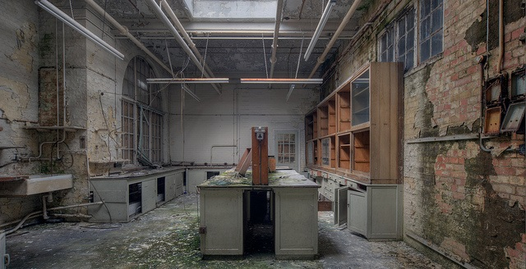
Image: https://www.flickr.com/photos/howzey/7386743932 by Paul / CC BY-NC-ND 2.0
Methods Mentioned Less than 1%
Historical method (1.0%)
Observation (0.8%)
Ethnography/field study (0.8%)
Focus groups (0.6%)
Transaction log analysis (0.3%)
Delphi study (0.3%)
Research diary/Journal (0.2%)
Think aloud protocol (0.1%)
n=2460
(Jasiewicz, J., In press)
Notes:
Image: https://www.flickr.com/photos/howzey/7386743932 by Paul / CC BY-NC-ND 2.0
Methodology of articles published in top LIS research journals, as determined by analysis of article abstracts.
Jasiewicz, J. (In Press). Social science research methods in library science between 2010 and 2015. A bibliometric analysis.

Slide 16
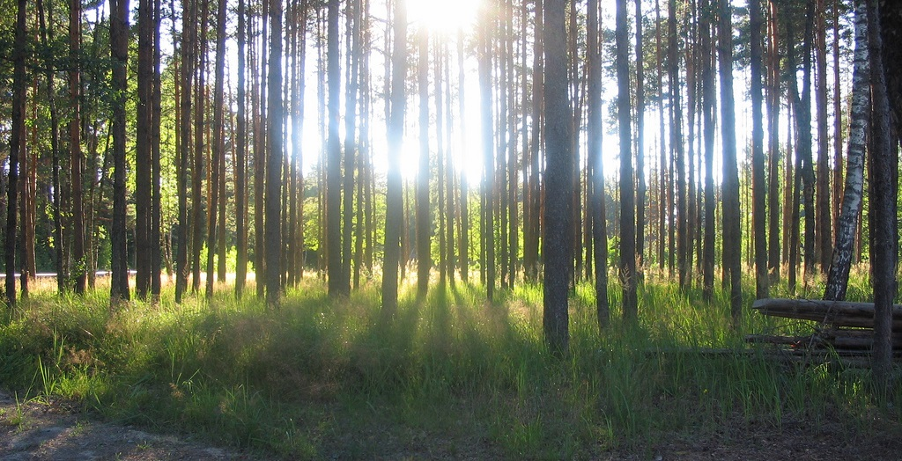
“To identify how and why people get information, it is necessary first to listen.”
(Connaway, 2017)
Image: https://www.flickr.com/photos/pjotr_savitski/2701378287 by Pjotr Savitski / CC BY 2.0
Notes:
Image: https://www.flickr.com/photos/pjotr_savitski/2701378287 by Pjotr Savitski / CC BY 2.0
“Unless we understand students’ lives, we will not be able to fit within their natural information flows. Opportunities become clearer when we begin by simply walking on campus, sitting in on classes, and strolling through the library, student centers, and other campus locations. These actions allow librarians to observe, listen, and note how students and faculty are communicating, studying, learning, teaching, and interacting in everyday life situations.“
Connaway, L. S. (2017, June 19). Putting the library in the life of the user: Listen, then lead, to promote a unique and compelling role for academic libraries. Guest of Choice, Choice360 blog. Retrieved from http://www.choice360.org/blog/putting-the-library-in-the-life-of-the-user

Slide 17
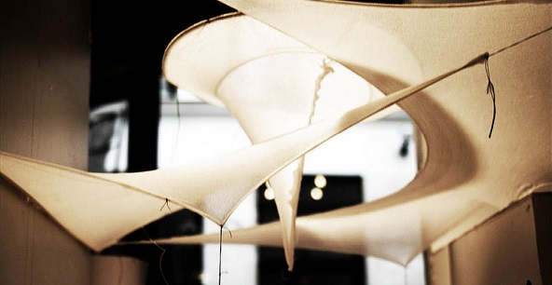
Information Behaviour Research Methods:
JASIST, Information Research 2012-2013
JDOC, iConference Proceedings 2013-2014
Interviews, 51
Surveys, 34
Content Analysis, 28
(Greifeneder, 2014)
Image: https://www.flickr.com/photos/hdaparis/11288970914 by Hugh Dutton Associes / CC BY-NC-ND 2.0
Notes:
Image: https://www.flickr.com/photos/hdaparis/11288970914 by Hugh Dutton Associes / CC BY-NC-ND 2.0
Greifeneder, E. (2014). Trends in information behaviour research. In Proceedings of ISIC, the Information Behaviour Conference, Leeds, 2-5 September, 2014: Part 1. http://InformationR.net/ir/19-4/isic/isic13.html
“Forty-five percent of all studies in the sample applied a mixed-method approach.”
“Only 11 studies (7%) combined more than two methods. 69% of mixed-method approaches were a qualitative-qualitative combination and 31% were a quantitative-qualitative combination. Not a single study combined a quantitative with another quantitative method.”
“Interviews, surveys and content analyses were the most frequently used methods in the last years. It was also obvious that traditional qualitative research, making use of interviews, observations, focus groups or diaries (marked in blue in figure 1) still dominate information behaviour research. Anderson's expectation that these methods will vanish was clearly proven wrong.”

Slide 18
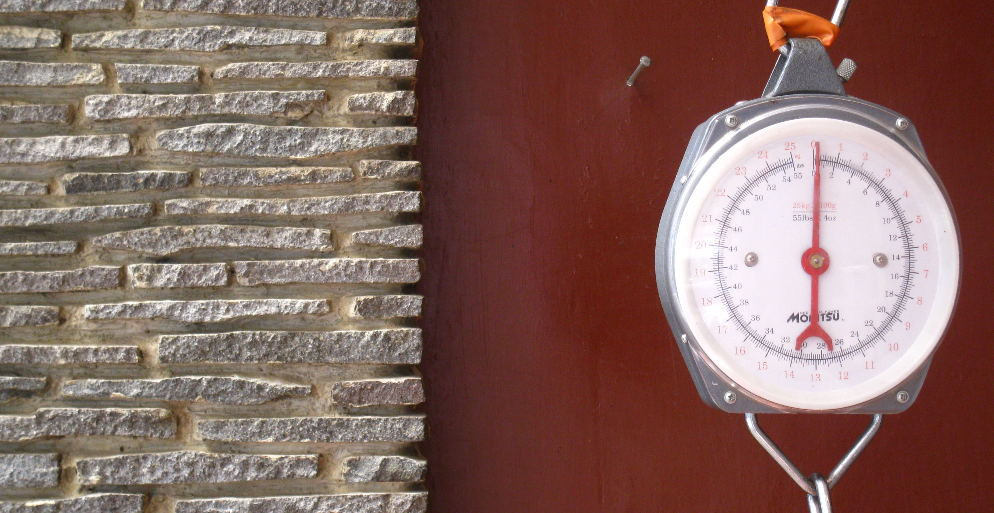
Information Behaviour Research Methods:
JASIST, Information Research 2012-2013
JDOC, iConference Proceedings 2013-2014
Methods used less than five times:
  Delphi studies (Poirier & Robinson, 2014)
  Eye-tracking (e.g. Balatsoukas & Ruthven, 2012; Wildemuth, 2009)
  Log file analysis (Jiang, 2014)
  Participatory designs
(Greifeneder, 2014)
Image: https://www.flickr.com/photos/ikhlasulamal/4538617347 by Ikhlasul Amal / CC BY-NC 2.0
Notes:
Image: https://www.flickr.com/photos/ikhlasulamal/4538617347 by Ikhlasul Amal / CC BY-NC 2.0
Greifeneder, E. (2014). Trends in information behaviour research. In Proceedings of ISIC, the Information Behaviour Conference, Leeds, 2-5 September, 2014: Part 1. http://InformationR.net/ir/19-4/isic/isic13.html
“Forty-five percent of all studies in the sample applied a mixed-method approach.”
“Only 11 studies (7%) combined more than two methods. 69% of mixed-method approaches were a qualitative-qualitative combination and 31% were a quantitative-qualitative combination. Not a single study combined a quantitative with another quantitative method.”
“Interviews, surveys and content analyses were the most frequently used methods in the last years. It was also obvious that traditional qualitative research, making use of interviews, observations, focus groups or diaries (marked in blue in figure 1) still dominate information behaviour research. Anderson's expectation that these methods will vanish was clearly proven wrong.”

Slide 19
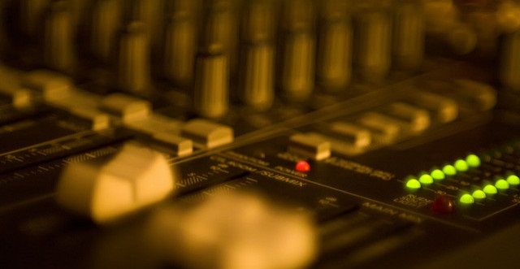
Information Behaviour Research Methods:
JASIST, Information Research 2012-2013
JDOC, iConference Proceedings 2013-2014
Mixed Methods, 45%
  More than two methods, 7%
  Qualitative-Qualitative, 69%
  Quantitative-Qualitative, 31%
  Quantitative-Quantitative, 0%
(Greifeneder, 2014)
Image: https://www.flickr.com/photos/viatorci/3176779507 by David Torcivia / CC BY 2.0
Notes:
Image: https://www.flickr.com/photos/viatorci/3176779507 by David Torcivia / CC BY 2.0
Greifeneder, E. (2014). Trends in information behaviour research. In Proceedings of ISIC, the Information Behaviour Conference, Leeds, 2-5 September, 2014: Part 1. http://InformationR.net/ir/19-4/isic/isic13.html
“Forty-five percent of all studies in the sample applied a mixed-method approach.”
“Only 11 studies (7%) combined more than two methods. 69% of mixed-method approaches were a qualitative-qualitative combination and 31% were a quantitative-qualitative combination. Not a single study combined a quantitative with another quantitative method.”
“Interviews, surveys and content analyses were the most frequently used methods in the last years. It was also obvious that traditional qualitative research, making use of interviews, observations, focus groups or diaries (marked in blue in figure 1) still dominate information behaviour research. Anderson's expectation that these methods will vanish was clearly proven wrong.”

Slide 20
Data Collection Tools
and methods

Slide 21

What is Qualitative Research?
A type of scientific research that:
  Seeks answers to a question
  Systematically uses predefined set of procedures to answer question
  Collects evidence
  Produces findings that:
    Are not determined in advance
    Apply beyond immediate boundaries of study
Image: https://www.flickr.com/photos/katesheets/5772901616 by katesheets / CC BY-NC 2.0
Notes:
Image: https://www.flickr.com/photos/katesheets/5772901616 by katesheets / CC BY-NC 2.0

Slide 22
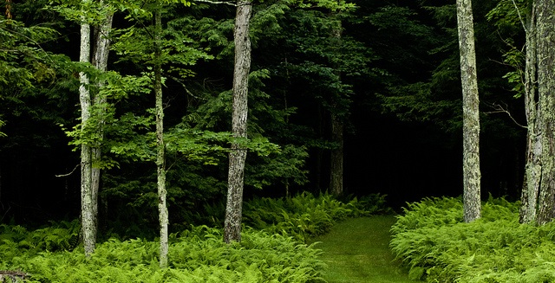
Qualitative research:
Tends to use multiple methods
  Interviews
  Observations
  Diaries
Is open to developing new approaches
(Connaway & Radford, 2017)
Image: https://www.flickr.com/photos/freezr/5962512620 by Nekenasoa / CC BY 2.0
Notes:
Image: https://www.flickr.com/photos/freezr/5962512620 by Nekenasoa / CC BY 2.0
Connaway, Lynn Silipigni, and Marie L. Radford. 2017. Research Methods for Library and Information Science, 6th ed. Westport, CT: Libraries Unlimited.

Slide 23
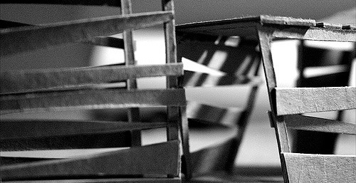
What is Quantitative Research?
Based on the scientific method of inquiry
  Theory
  Problem
  Hypothesis
  Measurement
    Validity, reliability, and level
Includes survey research and experimental research
Utilizes statistical analysis methods
  Image: https://www.flickr.com/photos/zoghal/372832109 by zoghal / CC BY-SA 2.0
Notes:
Image: https://www.flickr.com/photos/zoghal/372832109 by zoghal / CC BY-SA 2.0
Connaway, L. S., & Radford, M. L. (2017). Research Methods for Library and Information Science, 6th ed. Westport, CT: Libraries Unlimited.

Slide 24
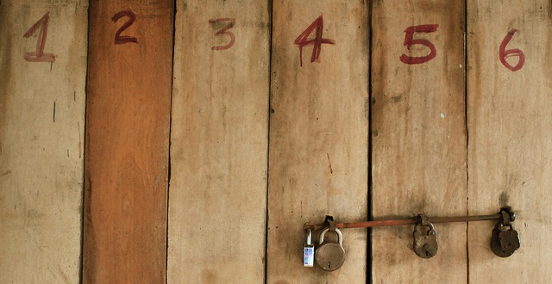
Quantitative Research
Log Analysis
Experiment
Bibliometric Analysis
Survey/Questionnaire
Image: https://www.flickr.com/photos/fukechanabil/6836092392 by Syed Nabil Aljunid / CC BY-NC 2.0
Notes:
Image: https://www.flickr.com/photos/fukechanabil/6836092392 by Syed Nabil Aljunid / CC BY-NC 2.0

Slide 25
Image: https://www.flickr.com/photos/hdaparis/11288970914 by Hugh Dutton Associes / CC BY-NC-ND 2.0
Any combination of research methods
  Qualitative
  Quantitative
  Participatory
  Action
  Design
Equal attention to all stages of research process
Findings should be iterative & informative
Mixed Methods Research
(Kazmer 2017, 232-233)
Notes:
Image: https://www.flickr.com/photos/hdaparis/11288970914 by Hugh Dutton Associes / CC BY-NC-ND 2.0
“Mixed methods research is often thought of as quantitative/qualitative, but other approaches are important to consider: participatory, action, design, etc. Don't think of mixed methods as "survey plus interview" (or worse, "survey with open-ended questions tacked onto the end").
Mixed methods should be deeply integrated, and not parallel tracks that don't intersect. Mixing methods effectively means equal attention to all stages of the research process, from problem statement or hypothesis through analysis; don't focus on the data collection methods to the detriment of the other phases.
And rather than quantitative findings followed by a few attractive quotes from the qualitative data organized according to "themes," the findings from mixed methods should be iterative and mutually-informing.
Very few people can do mixed methods research alone, so embrace cooperative research. Each person needs to understand all the methods being used, but it's natural that each person will have more expertise in one area. Find research partners who have a deep and true appreciation for your contributions; mixed methods research just to satisfy a funding agency is never as fulfilling or productive as it could be. Work closely together so that the overall research design doesn't privilege one method over another just for the sake of method, but so that the combined approach will answer the research questions and allow you to effect change in the world.”
Kazmer, M. (2017). “Mixed Methods.” In Research Methods for Library and Information Science, 6th ed., edited by L. S. Connaway and M. L. Radford, 232-233. Westport, CT: Libraries Unlimited.

Slide 26
Mixed Methods
“Miles, Huberman, and Saldaña also pointed out that although designing and conducting a mixed method research project involves careful planning and more effort in execution, the benefits greatly outweigh the difficulties (including philosophical ones).”
(Connaway and Radford 2017, 229)
Image: https://www.flickr.com/photos/ikhlasulamal/4538617347 by Ikhlasul Amal / CC BY-NC 2.0
Notes:
Image: https://www.flickr.com/photos/ikhlasulamal/4538617347 by Ikhlasul Amal / CC BY-NC 2.0
“Miles, Huberman, and Saldaña also pointed out that although designing and conducting a mixed method research project involves careful planning and more effort in execution, the benefits greatly outweigh the difficulties (including philosophical ones).” (Connaway and Radford 2017, 229)
Connaway, L. S., & Radford, M. L. (2017). Research Methods for Library and Information Science, 6th ed. Westport, CT: Libraries Unlimited.
Miles, M. B., Huberman, M., & Saldaña, J. (2014). Qualitative Data Analysis: A Methods Sourcebook, 3rd ed. Thousand Oaks, CA: Sage.

Slide 27
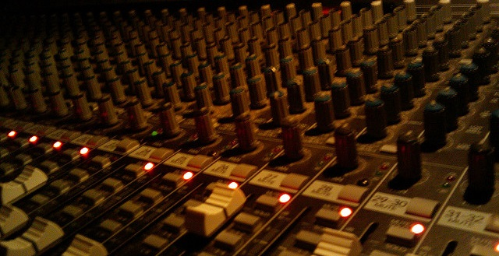
Mixed Methods Research
Any combination of research methods
  Qualitative
  Quantitative
  Participatory
  Action
  Design
Equal attention to all stages of research process
Findings should be iterative & informative
Image: https://www.flickr.com/photos/jmarty/3591153133 by Justin / CC BY-SA 2.0
(Kazmer 2017, 232-233)
Notes:
Image: https://www.flickr.com/photos/jmarty/3591153133 by Justin / CC BY-SA 2.0
“Mixed methods research is often thought of as quantitative/qualitative, but other approaches are important to consider: participatory, action, design, etc. Don't think of mixed methods as "survey plus interview" (or worse, "survey with open-ended questions tacked onto the end").
Mixed methods should be deeply integrated, and not parallel tracks that don't intersect. Mixing methods effectively means equal attention to all stages of the research process, from problem statement or hypothesis through analysis; don't focus on the data collection methods to the detriment of the other phases.
And rather than quantitative findings followed by a few attractive quotes from the qualitative data organized according to "themes," the findings from mixed methods should be iterative and mutually-informing.
Very few people can do mixed methods research alone, so embrace cooperative research. Each person needs to understand all the methods being used, but it's natural that each person will have more expertise in one area. Find research partners who have a deep and true appreciation for your contributions; mixed methods research just to satisfy a funding agency is never as fulfilling or productive as it could be. Work closely together so that the overall research design doesn't privilege one method over another just for the sake of method, but so that the combined approach will answer the research questions and allow you to effect change in the world.”
Kazmer, Michelle. 2017. “Mixed Methods.” In Research Methods for Library and Information Science, 6th ed., edited by Lynn Silipigni Connaway and Marie L. Radford, 232-233. Westport, CT: Libraries Unlimited.

Slide 28
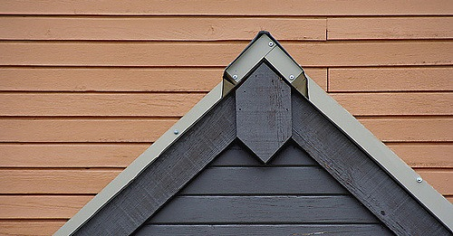
Image: https://www.flickr.com/photos/ytwhitelight/49895159 by Amanda Graham / CC BY-NC-ND 2.0
Triangulation
Term coined by Webb et al. (1966)
Multiple methods of data collection (e.g., interviews – individual & group, observation, literature, archives)
  Agree, or at least don’t contradict (Miles and Huberman 1994, 266)
Multiple investigators
Multiple contexts/situations
Notes:
Image: https://www.flickr.com/photos/ytwhitelight/49895159 by Amanda Graham / CC BY-NC-ND 2.0
Adapted from slides by Ellen Olshansky
Miles, M. B., & Huberman, A. M. (1994). Qualitative Data Analysis: A Sourcebook. Beverly Hills: Sage Publications.
Webb, E. J., Campbell, D. T., Schwartz, R. D., & Sechrest, L. (1966). Unobtrusive Measures: Nonreactive Research in the Social Sciences, Vol. 111. Chicago: Rand McNally.

Slide 29
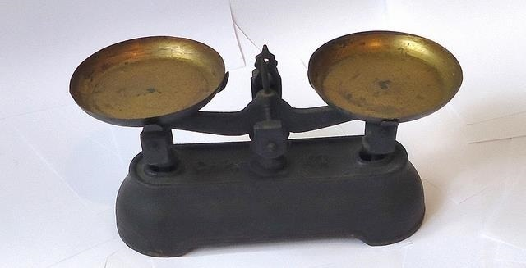
Sampling
Nonprobability Sampling
  Accidental sample
  Quota sample
  Snowball sample
  Purposive sample
  Self-selected sample
  Incomplete sample
Probability Sampling
  Simple random sample
  Systematic sample
  Stratified random sample
  Cluster sample
Image: https://www.flickr.com/photos/mauroescritor/17137445937 by Mauro Cateb / CC BY 2.0
Notes:
Image: https://www.flickr.com/photos/mauroescritor/17137445937 by Mauro Cateb / CC BY 2.0
Connaway, L. S. & Radford, M. L. (2017). Research Methods for Library and Information Science, 6th ed. Westport, CT: Libraries Unlimited.

Slide 30
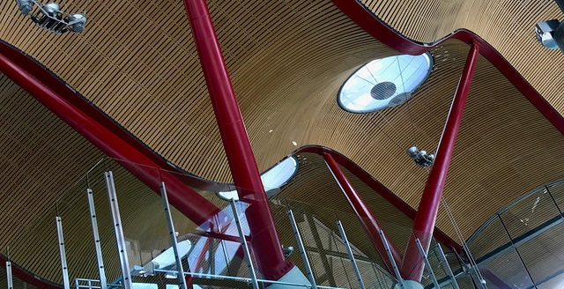
Types of Interviews
Structured
Semi-structured
Formats:
  Individual
    Face-to-face
    Telephone
    Skype
  Focus Group Interviews
Image: https://www.flickr.com/photos/sdobie/39647731704 by sdobie / CC BY-NC 2.0
Notes:
Image: https://www.flickr.com/photos/sdobie/39647731704 by sdobie / CC BY-NC 2.0

Slide 31
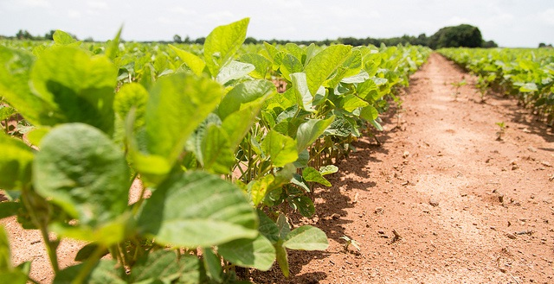
Image: https://www.flickr.com/photos/unitedsoybean/9621771533 by United Soybean Board / CC BY 2.0
Interviews: Advantages
Face-to-face interaction
In-depth information
Understand experiences & meanings
Highlight individual’s voice
Preliminary information to “triangulate”
Control sampling
  Include underrepresented groups
Greater range of topics
Notes:
Image: https://www.flickr.com/photos/unitedsoybean/9621771533 by United Soybean Board / CC BY 2.0

Slide 32
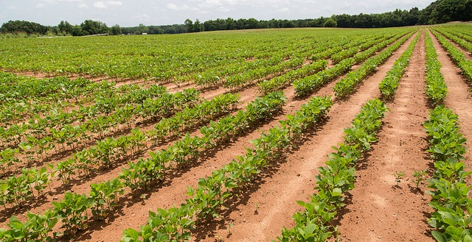
Image: https://www.flickr.com/photos/unitedsoybean/9621769847 by United Soybean Board / CC BY 2.0
Interviews: Disadvantages
Time Factors
  Varies by number &depth
  Staff intensive
Cost Factors
  Higher the number, higher the cost
Additional Factors
  Self-reported data
  Errors in note taking possible
Notes:
Image: https://www.flickr.com/photos/unitedsoybean/9621769847 by United Soybean Board / CC BY 2.0

Slide 33
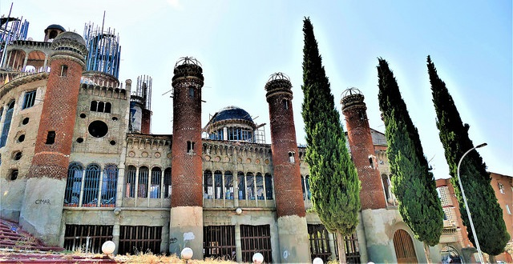
Image: https://www.flickr.com/photos/antoniomarinsegovia/30043238888 by Antonio Marin Segovia / CC BY-NC-ND 2.0
Semi-structured Interviews
Incredibly detailed data
Time consuming
  Establishing rapport
  Selecting research participants
  Transcribing observations & conversations
Notes:
Image: https://www.flickr.com/photos/antoniomarinsegovia/30043238888 by Antonio Marin Segovia / CC BY-NC-ND 2.0
Connaway, L. S., & Radford, M. L. (2017). Research Methods for Library and Information Science, 6th ed. Westport, CT: Libraries Unlimited.

Slide 34
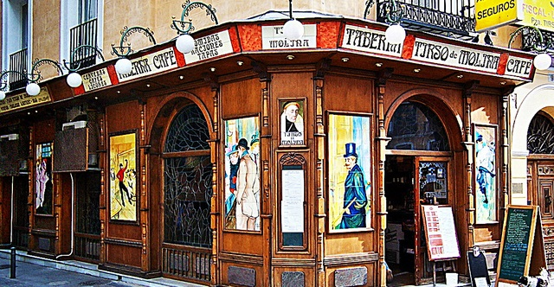
Conducting the Interview
Thematizing: Clarifying the interview’s purpose
Designing: Defining the interview’s purpose
Interviewing: Conducting the interview
Transcribing: Creating a written verbatim text of the interview
Analyzing: Figuring out the meaning of data
Verifying: Determining the reliability & validity of the data
Reporting: Telling others about the findings
(Connaway and Radford 2017, 244)
Image: https://www.flickr.com/photos/ferlomu/2337610622 by Fernando Lopez / CC BY-NC-ND 2.0
Notes:
Image: https://www.flickr.com/photos/ferlomu/2337610622 by Fernando Lopez / CC BY-NC-ND 2.0
“Thematizing: Clarifying the interview’s purpose and the concepts to be explored.
Designing: Defining the interview’s purpose and the concepts to be considerations.
Interviewing: Conducting the interview.
Transcribing: Creating a written verbatim text of the interview.
Analyzing: Figuring out the meaning of data in relation to the study’s research questions.
Verifying: Determining the reliability and validity of the data.
Reporting: Telling others about the findings.” (Connaway and Radford 2017, 244)
Connaway, L. S., & Radford, M. L. (2017). Research Methods for Library and Information Science, 6th ed. Westport, CT: Libraries Unlimited.

Slide 35
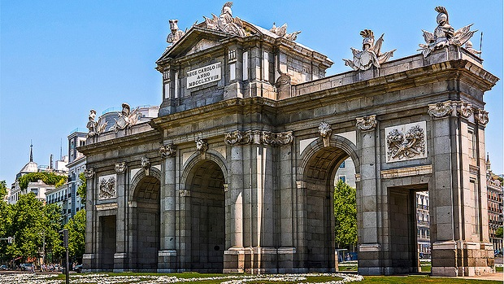
Image: https://www.flickr.com/photos/edomingo/34756113223 by Enrique Domingo / CC BY-NC-ND 2.0
Public Libraries Respond to the Opioid Crisis with Their Community
How did your library decide to offer this program/these services
How did you go about building awareness, understanding, support for the program inside your organization? Outside your organization?
With whom did you work with to make this program/these services happen?
How did you find the resources needed to support this work?
What feedback/reactions did you get from the community?
What feedback/reactions did the local media have about the offering of this program/these services?
What challenges and new opportunities arose as you worked with other community services?
Notes:
Image: https://www.flickr.com/photos/edomingo/34756113223 by Enrique Domingo / CC BY-NC-ND 2.0

Slide 36
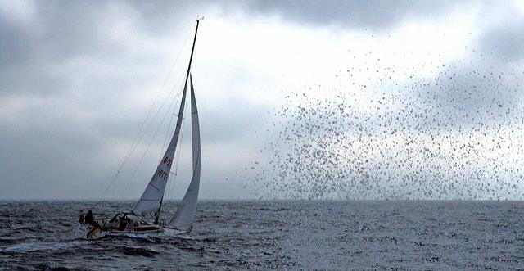
Types of Surveys
Exploratory surveys
  Increase familiarity
  Clarify concepts
  Direct future research
Descriptive surveys
  Includes analytical surveys
  Describe characteristics/population of interest
  Estimate proportions in the population
  Make predictions
  Test associational relationships
  Explore causal relationships
Image: https://www.flickr.com/photos/pixel_addict/1842285901 by Pixel Addict / CC BY 2.0
Notes:
Image: https://www.flickr.com/photos/pixel_addict/1842285901 by Pixel Addict / CC BY 2.0
Connaway, L. S. & Radford, M. L. (2017). Research Methods for Library and Information Science, 6th ed. Westport, CT: Libraries Unlimited.

Slide 37
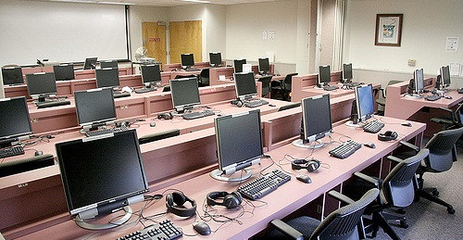
Image: https://www.flickr.com/photos/stanfordedtech/4115393539 by EdTech Stanford University School of Medicine / CC BY-NC-ND 2.0
Online Surveys vs Interviews
Response rate can be improved with email follow ups
Quicker responses
May be less expensive
Numerous existing tools to administer the survey and host data
Decrease manual entry for researcher
Can be easier to analyze
Notes:
Image: https://www.flickr.com/photos/stanfordedtech/4115393539 by EdTech Stanford University School of Medicine / CC BY-NC-ND 2.0
Connaway, L. S., & Radford, M. L. (2017). Research Methods for Library and Information Science, 6th ed. Westport, CT: Libraries Unlimited.

Slide 38
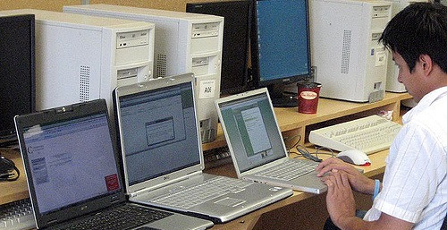
Image: https://www.flickr.com/photos/theotherdan/1440542510 by The Other Dan / CC BY-NC 2.0
Online Surveys
Use a database, programming code, & interface to distribute surveys and collect responses
Drawbacks
  Lower response rates than paper
  Concerns over privacy and confidentiality
  Can be spammed
  Difficult to get a random sample
  May underrepresent those without computers
Notes:
Image: https://www.flickr.com/photos/theotherdan/1440542510 by The Other Dan / CC BY-NC 2.0
Connaway, L. S., & Radford, M. L. (2017). Research Methods for Library and Information Science, 6th ed. Westport, CT: Libraries Unlimited.

Slide 39
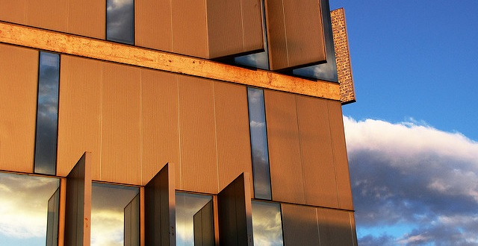
Image: https://www.flickr.com/photos/chemaminguez/3941465351 by Chema Minguez / CC BY-NC-ND 2.0
Survey Research Advantages
Explores many aspects of service
Demographic information
Controlled sampling
High response rates possible
Data reflect characteristics and opinions of respondents
Cost effective
Can be self-administered
Survey large numbers
Online surveys (e.g., Survey Monkey) provide statistical analysis
Notes:
Image: https://www.flickr.com/photos/chemaminguez/3941465351 by Chema Minguez / CC BY-NC-ND 2.0
Adapted from Hernon & Altman, 1998
Hernon, P., & Altman, E. (1998). Assessing Service Quality: Satisfying the Expectations of Library Customers. Chicago, IL: American Library Association.

Slide 40
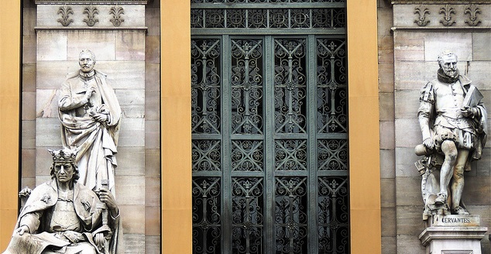
Survey Research Disadvantages
Produces a snapshot of situation
May be time consuming to analyze and interpret results
Produces self-reported data
Data lack depth of interviewing
High return rate can be difficult
Image: https://www.flickr.com/photos/jlcernadas/8633979627 by Jose Luis Cernadas Iglesias / CC BY 2.0
Notes:
Image: https://www.flickr.com/photos/jlcernadas/8633979627 by Jose Luis Cernadas Iglesias / CC BY 2.0
Adapted from Hernon & Altman, 1998
Hernon, P., & Altman, E. (1998). Assessing Service Quality: Satisfying the Expectations of Library Customers. Chicago, IL: American Library Association.

Slide 41

Worthington V&R Screening Survey
When was the most recent time you completed the following in-person activities?
When was the most recent time you completed the following online activities?
When was the most recent time you completed the following activities at the library?
When was the most recent time you completed the following activities on the library website or online catalog?
Have you heard of the following library services and materials offered by Worthington Libraries? Check all that apply.
Image: https://www.flickr.com/photos/d_lazaro/7012073691 by Daniel Lazaro Fernandez / CC BY-NC 2.0
Notes:
Image: https://www.flickr.com/photos/d_lazaro/7012073691 by Daniel Lazaro Fernandez / CC BY-NC 2.0

Slide 42

Diaries
Keep directions minimal and open
Offer participants a variety of ways to report
  Written
  Photo
  Video
  Audio
Data can be rich and detailed, but is self-reported
Does not require researcher presence
(Connaway and Radford, 2017)
Image: https://www.flickr.com/photos/10154402@N03/8421806383 by Bruce Guenter / CC BY 2.0
Notes:
Image: https://www.flickr.com/photos/10154402@N03/8421806383 by Bruce Guenter / CC BY 2.0
Connaway, L. S., & Radford, M. L. (2017). Research Methods for Library and Information Science, 6th ed. Westport, CT: Libraries Unlimited.

Slide 43
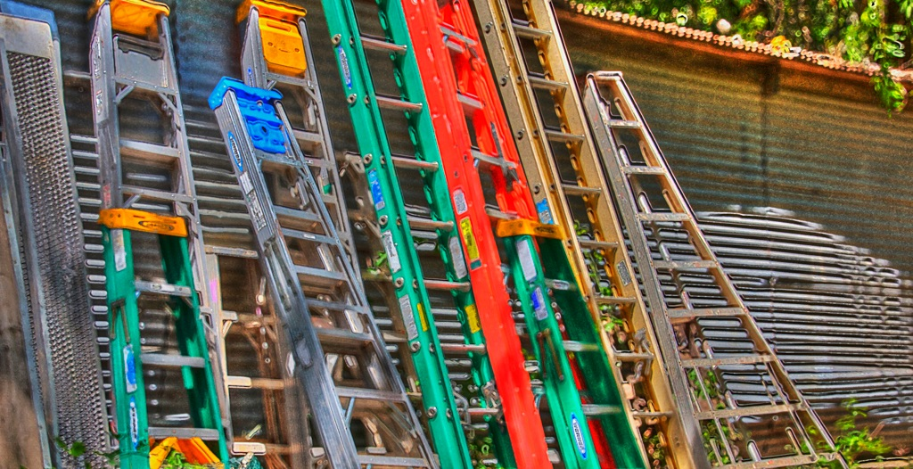
V&R Diary Template
Explain a time in the past month when you were SUCCESSFUL in completing an ACADEMIC assignment. What steps did you take?
Think of a time fairly recently when you struggled to find appropriate resources to help you complete an ACADEMIC assignment. What happened?
Notes:
Image: https://www.flickr.com/photos/elliotmar/8913124849 by Elliot Margolies / CC BY-NC-ND 2.0
Explain a time in the past month when you were SUCCESSFUL in completing an ACADEMIC assignment. What steps did you take?
Think of a time fairly recently when you struggled to find appropriate resources to help you complete an ACADEMIC assignment. What happened?
Explain a time in the past month when you were successful in getting what you needed in a PERSONAL situation. What steps did you take?
Explain a time in the past month when you were NOT successful in getting what you needed in a PERSONAL situation. What steps did you take?
Tell me something interesting that has happened in the past month in the social media that you used for ACADEMIC purposes.
Tell me something interesting that has happened in the past month in the social media that you used for PERSONAL situations.
What do you have to add to our discussion today about how you got information in the past month for both PERSONAL and ACADEMIC situations?
White, D. S., & Connaway, L. S. (2011-2014). Visitors & Residents: What Motivates Engagement with the Digital Information Environment. Funded by JISC, OCLC, and Oxford University. http://www.oclc.org/research/activities/vandr/.

Slide 44
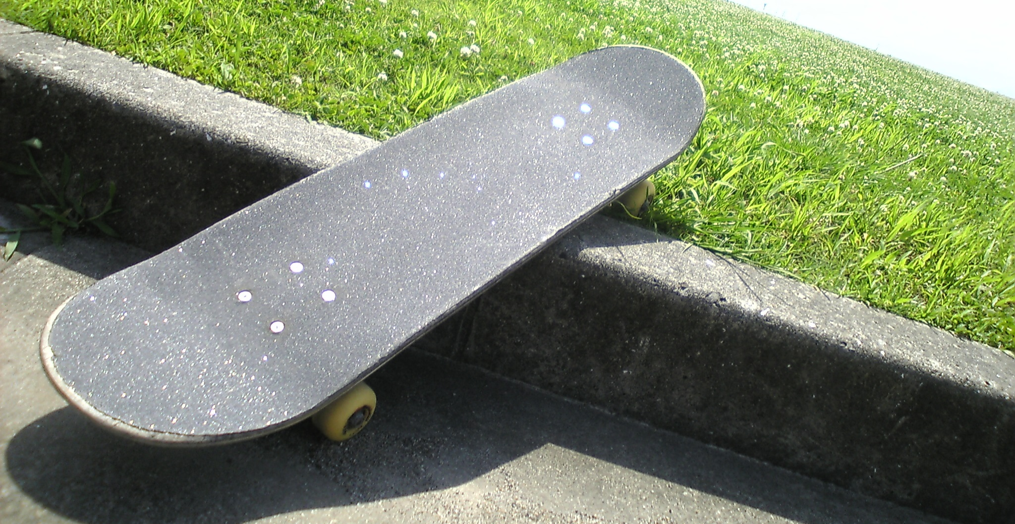
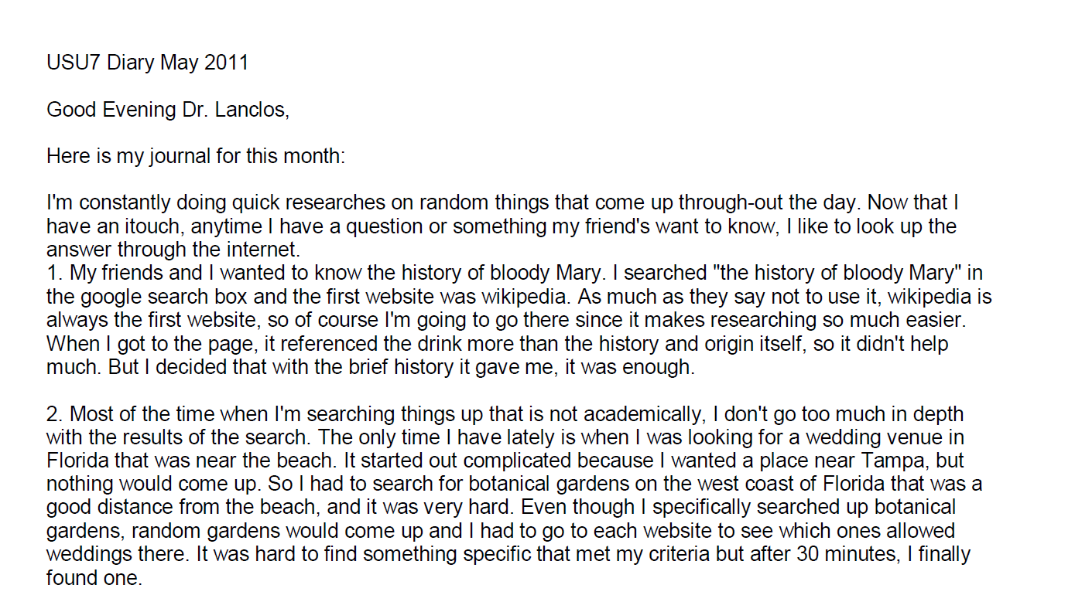
Example: Digital Visitors and Residents Diaries
Notes:
Image: https://www.flickr.com/photos/dancingpapa2007/3674686528 by Naoki Tomeno / CC BY 2.0
Screenshot: USU7 Emg Dry1 Ph1 (Digital Visitors and Residents, USU7, Female, Age 19)
“March was a little more serious. We’re nearing election time and all that jazz, and this is the first election I’ll be able to vote in, so I’ve been doing a bit of reading on a few of the candidates (not much, mind you). As a side note, I’m kind of debating whether or not I should actually vote in this election since I have such little knowledge on the candidates.” (Digital Visitors and Residents, USU12, Male, Age 19) USU12 Est Dry2 Ph2
“Um they do have a search box but I didn’t—I didn’t use that. Um I pretty much just, I pretty much just clicked links.” (Digital Visitors and Residents, USU12, Male, Age 19, 30:37) USU12 Est Follup Int1 Ph3
White, D. S., & Connaway, L. S. (2011-2014). Visitors & Residents: What Motivates Engagement with the Digital Information Environment. Funded by JISC, OCLC, and Oxford University. http://www.oclc.org/research/activities/vandr/.

Slide 45
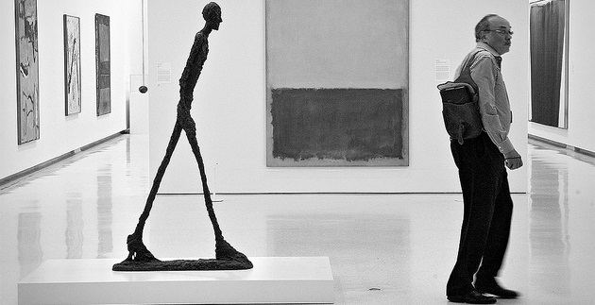
Image: https://www.flickr.com/photos/anjan58/7346141798 by anjan58 / CC BY-NC-ND 2.0
Observation
“Perhaps the most convenient method of studying the consequences of this law will be to follow the reader from the moment he enters the library to the moment he leaves it…”
(Ranganathan 1931, 337)
Notes:
Image: https://www.flickr.com/photos/anjan58/7346141798 by anjan58 / CC BY-NC-ND 2.0
Save time of the reader, previously #4, is now more important (#1) (107)
Connaway, L. S., & Faniel, I. M. (2014). Reordering Ranganathan: Shifting user behaviors, shifting priorities. Dublin, OH: OCLC Research. http://www.oclc.org/content/dam/research/publications/library/2014/oclcresearch-reordering-ranganathan-2014.pdf.
Ranganathan, S. R. (1931). The five laws of library science. London: Edward Goldston, Ltd.

Slide 46
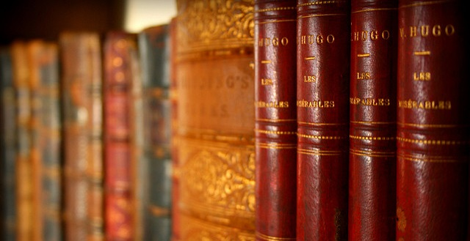
Participant/Immersive Observations
  Image: https://www.flickr.com/photos/jafsegal/5438336871 by Juan Antonio Segal / CC BY 2.0
Unstructured observation
  No predetermined categories of behavior
  Flexible, exploratory
  Notes should be recorded as soon as possible
Structured observation
  Predeveloped observational categories
  Rating scales and/or checklists
  Audio and/or video recording
(Connaway and Radford, 2017)
Notes:
Image: https://www.flickr.com/photos/jafsegal/5438336871 by Juan Antonio Segal / CC BY 2.0
Connaway, L. S., & Radford, M. L. (2017). Research Methods for Library and Information Science, 6th ed. Westport, CT: Libraries Unlimited.

Slide 47
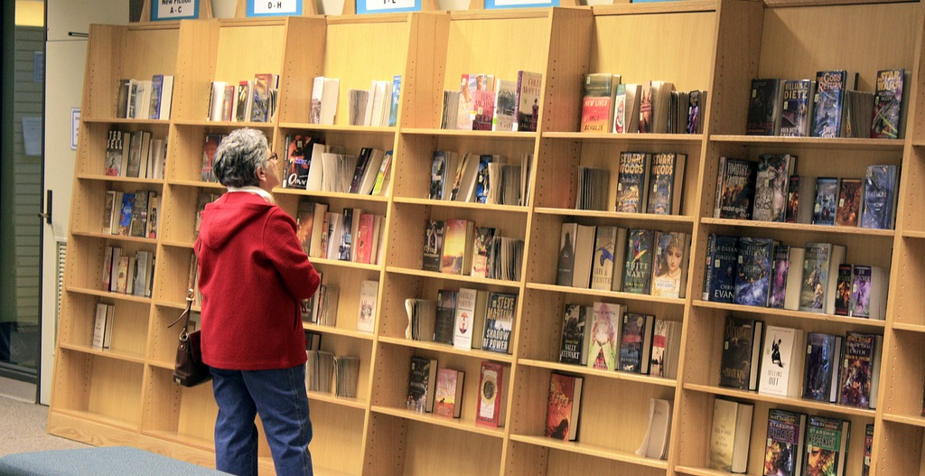
Participant/Immersive Observations
Move into the setting as deeply as possible
Disturb participants as little as possible
Participant observation
  Open, direct interaction & observation as part of the group
(Connaway & Radford, 2017)
Image: https://www.flickr.com/photos/njla/3306454031/ by NJLA: New Jersey Library Association / CC BY-NC-ND 2.0
Notes:
Image: https://www.flickr.com/photos/njla/3306454031/ by NJLA: New Jersey Library Association / CC BY-NC-ND 2.0
Example of participant observation: researcher appears to reference librarians as a patron.
Connaway, L. S., & Radford, M. L. (2017). Research Methods for Library and Information Science, 6th ed. Westport, CT: Libraries Unlimited.

Slide 48

WebJunction Observations
Scenario and Task 1
You are interested in taking free courses from the WebJunction course catalog. Please go to the first task.
Please go to webjunction.org before proceeding You are interested in participating in free courses and webinars offered by WebJunction. A. Find where you can enroll in free library-specific courses and webinars.
(Connaway and Radford, 2017, p. 274)
Notes:
Image: https://www.flickr.com/photos/larrywkoester/21500417954 by Larry Koester / CC BY 2.0
Task 1 Usability Questions: From WebJunction.org, is the user able to easily:
Navigate to learn.wenjunction.org in order to access the course catalog?
Find the link to the catalog?
Task 1 Quantitative Measures: User completes task correctly by
(A1) Opening the “Find Training” menu (Y or N)
(A2) Clicking the link “Go to Courses” to get to the course catalog option (Y or N)
OR
(B1) Entering search terms to get to the course catalog option (Y or N)
Connaway, L. S., & Radford, M. L. (2017). Research Methods for Library and Information Science, 6th ed. Westport, CT: Libraries Unlimited.

Slide 49
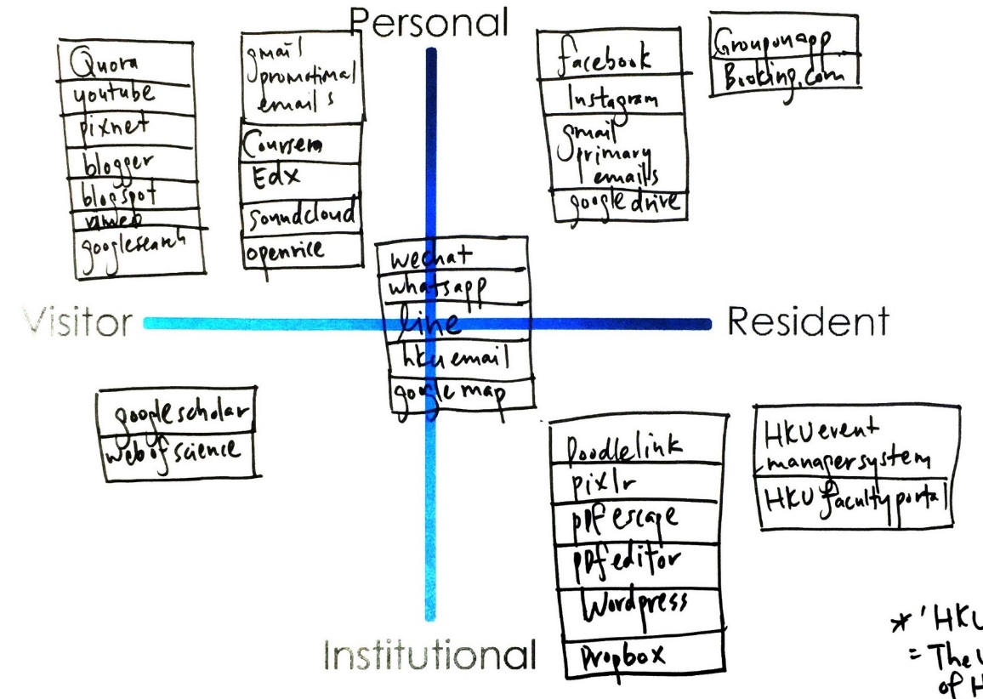
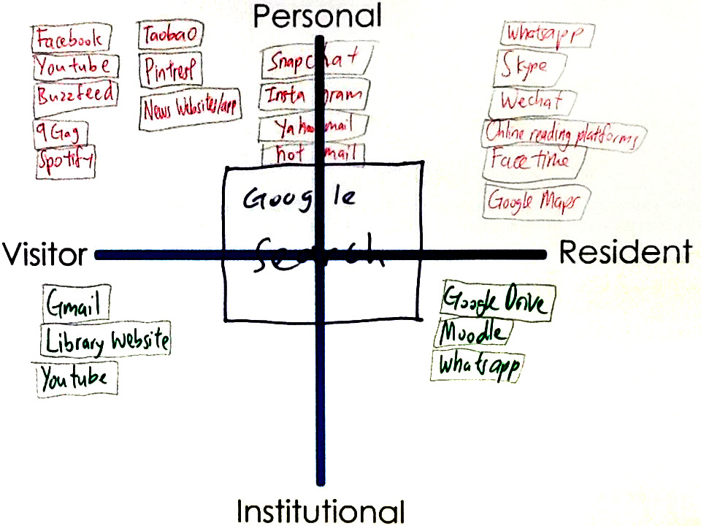
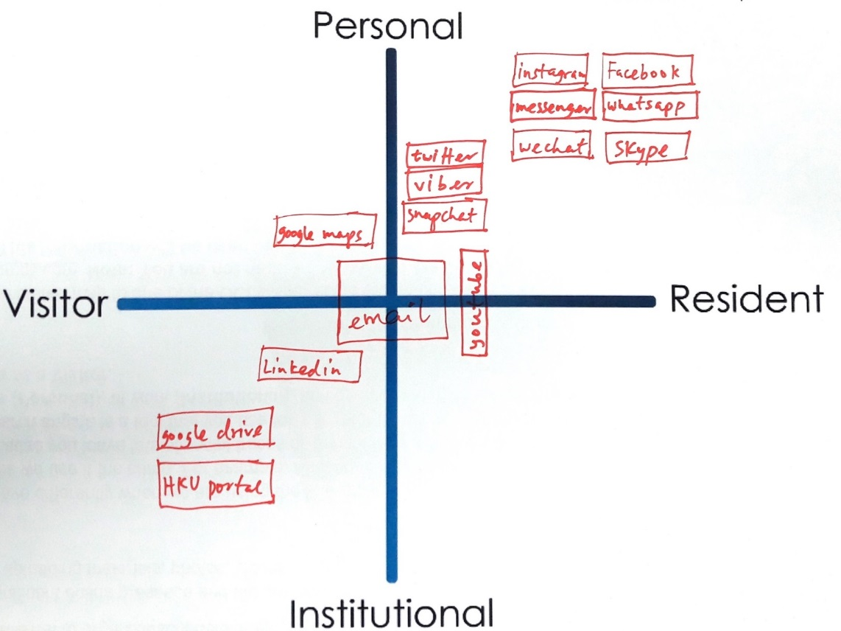
Mapping
Visitors and Residents Sample Maps
Notes:
Quadrant 1:
HKU, 1st year undergrad
Realized I am not that hard working
In desperation when I have to directly go to library website
Google search: usually don’t login, just search, more on visitor side
Snapchat …Hotmail : Not too often do sharing
A way to release my burden
FB try not to post/share, look at what my friends share
Quadrant 2:
HKU, upper undergrad
Library- Borrow book for personal
Google drive – only for group project (visitor)
Social media apps make us anti – social
Quadrant 3:
HKU, faculty researcher and/or scholar
Research assistant
Least Digital footprint as possible, substantial, good thing to live (the left side of the map)
Middle – use a lot in work, create contacts
Use HKU specific apps for work, wordpress, create webpage
Learn about yourself: need to learn more & contribute more in digital footprint (at work and in personal)
White, D. S., & Connaway, L. S. (2011-2014). Visitors & Residents: What Motivates Engagement with the Digital Information Environment. Funded by JISC, OCLC, and Oxford University. http://www.oclc.org/research/activities/vandr/.

Slide 50
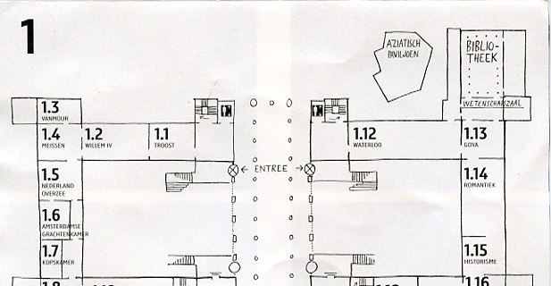
Image: https://www.flickr.com/photos/dutchsimba/15704925354 by Dutch Simba / CC BY-NC-ND 2.0
Cognitive Mapping
Participant draws a map of the area of interest
Fast and easy to conduct
Small time commitment from participants
Can be ambiguous or difficult to interpret
Notes:
Image: https://www.flickr.com/photos/dutchsimba/15704925354 by Dutch Simba / CC BY-NC-ND 2.0
Asher, A. & Miller, S. (2011). So You Want to Do Anthropology in Your Library? Or a Practical Guide to Ethnographic Research in Academic Libraries. Chicago: The ERIAL Project.

Slide 51
Mapping Diaries
Give participants a map & ask them to record their movements
Can use maps as basis for individual interviews
From Clark (2007), “Mapping Diaries, or Where Do They Go All Day?”, p. 49
Notes:
Clark, K. (2007). Mapping Diaries, or Where Do They Go All Day? In N. Foster & S. Gibbons (Eds.), Studying Students: The Undergraduate Research Project at the University of Rochester. Chicago: Association College and Research Libraries.

Slide 52
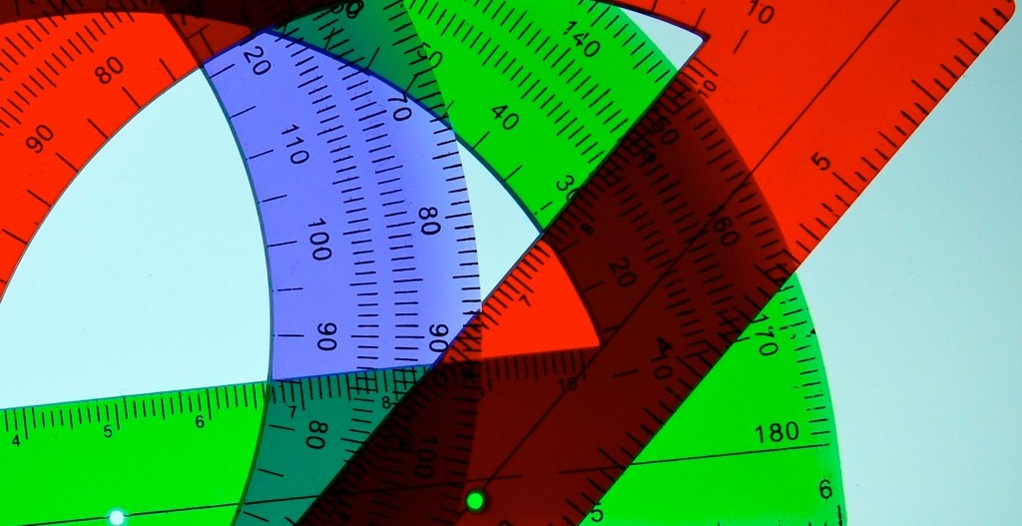
Usability Testing
Degree to which a user can successfully learn & use a product to achieve a goal
Evaluation research methodology
Observation & analysis of user behavior while users use a product or product prototype to achieve a goal
(Dumas and Redish 1993, 22)
Image: https://www.flickr.com/photos/deanhochman/14481958642 by Dean Hochman / CC BY 2.0
Notes:
Image: https://www.flickr.com/photos/deanhochman/14481958642 by Dean Hochman / CC BY 2.0
Dumas, J. S., & Redish, J. C. (1993). A Practical Guide to Usability Testing. Portland, OR: Intellect Books.

Slide 53
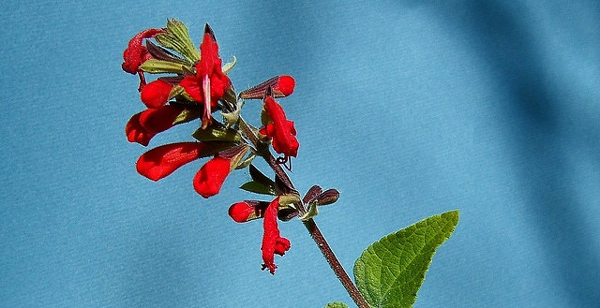
Image: https://www.flickr.com/photos/teagrrl/269862000 by tracy ducasse / CC BY-NC-ND 2.0
Comprised of three parts:
Pre-session interview
Scenario and task structured test
Post-session survey
(Tang 2017, 278)
Usability Testing: Components
Notes:
Image: https://www.flickr.com/photos/teagrrl/269862000 by tracy ducasse / CC BY-NC-ND 2.0
Tang, R. (2017). “Usability Research.” In Research Methods for Library and Information Science, 6th ed., edited by L. S. Connaway & M. L. Radford, 277-278. Westport, CT: Libraries Unlimited.

Slide 54
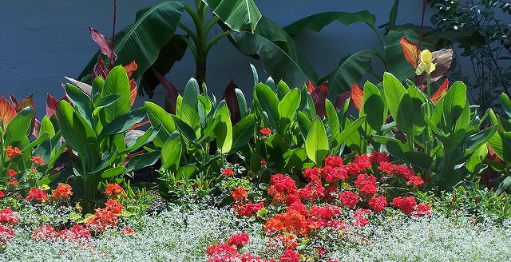
Usability Testing: Methodology
Artificial environment (laboratory)
  Maintain more control
  May provide more specific data on a particular feature
Natural environment
  Better holistic representation of real people doing real work
(Tang 2017, 278)
Image: https://www.flickr.com/photos/nationwideclassifieds/3120876337 by Brian Hanson / CC BY-NC 2.0
Notes:
Image: https://www.flickr.com/photos/nationwideclassifieds/3120876337 by Brian Hanson / CC BY-NC 2.0
Key tip: A major lesson I learned over the years of conducting usability research is that in addition to producing results and recommendations that are practical for stakeholders, it is necessary to pay attention to the scholarly value of your work. Relevant theoretical frameworks might be applied to guide you through analyzing the interplay among behavior variables and interaction patterns (Tang 2017, 278).
Tang, R. (2017). “Usability Research.” In Research Methods for Library and Information Science, 6th ed., edited by L. S. Connaway & M. L. Radford, 277-278. Westport, CT: Libraries Unlimited.

Slide 55
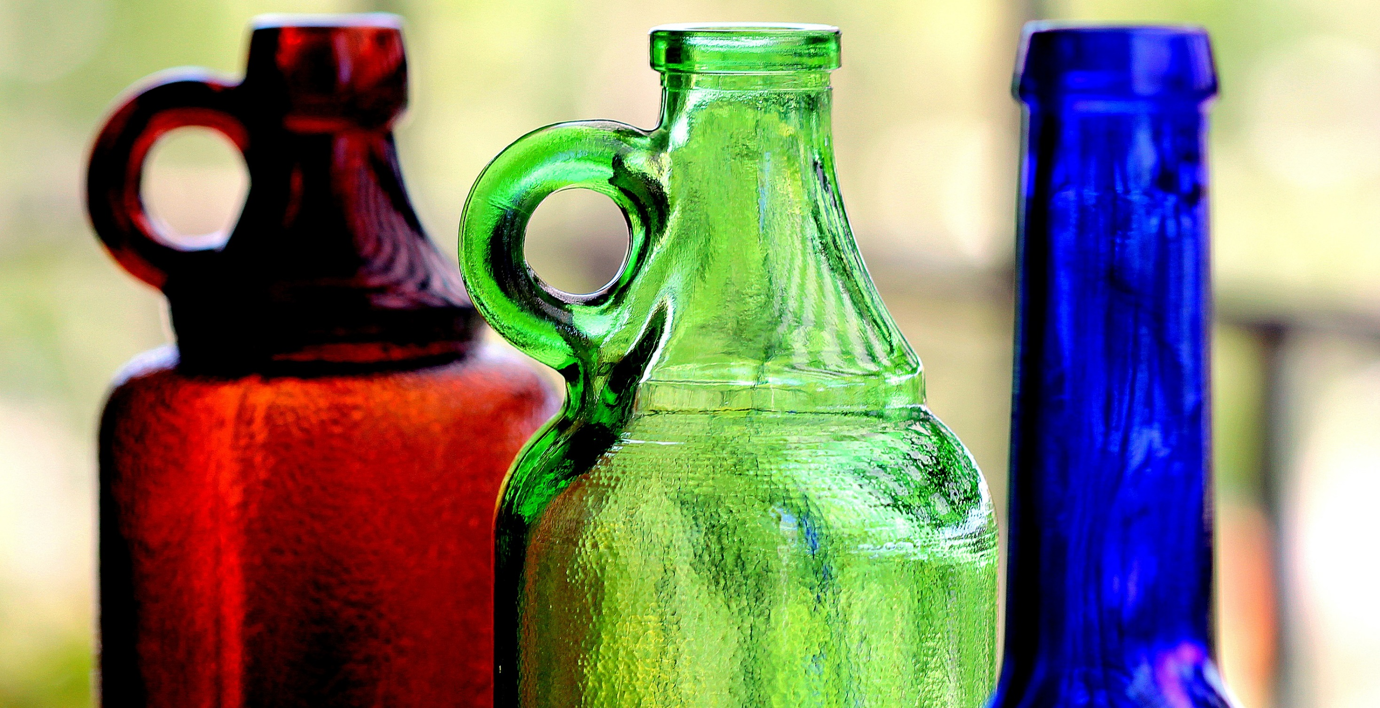
V&R Mapping App Usability Testing
TASK
Think of around 10 websites you use or online activities that you regularly perform. Place each of these websites or activities on the map in a way that represents how you feel you use them (as a 'Visitor' or as a 'Resident') and the typical context in which you use them ('Personal' or 'Institutional’).
PROCEDURE
Read the task aloud
Using the app, complete the task while thinking aloud
Indicate when they felt they had completed the task
Notes:
Image: https://www.flickr.com/photos/marcelxxl/14217231657/ by M.G.N. – Marcel / CC BY-NC-ND 2.0
White, D. S., & Connaway, L. S. (2011-2014). Visitors & Residents: What Motivates Engagement with the Digital Information Environment. Funded by JISC, OCLC, and Oxford University. http://www.oclc.org/research/activities/vandr/.

Slide 56
Data Analysis Tools and Methods

Slide 57
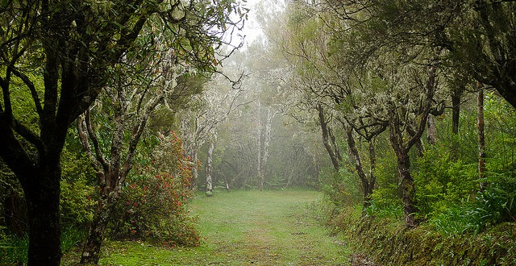
Qualitative Analysis
Coding
Ethnographic Analysis
Image: https://www.flickr.com/photos/mathias764/41233631655 by Mathias Liebing / CC BY-NC-ND 2.0
Notes:
Image: https://www.flickr.com/photos/mathias764/41233631655 by Mathias Liebing / CC BY-NC-ND 2.0

Slide 58
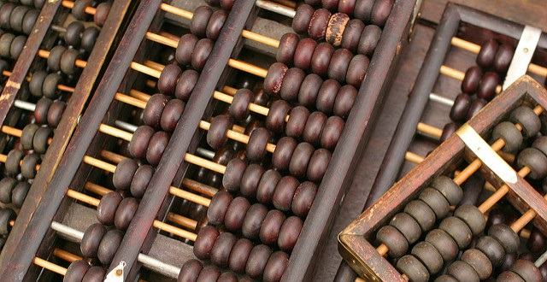
Coding
Analyzing the gathered data involves coding the responses (or placing each item in the appropriate category), tabulating the data, and statistical computations.
Categories for coding generally evolve from the data, there are some common areas such as setting, situation, perspective, process, activity, event, relationship, role, practice, etc.
Image: https://www.flickr.com/photos/beggs/130718089 by Brian Jeffery Beggerly / CC BY 2.0
Notes:
Image: https://www.flickr.com/photos/beggs/130718089 by Brian Jeffery Beggerly / CC BY 2.0
Connaway, L. S., & Radford, M. L. (2017). Research Methods for Library and Information Science, 6th ed. Westport, CT: Libraries Unlimited.
So again, I just want to emphasize that when we are talking about coding the interview transcripts, we are talking about a codebook that evolves from interviews (and thus the participants). We aren’t imposing anything on the participants or the data.

Slide 59
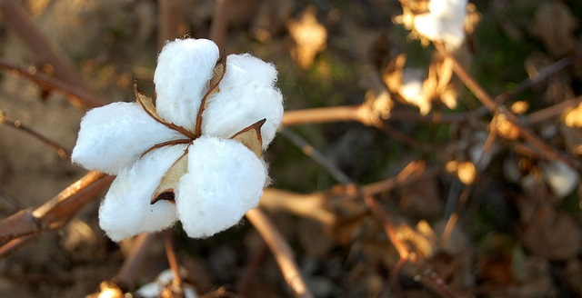
Image: https://www.flickr.com/photos/edgarpierce/6279370863 by Edgar Pierce / CC BY 2.0
Ethnographic Analysis
Use people’s own categories
Avoid assuming what one will find
Complementary to quantitative methods
Retain ‘richness’/‘thick description’
Numerical compatibility
(Asher 2017, 264)
(Connaway and Radford 2017, 282)
Notes:
Image: https://www.flickr.com/photos/edgarpierce/6279370863 by Edgar Pierce / CC BY 2.0
Ethnographic research methods seek to use people’s own categories of analysis as a way of understanding social and cultural processes on their own terms. Researchers using ethnographic approaches must be careful to avoid making assumptions about what they will find, to suspend judgment about people’s actions, and to attend to both people’s own explanations of the processes being studied as well as analytical or theoretical explanations. While ethnographic methods usually emphasize qualitative data, they should not be seen as opposed to quantitative approaches to research, but instead as a different, and often complementary, way of gathering evidence and discovering meaning within the complexities of human behavior (Asher 2017, 264).
Asher, A. (2017). On ethnographic research: How do students find the information they need? In Research Methods for Library and Information Science, 6th ed., edited by Lynn Silipigni Connaway and Marie L. Radford, 264. Westport, CT: Libraries Unlimited.
“The data collection methods discussed above are used in ethnographic research studies. The data analysis methods used for the qualitative data collected in diaries, journals, interviews, and mapping are the same as those discussed in chapters 7 and 8. The data must be interpreted in a manner that retains their richness. This “thick description,” including group interactions, is one of their advantages of the ethnographic approach. The ethnographic summary and the content analysis approach of open and thematic coding are not conflicting means of analysis. If quantitative data are collected in the interviews and FtF survey questions, the data analysis methods should be compatible. The analyses most likely will include descriptive statistics but may include inferential statistics, which are discussed in chapter 6.” (Connaway and Radford 2017, 282)
Connaway, L. S., & Radford, M. L. (2017). Research Methods for Library and Information Science, 6th ed. Westport, CT: Libraries Unlimited.

Slide 60
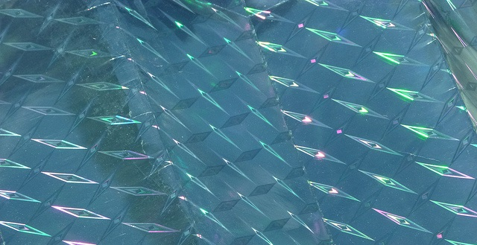
Computer-Assisted Qualitative Data Analysis Software (CAQDAS)
Contain all data sources
Create and apply codes
Enable running queries
Develop visualizations
Deliver reports
(Connaway and Radford 2017)
Image: https://www.flickr.com/photos/zeevveez/6222570825 by zeevveez / CC BY 2.0
Notes:
Image: https://www.flickr.com/photos/zeevveez/6222570825 by zeevveez / CC BY 2.0
“The CAQDAS packages help to provide a place to contain all data sources and have multiple affordances, especially for large data sets common in qualitative projects. There is a growing number of these products available, in both proprietary and open source versions. Proprietary products include ATLAS.ti, Dedoose, HyperRESEARCH, MAXQDA, Nvivo, QDA Minder Qiqqa, and Xsight. Open source software includes Aquad, Coding Analysis Toolkit, Compendium, and RQDA.” (Connaway and Radford 2017, 290)
“Common features of all these packages include creating and applying codes. Some...have advanced features that support such enhancements as enabling queries (to explore data to discover patterns, connections, etc.), supporting visualizations (to create charts, models, maps, and cluster analyses), and delivering reports (to document and export findings).” (Connaway and Radford 2017, 290)
Connaway, L. S., & Radford, M. L. (2017). Research Methods for Library and Information Science, 6th ed. Westport, CT: Libraries Unlimited.

Slide 61
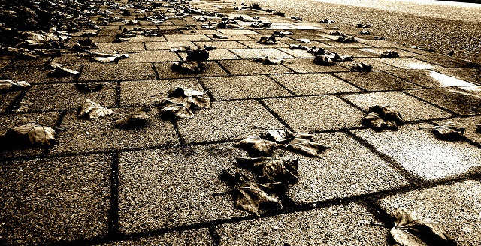
Grounded Theory
Draw on data...in service of developing new conceptual categories
Develop inductive abstract analytic categories through systematic data analysis
Emphasize theory construction rather than description or application of current theories
(Connaway and Radford 2017)
Image: https://www.flickr.com/photos/brandsvig/6331843056 by Christer / CC BY-NC-ND 2.0
Notes:
Image: https://www.flickr.com/photos/brandsvig/6331843056 by Christer / CC BY-NC-ND 2.0
“1. Conduct data collection and analysis simultaneously in an iterative process.
2. Analyze actions and processes rather than themes and structure.
3. Use comparative methods.
4. Draw on data (e.g., narratives and descriptions) in service of developing new conceptual categories.
5. Develop inductive abstract analytic categories through systematic data analysis.
6. Emphasize theory construction rather than description or application of current theories.
7. Engage in theoretical sampling.
8. Search for variation in the studied categories or process.
9. Pursue developing a category rather than covering a specific empirical topic.” (Connaway and Radford 2017, 297)
Connaway, L. S., & Radford, M. L. (2017). Research Methods for Library and Information Science, 6th ed. Westport, CT: Libraries Unlimited.

Slide 62
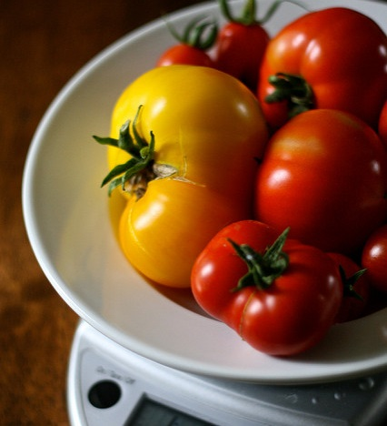
“A major strategy for analysis of qualitative data is the use of the constant comparative method, which embraces ‘constant comparisons’ defined as ‘the analytic process of comparing different pieces of data against each other for similarities and differences.’”
(Connaway and Radford 2017, 298)
Image: https://www.flickr.com/photos/chiotsrun/3748199122 by Chiot’s Run / CC BY-NC 2.0
Notes:
Image: https://www.flickr.com/photos/chiotsrun/3748199122 by Chiot’s Run / CC BY-NC 2.0
“A major strategy for analysis of qualitative data is the use of the constant comparative method, which embraces “constant comparisons” defined as “the analytic process of comparing different pieces of data against each other for similarities and differences.” It requires the researcher to ask continually: “What is this piece of data saying?” “Is this different from or similar to the next segment?” This involves comparing and aggregating pieces of data on the basis of similar characteristics and beginning the process of sorting these into interim groups or emerging themes.” (Connaway and Radford 2017, 298)
Connaway, L. S., & Radford, M. L. (2017). Research Methods for Library and Information Science, 6th ed. Westport, CT: Libraries Unlimited.

Slide 63
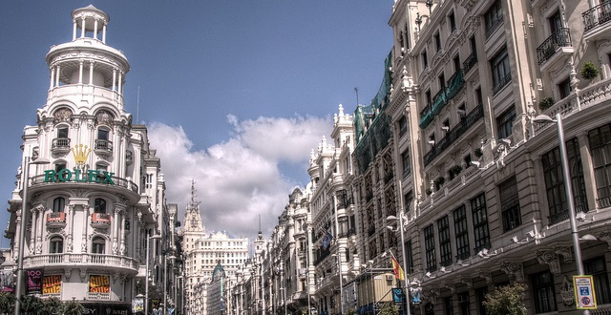
Image: https://www.flickr.com/photos/felipe_gabaldon/4789306741 by Felipe Gabaldon / CC BY 2.0
Conversation Analysis
Context & social conduct
Discourse Analysis
The library within a larger social & cultural context
(Connaway and Radford 2017)
Notes:
Image: https://www.flickr.com/photos/felipe_gabaldon/4789306741 by Felipe Gabaldon / CC BY 2.0
“Conversation analysis (CA) is an approach to analyzing talk that is captured in natural settings and has become well established in the disciplines of communication, sociology, linguistics, ethnomethodology, ethnography, and social psychology....It highlights the importance of context and revealing regularities of social conduct through examining particular episodic interactions.” (Connaway and Radford 2017, 312)
“Budd had divided discourse analysis (DA) into two different approaches: CA in the form of “linguistic-based analysis,” which is discussed above, and “culturally or socially based discursive practices,” such as those that Foucault has developed...The overarching premise of DA is to question and explore the relationship of the library as an institution and/or LIS as a field of research within a larger social and cultural context.” (Connaway and Radford 2017, 312-313)
Connaway, L. S., & Radford, M. L. (2017). Research Methods for Library and Information Science, 6th ed. Westport, CT: Libraries Unlimited.
Budd, J. M. (2006). Discourse analysis and the study of communication in LIS. Library Trends 55, no. 1: 65-82.

Slide 64
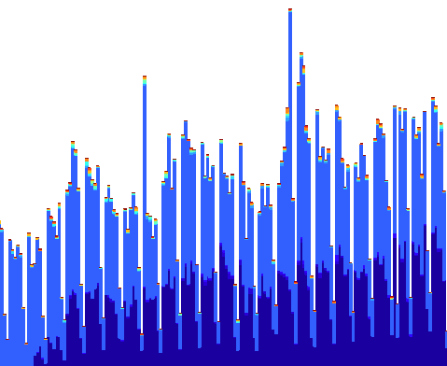

Quantitative Analysis
Descriptive statistics
Parametric statistics
Non-parametric statistics
Image: https://www.flickr.com/photos/ekurvine/6964282187 by Esko Kurvinen / CC BY-NC 2.0
Notes:
Image: https://www.flickr.com/photos/ekurvine/6964282187 by Esko Kurvinen / CC BY-NC 2.0
Connaway, Lynn Silipigni, and Marie L. Radford. 2017. Research Methods for Library and Information Science, 6th ed. Westport, CT: Libraries Unlimited.
Taylor, C. (2018, January 26). Parametric and nonparametric methods in statistics. ThoughtCo. Retrieved from https://www.thoughtco.com/parametric-and-nonparametric-methods-3126411.
There are a few divisions of topics in statistics. One division that quickly comes to mind is the differentiation between descriptive and inferential statistics. There are other ways that we can separate out the discipline of statistics. One of these ways is to classify statistical methods as either parametric or nonparametric.
We will find out what the difference is between parametric methods and nonparametric methods.
The way that we will do this is to compare different instances of these types of methods.
Parametric Methods
Methods are classified on the basis of what we know about the population we are studying. Parametric methods are typically the first methods studied in an introductory statistics course. The basic idea is that there is a set of fixed parameters that determine a probability model.
Parametric methods are often those for which we know that the population is approximately normal, or we can approximate using a normal distribution after we invoke the central limit theorem. There are two parameters for a normal distribution: the mean and the standard deviation.
Ultimately the classification of a method as parametric depends upon the assumptions that are made about a population. A few parametric methods include:
Confidence interval for a population mean, with known standard deviation.
Confidence interval for a population mean, with unknown standard deviation.
Confidence interval for a population variance.
Confidence interval for the difference of two means, with unknown standard deviation.
Nonparametric Methods
To contrast with parametric methods, we will define nonparametric methods. These are statistical techniques for which we do not have to make any assumption of parameters for the population we are studying.
Indeed, the methods do not have any dependence on the population of interest. The set of parameters is no longer fixed, and neither is the distribution that we use. It is for this reason that nonparametric methods are also referred to as distribution-free methods.
Nonparametric methods are growing in popularity and influence for a number of reasons. The main reason is that we are not constrained as much as when we use a parametric method. We do not need to make as many assumptions about the population that we are working with as what we have to make with a parametric method. Many of these nonparametric methods are easy to apply and to understand.
A few nonparametric methods include:
Sign test for population mean
Bootstrapping techniques
U test for two independent means
Spearman correlation test

Slide 65

Image: https://www.flickr.com/photos/sami73/36280554 by Sami Keinanen / CC BY-SA 2.0
Log Analysis
Analysis of requests made to a website or application
  Log records requests that a browser makes to the server
Session logs
Aggregate statistics
Notes:
Image: https://www.flickr.com/photos/sami73/36280554 by Sami Keinanen / CC BY-SA 2.0

Slide 66

Log Analysis
Advantages
  Naturalistic
  Accurate
  Real time
  Inexpensive to gather large number of observations
Disadvantages
  Ambiguity of meaning
    Can be misleading
    Don’t know the why
  Data cleaning
  Selecting units of analysis
Image: https://www.flickr.com/photos/jocelyn777/41273404852 by Jocelyn Erskine-Kellie / CC BY 2.0
Notes:
Image: https://www.flickr.com/photos/jocelyn777/41273404852 by Jocelyn Erskine-Kellie / CC BY 2.0

Slide 67

Image: https://www.flickr.com/photos/felipe_gabaldon/3290155994 by Felipe Gabaldon / CC BY 2.0
WorldCat Discovery & Access
Mixed-methods research
  Combine log analysis with user interviews
Two types of log analysis
  Match session log with user
    Use as guide for interview questions
  Aggregate statistics
    Categorized types of “requests” and “click events”
    Divided by type of institution
Notes:
Image: https://www.flickr.com/photos/felipe_gabaldon/3290155994 by Felipe Gabaldon / CC BY 2.0

Slide 68
Challenges and Opportunities

Slide 69


Image: https://www.flickr.com/photos/smithser/3870653508/ by Brian Smithson / CC BY 2.0
Challenges: Research Environment
Reduced funding opportunities
Scholarly value
Practical implications
Weak relationships with other disciplines
Limited communication of research & outputs
Inconsistent quality
Notes:
Image: https://www.flickr.com/photos/smithser/3870653508/ by Brian Smithson / CC BY 2.0
Reduced Funds
Scholarly Value
Theoretical framework
Practical Implications
Link between research and practice
Weak relationships between LIS and other research communities
Communicating research and outputs
Besides traditional dissemination by presentation and publication we should consider
Blogs
Social media
Conferences
Webinars
Quality
Research methods

Slide 70

Challenges: Research Environment
Data collection & analysis
  Costs
  Bias
  Inaccurate & incomplete
Sampling
Massive amounts of data
Evolving technologies
Image: https://www.flickr.com/photos/travisjuntara/8146930619/ by Travis Juntara / CC BY 2.0
Notes:
Image: https://www.flickr.com/photos/travisjuntara/8146930619/ by Travis Juntara / CC BY 2.0
Bias presents a threat to validity , particularly the interviewer because of over-reacting to responses, etc.
Massive amounts of data
Interviews
Logs
Evolving Technology
Data on Wiki’s that is no longer available
Switching data platforms

Slide 71

“The creative process is not like a situation where you get struck by a single lightning bolt. You have ongoing discoveries, and there are ongoing creative revelations. Yes, it's really helpful to be marching toward a specific destination, but, along the way, you must allow yourself room for your ideas to blossom, take root, and grow. “
–Carlton Cuse
Image: https://www.flickr.com/photos/hunty66/390350345 by Pete Hunt / CC BY-NC 2.0
Notes:
Image: https://www.flickr.com/photos/hunty66/390350345 by Pete Hunt / CC BY-NC 2.0
“Carlton Cuse Quotes.” BrainyQuote. Accessed February 23, 2018. https://www.brainyquote.com/quotes/quotes/c/carltoncus644835.html.

Slide 72

Not failure but opportunities for engagement & progress
Image: https://www.flickr.com/photos/w4nd3rl0st/6836056258 by Jason Mrachina / CC BY-NC-ND 2.0
Notes:
Image: https://www.flickr.com/photos/w4nd3rl0st/6836056258 by Jason Mrachina / CC BY-NC-ND 2.0
Influence practice by engaging with users and potential users of library services and systems
Development of services and systems that meet their needs
New theory
Models
Relationship building
Services and system users and potential users
Practitioners
Other researchers
LIS
Other disciplines

Slide 73
Acknowledgements
I would like to thank Brittany Brannon for her assistance in preparing this presentation.

Slide 74
References
Asher, A. & Miller, S. (2011). So You Want to Do Anthropology in Your Library? Or a Practical Guide to Ethnographic Research in Academic Libraries. Chicago: The ERIAL Project.
Asher, A. (2017). On ethnographic research: How do students find the information they need? In Research Methods for Library and Information Science, 6th ed., edited by Lynn Silipigni Connaway and Marie L. Radford, 264. Westport, CT: Libraries Unlimited.
Budd, J. M. (2006). Discourse analysis and the study of communication in LIS. Library Trends 55, no. 1: 65-82.
Chu, H. (2015). Research Methods in Library and Information Science: A Content Analysis. Library & Information Science Research 37(1), 36-41.
Clark, K. (2007). Mapping Diaries, or Where Do They Go All Day? In N. Foster & S. Gibbons (Eds.), Studying Students: The Undergraduate Research Project at the University of Rochester. Chicago: Association College and Research Libraries.
Connaway, L. S. (2017, June 19). Putting the library in the life of the user: Listen, then lead, to promote a unique and compelling role for academic libraries. Guest of Choice, Choice360 blog. Retrieved from http://www.choice360.org/blog/putting-the-library-in-the-life-of-the-user
Connaway, L. S., & Faniel, I. M. (2014). Reordering Ranganathan: Shifting user behaviors, shifting priorities. Dublin, OH: OCLC Research. http://www.oclc.org/content/dam/research/publications/library/2014/oclcresearch-reordering-ranganathan-2014.pdf.

Slide 75
References
Connaway, L. S., & Radford, M. L. (2017). Research Methods for Library and Information Science, 6th ed. Westport, CT: Libraries Unlimited.
Dumas, J. S., & Redish, J. C. (1993). A Practical Guide to Usability Testing. Portland, OR: Intellect Books.
Greifeneder, E. (2014). Trends in information behaviour research. In Proceedings of ISIC, the Information Behaviour Conference, Leeds, 2-5 September, 2014: Part 1. http://InformationR.net/ir/19-4/isic/isic13.html
Hernon, P., & Altman, E. (1998). Assessing Service Quality: Satisfying the Expectations of Library Customers. Chicago, IL: American Library Association.
Jasiewicz, J. (In Press). Social science research methods in library science between 2010 and 2015. A bibliometric analysis.
Kazmer, M. (2017). “Mixed Methods.” In Research Methods for Library and Information Science, 6th ed., edited by L. S. Connaway and M. L. Radford, 232-233. Westport, CT: Libraries Unlimited.
Luo, L., & McKinney, M. (2015). JAL in the Past Decade: A Comprehensive Analysis of Academic Library Research. The Journal of Academic Librarianship 41(2),123-129.
Miles, M. B., & Huberman, A. M. (1994). Qualitative Data Analysis: A Sourcebook. Beverly Hills: Sage Publications.

Slide 76
References
Miles, M. B., Huberman, M., & Saldaña, J. (2014). Qualitative Data Analysis: A Methods Sourcebook, 3rd ed. Thousand Oaks, CA: Sage.
Polkinghorne, D. (1983). Methodology for the human sciences: Systems of inquiry. Albany, NY: State University of New York Press.
Powell, R. (1999). Recent Trends in Research: A Methodological Essay. Library & Information Science Research 21(1), 91-119.
Ranganathan, S. R. (1931). The five laws of library science. London: Edward Goldston, Ltd.
Runes, D. D. (Ed.). (2001). The dictionary of philosophy. New York, NY: Citadel Press.
Tang, R. (2017). Usability research. In Research Methods for Library and Information Science, 6th ed., edited by L. S. Connaway & M. L. Radford, 277-278. Westport, CT: Libraries Unlimited.
Taylor, C. (2018, January 26). Parametric and nonparametric methods in statistics. ThoughtCo. Retrieved from https://www.thoughtco.com/parametric-and-nonparametric-methods-3126411.
Webb, E. J., Campbell, D. T., Schwartz, R. D., & Sechrest, L. (1966). Unobtrusive Measures: Nonreactive Research in the Social Sciences, Vol. 111. Chicago: Rand McNally.
White, D. S., & Connaway, L. S. (2011-2014). Visitors & Residents: What Motivates Engagement with the Digital Information Environment. Funded by JISC, OCLC, and Oxford University. http://www.oclc.org/research/activities/vandr/.

Slide 77
Questions & Discussion
Lynn Silipigni Connaway, PhD
Director of Library Trends and
User Research, OCLC
connawal@oclc.org
@LynnConnaway

