Slide 1
Krakow, Poland • 9-11 October 2018
Interdisciplinary Approaches to Research Methods in Information Behavior Studies
Lynn Silipigni Connaway, PhD
Director of Library Trends and User Research
connawal@oclc.org
@LynnConnaway

Slide 2
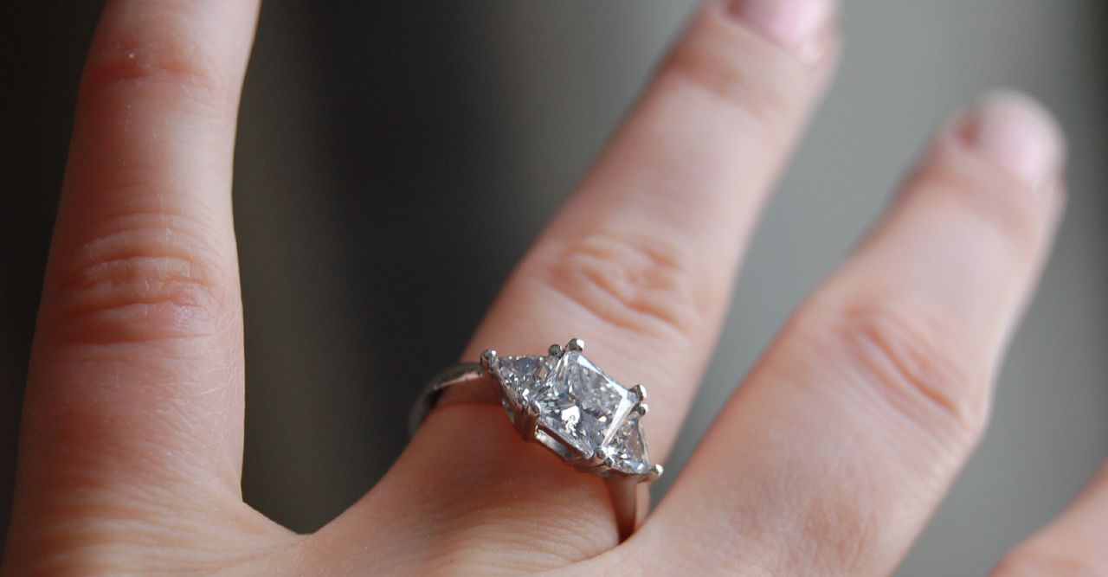
“A diamond is a chunk of coal made good under pressure.”
(Henry Kissinger)
Image: https://www.flickr.com/photos/jdickert/477633643/ by ilovebutter / CC BY 2.0
Notes:
Image: https://www.flickr.com/photos/jdickert/477633643/ by ilovebutter / CC BY 2.0

Slide 3
Data collection methods

Slide 4
What is Qualitative Research?
A type of scientific research that:
Seeks answers to a question
Systematically uses predefined set of procedures to answer question
Collects evidence
Produces findings that:
Are not determined in advance
Apply beyond immediate boundaries of study
(Connaway & Radford, 2017)
Image: https://www.flickr.com/photos/katesheets/5772901616 by katesheets / CC BY-NC 2.0
Notes:
Image: https://www.flickr.com/photos/katesheets/5772901616 by katesheets / CC BY-NC 2.0
Connaway, Lynn Silipigni, and Marie L. Radford. 2017. Research Methods for Library and Information Science, 6th ed. Westport, CT: Libraries Unlimited.

Slide 5
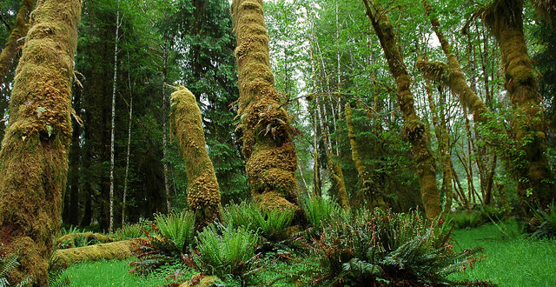
Qualitative Research
Semi-structured Interviews
Theoretical approach
Content analysis
Survey/Questionnaire
Diaries
Observation
Image: https://www.flickr.com/photos/127107506@N02/15292856445 by Moiggi Interactive / CC BY-NC 2.0
Notes:
Image: https://www.flickr.com/photos/127107506@N02/15292856445 by Moiggi Interactive / CC BY-NC 2.0

Slide 6
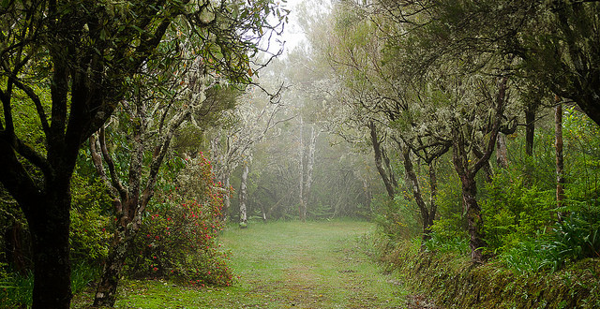
Qualitative Analysis
Coding
Ethnographic Analysis
Image: https://www.flickr.com/photos/mathias764/41233631655 by Mathias Liebing / CC BY-NC-ND 2.0
Notes:
Image: https://www.flickr.com/photos/mathias764/41233631655 by Mathias Liebing / CC BY-NC-ND 2.0

Slide 7
Qualitative research:
Tends to use multiple methods
Interviews
Observations
Diaries
Is open to developing new approaches
(Connaway & Radford, 2017)
Image: https://www.flickr.com/photos/freezr/5962512620 by Nekenasoa / CC BY 2.0
Notes:
Image: https://www.flickr.com/photos/freezr/5962512620 by Nekenasoa / CC BY 2.0
Connaway, Lynn Silipigni, and Marie L. Radford. 2017. Research Methods for Library and Information Science, 6th ed. Westport, CT: Libraries Unlimited.

Slide 8
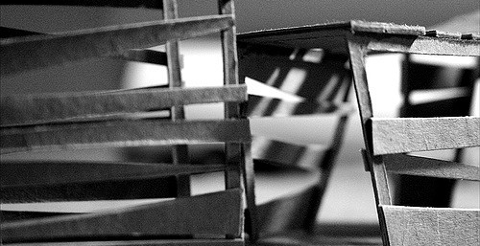
What is Quantitative Research?
Based on the scientific method of inquiry
Theory
Problem
Hypothesis
Measurement
Validity, reliability, and level
Includes survey research and experimental research
Utilizes statistical analysis methods
(Connaway & Radford, 2017)
Image: https://www.flickr.com/photos/zoghal/372832109 by zoghal / CC BY-SA 2.0
Notes:
Image: https://www.flickr.com/photos/zoghal/372832109 by zoghal / CC BY-SA 2.0
Connaway, Lynn Silipigni, and Marie L. Radford. 2017. Research Methods for Library and Information Science, 6th ed. Westport, CT: Libraries Unlimited.

Slide 9
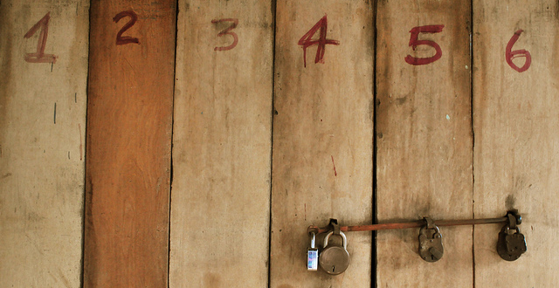
Quantitative Research
Log Analysis
Experiment
Bibliometric Analysis
Survey/Questionnaire
Image: https://www.flickr.com/photos/fukechanabil/6836092392 by Syed Nabil Aljunid / CC BY-NC 2.0
Notes:
Image: https://www.flickr.com/photos/fukechanabil/6836092392 by Syed Nabil Aljunid / CC BY-NC 2.0

Slide 10
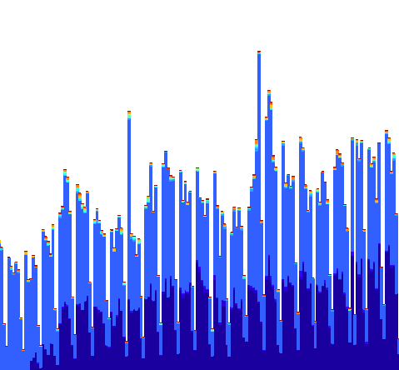
Quantitative Analysis
Descriptive statistics
Parametric statistics
Non-parametric statistics
Image: https://www.flickr.com/photos/ekurvine/6964282187 by Esko Kurvinen / CC BY-NC 2.0
Notes:
Image: https://www.flickr.com/photos/ekurvine/6964282187 by Esko Kurvinen / CC BY-NC 2.0
Connaway, Lynn Silipigni, and Marie L. Radford. 2017. Research Methods for Library and Information Science, 6th ed. Westport, CT: Libraries Unlimited.

Slide 11
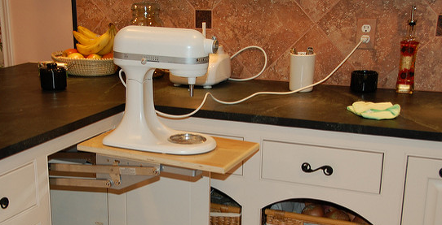
Mixed Methods
“Miles, Huberman, and Saldaña also pointed out that although designing and conducting a mixed method research project involves careful planning and more effort in execution, the benefits greatly outweigh the difficulties (including philosophical ones).”
(Connaway and Radford 2017, 229)
Image: https://www.flickr.com/photos/gutdoctor/4231406746 by Loren Owensby / CC BY-NC-ND 2.0
Notes:
Image: https://www.flickr.com/photos/gutdoctor/4231406746 by Loren Owensby / CC BY-NC-ND 2.0
“Miles, Huberman, and Saldaña also pointed out that although designing and conducting a mixed method research project involves careful planning and more effort in execution, the benefits greatly outweigh the difficulties (including philosophical ones).” (Connaway and Radford 2017, 229)
Connaway, Lynn Silipigni, and Marie L. Radford. 2017. Research Methods for Library and Information Science, 6th ed. Westport, CT: Libraries Unlimited.
Miles, Matthew B., Michael Huberman, and Johnny Saldaña, eds. 2014. Qualitative Data Analysis: A Methods Sourcebook, 3rd ed. Thousand Oaks, CA: Sage.

Slide 12
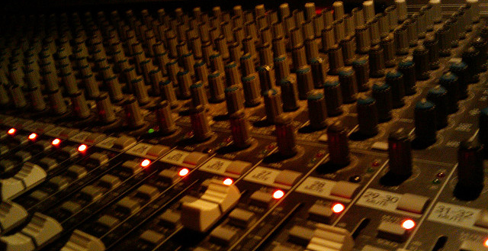
Mixed Methods Research
Any combination of research methods
Qualitative
Quantitative
Participatory
Action
Design
Equal attention to all stages of research process
Findings should be iterative & informative
Image: https://www.flickr.com/photos/jmarty/3591153133 by Justin / CC BY-SA 2.0
(Kazmer 2017, 232-233)
Notes:
Image: https://www.flickr.com/photos/jmarty/3591153133 by Justin / CC BY-SA 2.0
“Mixed methods research is often thought of as quantitative/qualitative, but other approaches are important to consider: participatory, action, design, etc. Don't think of mixed methods as "survey plus interview" (or worse, "survey with open-ended questions tacked onto the end").
Mixed methods should be deeply integrated, and not parallel tracks that don't intersect. Mixing methods effectively means equal attention to all stages of the research process, from problem statement or hypothesis through analysis; don't focus on the data collection methods to the detriment of the other phases.
And rather than quantitative findings followed by a few attractive quotes from the qualitative data organized according to "themes," the findings from mixed methods should be iterative and mutually-informing.
Very few people can do mixed methods research alone, so embrace cooperative research. Each person needs to understand all the methods being used, but it's natural that each person will have more expertise in one area. Find research partners who have a deep and true appreciation for your contributions; mixed methods research just to satisfy a funding agency is never as fulfilling or productive as it could be. Work closely together so that the overall research design doesn't privilege one method over another just for the sake of method, but so that the combined approach will answer the research questions and allow you to effect change in the world.”
Kazmer, Michelle. 2017. “Mixed Methods.” In Research Methods for Library and Information Science, 6th ed., edited by Lynn Silipigni Connaway and Marie L. Radford, 232-233. Westport, CT: Libraries Unlimited.

Slide 13
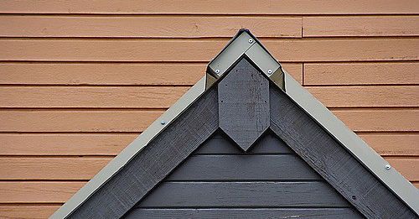
Triangulation
Term coined by Webb et al. (1966)
Multiple methods of data collection (e.g., interviews – individual & group, observation, literature, archives)
Agree, or at least don’t contradict (Miles and Huberman 1994, 266)
Multiple investigators
Multiple contexts/situations
Image: https://www.flickr.com/photos/ytwhitelight/49895159 by Amanda Graham / CC BY-NC-ND 2.0
Notes:
Image: https://www.flickr.com/photos/ytwhitelight/49895159 by Amanda Graham / CC BY-NC-ND 2.0
Adapted from slides by Ellen Olshansky
Miles, Matthew B., and A. Michael Huberman. 1994. Qualitative Data Analysis: A Sourcebook. Beverly Hills: Sage Publications.
Webb, Eugene J., Donald T. Campbell, Richard D. Schwartz, and Lee Sechrest. 1966. Unobtrusive Measures: Nonreactive Research in the Social Sciences, Vol. 111. Chicago: Rand McNally.

Slide 14
Most widely used research methods in LIS
Notes:
What do you think the most widely used data collection method was from 1950-1975?

Slide 15
Survey research is one of the most popular methods used in the LIS literature.
(Case & Given, 2016)
Image: https://www.flickr.com/photos/courtneymcgough/3267225383 by Courtney McGough / CC BY-NC-ND 2.0
Notes:
Image: https://www.flickr.com/photos/courtneymcgough/3267225383 by Courtney McGough / CC BY-NC-ND 2.0
Case, D. O., & Given, L. S. (2016). Looking for information: A survey of research on information seeking, needs, and behaviour. Bingley, UK: Emerald.

Slide 16
Qualitative and mixed-method studies are not as prevalent in information behavior studies but demonstrate a greater variety of research strategies and data collection techniques.
(Matusiak, 2017; McKechnie et al., 2002)
Image: https://www.flickr.com/photos/stewdean/3801630111 by Stew Dean / CC BY-NC 2.0
Notes:
Image: https://www.flickr.com/photos/stewdean/3801630111 by Stew Dean / CC BY-NC 2.0
Matusiak, K. K. (2017). Studying information behavior of image users: An overview of research methodology in LIS literature, 2004-2015. Library and Information Science Research 39 (1), 53–60.
McKechnie, L. M., Baker, L., Greenwood, M., & Julien, H. (2002). Research method trends in human information behaviour literature. The New Review of Information Behaviour Research: Studies of Information Seeking in Context (Proceedings of ISIC 2002), 3, 113-125.

Slide 17
Research Papers by Methodology & Year
Methodology | 1950 | 1960 | 1965 | 1970 | 1975 | Total* | %*
Theoretical-analytical | 11 | 17 | 11 | 36 | 52 | 127 | 14
Information system design | 7 | 16 | 21 | 57 | 49 | 150 | 17
Surveys on the public | 3 | 2 | 9 | 20 | 19 | 53 | 3
Survey or experiment on libraries, etc. | 22 | 15 | 45 | 89 | 113 | 284 | 32
Bibliometric and similar studies | 0 | 1 | 7 | 14 | 16 | 38 | 4
Content analysis | 0 | 1 | 2 | 1 | 3 | 7 | 1
Secondary analysis | 6 | 15 | 15 | 13 | 27 | 76 | 8
Historical methodologies | 21 | 26 | 25 | 49 | 42 | 163 | 18
Descriptive bibliography | 7 | 4 | 6 | 4 | 9 | 30 | 3
Comparative studies | 0 | 2 | 6 | 4 | 7 | 19 | 2
Other and multiple | 3 | 1 | 7 | 9 | 10 | 30 | 3
All papers* | 76 | 96 | 139 | 274 | 315 | 900 | 100
(Powell, 1999)
Notes:
*Note: The figures add to more than the total number of papers (and the percentages add to more than 100), since a paper may have more than one methodology
Table (2) from Powell, 1999
Powell, R. (1999). Recent Trends in Research: A Methodological Essay. Library & Information Science Research 21(1), 91-119.

Slide 18
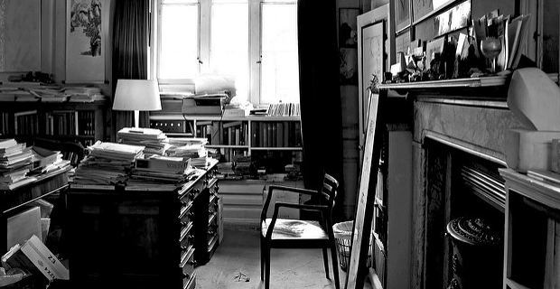
Research Methods: JDoc 2001-2010
N=367
Theoretical approach, 38%
Content analysis, 14%
Questionnaire, 13.8%
Experiment, 13.4%
Interview, 13.4%
(Chu, 2015)
Image: https://www.flickr.com/photos/jaypeg/3658793747 by Jaypeg / CC BY-NC 2.0
Notes:
Image: https://www.flickr.com/photos/jaypeg/3658793747 by Jaypeg / CC BY-NC 2.0
“The LIS field is maturing in terms of research method selection and application in that a greater number and wider variety of research methods are used in all the research publications this study examines. All the methods reported in the 1162 scholarly publications in a sense constitute a toolbox of research methods. Scholars are no longer limited to the research methods traditionally applied in LIS explorations (e.g., questionnaire and historical method). Researchers can instead choose research methods from this expanded toolbox according to their study objectives” (Chu, 2015, p. 40).
Chu, H. (2015). Research Methods in Library and Information Science: A Content Analysis. Library & Information Science Research 37(1), 36-41.

Slide 19
Research Methods: JASIS&T 2001-2010
N=554
Experiment, 31%
Bibliometrics, 23%
Questionnaire, 14%
Content analysis, 13%
Theoretical approach, 12%
(Chu, 2015)
Image: https://www.flickr.com/photos/bull3t/3271752011
Notes:
Image: https://www.flickr.com/photos/bull3t/3271752011
Chu, H. (2015). Research Methods in Library and Information Science: A Content Analysis. Library & Information Science Research 37(1), 36-41.

Slide 20
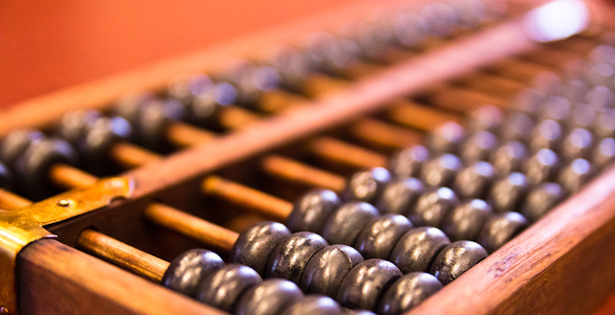
Research Methods: LISR 2001-2010
N=241
Content analysis, 30%
Questionnaire, 28%
Interview, 20%
Theoretical approach, 15%
Experiment, 9%
(Chu, 2015)
Image: https://www.flickr.com/photos/stevendepolo/6752594589 by Steven Depolo / CC BY 2.0
Notes:
Image: https://www.flickr.com/photos/stevendepolo/6752594589 by Steven Depolo / CC BY 2.0
Chu, H. (2015). Research Methods in Library and Information Science: A Content Analysis. Library & Information Science Research 37(1), 36-41.

Slide 21
Research Methods: JAL 2004-2013
Method | Percentage (n=346)
Questionnaire | 47.6
Test or Quiz | 2.6
Diary | 0.6
Content Analysis | 27.2
Semi-structured Interviews | 14.0
Analysis of existing statistics | 6.6
Citation Analysis | 6.3
Focus Group Interview | 5.7
Observation | 4.3
Log Analysis | 3.4
Task Analysis | 2.9
(Luo & McKinney, 2015)
Notes:
**used in primary research articles
Questionnaire: a standard survey questionnaire, 47.6
A test or quiz in the questionnaire format, usually used in experimental or quasi-experimental deign, 2.6
Diary, a type of self-administered questionnaire often used to record frequent or contemporaneous events or experiences, 0.6
Content analysis, 27.2
Semi-structured or in-depth interview, 14.0
Analysis of existing statistics (e.g. results from previous surveys, or circulation statistics), 6.6
Citation analysis, 6.3
Focus group interview, 5.7
Observation, including both quantitative and qualitative observation, 4.3
Log analysis, 3.4
Task analysis — the analysis of the completion of search tasks, 2.9
Luo, L., & McKinney, M. (2015). JAL in the Past Decade: A Comprehensive Analysis of Academic Library Research. The Journal of Academic Librarianship 41(2),123-129.

Slide 22
Research Methods by Popularity, 2010-2015
Method | Percentage (n=2460)
Bibliometrics | 16.6
Other Methods | 12.8
Theoretical Approach | 10.3
Questionnaire | 10.3
Content Analysis | 8.0
Mixed Methodology | 6.6
Webometrics | 5.4
Big data, TDM | 4.9
Interview | 3.7
Experiment | 2.6
Not mentioned | 14.5
(Jasiewicz, J., In press)
Notes:
Methodology of articles published in top LIS research journals, as determined by analysis of article abstracts.
Jasiewicz, J. (In Press). Social science research methods in library science between 2010 and 2015. A bibliometric analysis.

Slide 23
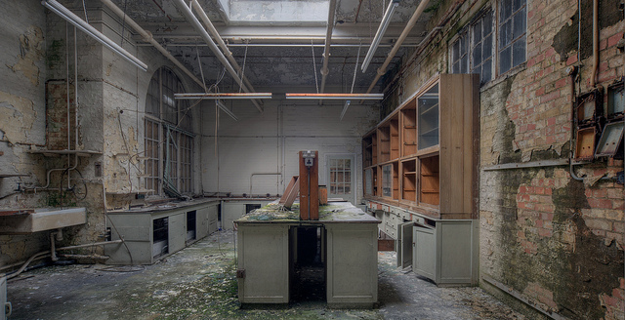
Image: https://www.flickr.com/photos/howzey/7386743932 by Paul / CC BY-NC-ND 2.0
Methods Mentioned Less than 1%
Historical method (1.0%)
Observation (0.8%)
Ethnography/field study (0.8%)
Focus groups (0.6%)
Transaction log analysis (0.3%)
Delphi study (0.3%)
Research diary/Journal (0.2%)
Think aloud protocol (0.1%)
n=2460
(Jasiewicz, J., In press)
Notes:
Image: https://www.flickr.com/photos/howzey/7386743932 by Paul / CC BY-NC-ND 2.0
Methodology of articles published in top LIS research journals, as determined by analysis of article abstracts.
Jasiewicz, J. (In Press). Social science research methods in library science between 2010 and 2015. A bibliometric analysis.

Slide 24
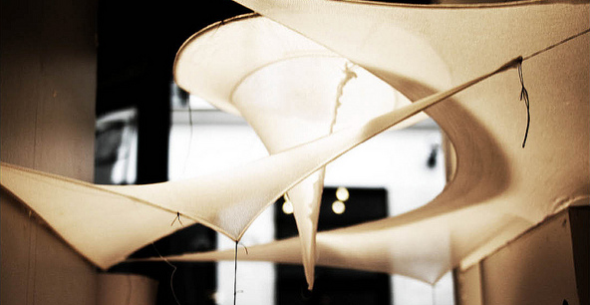
Information Behaviour Research Methods: JASIST, Information Research 2012-2013 JDOC, iConference Proceedings 2013-2014
Interviews, 51
Surveys, 34
Content Analysis, 28
(Greifeneder, 2014)
Image: https://www.flickr.com/photos/hdaparis/11288970914 by Hugh Dutton Associes / CC BY-NC-ND 2.0
Notes:
Image: https://www.flickr.com/photos/hdaparis/11288970914 by Hugh Dutton Associes / CC BY-NC-ND 2.0
Greifeneder, E. (2014). Trends in information behaviour research. In Proceedings of ISIC, the Information Behaviour Conference, Leeds, 2-5 September, 2014: Part 1. http://InformationR.net/ir/19-4/isic/isic13.html
“Forty-five percent of all studies in the sample applied a mixed-method approach.”
“Only 11 studies (7%) combined more than two methods. 69% of mixed-method approaches were a qualitative-qualitative combination and 31% were a quantitative-qualitative combination. Not a single study combined a quantitative with another quantitative method.”
“Interviews, surveys and content analyses were the most frequently used methods in the last years. It was also obvious that traditional qualitative research, making use of interviews, observations, focus groups or diaries (marked in blue in figure 1) still dominate information behaviour research. Anderson's expectation that these methods will vanish was clearly proven wrong.”

Slide 25
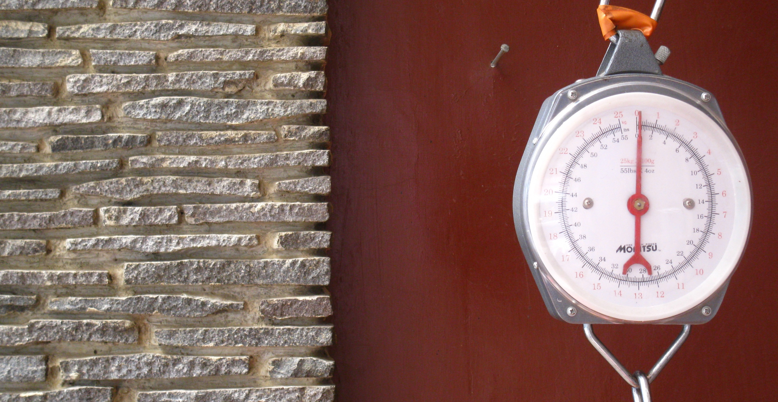
Information Behaviour Research Methods: JASIST, Information Research 2012-2013 JDOC, iConference Proceedings 2013-2014
Methods used less than five times:
Delphi studies (Poirier & Robinson, 2014)
Eye-tracking (e.g. Balatsoukas & Ruthven, 2012; Wildemuth, 2009)
Log file analysis (Jiang, 2014)
Participatory designs
(Greifeneder, 2014)
Image: https://www.flickr.com/photos/ikhlasulamal/4538617347 by Ikhlasul Amal / CC BY-NC 2.0
Notes:
Image: https://www.flickr.com/photos/ikhlasulamal/4538617347 by Ikhlasul Amal / CC BY-NC 2.0
Greifeneder, E. (2014). Trends in information behaviour research. In Proceedings of ISIC, the Information Behaviour Conference, Leeds, 2-5 September, 2014: Part 1. http://InformationR.net/ir/19-4/isic/isic13.html
“Forty-five percent of all studies in the sample applied a mixed-method approach.”
“Only 11 studies (7%) combined more than two methods. 69% of mixed-method approaches were a qualitative-qualitative combination and 31% were a quantitative-qualitative combination. Not a single study combined a quantitative with another quantitative method.”
“Interviews, surveys and content analyses were the most frequently used methods in the last years. It was also obvious that traditional qualitative research, making use of interviews, observations, focus groups or diaries (marked in blue in figure 1) still dominate information behaviour research. Anderson's expectation that these methods will vanish was clearly proven wrong.”

Slide 26
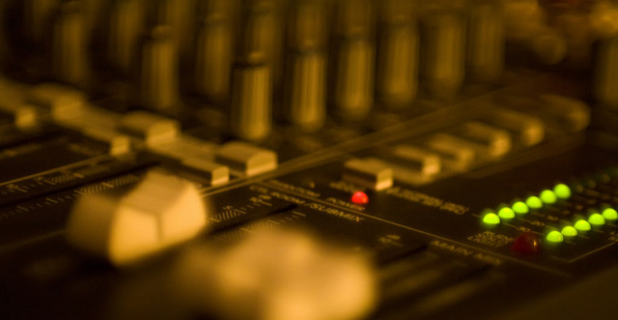
Information Behaviour Research Methods: JASIST, Information Research 2012-2013 JDOC, iConference Proceedings 2013-2014
Mixed Methods, 45%
More than two methods, 7%
Qualitative-Qualitative, 69%
Quantitative-Qualitative, 31%
Quantitative-Quantitative, 0%
(Greifeneder, 2014)
Image: https://www.flickr.com/photos/viatorci/3176779507 by David Torcivia / CC BY 2.0
Notes:
Image: https://www.flickr.com/photos/viatorci/3176779507 by David Torcivia / CC BY 2.0
Greifeneder, E. (2014). Trends in information behaviour research. In Proceedings of ISIC, the Information Behaviour Conference, Leeds, 2-5 September, 2014: Part 1. http://InformationR.net/ir/19-4/isic/isic13.html
“Forty-five percent of all studies in the sample applied a mixed-method approach.”
“Only 11 studies (7%) combined more than two methods. 69% of mixed-method approaches were a qualitative-qualitative combination and 31% were a quantitative-qualitative combination. Not a single study combined a quantitative with another quantitative method.”
“Interviews, surveys and content analyses were the most frequently used methods in the last years. It was also obvious that traditional qualitative research, making use of interviews, observations, focus groups or diaries (marked in blue in figure 1) still dominate information behaviour research. Anderson's expectation that these methods will vanish was clearly proven wrong.”

Slide 27
Challenges and Opportunities

Slide 28
Challenges: Research Environment
Reduced funding opportunities
Scholarly value
Practical implications
Weak relationships with other disciplines
Limited communication of research & outputs
Inconsistent quality
Image: https://www.flickr.com/photos/76657755@N04/7027604401/ by Tax Credits / CC BY 2.0
Notes:
Image: https://www.flickr.com/photos/76657755@N04/7027604401/ by Tax Credits / CC BY 2.0

Slide 29
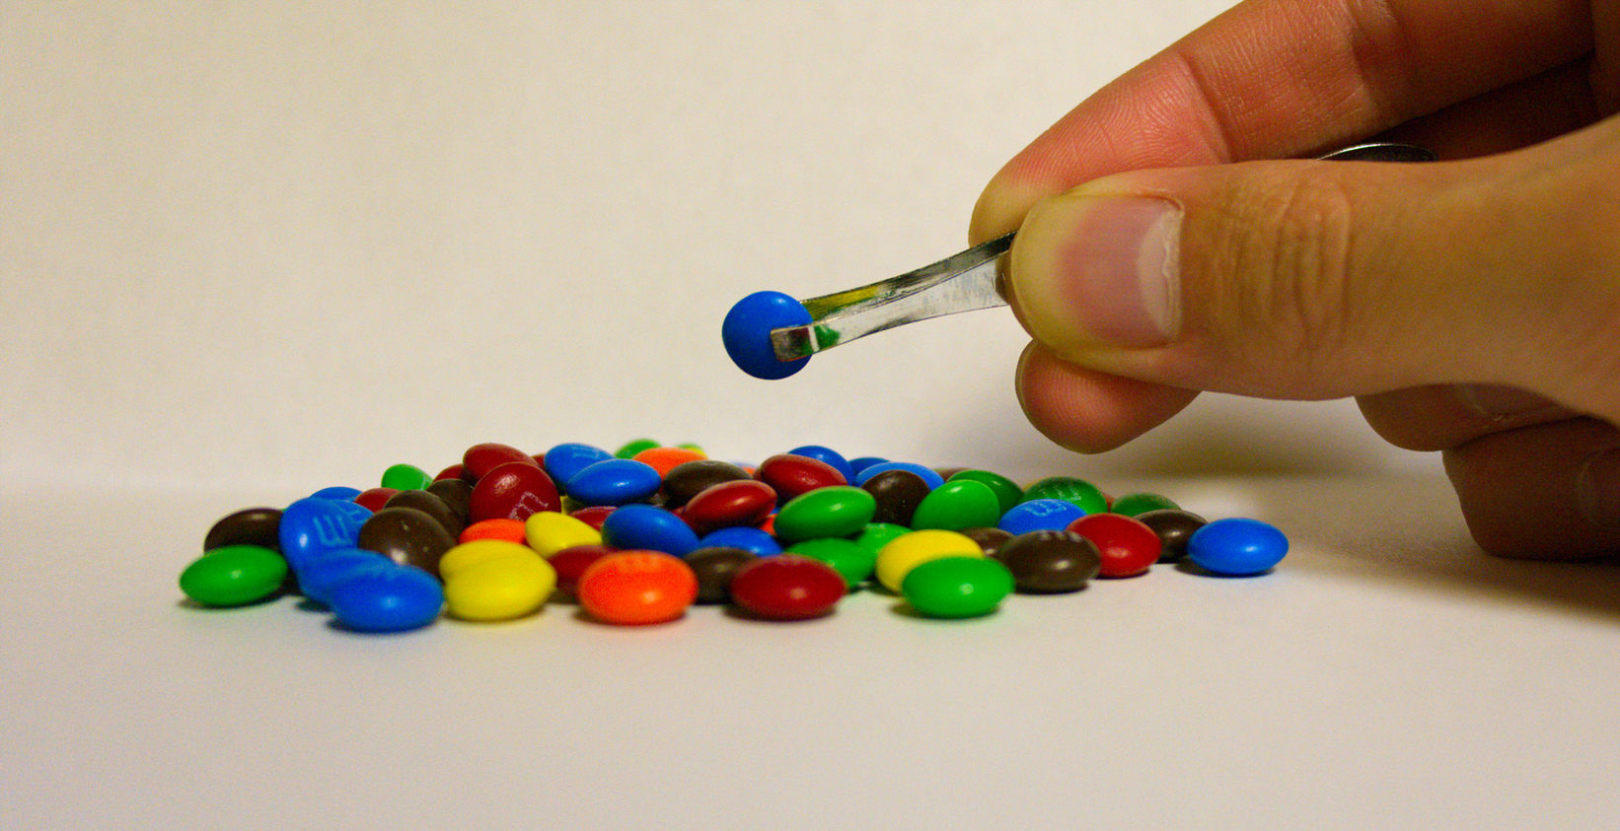
Challenges: Research Environment
Data Collection & Analysis
Costs
Bias
Inaccurate & incomplete
Sampling
Massive amounts of data
Evolving technologies
Image: https://www.flickr.com/photos/travisjuntara/8146930619/ by Travis Juntara / CC BY 2.0
Notes:
Image: https://www.flickr.com/photos/travisjuntara/8146930619/ by Travis Juntara / CC BY 2.0
Bias presents a threat to validity , particularly the interviewer because of over-reacting to responses, etc.
Massive amounts of data
Interviews
Logs
Evolving Technology
Data on Wiki’s that is no longer available
Switching data platforms

Slide 30
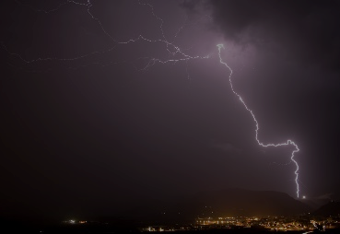
“The creative process is not like a situation where you get struck by a single lightning bolt. You have ongoing discoveries, and there are ongoing creative revelations. Yes, it's really helpful to be marching toward a specific destination, but, along the way, you must allow yourself room for your ideas to blossom, take root, and grow. “
–Carlton Cuse
Image: https://www.flickr.com/photos/hunty66/390350345 by Pete Hunt / CC BY-NC 2.0
Notes:
Image: https://www.flickr.com/photos/hunty66/390350345 by Pete Hunt / CC BY-NC 2.0
“Carlton Cuse Quotes.” BrainyQuote. Accessed February 23, 2018. https://www.brainyquote.com/quotes/quotes/c/carltoncus644835.html.

Slide 31
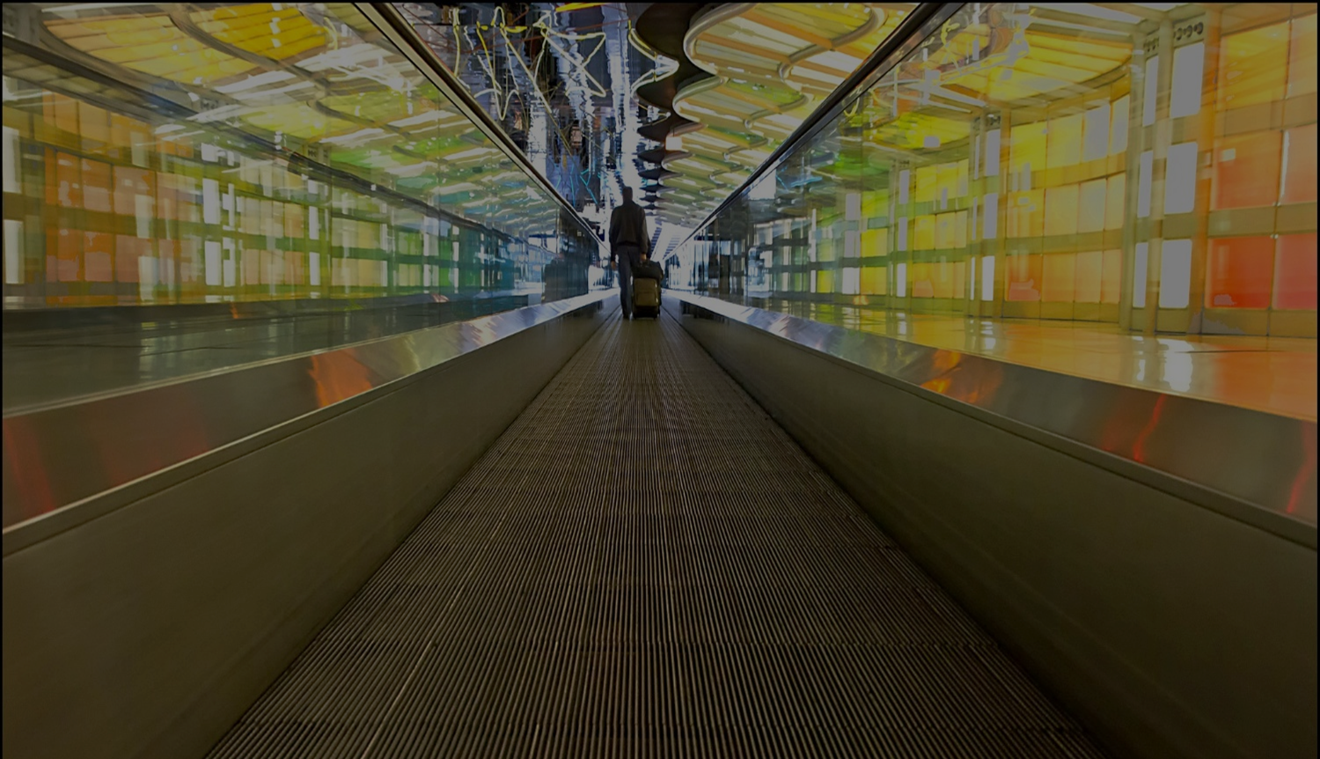
Not failure but opportunities for engagement & progress
Image: https://www.flickr.com/photos/w4nd3rl0st/6836056258 by Jason Mrachina / CC BY-NC-ND 2.0
Notes:
Image: https://www.flickr.com/photos/w4nd3rl0st/6836056258 by Jason Mrachina / CC BY-NC-ND 2.0
Influence practice by engaging with users and potential users of library services and systems
Development of services and systems that meet their needs
New theory
Models
Relationship building
Services and system users and potential users
Practitioners
Other researchers
LIS
Other disciplines

Slide 32
Acknowledgements
I would like to thank Brittany Brannon for her assistance in preparing this presentation.

Slide 33
References
Case, D. O., & Given, L. S. (2016). Looking for information: A survey of research on information seeking, needs, and behaviour. Bingley, UK: Emerald.
Chu, H. (2015). Research Methods in Library and Information Science: A Content Analysis. Library & Information Science Research 37(1), 36-41.
Connaway, Lynn Silipigni, and Marie L. Radford. 2017. Research Methods for Library and Information Science, 6th ed. Westport, CT: Libraries Unlimited.
Greifeneder, E. (2014). Trends in information behaviour research. In Proceedings of ISIC, the Information Behaviour Conference, Leeds, 2-5 September, 2014: Part 1. http://InformationR.net/ir/19-4/isic/isic13.html
Jasiewicz, J. (In Press). Social science research methods in library science between 2010 and 2015. A bibliometric analysis.

Slide 34
References
Kazmer, Michelle. 2017. “Mixed Methods.” In Research Methods for Library and Information Science, 6th ed., edited by Lynn Silipigni Connaway and Marie L. Radford, 232-233. Westport, CT: Libraries Unlimited.
Luo, L., & McKinney, M. (2015). JAL in the Past Decade: A Comprehensive Analysis of Academic Library Research. The Journal of Academic Librarianship 41(2),123-129.
Matusiak, K. K. (2017). Studying information behavior of image users: An overview of research methodology in LIS literature, 2004-2015. Library and Information Science Research 39 (1), 53–60.
McKechnie, L. M., Baker, L., Greenwood, M., & Julien, H. (2002). Research method trends in human information behaviour literature. The New Review of Information Behaviour Research: Studies of Information Seeking in Context (Proceedings of ISIC 2002), 3, 113-125.

Slide 35
References
Miles, M. B., & Huberman, A. M. (1994). Qualitative Data Analysis: A Sourcebook. Beverly Hills: Sage Publications.
Miles, M. B., Huberman, M., & Saldaña, J. (2014). Qualitative Data Analysis: A Methods Sourcebook, 3rd ed. Thousand Oaks, CA: Sage.
Powell, R. (1999). Recent Trends in Research: A Methodological Essay. Library & Information Science Research 21(1), 91-119.
Webb, E. J., Campbell, D. T., Schwartz, R. D., & Sechrest, L. (1966). Unobtrusive Measures: Nonreactive Research in the Social Sciences, Vol. 111. Chicago: Rand McNally.

Slide 36
Questions?
Lynn Silipigni Connaway, PhD
Director of Library Trends and User Research
connawal@oclc.org
@LynnConnaway

Slide 37
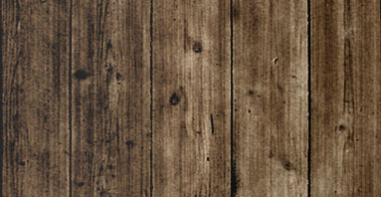
What other data collection and analysis methods have you used to study information-seeking behavior in individuals' personal lives?
What are the advantages and disadvantages of using these methods?
What advice would you give to others considering using these data collection and analysis methods to study information-seeking behavior?
Image: https://www.flickr.com/photos/matthamm/3345597511 by Matt Hamm / CC BY-NC 2.0
Notes:
Image: https://www.flickr.com/photos/matthamm/3345597511 by Matt Hamm / CC BY-NC 2.0

Slide 38
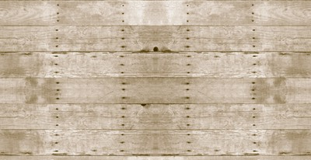
What other data collection and analysis methods have you used to study information-seeking behavior in individuals’ academic or professional lives?
What are the advantages and disadvantages of using these methods?
What advice would you give to others considering using these data collection and analysis methods to study individuals’ academic or professional life information-seeking behavior?
Image: https://www.flickr.com/photos/matthamm/3345597511 by Matt Hamm / CC BY-NC 2.0
Notes:
Image: https://www.flickr.com/photos/matthamm/3345597511 by Matt Hamm / CC BY-NC 2.0

Slide 39
3. What type of visual evidence have you had a chance to collect for studying information behavior?
What challenges have you experienced in collecting and managing visual research data?
What approaches have you selected for analysis of visual data?
Image: https://www.flickr.com/photos/matthamm/3345597511 by Matt Hamm / CC BY-NC 2.0
Notes:
Image: https://www.flickr.com/photos/matthamm/3345597511 by Matt Hamm / CC BY-NC 2.0

Slide 40
4. What information behavior research problems may be analyzed using biometrics methods?
What other data collection and analysis methods should be combined with biometrics methods to deepen the knowledge of information behaviors?
Image: https://www.flickr.com/photos/matthamm/3345597511 by Matt Hamm / CC BY-NC 2.0
Notes:
Image: https://www.flickr.com/photos/matthamm/3345597511 by Matt Hamm / CC BY-NC 2.0

