Slide 1
ALAO • 2 November 2018
You Talked To Your Users–What Now?
Developing Codebooks For Qualitative Data Analysis
Brittany Brannon
Research Assistant, OCLC
brannonb@oclc.org

Slide 2
What is coding?
Notes:
How many of you are familiar with the concept of coding?
How many of you have coded before?
At the most basic level, coding is categorizing qualitative data. You put different bits of data into different categories in order to draw conclusions about your data overall. As you’ll see, this process can vary greatly in complexity.

Slide 3
“The goal of coding is ultimately data reduction…”
(Connaway & Radford, 2017, p. 299)
Connaway, L. S., & Radford, M. L. (2017). Research methods in library and information science (6th ed.). Santa Barbara, CA: Libraries Unlimited.
Notes:
“The goal of coding is ultimately data reduction and theory construction, by identifying possible patterns and distilling and sorting the data for making comparisons with other data segments.” (p. 299)
Connaway, L. S., & Radford, M. L. (2017). Research methods in library and information science (6th ed.). Santa Barbara, CA: Libraries Unlimited.

Slide 4
Codebook
Habitat
Trees and/or wood
Grasses and/or straw
Growth
Wild
Cultivated
Human use
Edible
Toxic
Deadly
Psychoactive
Medicinal
Name
Scientific name
Common name
Native location
North America
South America
Europe
Asia
Australia
Africa
Antarctica
Notes:
Let’s start by trying our hand at doing some coding. It seems counterintuitive, but it’s very difficult to develop a codebook if you don’t have a practical sense of what you’ll be doing with it.
I adapted this activity from one that my colleague Erin Hood does when teaching people how to use Nvivo.
This miniature codebook was developed after reviewing the summaries from about 15 Wikipedia articles on mushrooms.
Take five minutes and apply this codebook to the two Wikipedia article summaries.

Slide 5
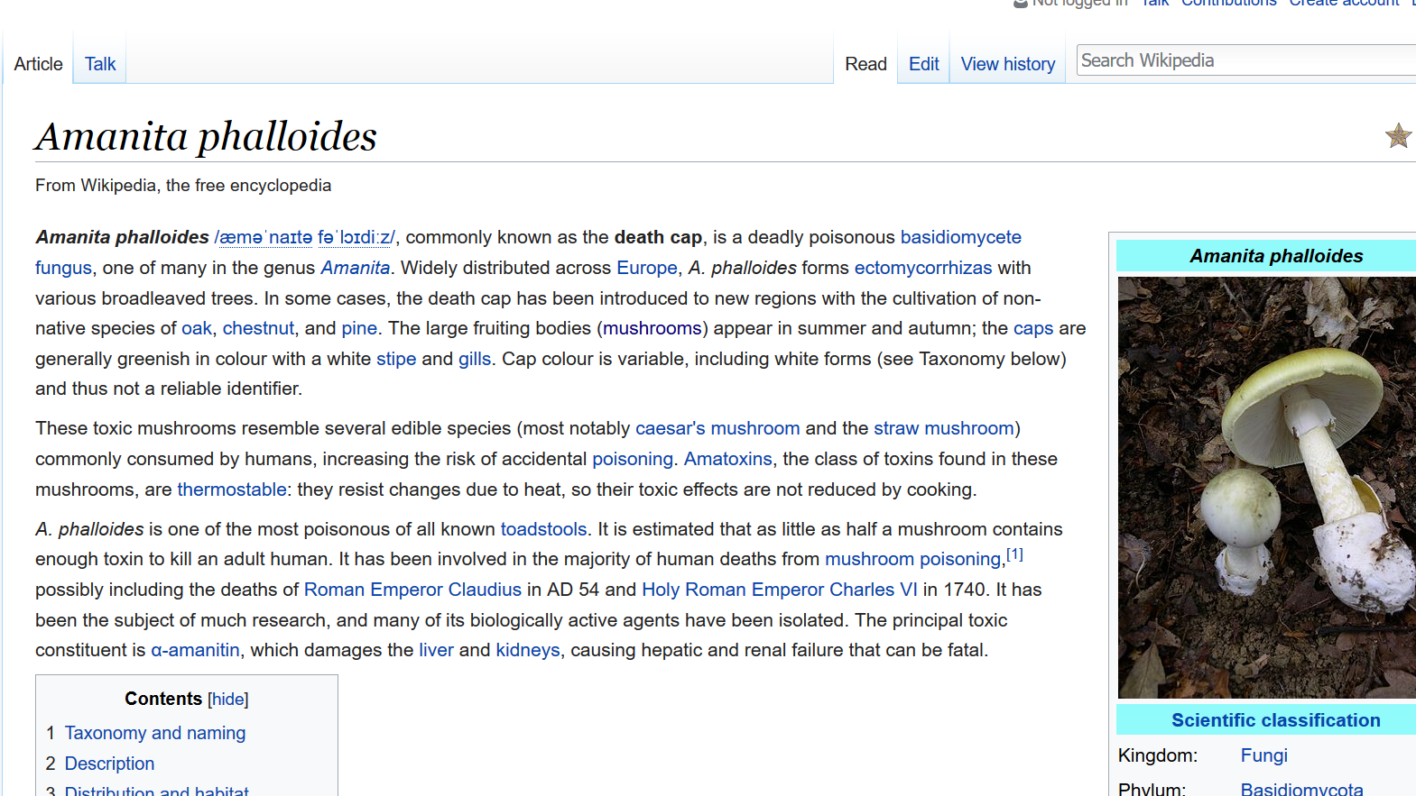
“Amanita phalloides.” (2018, October 11). Wikipedia, The Free Encyclopedia. https://en.wikipedia.org/wiki/Amanita_phalloides
1a
1b
5bi
2c
3a
Notes:
“Amanita phalloides.” (2018, October 11). Wikipedia, The Free Encyclopedia. https://en.wikipedia.org/wiki/Amanita_phalloides
1a – Scientific name
1b – Common name
5bi – Deadly
2c – Native location – Europe
3a – Habitat – Trees and/or wood

Slide 6
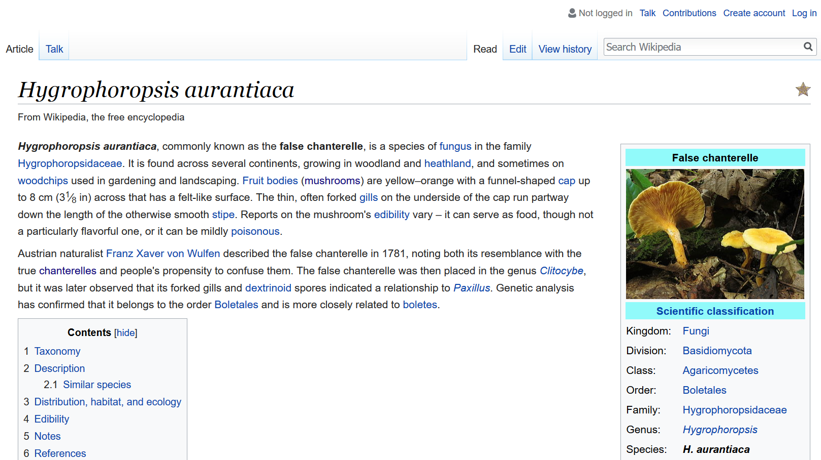
“Hygrophoropsis aurantiaca.” (2018, March 23). Wikipedia, The Free Encyclopedia. https://en.wikipedia.org/wiki/Hygrophoropsis_aurantiaca
1a
1b
3a
2
5a, 5b
Notes:
“Hygrophoropsis aurantiaca.” (2018, March 23). Wikipedia, The Free Encyclopedia. https://en.wikipedia.org/wiki/Hygrophoropsis_aurantiaca
1a – Scientific name
1b – Common name
2 – Native location
3a – Habitat – Trees and/or wood
5a – Human use – Edible
5b – Human use – Toxic

Slide 7
Considerations in Coding and Codebook Development
Research questions/Purpose of research
Type of data
Anticipated analysis
Literature/Theoretical framework
Size of research team
Notes:
Will this help answer my research question(s)?
Is this appropriate for the type of data I have?
Will this enable me to do the type of analysis I want to do?
Does this make sense in the context of the literature and theoretical framework I’m using?
Can I accomplish this with the number of people that will be coding?

Slide 8
Researching Students’ Information Choices (RSIC): Determining Identity and Judging Credibility in Digital Spaces
@RSICstudy
http://guides.uflib.ufl.edu/RSIC
LG-81-15-0155
Notes:
Three projects that I will use as examples throughout this presentation:
IMLS-funded study Researching Students’ Information Choices: Determining Identity and Judging Credibility in Digital Spaces (http://guides.uflib.ufl.edu/RSIC) – IMLS grant project
OCLC internal project on use of the Discovery tool – Discovery project
Library assessment survey used for strategic planning and annual report – Assessment project
Different types of research projects – different scales, timelines, and goals

Slide 9
Considerations in Coding and Codebook Development
Research questions/Purpose of research
Type of data
Anticipated analysis
Literature/Theoretical framework
Size of research team
Notes:
IMLS grant project:
Do STEM students differentiate among different types of digital resources during point of selection?
What cues from a web search results screen do students use to identify digital resources?
How do students’ characteristics influence their identification behavior?
How do STEM students determine the credibility of digital resources?
What cues from a web search results screen do students use to judge the credibility of digital resources?
How do students’ characteristics influence their credibility judgments?
Discovery project:
1. How do users navigate the path from discovery to access?
Assessment project:
Purpose – identify the value of the library to users, what would help the library better meet user needs

Slide 10
Considerations in Coding and Codebook Development
Research questions/Purpose of research
Type of data
Anticipated analysis
Literature/Theoretical framework
Size of research team
Notes:
IMLS grant project:
175 transcripts of TAP from simulations (12-30 pages each)
Discovery project:
15 transcripts of user interviews based on log analysis (10-15 pages each)
Assessment project:
200-300 open-text responses from survey (a couple words to four sentences each)

Slide 11
Considerations in Coding and Codebook Development
Research questions/Purpose of research
Type of data
Anticipated analysis
Literature/Theoretical framework
Size of research team
Notes:
What do you want to be able to do with your data? What do you want to be able to say about your data?

Slide 12
Considerations in Coding and Codebook Development
Research questions/Purpose of research
Type of data
Anticipated analysis
Literature/Theoretical framework
Size of research team
Notes:
Are there any areas from the existing literature or from your theoretical framework that you need to be sure to include?

Slide 13
Considerations in Coding and Codebook Development
Research questions/Purpose of research
Type of data
Anticipated analysis
Literature/Theoretical framework
Size of research team
Notes:
How many people are going to participate in coding?
IMLS grant project: about 10 people
Discovery project: about 5 people
Assessment project: just me

Slide 14
Developing a codebook

Slide 15
Approaches to Coding
Deductive
Use of established coding schemes
Inductive
Coding schemes emerge from data
Notes:
Deductive: Provisional list of codes pulled from the topic area or study
Theoretical frameworks
Research questions or hypotheses
Problem areas
Key variables
Inductive:
Grounded theory
Constant comparative method
Theme analysis
Most codebooks involve both.
Assessment project: Started with codes/themes for known building issues, including temperature, outlets, seating, and study spaces.

Slide 16
Generating Codes
Review a sample of your data
Identify patterns and themes
Compare different pieces of data to one another
Determine most important themes
Notes:
I’ve developed a preliminary set of a total of eight steps to developing a codebook. They’re divided up here into two sections, four steps to generate codes and four steps to develop them into a codebook, but realistically they’re all part of the same process.

Slide 17
Developing the Codebook
Compare themes to one another
Organize themes into a hierarchy (preliminary codebook!)
Code a different sample using the preliminary hierarchy
Revise!

Slide 18
Generating Codes
Review a sample of your data
Identify patterns and themes
Compare different pieces of data to one another
Determine most important themes
Notes:
The size of your sample depends on how much data you have. I would recommend reviewing as large a sample as possible—it will improve the accuracy and coverage of your codebook.

Slide 19
1. Sample sizes
IMLS grant project – 10% of data (180 transcripts, we reviewed 18)
Discovery project – 100% of data (15 transcripts)
Assessment project – 100% of data (several open-ended text responses)
Notes:
Other things to note:
For the IMLS grant project, the transcripts are long and complex. For the discovery project, the transcripts are shorter and less dense.

Slide 20
Generating Codes
Review a sample of your data
Identify patterns and themes
Compare different pieces of data to one another
Determine most important themes
Notes:
At this stage, identify all patterns and themes of interest in each data source selected.
- You may want to go through your data sources multiple times depending on what you find as you go through each successive piece.

Slide 21
Generating Codes
Review a sample of your data
Identify patterns and themes
Compare different pieces of data to one another
Determine most important themes
Notes:
Are you seeing themes in more than one data source? Do the different data sources talk about similar topics in different ways or about different topics in similar ways?

Slide 22
3. Are these the same concept?
“This is kind of like a counterargument of what I would say. So it's going to have both sides.” (U23 45:04)
“So this is interesting because the title is actually suggesting that it is going to take a different viewpoint” (H20 25:48)
“I don't like Wikipedia because other people can give you different information and their opinion, so I don't use Wikipedia.” (E14 04:07)
“TIME Magazine I'll just put somewhat credible because I'm sure there's some kind of bias involved in the magazine setting.” (G01 48:16)
Notes:
IMLS grant project: “Opinion”
When positive, referred to as “different viewpoint”, “counterargument”
When negative, referred to as “opinion”, “bias”
“Well, normally when I write papers, I try to come up with a solution for the issue. So this could be a-- arguing side of the other side. That didn't make any sense. I don't really know how to say what I'm trying to say. This is kind of like a counterargument of what I would say. So it's going to have both sides.” (U23 45:04)
“So this is interesting because the title is actually suggesting that it is going to take a different viewpoint, because everything we've seen so far is that the pythons should not be there and they should be removed, which they've had some pretty good evidence for that [laughter]. But I'd love to see how different people have different views on things, so let's check it out.” (H21 25:48)
“I don't like Wikipedia because other people can give you different information and their opinion, so I don't use Wikipedia.” (E14 04:07)
“TIME Magazine I'll just put somewhat credible because I'm sure there's some kind of bias involved in the magazine setting.” (G01 48:16)

Slide 23
Generating Codes
Review a sample of your data
Identify patterns and themes
Compare different pieces of data to one another
Determine most important themes
Notes:
Evaluate the themes you’ve identified. Which are important enough to keep and which should be eliminated?

Slide 24
4. Which codes are important?
Repetition
Research questions
Anticipated analysis
Literature
Notes:
Remember the quote that we started with: Coding is about data reduction! Try to think carefully about which themes you will really use and which themes will benefit your project.
Repetition is an important element to consider when determining which themes will be worth including in the codebook. Themes that occur in all or most of your sample are likely important to include in your codebook. However, themes that only occur in one or two data sources may also be important to include (especially if it’s something you were expecting to see!).
Remember to think about:
Research questions
Think about scope and scope creep
In grounded theory and user-driven research, it can be great to discover new things. It can also pull you off task.
Data reuse is awesome! There may be areas of interest that are outside the scope of this project but would be great for additional rounds of analysis or that may suggest new avenues for future research. Keep notes on these areas as you go.
Do you have obligations for this research?
IMLS grant project
Received grant money to research a specific topic – this limits our scope
The type of analysis you want to perform
The literature that you’re drawing from
Good opportunity to think about blending deductive and inductive approaches
IMLS grant project
Included certain dimensions of credibility based on our review of the credibility literature

Slide 25
Developing the Codebook
Compare themes to one another
Organize themes into a hierarchy (preliminary codebook!)
Code a different sample using the preliminary hierarchy
Revise!
Notes:
Are there themes that seem to fall into similar categories? Codes that have logical relationships to one another?
Discovery project
Limiters
Revising search terms
Using different search tools
All examples of search strategies!

Slide 26
Developing the Codebook
Compare themes to one another
Organize themes into a hierarchy (preliminary codebook!)
Code a different sample using the preliminary hierarchy
Revise!
Notes:
Group them! Create a hierarchy that helps to explain the meaning of each code.
IMLS grant project
Cues
Judgments
Personal Commentary
Decide how you want to use the hierarchy. Are you going to use parent nodes or are they only there to help organize? Do you need to add “Other” codes to each section?
It may be worthwhile to add definitions to your codes at this stage.

Slide 27
Developing the Codebook
Compare themes to one another
Organize themes into a hierarchy (preliminary codebook!)
Code a different sample using the preliminary hierarchy
Revise!
Notes:
Now that you have a hierarchy, try to code a portion of your data. What works and what doesn’t? Were there things that you couldn’t capture? Codes that captured more than one concept? If you’re coding with someone else, compare to make sure you were applying codes in the same way. If you’re coding on your own, double-check yourself. Do all of the items that you applied a particular code to represent the same concept?

Slide 28
Developing the Codebook
Compare themes to one another
Organize themes into a hierarchy (preliminary codebook!)
Code a different sample using the preliminary hierarchy
Revise!
Notes:
Based on the problem areas and pain points that emerged from your trial coding, revise your codebook as necessary. Things you may need to do:
Add or delete codes
Combine codes
Separate one code into multiples
Change the definition of a code or specify the rules for applying it

Slide 29
Activity
Notes:
You have a transcript excerpt from the IMLS grant project.
G11 Helpful Task
Had been given a fictional research prompt
Presented with search results (4 pages, 10 results each)
Choose 20 resources that you find helpful

Slide 30
Read through G11 and identify themes. (10 minutes)
Find a group and compare.
Do some themes seem more important than others?
Do some themes represent similar concepts?
Do some themes have logical relationships with other themes?

Slide 31
Additional considerations

Slide 32
Unit of Analysis
Turn of conversation
Word
Line
Segment
Incident

Slide 33
Application of Codes
Literal
Thematic
Implied
Notes:
Literal: If you intend to only use literal coding (applying a code if and only if the word of the code is used), you may be better off using text analysis software. Coding is time- and labor-intensive.
Thematic: Applying codes based on the meaning of what the participant has said.
Implied: In the death cap article, wild is implied because the mushroom is deadly. However, other potentially deadly plants are cultivated. Can you code that?

Slide 34
Coding Tools
Specialty software
NVivo
Qualtrics
Spreadsheet software
Survey software
No software!

Slide 35
Questions?
Brittany Brannon
brannonb@oclc.org

