Slide 1
CONTENTdm User Group Meeting, August 1-2, 2018, Columbus Metropolitan Library
Using Wikibase to Manage Linked Data for Digital Collections
Bruce Washburn Principal Engineer OCLC Membership & Research
Jeff Mixter Lead Software Engineer OCLC Membership & Research
Jean Godby Senior Research Scientist OCLC Membership & Research
Presented by Jean Godby and Jeff Mixter

Slide 2
What we’ll be covering today…
Looking back on OCLC’s Linked Data work
Getting to know Wikidata and Wikibase
Reviewing OCLC / Wikibase research results
Considering Wikidata and Wikibase for digital materials
Summing up: Lessons learned and caveats

Slide 3
Looking back on OCLC’s Linked Data work

Slide 4
OCLC’s History with Linked Data
2009: Introduced VIAF as Linked Data (now one of the most widely used linked data resources published by the library community)
2011: Introduced FAST as Linked Data
2012: Added Schema.org descriptions to WorldCat.org
Notes:
OCLC has been working with Linked Data for many years.
Our early work focused on converting existing (authority) resources, like the authority file clusters in VIAF and the subject heading facets in FAST, to Linked Open Data.
In 2012, Schema.org markup was added to records in WorldCat.org, enriching those descriptions with Linked Data identifiers to related entities in VIAF, FAST, and other vocabularies.

Slide 5
OCLC’s History with Linked Data
2014: Added WorldCat work entities to WorldCat.org
2015: Added WorldCat person entities to WorldCat.org
2015: Launched Person Entity Lookup pilot program
2015-2016: Created a Metadata Refinery prototype, tested converting CONTENTdm metadata to Linked Data
2017: Added IIIF Image and Presentation API support to CONTENTdm
Notes:
More recently, our focused has shifted to creating new entities based on bibliographic data in WorldCat.
Work entities have been published that provide a way to pull together related editions of a work and connect these and their associated entities to other Linked Data sources.
Similarly, entities have been published representing people that can be identified in WorldCat bibliographic data.
A pilot project related to the Person Entity data tested how services for reconciling personal names to entities fit into existing cataloging workflows.
And lessons learned from that pilot contributed to an experimental prototype to evaluate workflows for analyzing, reconciling, and transforming CONTENTdm metadata into Linked Data.
CONTENTdm has also played another role in OCLC’s Linked Data work, as the system within which the IIIF APIs have been implemented.

Slide 6
OCLC’s History with Linked Data
2017-2018: Partnered with 16 libraries to evaluate a platform for creating and managing bibliographic linked data at scale.
2018: Added support for URIs (Uniform Resource Identifiers) in WorldCat MARC records
2018: Production planning begins to support future services to create, manage and reconcile data in a variety of formats, including MARC, Schema.org, and BIBFRAME
https://www.oclc.org/research/themes/data-science/linkeddata.html
Notes:
More recently we’ve launched a new pilot project to evaluate a platform for creating and managing linked data at scale, added support for URIs in WorldCat, and have begun planning for production services for linked data management.
For more information on past, current, and future work, consult the OCLC Research website.

Slide 7
OCLC’s History with Linked Data
2015-2016: Created a Metadata Refinery prototype, tested converting CONTENTdm metadata to Linked Data
2017-2018: Partnered with 16 libraries to evaluate a platform for creating and managing bibliographic linked data at scale.
Notes:
These two efforts previously described form the backdrop to the discussion we’d like to have today. The Metadata Refinery prototype gave us insights into how linked data services could be adapted to present workflows, and also how workflows and systems may need to adjust to take full advantage of linked data.
And the evaluation of a potential linked data platform, work that it still in progress, is telling us a lot as well.
Jeff Mixter will be talking next, about that project and its implications.

Slide 8
A project vision statement
Work with our members through a foundational shift in the collaborative work of libraries, communities of practice, and end-users—dramatically improving efficiency, embracing the inclusive, diverse, and earnest OCLC membership, and empowering a new and trusted knowledge network enabled by the web.

Slide 9
Who
Phase II Partners (!!!!) (May ‘18 – Sep ‘18)
American University
Brigham Young University
Cleveland Public Library
Gale Cengage
Harvard University
Michigan State University
National Library of Medicine
North Carolina State University
Northwestern University
Princeton University
Smithsonian Library
Temple University
University of Minnesota
University of New Hampshire
Yale University
Phase I Partners (Dec ’17 - Apr ‘18)
Cornell University
University of California, Davis
OCLC Research
OCLC Global Technolo-gies
OCLC Global Product Management

Slide 10
Getting to know Wikidata and Wikibase

Slide 11
Disambiguating Wiki*
Wikipedia – a multilingual web-based free-content encyclopedia
Wikidata.org - a collaboratively edited structured dataset used by Wikimedia sister projects and others

Slide 12
Disambiguating Wiki*
Wikipedia – a multilingual web-based free-content encyclopedia
MediaWiki - a free and open-source wiki software
Wikidata.org - a collaboratively edited structured dataset used by Wikimedia sister projects and others
Wikibase - a MediaWiki extension to store and manage structured data

Slide 13
MediaWiki Features
Search/Autosuggest/APIs
Multilingual UI
Wikitext editor
Change history
Discussion pages
Users and rights
Watchlists
Maintenance reports
Etc.

Slide 14
MediaWiki+Wikibase Features
Search/Autosuggest/APIs/Linked Data/SPARQL
Multilingual UI
Structured data editor
Change history
Discussion pages
Users and rights
Watchlists
Maintenance reports
Etc.

Slide 15
Wikibase advantages
Open source
An all-purpose data model that takes knowledge diversity, sources, and multilingual usage seriously
Collaborative – can be read and edited by both humans and machines
User-defined properties
Version history

Slide 16
Reviewing OCLC / Wikibase research results

Slide 17
A few key terms
Entity – the content of a page in the system that represents an item or a property.
Item -- a real-world object, concept, or event that is given a unique system identifier together with information about it. E.g., the book titled “Sense and Sensibility” by Jane Austen is an item entity.
Items include an identifying "fingerprint" of labels, descriptions, and aliases. The main data part of an item is the list of statements about the item.
Property -- each statement on an item page links to a property, and assigns the property one or more values. E.g., “author” is a property entity.
Property entity pages specify the property's assigned datatype and other statements.

Slide 18
A few key terms
Statement -- a piece of data about an item, recorded on the item's page.
A statement consists of a claim, and may be augmented with references (giving the source for the claim) and a rank (used to distinguish between several claims containing the same property).
Claim -- a piece of data about the entity on whose page the claim appears.
A claim consists of a property (such as “author") and either a value (e.g., “Jane Austen") or one of the special cases "no value" and "unknown value". A claim can have qualifiers, such as temporal qualifiers saying that the claim is valid within a specific time frame.

Slide 19
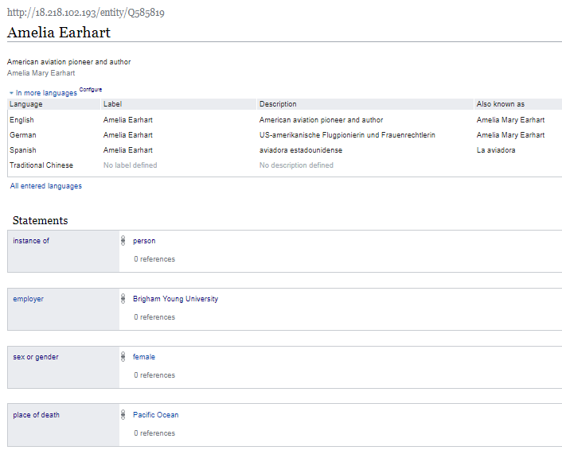

Slide 20
Item URL
Label
Item Identifier
Description
Additional labels, descriptions, and aliases, in other languages.
Aliases
Property
Statement
Rank
Value
Claim

Slide 21
Use case: Manual data entry
For manual creation and editing of entities,
Wikibase is the default technology.
It has a powerful and well-tested set of features that speed the data entry process and assist with quality control and data integrity.

Slide 22
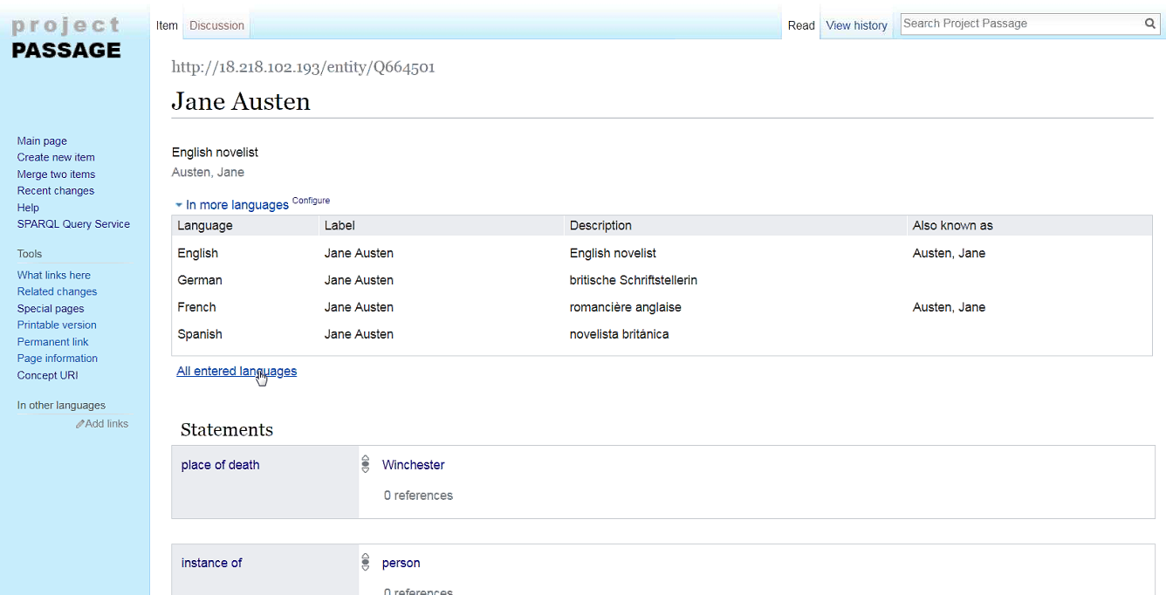

Slide 23
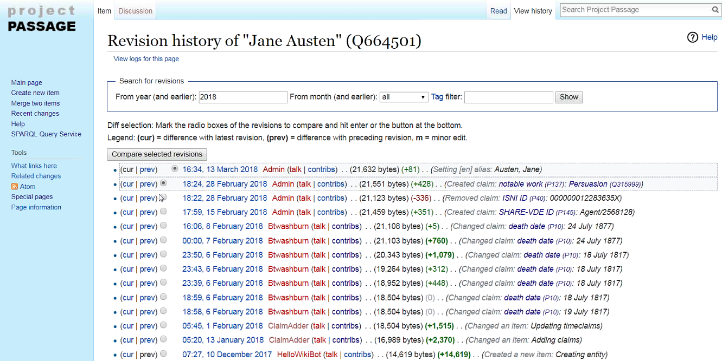

Slide 24
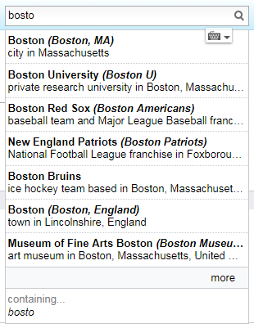
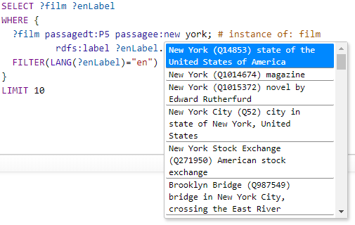
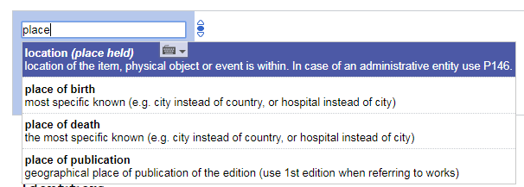
Use case: Autosuggest
Searching for entities as you type is supported by the Mediawiki API. This feature is found in both the prototype UI and in the SPARQL Query Service UI.
Notes:
Not necessary to demo this at this point. It would have been seen in the previous Wikibase UI demo and could be again in the SPARQL Query Service demo

Slide 25
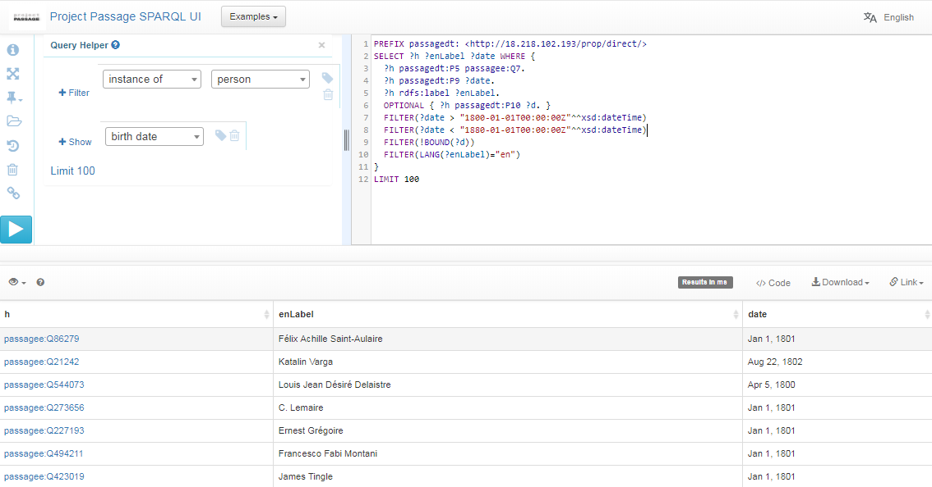
Use case: Complex queries
SPARQL (pronounced "sparkle") is an RDF query language … a semantic query language for databases. The prototype provides a SPARQL endpoint, including a user-friendly interface for constructing queries. With SPARQL you can extract any kind of data, with a query composed of logical combinations of triples.
In this example SPARQL query, items describing people born between 1800 and 1880, but without a specified death date, are listed.
Notes:
From the Query UI, things to demo:
From the examples list select the simple query to search for people
Use the autosuggest to show how to change the query to search for dogs, or cats
Use the autosuggest to show QA uses (people born between 1800 and 1880 that lack a death date)

Slide 26
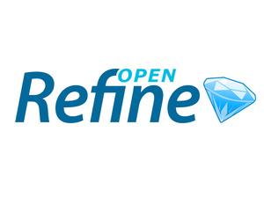
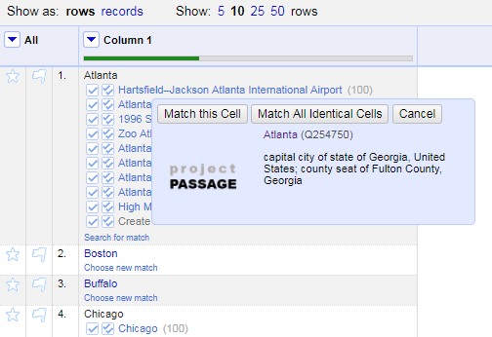
Use case: Reconciliation
Reconciling strings to a ranked list of potential entities is a key use case to be supported.
We are testing an OpenRefine-optimized Reconciliation API endpoint for this use case.
The Reconciliation API uses the prototype’s Mediawiki API and SPARQL endpoint in a hybrid tandem to find and rank matches.
Notes:
Why OpenRefine? Because it is popular, powerful, and ubiquitous. Though it might not be as commonly used with those managing MARC data? Something for us to learn more about.

Slide 27
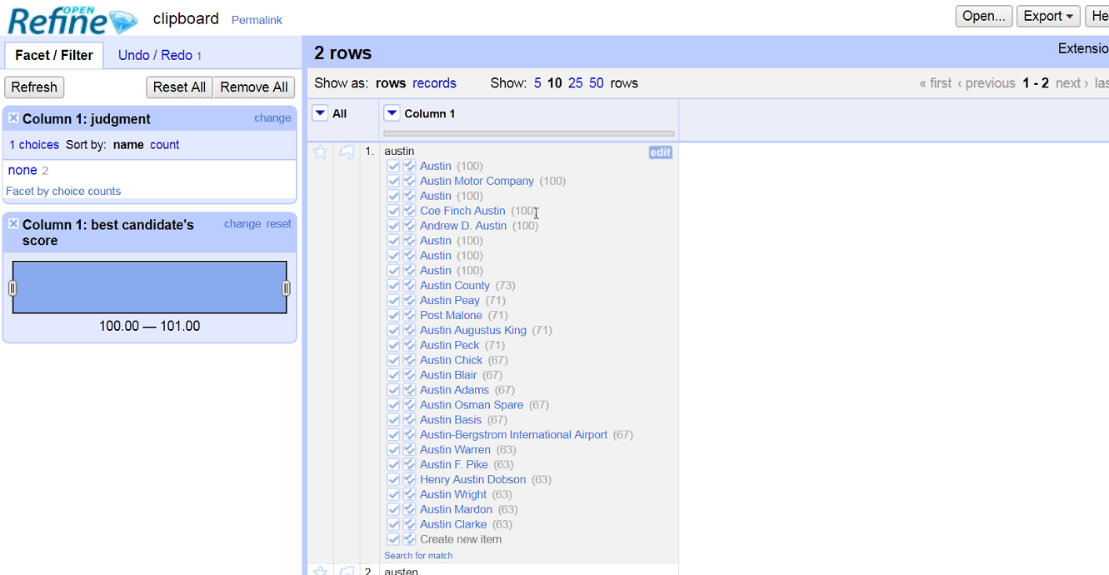

Slide 28
Use case: Batch loading
For batch loading new items and properties, and subsequent batch updates and deletions, OCLC staff use Pywikibot.
It is a Python library and collection of scripts that automate work on MediaWiki sites. Originally designed for Wikipedia, it is now used throughout the Wikimedia Foundation's projects and on many other wikis.
Notes:
Nothing to demo here but taking a look at the ClaimAdder updates is a way to also show Wikibase UI history pages, undo options, etc.
Note that we have not yet investigated, but plan to look at, other batch loading processes, including OpenRefine and QuickStatements

Slide 29
Considering Wikidata and Wikibase for digital materials

Slide 30
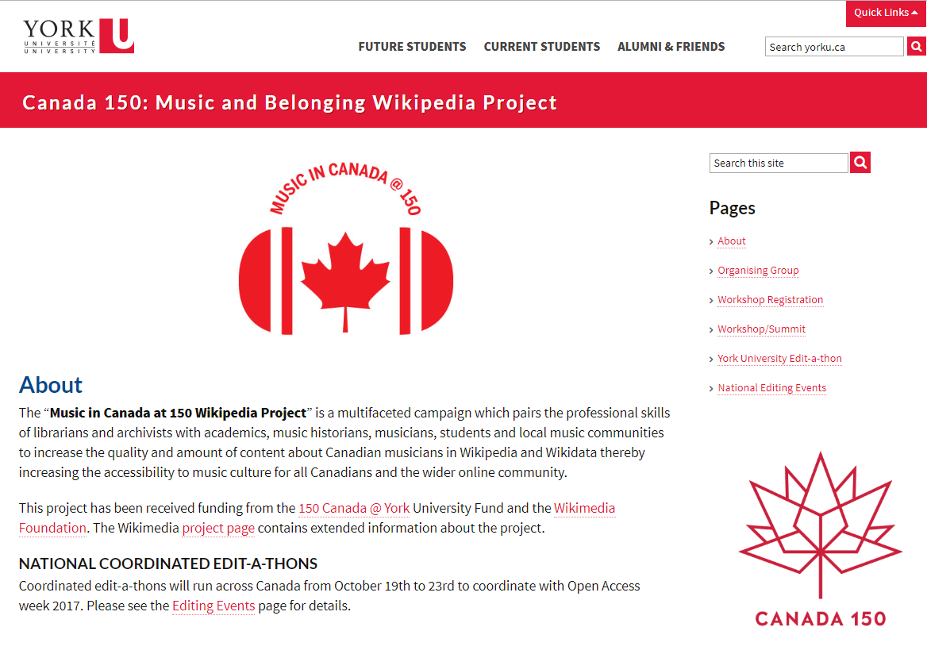
Wikidata cultural material projects
Music in Canada at 150 Wikipedia Project
“Pairs the professional skills of librarians and archivists with academics, music historians, musicians, students and local music communities to increase the quality and amount of content about Canadian musicians in Wikipedia and Wikidata thereby increasing the accessibility to music culture for all Canadians and the wider online community.”
https://wikimusic.library.yorku.ca/
Notes:
The “Music in Canada at 150 Wikipedia Project” is a multifaceted campaign which pairs the professional skills of librarians and archivists with academics, music historians, musicians, students and local music communities to increase the quality and amount of content about Canadian musicians in Wikipedia and Wikidata thereby increasing the accessibility to music culture for all Canadians and the wider online community.
This project has been received funding from the 150 Canada @ York University Fund and the Wikimedia Foundation. The Wikimedia project page contains extended information about the project.
NATIONAL COORDINATED EDIT-A-THONS
Coordinated edit-a-thons will run across Canada from October 19th to 23rd to coordinate with Open Access week 2017.

Slide 31
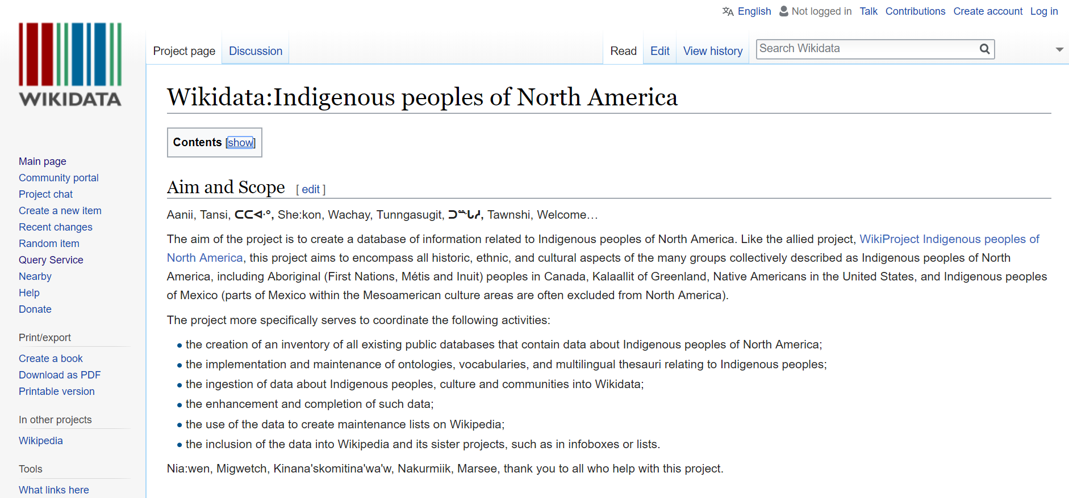
Wikidata cultural material projects
Wikidata:Indigenous peoples of North America
“The aim of the project is to create a database of information related to Indigenous peoples of North America.
This project aims to encompass all historic, ethnic, and cultural aspects of the many groups collectively described as Indigenous peoples of North America, including Aboriginal (First Nations, Métis and Inuit) peoples in Canada, Kalaallit of Greenland, Native Americans in the United States, and Indigenous peoples of Mexico (parts of Mexico within the Mesoamerican culture areas are often excluded from North America).
https://www.wikidata.org/wiki/Wikidata:Indigenous_peoples_of_North_America
Notes:
The aim of the project is to create a database of information related to Indigenous peoples of North America. Like the allied project, WikiProject Indigenous peoples of North America, this project aims to encompass all historic, ethnic, and cultural aspects of the many groups collectively described as Indigenous peoples of North America, including Aboriginal (First Nations, Métis and Inuit) peoples in Canada, Kalaallit of Greenland, Native Americans in the United States, and Indigenous peoples of Mexico (parts of Mexico within the Mesoamerican culture areas are often excluded from North America).
This project has been launched in 2017 as a side product of a project by the Association of Research Libraries (ARL) in cooperation with the York University Libraries. As part of the work of this project, data models for contemporary Indigenous people are being developed. The project is focused on ingesting data into Wikidata as well as looking at ways to bring data (roundtrip) the data back to research libraries, cultural heritage institutions and communities.

Slide 32
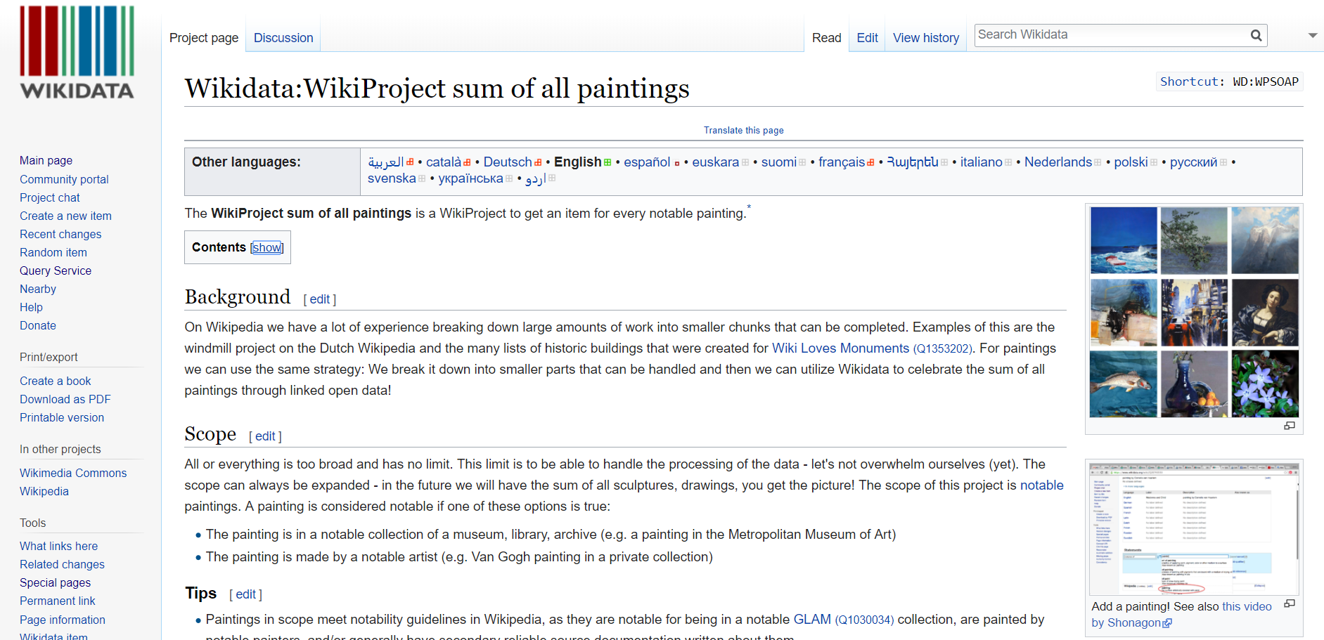
Wikidata cultural material projects
Wikidata WikiProject: Sum of All Paintings
The aim of the project is to create a Wikidata item for every notable painting.
“On Wikipedia we have a lot of experience breaking down large amounts of work into smaller chunks that can be completed.
For paintings we can use the same strategy: We break it down into smaller parts that can be handled and then we can utilize Wikidata to celebrate the sum of all paintings through linked open data!”
https://www.wikidata.org/wiki/Wikidata:WikiProject_sum_of_all_paintings
Notes:
The WikiProject sum of all paintings is a WikiProject to get an item for every notable painting.
On Wikipedia we have a lot of experience breaking down large amounts of work into smaller chunks that can be completed. Examples of this are the windmill project on the Dutch Wikipedia and the many lists of historic buildings that were created for Wiki Loves Monuments (Q1353202). For paintings we can use the same strategy: We break it down into smaller parts that can be handled and then we can utilize Wikidata to celebrate the sum of all paintings through linked open data!
All or everything is too broad and has no limit. This limit is to be able to handle the processing of the data - let's not overwhelm ourselves (yet). The scope can always be expanded - in the future we will have the sum of all sculptures, drawings, you get the picture! The scope of this project is notablepaintings. A painting is considered notable if one of these options is true:
The painting is in a notable collection of a museum, library, archive (e.g. a painting in the Metropolitan Museum of Art)
The painting is made by a notable artist (e.g. Van Gogh painting in a private collection)

Slide 33
The Wiki* Ecosystem
Wikipedia for contextual narrative
Wikidata for entities described by factual, verifiable statements, connected to other entities by relationships
Wikimedia Commons for digital media, rights statements, and technical metadata
Notes:
Taking a step back from Wikibase, and its implementation in support of Wikidata, there are two other Wiki* resources to keep in mind.
[Step through each, briefly]

Slide 34
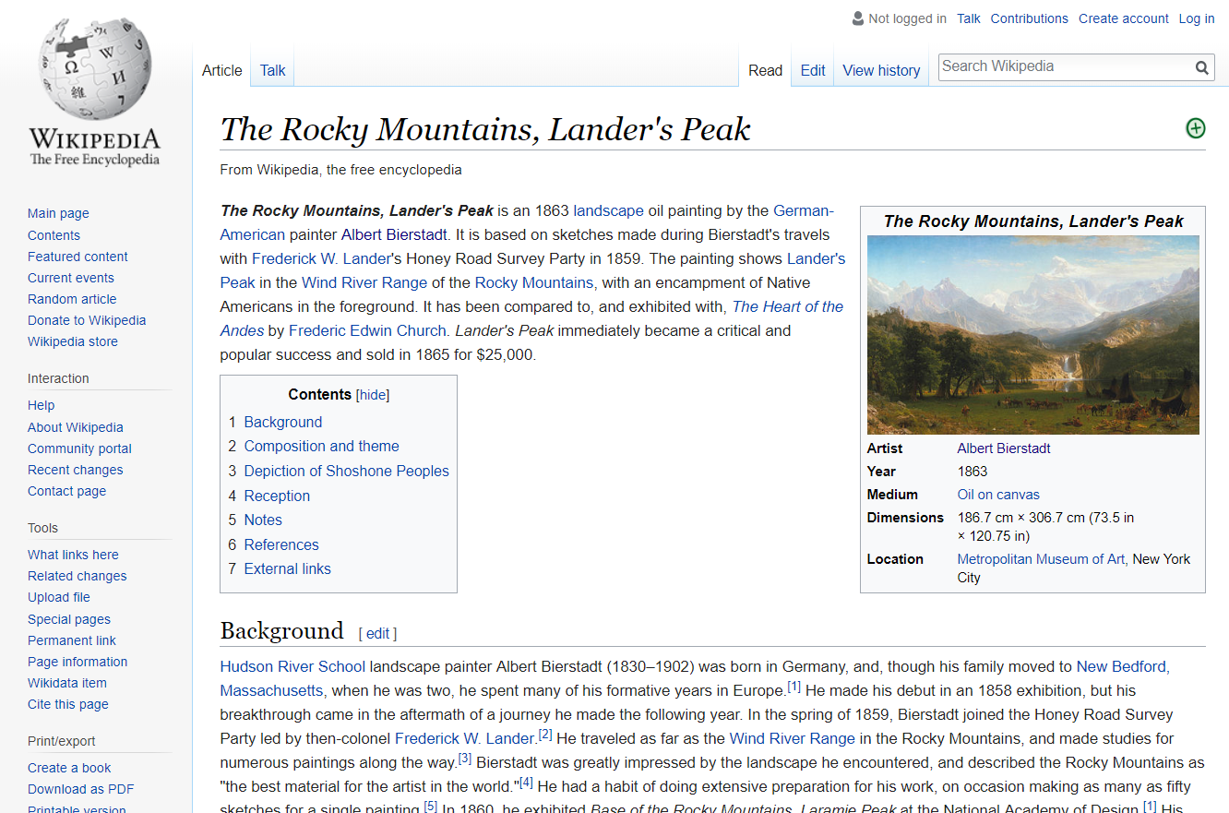
A painting in Wikipedia
Narrative description of the work
Claims backed by citations
Crowd-sourced data and review
“Info Box” statements can be linked to Wikidata items and statements.

Slide 35
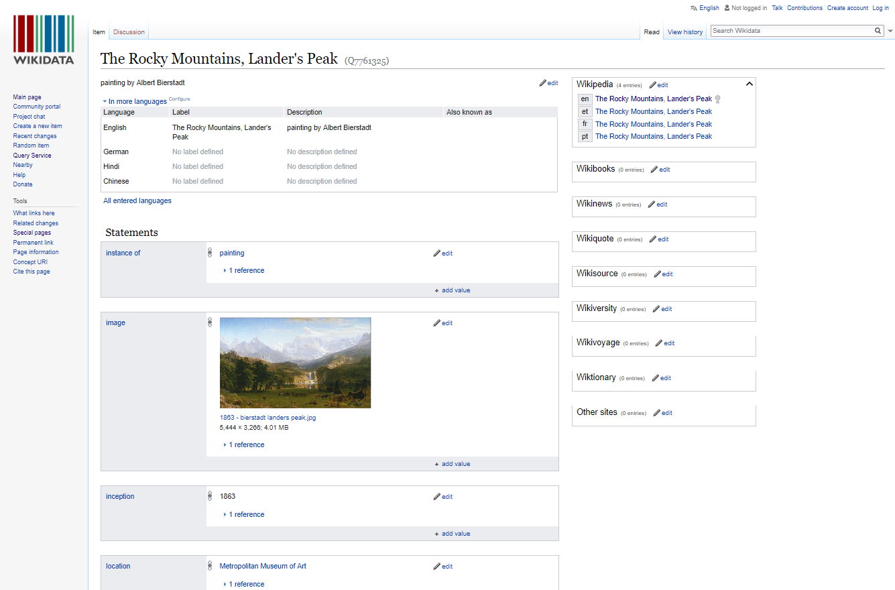
The same painting in Wikidata
“Fingerprint” data to help people find the item
Statements with references for verifiability
Crowd-sourced data and review
Statements can be linked to Wikipedia info boxes.

Slide 36
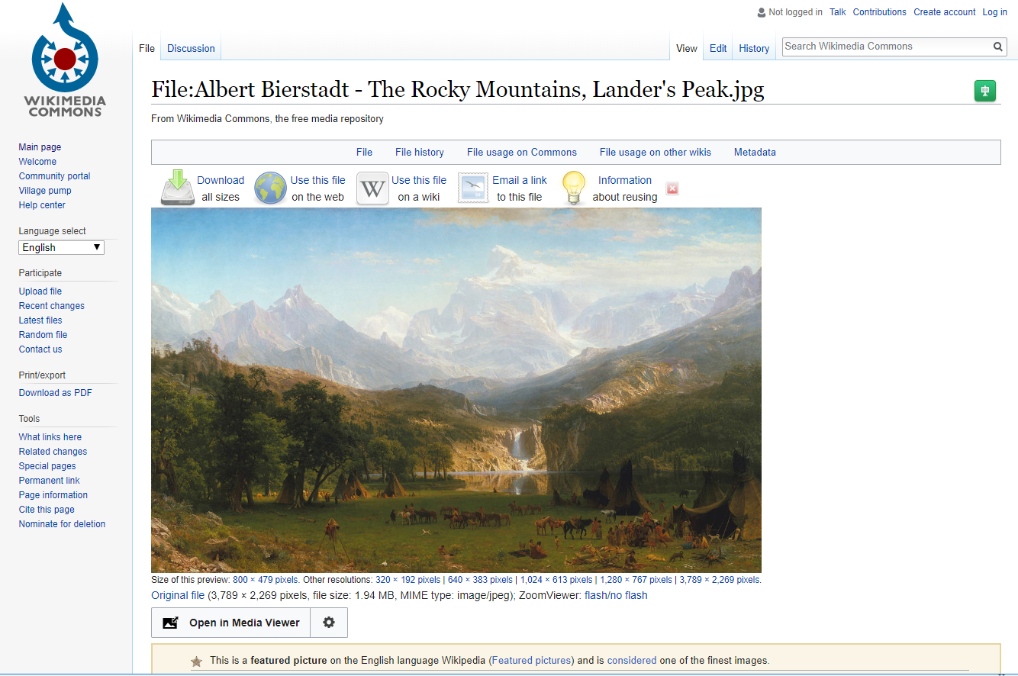
And in Wikimedia Commons
Wikimedia Commons manages images and other media
Rights and technical metadata can be described here
Crowd-sourced data and review

Slide 37
A separation of related concerns
Wikipedia
Contextual narrative
Wikidata
Verifiable statements, entity properties and relationships
Wikimedia Commons
Digital media, rights, and technical metadata

Slide 38
Pattern Recognition
We can see the potential for a similarly interconnected ecosystem for the data created and managed in CONTENTdm

Slide 39
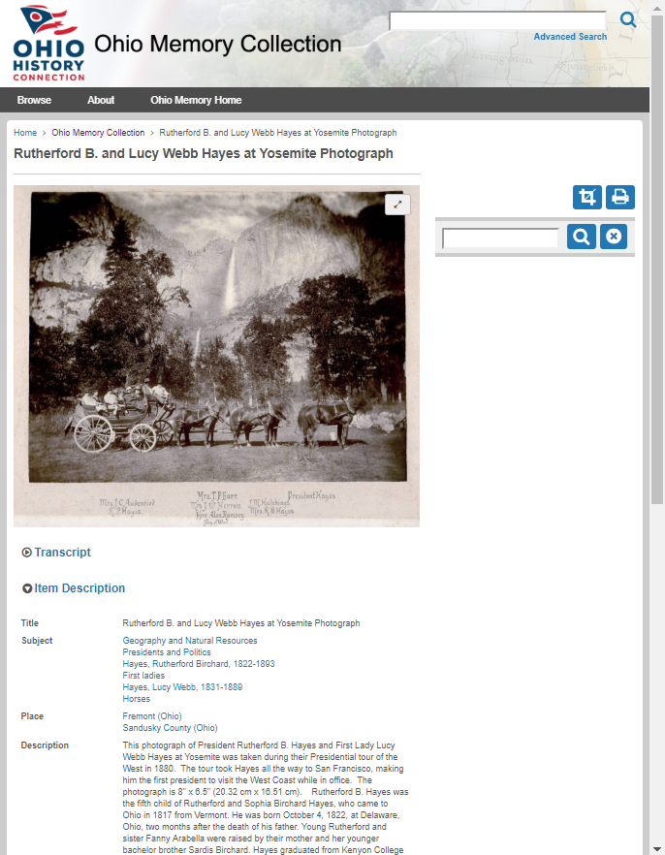
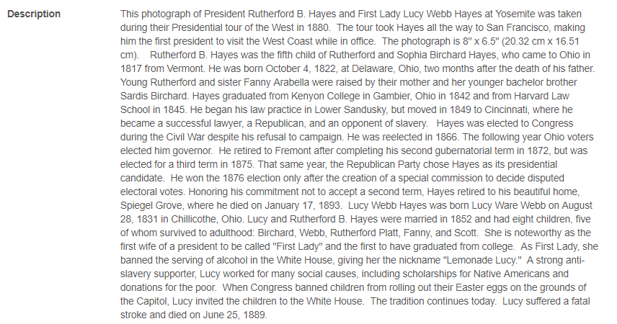
CONTENTdm item description
Notes:
Similar to Wikidata, in that it combines info-box-like statements, embedded media, and can include extensive narrative description

Slide 40
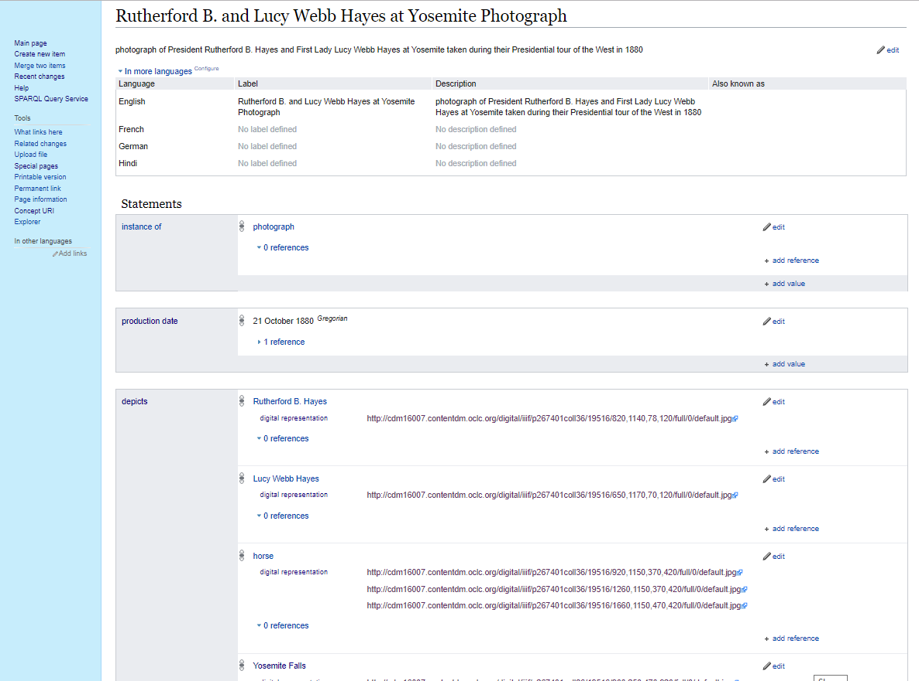
A CONTENTdm photograph in Wikibase
“Fingerprint” data to help people find the item
Statements with references for verifiability
Community-managed data and review
CONTENTdm metadata could be reconciled to entities
Notes:
This is a prototype of a photograph described in Wikibase

Slide 41
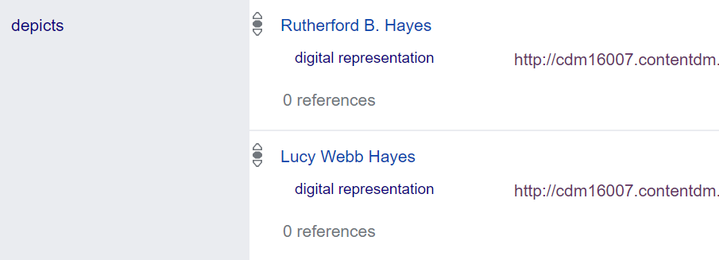
A CONTENTdm photograph in Wikibase
Extended properties for the image can be associated with fine-grained IIIF image URLs, to surface more interoperable data.
Notes:
The Wikibase software foundation’s affordances are a significant potential improvement for access and discovery. Rather than just contextual narrative mentioning who is depicted in a photograph, the structured data in Wikibase can specify the “depicts” property of the photograph, relating that to other specific entities, and qualifying those statements with representations linked to “snippets” of the full photograph, depicting the persons, using the capabilities of the CONTENTdm IIIF Image API.

Slide 42
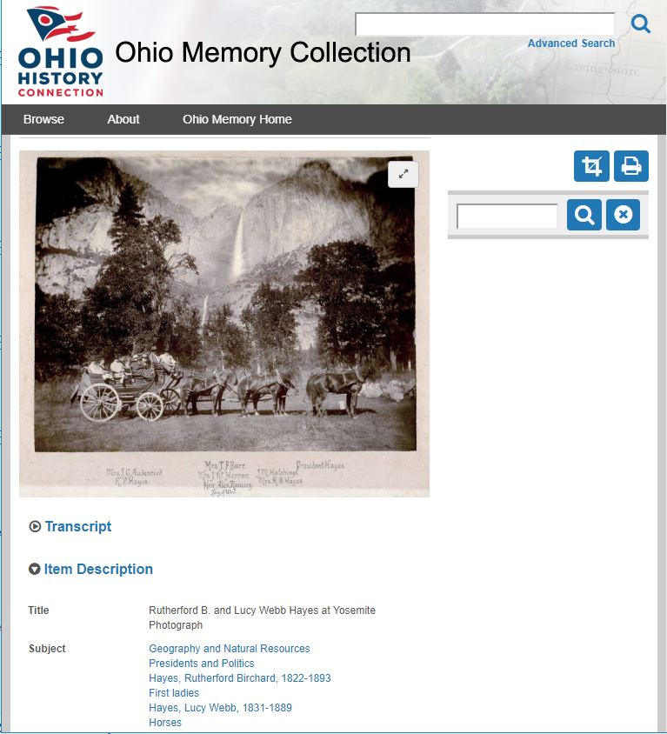
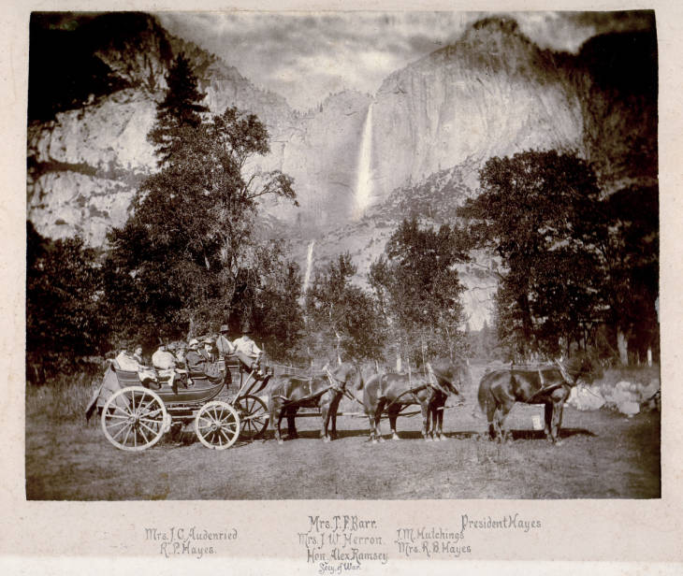
A separation of related concerns
CONTENTdm
Contextual narrative
Wikibase
Verifiable statements, entity properties and relationships
IIIF APIs
Digital media, rights, and technical metadata
Notes:
We can see a similar separation of concerns with the recent introduction of IIIF API support for CONTENTdm digital media, the existing capabilities of CONTENTdm for managing contextual narrative, and the potential entity data management in a platform like Wikibase.

Slide 43
SUMMING UP: Lessons learned and caveats

Slide 44
Lessons Learned and concerns so far | Next Steps
The Mediawiki-based API is not sufficient for reconciliation | Provide an OpenRefine API for matching by class and properties
The prototype data model for dates is capable but not user friendly | Document techniques for entering dates, mapping to LC's EDTF patterns
The prototype UI doesn't highlight connections to more information on the web | Prototype a UI that uses system data to connect to Dbpedia, Geonames, etc.
Autosuggested links aren't working well for personal names in indirect order | Add more aliases to the Wikibase to improve autosuggest matching, based on headings in VIAF
It's not yet clear how to handle creative works and editions in the prototype | Provide guidance and examples, beginning with works and translations
Will the Wikibase platform scale to billions of entities? | Fruitful discussions with Wikimedia Deutschland started
Notes:
Library data is special
Conversation is continual regarding how we do things now, how we could do things, and moving away from current constraints/Endeavor like this represents a paradigm shift and requires adaptive change (everyone gets to change their behavior) - small project with transformative results.

Slide 45
Wikidata/Wikibase Caveats | Potential Remedies
Property and Item entity identifiers are opaque. That’s OK within Wikibase, not OK outside. | When publishing and syndicating data, labels and equivalent item and property identifiers from other systems can be provided
If using Wikidata, you may lose URI branding, provenance, and authority of your data. | In a separate instance of Wikibase, you can brand your own URIs and maintain provenance.
Anyone can say anything about anything, which can lead to data quality issues that are hard to spot and problematic to clean up. | In a separate instance of Wikibase, its community can publish data quality guidelines and set constraints in the system.
The data model can be difficult to understand, where the same things can be said in many different ways. | In a separate instance of Wikibase, its community can set and govern the data model.
The user interface makes it hard to create many different related entities at the same time. | We’re testing an extension to the Wikibase UI that may help with this.

Slide 46
Discussion Time

