Slide 1
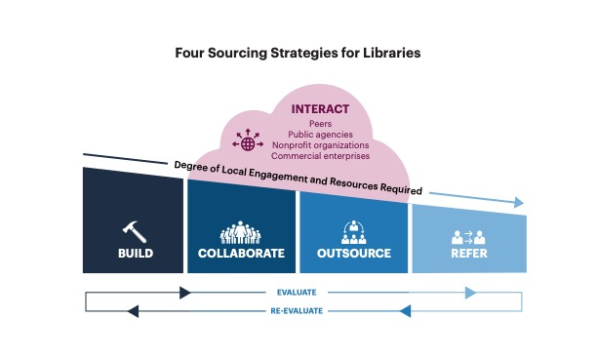
“Four Sourcing Strategies for Libraries” by OCLC Research, from Library Collaboration as a Strategic Choice: Evaluating Options for Acquiring Capacity (https://doi.org/10.25333/mt16-0c57), CC BY 4.0

Slide 2
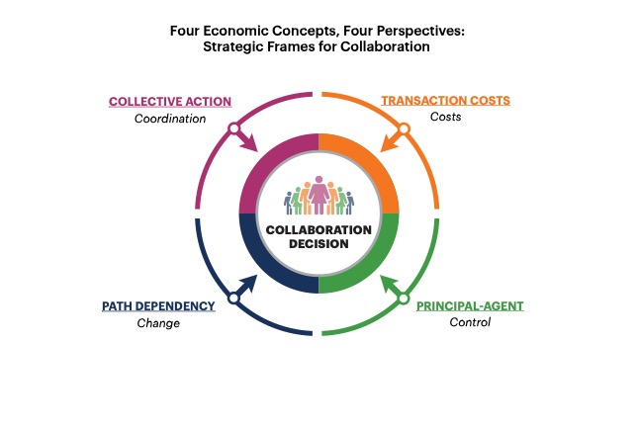
“Four Economic Concepts, Four Perspectives: Strategic Frame for Collaboration” by OCLC Research, from Library Collaboration as a Strategic Choice: Evaluating Options for Acquiring Capacity (https://doi.org/10.25333/mt16-0c57), CC BY 4.0

