Slide 1
Easy as Pi! Developing Computational Thinking Through the Public Library
Eric M. Meyers

Slide 2
Raspberry Pi - What Is It?

Slide 3
Barriers to Use in Libraries
Cost (program investment)
Technical proficiency of staff
Staff insecurity
No “casual” curriculum
Intimidating user community

Slide 4
Research Questions
How can libraries support the development of computational thinking?
How can we investigate and understand the learning of new skills with and attitudes toward digital tools?

Slide 5
Computational Thinking
"the process of recognising aspects of computation in the world that surrounds us, and applying tools and techniques from Computer Science to understand and reason about both natural and artificial systems and processes" (Royal Society, 2012 p. 29)

Slide 6
Pilot, 2014-16
Combining elements of physical manipulation, crafting, coding in an informal digital literacy program
Unpacking and simplifying aspects of computing that lack transparency; making computing fun
Experimenting with different contextually sensitive implementation programs

Slide 7
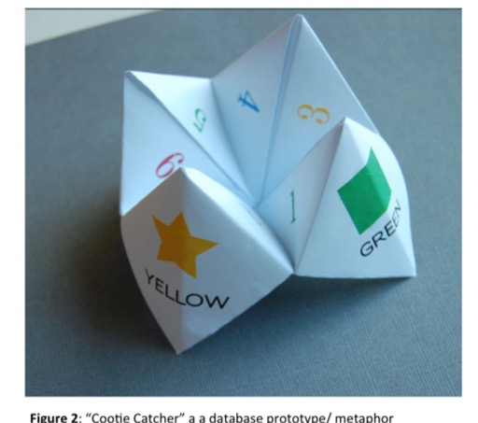
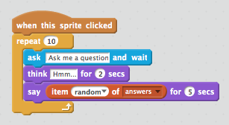
How It Works
Everyday objects
Coding and creating

Slide 8
Implementation Cases
2 Libraries in Metro Vancouver with different demographic profiles
Library 1: Stratified community with distinct ethnic enclaves
Library 2: Lower SES; high transitional; nearby First Nations reserve

Slide 9
Equity & Diversity
Targeting communities with high immigrant populations, visible minorities, First Nations
Gender balanced or girls only
Working through and with institutional professionals to build capacity

Slide 14
Library 1
Strong support from library admin
In-house technical support, interest
Motivated staff
Outcomes
Program replication and extension
Development of new implementation models
Expanding to other technologies

Slide 15
Library 2
Strong staff support, but lacked confidence
Logistical challenges
Limited commitment to extending program
Outcomes
Program not replicated
Considering alternate approach

Slide 16
Next Phase
Broader implementation through day-long workshops, distributing hardware and curriculum
Integrating the Pi with other design activities

Slide 18
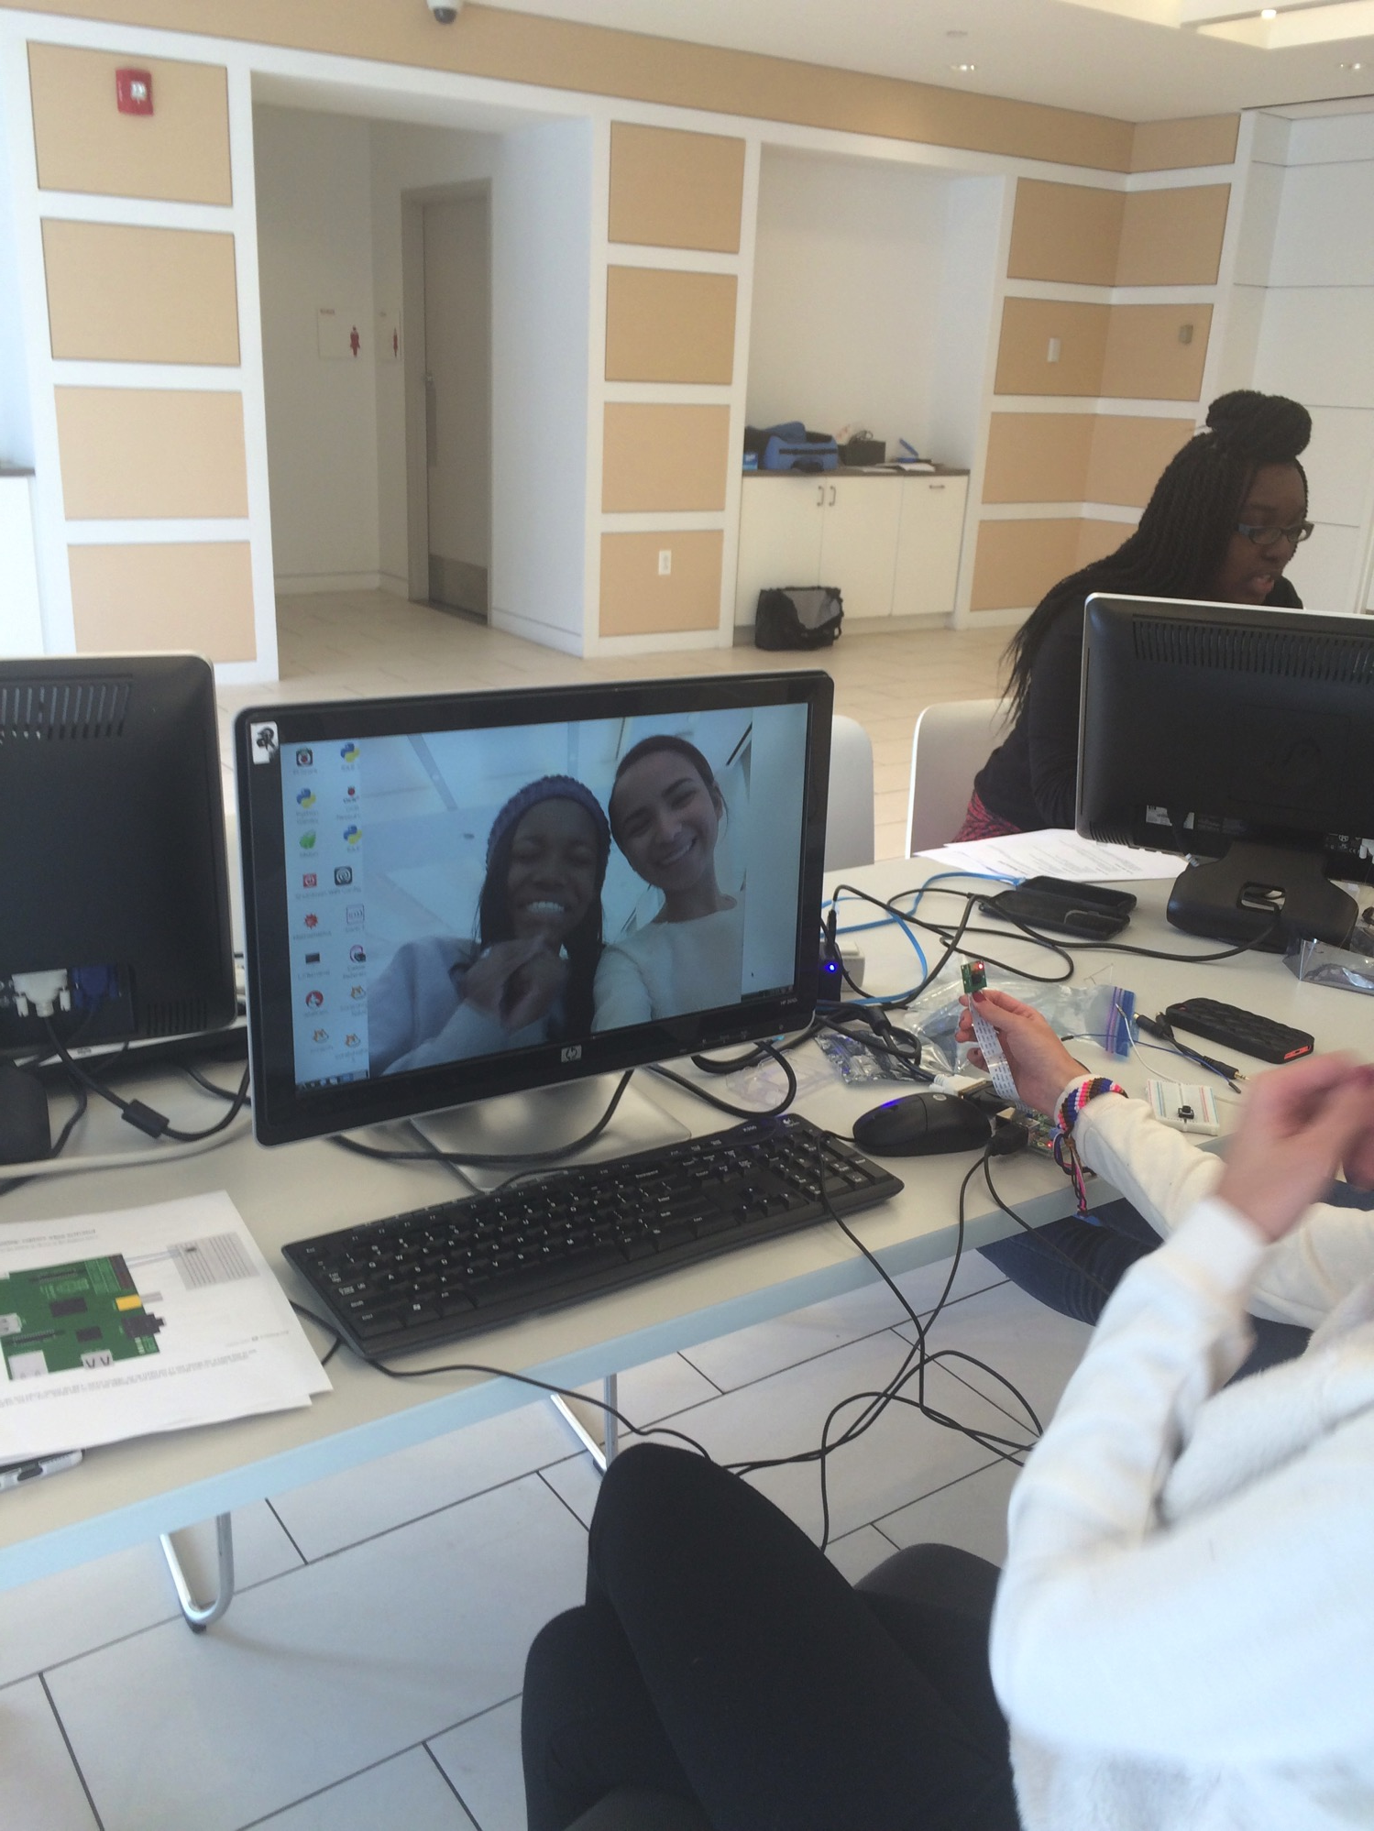

Slide 19
Assessment
Engagement & Self-efficacy measures
Artefact analysis
Transformational (longitudinal) data
Multi-stakeholder interviews/Q-sort

Slide 20
Questions?
Eric M. Meyers
University of British Columbia
eric.meyers@ubc.ca

