Slide 1
Appeal Factors: Enabling Cross-media Advisory Services
Jin Ha Lee, Travis Windleharth, & Hyerim Cho
University of Washington, Information School
ALISE 2016

Slide 2
Reader’s advisory
“mission-critical and an area of growth”
84% stated that RA is important or very important to meeting the library’s mission
More than half reported that RA will become even more important in the next 3 years
From a survey of 694 public librarians conducted by Library Journal, NoveList, and RUSA

Slide 3
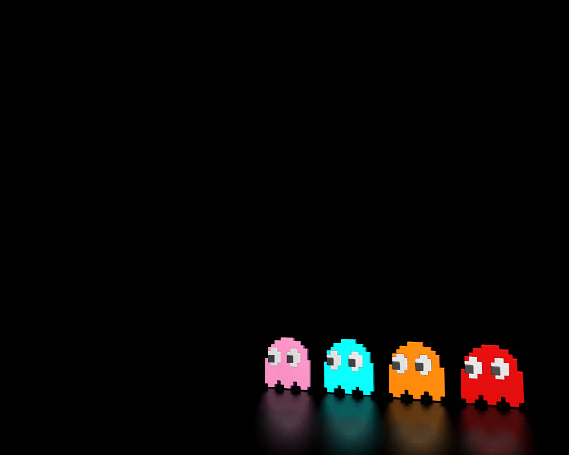
Problem
Angst in providing RA – new books and unfamiliar genres
Lack of training/support for RA
Heavy reliance on recommendation tools
Lack of confidence in advising children or young adults
Most RA work focused heavily on books and audiobooks

Slide 4
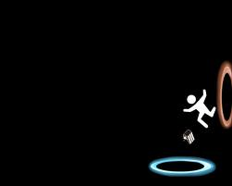
Our approach
We seek to address these pressing challenges based on the idea of “appeals”—that certain people are attracted to certain types of materials, regardless of format.
Previous research suggests that patterns of user preference can be reduced down to a small number of categories
(e.g., Saricks, 2005; Mediatore, 2003; Bartle, 1990; Hunicke et al., 2004; Sherry et al., 2006;Tamborini & Stiff, 1987, Junkel, 2008; Trott & Williamson, 2011).

Slide 5
Study objective
Investigate and identify common appeal factors across multiple types of media and develop ways to describe those appeals in a manner which facilitates crossmedia advisory services.
Notes:
Support librarians to recommend information objects that may be of interest to users across a number of different media formats.

Slide 6
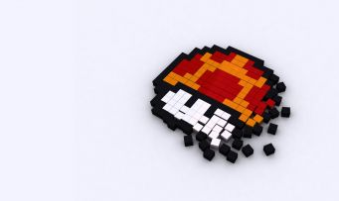
Research questions
RQ1. What are the most common appeal factors across multiple types of media?
RQ2. What are the appropriate terms required to describe different values for these common appeal factors?
hdwallpapers4desktop.com

Slide 7
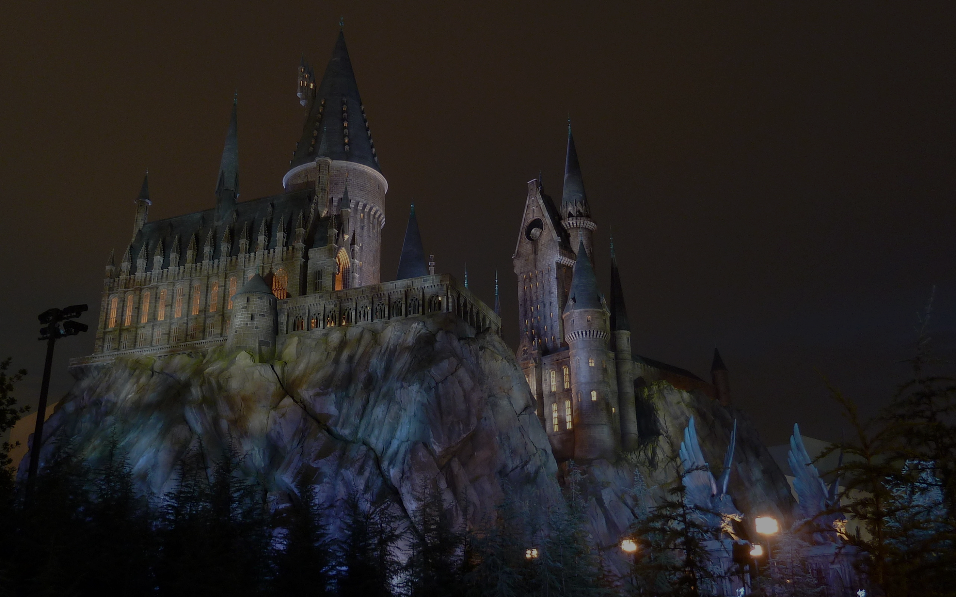
Supporters
Advisory board
Nancy Pearl: Author & Adjunct Faculty, University of Washington
John Vallier: Head, Distributed Media Services, University of Washington Libraries
Judi Windleharth: Director, Library and Learning Resource Center, Digipen Institute of Technology
31 students from the “Metadata for Interactive Media” course

Slide 8
Study design
Domain analysis
Test cataloging
Consult Librarians
Identify commonappeals
Survey
Interview
How to describe appeals

Slide 9
Domain analysis
Sought all work on media appeal factors
Found domain-specific work on appeals
A lot on books and film
Some on video games and music
Less on comics/graphic novels and manga

Slide 10
Examples
Appeal
Mood | e.g., Griffiths, 1991; Klimmt, 2003; Norton, 2003; Hollands, 2006; Sherry et al, 2006; Saricks, 2009; Abbott, 2010
Setting | e.g., Malone, 1981; Trott & Williamson, 2000; Ross & Chelton, 2001; Saricks, 2009; Pearl, 2012
Challenge | e.g., Selnow, 1984; Csikszentmihalyi, 1990; Hunicke, LeBlanc, & Zubek, 2004; Goldsmith, 2010
Sensation | e.g., Tamborini & Stiff, 1987; Griffiths, 1991; Klimmt, 2003; Hunicke, LeBlanc, & Zubek, 2004; Ermi & Mayra, 2005; Abbott, 2010; Holmstrom, 2010;
 | … and more!

Slide 11
Appeal selection process
A number of candidate appeals emerged based on the literature
We tested their applicability by describing familiar media objects
Some appeals were not easily transferrable to certain media (e.g., visual aesthetics – music)
Some could be address through other metadata elements (e.g., character – series/franchise)
Some were too dependent on each individual’s case (e.g., topical relevance)

Slide 12
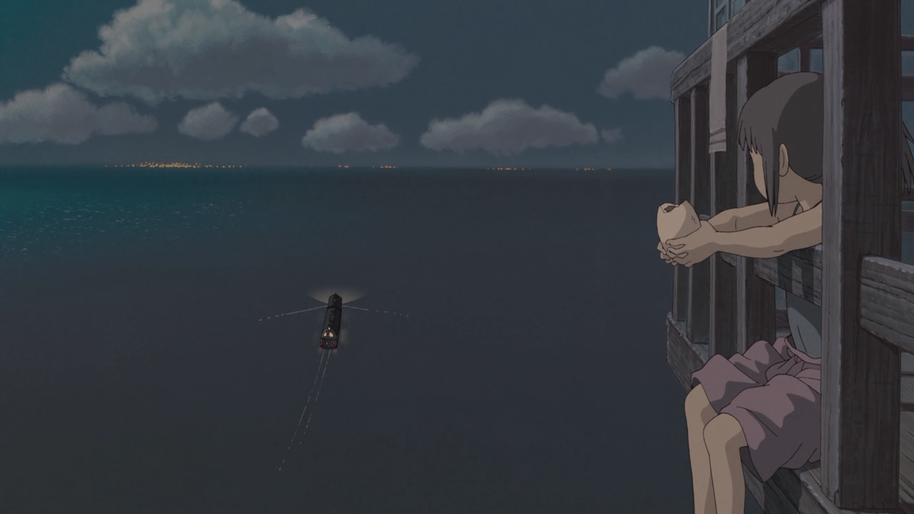
Cross-Media Appeals
After domain analysis, meetings with the advisory board, and numerous working sessions three common appeals were selected:
Mood: feelings intended to be evoked
Setting: the type of world where the work takes place
Complexity: cognitive load

Slide 13
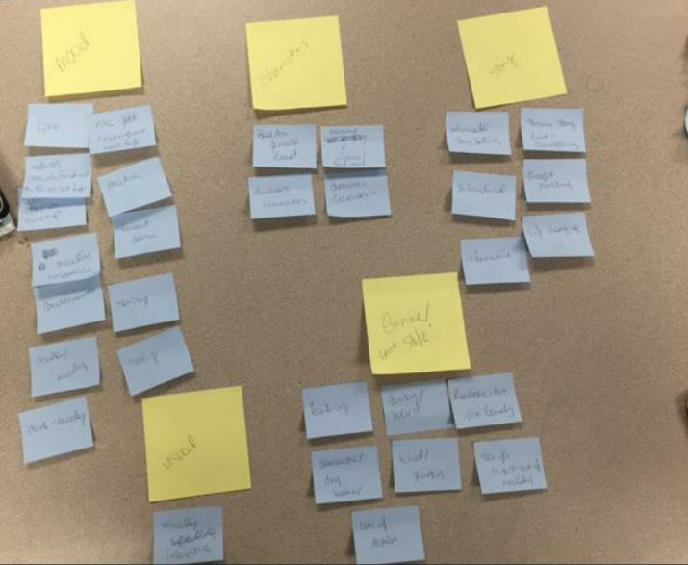
Class activity 1) Card Sort
“Metadata for Interactive Media”
5th year, included 31 students
Conducted appeal factor card sort
Listed media items they liked
Listed appeals
Categorized appeals

Slide 14
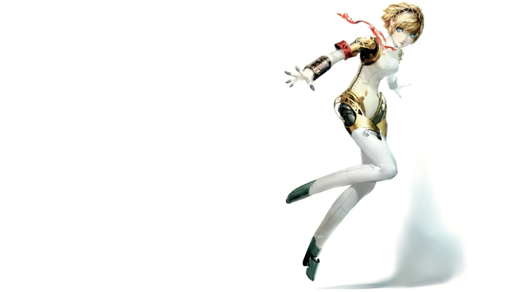
Class activity 2) User Study
Eight groups completed pilot user studies
Different aspects of appeals
Linking media appeals to other activities
Complexity as appeal
Media for relaxation
Appeal overlap between formats
…and more!
www.wallpaperfo.com

Slide 15
Insights
Reinforced “Mood” as major appeal factor
Gained more insight into “Complexity” as appeal
Tested some instrument questions
Appeal | Count
Mood | 16
Narrative/Plot/Story | 11
Character | 10
Sensation (e.g., visual, audio,…) | 9
Setting (e.g., our world, futuristic,…) | 9
Complexity/Cognitive load | 7
www.wallpaperfo.com
Notes:
“Mood” appears to be the dominant appeal
Media use is also “Mood Dependent”
Five appeals appear to be the most important
These include the three in our analysis
Other terms were hard to apply

Slide 16
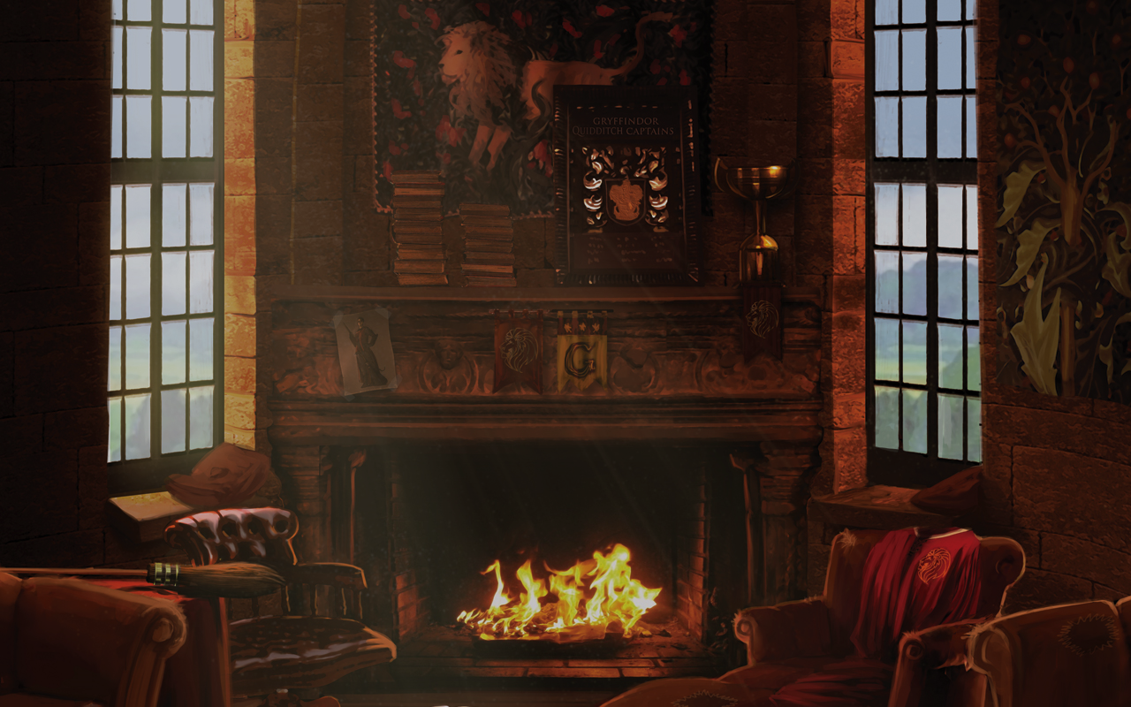
Next step: Interview
Participants recruitment
Pre-interview questionnaire
Semi-structured interview
30 interviews in total
Snowball sampling
Media types that participants consume
What they like about them
Approx. 20-30 min.
Questions focused on mood, setting, and complexity
Also asked about additional appeals

Slide 17
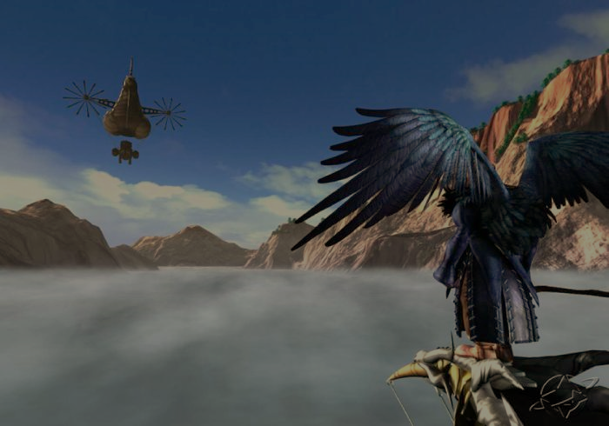
Codebook
Appeals
Mood, Setting, Complexity, and others
Relevance
Sentiment
Sources for recommendations

Slide 18
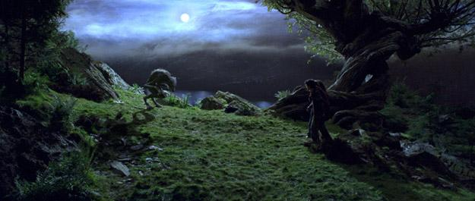
Preliminary findings: Mood
Most frequently mentioned appeal
Many find it easier to say what they dislike than like
Mood of the day and type of task matter
“If I need to get something done, that’s just kind of mindless, doing the task that’s very repetitive, I’ll listen to more upbeat music. If I’m reading or writing I might listen to music that’s slower, like more meditative.”
Notes:
When choosing media, mood of the day affects participant’s choice
“I don’t like XXX” than “I like XXX”
“I don’t like overly sentimental things.”
“I hate scary things.”
Combinations of two different ends of the moods
“I like things that have kind of dark sense of humor. (…) I never watched, ever ever ever watched like Sex and the City or Friends. (…) I tend to be drawn to things that are probably a little darker.”
(freq.) Exciting > Unsettling > Humorous = Sad > Peaceful > Serious …

Slide 19
Preliminary findings: Setting
Participants showed strong preferences on specific setting
Imaginary world: “I prefer more imaginary worlds like Game of Thrones.”
Our world: “It’s too much work to imagine that…like elves, fairies, and things like that, I want to focus more on the characters, themes, and the questions.”
Alternate world: “Like some settings, most would be places that are in real…but like these people exist there. There’re fairies there, or something like that.”
Positive reactions to the three setting categories
Notes:
“That’s an interesting category! I think it makes sense.”

Slide 20
Preliminary findings: Complexity
Some always preferred complex settings/structures
“If I can figure out what’s going to happen too quickly, I will easily get disinterested…If I can figure it out, then, I’m just over it at that point… I want to feel like I’m outsmarted. Does it make sense?”
Others chose the complexity level depending on their mood/situation
“If I’m like completely brain-dead, you know, if I’ve been studying a lot or writing, then I will tend to choose something that’s like…less complex, less challenging.”
Notes:
“Yes, I do think it does have some complex settings sometimes, and, sometimes, it does not. (…) So, it depends on the timing. If I’m bored, I tend to go toward, like, thinking a lot, and complex, but if I feel stressed, I will go with that has nothing to think about.”

Slide 21
Preliminary findings: Other appeals
Character
Strong female lead: “Books for sure, almost every single book I read has a strong female lead. I didn’t notice that until today, but, clearly that’s something I look for.”
Theme: e.g., supernatural element, space-related
Visual style: e.g., beautiful design, good-looking actors
Discovery
“I really like things whether it’s music or movies, or books, or video games, or even Podcast, you know, I like something that there’s always an element of kind of discovery or surprise.”
Notes:
Funny sidekick: “Most of the times, I guess there’s some funny sidekick? So, even in my somber books, I need a funny element.”

Slide 22
Discussion
Describing appeals is extremely challenging for many people (“Genre” coin jar)
For some people, some common appeals exist for certain media types but not all
Appeals are very much context-dependent
https://www.wallpapervortex.com
Notes:
Genre itself “doesn’t say a whole lot” and

Slide 23
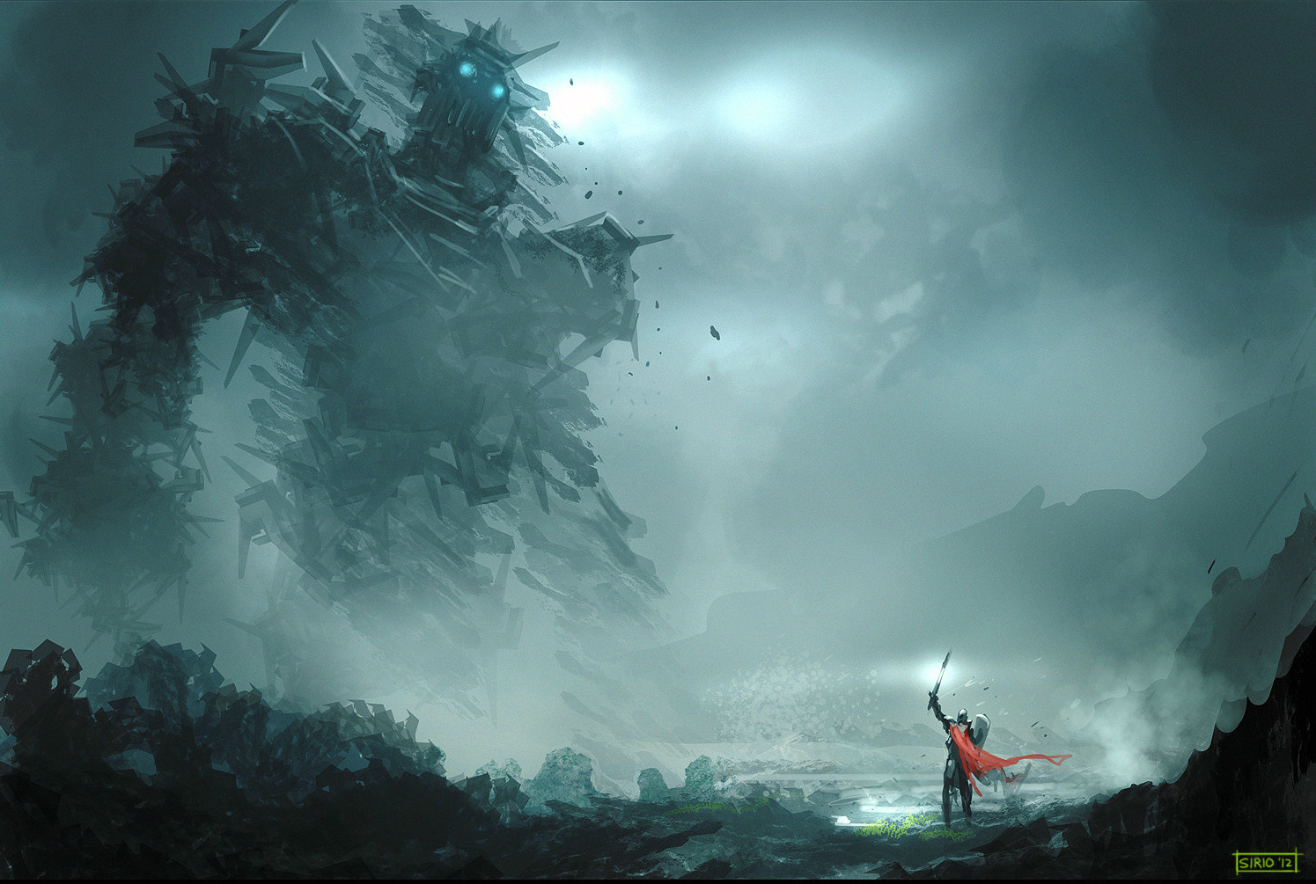
Future direction
Identifying common appeals has proved challenging but we found some critical factors
Online survey will be launched in Spring
Developing a cross-media recommendation tool is one of our goals
http://www.officialplaystationmagazine.co.uk/2012/07/18/heres-a-beautiful-shadow-of-colossus-painting-for-your-eyes/
Notes:
Artistic or visual style of the game seemed to heavily affect how users feel about games

Slide 24
Special thanks to
Matthew Phillips and Amber Kim
Student in INFX 536
Questions?
total-wallpapers.com
Notes:
– which source should be used to obtain the game information?

