Slide 1
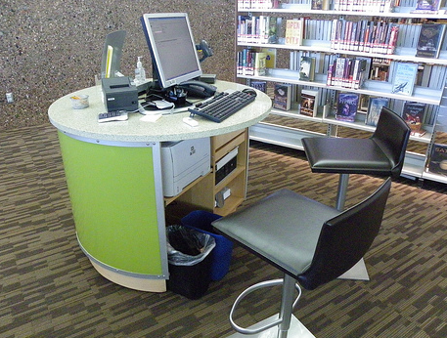
Out of Place? Examining User-Centeredness and Roving Reference Service in Academic and Public Library Spaces
City of Troy Public Library
Scottsdale Public Library
Matthew Griffis, Assistant Professor
School of Library and Information Science, The University of Southern Mississippi
matthew.griffis@usm.edu

Slide 2
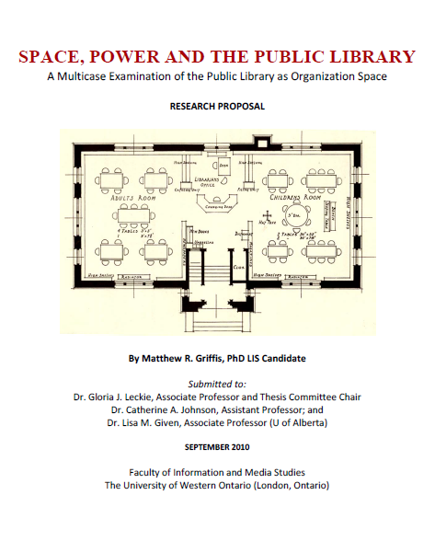
“Space, Power and the Public Library”
findings published in (2014) Advances in Library Administration and Organization, 32(1), 1-106.
multicase (3 public libraries)
found that traditional, models of space design and spatial practice prevail (even in new libraries)

Slide 3
Conceptual Framework
social space: Lefebvre (1991), Lawson (2001)
space is socially produced and determines and influences relationships between people
organization space: Gutman (1972) Dale & Burrell (2008)
modern organizations use space design to enforce processes and outcomes favorable to their objectives
panopticism : Foucault (1973, 1977), Black, Pepper and Bagshaw (2009), Andrejewski (2008)
modern institutional building types have been based on “maximum efficiency” (“prison”) design

Slide 4
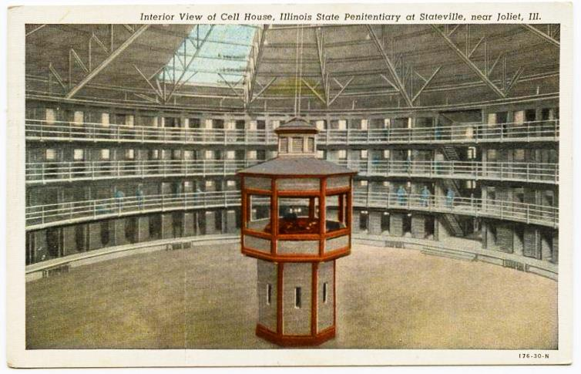
Alex Wellerstein, Stevens Institute of Technology (http://alexwellerstein.com)

Slide 5
Roving Reference
“the practice of discreetly walking about the reference area of a library in search of users who need assistance, as opposed to remaining seated at the reference desk, waiting for patrons to approach with their questions”
- “roving”, Online Dictionary of LIS
hybrid (desk-based and scheduled roving) vs. fully roving (“deskless”)
City of Troy Public Library

Slide 6
Research Question
To what extent, if any, do roving reference service models change the relationships that define the traditional paradigm?
Library Buildings: Notes and Plans, American Library Association, 1924

Slide 7
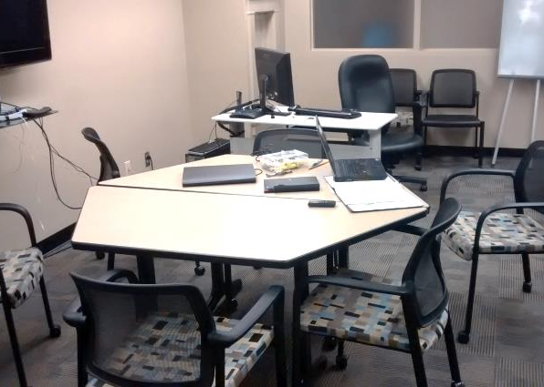
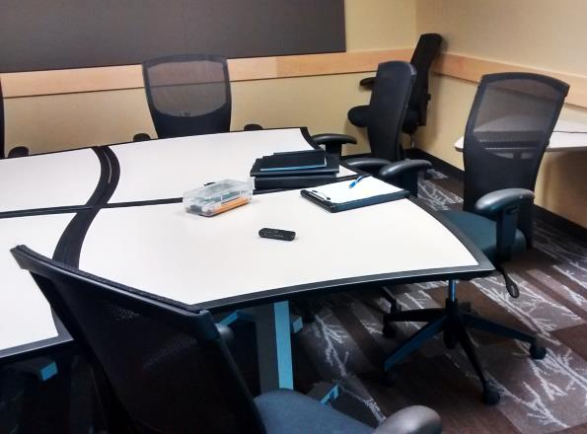
Data Collection and Analysis
3 libraries (2 academic, 1 public)
site visits (5-6 days per visit)
semi-structured interviews with librarians and users
mental mapping exercises
observations of library activity
photography
IRB approval
02-04-15, protocol #CH15020304

Slide 8
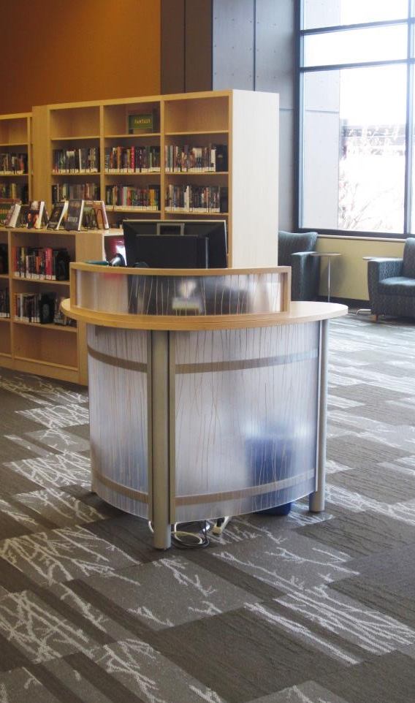
Multicase Study
Library A (academic library)
hybrid model
old building (ca. 1930s) with addition
5 operational levels
Library B (academic library)
hybrid model
old building (ca. 1940s) with extension
3 operational levels
Library C (public library)
full roving model
main library of 7-branch system
new building (ca. 2009-10)
1 operational level
Library C

Slide 9
Data Collection and Analysis
DATA SOURCES | LIBRARY A | LIBRARY B | LIBRARY C | TOTALS
Interviews | 8L, 3U | 4L, 5U | 6L, 10U | 36 interviews (18 L, 18U)
Photographs | 355 | 234 | 457 | 1046 photographs
Observations | 11p | 9p | 13p | 33 pages

Slide 10
Findings
Roving reference service models do not change the traditional, underlying power relationships within the library space.
instead, these relationships are intensified
roving is an alternate (and perhaps more effective) way for the librarian to be “everywhere at once”

Slide 11
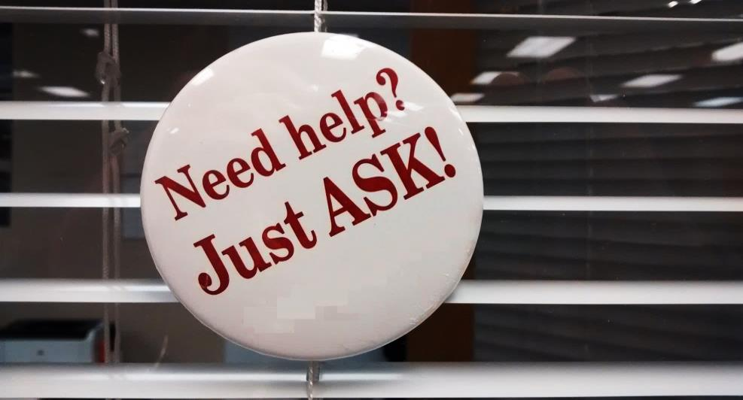
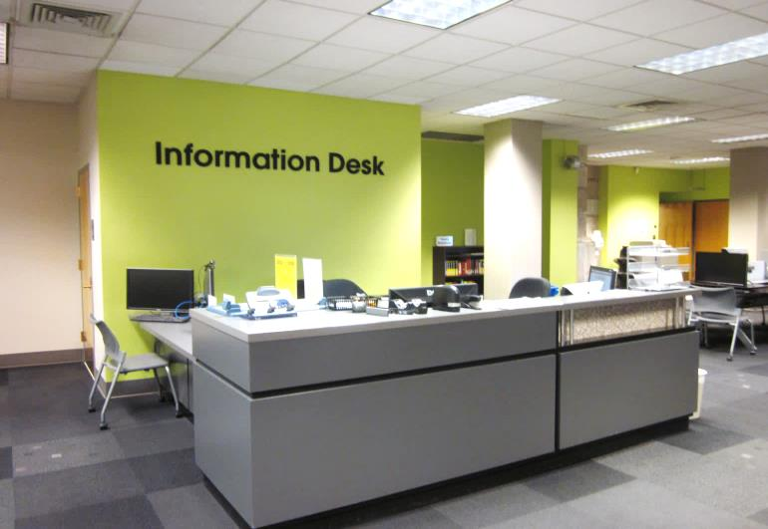
Findings
Despite the introduction of roving service to these libraries, the spatial practices of the traditional model still prevailed.
in the hybrid libraries (A & B), users were still inclined towards using fixed service options rather than roving options
at Library C, under certain conditions users and librarians reproduced spatial practices from the traditional model

Slide 12
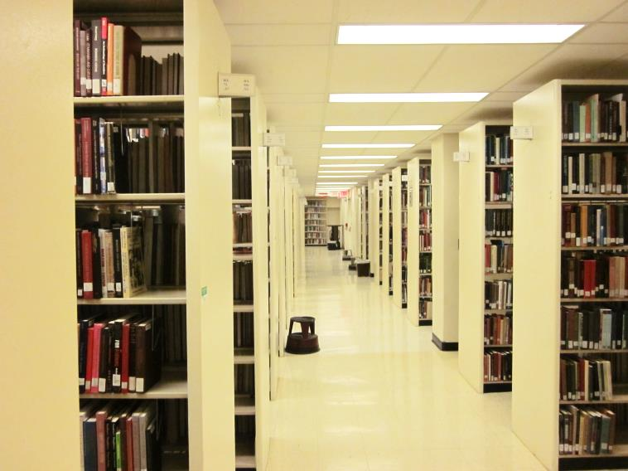
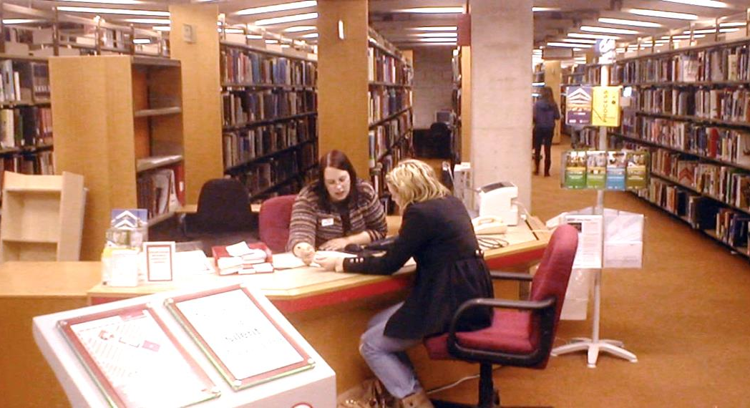
Findings
“Roving reference” as a form of information service has very limited capacity.
Most substantial reference questions or queries could not be answered at the “point of need” and still required either directing the a stationary desk or removing them to an office.

Slide 13
Conclusions
To what extent, if any, does the roving reference model change the traditional, desk-based spatial model?
It does not. It reinforces the underlying power relationships of the traditional model.
the user experience is not substantially different
multiple modes of service working in partnership is ideal
roving reference better as an extension of (i.e., but not a replacement for) traditional, desk-based service?

Slide 14
Acknowledgements
This research was funded with a 2015 OCLC/ALISE Research grant.
The researcher further acknowledges the interest and cooperation of the anonymous case libraries and the anonymous interview participants.
References
Andrejewski, A. V. (2008). Building power: Architecture and surveillance in Victorian America. Knoxville: University of Tennessee Press.
Black, A., Pepper, S., and Bagshaw, K. (2009). Books, buildings and social engineering. London: Ashgate.
Dale, K. & Burrell, G. (2008). The spaces of organization and the organization of space: Power, identity and materiality at work. New York: Palgrave.
Foucault, M. (1973). The birth of the clinic: An archaeology of medical perception. New York: Vintage.
Foucault, M. (1977). Discipline and punish: The birth of the prison. New York: Random House.
Gutman, R. (1972). People and buildings. New York: Basic.
Lawson, B. (2001). The language of space. Boston: Architectural Press.
Lefebvre, H. (1991). The production of space. D. Nicholson-Smith, trans. Oxford: Blackwell.

