Slide 1
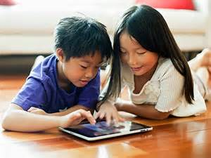
“Every single one is my favourite” (Theo, 4 years):
Children’s Experiences and Perceptions of
E-Book Reading
Lynne (E.F.) McKechnie
Kathleen Schreurs
University of Western Ontario
OCLC/ALISE LIS Research Grant Program
ALISE
January 2015

Slide 2
Introduction
About 70 billion apps available for download with more than 80% of the top selling ones targeted at children (Shuker, Levine & Ree, 2012)
Percentage of children who have read an e-book increased from 25% to 61% since 2010 (Scholastic. Kids & Family Reading report, 5th ed., 2015)
77% of children who have read an e-book said most of the books they read are print and 65% report they will still read print books even when e-books are available (Scholastic, 2015)

Slide 3
Literature search
Broad surveys on the production and sales of e-books and children’s e-book reading habits
Growing body of work that focuses on e-books, literacy and education
LIS literature has looked at digital libraries for children, classification of e-books, user interface design and building collections
Almost all of this literature is adult-centric and very little explores reading for pleasure

Slide 4
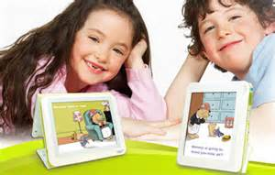
This study sought to explore . . .
. . . the experience of e-book reading from the perspectives of the children themselves

Slide 5
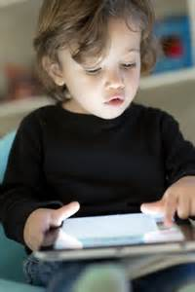
Method
Contextual inquiry (Beyer & Holtzblatt,1998)
Observation and interviews with data captured through field notes and audio-recording
Convenience and purposeful sampling
n = 20 children from 2 – 12 years
Analysis - Ground theory (Corbin & Strauss, 2008)

Slide 6
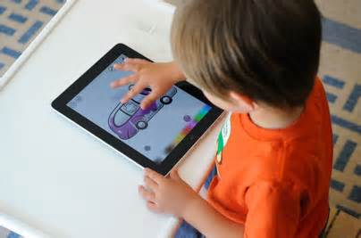
Data collection

Slide 7
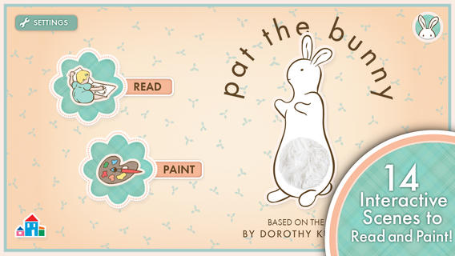
Pat the Bunny Book trailer, Random House Children’s Books, accessed January 26, 2015. https://www.youtube.com/watch?v=vBUa97Z-JZo

Slide 8
Findings
Most of the children regarded their device first as a gaming space
These kids were all tech savvy
Becoming tech / e-book savvy
Traditional books are still important
E-books and book apps went beyond the book

Slide 9
“Wait a minute . . . E-books also have games?” (Suzanne, 8 years): Device as gaming space
ON: Eva (mother of Marietta, 3 years) opens Pixel and Parker (interactive e-book).
ON: Marietta closes Pixel and Parker and opens a game.
Mom: No movies Rapunzel (3 years)!
Rapunzel: Please Mama, please.
When asked what he uses his iPad for, Jake (12 years) responds: “Well, I play games. I have lots of games on it. I used to watch hockey on it. And I probably watch videos on it too.”

Slide 10
“My first time I knew it. I knew it before I even learned it.” (Hero, 8 years): Tech savvy
ON: Mom asks Olivia (2 years)to turn the volume down and she does.
Lynne: Oh, you know how to turn the volume down. That’s really good Olivia.

Slide 11
“I got it!” [Stella, 3 years]: Becoming tech savvy
Stella (3 years): Where is the airplane?
Mom: There it is.
Stella: [Touching cloud again. Plane appears. Sounding very pleased with herself] I got it!
ON: Stella touches word after word and the book app reads the words aloud. Stella has learned to do this very quickly (in a minute or two in front of me).
TN: Stella is remarkably independent using this book app. She knows the basic functions like how to turn a page, tapping images and that the words turn red in colour as they are read.
Notes:
Can see the four elements in this single incident:
Learning from someone else (scaffolding / shared reading)
Exploring on your own
Transferring skills learned on other apps
The structure of the apps themselves

Slide 12
1. Becoming tech savvy: Shared reading
ON: Lianne (6years) instructs her sister (Silvia, 4 years)on what to do by showing her with her own finger. Or pointing to the correct application.

Slide 13
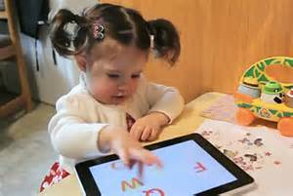
2. Becoming tech savvy: Exploring apps
ON: Catherine (2 years) presses all the options to make sounds. Presses all areas of the screen to see what makes sounds or produces animation . . . [Later] Begins e-book again. Goes through the pages much faster now that she knows what to press and what makes sounds and animations.

Slide 14
3. Becoming tech savvy: Transferability of skills
“Houses or anything like that . . . House is always home. Of course.” (Hero, 8 years)
Joel (8 years): [Reading/playing Don’t Let the Pigeon Run This App!] Ahh, this is where you yell “NO!”
TN: Transfer of print reading skills to e-reading contexts.

Slide 15
4. Becoming tech savvy: Apps structured to teach the tech
ON/TN: [Referring to Elsa 1’s (6 years) reading of Pat the Bunny] In fact this book app provides child friendly icons (all images, no text which requires reading) and verbal instructions about how to play. It also suggests repeats – “Do you want to play again?” – and feedback – “You did it!” – which reinforces the learning. This is an exceptional example of how an app itself can be designed so as to make how it works transparent to even very young children.
Notes:
ON/TN continued: Not surprising as Pat the Bunny in its first interactive toy book format (c 1940) is intended for very young children (0 – 2 years). But surprising in that, although other book apps for very young children could benefit from this approach to design, I have not seen any other that uses it.

Slide 16
“That one smells.”(Stella, 3 years): Traditional print books
“It’s like the Captain Underpants books. Like you can use your thumb and landscape through the pages and make it look like it’s moving. You can’t do that on an iPad.” (Jake, 12 years)
“It just doesn’t need electricity. It’s better for the environment.” (Hero, 8 years)

Slide 17
“You don’t have to read them. They read themselves to you.” (Joel, 8 years): Beyond the book
“That you can press the animals and they do stuff and say stuff.” (Theo, 4 years)
“I like e-books because they light up. They are different from paper books because they have lights and the iPad lights.” (Jayne, 6 years)
[Whispering in Mom’s ear] “Because they can speak.” (Elsa 1, 6 years)
“You don’t need a bookshelf.” (Sarah, 11 years)
“Because they are most fun.” (Lydia, 4 years)
“I want to turn this one off.” (Stella, 3 years)

Slide 18
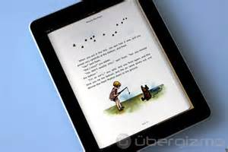
But, a book is a book. . .
“I like reading paper books better because when you press the screen it turns the pages. That is why I like paper books better on the iPad.” (Lianne, 6 years)
Wolfman (8 years): [When asked if he prefers print or e-books] I read practically the same.

Slide 19
Conclusions
The children loved e-books
The importance of public libraries in developing strong e-book collections for children, enabling access to them and educating parents and other adults
Voluntary free e-reading

Slide 20
What’s next?
Dissemination of results
LISR, Children and Libraries, OLA, SHARP
Further research drawing on these results
Case study of Stella (3 years)
Case study of Goodnight Moon
Selection criteria and collection development practices which account for children’s experiences and perspectives
Further research
Political economy of e-book production and distribution

Slide 21
References
Beyer, H., and Holtzblatt, K. (1998). Contextual design: Defining customer-centered systems. San Francisco, CA: Morgan Kaufman Publishers.
Corbin, J., and Strauss. (2008). A. Basics of qualitative research: Techniques and procedures for developing grounded theory, 3rd ed. Thousand Oaks, CA: Sage.
Scholastic. (2015). Kids and family reading report, 5th ed.
Shuler, C., Levine, Z, & Ree, J. (2012). iLearn II: An analysis of the educational category of Apple’s app store. In New York: The Joan Ganz Cooney Center of Sesame Workshops.

