Slide 1
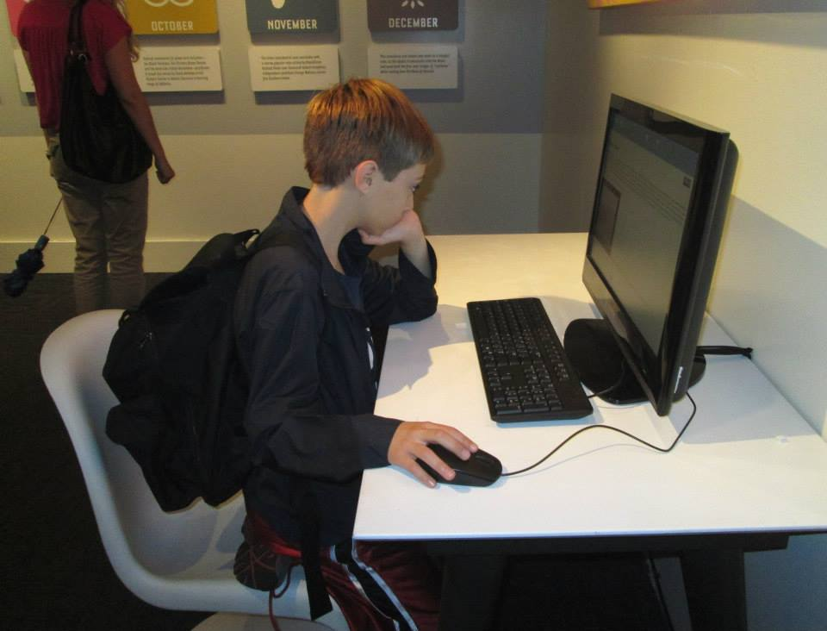
A New Role for Libraries: Promoting Teens' Privacy and Safety in the Digital Age
Denise E. Agosto
Drexel University
dea22@drexel.edu
June Abbas
University of Oklahoma
jmabbas@ou.edu
This work was supported by a 2014 OCLC/ALISE Library and Information Science Research Grant (LISRG).

Slide 2
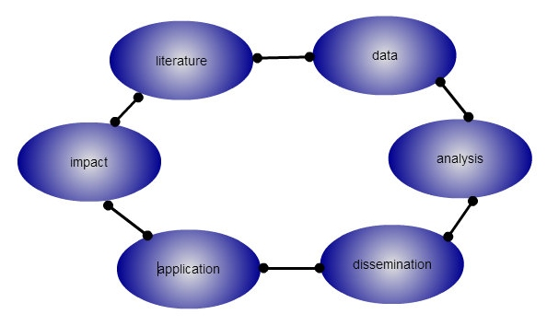
Project Outcomes
1) a deeper understanding of teens' online privacy and safety beliefs.
2) an increased awareness of practices teens use to protect themselves in online environments.
3) a set of publically-available youth-centered guidelines for libraries, schools, and other organizations to use in educating youth to become more informed, safer social media users.

Slide 3
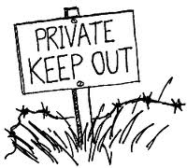
What is “privacy,” anyway?
Westin (1967) = the ability to control the terms under which personal information is acquired and used
In social media, “privacy” is tied to having control over the types of personal information made available online and having control over who can access it (Livingstone, 2008; Mallan, 2009).
Additional factors when studying youth:
parental control over the release of youths’ private information
the connection between privacy and safety

Slide 4
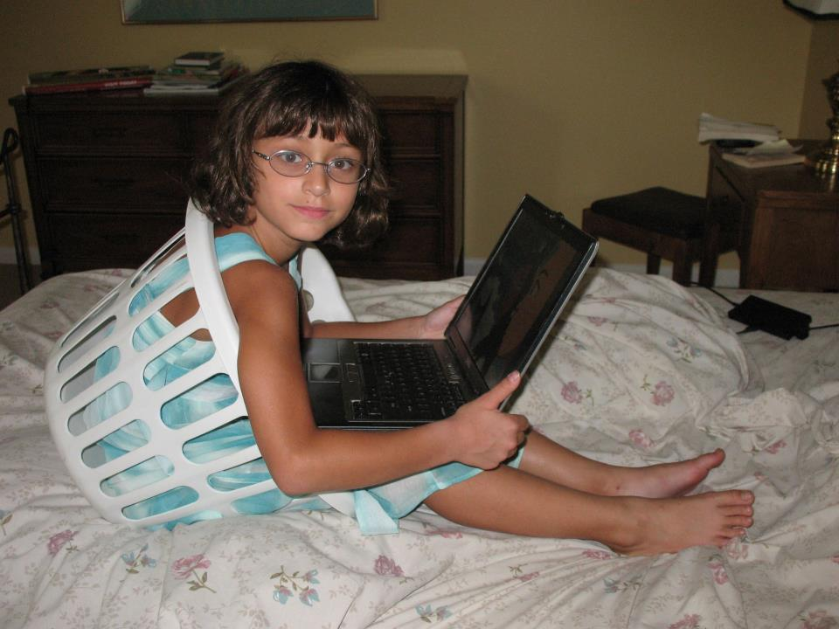
What is “safety,” anyway?
Most definitions speak of the elimination of harm or risk, or of the reduction of harm or risk to an acceptable level.
“freedom from unacceptable risk” (Hollnagle, 2011)

Slide 5
The Backdrop: Polarized Discourses
Popular narratives often characterize youths’ use of social media as overwhelmingly negative (e.g. boyd, 2014; Christofides, Muise, & Desmarais, 2012; Hasinoff, 2013; Hinduja & Patchin, 2008).
Value-laden judgments: “Adolescents also often are reckless in their online activities” (Notten & Nikken, 2014).
“Technopanics” (Marwick, 2008):
1. focus on new media forms
2. pathologize young people’s use of the media
3. result in an attempt to modify or regulate young people’s behavior

Slide 6
The Middle Ground
Most researchers offer a more balanced perspective of opportunity coupled with risk (e.g. Agosto & Abbas, 2011; Livingstone, 2008).

Slide 7
Participants & Methods
98 seniors at two suburban U.S. public high schools
nationally-representative student bodies
46 (47%) females/52 (53%) males
85 (87%) = age 18; 13 (13%) = age 19
Surveys
91 (93%) owned a laptop or desktop
91 (93%) had home Internet access
96 (98%) owned a cell phone
85 (87%) used SNS at least once a week
One-hour focus groups – 15 groups over four days
Why focus groups?
Often more effective for gathering data from youth than interviews because of power shifts and comfort levels (e.g. Eder & Fingerson, 2002; Heath et al., 2009).

Slide 8
Privacy Attitudes
1. There is no true privacy online.
“It seems like it’s similar to speaking in public. You wouldn’t say something that’s personal and private to you out in a crowd…. Being on Facebook and Twitter, that’s what it’s like. Whenever you post something, it’s like you’re speaking it out loud in front of a massive crowd, so it seems like privacy is not really there.”

Slide 9
Privacy Attitudes
2. Discomfort with unintended audiences accessing/capturing personal data
“One time I was just curious. I googled my name and pictures popped up that I had posted years ago, and that account never even existed any more. That made me feel uncomfortable with the fact that complete strangers could just go to Google, type in my name, click images, and there’s my face. That’s kind of weird. I didn’t like that.”

Slide 10
Privacy Attitudes
3. Tension between the desire to share and withhold information
“Where it kind of gets a little foggy is, like just logistically, the more followers that you have on Instagram, the more likes you’re going to get on the picture, because if you only have twenty followers, you might only get five likes. But if you have a thousand followers, you’re going to get two hundred or three hundred. So it kind of gets a little wishy-washy, because okay, do I just accept this person who I don’t know just to get followers so that he’ll like my pictures so that my likes will go up? Or do I just not accept people that I don’t know?”

Slide 11
Privacy Attitudes
4. Privacy concerns affect technology choices (audience, tailoring message, purpose)
Moderator: How often when you post something do you consider who’s going to see it?
Student: Probably every time I post on Facebook. But if it’s Twitter I don’t really care because it’s not family.
Moderator: So what’s the difference there?
Student: None of my family has Twitter.

Slide 12
Safety Attitudes
1. Generally more concerned about potential loss of online privacy than about potential safety issues
“I feel safe [online] because I’m not stupid and put stuff I don’t want people knowing out there.”
Student: My mother, she freaks out about the whole security thing…. People need to chill out and realize that those websites actually are pretty safe.
Moderator: Do you always feel that you’re secure online?
Student: I always feel that I’m in control.

Slide 13
Safety Attitudes
2. Online safety is a learning process that takes time to develop and also develops with increased age, experience, and maturity.
“My Instagram wasn’t private for the longest time, because I didn’t realize that it could be private. And then people started making [theirs] private, and I was like, ‘Oh, I should do that.’”
“You kind of just learn after you get older what not to put on there and what to put on there.”

Slide 14
Safety Attitudes
3. Teens tend to believe that other generations are less knowledgeable about online safety.
“Just this past weekend I went to Dallas for a college accepted students’ reception with my parents. And my mom is a complete Facebook nut, so she’s like driving to Dallas in the rain with me and my dad, and then like [posts], ‘Oh, we’re in Dallas now.’ It’s like, ‘Hey! We’re not at home! Come to our house and rob it!’ That was a fun experience.”
“I think that middle schoolers know how to do the [privacy] settings, but they just don’t care and don’t think of the consequences. People our age, they do care, and they do think of the consequences.”

Slide 15
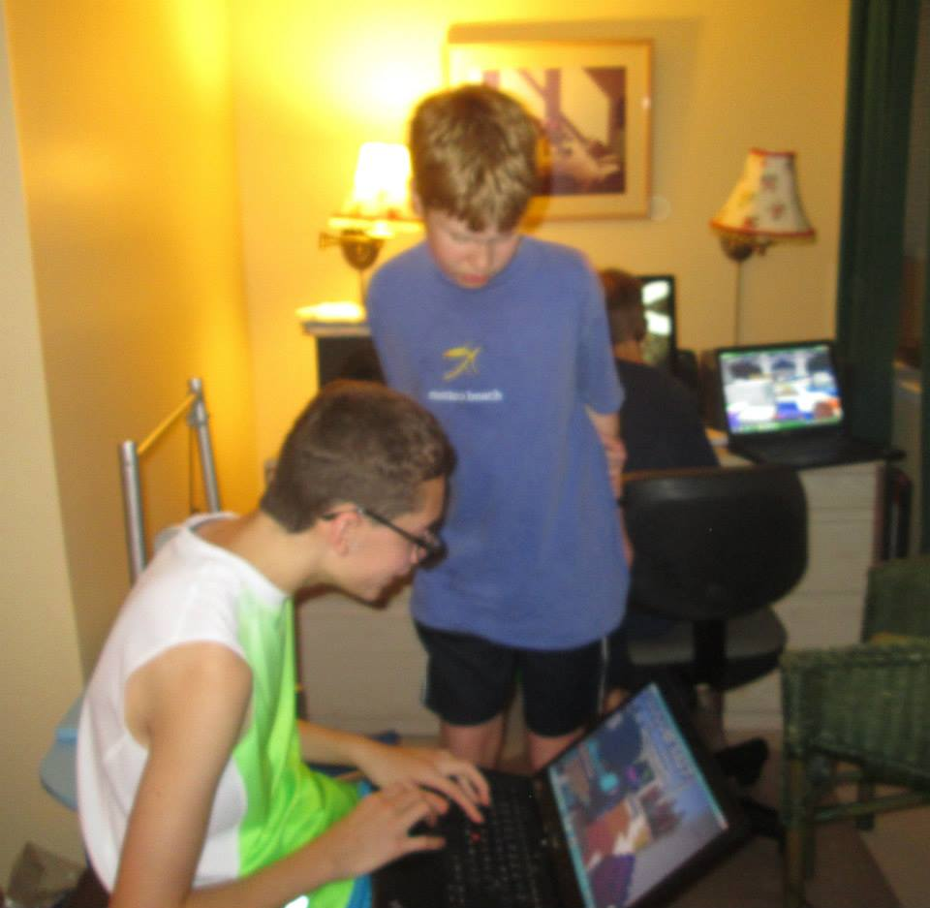
Recommendations for Improving Online Safety Education
1. Teach students about risk/benefit analysis.
“If you’re going to go to a site, know the risks and benefits. Is the entertainment or knowledge of this information outweighing the risk?”
2. Build on strong student-teacher relationships.
“I had a new advisory teacher this year. She didn’t really know who we were, and we didn’t know who she was. It’s just weird for us to be talking about our experiences online with a person that we just met that we don’t really have classes with.”

Slide 16
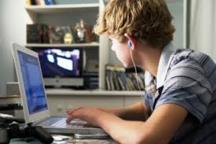
3. Use personal stories/testimonials.
“I went through a chatting thing when I was little, and it really affected me negatively because of the things that were said to me. I was 11 years old. I didn’t know what I was getting into, but it was a chat room and some of the things that were said really affected where I am now…. [It ended when] my mom walked in and she was like, ‘Okay, what’s going on?’ Because I was online chatting for about two months and so she walked in one morning. It was Dec. 27th at 2:00 am. I still remember because it was just, ‘Wow! I got caught.’ And it was a guy asking for me to create a Facebook account and to put pictures on there, and I do believe that God saved me from human trafficking.”
Personal stories make the lessons “closer, more real.”

Slide 17
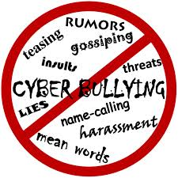
4. Avoid scare tactics. Frame lessons in positive terms.
Student 1: They’ll sometimes talk about cyberbullying and stuff, but normally in a negative way.
Student 2: I feel like if they went about it in a way of how to be safe on it, or telling us how you could use it to your advantage to meet people and stuff, then we would be more willing to learn about it from the school. But when the school is just constantly like, “Well, you’re either using it to cyberbully,” or “It’s a bad account that’s just getting kids in trouble,” I think that’s not enough.
Student 1: They show us these depressing videos. They basically try to guilt-trip us out of doing it. They’re going about this the wrong way, man.
Student 2: Yeah, it’s just “Oh, anything you’ve ever done online might be cyberbullying.”

Slide 18
5. Offer hand-ons lab sessions and live demonstration to teach students how to use privacy settings and how to set up their accounts wisely.
“My advisory teacher, she googled her name and her address and number, and all that popped up. That is kind of uncomforting. Anybody can go on there and see where you live… your number, or your full name. It kind of made me uneasy about how easy they can access my social [security number] or any of my information of where I was born or anything…. It kind of made me uneasy about that.”
6. Take advantage of teachable moments/incidents.
“That crushes account was brought to the attention of the school [and shut down]. But surprisingly, afterwards they didn’t discuss it. I think they should’ve done that.”

Slide 19
New role to play
Libraries have an important role to play in teaching teens about online safety and security. Involve teens in developing programming.
While the teens we talked to reported using privacy and security settings, they say that they learned how to use the settings by experimenting with them on their own. Libraries offer adult programming on social media so why not offer the same to teens? Or better yet, have teens help develop the programming for other teens.
2. Be a social media role model!
Librarians need to promote and model good safe, ethical and legal social media practices. Educating teens about how to stay safe online and about their rights and responsibilities as digital citizens is a critical role for libraries.

Slide 20
Create a culture of social learning.
Rather than creating a culture of fear by focusing on the negative aspects of social media use, design programs that stress the rights and responsibilities of use. Teens must learn how to make good choices in social media environments, and librarians can teach them about their rights regarding copyright, privacy, reporting cyberbullying and/or stalking, and how to make good choices online.
4. Be involved in policy decisions about online social media use in the library or school.
Teens reported confusing, inconsistent practices of social media restrictions in schools. Teens were not permitted to use social media sites during the school day or to friend teachers on the sites but teachers often circumvented these restrictions and put up their own class-related social media sites where they posted assignments and schedules. Librarians should routinely work with administrators and teachers to develop more inclusive Internet Use Policies (IUPs).

Slide 21
5. Librarians can collaborate with teachers or other stakeholders to develop positive learning experiences.
School librarians work closely with teachers in other areas of curricular development. Why not work with teachers to integrate reflective, safe social media use into the curriculum as well?
6. Be an advocate for teens!
Parents and teachers may have unrealistic or unfounded ideas of how and why teens use social media, as well as the dangers of social media sites. Librarians can serve as advocates for teens by providing parents, teachers, and other key stakeholders in teens’ everyday lives about the social, developmental, and educational benefits of social media use.

Slide 22
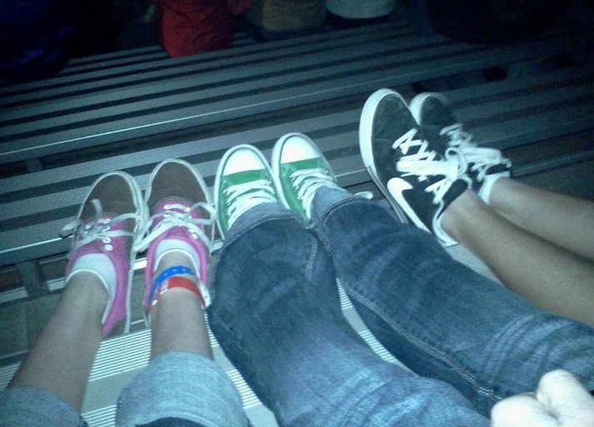
Conclusion: Points to Remember
--Teens’ opinions, perceptions, and behaviors surrounding online privacy and safety vary widely.
--Educators, parents, and other concerned adults should frame online safety education in positive terms, encouraging teens to be thoughtful, reflective social media users and to judge the possible benefits and harms of use.
----------
“Really, social media is only growing.”

Slide 23
References
Agosto, D. E., & Abbas, J. (2011). “Teens, social networking, and safety and privacy issues.” In D. E. Agosto & J. Abbas (Eds.), Teens, Libraries, and Social Networking: What Librarians Need to Know (pp. 59-75). Santa Barbara, CA: Libraries Unlimited.
boyd, d. (2014). It's complicated: The social lives of networked teens. New Haven: Yale University Press.
Christofides, E., Muise, A., & Desmarais, S. (2012). Hey Mom, what’s on your Facebook? Comparing facebook disclosure and privacy in adolescents and adults. Social Psychological and Personality Science 2012, 3, 48-54.
Eder, D., & Fingerson, L. (2002). Interviewing children and adolescents. In J. F. Gubrium & J. A. Holstein (Eds.), Handbook of interview research. Thousand Oaks, CA: Sage.
Hasinoff, A. A. (2013). Sexting as media production: Rethinking social media and sexuality. New Media & Society, 15, 449-465.
Heath, S., Brooks, R., Cleaver, E., & Ireland, E. (2009). Qualitative interviewing. In Researching young people's lives (pp. 79-98). Los Angeles: Sage.

Slide 24
Hinduja, S., & Patchin, J. W. (2008). Personal information of adolescents on the Internet: A quantitative analysis of MySpace. Journal of Adolescence, 31, 125-146.
Hollnagel, E. (2011). Prologue: The scope of resilience engineering. In Hollnagel, E., Pariès, J., Woods, D.D., & Wreathall, J. (Eds.), Resilience Engineering in Practice. A Guidebook. Surrey: Ashgate.
Livingstone, S. (2008). Taking risky opportunities in youthful content creation: Teenagers use of social networking sites for intimacy, privacy and self-expression. New Media & Society 10, 393–411.
Mallan, K. (2009). Look at me! Look at me! Self-representation and self-exposure through online networks. Digital Culture & Education, 1, 51-66.
Marwick, A. (2008). To catch a predator? The MySpace moral panic. First Monday, http://journals.uic.edu/ojs/index.php/fm/article/view/2152/1966.
Notten, N., & Nikken, P. (2014). Boys and girls taking risks online: A gendered perspective on social context and adolescents’ risky online behavior. New Media & Society, doi:10.1177/1461444814552379.
Palfrey, J., & The Internet Safety Technical Task Force. (2008). Enhancing Child Safety and Online Technologies. Cambridge, MA: Berkman Center for Internet and Society.
Westin, Alan F. (1967). Privacy and freedom. New York: Atheneum.

