Slide 1
Understanding Health Information Behaviors in Social Q&A:
Text Mining of Health Questions in Yahoo! Answers
Florida State University
School of Library & Information Studies
College of Communication and Information
Sanghee Oh
MinSook Park
shoh@cci.fsu.edu
mp11j@my.fsu.edu
Notes:
Good morning everyone. I am MinSook Park, a 3rd year doctoral student at Florida State University. First of all, I’d like to thank you for giving me a chance to talk about the study that Dr. Oh and I have worked on.
Topic: understanding people’s behaviors of using social media for seeking and sharing health information
I have been participating Dr. Oh’s study as her research assistant. Today, I am presenting this study on behalf of Dr. Oh. She is not available to attend this conference in person because she recently has her adorable first baby.

Slide 2

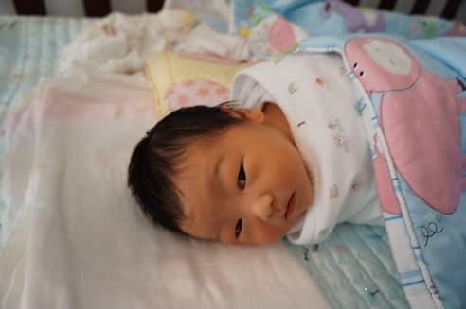
Hello ALISE, I am David!

Slide 3
Social Media and Health
2013 Pew Research Center Report (Fox & Duggan, 2013)
  16% of those who seek health information online look for others who have similar health concerns.
  26% of the Internet users have read the personal experiences of others pertaining to their health conditions.
  30% of them referred to online reviews or rankings of health care services or treatments during the past year.
How America Searches: Health and Wellness (iCrossing, 2008)
  Social media is the third most popular online tool people use to locate health information (34%), following general search engines (67%) and health portals (46%).
  Wikipedia is the most frequently used social media service for health information (21%), followed by online forums (15%), social networks (6%), video-sharing sites (5%), and blogs (4%).
Notes:
Let me first give you the background of social media and health research in the field.

Slide 4
Social Q&A
Web-based service allowing people to ask and answer one another in many different topic areas
Free and easy to access and use
People can benefit from the varying levels of knowledge, expertise, and experiences.
People can elaborate on their information needs in questions or describe sources of information in answers with their own words, explaining their diseases, medical histories, conditions, or resources with as much (or as little) detail as they wish.
Examples
  Yahoo! Answers
  WikiAnswers
  AnswerBag

Slide 5

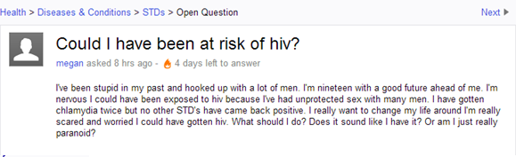
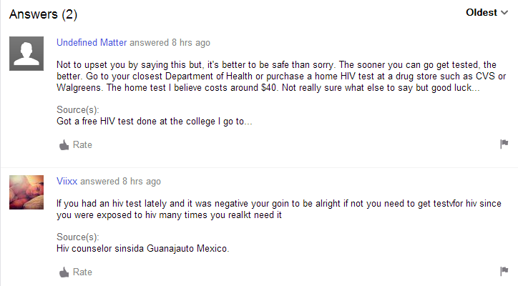
Notes:
Here is an example of question and associated answers.
All of the questions and answers in social Q&A describe real-life problems and issues people experience in everyday life.
Therefore, by analyzing health questions and answers, we can understand the information needs of users about topics and issues

Slide 6
Research Questions
  What is the disease specific information (e.g., prevention, risk factors, symptoms, diagnosis, treatments) people would most likely discuss in health questions?
  What are the personal experiences, expertise, and resources people share in health questions?
  What are the social and emotional supports people would like to receive or share in health questions?
  How have the findings from the research questions above been evolved by time, from 2009 to 2012?
Notes:
We specified the important topics that people discuss in social Q&A

Slide 7
Information Framework for Health Questions
 | Types of Information | Sub-Types
 | Demographic | Sex, age, relationship between questioners and patients or potential patients
Information Sharing | Disease-specific | Prevention/causes, symptoms, tests, treatments, diagnoses
 | Life style | Medical records, family medical history, food/exercise, smoking/alcohol, environmental factors
Information Seeking | Diseases-specific | Prevention, symptoms, diagnoses, tests, treatment, prognoses
 | Socio-emotional | Isolation, acceptance, social supports, coping
 | Life style | Alcohol, smoking, environmental factors
Notes:
Demographic: Demographic information of patients or care givers
Disease specific: Disease-related information in which people explained about the conditions of patients or potential patients
Life style: information that people share about their personal records or lifestyles for maintaining health
Disease-specific: Information asked by patients or potential patients about the disease that they are suspicious about having or for which they are already diagnosed.
Socio-emotional: Information asked for by patients or potential patients about the ways of handling their situations emotionally.
Lifestyle: information asked by patients or potential patients for maintaining healthy lives.

Slide 8
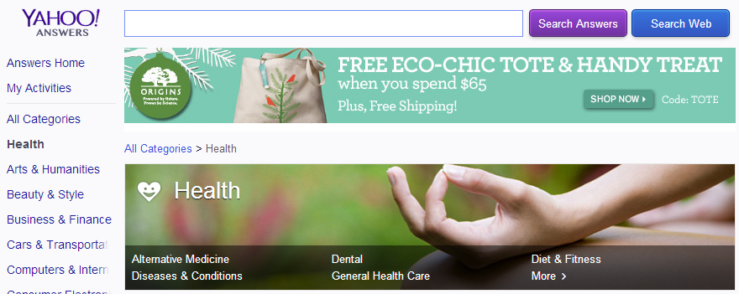

Method
Test bed: Yahoo! Answers
  About 20 health-topic categories are available (e.g., Cancer, Women’s Health, Dental, Diabetes, Sexually Transmitted Diseases).
Notes:
Our test bed is Yahoo Answers
According to types of disease people’s information needs may vary. Thus, in this presentation, we focus on Sexually transmitted disease.

Slide 9
Data Collection
Collecting up to 5,000 health-related questions and corresponding answers per day, using the Yahoo! Answers API (Application Programming Interface).
Collecting data about questions, answers, best answers, resources (references), ratings, timestamps, user nick names, etc.
Approx. 1 million questions and 5 million answers are available for the analysis.
# of health-related questions posted in 2012: 468,655
# of corresponding health-related answers to the questions: 1,267,554
# of STD questions posted between 2009 to 2012: 69,363
Notes:
Associated data – ratings, timestamps, user nick name etc
Today we will report health questions regarding Sexually transmitted diseases
Future study will include cancer because other health categories may reflect different health information needs. And we will analyze answers as well.

Slide 10
Text Mining
  To observe health information needs presented in a large and complex collection of health questions from a social Q&A service, Yahoo Answers
  Interpretation of the results from text mining could be mostly based on terms without considering the contexts. Thus, content analysis of the questions was carried out prior to text mining in order to capture the contexts of the information behaviors of the questioners.
Text Mining
(69,363 questions)
Content Analysis
(1,118 questions)
Information Framework of Health Questions Development
Notes:
In order to understand the contexts of the information behaviors of the questioners, prior to text mining, we examined a small set of health questions (about 1,000), using content analysis

Slide 11
Text-Mining Software
Dataset: 69,363 health questions about STDs posted from 2009 to 2012.
IBM SPSS Modeler Premium: Text Analytics
  Text mining software is designed to analyze unstructured data, extracting words and concepts from texts and identifying the relationships among them using predictive models.
  Extracting words and concepts from texts, using MeSH (Medical Subject Headings) and a customized dictionary for STDs
Counting the frequency of the concepts
Extracted concepts were grouped into the categories of the information framework developed by content analysis in a previous study.
Notes:
Concepts: expressions that people used to describe and discuss their health conditions. It is not simple account of terms but concepts represent meaningful terms such as disease names, symptoms and risk factors.
MeSH was employed to control and analyze medical vocabularies whereas a customized set of subject headings was created to control a number of idioms and daily expressions that people use to describe health issues in their questions.

Slide 12
Data Analysis Process
Concept Extraction
Extract concepts and calculate frequencies of questions associated with each concept
--------------------------------------------------------
STDs: 18,229
herpes: 15,432
HIV: 11,739
doctor: 10,168
test: 7,543
symptoms: 7,259
AIDS: 5,669
…
Question
--------------------------------------------------------
Question
--------------------------------------------------------
Health Question
--------------------------------------------------------
Text Preparation
Research Database
Generate concept maps and identify the relationships/similarity of the terms in health questions
Data Collection
Yahoo! Answers
Notes:
Our own research database
Unique number of questions associated with each concepts

Slide 13
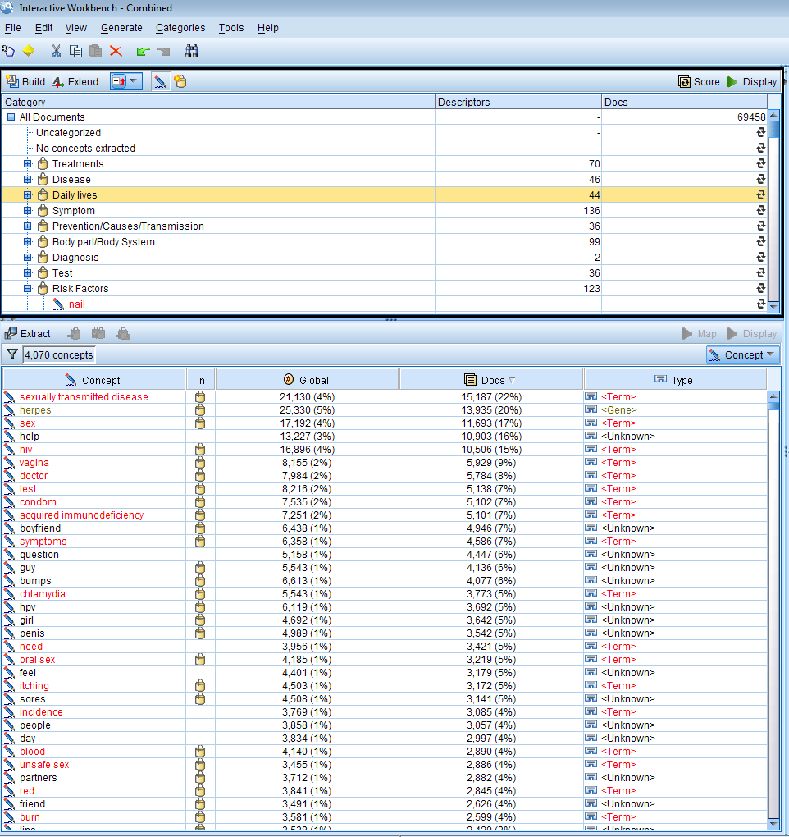
STD Concept Extraction (5,000 concepts)
Rank | Major Concepts | No. of Questions
1 | STDs | 18229
2 | Sex | 17945
3 | Herpes | 15432
4 | help | 15029
5 | HIV | 11739
6 | Doctor | 10168
7 | Vagina | 7866
8 | Boyfriend | 7800
9 | Condom | 7737
10 | Test | 7543
11 | Symptoms | 7259
12 | Guy | 7052
13 | Bumps | 6361
14 | Question | 6211
15 | Girl | 6014
16 | AIDS | 5669
17 | Feel | 5639
18 | Need | 5435
19 | Day | 5428
20 | Penis | 5382
Table 1. The top 20 most popular concepts in STD questions.
Notes:
Unique number of questions

Slide 14
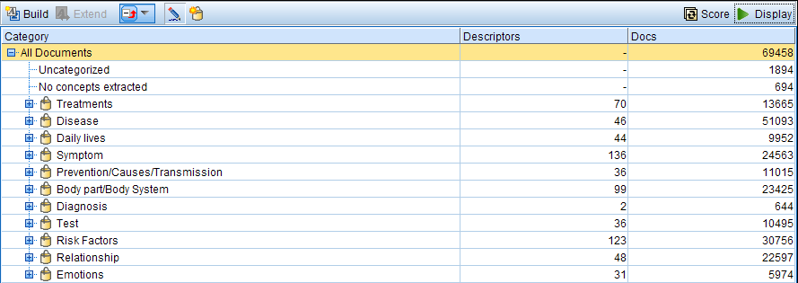
What is the disease specific information people would most likely discuss in health questions and answers?
Notes:
Overview of what people discussed about disease specific information
Type of STDs they suspect they may have: HIV, Herpes, Gonorrhea, HPV
Risk factors: sexual behaviors, sharing foods with a potential carrier,
Symptoms: heavy discharge, changes in skin color or pain

Slide 15
  Types of STDs
Rank | Major Concepts | No. of Questions
1 | STDs | 18229
2 | Herpes | 15432
3 | HIV | 11739
4 | AIDS | 5669
5 | HPV | 4173
6 | Chlamydia | 4548
7 | Genital warts | 2767
8 | Yeast infection | 2448
9 | Syphilis | 903
10 | Hepatitis | 583
11 | Bacterial Vaginosis | 529
12 | Trichomoniasis | 312
13 | Gonorrhea | 15
Table 2. The top 13 most frequently
discussed STD diseases

Slide 16
  Concept Map: Herpes
  (Maximum concept on map: 30)co
Notes:
Each concept that people discussed in their questions can be visually displayed in this concept map
SPSS Modeler provides concept maps that indicate the relationships among the major concepts by measuring the frequencies of the concepts commonly appeared in multiple questions.
Similarity are calculated based on number of questions that have some concepts
Show co-concurrence link (discover similarity metrics, document metrics).
Confidence metrics
similarity metric). similarity metric). With this metric, the strength of the link is calculated using algorithm that takes into account how often two concepts appear apart as well as how often they appear together. A high strength value means that a pair of concepts tend to appear more frequently together than to appear apart.

Slide 17
Types of Concept Maps in SPSS Modeler
Co-occurrence links
• Discover (similarity metric). With this metric, the strength of the link is calculated using more calculation formula in SPSS that takes into account how often two concepts appear apart as well as how often they appear together. A high strength value means that a pair of concepts tend to appear more frequently together than to appear apart.
• Organize (document metric). The strength of the links with this metric is determined by the raw count of co-occurrences. In general, the more frequent two concepts are, the more likely they are to occur together at times. A high strength value means that a pair of concepts appear together frequently.
Confidence metric
You can choose other links to display; these may be semantic, derivation (morphological), or inclusion (syntactical) and are related to how many steps removed a concept is from the concept to which it is linked. These can help you tune resources, particularly synonymy or to disambiguate.

Slide 18
  Concept Map: Herpes
  (Maximum concept on map: 30)

Slide 19
  Concept Map: Herpes
  (Maximum concept on map: 30)

Slide 20
  What are the personal experiences, expertise, and resources people share in health questions?
 | Concepts | No of Questions
1 | virginity | 3875
2 | life | 3145
3 | pregnancy | 2584
4 | baby | 976
5 | kids | 975
6 | situation | 872
7 | health | 871
8 | birth control | 766
9 | health insurance | 656
10 | money | 517
11 | effect | 471
12 | planned parenthood | 441
13 | paperwork | 416
14 | lead | 359
15 | pay | 321
16 | cost | 313
17 | lie | 307
18 | future | 286
19 | infertility | 271
20 | marriage | 220
Table 3. The top 20 most popular life issues
Notes:
People also look for information about personal experiences, regarding their health issues and problems
Impacts on their pregnancy, life, and infertility
Economic aspects: insurance, costs for test and treatments
Social life: future relationship,

Slide 21
  What are the social and emotional supports people would like to receive or share in health questions?
 | Concepts | No of Questions
1 | freaking | 1213
2 | worried | 980
3 | I don't know | 718
4 | love | 640
5 | Fear | 334
6 | trust | 329
7 | anxiety | 325
8 | mistake | 290
9 | hate | 287
10 | doubt | 278
11 | nasty | 243
12 | concern | 235
13 | embarrassing | 169
14 | panic | 149
15 | ease | 144
16 | regret | 138
17 | hypochondria | 107
18 | fault | 90
19 | relief | 86
20 | pleasure | 86
Table 4. The top 20 most frequently discussed Emotions

Slide 22
How have the findings from the research questions above been evolved by time, from 2009 to 2012?
Notes:
Lastly, We examined if there are changes in topics people discuss in social QA regarding STDs issues.
We could not identify dramatic changes but there are slight decrease during the winter and slight increases from springs to summer.

Slide 23
Discussion / Implication
Text mining has been an effective method with which to understand and identify relationships among concepts in a large dataset.
Text mining will continue to identify the information people seek and share in health questions and answers in social Q&A.
Findings could be beneficial for health information professionals to better understand the health information needs and behaviors of people in real life.
Findings could inform the design, evaluation, or improvement of services and systems to help guide people in making informed health care decisions.
The proposed method is applicable to analyzing questions and answers in other topic areas as well as in examining information shared in other types of social media (e.g., wall messages in social networking sites, tweets, blogs, wikis).

Slide 24
References
Liddy (2000) http://gate.ac.uk/sale/talks/text-mining-course-sslst2011/slides/module1-intro.pdf
M. Hearst, “Untangling Text Data Mining,” in the Proceedings of the 37th Annual Meeting of the Association for Computational Linguistics, 1999.
E. Riloff and R. Jones, “Learning Dictionaries for Information Extraction Using Multi-level Boot-strapping,” in the Proceedings of AAAI-99, 1999.
K. Nigam, A. McCallum, S. Thrun, and T. Mitchell, “Text Classification from Labeled and Unlabeled Documents using EM,” in Machine Learning, 2000.
M. Grobelnik, D. Mladenic, and N. Milic-Frayling, “Text Mining as Integration of Several Related Research Areas: Report on KDD’2000 Workshop on Text Mining,” 2000.

Slide 25
Thank you!
Questions & Comments?
Sanghee Oh, assistant professor at Florida State University (FSU)
Contact Information
  Office: 1-850-645-2493
  Email: shoh@cci.fsu.edu
  Personal Website: http://shoh.cci.fsu.edu
  Research Website: http://socialqa.cci.fsu.edu

