Slide 1
Social Media as Information Sources
by Kyung-Sun Kim & Sei-Ching Joanna Sin
University of Wisconsin-Madison, Nanyang Technological University
Use and Evaluation of Information from Social Media

Slide 2
Background
Some social media platforms, such as Wikipedia and YouTube, have emerged as important information sources (Head & Eisenberg, 2011; Holcomb et al. 2013; Lim, 2009).
About 50% of online teens and over 80% of college students use social media for their academic as well as everyday life research (Head & Eisenberg, 2009, 2010; Pew, 2009).
It is important to understand how users evaluate and use information from social media, as it can help provide assistance for the effective use of social media.

Slide 3
Research Questions
In what contexts do undergraduates use different social media platforms as information sources?
What types of social media do they use, for what purposes?
What actions do they take for evaluating the information provided by different social media platforms?
What kinds of metadata elements and system features can support users’ evaluation of information from social media?

Slide 4
Methods
Data collection:
Phase 1 – Web survey
Phase 2 – Focus groups (On RQ 4)
Participants
Population: Undergraduate students in US & Singapore
Sampling: Non-probability sampling method used
(Email solicitation and voluntary participation)
Sample:
Phase 1 – 1,500 respondents : US (n= 1,300), Singapore (n=200)
Phase 2 – 40 participants (n=20 from each country)

Slide 5
RQ 1: Social media use for information seeking in different contexts (1/2)

Slide 6
RQ 1: (2/2)
Academic context
US |  |  | Singapore
Wikis | 3.51 |  | Wikis | 4.05
Q&A Sites | 2.22 |  | Media-Sharing Services | 2.61
Media-Sharing Services | 2.18 |  | Q&A Sites | 2.57
Internet Forums | 1.74 |  | Internet Forums | 2.28
Blogs | 1.63 |  | Social Networking Sites | 1.89
Everyday context
US |  |  | Singapore
Social Networking Sites | 3.74 |  | Media-Sharing Services | 4.11
Media-Sharing Services | 3.48 |  | Social Networking Sites | 4.06
Wikis | 3.37 |  | Wikis | 3.50
User Reviews | 2.88 |  | Microblogs | 2.84
Microblogs | 2.58 |  | Q&A Sites | 2.77

Slide 7
RQ 2: Social media use & purposes (1/3)
Platform | Top purpose | 2nd top purpose
Wikis | To get background information | To check factual information
Media-Sharing Services | To be aware of popular trends | To get updates / news
Social Networking Sites | To establish / maintain relationships with others | To share information with others
Q&A Sites | To find solutions to a problem or how-to instructions | To get background information
User Reviews | To obtain others’ opinions / comments | To get background information
Microblogs | To be aware of popular trends | To establish / maintain relationships with others
Internet Forums | To find solutions to a problem or how-to instructions | To obtain others’ opinions / comments
Blogs | To obtain others’ opinions / comments | To be aware of popular trends
Social Bookmarking/ Scrapbooking | To be aware of popular trends | To collect / organize digital objects
Top purpose | 2nd top purpose
To get background information | To check factual information
To be aware of popular trends | To get updates / news
To establish / maintain relationships with others | To share information with others
To find solutions to a problem or how-to instructions | To get background information
To obtain others’ opinions / comments | To get background information
To be aware of popular trends | To establish / maintain relationships with others
To find solutions to a problem or how-to instructions | To get background information
To be aware of popular trends | To obtain others’ opinions / comments
To be aware of popular trends | To collect / organize digital objects

Slide 8
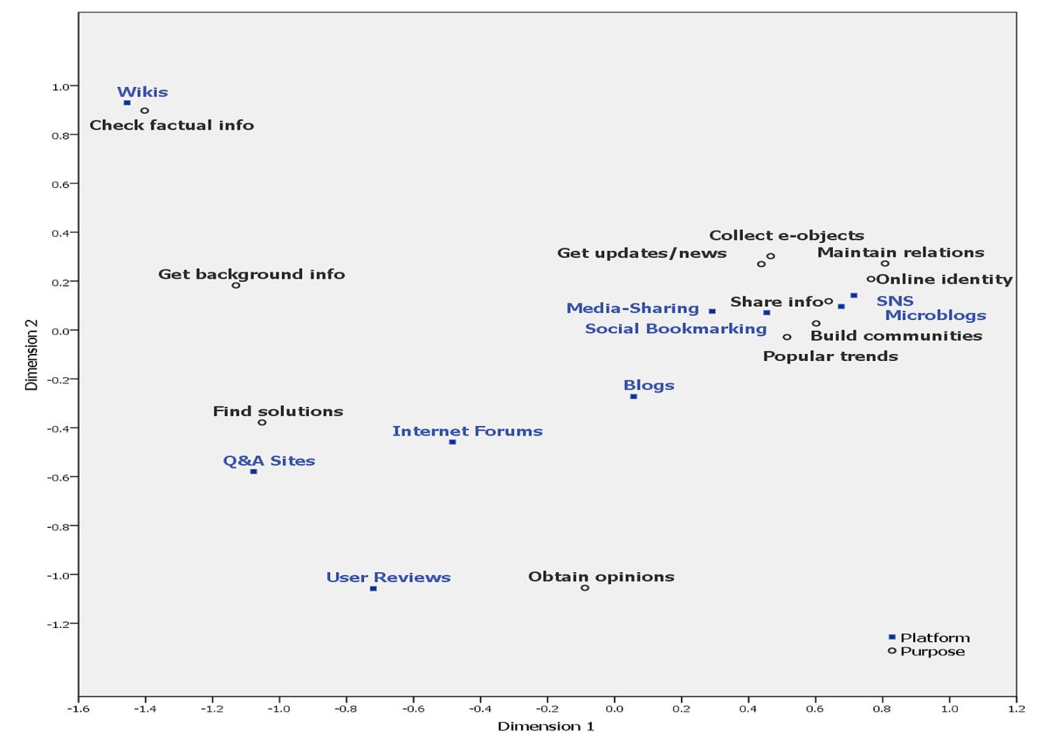
RQ 2: Platforms & purposes (2/3)

Slide 9
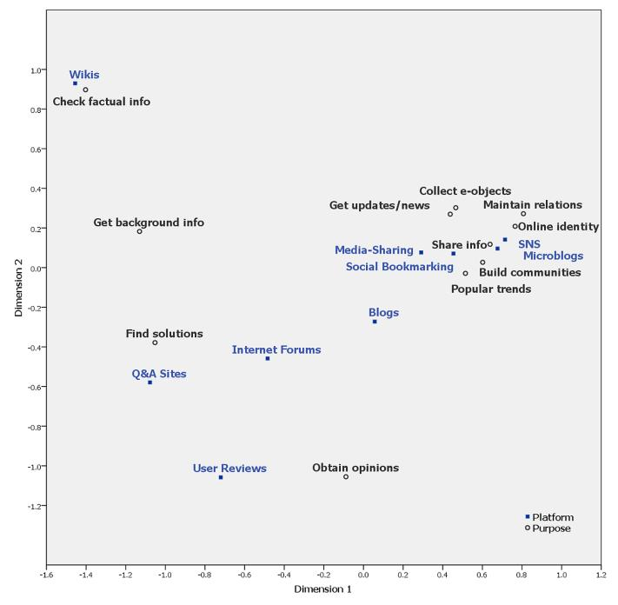
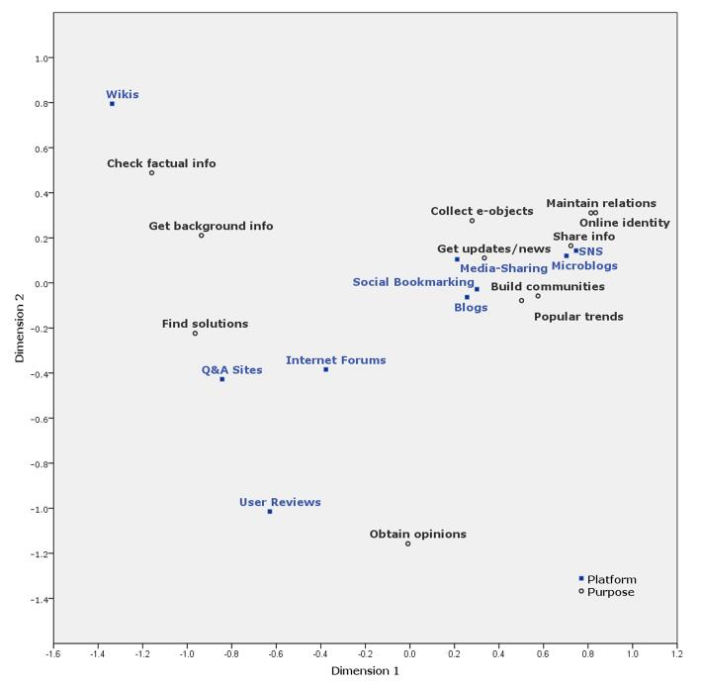
RQ 2: Platforms & purposes (3/3)
US
Singapore

Slide 10
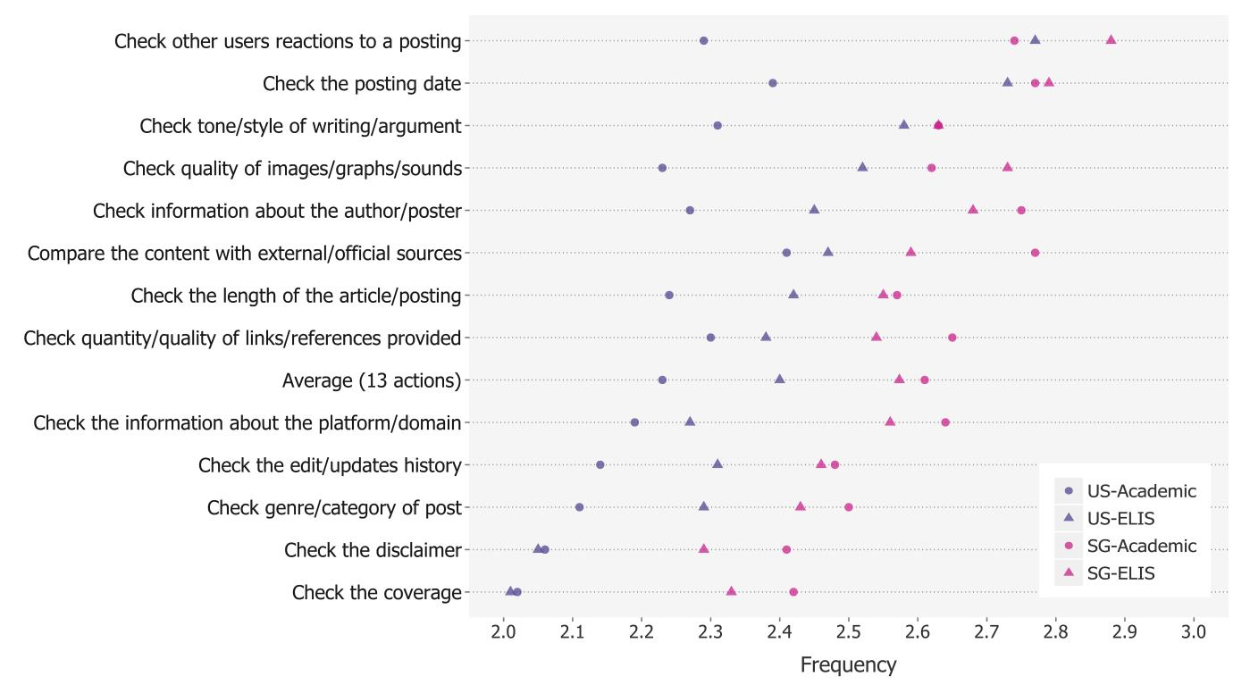
RQ 3: Evaluative actions (1/3)

Slide 11
RQ 3: Evaluative actions, platforms, & contexts (2/3)
cv
cv

Slide 12
RQ 3: Evaluative actions, platforms, & contexts (3/3)
US: Academic context
 | Wikis | SNS | Media-Sharing | Q&A | Microblog
1st | Compare the content with external / official sources | Check the posting date | Check the posting date | Check other users reactions to a posting | Check information about the author / poster
2nd | Check quantity / quality of links / references provided | Compare the content with external / official sources | Check quality of images / graphs / sounds | Check the posting date | Check the posting date
3rd | Check the length of the article / posting | Check information about the author / poster | Check other users reactions to a posting | Compare the content with external / official sources | Compare the content with external / official sources
US: Everyday context
 | Wikis | SNS | Media-Sharing | Q&A | Microblog
1st | Check the length of the article / posting | Check other users reactions to a posting | Check quality of images / graphs / sounds | Check other users reactions to a posting | Check the posting date
2nd | Check tone / style of writing / argument | Check the posting date | Check other users reactions to a posting | Check the posting date | Check other users reactions to a posting
3rd | Compare the content with external / official sources | Check information about the author / poster | Check the posting date | Compare the content with external / official sources | Check information about the author / poster

Slide 13
RQ 4: Useful metadata elements (1/2)
Focus |  | Elements | Comments
Poster (e.g., author; commenter/ follower; reviewer) (45%) | Demographics Experience Reputation | Age; Gender; Location Experience level Expertise/Education Interest area Occupation Cultural/Political Awards Endorsement | “…like reviews by a person who is most similar (for ELIS) to you in age, gender, location, etc.” “the expertise and experience would be important to know, especially in the case of news.”
Posting (30%) | Aim Time Content Characteristics References Reactions | Purpose Target audience Posting date Topic Genre; Format Language Status (complete) Quality; Quantity Popularity Rating | “I think the purpose of the posting would be important too. So if it’s educational versus it’s just for entertainment.” “I always check the date published and make sure it’s not a really outdated source that I’m looking at.”
Source (15%) | Source | Community info. Funding source | ”Whether they have a financial gain from, if there’s the potential for that kind of conflict of interest, I’d rather know what that is.”

Slide 14
RQ 4: Useful system features (2/2)
Functions | Elements
Filter/Sort (35%) | Poster (e.g., age, gender, location, experience, interest, reputation) Posting (e.g., date, format/type , genre, popularity , purpose , topic)
Search/Query (10%) | Poster ; Keywords
Rate (10%) | Rating by multiple criteria ; Rating references, quality of media posted
Display (30%) Charts/Graphs Map Popup window Links Statistics Tag Clouds | Poster (e.g., age, gender, location, experience, interest, verification) - Poster profile in popup window ; Certified author stamps Posting (e.g., format/type , purpose , popularity, topic) - Categorization; Tree branches of postings/threads Related sites, references, reviews - Links to references, related sites, etc. - Categorized references - Aggregated and categorized sites/resources related to the posting - Categorized reviews (pro/con) with statistics Status icon (e.g., answered/unanswered)
Compare | Compare certain features, ratings
Cross referencing | Terms in different languages are connected and searched simultaneously

Slide 15
Implications
For information literacy education
To cover social media platforms that are frequently used as information sources
To suggest effective strategies for evaluating information from different types of social media
To help contribute quality information to social media
For social media systems design
Metadata: Provide a form with useful metadata elements, which posters can fill out
Interface: Add devices to support retrieval and evaluation of information from social media

Slide 16
Future Research
Gap analysis
Findings of the current study on students
Which social media platforms are used for what purposes
What students do to evaluate information from social media
Findings of a study on librarians – best practices
Comparing the two can help refine IL training programs
Users individual differences
Focus group interviews revealed individual differences in strategies and preferences
Demographics including gender, class level, academic orientation
Problem solving styles

Slide 17
Acknowledgment
Research sponsored by:
OCLC / ALISE 2013 Research Grant

