Slide 1
Reference Competencies from the Practitioner’s Perspective: An International Comparison
Laura Saunders
Mary Wilkins Jordan
Simmons College
ALISE conference January 2013

Slide 2
Introduction
Original U.S. survey: public and academic
Collaboration initiated at Krakow Conference on LIS Education.
This study examines the following questions:
Are expectations around reference competencies consistent across different countries?
If so, can an international standard or core list of competencies for reference librarians be determined?
Are there statistically significant differences among different nations with regard to reference competencies and qualifications?
If so, which competencies are preferred by which countries, and is there a discernible cultural pattern?

Slide 3
Survey
3 categories of competencies:
General
Technical
Interpersonal
Indicate all important competencies
Select three most important in each category
Predict which competencies would be important in the next ten years, and again which three in each category would be most important

Slide 4
International Participants
Participants recruited through personal knowledge, recommendation, and outreach
15 participants join
13 submit data

Slide 5
Survey & Samples
Original survey translated by participants
researchers made every effort to keep the meaning and intent of the original survey
all changes centered on demographic questions
Original U.S. surveys were random samples. All others were a census.

Slide 6
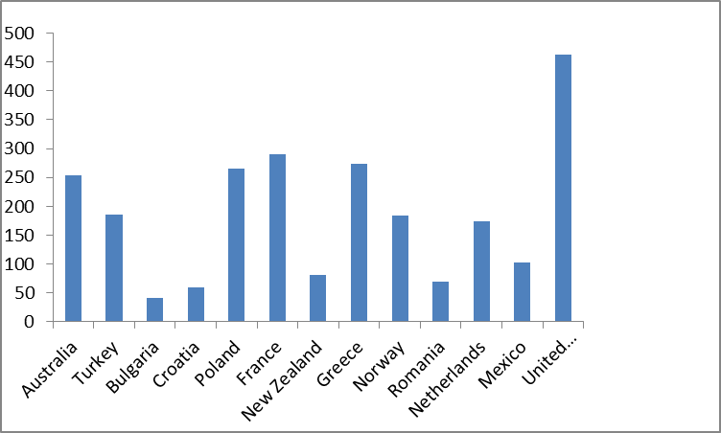
Demographics
2444 responses from 13 different countries

Slide 7
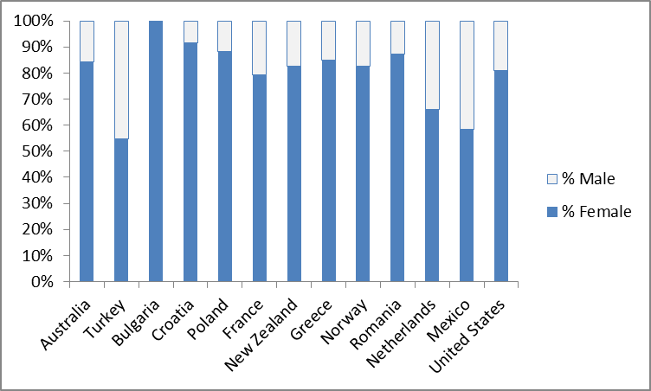
Males and Females
79.3% were female
Bulgaria had the highest percentage of female respondents at 100%
Turkey had the lowest at 54.8%

Slide 8
Age ranges
The majority of participants were between the ages of 31 and 40 (28.0%)
the 41-50 age range (26.0%)
the 51-60 age range (24.3%)
Turkey had the youngest librarians on average, at 34.9 years, while New Zealand had the highest average age at 49.4 years

Slide 9
General skills
Search skills
Ranked highest or tied for highest in ten out of thirteen countries
Knowledge of online resources
Customer service
Foreign language
A second Master’s degree (or a second Bachelor’s degree for those countries requiring only a Bachelor to practice) was the overall least often selected competency, followed by budgeting

Slide 10
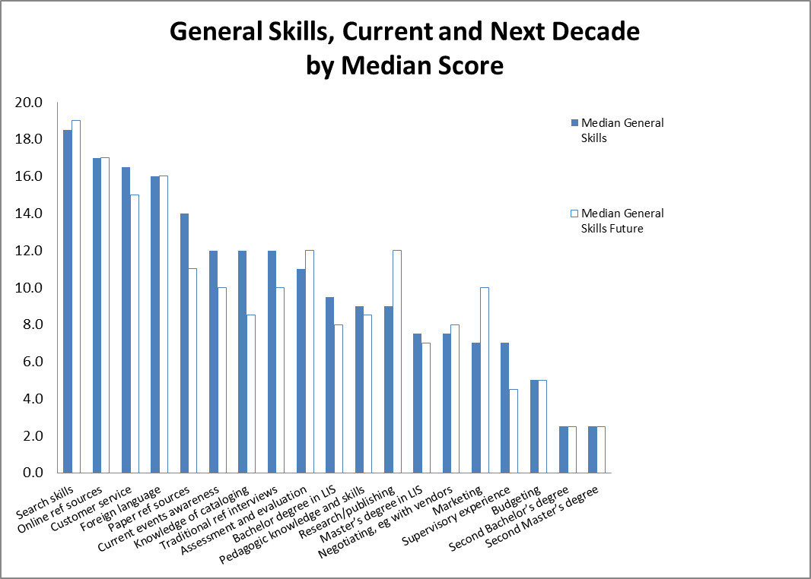

Slide 11
Technical Skills
Online searching
Ranked number one by all thirteen countries
Knowledge of and facility with social media
Hardware troubleshooting, and software troubleshooting are ranked very differently by different countries, appearing among the top three in some cases, and the bottom three in others
Programming was the bottom-ranked skill

Slide 12
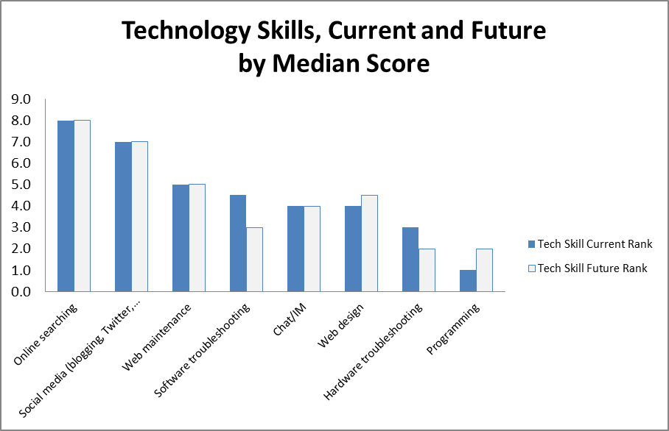

Slide 13
Personal skills
Verbal communication
Unanimously ranked first by all thirteen countries
Listening
Approachability
Conflict management and stress management were consistently ranked as the bottom two

Slide 14
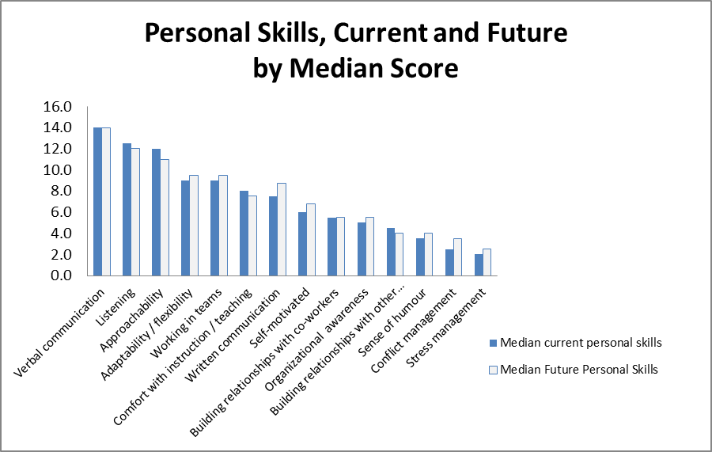

Slide 15
Consensus & contrast
Across Countries

Slide 16
Consensus
More consensus on hard skills:
technical skills were likely to be ranked similarly across countries
certain general skills such as searching, and knowledge of online and print reference sources
Core academic reference services are similar from one country to another

Slide 17
Contrasts
Less on soft skills:
interpersonal skills including sense of humor, conflict management, and self-motivation show the greatest variation
cultural differences in norms and expectations for interpersonal interactions
sensitivity to possible differences in how patrons and colleagues interact
the expected relationships between employees and supervisors
Cultural differences influence expectations of the interpersonal interactions involved in providing those services

Slide 18
Conclusions:
Academic reference skills are transferable:
Exchange programs such as Fulbright and Erasmus Scholarships
Librarians interested in relocating temporary or permanent basis.
Suggests that library science curricula could have similar focal points for reference courses
allowing some flexibility for transfer of credits,
study abroad programs, or
relocating after graduation

Slide 19
Final lessons
Librarians can see the extent their international counterparts face similar challenges and expectations with regard to delivering reference services
LIS Teaching faculty can understand reference competencies and expectations in other countries
teaching greater numbers of international students
consider collaborating with international colleagues
developing students who can compete in a global job market
By identifying areas of commonality and difference in the area of academic reference services, this study might inspire further collaboration among colleagues from different countries to continue to explore cultural differences in the approach to reference services.

