Slide 1
Transformation of the Academic Library Kurt De Belder
OCLC Research Distinguished Seminar, 10 May 2013

Slide 2
You never want a serious crisis to go to waste.
Things that we had postponed for too long, that were long-term, are now immediate and must be dealt with. This crisis provides the opportunity for us to do things that you could not do before.
Rahm Emanuel
Chief of Staff, Barack Obama
Wall Street Journal, November 21st 2008

Slide 3
Urgency for university libraries
Disruptive elements:
Google search
Google books, e-books, e-readers, printing on demand
Information = digital & pluriform
Mobile technology (smart phones, tablets & pads)
Changes in science and scholarship: collaborative, programmatic, more data focussed, use resources from outside institution, e-science/e-humanities/e-research

Slide 4
Science paradigms (Jim Gray)
The Fourth Paradigm: Data-Intensive Scientific Discovery, 2009, p. xx

Slide 5
Urgency for university libraries
Disruptive elements:
Google search
Google books, e-books, e-readers, printing on demand
Information = digital & pluriform
Mobile technology (smart phones, tablets & pads
Changes in science and scholarship: collaborative, programmatic, more data focussed, use resources from outside institution, e-science/e-humanities/e-research
Changes in scholarly publishing
Changes at universities: focus on added value, making choices
Pressures from society/politics/media: relevance & trustworthiness of science, cost & effectiveness of education
Technological advancement takes place in consumer market

Slide 6
Technological progress
Intuitive linear vs historical exponential view
Ray Kurzweil: The singularity is near: when humans transcend biology. 2005. p. 50

Slide 7
Urgency for university libraries
Disruptive elements:
Google search
Google books, e-books, e-readers, printing on demand
Information = digital & pluriform
Mobile technology (smart phones, tablets & pads)
Changes in science and scholarship: collaborative, programmatic, more data focussed, use resources from outside institution, e-science/e-humanities/e-research
Changes in scholarly publishing
Changes at universities: focus on added value, making choices
Pressures from society/politics/media: relevance & trustworthiness of science, cost & effectiveness of education
Technological advancement takes place in consumer market
Major budget cuts
Increase of cost of information keeps outpacing inflation

Slide 8
How do libraries deal with change?
Libraries have changed tremendously, have innovated, have added digital services, have generated more research/teaching time at the faculty level
But to a great extent have not ended services and have kept within the existing library paradigm
Major driver for decisions about libaries within university administrations: budgetary considerations
Change is outpacing us.

Slide 9
Some traditional functions
Selection/Acquisition
Cataloging
Archiving
Reference desk
Outreach
Making available
“Find it” business
Special Collections
Technology management

Slide 10
Selection and acquistion
Journals:
NOW: licensing, big deals (consortial)
<3 YRS: + flexible big deals based on usage and research profiles
<3 YRS: + backfiles from digital period will be OA?
<3 YRS: + experiments with publishers to transition to OA based on big deal financing
TREND: LESS SELECTION

Slide 11
Selection and acquistion
Books:
NOW: title by title selection ➔ approval plans
<3 YRS: big deals based on licensing?
<3 YRS: ordered directly by user at moment of need (various forms of PDA)?
<5 YRS: books as a subscription stream (“Spotify for books”)?
TREND: SELECTION OUTSIDE LIBRARY
<5 YRS: title by title selection by library/prospective user for OA financing

Slide 12
Selection and acquistion
Institutional repository:
NOW: variety of formal and grey literature
<3 YRS: dissertations & theses
<3 YRS: grey literature
<3 YRS: teaching related (e.g. course on video)
<3 YRS: open access mandated publications by funding agency
SELECTION OUTSIDE LIBRARY

Slide 13
Cataloging
NOW: record sharing and duplication and ‘item by item’ cat
NOW: real efficiency in and outsourcing of the back office processes at the top of agendas.
<3 YRS: towards managing record/data flow
<3 YRS: 3rd party created records with added enrichment & user created information
<5 YRS: focus on special collections & local info
<5 YRS: data flow managed at a national or international level through Knowledge Bases with some local enrichment
TREND: DELOCALIZATION & NON DUPLICATION

Slide 14
Archiving
Paper collections:
NOW: in stacks locally, curated and managed
NOW: shift from open to closed stacks
<10 YRS: paper has been digitized (= mode of delivery)
<10 YRS: paper collections warehoused on a national/regional level or national retention arrangements
<15 YRS: only special collections are locally curated and managed
TREND: DELOCALIZATION

Slide 15
Archiving
Electronic collections:
NOW: relatively vague agreements between libraries and publishers about permanent access
<5 YRS: clear agreements and collaboration between publishers and national libraries and/or transnational digital archives
<10 YRS: national digital archiving strategy
TREND: (INTER)NATIONAL ARRANGEMENTS

Slide 16
Archiving
Digital collections & data:
NOW: ad hoc local
<10 YRS: agreements and facilities at national and/or transnational level
TREND: (INTER)NATIONAL FACILITIES & ARRANGEMENTS

Slide 17
Reference desk
NOW: plenty of libraries still have reference desk staffed with highly qualified staff in conjunction with virtual desk
<3 YRS: replaced by virtual desk (email, chat, telephone)
<3 YRS: and/or replaced by physical who/what/where
<3 YRS: and/or replaced by multi-organisation service desk
TREND: MINIMIZED

Slide 18
Outreach
NOW: away from collection specialists to faculty liaison and development of ‘typical’ library services
<3 YRS: faculty liaison, services specialists & partners in research & teaching
data curation
copyright
text and datamining
e-publishing & dissemination
GIS
datasets
...
TREND: SERVICE & EXPERTISE BASED

Slide 19
Making available
NOW: we build traditional ‘just in case’ collections
<3 YRS: e-books / e-readers will become standard
<3 YRS: libraries offer printing on demand services
<5 YRS: paper books are delivered in digitized form upon request
<10 YRS: from ‘just in case’ collections to ‘just in time’ collections?
<10 YRS: digital collections with focus on computational use
<10 YRS: general paper collections are housed in national/regional warehouses
TREND: DIGITAL, JUST IN TIME, COMPUTATIONAL

Slide 20
‘Find it’ business
NOW: libraries are still in the ‘find it’ business
<5 YRS: libraries have left to a great extent the ‘find it’ business as a local service and subscribe to ‘find it’ cloud services
<5 YRS: libraries have moved into the ‘get it’ business and are providing another array of services
TREND: SHIFT TO GET IT

Slide 21
Special collections
NOW: special collections often a traditional prestige object and role in research and teaching is not always substantial
<3 YRS: special collections at a university library need to have an active role in research and teaching (more than just the study of the book) and are focal point for fundraising and therefore also for societal outreach
<10 YRS: special collections with only museum function will be moved to museums
TREND: RESEARCH, TEACHING, SOCIETAL & FUNDRAISING ROLE

Slide 22
Technology management
NOW: local management of a large number of library & information systems
NOW: more systems / investments for our traditional processes will increasingly become a hard sell.
<3 YRS: present library information systems are moved to the cloud (discovery layer, catalog, acq/cat, circ, digital library, linking server, repository)
<5 YRS: technology efforts focussed on connection between information systems in the cloud and local application and tools?
<5 YRS: some national information infrastructure will become irrelevant
TREND: DELOCALIZATION

Slide 23
How do we act in a context of exponential change?
Stop doing generic work that can easily be outsourced.
Focus on specific needs for furthering education and research at your own institution.
Collaborate on a national or transnational level (Portico, HathiTrust, …).

Slide 24
The function of libraries?
Fullfill information needs of faculty, researchers, students, university.
An attractive work, meeting and social space.
Information manager for the university (CRIS, research data, research output, e-learning objects).
Expert centre digital information for research and teaching.
Part of the research & teaching workflow.
Support knowledge creation & dissemination.
Integrate information literacy in regular curriculum.
Bring information and tools in the environments our users are utilizing.
Support e-research.
➔Larger organisations and collaboration with external parties.

Slide 25
Leiden University Libraries – Strategic plan 2011-2015: Partner in Knowledge
http://media.leidenuniv.nl/legacy/meerjarenbeleidsplan-ubl-2011-2015.pdf

Slide 26
Partner in Knowledge (1)
Library to become expert centre digital information for research and teaching.
New areas of expertise in research support:
Virtual Research Environments (production)
Data management & curation (pilots)
Text & data mining (exploring project)
Copyright (production)
GIS (exploring project)
Publication support (exploring project)
[further areas to be identified through in-depth focus group discussions with researchers]

Slide 27
Partner in Knowledge (2)
New developments in teaching support
VRE’s for education (pilots)
Thesis repository (BA/MA) (production)
Digital info skills in curriculum (production)
Support for OpenCourseWare (pilots)
Support for MOOCS (pilots)
Library Learning Centres (space) (production)

Slide 28
Partner in Knowledge (3)
Important for Leiden University Libraries:
One organisation in 2010
Strategic plan developed with library staff
Changes in function profiles (e.g. subject specialists)
Within appointments time explicitly allocated for development of new expertise
Focus on working in projects
Sufficient funding for staff training and development

Slide 29
Partner in Knowledge (4)
Approach
Increased emphasis on expertise approach instead of subject approach.
Balance between own expertise and mediation.
Collaboration is central: with faculty & researchers, research groups, teaching & research units, academic affairs, computing centre, CWTS and external partners such as SURF, national data archives (DANS & 3TU.Datacentre), Microsoft Research.
Bottom up but accompanied by strategic discussion at leadership level of university.

Slide 30
Research life cycle
Leo Waaijers: The DARE Chronicle: Open Access to Research Results and Teaching Material in the Netherlands, Ariadne, 53, October 30, 2007. http://www.ariadne.ac.uk/issue53/waaijers

Slide 31
RESEARCH
Virtual Research Environments (VRE) for research groups (planning, workflow, collaboration, bibliographic management, versioning, library services, ...).
Data Information Office (data management plans, data models, …).
DataLabs (data gathering, data storage, data use, …).
New areas of expertise (text & data mining, linked data, geographical information, …).

Slide 33
PUBLICATION
Virtual Research Environments (VRE) for research groups (push to repository, management of public website/blog/wiki).
Institutional Repository.
Support for enhanced/enriched publications.
Set up Leiden University Press.
Copyright Office.
Publication advice services.

Slide 34
REGISTRATION
ARCHIVING
Current Research Information System (CRIS) for registration of publications and research projects.
Library assigns Digital Author Identifier for university’s authors.
Institutional Repository.
Virtual Research Environments (VRE) & DataLabs (library focuses on data management during research project).
Digital Faculty Archives.

Slide 35
REVIEW
No activities by library
Open peer review support.

Slide 36
CURATION
Repository materials curated at E-depot from KB (National Library, The Netherlands).
Research data to be curated at DANS and 3TU.DataCentre.
2013 close down of first VRE => project with research group to look at long term curation of research materials.

Slide 37
DISSEMINATION
Repository connected with general search engines (Google, WorldCat, …), specialized search engines (NARCIS, DRIVER, DART, …).
Manages publication pages of faculty.
VRE (public website, blog, wiki).
Leiden University Press.
Founding member of OAPEN (Open Access Publishing in European Networks – www.oapen.org).
Partner in Knowledge Unlatched (www.knowledgeunlatched.org)

Slide 38
IMPACT
Publication advice
Monthly repository statistics per publication available to authors
Set up or work with bibliometric centre for impact measurement of research impact: collaboration with Leiden’s CWTS

Slide 39
FUNDING
Collaborate with university’s Research and Innovation Services (LURIS).
Incorporate topics such patent information, IPR in information literacy programmes.

Slide 40
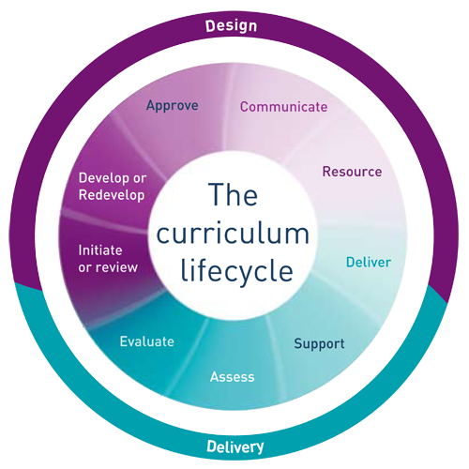
Curriculum life cycle
JISC Curriculum Design and Delivery: http://jisccdd.jiscinvolve.org/wp/2010/02/

Slide 41
VRE as a tool for involving BA/MA students in research
Open Courseware & MOOC support
Copyright learning objects
Reading lists
Digital Information Literacy in curriculum
BA & MA thesis repository

Slide 42
Results
Library becomes known within the university for these new services and its image changes.
Library staff is enthusiastic.
Library is invited to participate with (large) research funding requests.
Extra university funding allocated for some of these services.
Quick reaction time in related areas (e.g. copyright).
Unexpected opportunities present themselves (e.g. research/teaching)
Waiting list of research groups for VRE’s.
Show impact of library on primary processes.

Slide 43
Changing a university is like moving a graveyard - you get no help from the people inside.
Many authors i.a. Geoffrey Boulton

Slide 44
What holds us back?
Transition is difficult to manage and takes years.
Some of our users.

Slide 45
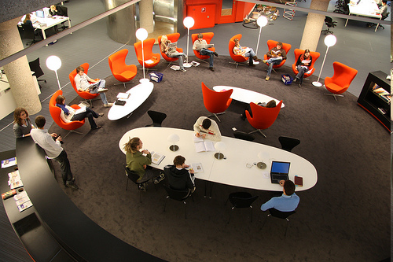
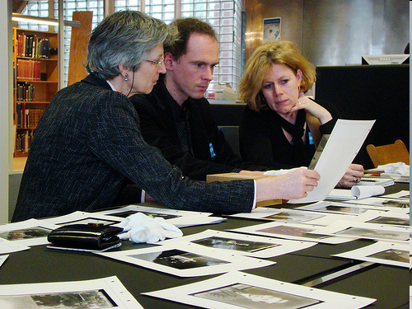
Pushing the paradigm’s envelope
2009 survey among humanities students & faculty with regard to library facilities in Leiden.
High on wish list:
Monitor quiet study area
Creating variety of study areas (quiet, noise, collaborative, lounge)
More material in open stacks
Reduced size open stacks: creating learning environment
Limited need for group spaces
Creating variety group spaces
Don’t close institute libraries
Closed down small libraries and transferring collections to main library/closed stacks

Slide 46
But ... what holds us back?
Transition is difficult to manage and takes years.
Some of our users.
Some of our librarians.
Our framework, our tradition.
Institutional territory.
It’s risky.
But also plenty of uncertainties:
Are we indeed moving towards the end of the hybrid library?
Will Google continue to invest in becoming the “world library.”
Will e-books become the norm?
Will open access become a viable model?
Will faculty support the transformation of the library into the university’s information manager?
Major publishers seem to pursue competitive strategies.
Will libraries play a role in e-research and which ones?
Lack of scale.

Slide 47
Lack of scale
Roll out services university wide
Breadth & depth issues
We cannot specialize in the whole range of needed expertise
Beyond collaboration
New (inter)national infrastructures
Network nodes, member organizations, strategic alliances

Slide 48
Moving forward
Start this discussion with library staff, the university administrators and faculty.
Personnel transition, new specification of skills, training & education.
Collaborate with other libraries and other organisations.
Starting with pilot project in close collaboration with faculty.
Demonstrate the value and the impact of these new services.
Be proud of and show your results.

Slide 49
Lets put the fundamental transformation of the library on the agenda & create the roadmap.
Thank you for your attention!
k.f.k.de.belder@library.leidenuniv.nl
www.linkedin.com/in/kurtdebelder
@KurtDeBelder

