Slide 1
25 February 2019 - Marseille
OCLC Research Library Partnership Meeting –
Leading the 21st Century Research Library

Slide 2
RLP meeting, 25 February 2019 - Marseille
Welcome and Introduction
Rachel Frick
Executive Director, Research Library Partnership
frickr@oclc.org
@rlfrick

Slide 3
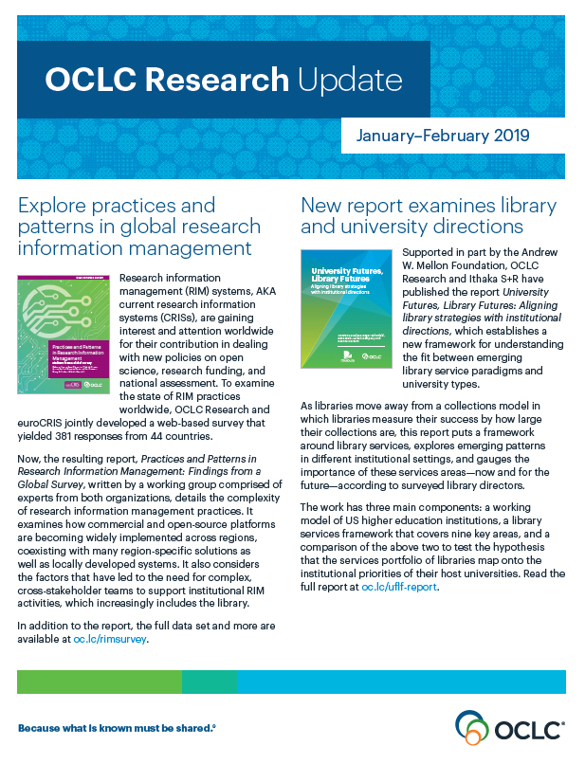
OCLC Research
Scale and accelerate library learning innovation and collaboration.

Slide 4
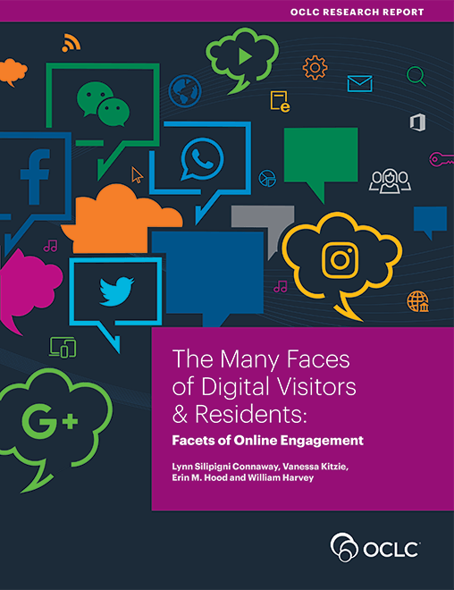
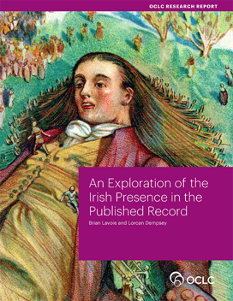

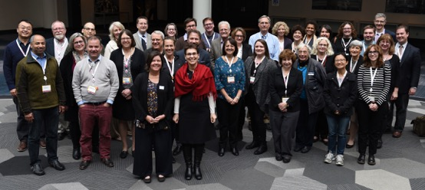
OCLC’s Membership and Research Division
Research devoted exclusively to the challenges facing libraries and archives
Community resource for shared Research and Development
RLP is the platform to collaborate with institutions on research and issues
Lifelong learning from WebJunction
OCLC
Research Library Partnership

Slide 5
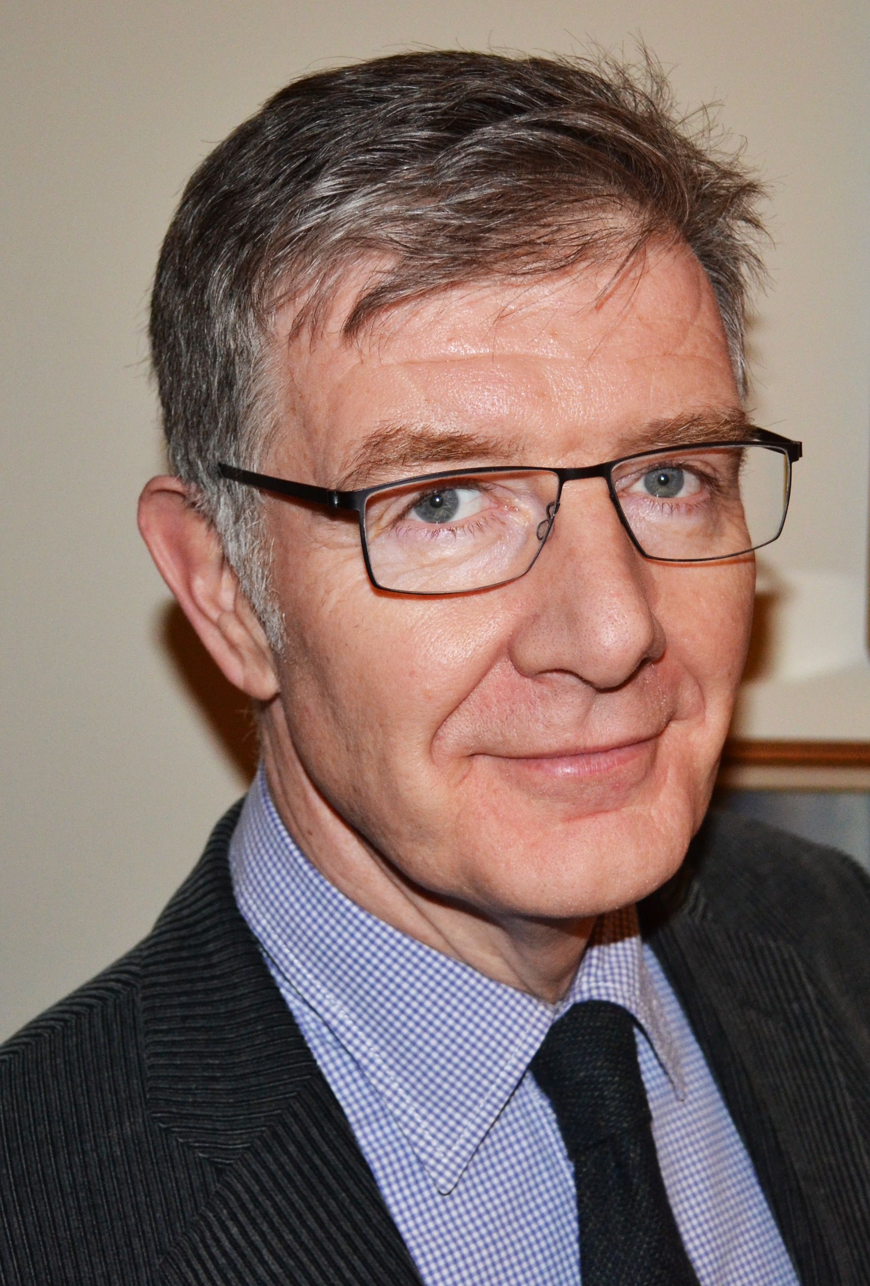
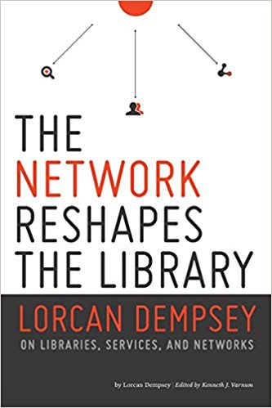
Lorcan Dempsey, VP Research, Chief Strategist

Slide 6
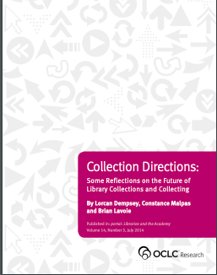
“An inside-out orientation will become more important as universities focus attention on distinctive institutional assets and libraries direct increased curatorial attention toward special collections, new scholarly products, research preprints, and pedagogical resources” – Dempsey

Slide 7
In rapidly changing environments, it’s important to realize that tacit knowledge trumps explicit knowledge. …
Tacit knowledge becomes accessible through shared practice
Because it’s so hard to express, tacit knowledge is not easily accessible. The best way to access it is to work together and to observe the practices that emerge from this tacit knowledge. By working together, we also develop deeper, trust-based relationships that create a safer environment for us to explore new insights with others in our group that we have a hard time expressing to ourselves.
John Hagel

Slide 8


Learning:
Soft power of existing networks
… networking
… discuss direction
… 'pool uncertainty’
… shared practices
… communities of practice
… peer learning
Scaling learning
Scaling innovation

Slide 9
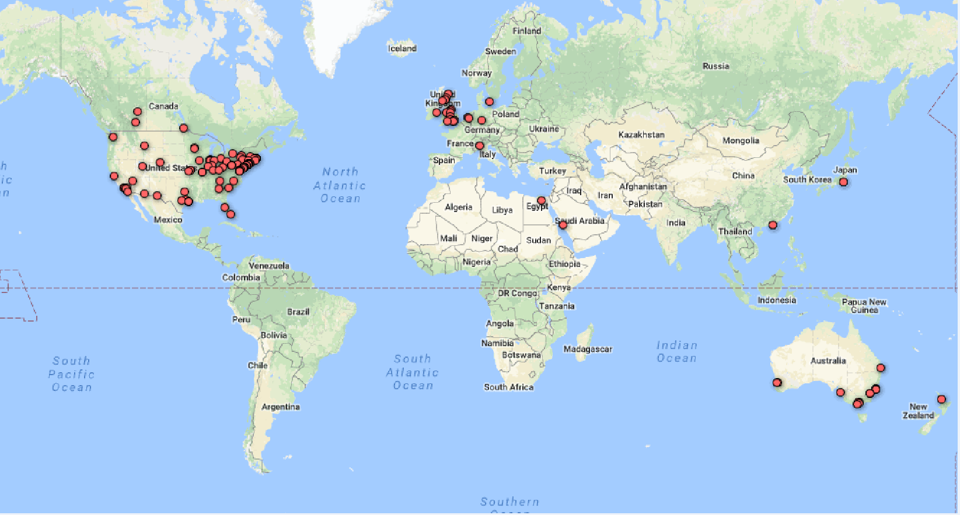
OCLC Research Library Partnership (RLP)
Transnational collaborative network
Research / Academic libraries
Direct interaction with OCLC Research
Shared Understanding for Collaborative Solutions

Slide 10
RLP
Philosophy
People are connections to knowledge
Peer to Peer collaborative learning
Strategic thinking to practical application
Influence service design and future research
Shared understanding for faster innovation

Slide 11
Areas of Focus
Research support and information management
Special collections and archives
Metadata
Resource sharing / Collective collections

Slide 12
OCLC Innovation Surveys
In 2017, OCLC Research was encouraged by OCLC EMEA Regional Council to sharpen intelligence around research library needs and priorities outside the United States
  2017: survey of library directors at 238 institutions in the UK, the Netherlands, Germany, Austria, Switzerland, Denmark, Spain, France, and Italy
  2018: survey of library directors in CARL and CAUL
  2019: Global Analysis

Slide 13
Top Level Initial Observations
Support for researchers: high interest in getting staff / faculty skilled up. Opportunity to highlight good work we’ve already done.
Special collections: still seen as being central even if they may have fallen below the fold in terms of the “top three” priorities
Linked data: not being well understood by library leadership (and it may even be viewed with skepticism).
Open access: good area for further exploration and discussion.

Slide 14
OCLC Research:
European Library Practices
Research Information Management
Linked Data
The Shift to Open

Slide 15
RLP meeting, 25 February 2019 - Marseille
Research Information Management
Rebecca Bryant, PhD
Dr. Annette Dortmund
Sr. Program Officer, OCLC Research
Research Consultant, OCLC
bryantr@oclc.org
annette.dortmund@oclc.org
@rebeccabryant18
@libsun
https://orcid.org/0000-0002-0725-6493
https://orcid.org/0000-0003-1588-9749

Slide 16

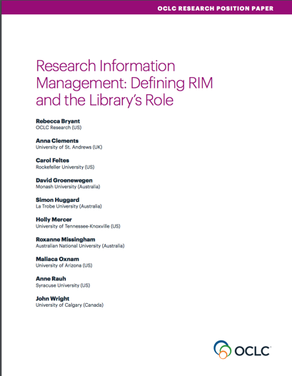
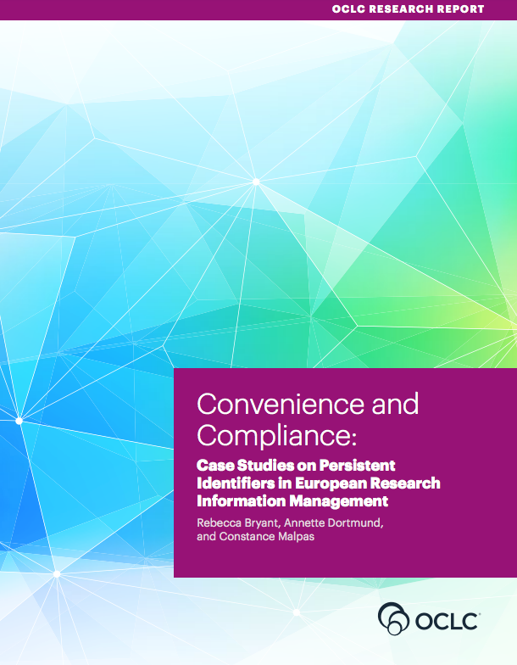
OCLC Research publications on Research Information Management
oc.lc/rim

Slide 17


Research Information Management
Research Information: Metadata about research activities and outputs (e.g. projects, publications, …)
Research Information Management (RIM):
Aggregation, curation, & utilization of research information
(e.g. in CRIS systems)

Slide 18
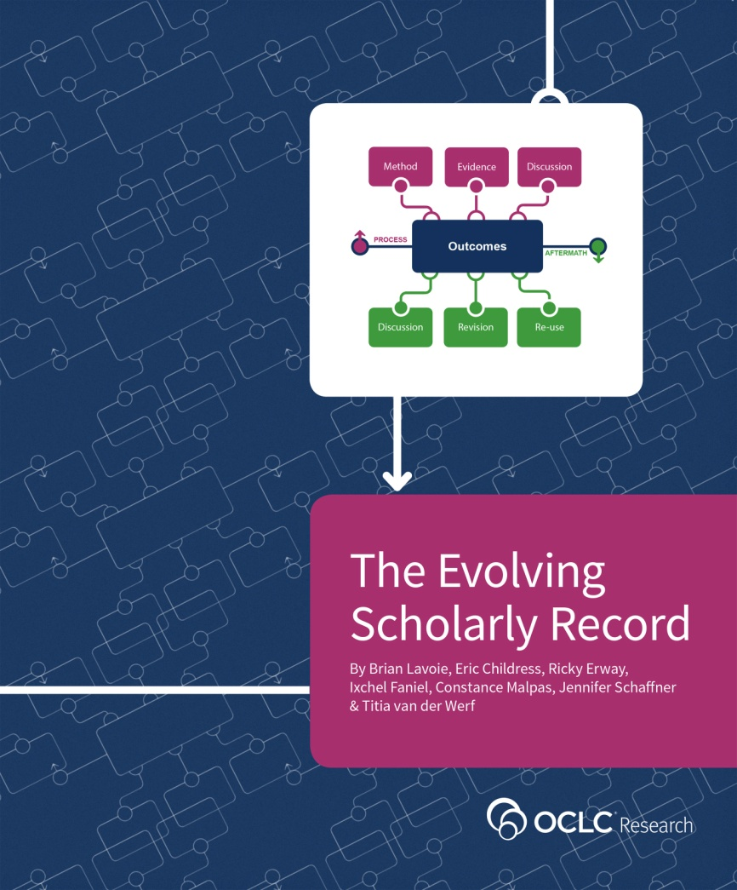
The Evolving Scholarly Record
Provides a framework for understanding changes in the scholarly ecosystem
Foundational to our work on Research Information Management
French translation now available
http://oc.lc/esr

Slide 19

Defining RIM and the Library‘s Role
oc.lc/rim

Slide 20
Libraries and RIM
“Libraries in Research Information Management” by OCLC Research, from Research Information Management: Defining RIM and the Library’s Role (doi.org/10.25333/C3NK88), CC BY 4.0

Slide 21
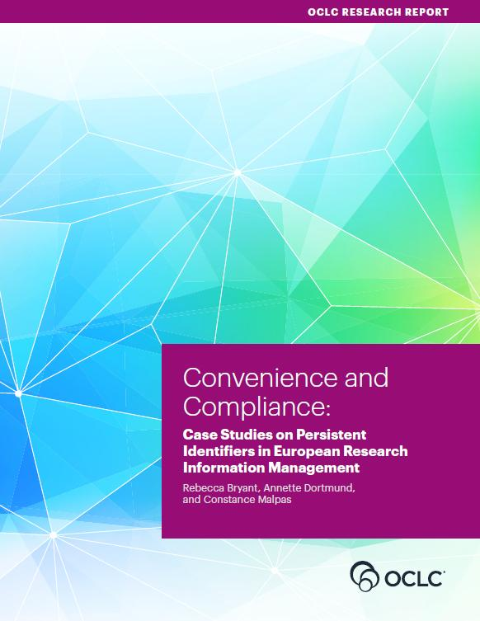
Convenience and Compliance
oc.lc/rim

Slide 22
European RIM workflows
Adoption of persistent identifiers (PIDs)
in European RIM workflows
PIDs: Important infrastructure for
unambiguous referencing and linking
of resources
(e.g. ORCID, ISNI, ARK, DOI, …)
Case studies on Finland,
The Netherlands, Germany based on
interviews with selected institutions
doi:10.25333/C32K7M
also via oc.lc/rim

Slide 23
What characterizes RIM in Europe?
Country specific factors and infrastructures play an important role
  Environments different but still have many similarities
National or European mandates or funding requirements are strong drivers of CRIS adoption where they exist.
  In their absence ROI remains unclear.
  Internal uses of RIM are welcome benefits but rarely drive CRIS adoption.

Slide 24
What characterizes PID adoption?
Stronger adoption for person identifiers
  ORCID becoming a de facto standard in scholarly literature, but other identifiers also needed and used
Organizational identifiers largely unused
PID adoption is strongest where they facilitate interoperability, such as harvesting of publication metadata into CRIS systems

Slide 25
Practices and
Patterns
oc.lc/rim

Slide 26
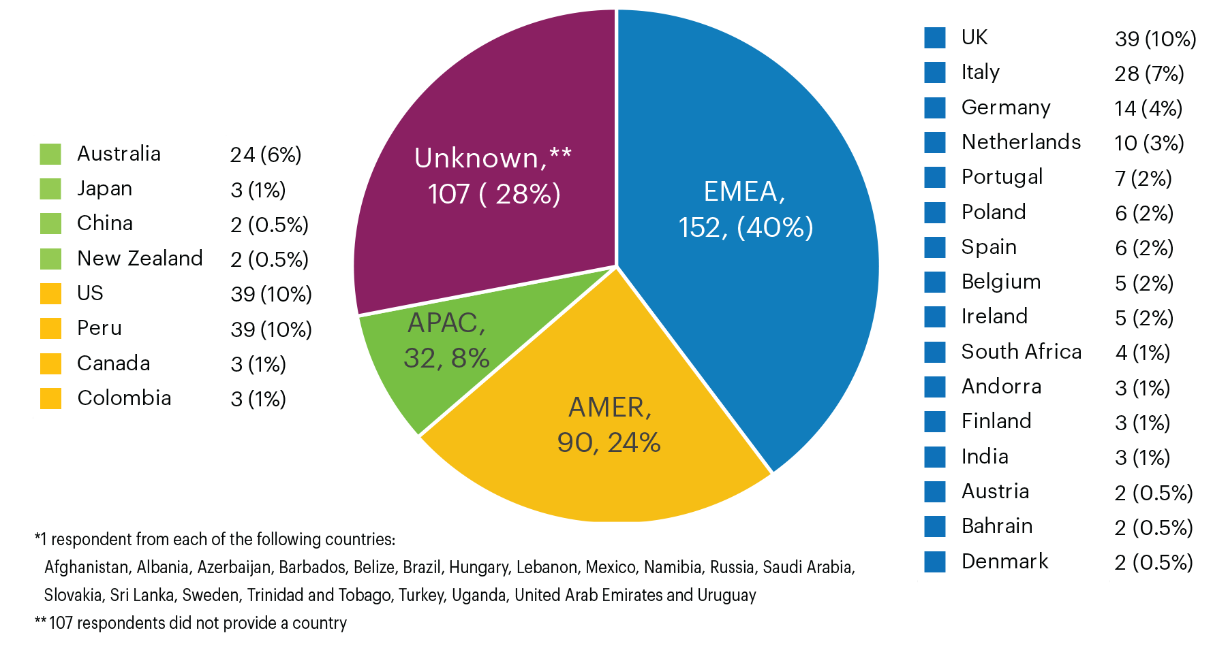

RIM Survey responses: geographic overview
381 survey respondents from 44 countries
“Total number of survey respondents, by broad region” by OCLC and euroCRIS, Practices and Patterns in Research Information Management: Findings from a Global Survey (DOI:10.25333/BGFG-D241), CC BY 4.0

Slide 27
Survey confirmed findings for Europe
Results confirmed “Convenience & Compliance” findings regarding drivers of RIM adoption.
RIM have multiple uses, with some variation by region
  as a registry of the institution’s research outputs
  for external & internal assessment or to manage OA compliance
  less so to enable discovery of potential research collaborators
Merge of RIM / IR functional categories stronger in Europe
US is the outlier, not representing or leading global practices

Slide 28
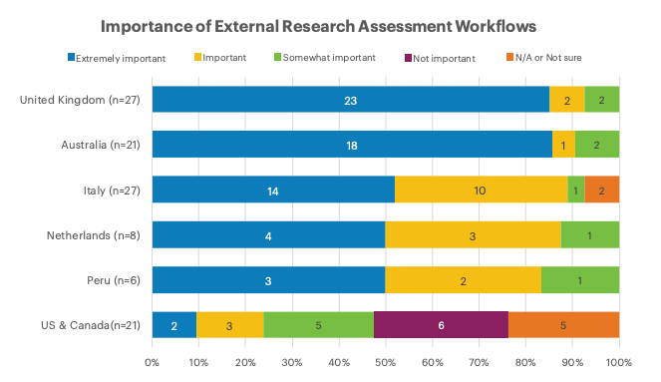
Practices and Patterns in Research Information Management: Findings from a Global Survey (DOI:10.25333/BGFG-D241), CC BY 4.0

Slide 29
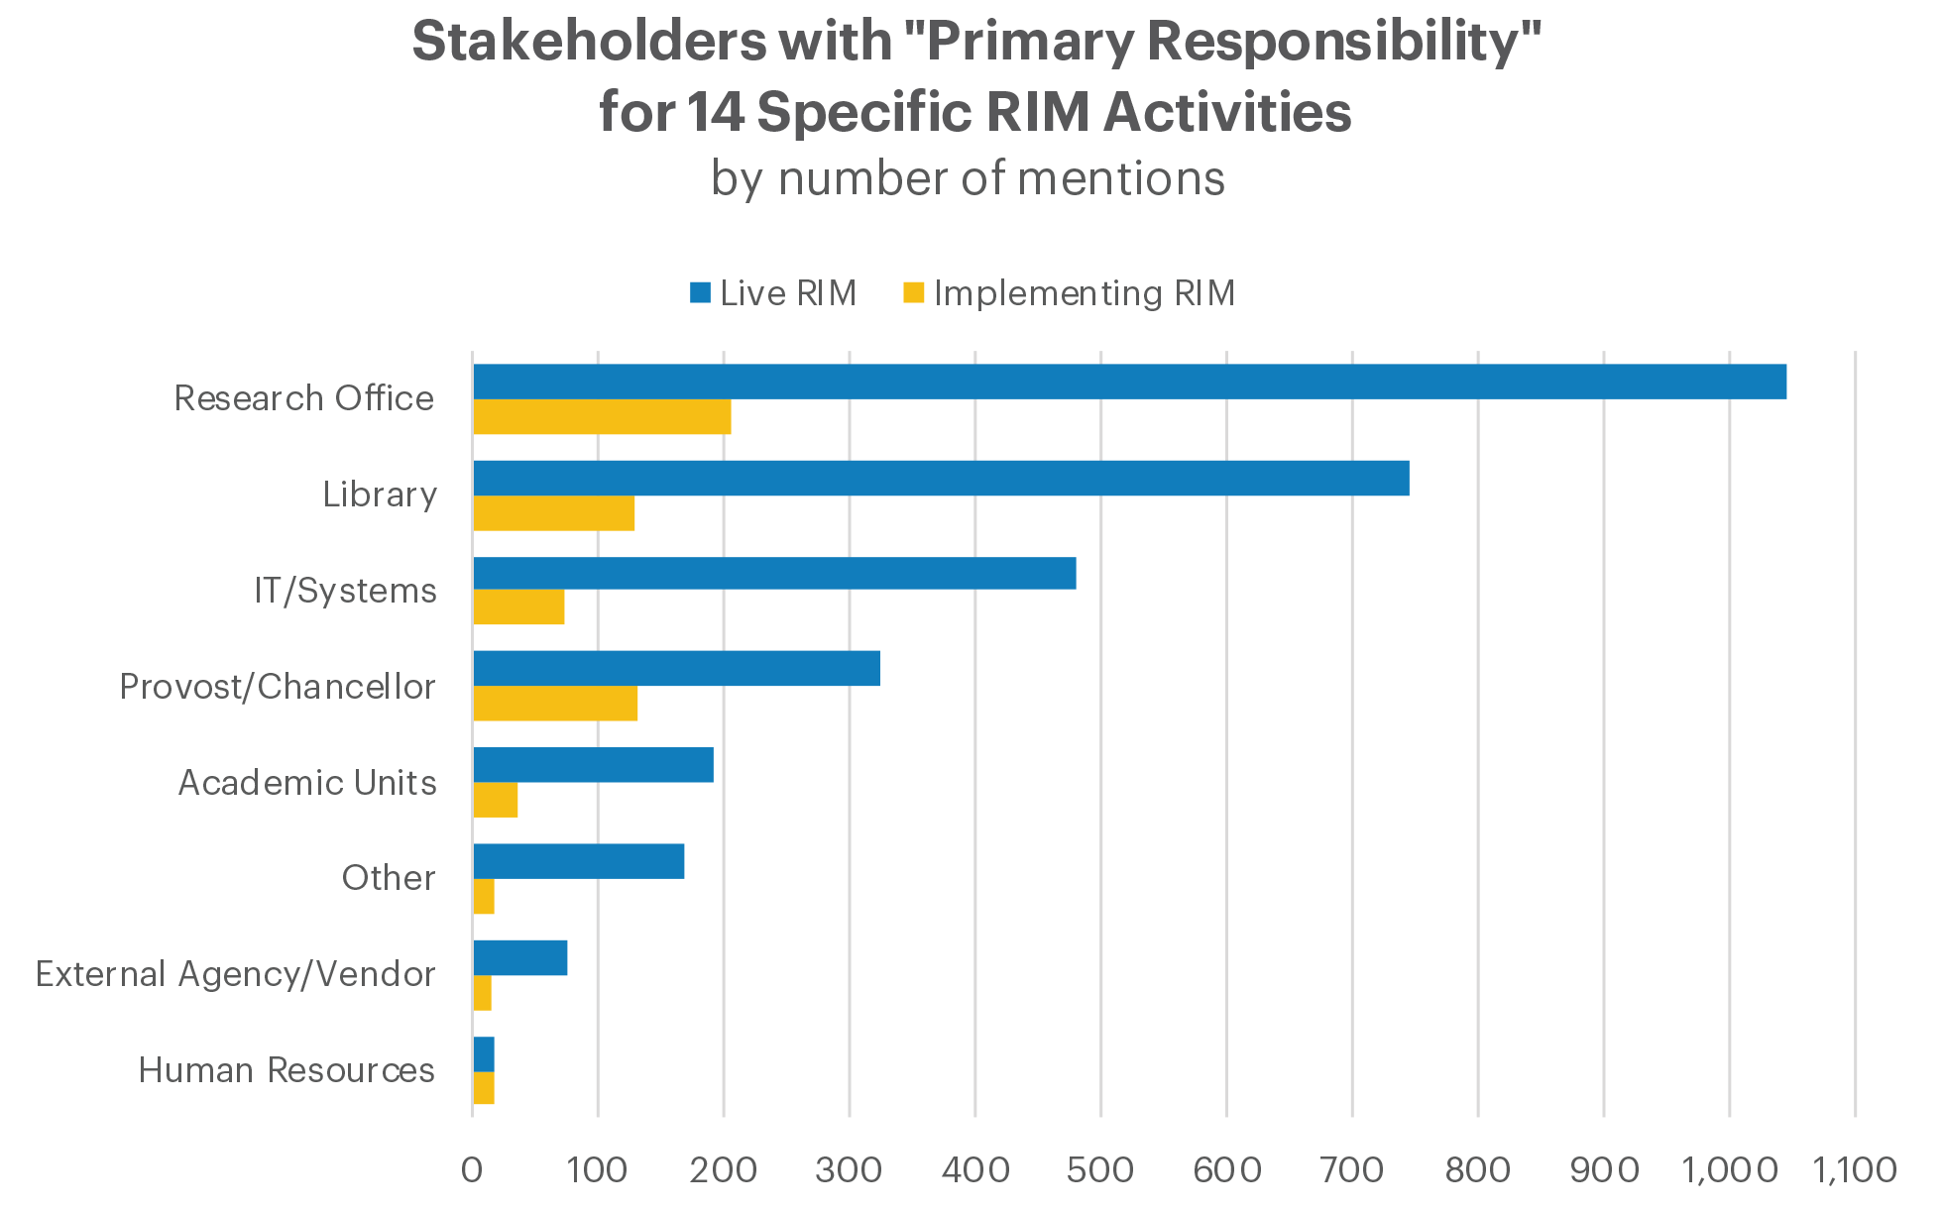
“Primary stakeholders based on total number of mentions across all responses for all areas of activity, in aggregate. Note that multiple primary stakeholders could be selected per area of activity” by OCLC and euroCRIS, Practices and Patterns in Research Information Management: Findings from a Global Survey (DOI:10.25333/BGFG-D241), CC BY 4.0

Slide 30
Stakeholders with Primary Responsibility for RIM Activities by Country
Based on # of Mentions (Decreasing Importance of Library)
Base: Institution with a Live RIM system
Practices and Patterns in Research Information Management: Findings from a Global Survey (DOI:10.25333/BGFG-D241), CC BY 4.0

Slide 31
Wrapping up

Slide 32
Get in touch
Find our full reports at oc.lc/rim
Let us know:
How does this compare to the situation in your country?
What else would you like to learn on this topic?
Would you like to work with us on RIM topics?
Get in touch today or via bryantr@oclc.org

Slide 33
References
Bryant, Rebecca, Anna Clements, Carol Feltes, David Groenewegen, Simon Huggard, Holly Mercer, Roxanne Missingham, Maliaca Oxnam, Anne Rauh and John Wright. 2017. Research Information Management: Defining RIM and the Library’s Role. Dublin, OH: OCLC Research. doi:10.25333/C3NK88
Bryant, Rebecca, Annette Dortmund, and Constance Malpas. 2017.
Convenience and Compliance: Case Studies on Persistent Identifiers in European Research Information. Dublin, Ohio: OCLC Research. doi:10.25333/C32K7M
Bryant, Rebecca, Anna Clements, Pablo de Castro, Joanne Cantrell, Annette Dortmund, Jan Fransen, Peggy Gallagher, and Michele Mennielli. 2018. Practices and Patterns in Research Information Management: Findings from a Global Survey. Dublin, OH: OCLC Research. https://doi.org/10.25333/BGFG-D241
Ribeiro, Lígia, Pablo De Castro, and Michele Mennielli. “EUNIS-EuroCRIS Joint Survey on CRIS and IR,” 2016. http://www.eurocris.org/news/cris-ir-survey-report.

Slide 34
RLP meeting, 25 February 2019 - Marseille
Thank you!
Rebecca Bryant, PhD
Dr. Annette Dortmund
Sr. Program Officer, OCLC Research
Research Consultant, OCLC
bryantr@oclc.org
annette.dortmund@oclc.org
@rebeccabryant18
@libsun
https://orcid.org/0000-0002-0725-6493
https://orcid.org/0000-0003-1588-9749

Slide 35
RLP meeting, 25 February 2019 - Marseille
Linked Data in EMEA
Karen Smith-Yoshimura
Senior Program Officer, OCLC Research
smithyok@oclc.org
@ KarenS_Y
https://orcid.org/0000-0002-8757-2962
Linking Open Data cloud diagram 2017, by Andrejs Abele, John P. McCrae, Paul Buitelaar, Anja Jentzsch and Richard Cyganiak. http://lod-cloud.net/ by CC-BY-SA license.

Slide 36

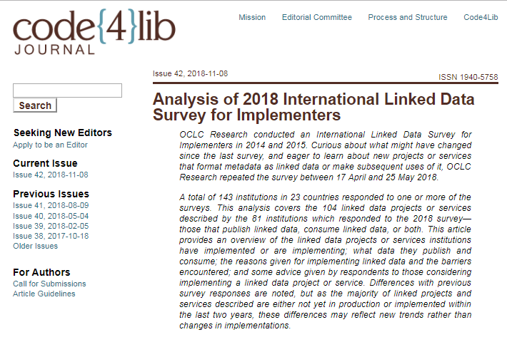
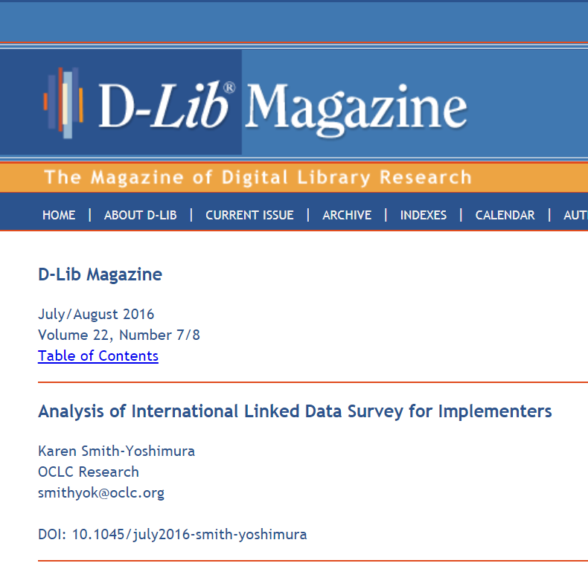
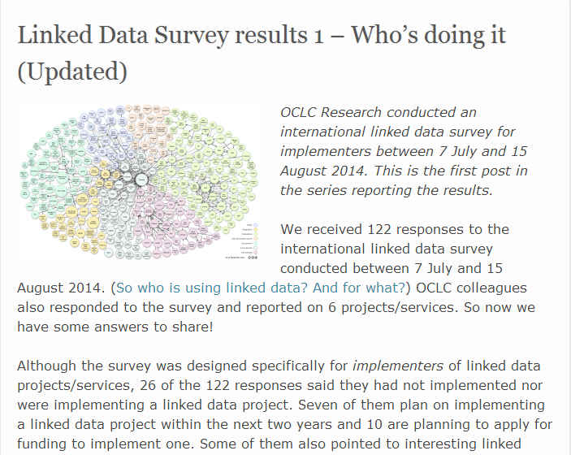
International Linked Data Surveys for Implementers
2014
2015
2018

Slide 37
Geographic breakdown
of 143 responding institutions
23 countries represented

Slide 38
Survey Respondents
N =143

Slide 39
How long linked data project or service in production

Slide 40
Success assessment
All
EMEA
Indicators of success:
Usage
Data re-use
Interoperability
User satisfaction
Influence
Professional development

Slide 41






  Some EMEA linked data datasets most accessed

Slide 42
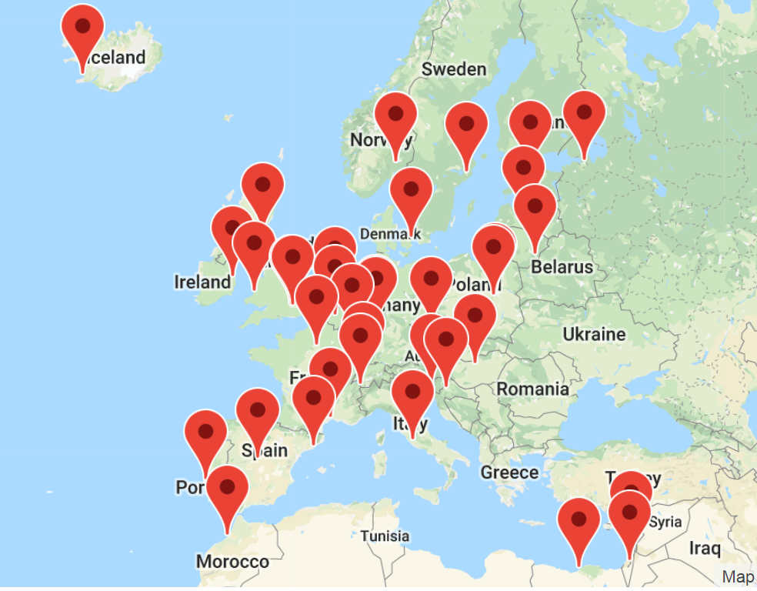
33 of 50 VIAF contributors are in EMEA

Slide 43
#1 Reason for Publishing Linked Data:
Expose to larger audience on the Web
#1 Reason for Consuming Linked Data:
Provide our users with a richer experience

Slide 44
Linked Data sources consumed

Slide 45





Some EMEA institutions that started consuming Wikidata

Slide 46
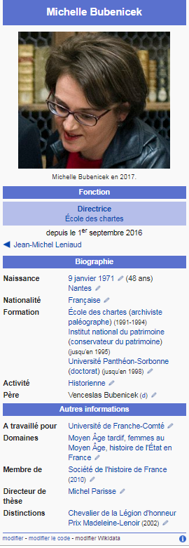
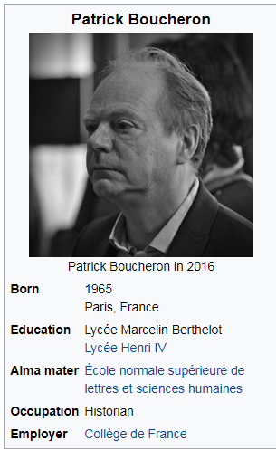
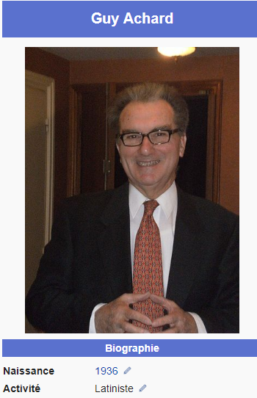
Some scholars are already represented in Wikidata
Guy Achard, né en 1936, est un latiniste et un historien de l'Antiquité romaine. Professeur émérite à l'université Lyon III, il est spécialiste de rhétorique latine et de sociologie romaine.

Slide 47
Aaron Tay, Musings about librarianship
“But given that libraries are now moving towards inside-out activities there is a natural focus on enhancing discovery which linked data is meant to help facilitate. This is particularly true as academic libraries are now trying to collect and curate more than the traditional outputs of book + proving access to articles and the way to do it is unclear. Could linked data be the solution for enhancing discovery?”
https://musingsaboutlibrarianship.blogspot.com/2018/12/6-inside-out-activities-librarians-are.html

Slide 48
RLP meeting, 25 February 2019 - Marseille
Thank you!
Karen Smith-Yoshimura
Senior Program Officer, OCLC Research
smithyok@oclc.org
@ KarenS_Y
https://orcid.org/0000-0002-8757-2962

Slide 49
RLP meeting, 25 February 2019 - Marseille
Preparing for the shift to OPEN
Titia van der Werf
Program Officer, OCLC Research
titia.vanderwerf@oclc.org

Slide 50
Preparing
for the shift to Open

Slide 51

  The scientific publishing ecosystem is shifting from paywalled to open access. In Europe it is reaching its tipping point.

Slide 52

OA in Europe: EU-level
2014: EC Research funding programme (Horizon 2020) mandates open access to all scientific publications
2016: EU member states issue joint statement about target to make all new papers OA by 2020
2018: 11 national research funders mandate OA for grantees by 2020 (Plan-S)
Netherlands, France, UK, Sweden, Norway, Austria, Ireland, Italy, Poland, Slovenia and Luxmbourg

Slide 53



OA in Europe: country level
2014: REF-OA-policy announced (4 HE funding bodies)
  self-archiving; max. embargo periods; licences
2021: REF 2021 open access policy
NL
2018: 50% of articles are open as a result of arduous negotiations with publishers
2020: 100% open in fully OA-journals
DE
2018: 350 German universities and research organizations have OA-policy; but no coordinated approach from the funders
2018: OA2020-DE and Knowledge Unlatched planning large-scale conversion of journals to Open Access

Slide 54
OA in France
2016: La loi pour une République numérique
  OA for scientific publications funded at least half by public funds
2018: Plan national pour la science ouverte
  Aiming for 100% OA:
  Mandate the OA publication of articles and books from research financed by public tender.
  Create a fund for open science.
  Support the national repository HAL and simplify the deposit by researchers who publish in open access

Slide 55
OA increasing part of library workflows
More OA-publications
More OA-aggregators and search services, directories of OA-repositories, etc. in the discovery layer
More responsibilities for IRs to manage OA-deposits
More reporting on OA-compliance to funders (CRIS/RIM)
More OA-metrics
…

Slide 56
Starting the conversation

Slide 57

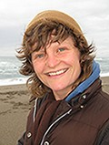
Featuring Char Booth on Open Access and Information Privilege

Slide 58
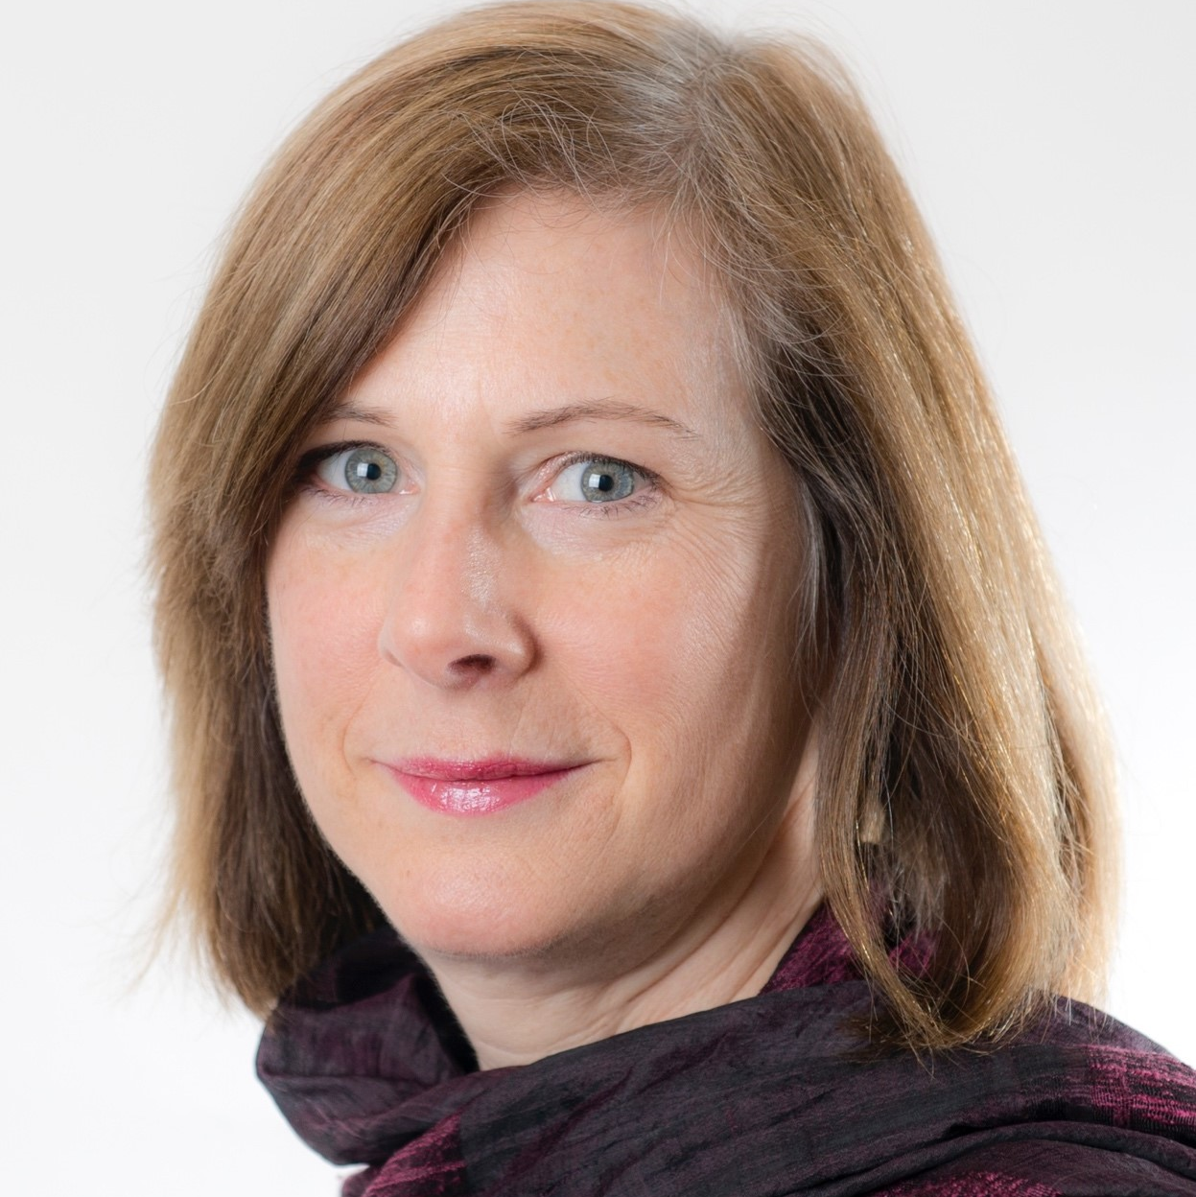
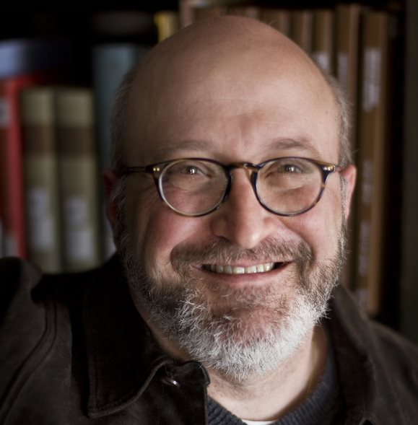

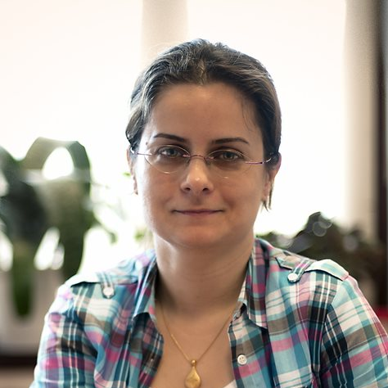
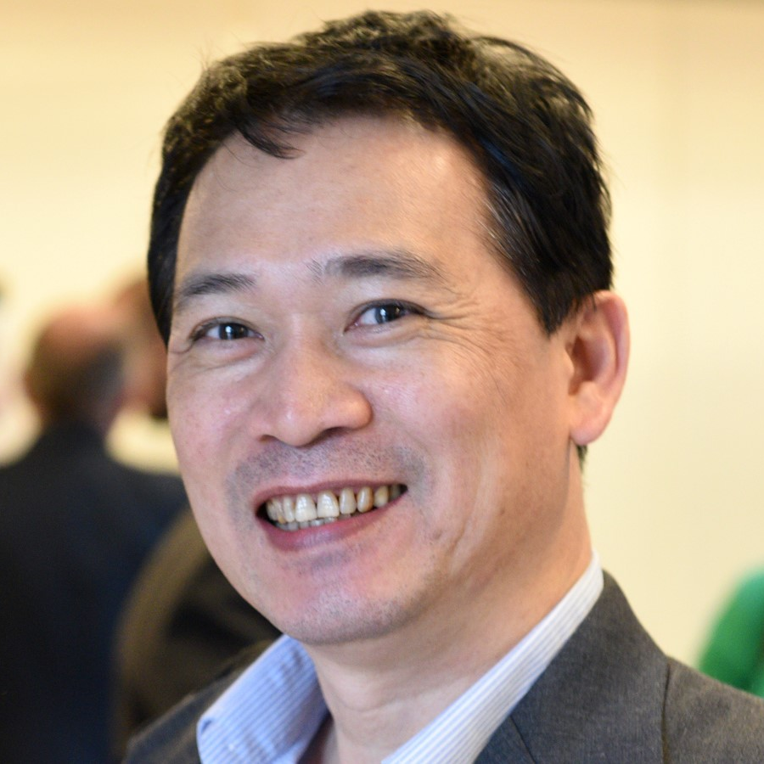
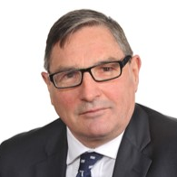
OCLC Global Council: OA and Open Content
Debbie Schachter, Chair (ARC)
Scott Walter (ARC)
Rupert Schaab (EMEA)
Tuba Akbaytürk (EMEA)
Howard Amos (APRC)
Kuang-hua Chen (APRC)

Slide 59
Defining Open Content
Open and freely available
Accessible immediately and online
Digital and usable in a digital environment
Acknowledging the "continuum of openness"

Slide 60
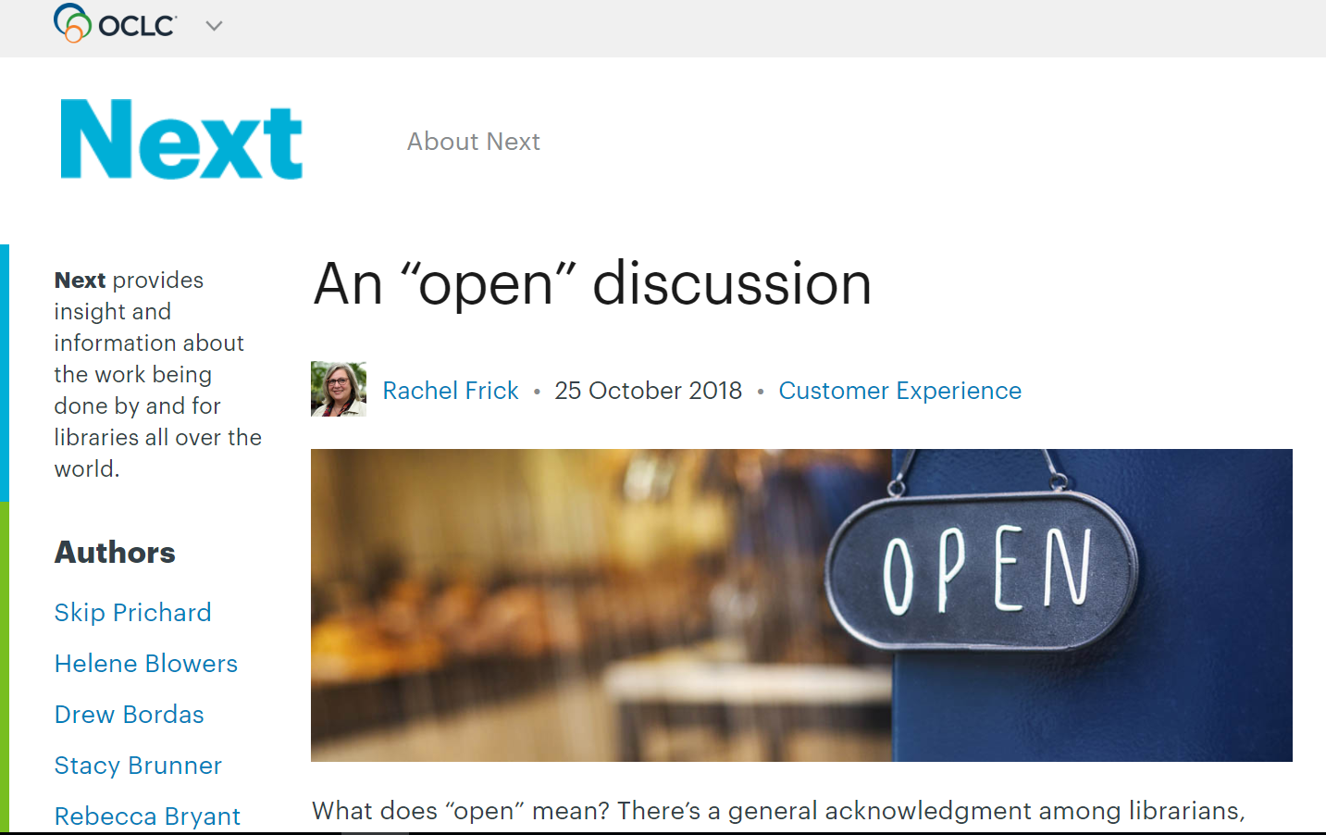
FRAMING THE OPEN CONTENT DISCUSSION

Slide 61
Sneak preview of survey findings
705 responses from 82 different countries
72% are Research and University libraries
91% are currently involved in Open Content activities
Current top 3 Open Content activities:
  Supporting users/instructors/digital literacy programmes
  Promoting the discovery of Open Content
  Operating an institutional repository

Slide 62
Planning for Open Content

Slide 63
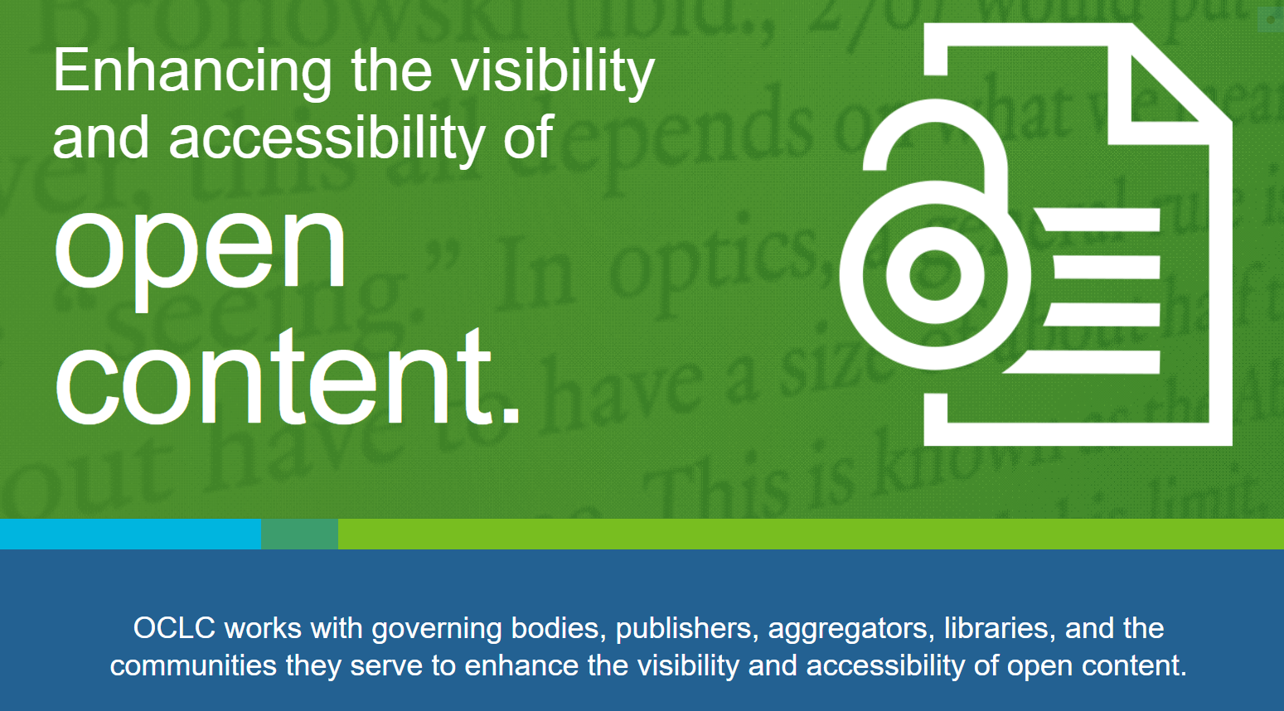

Slide 64










Slide 65

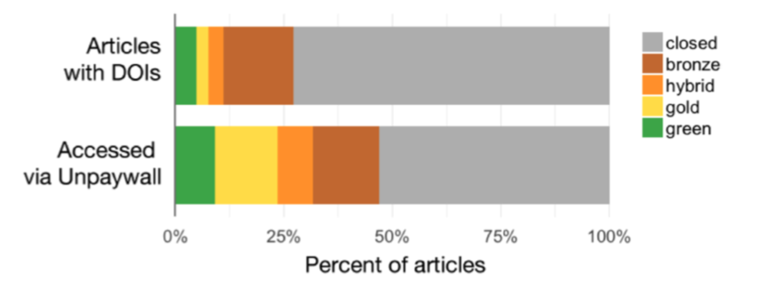
Leverage links from Unpaywall
Largest OA index
47% of articles viewed by Unpaywall users are OA
~.5 billion requests in 2017

Slide 66

Identify OA-links: MARC proposal accepted
Changes to MARC fields for designating Open Access and License information
Scales to millions of links at OCLC

Slide 67
Stewardship of open content

Slide 68
Areas of research?
Libraries' responsibilities/roles/capacities for stewardship of OA and Open Content
Metadata practices for OA and open content
Impact of OS on research libraries
Information privilege and access to open content
…

Slide 69
RLP meeting, 25 February 2019 - Marseille
Thank you!
Titia van der Werf
Program Officer, OCLC Research
titia.vanderwerf@oclc.org

Slide 70
Break

Slide 71
World Café

Slide 72
Café etiquette
Focus on what matters
Listen to understand others
Contribute
Speak your mind and heart
Link and connect ideas
Listen together for themes, insights, and deeper questions
Have fun!

Slide 73
Question #1:
What are some specific examples of successful collaboration?
Share about specific activities in your institution/region
What do you consider most important or successful?
And why?

Slide 74
Question #2: How does international collaboration make sense for your institution? Your researchers?
What are the limits?
What are the opportunities?
What are the challenges to overcome?
What additional resources / information might you need
to support you?

Slide 75
Conclusions
Learn more about the OCLC Research Library Partnership at oc.lc/rlp
A summary of this event will appear on HangingTogether.org
Please complete an event evaluation and give to Annette

Slide 76
Close of day
Learn more about the OCLC Research Library Partnership at oc.lc/rlp
A summary of this event will appear on HangingTogether.org

