Slide 1
Works in Progress Webinar
Collections as Data
12 February 2019

Slide 2
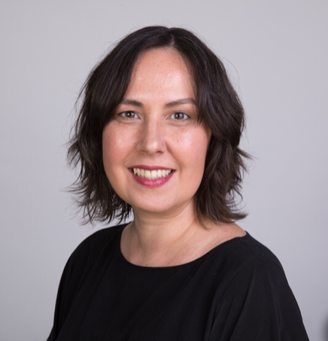
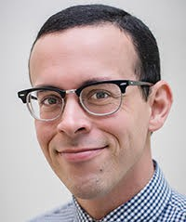
Rosemary Davis, Yale
Chela Scott Weber, OCLC
Thomas Padilla, UNLV

Slide 3
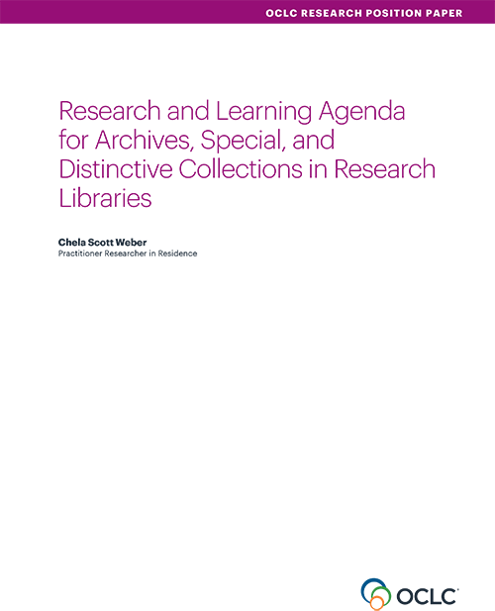
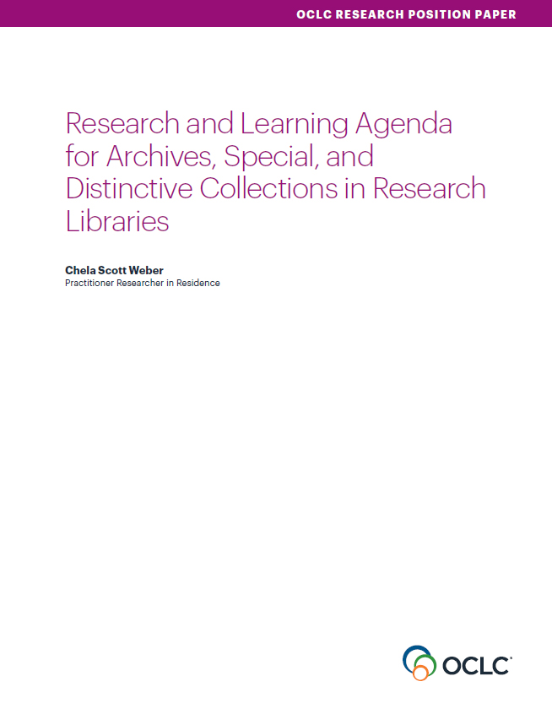
Our Work in Archives, Special, and
Distinctive Collections:
oc.lc/rlp-agenda
Notes:
OCLC Research has a long history of work in the area of archives, special, and distinctive collections in research libraries. We work in special collections because they are an important sight of knowledge creation, made possible by library’s commitment to the stewardship of their distinctive collections. The unique nature of material in special collections can make scaling a challenge, and we work to identify areas of common need and patterns of innovation to help libraries scale learning and expertise with these collections.
In October, we released the Research & Learning Agenda for Archives, Special, and Distinctive Collections.
The agenda was created via a participatory and iterative process, involving feedback and participation from colleagues across the RLP.
It discerns and articulates the shared challenges and opportunities research libraries are are facing in this sphere, and suggests approaches for working on them together.
The agenda will guide OCLC Research work in this area in the future, and we hope it will also serve to frame larger conversations and spur action across the field
This year, OCLC RLP will be presenting a number of webinars that respond to issue surfaced during our work on the agenda.

Slide 4
Collections as Data as Access
“Current interest in collections as data and a desire for computational access to collections are pushing the boundaries of what archives think of as access— and of what an object of research might be.”
Notes:
Collections as data was one of the issues surfaced in the agenda as an area of interest and in need of more understanding. There, we said that “Current interest in collections as data and a desire for computational access to collections are pushing the boundaries of what archives think of as access— and of what an object of research might be.”
While this is an area of interest across the library, I do think that archival and special collections offer opportunities for research access and methodologies we can’t offer with licensed, vendor- supplied materials, though we are still far from being able to fully release the potential of special collections as data.”

Slide 5
Collections as Data as Collaboration
“The growing interest in collections as data means we must collaborate with colleagues in scholarly communications, data services, and elsewhere across the library to grapple with what computational access to our collections might look like.”
Notes:
While I come at this from a special collections perspective, I fully acknowledge that this is not exclusively a special collections issue – there is broad interest and indeed, supporting computational access and data-fying our existing collections will require the skills, input, and collaboration across library departments and disciplines. That is why I was quite heartened to see the registration list for this webinar today, we’ve got a broad range of roles and institutions joining in today, and this full complement of collaborators will be necessary to push this work forward.

Slide 6
Notes:
And we need those collaborators because we all know that new services require all kinds of collaboration, conversation, investigation, planning, and funding.
And that’s why I was so pleased that Thomas Padilla agreed to join us here today. Some of you might know that Thomas currently working here with us at OCLC Research as a Researcher Practitioner in Residence over the next six months, but he also continues to work as the Visiting Digital Research Services Librarian, University of Nevada Las Vegas where he is the Principle Investigator for an Andrew W. Mellon Foundation funded project called Collections as Data: Parts To Whole, which is the second in a series of grant funded projects exploring computational access to library and archive collections. I’m excited for Thomas to share his work and learning from these projects with the RLP today.
With that, I’ll turn it over to Thomas.

