Slide 1



Practices and Patterns in Research Information Management: Findings from a Global Survey
30 January 2019
Rebecca Bryant, PhD, Senior Program Officer, OCLC Research
bryantr@oclc.org @RebeccaBryant18
https://orcid.org/0000-0002-2753-3881
Anna Clements, Assistant Library Director, University of St Andrews
akc@st-andrews.ac.uk @AnnaKClements
https://orcid.org/0000-0003-2895-1310
Jan Fransen, Service Lead for RIM Systems, University of Minnesota
fransen@umn.edu
https://orcid.org/0000-0002-0302-2761

Slide 2
Today’s webinar
Introducing OCLC Research, euroCRIS and their collaboration
Discuss joint Survey of Research Information Management Practice: goals, scope, aims
Share and discuss survey results and findings

Slide 3

Devoted to challenges facing libraries and archives since 1978
Community resource for shared Research and Development (R&D)
Engagement with OCLC members and the community around shared concerns
Learn more
  oc.lc/research
  Hangingtogether.org blog
Notes:
OCLC Research is a division of OCLC, established in 1978 to scale research and learning on behalf of libraries. I’m part of the OCLC Research division, where we conduct research on behalf of libraries, to report on rapid changes in the library ecosystem, and to inform decision making.
You can learn more at oc.lc./research and follow us on Hangingtogether.org.

Slide 4

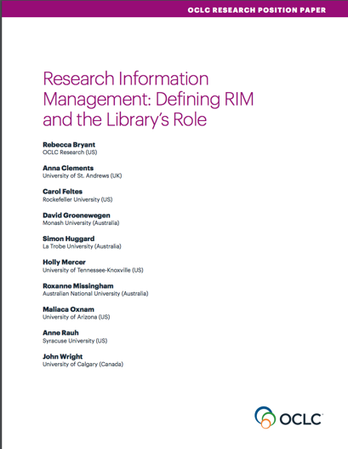
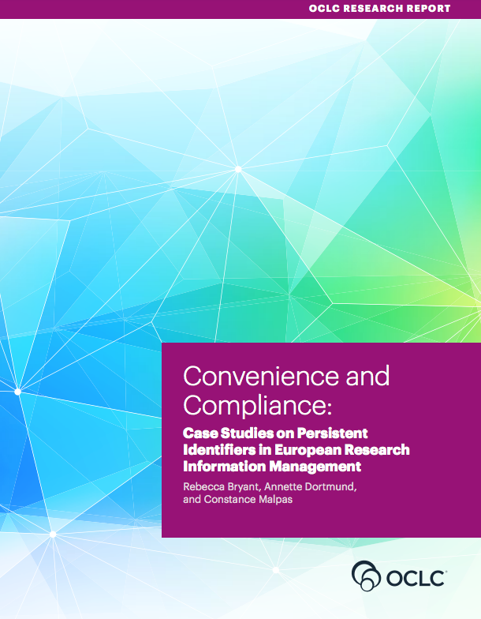
OCLC Research publications on Research Information Management
oc.lc/rim
Notes:
An area of recent research for OCLC is research information management, as we recognize this as an important emerging service categories for libraries. We’ve been developing an arc of research to describe, explain, and document international practices in research information management.
In October we released a position paper on research information management, which I’ll talk a bit more about in a minute.
In December we also published a research report, conducted in collaboration with LIBER, documenting case studies in persistent identifiers in research information management.
We have also been collaborating with euroCRIS on an international survey on Research Information Management Practices.

Slide 5

What is Research Information Management (RIM)?
The aggregation, curation, & utilization of metadata about research activities
Overlapping terms:
  CRIS (Current Research Information System)
  RIS (Research Information System)
  RNS (Research Networking System)
  RPS (Research Profiling System)
  FAR (Faculty Activity Reporting)
oc.lc/rim
Notes:
So one of the outputs we’ve had this year has been a position paper entitled, “Research Information Management, Defining Rim and the Library’s Role.” In our position paper, I worked closely with a working group of librarians from OCLC Research Library Partnership member institutions, and we had representation from librarians on three continents, we had a good representation of practice. It also included Anna Clements from St Andrews, who is also an active euroCRIS board member.
In this report, we offered a holistic definition of research information management (RIM) as the aggregation, curation, and utilization of metadata about research activities. One of my goals with this position paper was to provide a model for understanding different practices, as RIM practices vary widely by locale. Our model includes overlapping terms like CRIS and RIS, which are commonly used in Europe, as well as other practices like Research Profiling or Research Networking, which we see more commonly used in the Americas. It also synthesize the value proposition of libraries in RIM service provision.
You can access this report, as well as our other RIM publications, at oc.lc/rim

Slide 6
. . . In other words, RIM systems are used to collect the scholarly output of an institution.
And allow it to be combined with other information collected on campus.
oc.lc/rim
“RIM Metadata” by OCLC Research, from Research Information Management: Defining RIM and the Library’s Role (doi.org/10.25333/C3NK88), CC BY 4.0
Notes:
Regardless of the use, we define RIM as the collection of metadata, which almost always includes publications, but increasingly includes research data sets, preprints, and other outputs. It is also increasingly attempting to connect these outputs to grants, funders, equipment. We also see the collection of instructional history, PhD advisees, and service activities in RIM. We want to frame RIM as the collection of metadata because it can help to separate RIM practices from specific systems—and it can help practitioners with different uses to see the similarities of their activities.

Slide 7
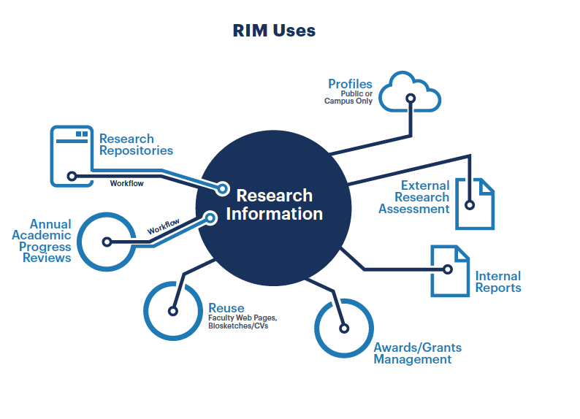
. . . In other words, RIM systems are used to collect the scholarly output of an institution.
And allow it to be combined with other information collected on campus.
oc.lc/rim
“RIM Uses” by OCLC Research, from Research Information Management: Defining RIM and the Library’s Role (doi.org/10.25333/C3NK88), CC BY 4.0
Notes:
We developed a second model that describes RIM uses. In general, if an institution is aggregating research metadata at least one of these uses, we would include it within our RIM model. In this way we unite CRIS type activities, so commonly seen in Europe, with other uses like supporting academic progress review workflows or displaying public profiles for institutional reputation management/public profiles, which are more prominent in the United States.
I expect this model to evolve over time, and it should work to represent new, extensible practices in research information management.

Slide 8

















An international not-for-profit association founded in 2002 to bring together experts on research information in general and research information systems (CRIS) in particular
45 Countries
>200 Members
15 Strategic Partners
Notes:
euroCRIS is an not for profit global association for research information experts, technology and best practice. Founded in 2002 – euroCRIS now has over 200 institutional and individual members in 45 countries – including Europe of course, but also North and South America, Australia / NZ, Middle East, China, Japan and India
EuroCRIS is a very collaborative organization, working with organisations and initiatives to improve the efficiency and effectiveness of research information management throughout the research lifecycle. This is done through strategic partnerships - currently 17 …of which the partnership with OCLC, agreed on 2017 is the latest – and this survey an excellent example of the practical outcomes for the wider community from our working collaboratively. This survey also builds on the CRIS/IR survey run jointly by Eunis and euroCRIS in 2015.
euroCRIS and OCLC entered into a strategic partnership in 2017. One of our goals is to conduct research together on research information management practices, including on this survey on research information management practices.

Slide 9
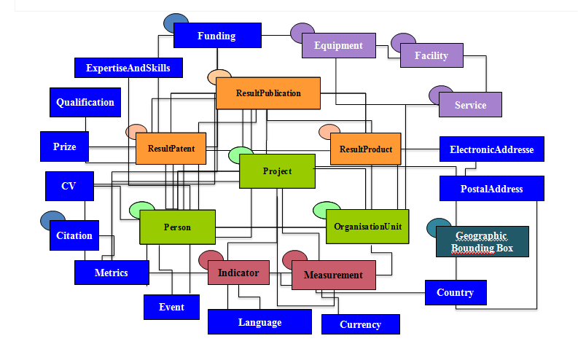
CERIF : an open standard data model and exchange form for research information
Notes:
One of euroCRIS’s main tasks is maintaining and developing the open standard data model – CERIF (Common European research information format) – and working with all stakeholders on adoption

Slide 10
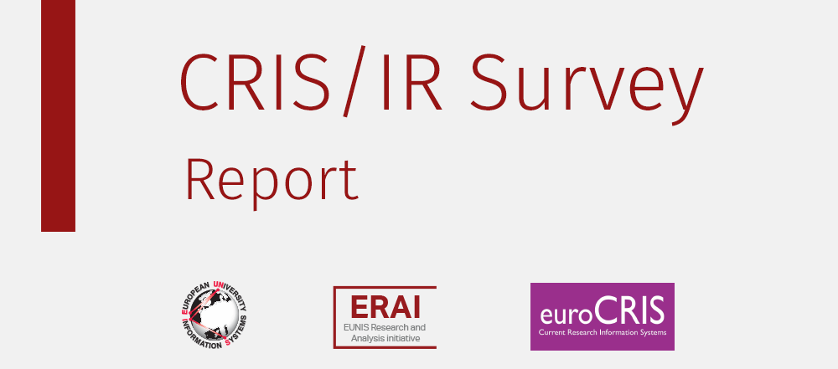
RIM Survey: building on previous work
Lígia Maria Ribeiro, lmr@fe.up.pt
Universidade do Porto – FEUP & EUNIS
Pablo de Castro, pablo.decastro@kb.nl
Stichting LIBER& euroCRIS
Michele Mennielli, m.mennielli@cineca.it
CINECA & EUNIS & euroCRIS
http://www.eunis.org/blog/2016/03/01/crisir-survey-report/
http://www.eunis.org/wp-content/uploads/2016/03/cris-report-ED.pdf
Notes:
This joint OCLC-euroCRIS survey builds upon previous research by euroCRIS.

Slide 11
Practices and Patterns in Research Information Management: Findings from a Global Survey
Rebecca Bryant, PI, OCLC Research
Pablo de Castro, Strathclyde University and euroCRIS
Anna Clements, University of St. Andrews and euroCRIS
Annette Dortmund, OCLC EMEA
Jan Fransen, University of Minnesota, Twin Cities
Michele Mennielli, DuraSpace and euroCRIS
Plus a number of valuable collaborators at OCLC
oc.lc/rim
Notes:
This year euroCRIS and OCLC Research, along with RLP library partners, have been working to survey international practices, which builds upon previous euroCRIS/EUNIS research. Together we developed a survey which ran from October 2017 to January 2018, and we heard back from 381 respondents in 44 countries. We are synthesizing the findings and will publish our findings as an OCLC Research Report later this year. Today you will be getting a sneak peak at our findings. There’s a great deal of data for us to dig through, and we’re early in this process, but we want to share with EARMA some of the findings we think will be of interest to you.
Our goals with this survey are broad, foundational. [discuss general goals, limitations, etc.]
- While comprehensive, the survey cannot (and does not intend to) reveal all the nuances of specific geographic environments. Results strongly suggest that follow-up national- or regional-level surveys or
To collect data about RIM practices worldwide, in order to identify national and regional practices
To gather evidence on the increasing role played by research libraries in RIM practices
To inform the research community about the goals, purposes, and scope of RIM practices
To examine and report on the institutional stakeholders, workflows, interoperability, and standards in use.
To serve as a foundation for future research.
scoping exercises could be the logic consequence of this v general insight into global trends

Slide 12
Results we’ll be talking about
Incentives for RIM Adoption
Functions/Uses of RIM
Interoperability
RIM Stakeholders
Use of Persistent Identifiers

Slide 13
Methodology & promotion
Online survey data collection: Oct 2017 – Jan 2018
  English and Spanish versions
Survey promotion through:
  OCLC and euroCRIS communications channels and events worldwide
  Communications by CRIS vendors and user communities
  Listservs, social media, and announcements to research & library organizations
Notes:
- Survey (methodological) shortcomings to be mentioned: there is a certain skew in the results due to quite tailored promotion effort (both for specific commercial stakeholders and national threads -- Norway missing is really significant in this sense considering it topped the previous EUNIS/euroCRIS survey in Europe)

Slide 14
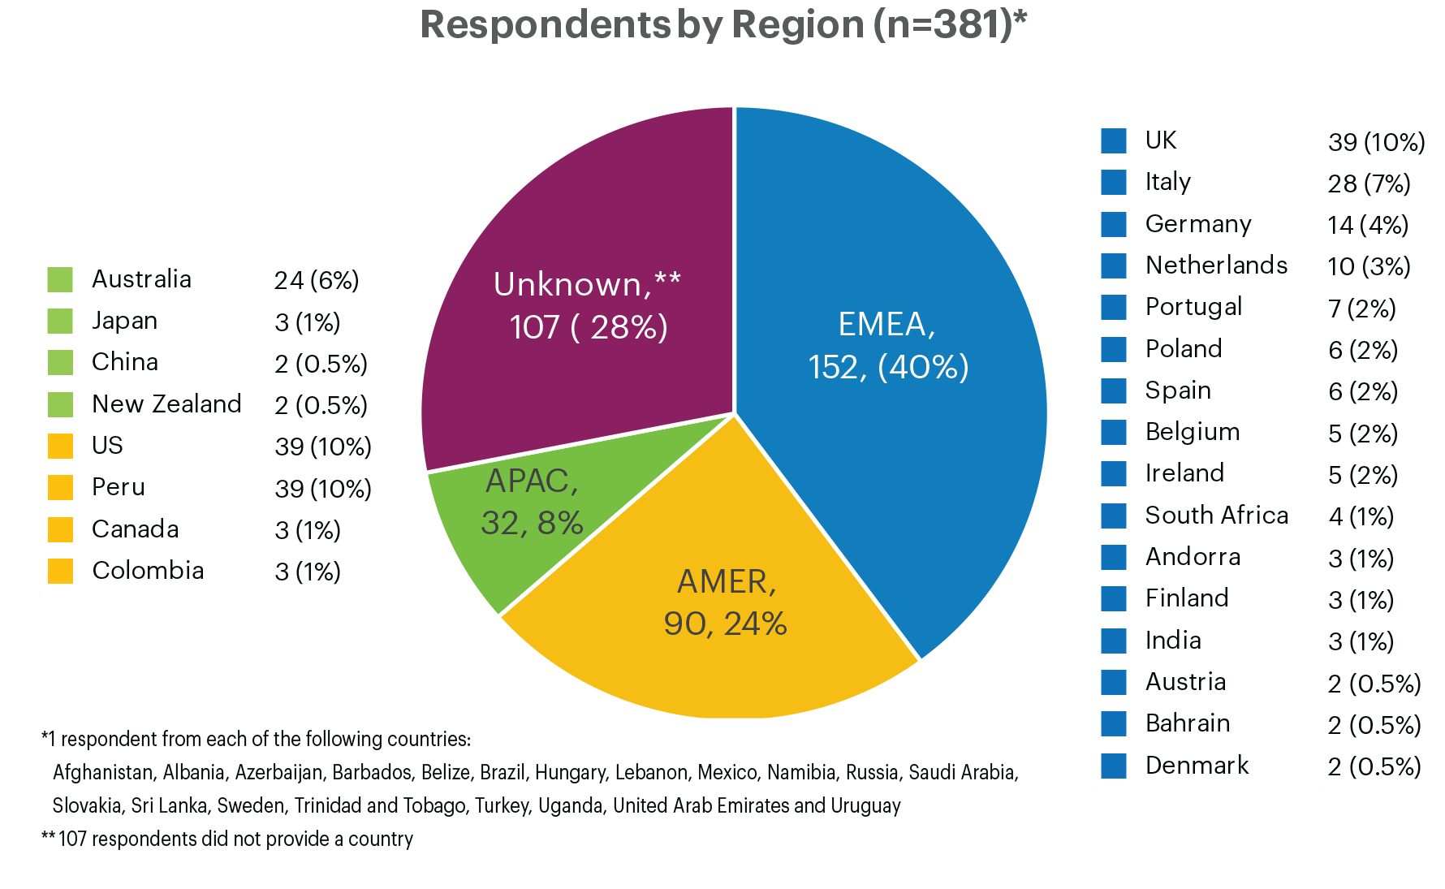

RIM Survey responses: geographic overview
381 survey respondents from 44 countries
“Total number of survey respondents, by broad region” by OCLC and euroCRIS, Practices and Patterns in Research Information Management: Findings from a Global Survey (DOI:10.25333/BGFG-D241), CC BY 4.0

Slide 15
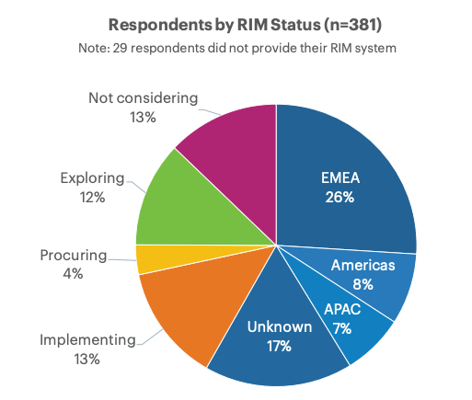
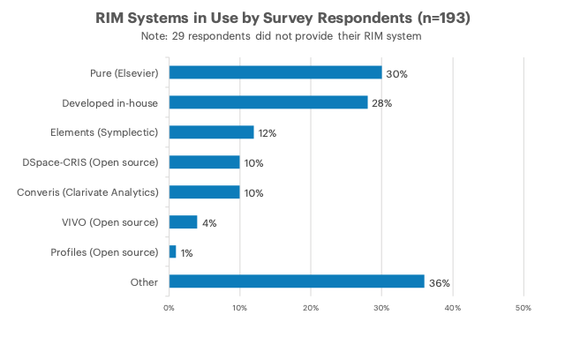
Research Information Management Systems
Well over half (58%) have a live RIM System
Practices and Patterns in Research Information Management: Findings from a Global Survey (DOI:10.25333/BGFG-D241), CC BY 4.0
Notes:
****Read the following (from the next slide) while allowing participants to continue viewing this slide:*******
Note that we invited research institutions at any stage of RIM adoption to participate
58% indicated they have a live RIM system, and another 13% are in process of implementation.
Reveals a quickly shifting landscape, with many institutions currently exploring RIM
> 200 institutions with an active RIM provides a significant sample
More synthesis may reveal regional differences
Diversity of RIM systems in use
Elsevier Pure and locally-developed systems have highest adoption
The “Other” category is also significant, featuring entries like IRIS (Italy), ResearchMaster (Aus/NZ), OMEGA-PSIR (Poland), InfoEd

Slide 16
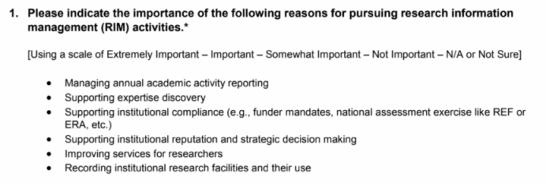
INCENTIVES FOR RIM ADOPTION

Slide 17
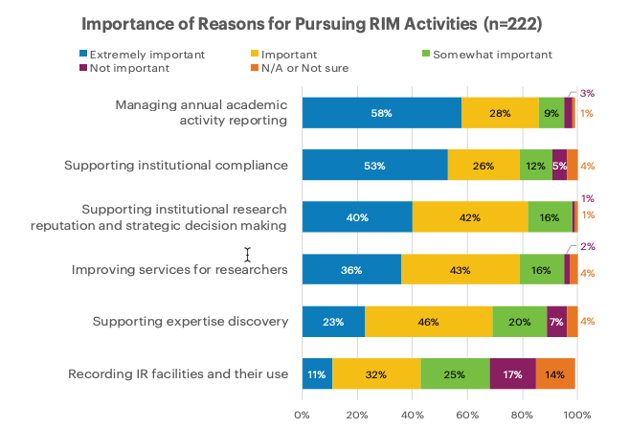
Reporting and compliance drive RIM adoption
Practices and Patterns in Research Information Management: Findings from a Global Survey (DOI:10.25333/BGFG-D241), CC BY 4.0
Notes:
Respondents were provided a list of six reasons for pursuing RIM activities and were asked the importance of those reasons for their institution. The reasons most indicated as being “extremely important” include managing annual academic activity reporting and supporting institutional compliance such as funder mandates or national assessment exercises.

Slide 18
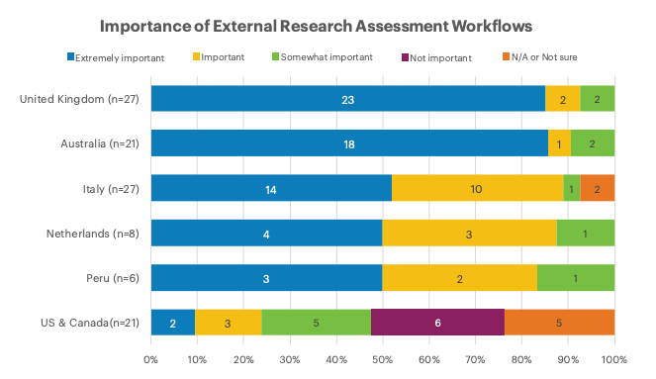
Practices and Patterns in Research Information Management: Findings from a Global Survey (DOI:10.25333/BGFG-D241), CC BY 4.0
Notes:
Since the research team represented several different countries, we were interested to see whether we’d see regional differences in how RIM was used. In addition to asking why institutions had pursued RIM, we also asked how they were using their current RIM system. One of the options was “Supporting external research assessment workflows,” and we saw some clear regional differences there. In the UK and Australia, countries with national research assessment exercises, this function was extremely important to nearly all respondents. And that use was at least important in most institutions in Italy, the Netherlands, and Peru. But it was far less important in the US and Canada, which don’t have standardized requirements for reporting research outcomes or national assessment exercises.
Figure 20. Importance of RIM function “External Research Assessment” by country.

Slide 19
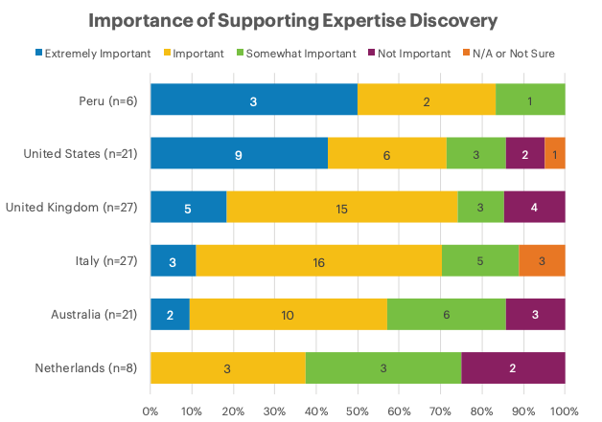
Practices and Patterns in Research Information Management: Findings from a Global Survey (DOI:10.25333/BGFG-D241), CC BY 4.0
Notes:
When we looked at Expertise Discovery as a reason for Pursuing RIM, however, we saw a much higher number of US and Canadian institutions indicate that it was extremely important. By contrast, no institutions in the Netherlands considered Expertise Discovery “extremely important.” This is likely because the Dutch have a nationally aggregated portal, NARCIS, for discovery of expertise and research.

Slide 20
Summary: Incentives for Adoption
US is an outlier
  No national compliance requirements
  Early emphasis on Research Networking Systems (e.g., Harvard Profiles)
Action for the next survey
  Different platforms emphasize different capabilities, so…
  Increase promotion to Profiles RNS and VIVO communities
Research Question for the next survey
  Will incentives for new adopters of RIM shift away from compliance and toward expertise discovery?
  Most institutions with reporting mandates will have already implemented RIM

Slide 21
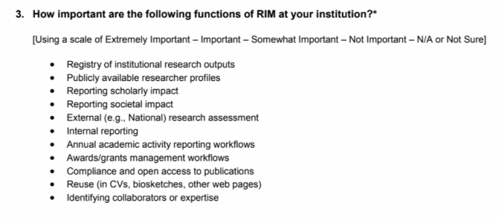
RIM functions
Notes:
This is the question I just mentioned: We knew that at many institutions the initial driver for adopting a RIM system may not account for all the uses that later develop, so we asked about the importance of a number of other RIM functions.

Slide 22
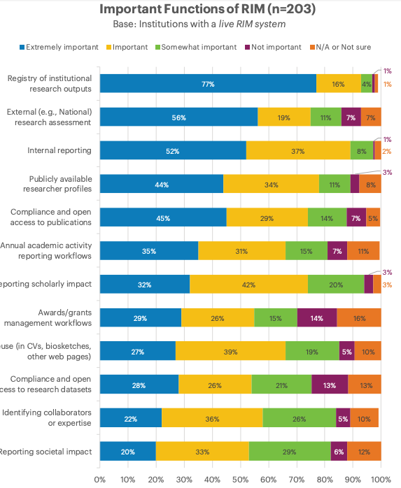
Practices and Patterns in Research Information Management: Findings from a Global Survey (DOI:10.25333/BGFG-D241), CC BY 4.0
Notes:
Three functions were listed as “extremely important” to at least half of respondents: Registry of institution research outputs, external research assessment as mentioned previously, and internal reporting. Every item we listed was considered extremely important by at least a few of the respondents.

Slide 23
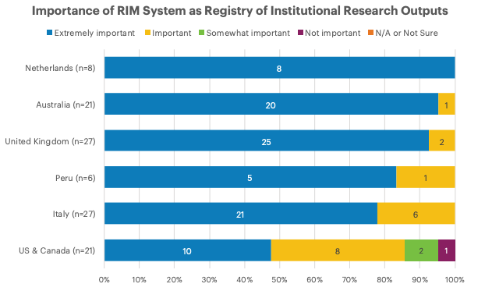
Practices and Patterns in Research Information Management: Findings from a Global Survey (DOI:10.25333/BGFG-D241), CC BY 4.0
Notes:
Again, we were interested in regional differences. As with compliance with external mandates, most countries with enough respondents to look at separately considered the RIM an extremely important registry of institutional research outputs. The US and Canadian respondents, however, placed far less importance on this function.
Figure 24. Importance of RIM function “Registry of Institutional Research Outputs,” grouped by country.

Slide 24
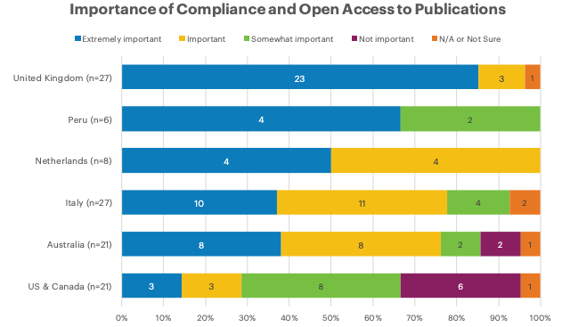
Practices and Patterns in Research Information Management: Findings from a Global Survey (DOI:10.25333/BGFG-D241), CC BY 4.0
Notes:
Although regional differences in responses related to Open Access to publications are not quite as stark, it’s easy to see which countries’ funders have Open Access mandates. In the US, compliance with open access to publications mandates is the responsibility of the researchers rather than their institutions.
Figure 21. Importance of RIM function “Compliance and Open Access to Publications,” grouped by country.

Slide 25
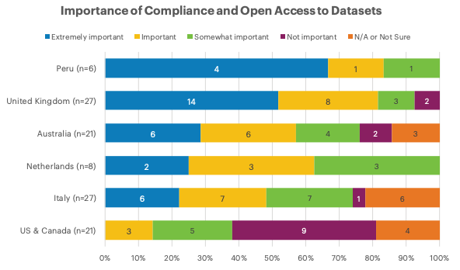
Practices and Patterns in Research Information Management: Findings from a Global Survey (DOI:10.25333/BGFG-D241), CC BY 4.0
Notes:
We see the lines drop back a bit for Open Access to Datasets. Mandates regarding access to publications have been around longer, so the responses to this function are likely to align more closely with the previous one in future surveys.
Figure 22. Importance of RIM function "Compliance and Open Access to Datasets," grouped by country.

Slide 26
Summary: RIM uses
For most, RIM is valuable as a registry of the institution’s research outputs
RIM has multiple uses at most institutions
  External & internal assessment are among the most important (and unsurprising)
  Managing OA compliance is also important
  Supporting the discovery of potential research collaborators is less important
As expected, some of these differences appear to vary by region
Notes:
While I don’t plan to display this slide in the presentation, I’d like to include it in the published deck. I plan to share this overview while discussing the previous slide.

Slide 27
Interoperability

Slide 28
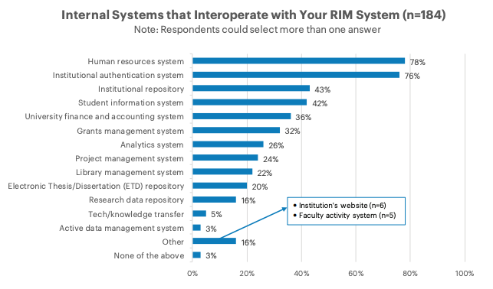
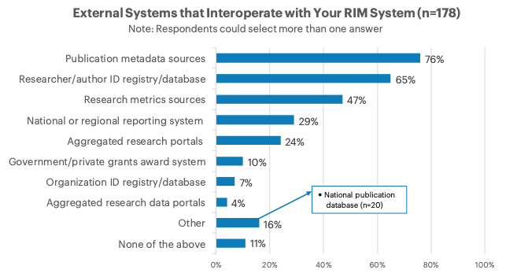
RIM systems interoperate with multiple internal and external systems
Practices and Patterns in Research Information Management: Findings from a Global Survey (DOI:10.25333/BGFG-D241), CC BY 4.0
Notes:
This could be useful to share in the published slide deck, but I’d like to move right on to the regional comparisons.
Respondents were presented with lists of external and internal systems and were asked with which of them their RIM interoperates. The internal systems most indicated as being interoperable include HR and authentication systems; external systems include publication metadata sources and researcher/author ID registries/databases.

Slide 29
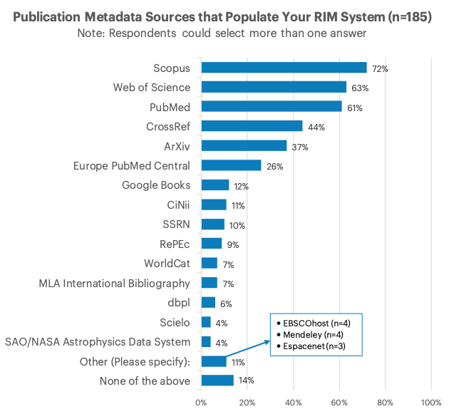
Practices and Patterns in Research Information Management: Findings from a Global Survey (DOI:10.25333/BGFG-D241), CC BY 4.0
Notes:
Figure 48. Sources of metadata used to populate live RIM systems.

Slide 30
Use of RIM Systems to support repository functions
Practices and Patterns in Research Information Management: Findings from a Global Survey (DOI:10.25333/BGFG-D241), CC BY 4.0
Notes:
Figure 26. Institutions with a live RIM platform reporting that their RIM system serves as their default institutional repository/ETD repository/research data repository (n=XX)

Slide 31
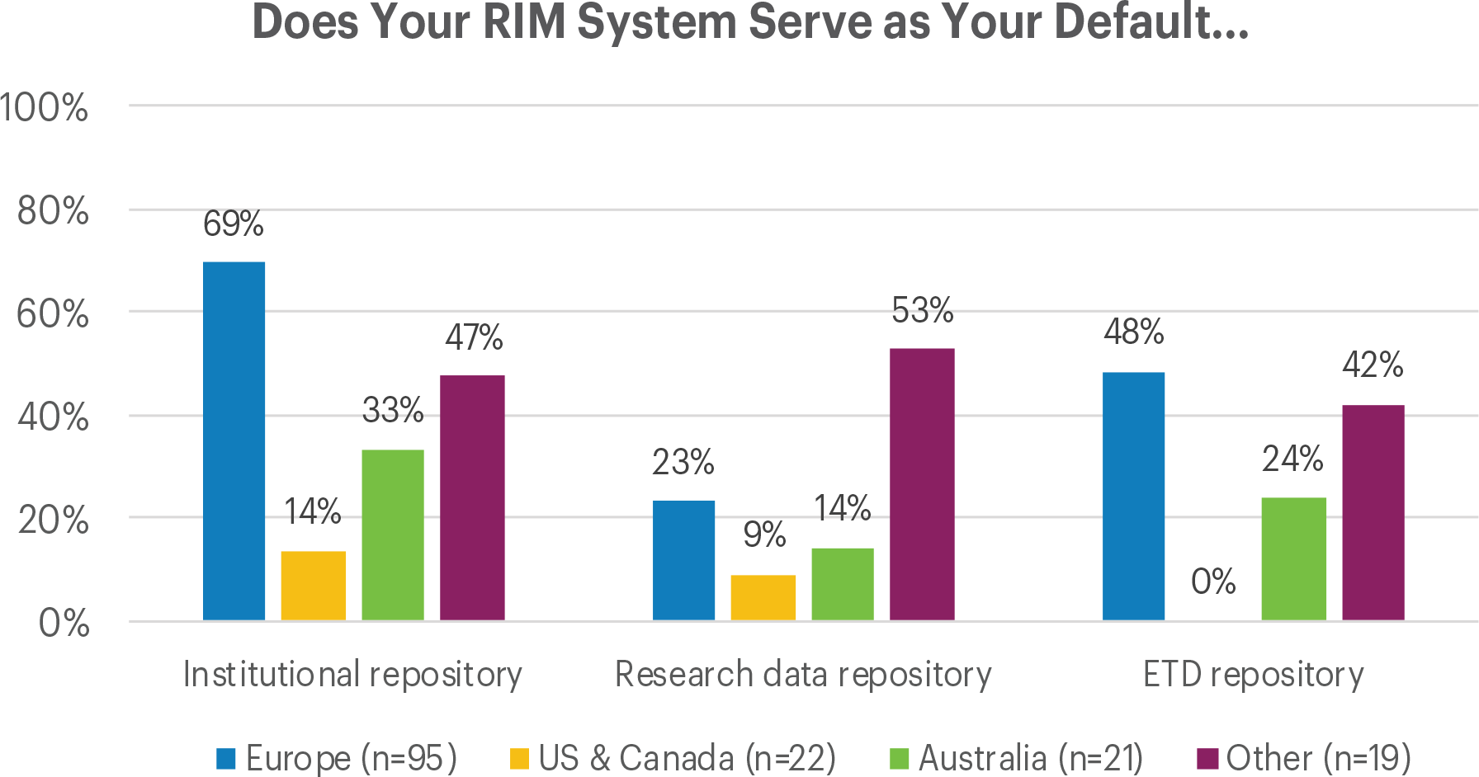
“Institutions with a live RIM system reporting that their RIM system serves as their default institutional repository/ETD repository/research data repository, with regional subdivisions” by OCLC and euroCRIS, Practices and Patterns in Research Information Management: Findings from a Global Survey (DOI:10.25333/BGFG-D241), CC BY 4.0
Notes:
Figure 27. Institutions with a live RIM system reporting that their RIM system serves as their default institutional repository/ETD repository/research data repository, with regional subdivisions

Slide 32
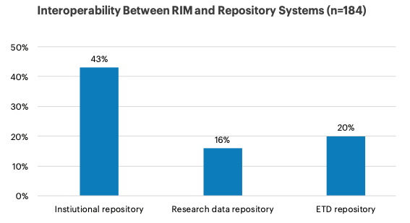
Practices and Patterns in Research Information Management: Findings from a Global Survey (DOI:10.25333/BGFG-D241), CC BY 4.0
Notes:
Figure 28. Institutions with live RIM instance reporting interoperability with institutional repository, research data repository, and ETD repository
Figure has been recreated for consistency and format.

Slide 33
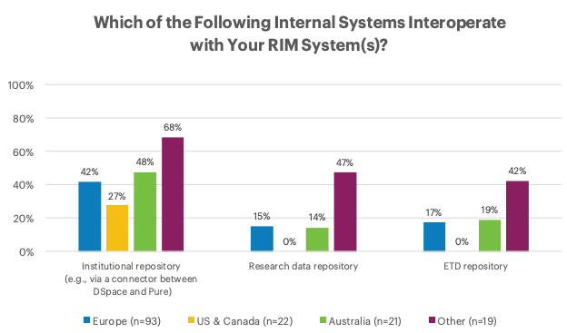
Practices and Patterns in Research Information Management: Findings from a Global Survey (DOI:10.25333/BGFG-D241), CC BY 4.0
Notes:
Figure 29. Institutions with live RIM system reporting internal interoperability with institutional repository, ETD repository, and ETD repository, with regional subdivisions

Slide 34
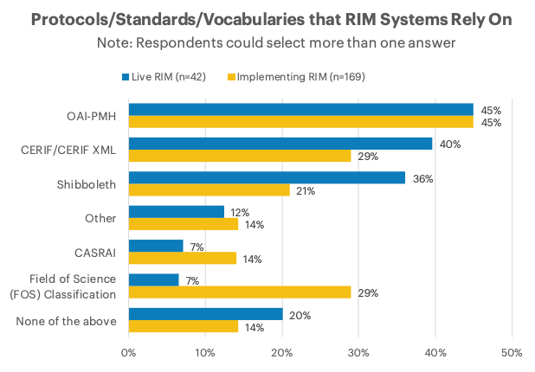
Practices and Patterns in Research Information Management: Findings from a Global Survey (DOI:10.25333/BGFG-D241), CC BY 4.0
Notes:
Figure 51. Protocols, standards, and vocabularies in use for both live and implementing institutions.

Slide 35
Some summary findings
Interoperability is important – a significant degree of RIM systems interoperate with multiple institutional systems – including IRs
Institutions leverage publications metadata harvesting
OAI-PMH & CERIF-XML important standards
“We have three best of breed RIM systems that are interoperable to some extent, so we have as good a RIM infrastructure as is currently possible. The key to successful RIM going forward will be to improve and maximise interoperability.”
“There is much room for improvement in the area of system interoperability. Only when such improvement takes place will the actual potential of RIM systems start to be realized.”
Notes:
While I don’t plan to display this slide in the presentation, I’d like to include it in the published deck. II believe we can cover these points in the previous, information rich slides.

Slide 36
Stakeholders

Slide 37
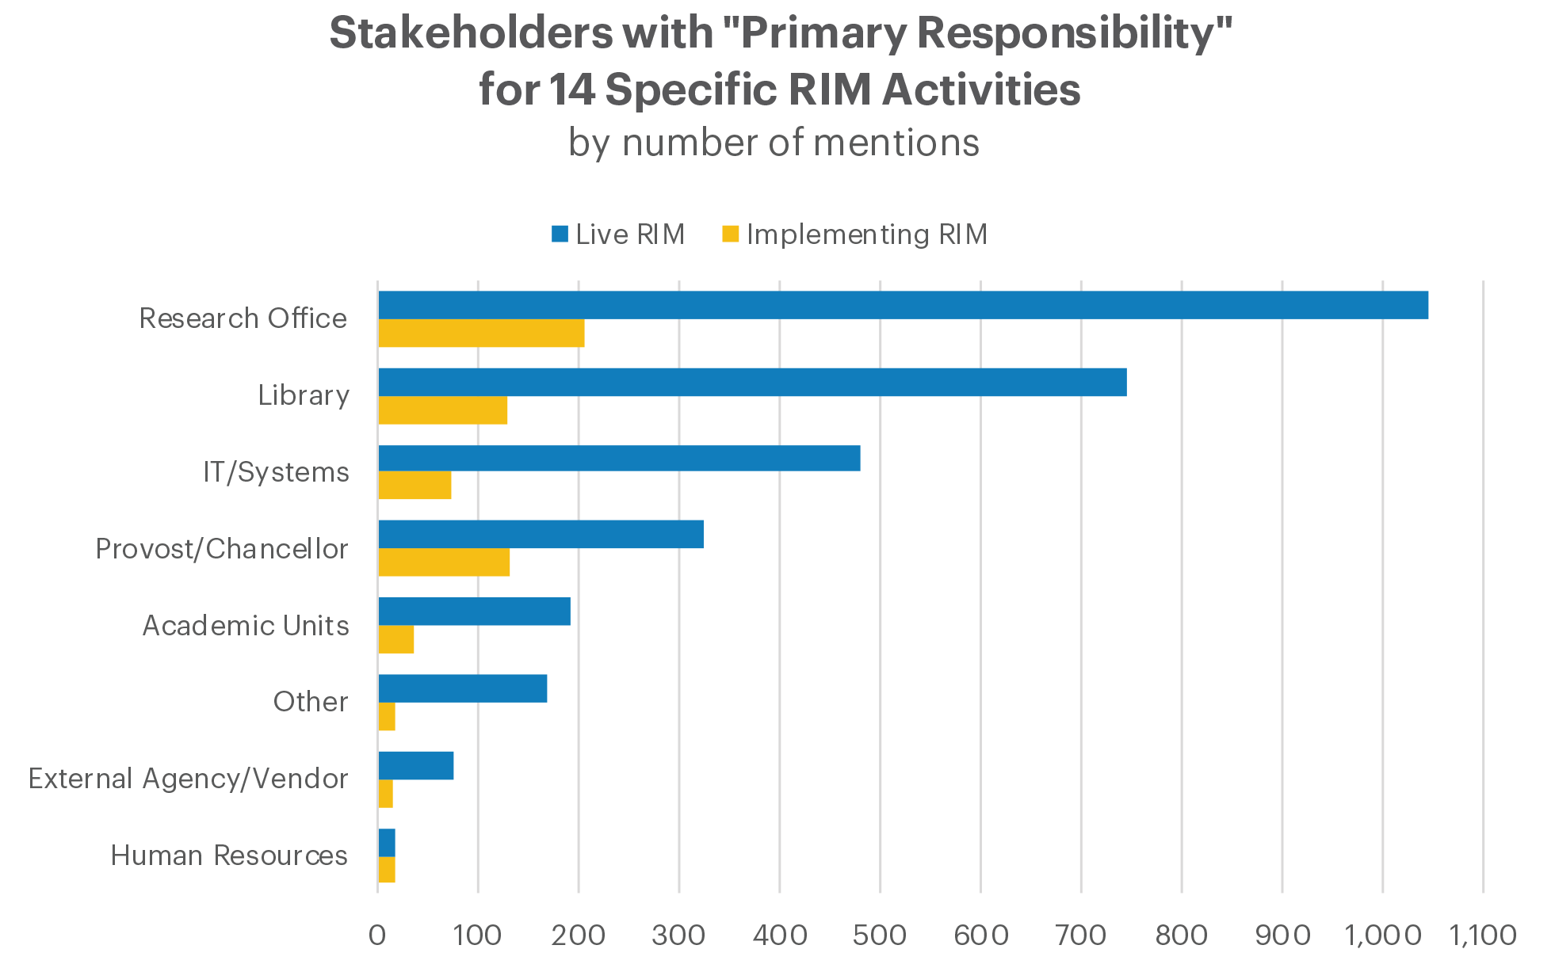
“Primary stakeholders based on total number of mentions across all responses for all areas of activity, in aggregate. Note that multiple primary stakeholders could be selected per area of activity” by OCLC and euroCRIS, Practices and Patterns in Research Information Management: Findings from a Global Survey (DOI:10.25333/BGFG-D241), CC BY 4.0

Slide 38
Stakeholders with Primary Responsibility for RIM Activities by Country
Based on # of Mentions (Decreasing Importance of Library)
Base: Institution with a Live RIM system
Practices and Patterns in Research Information Management: Findings from a Global Survey (DOI:10.25333/BGFG-D241), CC BY 4.0

Slide 39
Persistent identifiers

Slide 40
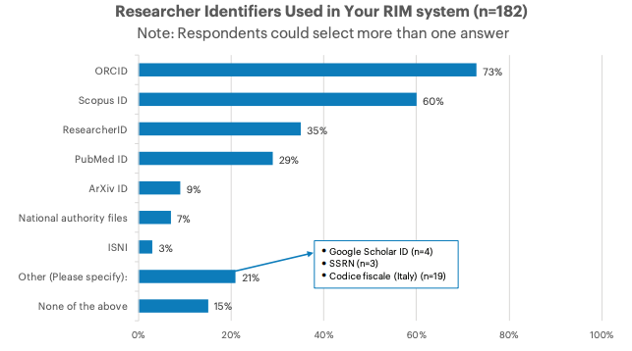
Practices and Patterns in Research Information Management: Findings from a Global Survey (DOI:10.25333/BGFG-D241), CC BY 4.0
Notes:
Figure 49. Researcher and person identifiers in use in live RIM systems.

Slide 41
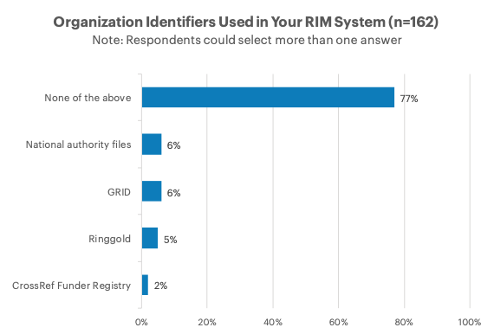
Practices and Patterns in Research Information Management: Findings from a Global Survey (DOI:10.25333/BGFG-D241), CC BY 4.0
Notes:
Figure 50. Organizational identifiers in use in live RIM systems.

Slide 42
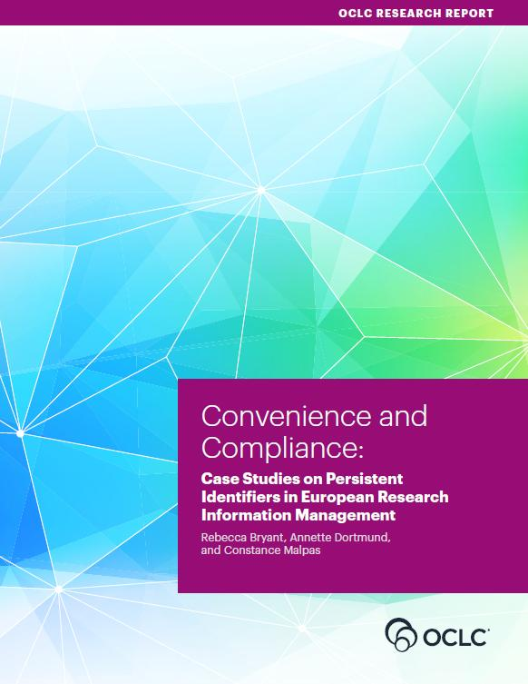
Some summary findings
Congruent with our qualitative Convenience and Compliance findings
Strong adoption of person identifiers
  ORCID becoming a de facto standard in scholarly literature, but other identifiers also needed and used
Organizational identifiers largely unused
oc.lc/rim

Slide 43
References
Bryant, Rebecca, Anna Clements, Carol Feltes, David Groenewegen, Simon Huggard, Holly Mercer, Roxanne Missingham, Maliaca Oxnam, Anne Rauh and John Wright. 2017. Research Information Management: Defining RIM and the Library’s Role. Dublin, OH: OCLC Research. doi:10.25333/C3NK88
Bryant, Rebecca, Annette Dortmund, and Constance Malpas. 2017.
Convenience and Compliance: Case Studies on Persistent Identifiers in European Research Information. Dublin, Ohio: OCLC Research. doi:10.25333/C32K7M
Bryant, Rebecca, Anna Clements, Pablo de Castro, Joanne Cantrell, Annette Dortmund, Jan Fransen, Peggy Gallagher, and Michele Mennielli. 2018. Practices and Patterns in Research Information Management: Findings from a Global Survey. Dublin, OH: OCLC Research. https://doi.org/10.25333/BGFG-D241
Ribeiro, Lígia, Pablo De Castro, and Michele Mennielli. “EUNIS-EuroCRIS Joint Survey on CRIS and IR,” 2016. http://www.eurocris.org/news/cris-ir-survey-report.

Slide 44
Discussion
Rebecca Bryant, PhD, Senior Program Officer, OCLC Research
bryantr@oclc.org @RebeccaBryant18
https://orcid.org/0000-0002-2753-3881
Anna Clements, Assistant Library Director, University of St Andrews; euroCRIS
akc@st-andrews.ac.uk @AnnaKClements
https://orcid.org/0000-0003-2895-1310
Jan Fransen, Service Lead for RIM Systems, University of Minnesota
fransen@umn.edu
https://orcid.org/0000-0002-0302-2761
oc.lc/rim

