Slide 1
5 September 2018
Works in Progress Webinar:
The OCLC RLP Special Collections and Archives Work Agenda
Chela Scott Weber, Senior Program Officer, OCLC Research
weberc@oclc.org | @partly_cloudy

Slide 2
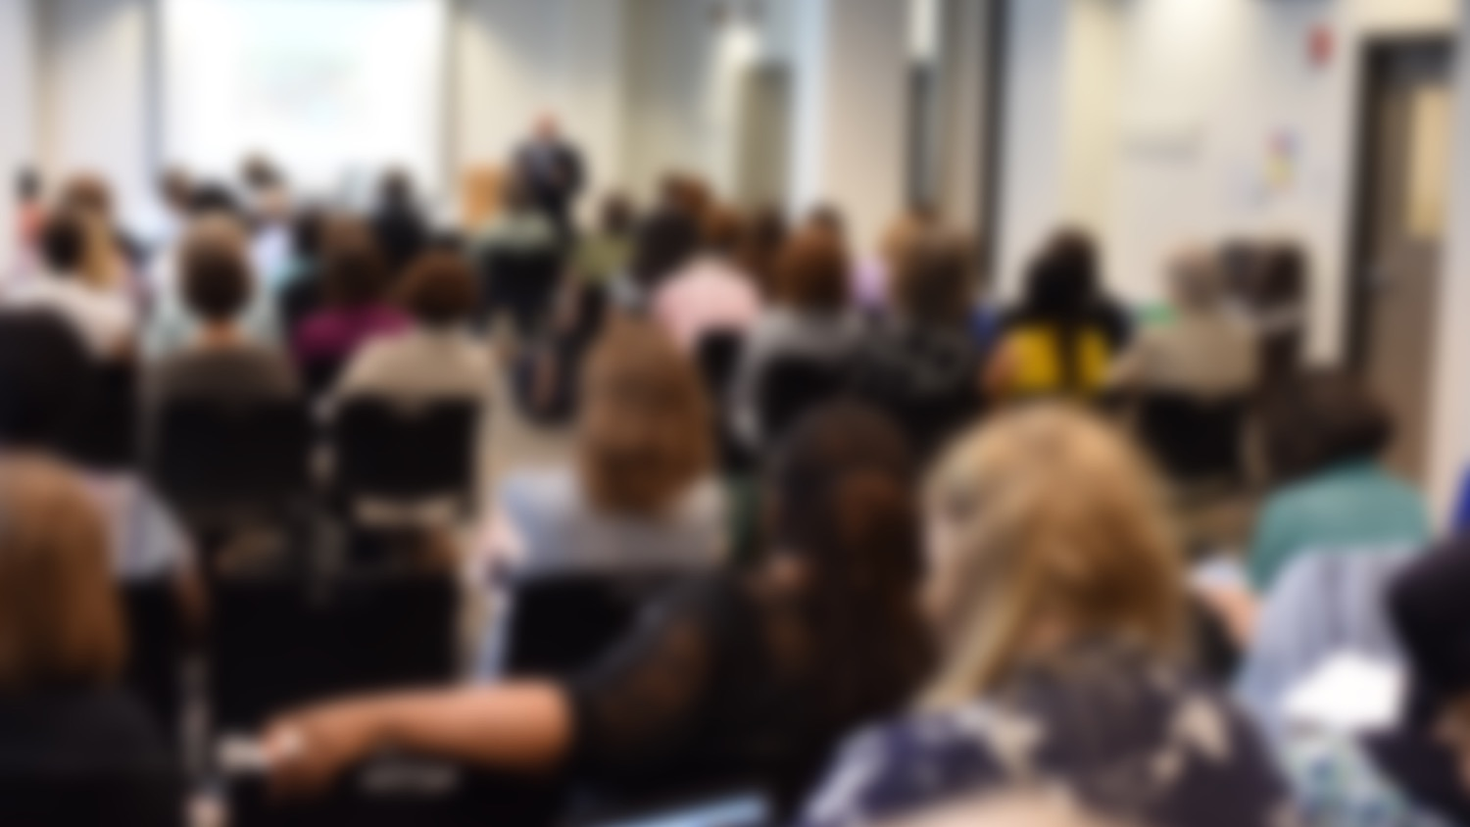


Slide 3
The Research Library Partnership is a program of the Research Division of OCLC, and provides
a unique transnational
collaborative network of peers to address common issues as well
as the opportunity to engage directly with OCLC Research

Slide 4
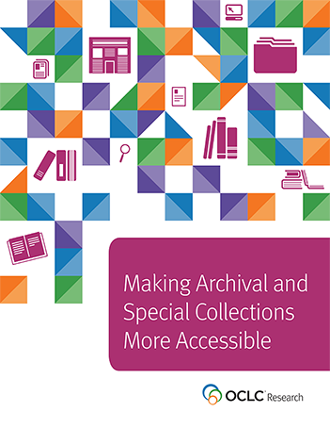
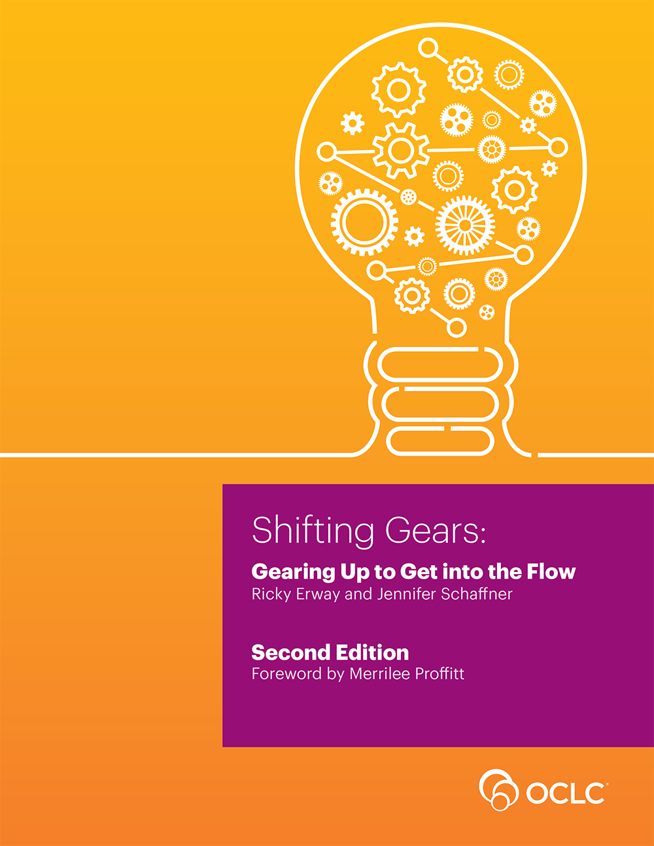
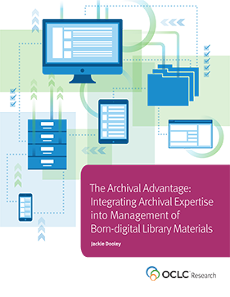
Archives, Special, and Distinctive Collections

Slide 5

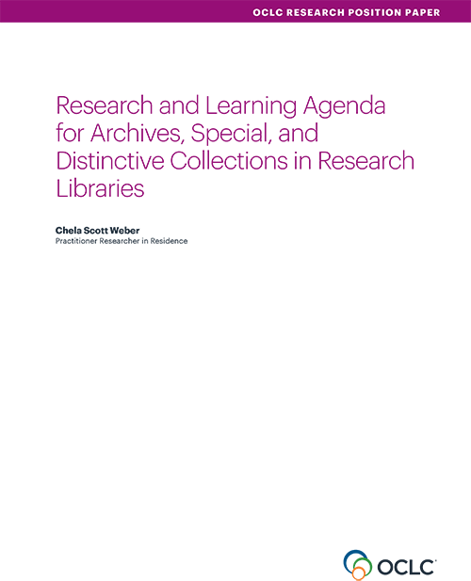
doi:10.25333/C3C34F

Slide 6
Iterative, Participatory Process
Advisory Board
Discussions with Colleagues, April-May 2017
Workshop early draft at RBMS, June 2017
Workshop later stage draft at SAA, July 2017
Open Community Comment, August 2017

Slide 7
Areas of Investigation
Convergence of Special Collections
& the Research Library

Slide 8
Areas of Investigation
Advocating for
Archives & Special Collections

Slide 9
Areas of Investigation
Next Steps for Born-Digital

Slide 10
Areas of Investigation
Addressing Audio-Visual Collections

Slide 11
Areas of Investigation
Evolving Systems Environments

Slide 12
Areas of Investigation
Stewardship Responsibilities
& Collections Management

Slide 13
Areas of Investigation
Engaging the Challenges
of Diversifying Our Collections

Slide 14
Overarching Themes
Structural and Organizational Positioning
Equity, Diversity, Inclusion and Accessibility
Appraisal
Access to Collections
Data and Systems

Slide 15
Next Steps
Expand the Discussion Beyond the U.S.
Encourage Action From and Collaboration with Allied Organizations and Individuals
Highlight Forward Thinking Work related to the Areas of Investigation
OCLC Research Library Partnership Action

Slide 16
Next Steps
Research Library Partnership Opportunities
  Working Group: Collection Building & Operational Impacts
  Interest Group: Research Data Management
  Interest Group: Wikimedia
  Learning Resource: Assessment Webinars

Slide 17


Slide 18
QUESTIONS? IDEAS?
LET’S TALK!
weberc@oclc.org
@partly_cloudy
doi:10.25333/C3C34F
©2018 OCLC. “This work is licensed under a Creative Commons Attribution 4.0 International License. Suggested attribution: This work uses content from ‘Works in Progress Webinar: The OCLC RLP Special Collections and Archives Work Agenda.’” © OCLC Chela Scott Weber used under a Creative Commons Attribution 4.0 International License: http://creativecommons.org/licenses/by/4.0/.

