Slide 1
Introducing a new data policy at Wageningen University & Research
April 20th 2018
Hilde van Zeeland, Wageningen University & Research Library

Slide 2
Contents
Wageningen University & Research (WUR)
The new policy: what and why?
Setting up the policy
Communicating the policy

Slide 3
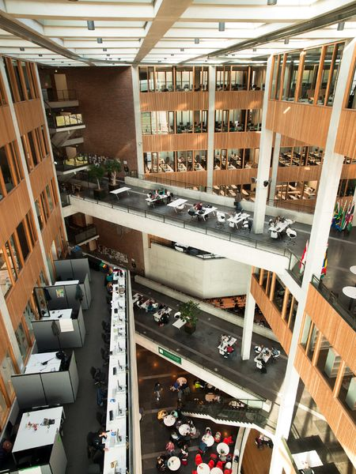
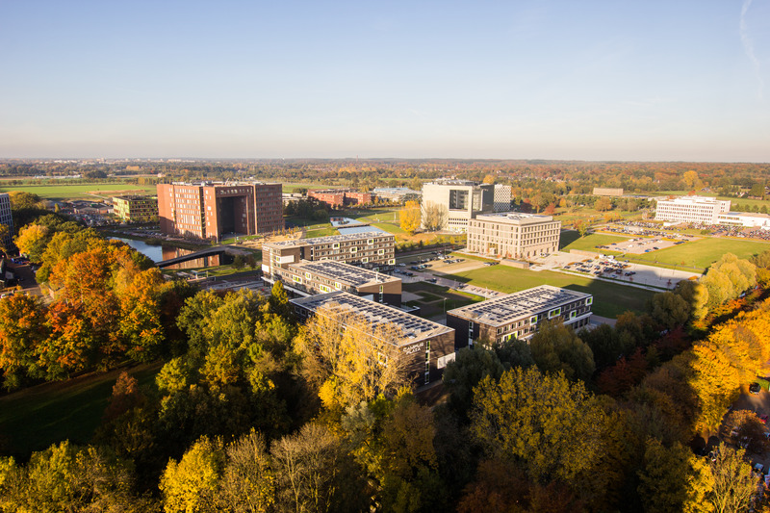
Wageningen University & Research (WUR)
85 chair groups and 9 research institutes
Domains: food, animal, environment, plant, social

Slide 4
2. The new policy: what and why?

Slide 5
The new policy: what and why?
2014: policy for university part
DMP requirement for PhDs and chair groups
2016: evaluation → storage unclear, little archiving
More binding policy needed

Slide 6
The new policy: what and why?
Academic Affairs → Data Management Support
What are the criteria of ‘good’ data management, to base our data policy on?
following existing laws, guidelines, frameworks
policy should reflect the diversity of WUR
it services
library
archiving
legal affairs

Slide 7
3. Setting up the policy
Defining criteria of ‘good’ data management
Defining data management practices (+ diversity!)
Comparing the two ...and writing the policy

Slide 8
Setting up the policy 1. Defining criteria of ‘good’ data management
Data Management:
Following existing laws, guidelines, frameworks
National Archives Act (‘Archiefwet’)
Netherlands Code of Conduct for Scientific Practice
FAIR principles
Storage
Archival
Registration

Slide 9
Setting up the policy 1. Defining criteria of ‘good’ data management
Storage
Archival
Registration
The storage solution allows the encryption of sensitive data files.
The stored data is protected against physical access and disasters and has an emergency power system.
The storage solution enables the sharing of data files.
The archive provides datasets with persistent identifiers. The archive provides metadata fields so that datasets can be described and found. The archive has a back-up and recovery system in place.
The registration system allows the establishing of links between articles and datasets. It is possible to set up links between the datasets and other organisational records.
It is possible to provide URLs to the location of the datasets.
Notes:
To define criteria of data storage, it was analysed what criteria were followed by the IT storage systems at WUR and by the data storage system used at the University of Utrecht.
For criteria of data archiving, the mentioned laws and frameworks were used. The national Archive Act, the National Code of Scientific Conduct, and the FAIR principles of data management all apply to the retention and findability of datasets, providing a set of criteria regarding the archiving of data. In addition, criteria were extracted of the Data Seal of Approval. Criteria also needed to be defined for the registration of datasets. To set up criteria, the possibilities offered by the output registration systems at Wageningen University & Research and at the University of Amsterdam were used.
MOSCOW:
The outcome of this was an overview of which criteria were considered crucial to follow in data storage, archiving and registration (Must-haves), and which were not. Criteria were mostly marked as Must-haves when they followed the law or the frameworks used (e.g. a criteria key to making data Findable according to the FAIR principles), although in some cases features were marked as Must-have based on the experience of Data Management Support staff.
The Must-haves and Should-haves in particular could be translated into guidelines for the RDM policy. Moreover, they provided a basis to evaluate the use cases’ practices, i.e. to explore to what extent these already aligned to the criteria set up (most importantly, the Must-have criteria).

Slide 10
Setting up the policy 1. Defining criteria of ‘good’ data management
Storage
Archival
Registration
The storage solution allows the encryption of sensitive data files.
The stored data is protected against physical access and disasters and has an emergency power system.
The storage solution enables the sharing of data files.
The archive provides datasets with persistent identifiers. The archive provides metadata fields so that datasets can be described and found. The archive has a back-up and recovery system in place.
The registration system allows the establishing of links between articles and datasets. It is possible to set up links between the datasets and other organisational records.
It is possible to provide URLs to the location of the datasets.
Our in-place curation services were used to define the criteria (IT secure storage, external archives, RIS system Pure)
Criteria categorised using MOSCOW:
Must-have, Should-have, Could-have, Won’t have
Bryant, Rebecca, Brian Lavoie and Constance Malpas. 2017. A Tour of the Research Data Management (RDM) Service Space. The Realities of Research Data Management, Part 1. Dublin, Ohio: OCLC Research. doi:10.25333/C3PG8J
Notes:
To define criteria of data storage, it was analysed what criteria were followed by the IT storage systems at WUR and by the data storage system used at the University of Utrecht.
For criteria of data archiving, the mentioned laws and frameworks were used. The national Archive Act, the National Code of Scientific Conduct, and the FAIR principles of data management all apply to the retention and findability of datasets, providing a set of criteria regarding the archiving of data. In addition, criteria were extracted of the Data Seal of Approval. Criteria also needed to be defined for the registration of datasets. To set up criteria, the possibilities offered by the output registration systems at Wageningen University & Research and at the University of Amsterdam were used.
MOSCOW:
The outcome of this was an overview of which criteria were considered crucial to follow in data storage, archiving and registration (Must-haves), and which were not. Criteria were mostly marked as Must-haves when they followed the law or the frameworks used (e.g. a criteria key to making data Findable according to the FAIR principles), although in some cases features were marked as Must-have based on the experience of Data Management Support staff.
The Must-haves and Should-haves in particular could be translated into guidelines for the RDM policy. Moreover, they provided a basis to evaluate the use cases’ practices, i.e. to explore to what extent these already aligned to the criteria set up (most importantly, the Must-have criteria).

Slide 11
Setting up the policy 2. Defining data management practices
Just the criteria of ‘good’ data management (/Must-haves) does not make up a policy!
Policy should also meet current practices
Academic Affairs: ‘reflecting the diversity of WUR’
Eight interviews on:
Various domains covered
Showed how use cases’ practices met the criteria
Storage
Archival
Registration

Slide 12
Setting up the policy 3. Comparing the two ...and writing the policy
Storage
Archival
Registration
Meeting Must-haves:
Storage on university network
Meeting Must-haves:
Archiving in certif. archive (FAIR)
Meeting Must-haves:
Registering in WUR’s RIS (Pure)
Not meeting Must-haves:
Storage on ext. hard-drives & USBs
Not meeting Must-haves:
Not archiving
‘Archiving’ at home
Not meeting Must-haves:
Not registering in WUR’s RIS (Pure)
Meeting Must-haves?
Own servers
Cloud services
Meeting Must-haves?
Discipline-specific archive

Slide 13
Setting up the policy 3. Comparing the two ...and writing the policy
Storage
Archival
Registration
Meeting Must-haves:
Storage on university network
Meeting Must-haves:
Archiving in certif. archive (FAIR)
Meeting Must-haves:
Registering in WUR’s RIS (Pure)
Best-practices: informing policy regulations
Not meeting Must-haves:
Storage on ext. hard-drives & USBs
Not meeting Must-haves:
Not archiving
‘Archiving’ at home
Not meeting Must-haves:
Not registering in WUR’s RIS (Pure)
Should also be covered in policy!
Meeting Must-haves?
Own servers
Cloud services
Meeting Must-haves?
Discipline-specific archive
Should also be covered in policy!

Slide 14
Setting up the policy 3. Comparing the two ...and writing the policy
Using this in the final policy:
Required → best-practices (meeting M-criteria) e.g. storage: university drive
Not allowed (not meeting M-criteria) e.g. storage: USBs
Allowed, if approved (meeting M-criteria?) e.g. storage: own server/external cloud service

Slide 15
4. Communicating the policy

Slide 16
Communicating the policy RDM, GDPR, IT: collaboration
A lot of data communication at WUR in 2018
RDM policy
GDPR
IT Security
New Wageningen Data Competence Centre
Collaboration

Slide 17
Communicating the policy RDM, GDPR, IT: collaboration
Our target groups...
RDM policy | GDPR | IT Security
Research positions (PhDs, Post Docs, Tenure Tracks) New research staff Chair holders Business Unit managers PhD supervisors Support staff | Researchers (project leads) New staff Contacts at institutes Secundary staff Students | Staff IT and FB Staff WUR Contacts at IT Directors and management Students Visitors / external parties

Slide 18
Communicating the policy RDM, GDPR, IT: collaboration
This is how to deal with personal data.
Do you know about the FAIR principles?
Staff IT and FB
Staff WUR
Contacts at IT
Directors and management
Students
Visitors / external parties
As a ..., you are responsible for ...
Beware of phishing emails!
Two-factor authentification
Research positions (PhDs, Post Docs, Tenure Tracks, Senior / Junior researchers)
New research staff
Chair holders
Business Unit managers
PhD supervisors
Support staff
Contacts at institutes
Secundary staff
Researchers (project leads)
New staff
Students
Secure your device!
The GDPR becomes active on the 25th of May 2018.
It is important to choose a suitable data repository.
Share your files in a secure environment.
Data Management Support can help
Use strong passwords
WUR’s new data policy covers the storage, archiving and registration of research data.
Notes:
Particulier ook nog van alles, internbankierne, phischingmaisl.

Slide 19
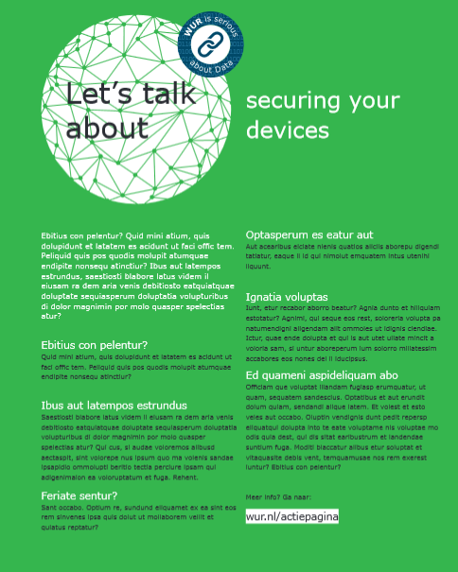
Communicating the policy RDM, GDPR, IT: collaboration
Common theme: Data
‘WUR is serious about Data’

Slide 20
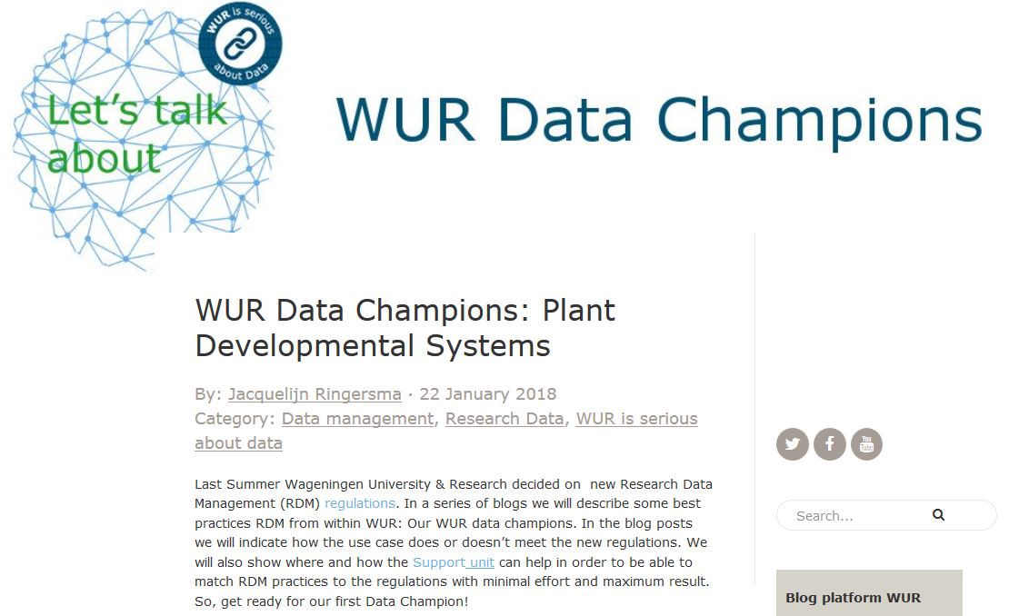
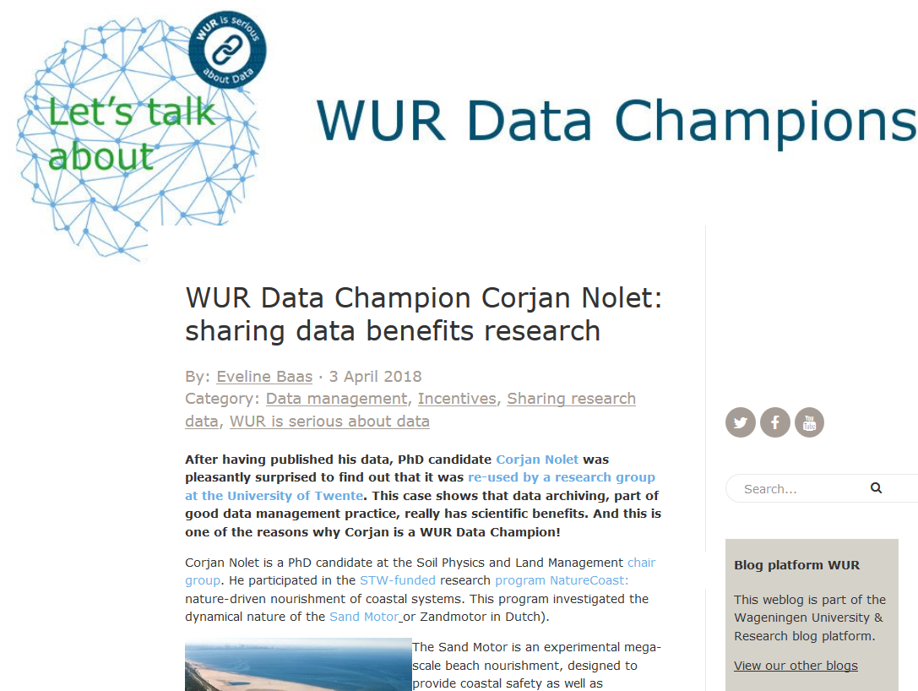
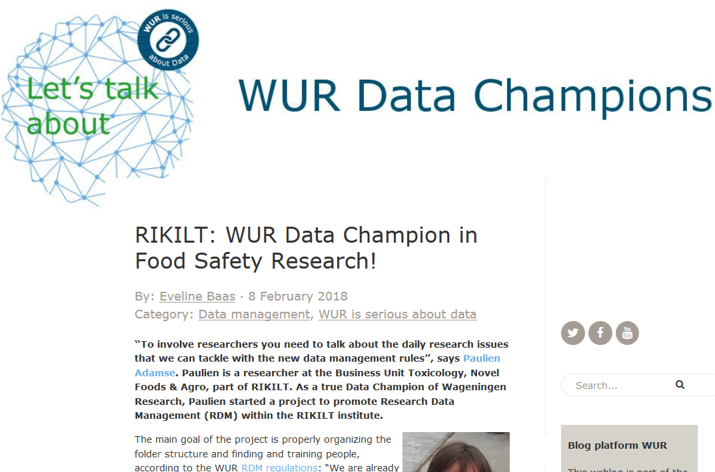
Communicating the policy RDM: going back to data management practices
For RDM policy: interviews with use cases (old and new)
Data Champions blog series

Slide 21
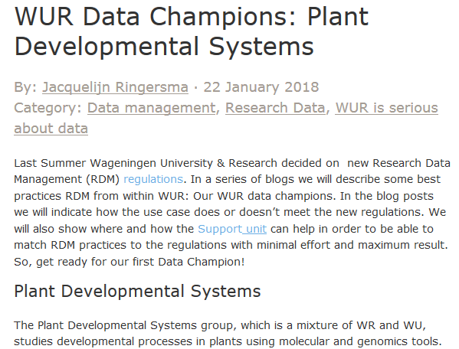
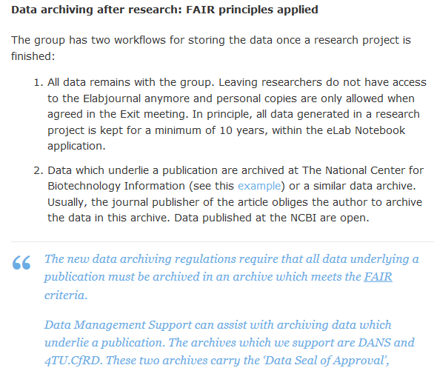
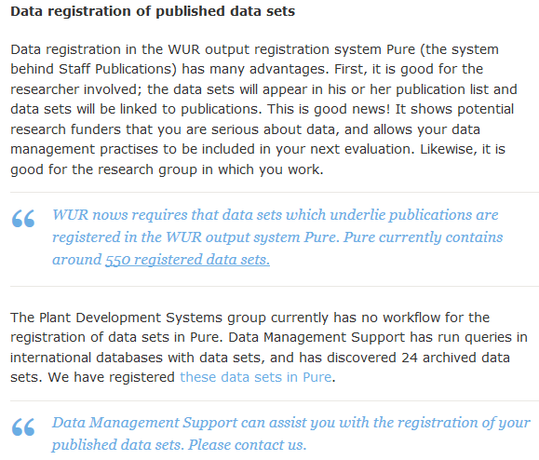
Communicating the policy RDM: going back to data management practices
Storage
Archival
Registration

Slide 22
Communicating the policy RDM: going back to data management practices
Presentations at various University and Research units
Focus: the ‘Why’ of RDM and of the policy
Referring to use cases in blog
Offering group-tailored support
Bryant, Rebecca, Brian Lavoie and Constance Malpas. 2017. A Tour of the Research Data Management (RDM) Service Space.The Realities of Research Data Management, Part 1. Dublin, Ohio: OCLC Research. doi:10.25333/C3PG8J

Slide 23
Questions?
More information:
Data policy at WUR
Data champions blog series
LIBER Quarterly paper
hilde.vanzeeland@wur.nl
jacquelijn.ringersma.@wur.nl
data@wur.nl

