Slide 1
Making the most of unique collections : developing new roles and approaches at LSE
Martin Reid, Deputy Director
Anna Towlson, Archive & Special Collections Manager
27 September 2018

Slide 2
Overview
Background and context – LSE and its Library
Drivers for change
New roles
Collection evaluation
Achievements
Challenges
Future plans

Slide 3
Institutional context
London School of Economics and Political Science (LSE)
World leading social science university founded in 1895
Dedicated to the betterment of society through study and analysis of social issues
Highly international staff and student body
- 11,000 students (5000 undergraduate, 6000 postgraduate)
- 3300 academic and support staff
- 23 academic departments & institutes
- 22 research centres

Slide 4
Institutional context
British Library of Political and Economic Science (BLPES)
Founded in 1896 to systematically collect material from around the world on the subjects studied by the School
World class collections across the social sciences
164,000 e-journals
200+ databases
1,500,000+ printed items (books, journals, pamphlets), + archives, photographs and museum objects
One of five national research libraries
Supports LSE research and teaching
Open to external researchers and the public

Slide 5
Drivers for change
Acquisition of The Women’s Library in 2013
Internationally significant collection on the history of women’s suffrage and activism
60,000 print volumes
500 archive collections
Museum objects
Creation of Library exhibition gallery 2014/15
Digital shift
Student experience
Reimaging Library space

Slide 6
Strategic response
Renewed focus on collections in Library Strategy for 2015-2020
Give unique and distinctive collections (UDCs) a greater role in education, research, public engagement, fundraising
Carry out a comprehensive collection evaluation
Adopt an integrated, thematic approach to understanding and management of primary sources – archives and special collections, print
Create new job roles to research, develop, promote UDCs
Curators
Education & Outreach Officer
Redefine relationships between academic liaison team and archives

Slide 7
New role - Curator
Conceived as a collection/content specialist for unique and distinctive collections (UDCs) spanning print, archives and special collections
Aim to bring a more integrated approach to the development, management, exploitation of collections
Key responsibilities
Research collections
Identify UDCs and build strengths
Promote use of UDCs - incorporate into teaching
Raise awareness of UDCs – contribute to education and outreach programme
Identify priorities for digitisation
Thematic approach/responsibility – core areas of collection strength
Economic and social policy
Politics and international relations
Equality, rights and citizenship

Slide 8
New role - Curator
Relationship with other roles
Liaison: builds expertise and credibility
Learning Support: contributes to skills training
Outreach: provides content, exhibitions
Reallocation of responsibilities within Archives team - frees resources to focus on cataloguing and description
Implementation
Three posts – one for each thematic area
No additional resources – convert existing posts
Develop job description
Recruit from existing Archives and Liaison/collection development teams
Appointments in place January 2016

Slide 9
New role – Education & Outreach Officer
Develop and deliver learning programme to engage schools and community groups with LSE collections
Develop digital resources for teachers and schools
Lead Library’s public events programme – lectures, talks, workshops etc.
Liaise with LSE Widening Participation and Events teams
Assist with exhibitions programme
Implementation
Fixed-term post funded by national funding agency’s Higher Education Museums Galleries and Collections fund
First appointment for 2 years in 2015
Funding renewed for 5 years in 2017

Slide 10
Collection evaluation
Comprehensive assessment of intellectual value and significance of collections
Aim:
Identify/clarify unique and distinctive collections
Prioritise material for retention, storage and disposal to enable effective stock and space management
Prioritise material for digitisation
Use a four level hierarchy:
Flagship
Heritage
Current research and teaching
Low priority

Slide 11
Our Flagship collections

Slide 12
Public engagement – exhibitions and events

Slide 13
Impact – Journeys to Independence
I wanted to express my thanks and appreciation for
the splendid exhibition you have put on to mark the
70th anniversary. It is a wonderful celebration of the
special relationship between South Asia and LSE
As an Indian at LSE, it is incredible that a non-British
perspective is being presented. It makes me proud to
go to LSE and to be an Indian.

Slide 14
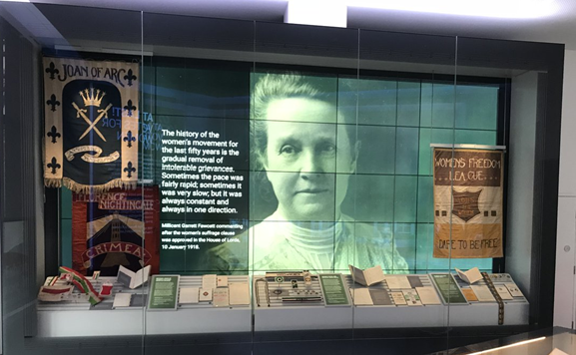
Public engagement – exhibitions and events

Slide 15
Impact – At Last! Votes for Women
Transforming hour in this room, Katie’s diary is
extraordinary. This exhibition is realk and true. I
feel very lucky to be a free woman reading their
history and courage.
This gives me hope that one day those of us
fighting for women’s voices in Kenya will prevail
Women still need to fight for parity in work, pay,
pensions, benefits and society. Use your vote!

Slide 16
Digital exhibits

Slide 17
Supporting learning – LSE, HE and beyond

Slide 18
Impact – universities
“Reading through many pieces of saved literature
cemented many aspects of the movement we were
studying in my mind. It was by far one of my favourite
seminar classes as engaging with real history and real
historical artefacts is far more interactive and engaging
than sitting and listening”
‘The feedback for the course this year has exceeded
all my expectations and every single student
commented on how much they got out of their
encounters with the archive.’

Slide 19
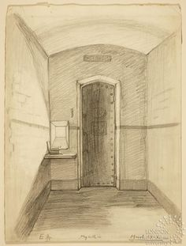
Impact - schools
It was amazing to handle the objects. I
discovered a lot more about the
Suffragettes.
The thing that will stay with me most is
the letter from Sylvia Pankhurst in jail.
She says ‘I am fighting, fighting, fighting’.
Loved loved love d seeing the REAL
LIFE diary the suffragettes kept in prison.

Slide 20
Supporting research

Slide 21
Building collections…

Slide 22
…and online resources

Slide 23
Challenges

Slide 24
Future plans
Building on Collection Evaluation
Collection/space management
Content review
Active UDC acquisitions strategy
Priorities for tackling uncatalogued material
Contribution to curriculum development
Archives in Teaching initiative
Digitisation roadmap
Establish priorities

