Slide 1
The Interoperability Imperative: A
Discussion of the Fractured Technical Landscape
Roy Tennant, with slides and input from Rebecca Bryant
Senior Program Officer
@rtennant
orcid.org/0000-0002-0725-6493

Slide 2
Outline
Brief introduction to the topic of discussion
Discussion of introduced questions/ comments (and your own) at each table
Reporting back on 2-3 of the most important things you discussed

Slide 3
Glossary
IR: institutional repository
RIM: research information management
RDM: research data management

Slide 4
A Brief Plug

Slide 5
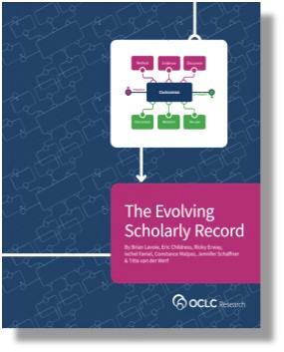
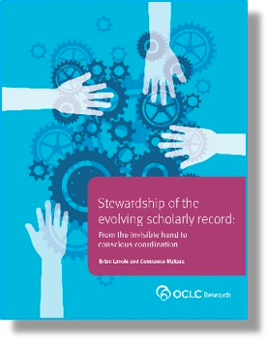
The Environment
Changes to the evolving scholarly record are being driven by evolutions in technology
Interoperability is becoming a key priority:
Efforts to improve workflows for researchers & reduce admin burden
RDM growing in importance
North American institutions are increasingly adopting RIM
Libraries are beginning to question the role of their institutional repository
Adams Becker, S., M. Cummins, A. Davis, A. Freeman, C. Giesinger Hall, V. Ananthanarayanan, K. Langley, and N Wolfson. Horizon Report: 2017 Library Edition. Austin, TX: The New Media Consortium, 2017. http://cdn.nmc.org/media/2017-nmc-horizon-report-library-EN.pdf.
Lavoie, Brian, Eric Childress, Ricky Erway, Ixchel Faniel, Constance Malpas, Jennifer Schaffner, and Titia van der Werf. 2014. The Evolving Scholarly Record. Dublin, Ohio: OCLC Research. https://doi.org/10.25333/C3763V.
#ALAAC18

Slide 6
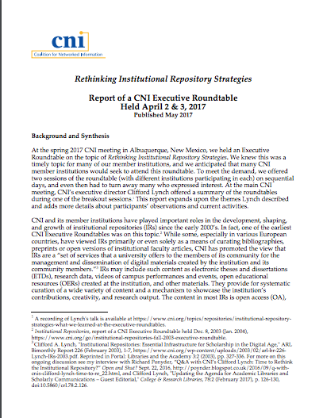
Rethinking Institutional Repository Strategies
A report of a CNI Executive Roundtable, April 2-3, 2017
An excellent summary of current thinking around institutional repositories
Here to talk about it,
Clifford Lynch, CNI
https://www.cni.org/wp-content/uploads/2017/05/CNI-rethinking-irs-exec-rndtbl.report.S17.v1.pdf

Slide 7
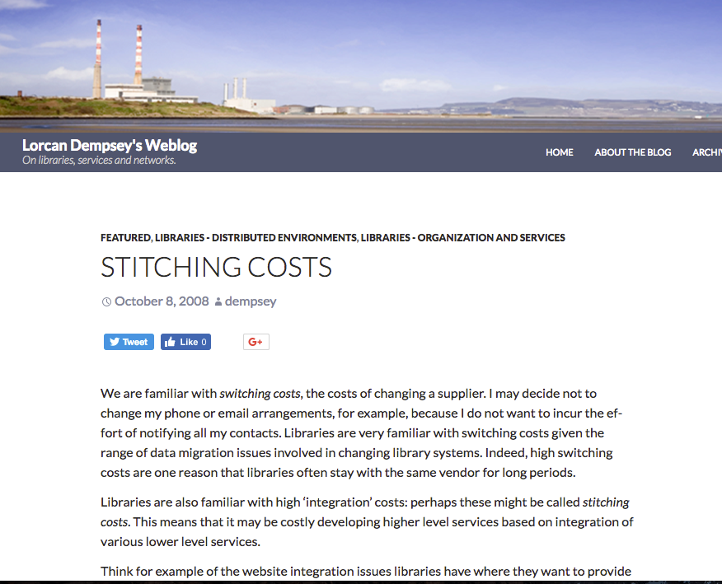
“Stitching costs”
Integration costs
Increased need for interoperability &/or integration between these 3 service categories
Drivers include:
researcher workflows
metadata harvesting at scale
OA mandates/tracking needed
Where do you want to be in 5 years?
Dempsey, Lorcan. “Stitching Costs.” Lorcan Dempsey’s Weblog. October 8, 2008. http://orweblog.oclc.org/stitching-costs/.

Slide 8
Group scale/integration
Are there benefits of working across institutions?
Can we increase efficiency? Reduce redundant efforts?
Are centralized, cloud-based services the right way to go?
What problems can we solve by working at group scale?

Slide 9
Vice president for research
Medical center
CIO
Tech Transfer Office
News Bureau
Institutional Reporting
Research Data Management
Advancement & corporate relations
Provost
Data Warehouse
RIM/Profiling system
Digital scholarship
Colleges & depts
LIBRARY
Institutional Repository
User education & training
Disciplines & departments
Graduate school
Office of undergraduate research
Campus center for teaching & learning

Slide 10
IR-RIM-RDM at Monash University
ARROW IR
Institution-scale
Group-scale
Grey literature, working papers, data & media files
Theses
Private or public (useful for active data management & collaboration)
decommissioned
Theses & data sets migrated
Research Data Australia
Monash.figshare
Publications
migrated
Discovery
Goal:
interoperability
Research Data Services/ VicNode
MyResearch
RIM
Integrated RIM/IR approach
Complete campus bibliography with metadata on all publications
Stores & provides links to OA publications
Elsevier Pure product
Preservation
https://www.monash.edu/library/about/initiatives/repository

Slide 11
Discussion
Do library problems intersect with other institutional problems? Are there other stakeholders to collaborate with?
What do you think you will need to offer your institution & researchers in 5 years?
Do you think new technologies, products, and service categories may merge or blend together?
How can OCLC Research investigations help inform these questions?
How many systems does your researcher have to sign into to report on their activities, share their research, and promote their professional identity?
How do your systems interoperate today? Do they need to? What problems are you trying to solve?
What about their:
Ease of workflows for researchers?
Functionality?
Scalability?
Age?
Support for institutional AND library goals?

Slide 12
Roy Tennant
Senior Program Officer
tennantr@oclc.org

