Slide 1
Non-Latin Script Access:
Past, Now, Future
Karen Smith-Yoshimura
Senior Program Officer
@KarenS_Y

Slide 2
Character sets
1980s, “JACKPHY”(+) scripts
漢字, カナ, 한글 (EACC, ANSI Z39.64)
Кириллица
עִברִית, ייִדיש
العربية, فارسی
1993: Unicode published as ISO 10646
Notes:
Let’s start with character sets. In the 1980’s the first set of non-Latin scripts became available for cataloging and access, called the JACKPHY scripts (Japanese-Arabic-Chinese-Korean-Persian-Hebrew-Yiddish). The first of these was “CJK” (Chinese, Japanese, Korean),: the “East Asian Character Code” (EACC) became an American standard in 1983. Cyrillic was added to the group next (to test out a simpler script using a standard keyboard) followed by the right-to-left scripts Hebrew and Yiddish, Arabic (which also included Urdu) and Persian.
The character sets used in bibliographic processing differed from those used by everyone else. A character set revolution occurred in 1993 – 25 years ago! – the publication of Unicode, encoding the world’s scripts into one giant character set, and established as an International Standard. There have been multiple additions since then, but Unicode has been widely implemented, allowing us to access and copy/paste any script between different applications, software, websites into others. But…

Slide 3
OCLC adds individual script support
Through 2000s
հայերեն
አማርኛ
Ελληνικά
বাঙালি, देवनागरी, हिंदी
ܡܲܕ݂ܢܚܵܝܵܐ
ไทย
2017: OCLC supports all Unicode
Notes:
OCLC continued to add support script-by-script through the 2000s: Armenian, Ethiopic (aka Amharic), Greek, Bengali-Devanagari-Hindi, Syriac and Thai. In 2017, OCLC added support for all Unicode.
This doesn’t mean you’ll now find lots of Unicode-script records in WorldCat. We still have, and will still have, lots of romanized-only records for resources written in non-Latin scripts. But it does mean that we will be able to provide access to all non-Latin scripts represented in Unicode going forward.

Slide 4
Non-Latin scripts in WorldCat (now)
30 million records in 34 non-Latin
scripts as of 2017-12-31
Notes:
The statistics for non-Latin script records in WorldCat reflects the chronology when the scripts were implemented. CJK scripts have been added to catalog records since 1983 – 35 years! So it should come as no surprise that they also represent 76% of all non-Latin script records in WorldCat. Although there are 34 different non-Latin scripts represented in WorldCat (counting “CJK” as one), 29 of them all together represents only 1% of the total.. For most non-Latin script languages, romanized-only records predominate.

Slide 5
In the beginning: Parallel fields
Notes:
When we first added non-Laitin script access, most library systems still supported only the Latin character sets. Non-Latin script fields were deemed “alternate graphic representations” of the romanizations! If you wanted to add a non-Latin script field, you had to “repeat” each field, first with the romanization, then the non-Latin scripts (communicated in multiple 880- fields) which many systems just stripped out if they couldn’t handle them. [Chinese translation of Genji Monogatari; excerpt from the WorldCat MARC export record)

Slide 6
Parallel fields requirement dropped
Notes:
Requiring romanized fields in countries that catalog their materials in their own language makes no sense. They don’t require romanization to read their own writing system! With the batch loads of millions of records created only with non-Latin scripts, the requirement for “parallel fields” was dropped—except for the 245 field, where OCLC inserts a placeholder of angle brackets. <click> (Korean-language cataloging record for a Korean translation of Genji Monogatari; excerpt from WorldCat MARC export record.). Note that Murasaki Shikabu is transliterated into hangul here.
Common practice within English language cataloging is still to include parallel fields (romanized paired with non-:Latin script fields) for descriptive cataloging.

Slide 7
Now millions of “parallel records”
040 __ $a CHVBK $b ger $c CHVBK
100 1_ $a Pankenier, David W. $q (William)
245 10 $6 880-01 $a Zhonguo shanggu shi jiemi : $b tianwen kaoguxue yanjiu / $c (Mei) Ban Dawei zhu ; Xu Fengxian yi.
260 __ $6 880-02 $a Shanghai : $b Shanghai guji, $c 2008.
300 __ $a 359 Seiten : $b Illustrationen.
880 10 $6 245-01/$1 $a 中國上古史揭秘 : $b天文考古學研究 / $c (美) 班大為著 ; 徐鳳先譯.
880 __ $6 260-02/$1 $a 上海 : $b 上海古籍, $c 2008.
040 __ $a CcBjTSG 2$b chi $c N5L
041 1_ $a chi $h eng
245 00 $6 880-01 $a Zhong guo shang gu shi shi jie mi / $c Ban da wei, xu feng xian.
260 __ $6 880-04 $a Shang hai : $b Shang hai gu ji chu ban she, $c 2008.
880 00 $6 245-01 $a 中国上古史实揭秘 / $c (美)班大为(David W. Pankenier)著 ;徐凤先译. 880 __ $6 260-04 $a 上海 : $b 上海古籍出版社, $c 2008.
880 __ $6 300-00 $a 359页 : $b 图 ; $c 21 cm.
Notes:
With the loading of so many records from other countries, we also have an increasing number of “parallel records” – those with different languages of cataloging. Here’s an example of a German-language cataloging record for a Chinese translation of David Pankenier’s work on Chinese astronomy. Note the German physical description field, And here <click> is a Chinese language cataloging record for the exact same work, ,where the physical description (same number of pages, also illustrated) is in Chinese only. There’s also an English-language cataloging record for the same work. They’re clustered together in WorldCat.

Slide 8
Looking Forward

Slide 9
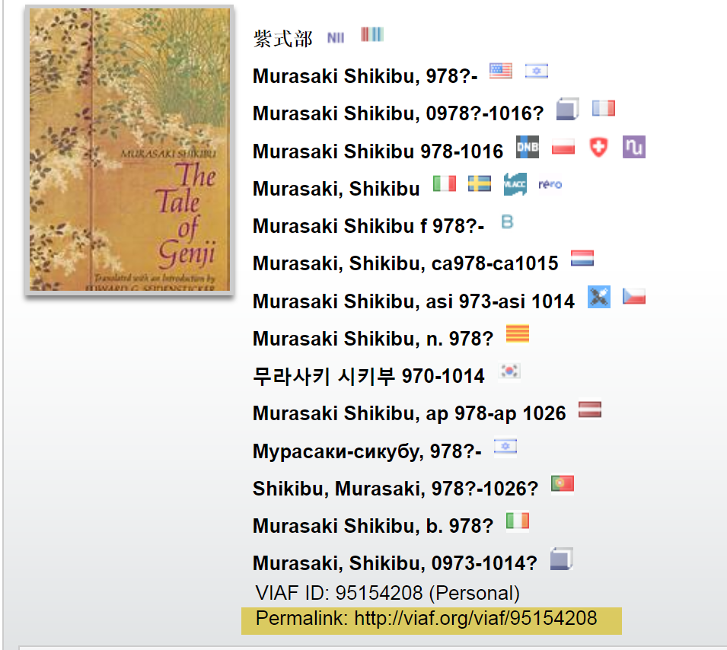
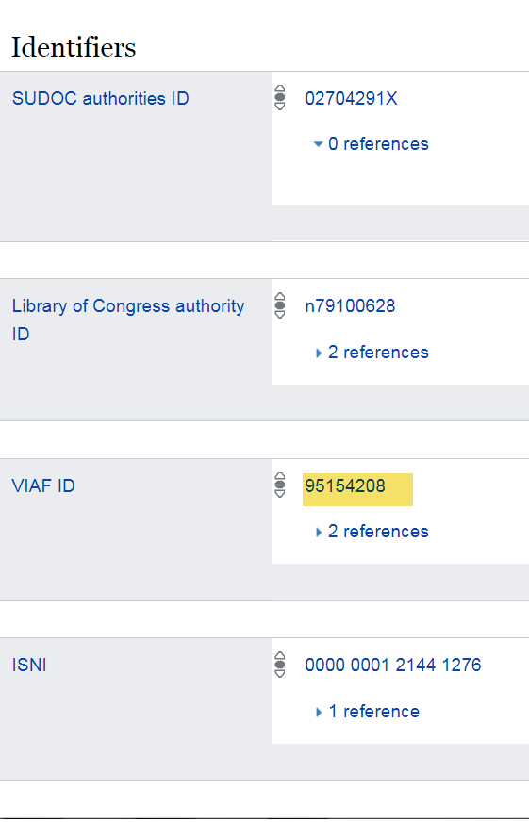
Identifiers rather than text strings
Notes:
OCLC’s Virtual International Authority File (VIAF) already has over 30 million identifiers – 22 million of them for personal names. Remember the different text strings we saw a little while ago for Murasaki Shikabu? They’re there – but linked to a permanent VIAF identifier – allowing applications to search for and display the name in the preferred script of the user. We see identifiers being included in other datasets – such as Wikidata, the foundation for all languages of Wikipedia. It’s entity description for Murasaki Shikabu has 34 different identifiers, including the VIAF identifier we see here.
“Identity management” is one of the key areas of focus in the Program for Cooperative Cataloging’s strategic directions for 2018-2021.

Slide 10
Lots of identifiers! Script-neutral!
data.bnf.fr
DBpedia
DNB Linked Data Service
DPLA
FAST (Faceted Application of Subject Terminology)
GeoNames
Getty Vocabularies
id.loc.gov
ISNI (International Standard Name Identifier)
MusicBrainz
VIAF
Wikidata
WorldCat.org
Notes:
These are just some of the linked data datasets that respondents to OCLC Research’s 2015 International Linked Data Survey for Implementers consume –. not just names, but also concepts, objects, and geographic coordinates that can be combined in different ways depending on one’s context. I’ve highlighted the ones cited the most by the 2015 respondents (the 2018 results haven’t been tabulated yet.)

Slide 11
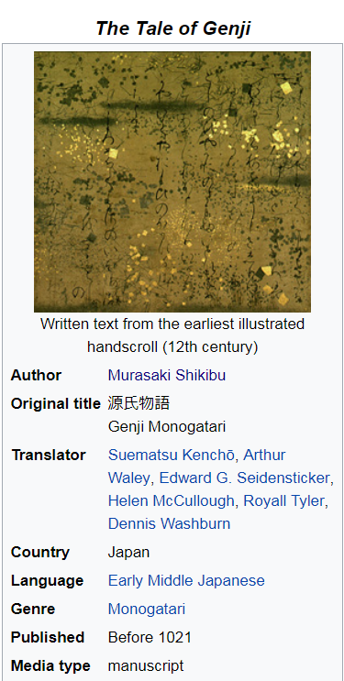
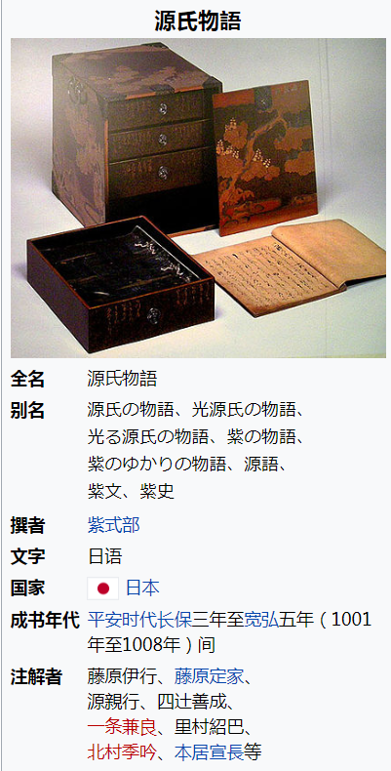
Statements rather than records
Some Wikidata statements
Instance of
Image
Author
Translator
Country of origin
Language of work or name
Notes:
The advent of linked data requires us to think of statements that relate to other entities and their statements rather than a “record” that combines descriptions and entity information. An indication of this future can be inferred from looking at Wikipedia pages and their respective, underlying Wikidata information.
These are two Wikipedia “Info boxes” for Genji monogatari, one in English, one Chinese. But both are tied to the identifiers and statements in Wikidata, some of which are shown on the right.

Slide 12
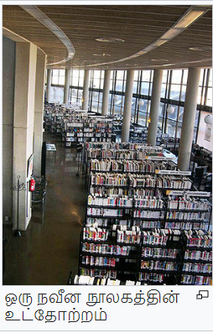
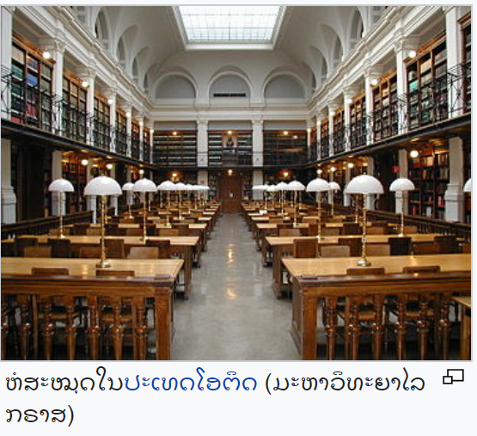
Some day we’ll be able to provide complete non-Latin script access!
Notes:
We are starting to have the infrastructure to support complete non-Latin script access to the resources curated and managed by libraries, everywhere. (Images taken from Wikipedia pages for “library” in Tamil, Georgian, and Lao – images all in Wikimedia commons.

Slide 13
Karen Smith-Yoshimura
Senior Program Officer
smithyok@oclc.org

