Slide 1
DLF 2018 Forum, Henderson, NV
16 October 2018
What’s changed in linked data implementations in the last three years?
Karen Smith-Yoshimura
OCLC Research
Linking Open Data cloud diagram 2017, by Andrejs Abele, John P. McCrae, Paul Buitelaar, Anja Jentzsch and Richard Cyganiak. http://lod-cloud.net/ by CC-BY-SA license.
Notes:
Background: The impetus for an “International Linked Data Survey for Implementers” were discussions with OCLC Research Library Partner metadata managers who were aware of a number of linked data projects or services but felt there must be more “out there”. In consultation with a number of colleagues and after some beta testing with a group of linked data implementers with the survey instrument, we conducted an initial survey in July – August 2014. The target audience were those who had already implemented a linked data project or service, or were in the process of doing so. Questions were asked both about publishing linked data and consuming linked data. I published the results in a series of posts on our HangingTogether blog.
One of the first criticisms we received were that the results did not include some leading linked data implementers such as the national libraries of France and Germany. So we repeated the survey between 1 June and 31 July 2015.
We were then curious about what might have changed in linked data implementations since 2015, so we repeated the survey again between 17 April and 25 May 2018.

Slide 2
International Linked Data Surveys for Implementers
Notes:
A total of 143 institutions reported one or more linked data project or service, either ones publishing linked data, consuming linked data, or both in the three surveys conducted. This chart shows the breakdown of the institutions responding to one or more surveys. 24 institutions (17%) responded to all three; 35 (24%) responded to only the 2018 survey. Of the 81 institutions that responded to the 2018 survey, 35 (24%) had not responded to previous surveys. So all comparisons are with the caveat that the respondent pool differs,

Slide 3
Geographic breakdown of 143 responding institutions
23 countries
represented
Notes:
These are the countries represented by the 143 institutions which have implemented or are implementing at least one linked data project or service. US respondents numbered 60, or 42% of the total.
Spain and the UK each had 14 respondents (10% each of the total) followed by The Netherlands’ 10 (7%). Canada and Germany complete the “top 5” countries represented with 5 institutions each.
Respondents from the United States to the 2018 survey accounted for 42% of the 81 responding institutions, with 34 institutions, followed by Spain (12), the United Kingdom (8), and The Netherlands (4).

Slide 4
Responding institutions by type
Notes:
We categorized the responding institutions by type. We were successful in our attempts to solicit responses from more national libraries in the 2015 survey compared to the 2014 survey, and almost the same number responded in 2018. Given that the survey was generally distributed on networks primarily used by libraries, most respondents in all three surveys tended to be from the library domain, with research libraries and national libraries the top two. The biggest change was for the first time <click> we received responses from service providers, which provide linked data services for their customers.

Slide 5
How long linked data project or service in production
 | 2018 | 2015
Not yet in production | 26 | 37
Less than one year | 14 | 19
More than one year, less than two years | 15 | 10
More than two years | 18 | 46
More than four years | 31
Total
104
112
Notes:
The 81 institutions responding to the 2018 survey described 104 linked data projects/services, compared to 71 institutions responding to the 2015 survey in which 112 were described. Institutions who had responded to a previous survey did not always describe the same linked data projects or services. Of the 104 linked data projects or services described, only 42 had been described previously. Even when the same project or service was described, the respondent sometimes differed from the one who responded previously. Some respondents did not answer every question, so the totals for each question may vary.
75% of the linked data projects/services described in 2018 are in production, slightly higher than the 67% reported in 2015. 40% of the linked data projects/services described in 2018 have been in production for more than four years.

Slide 6
How linked data is used
 | 2018 | 2015
Consume linked data | 34 | 38
Publish linked data | 5 | 10
Both consume & publish | 65 | 64
Notes:
In both the 2015 and 2018 surveys, most projects/services both consume and publish linked data. Relatively few only publish linked data, and the number of publish-only linked data projects/services decreased.

Slide 7
Success assessment
2018
2015
Notes:
More respondents reported that their linked data project or service was successful or “mostly” successful in 2018 than in 2015: 56% compared to 41%. Fewer didn’t know yet as their projects were still at an early stage (pre-implementation or early implementation.

Slide 8
Publishing Linked data

Slide 9
Reasons for publishing linked data (n=92 in both 2015 & 2018) | 2018 | 2015
Expose to larger audience on the Web | 74% | 73%
Demonstrate what could be done with datasets as linked data | 65% | 64%
Heard about linked data and wanted to try it out by exposing our data as linked data. | 45% | 47%
Needed to publish linked data in order to consume it | 25% | *
Notes:
The key motivations to publish linked data appear unchanged. Because some 2015 survey respondents had noted the need to publish linked data in order to consume it as an “other” motivation, we offered it as an option in the 2018 survey; it became the fourth most commonly cited reason.

Slide 10
Types of data published as linked data
Notes:
Given the relatively large representation of libraries among respondents, no surprise that descriptive, bibliographic and authority data are the most common types of data published in both surveys, with slight variations in numbers. “Data about people” was common enough in the “other” responses in the 2015 survey that we added it as an option in 2018 – it tied for fourth, with ontologies and vocabularies. There were also slight increases in the number of linked data projects/services publishing digital collections and geographic data in 2018.

Slide 11
RDF vocabularies/ontologies used
Notes:
We can see more differences in the RDF vocabularies and ontologies used in the last three years. This chart shows the top eight reported in 2018 (used by at least 20% of respondents) compared to 2015. We observe substantial increases in Schema.org and BibFrame, with decreased usage of SKOS and FOAF in particular.

Slide 12
Barriers to publishing linked data | 2018
Steep learning curve for staff | 41
Inconsistency in legacy data | 38
Selecting appropriate ontologies to represent our data | 26
Lack of resources | 23
Little documentation or advice on how to build the systems | 23
Establishing the links | 22
Notes:
The top six barriers cited by the 2018 survey respondents were almost the same as the 2015 survey respondents, “Lack of resources” was added as an option (a popular “other” response in 2015) and tied with little documentation. “Establishing the links” was the 4th top barrier in 2015.

Slide 13
Consuming Linked data

Slide 14
Reasons for consuming linked data | 2018 | 2015
Provide our users with a richer experience. | 54 | 51
Enhance our own data by consuming linked data from other sources. | 49 | 50
Heard about linked data and wanted to try it out by using linked data sources. | 23 | 17
More effective internal metadata management. | 21 | 32
Experiment with combining different types of data into a single triple store. | 20 | 17
Greater accuracy and scope in our search results | 19 | 27
See if consuming linked data would improve our Search Engine Optimization (SEO) | 7 | 19
Notes:
The top two reasons given for consuming linked data are the same among respondents to the 2015 and 2018 surveys. But there are drops in those motivated by <click> improving SEO (-18%), more effective internal metadata management (-17%), and achieving greater accuracy and scope in search results (-12%).
NB Number of respondents to this question was almost the same: 69 in 2018 vs. 68 in 2015

Slide 15
Linked Data sources consumed
Notes:
These are the top 10 linked data sources consumed by the 2018 survey respondents compared to 2015. The biggest change <click> was the surge in consuming Wikidata, more than four times that in the linked data implementations in 2015. We also see big increases in consuming WorldCat.org and ISNI. The asterisks indicate the ones which also responded to the survey.
These could be considered successful publishers of linked data by the degree to which others consume the data provided.
NB Number of respondents to this question was almost the same: 69 in 2018 vs. 68 in 2015

Slide 16
Barriers to consuming linked data | 2018 | 2015
Matching, disambiguating and aligning source data and linked data resources | 48% | 39%
What's published as linked data isn’t always reusable/lacks URIs | 31% | 27%
Size of RDF dumps | 28% | 20%
Unstable endpoints | 28% | 17%
Service reliability | 26% | 15%
Mapping of vocabulary | 26% | 29%
Understanding how data is structured before using it | 24% | 20%
Notes:
This lists the top 7 barriers in the 2018 survey responses. The top barrier in both the 2018 and 2015 surveys was matching, disambiguating, and aligning source data and linked data sources. The biggest difference: an uptick in the number of responses pointing to unstable endpoints and service reliability.
NB Number of respondents to this question was almost the same: 58 in 2018 vs. 59 in 2015

Slide 17
Some New examples In production
Notes:
I noted earlier that 40% of the linked data projects/services described in the 2018 survey had been in production for over four years, several of which appeared in the “sources most consumed” slide. I’ve selected a few examples from the 47 linked data implementations described that have put into production since the last survey.
Not so easy, as they are meant for machines to read, not a human like me. This is just a sampling.

Slide 18
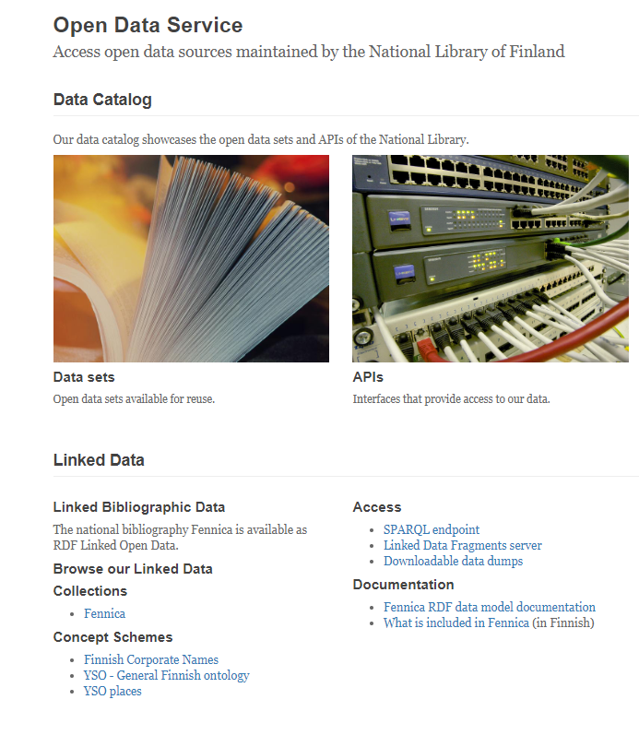
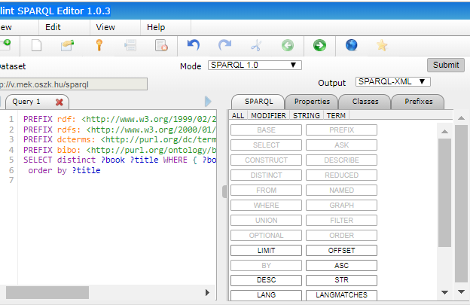
http://data.nationallibrary.fi
http://v.mek.oszk.hu/FlintSparqlEditor/index-mek.html
Notes:
The National Library of Finland’s service to access its bibliographic database has been in production for less than one year. It noted, “Creating this service has been a major milestone” and makes it clear what the possibilities and limitations are.”
<Cllick> The National Library of Hungary first converted its Hungarian common catalog into linked data and then provided this new service less than a year ago to provide access to its electronic library through SPARQL queries.

Slide 19
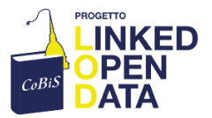
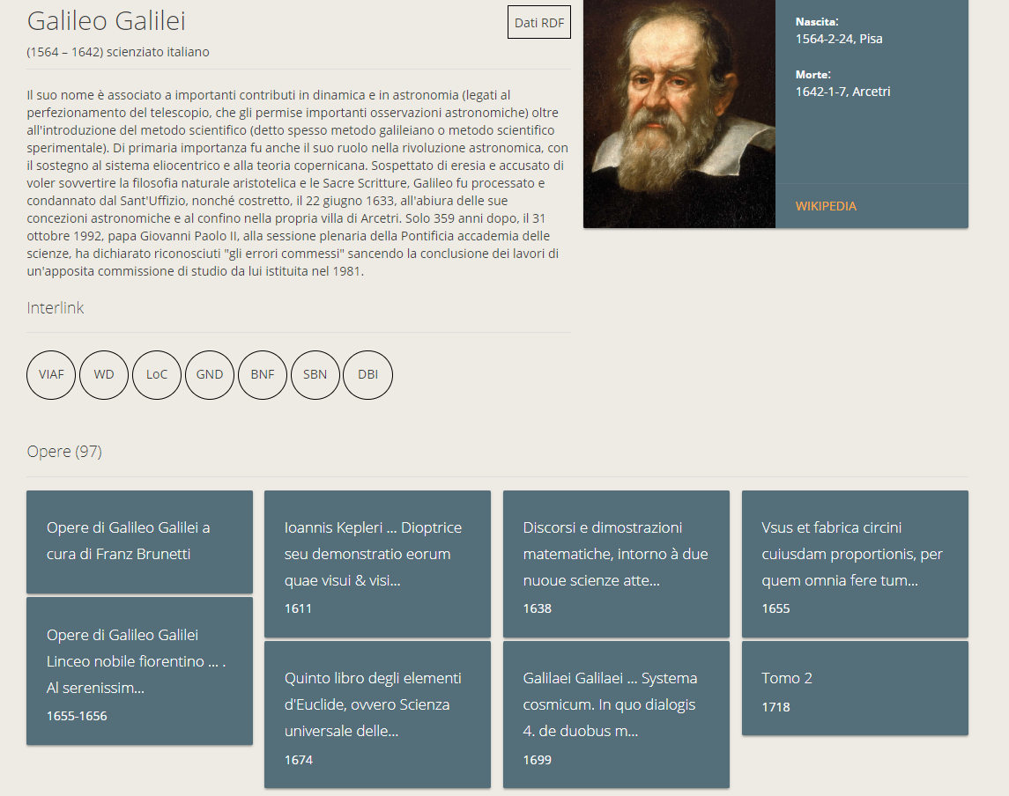
https://dati.cobis.to.it/
Notes:
CoBIS is a collaboration among six libraries in Turin, providing linked data access to their shared library collections, launched in December 2017. It noted it has been a “great success” in making their collections visible and is one of the “very few” such projects in Italy.

Slide 20
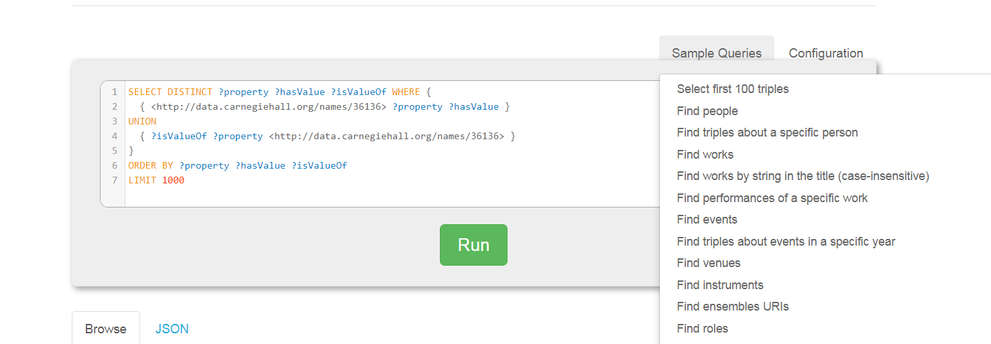
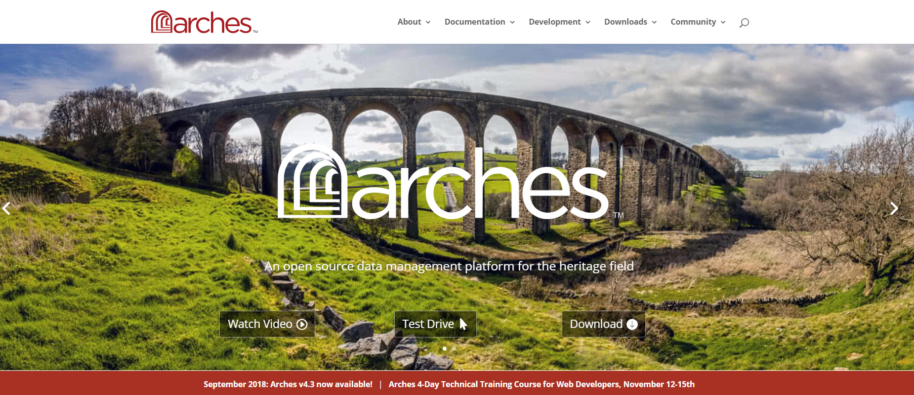
http://data.carnegiehall.org
http://archesproject.com/
Notes:
Closer to home, Carnegie Hall has released its performance history data from 1891 through the end of 2015 as linked data, launched less than a year ago.
<Click> The Getty Conservation Institute collaborated with the World Movements Fund to develop Arches, a geospatially-enabled software platform for cultural heritage inventory and management.

Slide 21
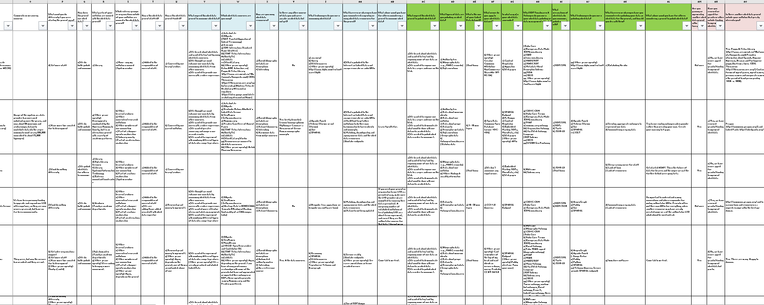
Details of all responses
oc.lc/ld-survey-responses
Notes:
We’ve added the responses to the 2018 survey to the Excel workbook with the 2014 and 2015 responses (without the contact information which we promised we’d keep confidential). Feel free to make your own comparisons, or focus on the institutions that most resemble yours.

Slide 22
DLF 2018 Forum, Henderson, NV
16 October 2018
Thank you!
Contact: Karen Smith-Yoshimura
smithyok@oclc.org
@KarenS_Y
©2018 OCLC. This work is licensed under a Creative Commons Attribution 4.0 International License. Suggested attribution: “This work uses content from What’s Changed in Linked Data Implementations in the Last Three Years? © OCLC, used under a Creative Commons Attribution 4.0 International License: http://creativecommons.org/licenses/by/4.0/.”

