Slide 1

and

Slide 2

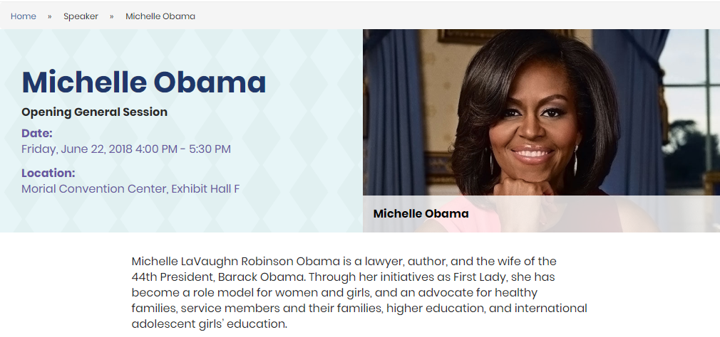

Slide 3
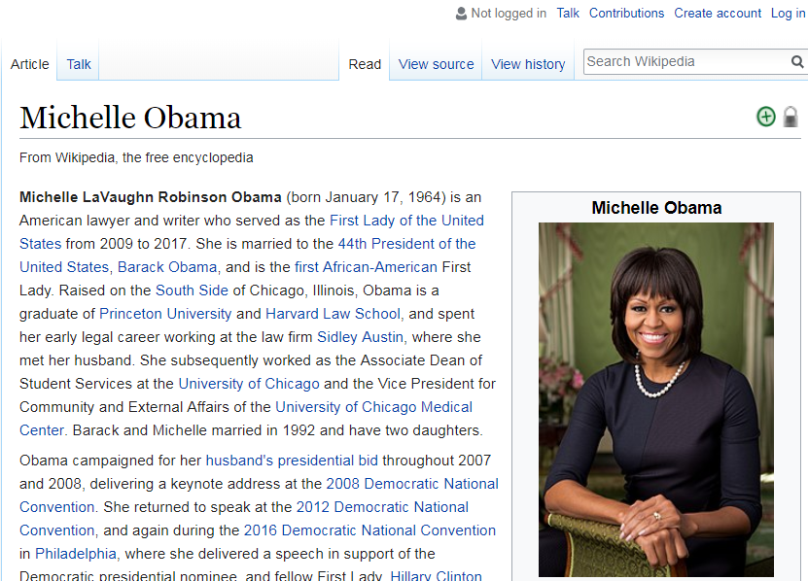

Slide 4
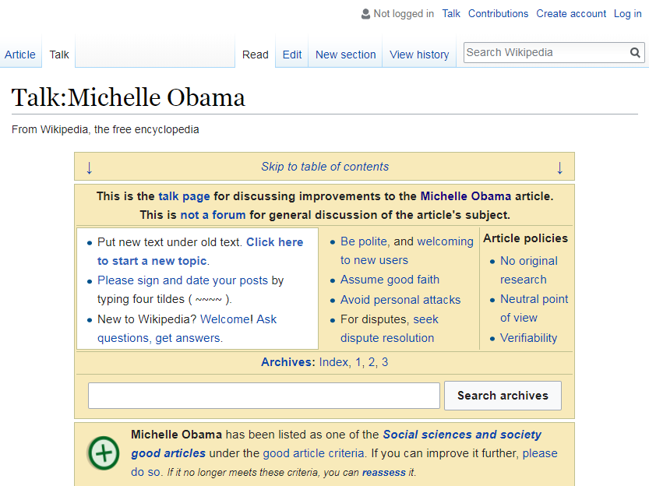

Slide 5
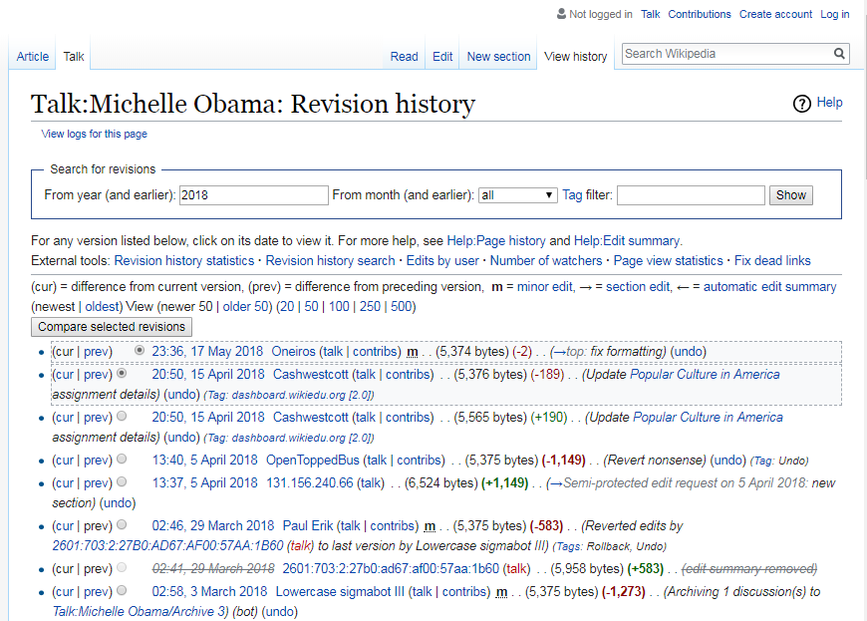

Slide 7
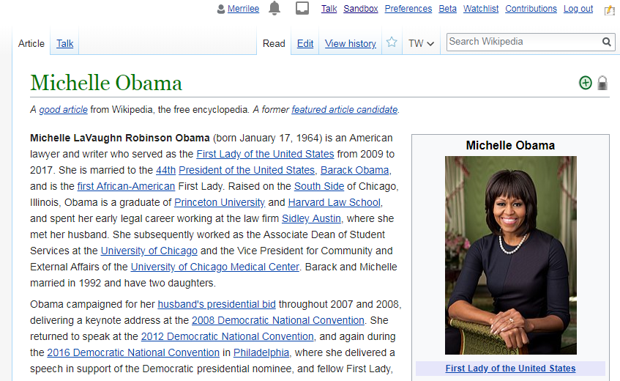

Slide 8
Core content policies
Neutral point
of view
No original research
Verifiability

Slide 9
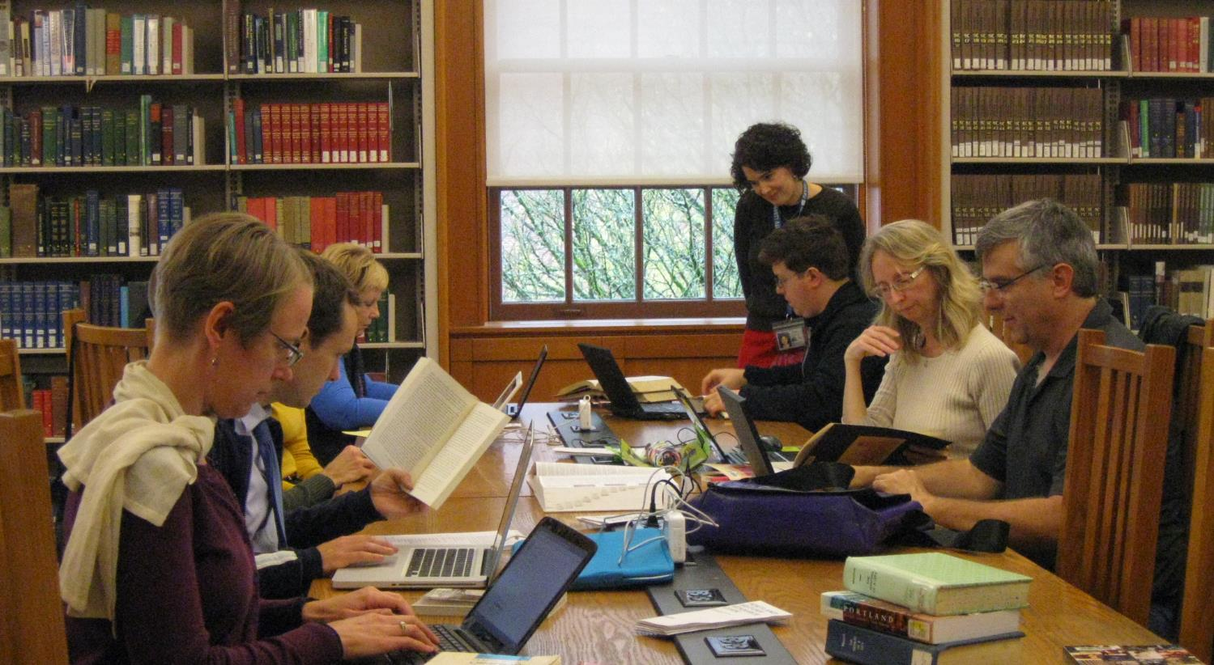
Librarians who Wikipedia
Wikipedia Loves Libraries: Portland. User Pdx.leecat own work. CC BY SA 3.0

Slide 10
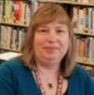
“Sources that are credible…”
“…I like that I can add sources that are credible and I am able to find information using my databases that others don’t have immediate access to.”
Jean King
West Hempstead Public Library
Photo courtesy Jean King

Slide 11
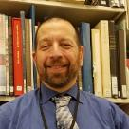
“Why not do this in Wikipedia? ”
“…I was coming across all of these musicals with no reference information. It would have helped me greatly to have some reference material to contextualize the music. I started to make my own lists, then it hit me: why not do this in Wikipedia so that it will help other people, too?”
Bob Kosovsky
New York Public Library
Photo courtesy Bob Kosovsky

Slide 12
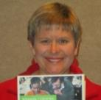
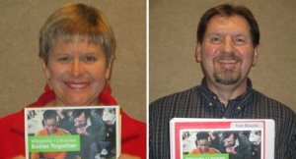
“…I, too, used to poo-poo Wikipedia. Now I consider myself a convert. I am pushing its value to help students be critical consumers of information. ”
Denise Davis
Morton James Public Library in Nebraska city, Nebraska
“I am pushing its value to help students…”
“…I, too, used to poo-poo Wikipedia. Now I consider myself a convert. I am pushing its value to help students be critical consumers of information. ”
Denise Davis
Morton-James Public Library
Photo courtesy Denise Davis

Slide 13

“A tremendous opportunity…”
“This is a tremendous opportunity here to make [Wikipedia] a very robust resource for everybody….
I dare you not to get excited.”
Kim Gile
Kansas City Public Library
“This is a tremendous opportunity here to make [Wikipedia] a very robust resource for everybody…. I dare you not to get excited.”
Kim Gile
Kansas City Public Library
Photo courtesy Kim Gile

Slide 14

“Longevity and visibility…”
“…writing the Wikipedia article makes this information available to everyone; it has longevity and visibility.
Susan Barnum El Paso Public Library
Credit: Susan Barnum CC BY-SA 4.0
2018 Library Journal Mover & Shaker for her advocacy work with Wikipedia!

Slide 15
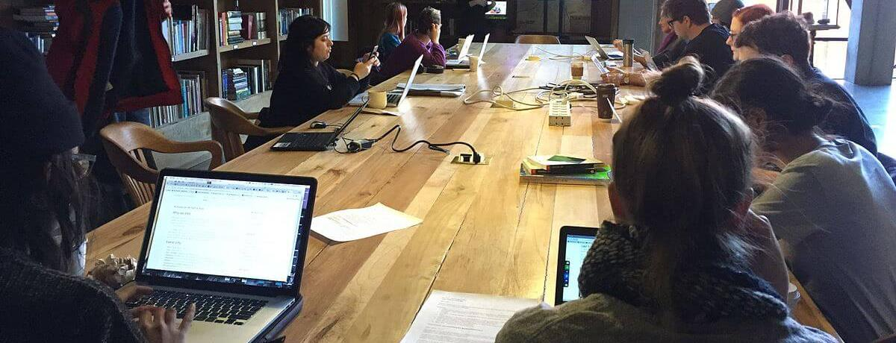


Wikipedia + Libraries: Better Together
Strengthening ties between public libraries and Wikipedia
oc.lc/oclc-wikilib
Image: Heathart CC BY-SA 4.0 via Wikimedia Commons

Slide 16
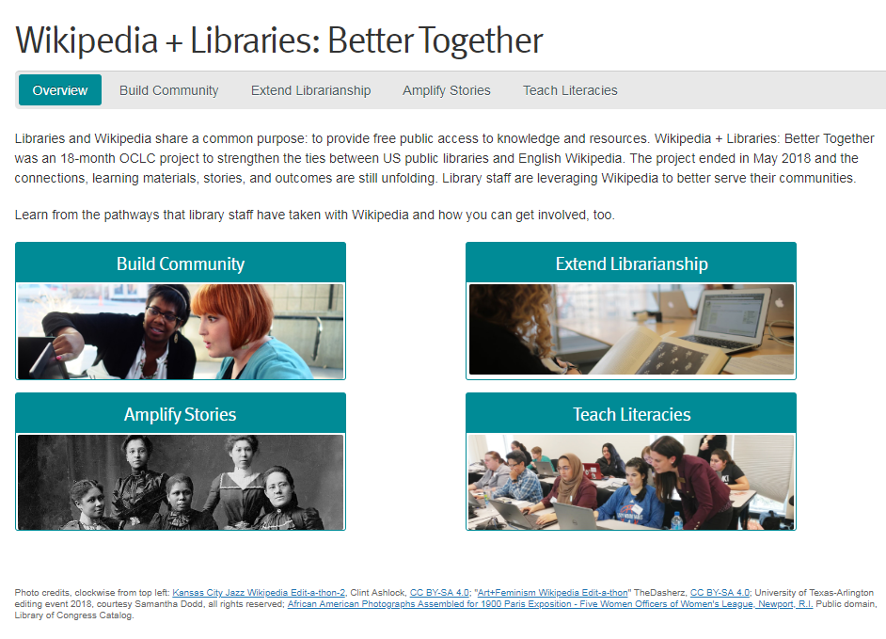

Slide 17
