Slide 1
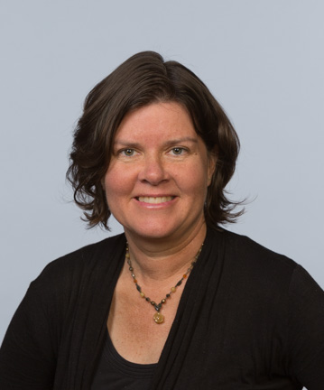
Merrilee Proffitt
Senior Program Officer, OCLC Research
@merrileeIam | proffitm@oclc.org

Slide 2

and

Slide 3
Connecting communities of knowledge
Work with Wikipedia helps us…
Connect collections with people who want and need them
Amplify voices of those in our communities
Create opportunities to join with others

Slide 4
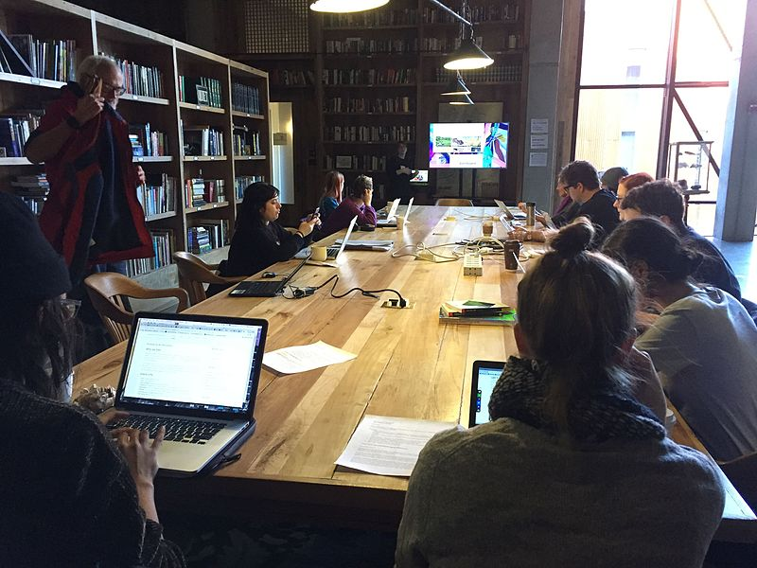


Wikipedia + Libraries:
Better Together
Strengthening ties between
public libraries and Wikipedia
Image: Heathart CC BY-SA 4.0 via Wikimedia Commons

Slide 5
Learning, the WebJunction way
Focus on the needs of adult learners
Put the “why” before the “how”
Meet people where they are
Show, don’t tell

Slide 6
Wikipedia + Libraries overview
1
Research public library connections
Build awareness/recruit US public library staff; design curriculum; recruit Wikipedia guides
Deliver 9-week online training program; Sept. 13 - Nov. 15, 2017
Enrolled ~300 U.S. public library staff
Collect / publish case studies and resources
Evaluate and share learnings
2
3

Slide 7
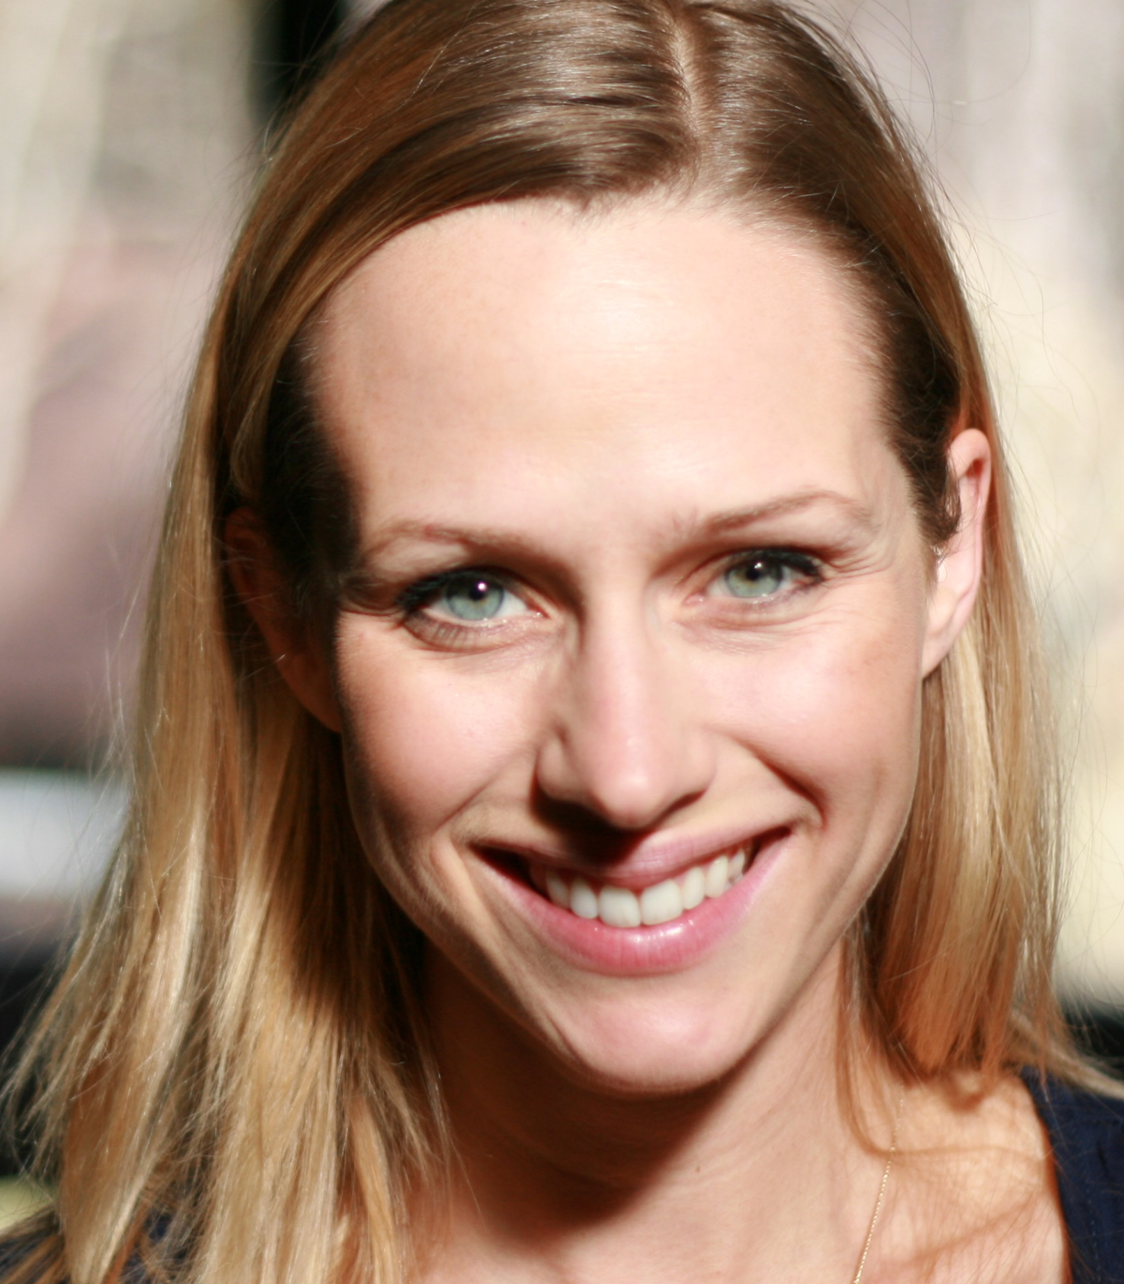
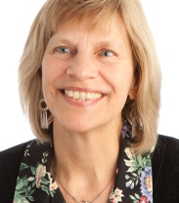
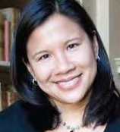
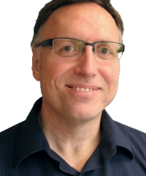
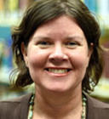
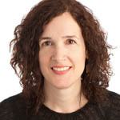
Wikipedia + Libraries project team
Monika Sengul-Jones
Wikipedian-in-Residence, Instructor
jonesm@oclc.org
Mercy Procaccini
Project Coordinator
procaccm@oclc.org
Dale Musselman
Technical Support
musselm@oclc.org
Betha Gutsche
Instructor
gutscheb@oclc.org
Merrilee Proffitt
Senior Program Officer
proffitm@oclc.org
Sharon Streams
WebJunction Director
streamss@oclc.org

Slide 8
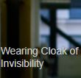
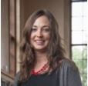
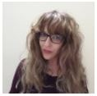
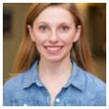
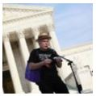
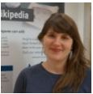
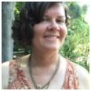
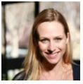
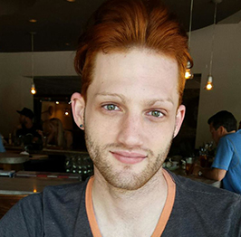
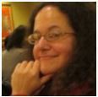
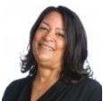
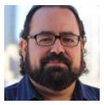
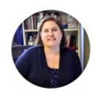
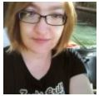
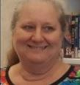
Wikipedia guides – the human to human element
Avery
Jensen
Emily
Jack
Jacinta
Sutton
Jackie Koerner
Jim
Hayes
Megan
Wacha
Merrilee
Proffitt
Monika
Sengul-Jones
Paul
Flagg
Rachel Wexelbaum
Rajene
Hardeman
Rob
Fernandez
Sara
Marks
Susan Barnum
Kerry
Raymond

Slide 9
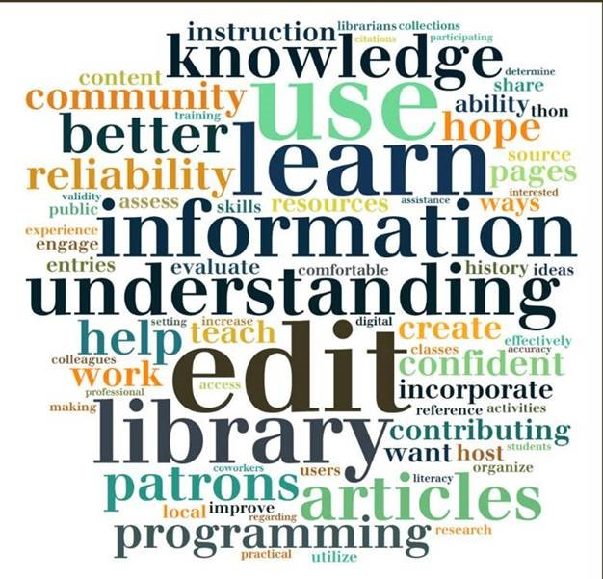
What do public library staff want?
Increase information literacy
Improve access to authoritative information online
Support research and critical thinking skills
Raise visibility of their libraries, communities
Enrich community programs
70% of participants had never edited Wikipedia

Slide 10
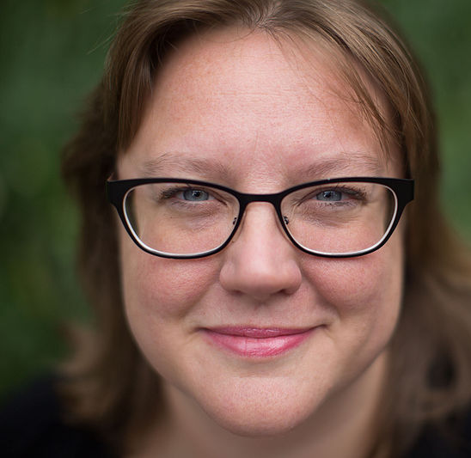
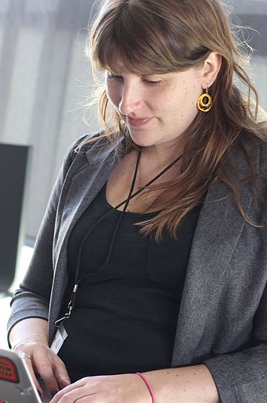
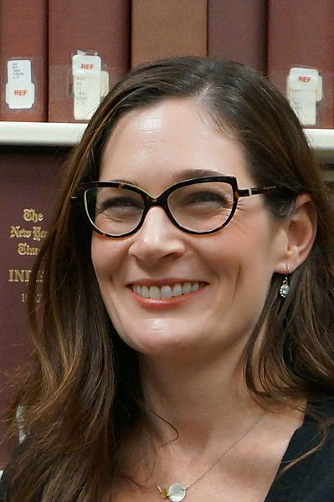
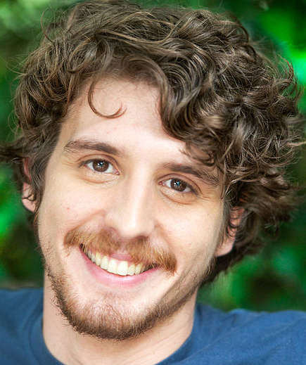
Librarians
Who
Wikipedia

Slide 11
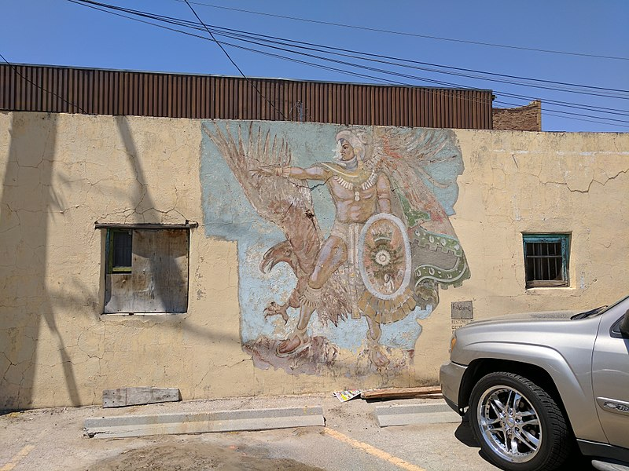
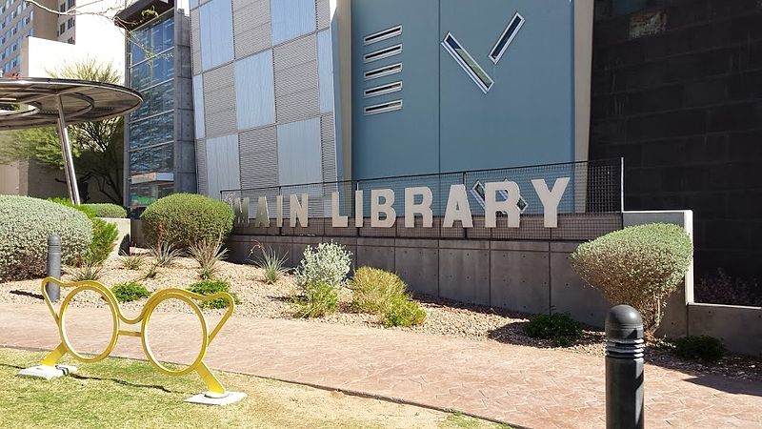
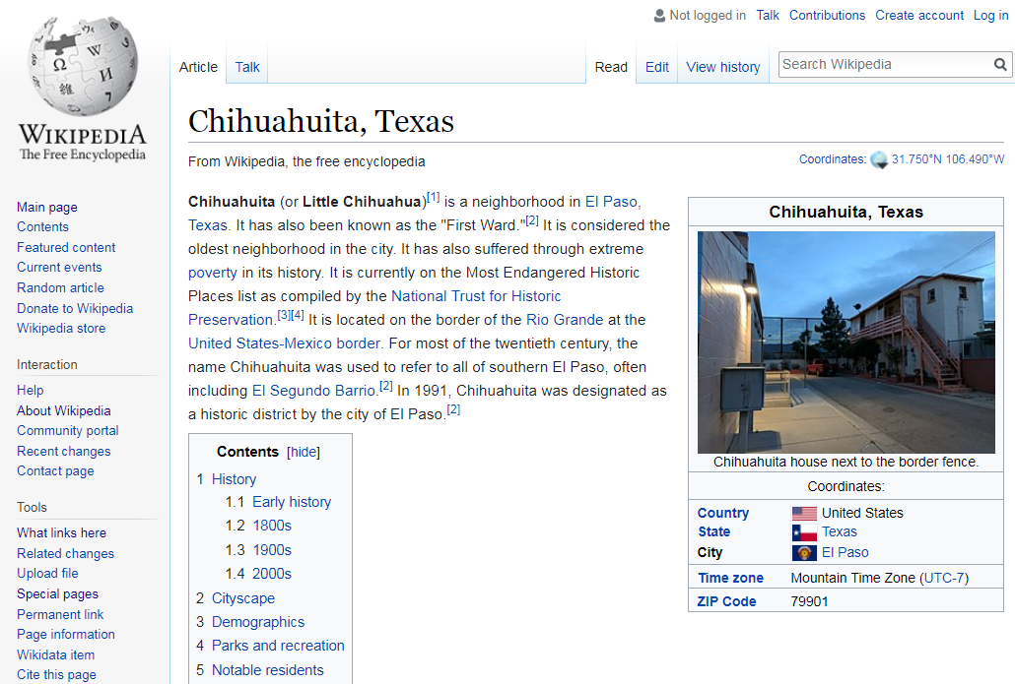
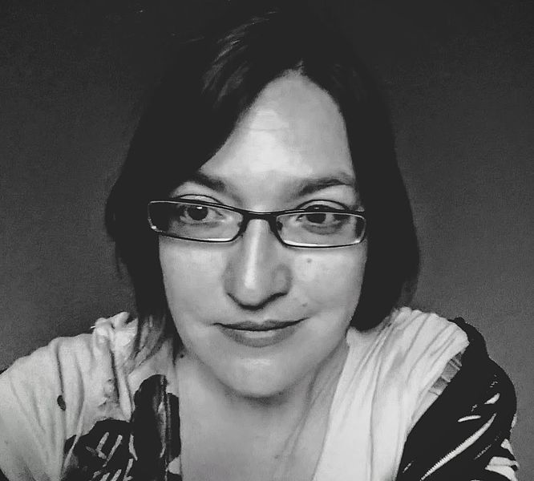
Images by Susan Barnum CC BY-SA 4.0

Slide 12
The reference librarian
“…writing the Wikipedia article makes this information available to everyone; it has longevity and visibility.

Slide 13
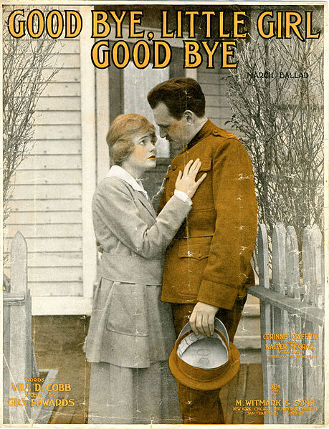
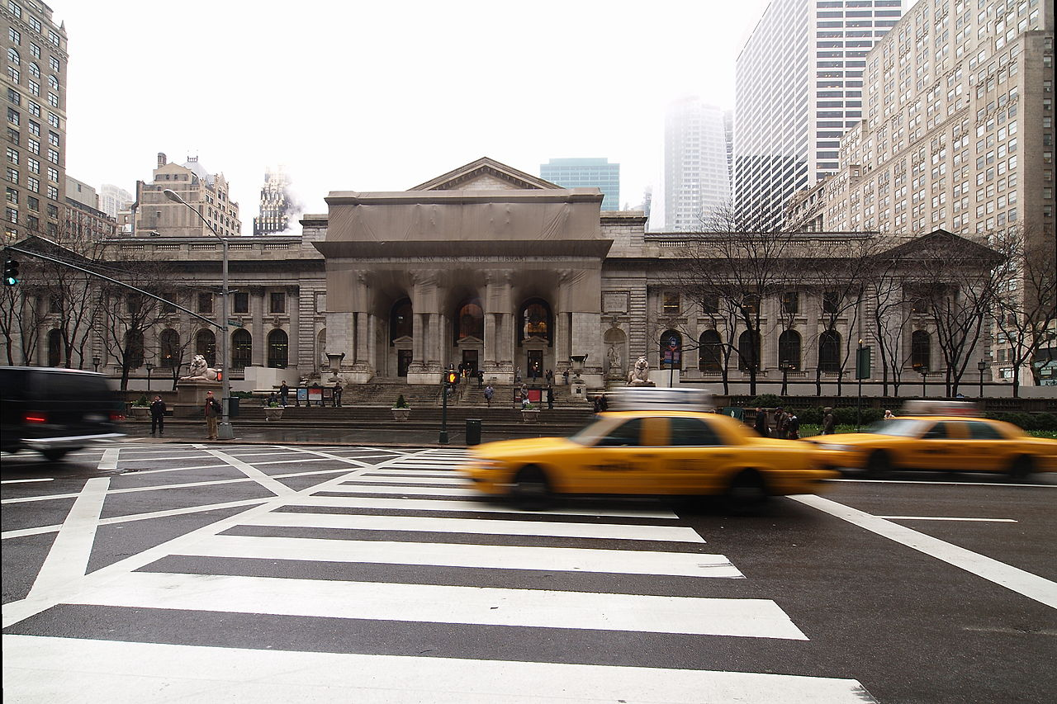
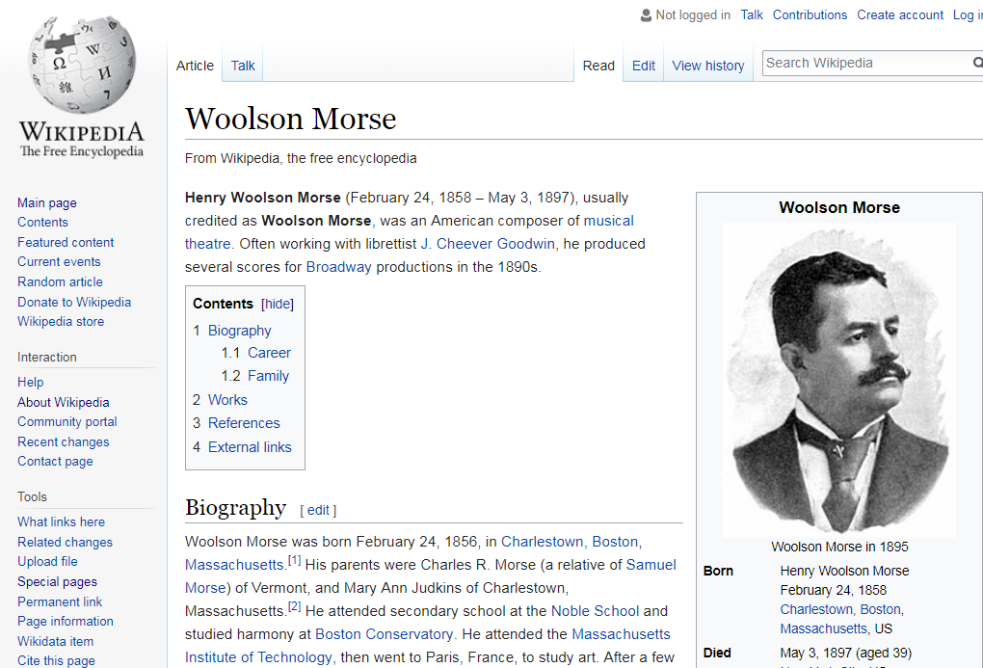
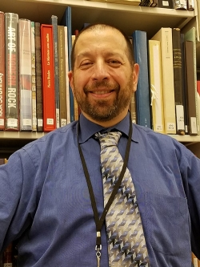
Arnoldius cc-by-SA 4.0

Slide 14
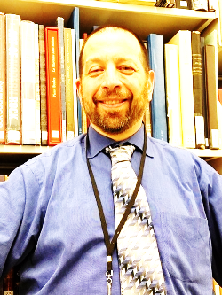
The subject specialist / curator
“…I was coming across all of these musicals with no reference information. It would have helped me greatly to have some reference material to contextualize the music. I started to make my own lists, then it hit me: why not do this in Wikipedia so that it will help other people, too?

Slide 15

Librarians rocked the course!
By the numbers*
The 236 active participant editors
made over 5900 edits
and 369 Commons (photo) uploads
to improve 799 articles
and create 6 new articles!
Since the start of the course, there have been 36.1m views of improved articles
*as of 13 February 2018

Slide 16
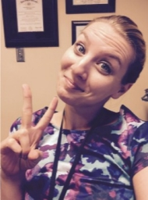
Connecting to other institutions
“This is a tremendous opportunity here to make [Wikipedia] a very robust resource for everybody….
I dare you not to get excited.

Slide 17
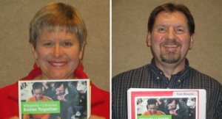
Information literacy
“…I, too, used to poo-poo Wikipedia. Now I consider myself a convert. I am pushing its value to help students be critical consumers of information.

Slide 18
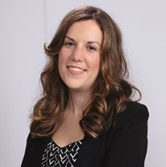
The campus connector
“…Think beyond the edit-a-thon. What we are developing [is] an ongoing Wikipedia project here—with the library as the center of it all.”

Slide 19
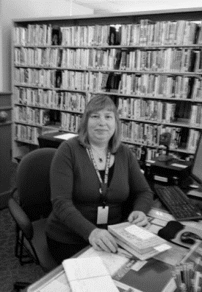
The individual contributor
“…I like that I can add sources that are credible and I am able to find information using my databases that others don’t have immediate access to.

Slide 20
Survey questions | Pre-course | Post-course
I understand how Wikipedia works and can explain to others | 18% | 77%
I do not know how to edit Wikipedia | 61% | 2%
I do not know how to organize an engagement program involving Wikipedia | 69% | 4%
I have helped patrons evaluate information on Wikipedia | 22% | 61%
I have helped a colleague with Wikipedia | 12% | 48%

Slide 21
“
As I have been talking with my colleagues about this class, almost EVERY person has said, 'but we tell people not to use Wikipedia!’ I … thought the same thing…my mind has been completely changed…I can all but guarantee we are steering people away from a good place to start their research.
“

Slide 22
“
I really liked the foundational information at the beginning, talking about the structure and layers of work going on with Wikipedia. I really had no idea that there were so many checks and balances on the articles.
“

Slide 23
“
I was one of 99% of users who think
of Wikipedia as a less reliable source.
I must say that this course was an
eye opener …
I am a changed librarian now.
A librarian who feels the worth of Wikipedia, crowdsourcing and contributing to the larger community.
“

Slide 24
Librarians have the power to make Wikipedia better and more reliable.
BE BOLD

Slide 25
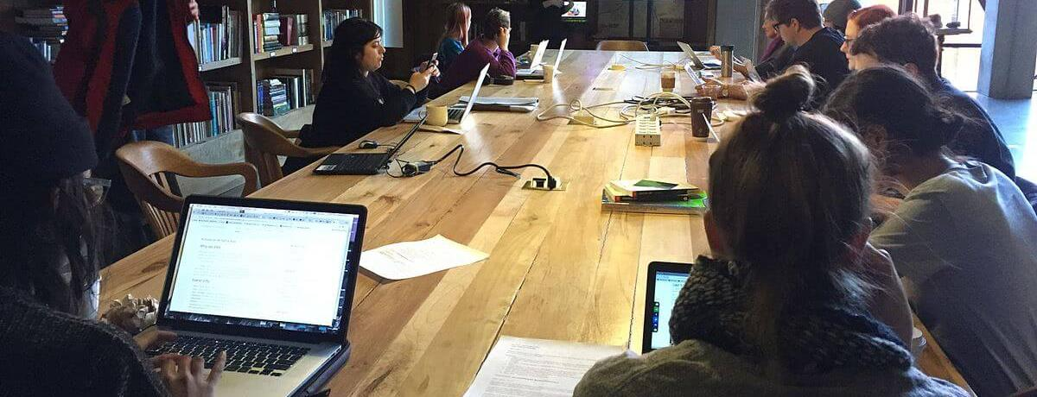


Wikipedia + Libraries: Better Together
Strengthening ties between
public libraries and Wikipedia
oc.lc/oclc-wikilib
Image: Heathart CC BY-SA 4.0 via Wikimedia Commons

Slide 26
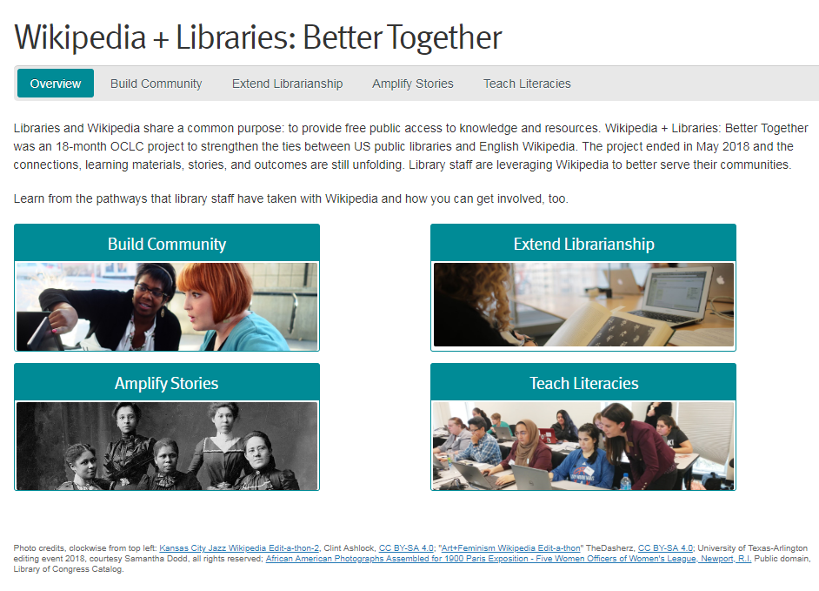

Slide 27
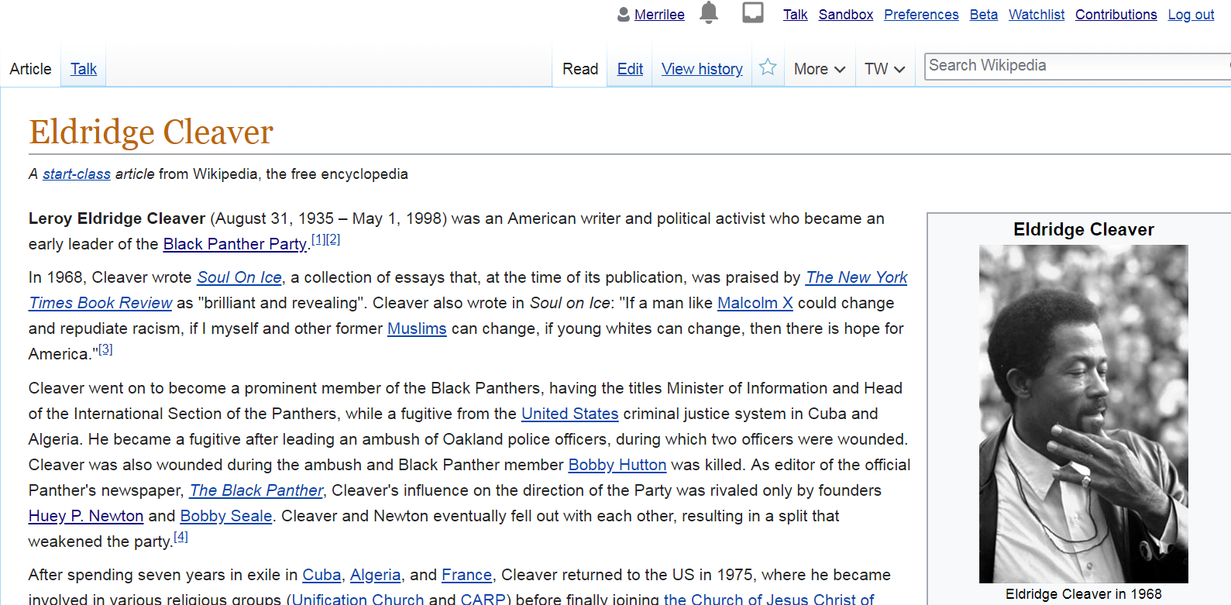

Slide 28
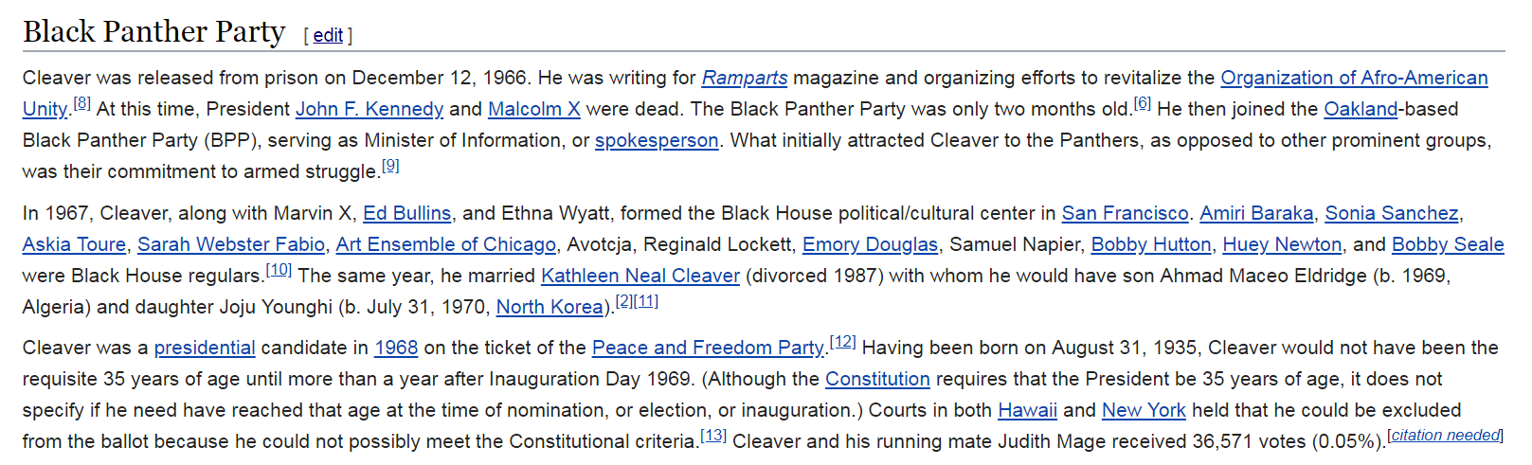

Slide 29
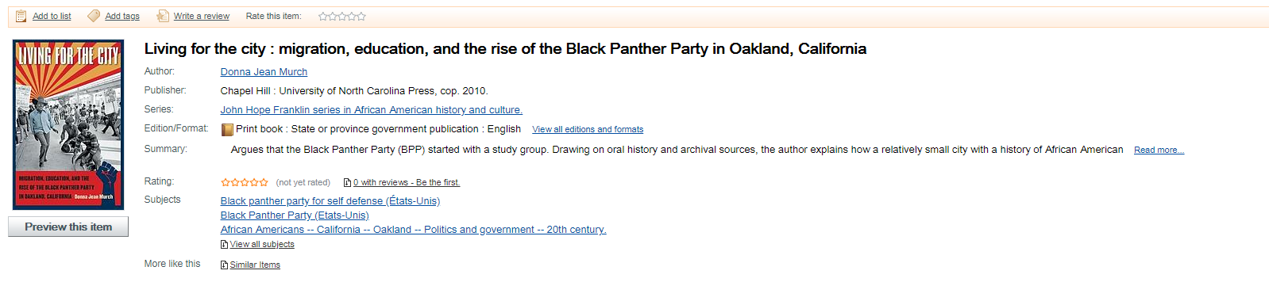
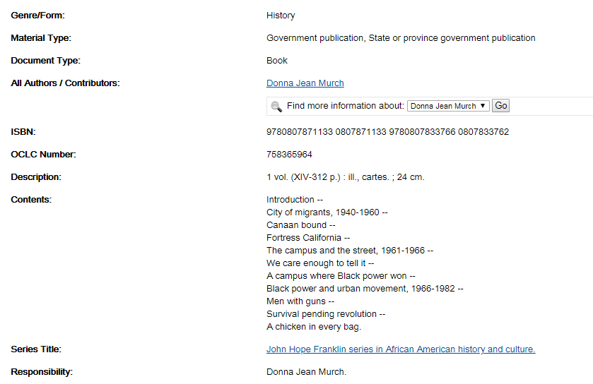

Slide 31
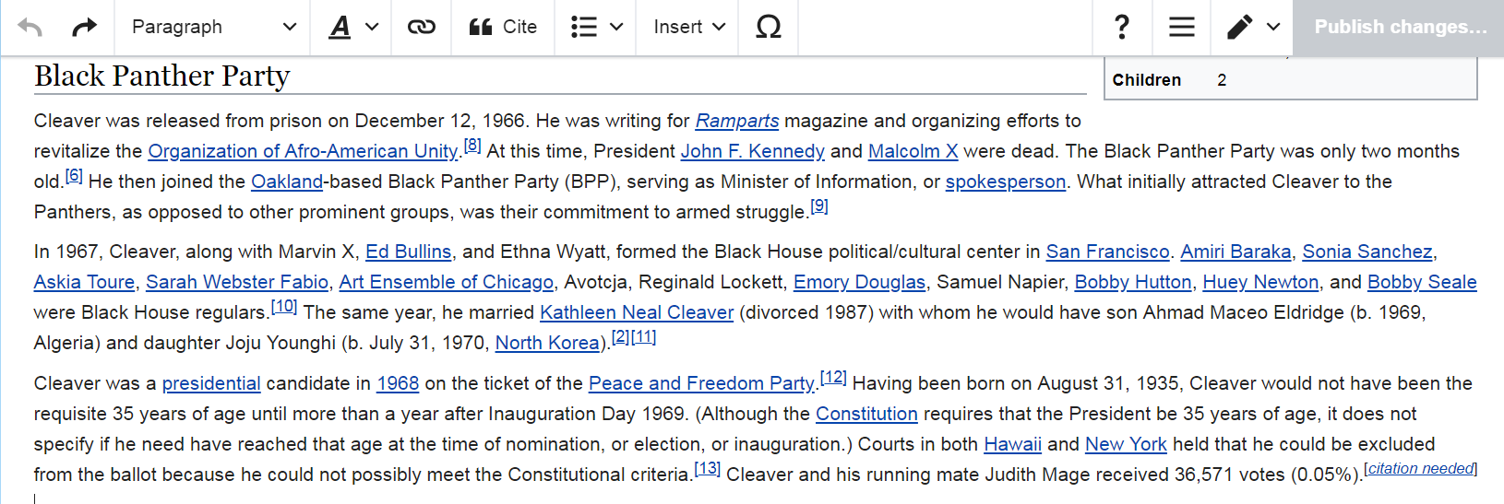

Slide 32
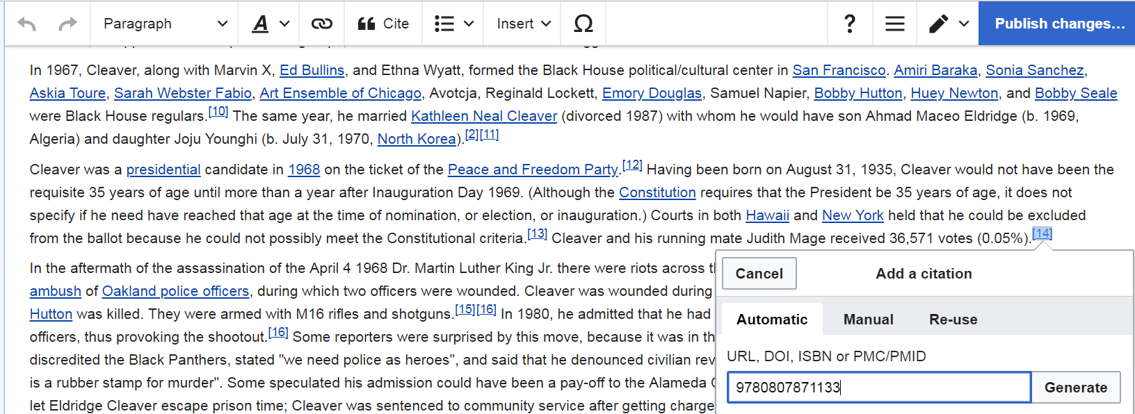

Slide 33
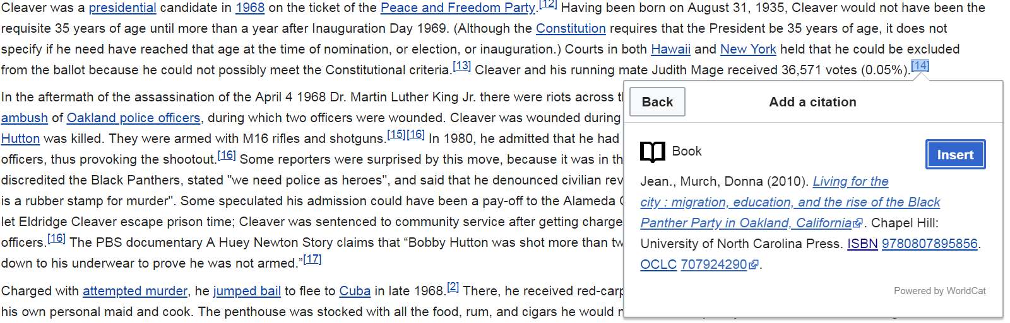

Slide 34


