Slide 1
The Smarter Library: A Vision from the Front Page of Wikipedia
MERRILEE PROFFITT, OCLC JAKE ORLOWITZ, WIKIMEDIA FOUNDATION
Notes:
I’m Merrilee Proffitt from OCLC Research and together with Jake we are going to explore the connections between Wikipedia and libraries. We are both very excited about the ideas surfaced in the smarter library theme and think that many of the smarter library themes connect directly with Wikipedia a 17 year old open knowledge project.

Slide 2
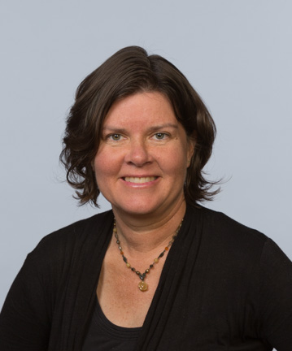
Merrilee Proffitt
Senior Program Officer, OCLC Research
@merrileeIam
Notes:
I have been editing Wikipedia since 2005 – I was first drawn to Wikipedia because I saw potential for harnessing it’s power, to help advance the cause of libraries. The more I imbedded myself in the community of Wikipedians and embarked I realized that is was not the power of the platform – which is fact is rather homely – but the power of the community behind it. Wikipedians and their values are closely allied with those of librarians, as we will explore in our talks today.

Slide 3
Connecting communities of knowledge
Work with Wikipedia helps us…
Connect collections with people who want and need them
Amplify voices of those in our communities
Create opportunities to join with others
Notes:
Working with the Wikipedia and broader Wikimedia Community has many positive outcomes – we can leverage the platform to help connect our collections with people who are looking for information. We can help the communities that we serve and represent to participate in this project, and we can use these opportunities to forge connections to a community that has values that are allied with our own. The possibilities mirror those that are layed out in our conference themes --
For example we can reimagine customer experiences by recognizing alternative pathways to information – not everyone comes through our front door.
Keeping pace with change through continuous innovation by learning now skills, and learning more about Wikipedia may be one way to do that.

Slide 4
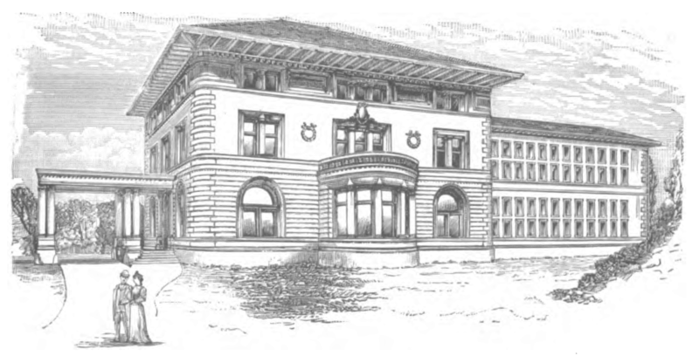
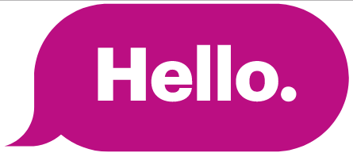
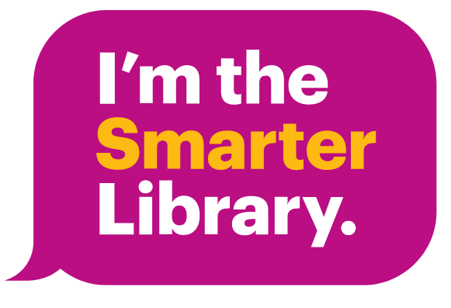
Work with Wikipedia helps us to...
Reconfirm and extend our professional values by connecting with an allied community
Image: Waterbury Bronson Library 1896 [Public domain], via Wikimedia Commons
Notes:
But I think the theme that is most relevant here is Confirm professional values confirming our professional values and
strengthening the communities we serve

Slide 5
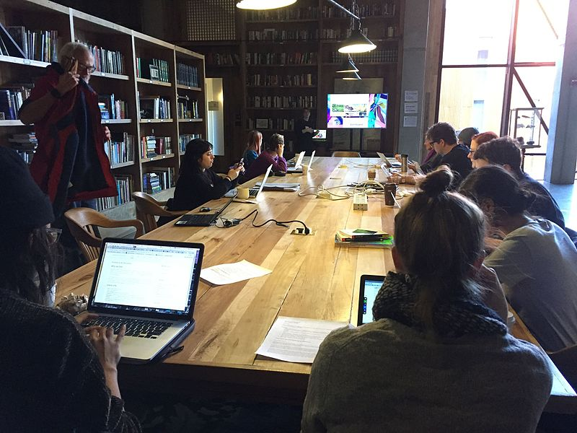


Wikipedia + Libraries:
Better Together
Strengthening ties between public libraries and Wikipedia
Image: Heathart CC BY-SA 4.0 via Wikimedia Commons
Notes:
In my presentation I want to share with you some in progress work being undertaken in WebJunction, which is part of OCLC Research. Since 2003 WebJunction has been the learning place for libraries and has served as a virtual gathering place where library staff build skills and find support in a profession that is rapidly evolving.
The Wikipedia + Libraries project seeks to strengthening ties between US public libraries and Wikipedia,
to expand public access to authoritative information,
and to serve public libraries’ diverse communities.
The project is funded by the John S. and James L. Knight Foundation and the Wikimedia Foundation
In this grant, we created a program designed for librarians that has three goals for participating library staff:
Engage and empower their community members to build information literacy skills and to access and create knowledge
Raise the visibility of their libraries and their unique, local collections
Build on their own digital, critical thinking, and community engagement skills—and encourage their colleagues to do the same.

Slide 6
Learning, the WebJunction way
Focus on the needs of adult learners
Put the “why” before the “how”
Meet people where they are
Show, don’t tell
Notes:
The web junction approach is very much geared to the needs of adult learners. We recognize that people who are already in the workplace and who are seeking to sharpen or develop their skills have limited time. The WebJunction team recognizes adult learners needs to be put skills to work in their current work, or their current workplace so we put the why before the how We spent very little time on, for example, the mechanics of editing Wikipedia. Instead we spent more time connecting various ways of engaging with Wikipedia to the work that librarians are already doing.
If we were going to get librarians to connect with Wikipedia we needed to give them very good examples of what is already working elsewhere for people who look like them, that is, librarians and that have jobs that look like theirs.
Show, don’t tell was something we tried to model in this course.

Slide 7
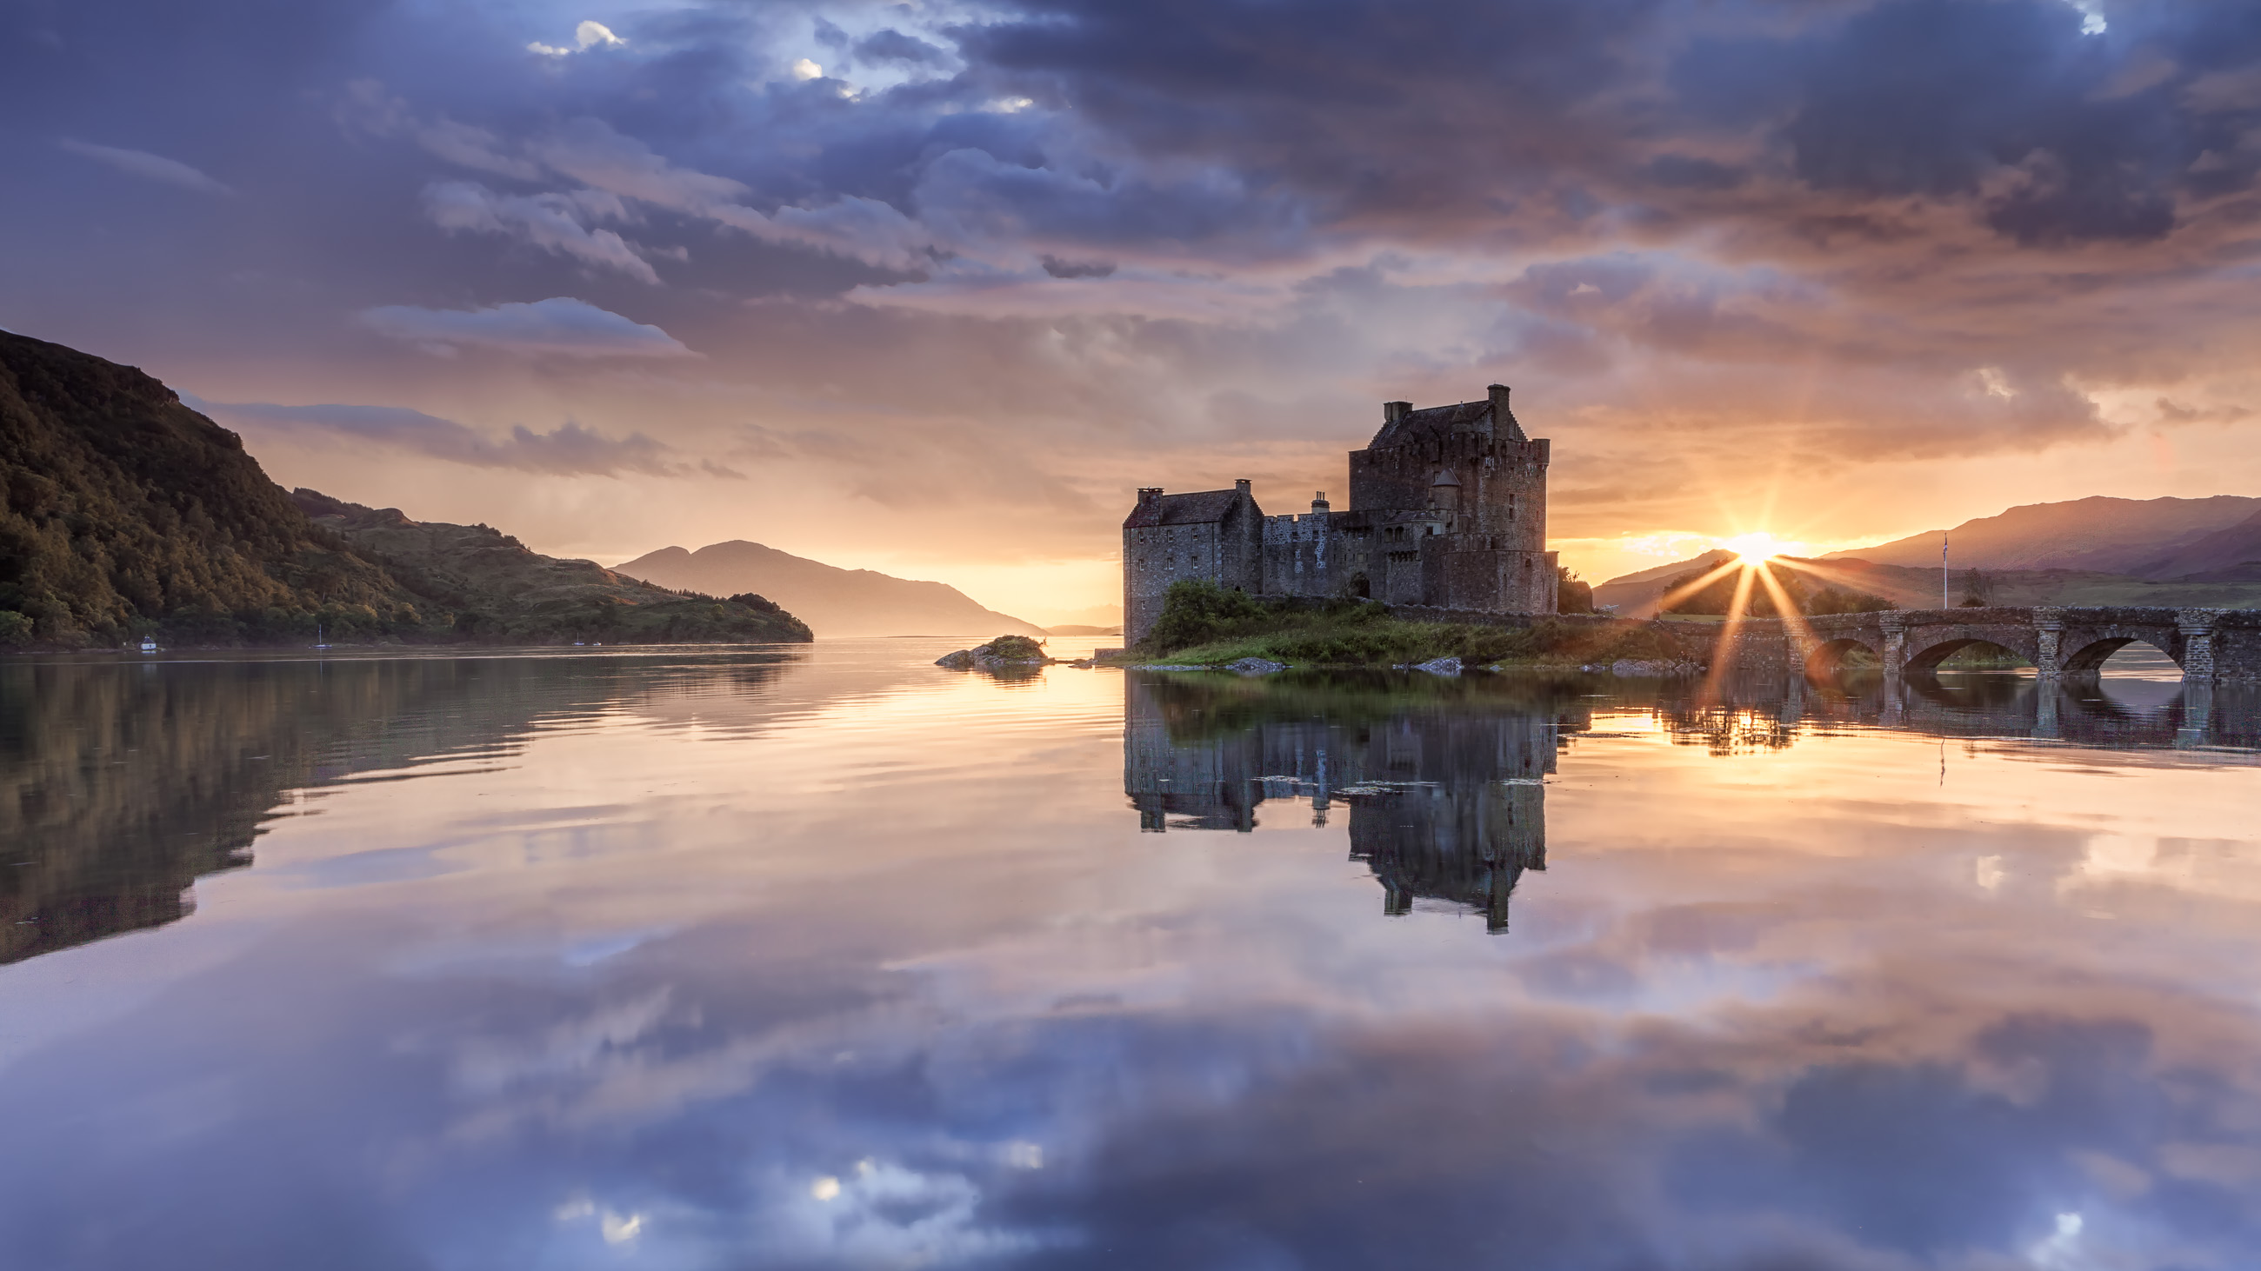
Inspire and guide
Not instruct
Image: Eilean Donan at DuskBy Syxaxis Photography [CC BY-SA 4.0 via Wikimedia Commons]

Slide 8
Wikipedia + Libraries overview
1
Research public library connections
Build awareness/recruit US public library staff; design curriculum; recruit Wikipedia guides
Deliver 9-week online training program; Sept. 13 - Nov. 15, 2017
Enrolled ~300 U.S. public library staff
Collect / publish case studies and resources
Evaluate and share learnings
2
3

Slide 9
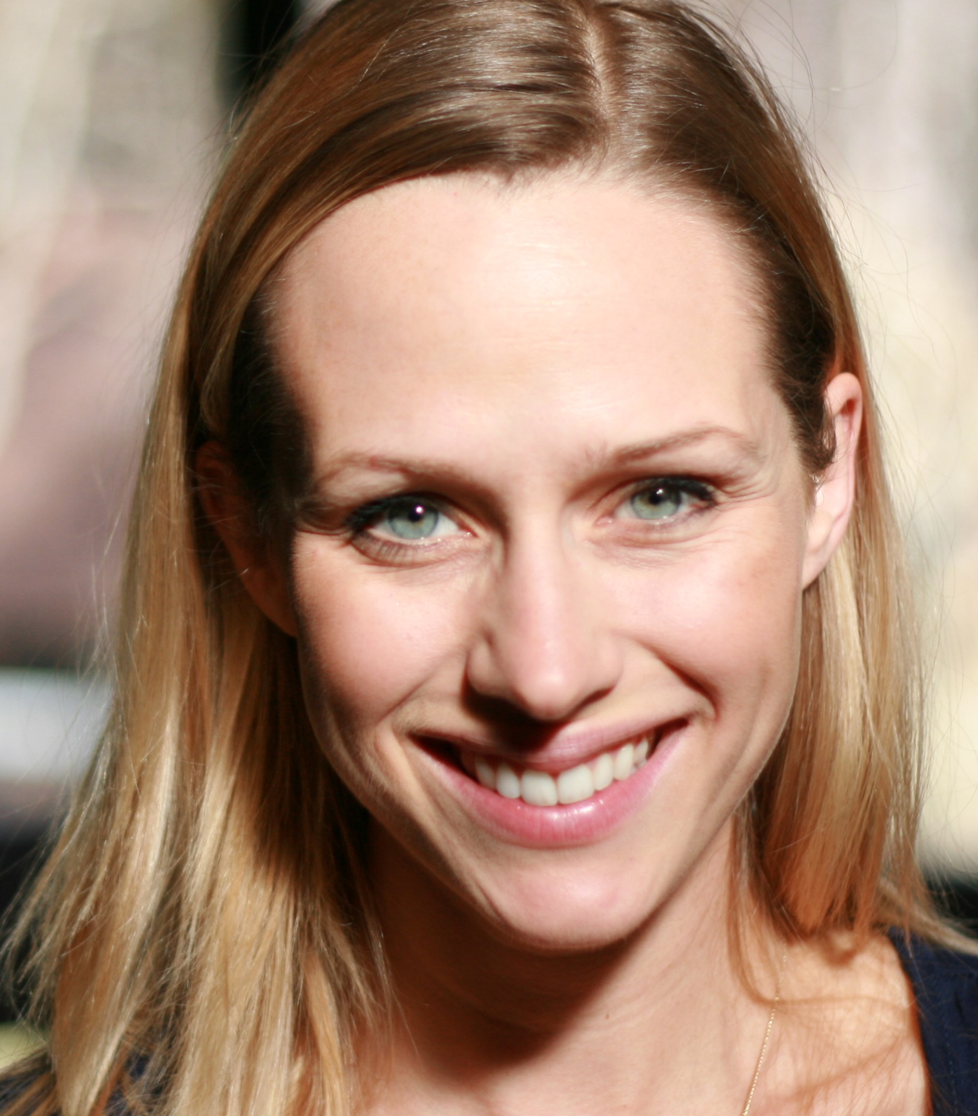
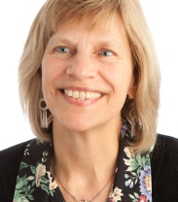
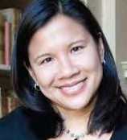
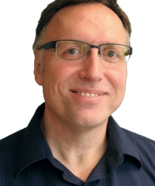
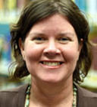
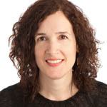
Wikipedia + Libraries project team
Monika Sengul-Jones Wikipedian-in-Residence, Instructor jonesm@oclc.org
Mercy Procaccini Project Coordinator procaccm@oclc.org
Dale Musselman Technical Support musselm@oclc.org
Betha Gutsche Instructor gutscheb@oclc.org
Merrilee Proffitt Senior Program Officer proffitm@oclc.org
Sharon Streams WebJunction Director streamss@oclc.org
Notes:
Funding from the Wikimeida Foundation supplemented our Knight Foundation Funding and allowed us to hire Monika, a Wikipedian with strong skills. She is not a librarian but she has a real passion for listening and learning which is exactly what we needed for this project. She was supported by the webjunction team and me as an additional member of OCLC team with Wikipedia editing and program experience.

Slide 10
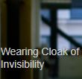
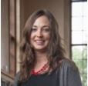
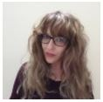
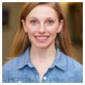
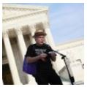
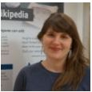
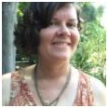
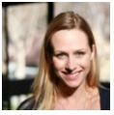
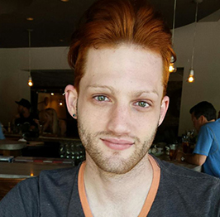
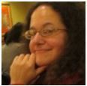
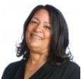
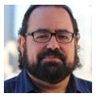
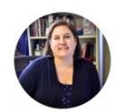
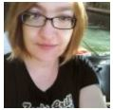
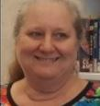
Wikipedia guides – the human to human element
Avery
Jensen
Emily
Jack
Jacinta
Sutton
Jackie Koerner
Jim
Hayes
Megan
Wacha
Merrilee
Proffitt
Monika
Sengul-Jones
Paul
Flagg
Rachel Wexelbaum
Rajene
Hardeman
Rob
Fernandez
Sara
Marks
Susan Barnum
Kerry
Raymond
Notes:
We were also supported by the volunteer Wikipedia community. We wanted to support our online learners both in online chat during class time and also in an active discussion space where they could supplement what their learned in class. Many of our Wikipedia Guides are also Wikibrarians. Two were from the State Library of Queensland showing the international reach of the Wikipedia project.

Slide 11
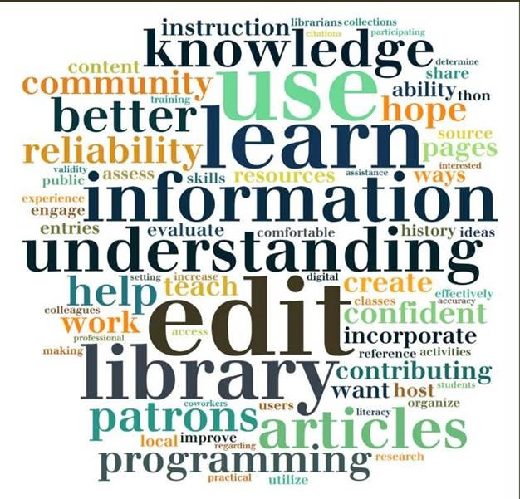
What do public library staff want?
Increase information literacy
Improve access to authoritative information online
Support research and critical thinking skills
Raise visibility of their libraries, communities
Enrich community programs
70% of participants have never edited Wikipedia
Notes:
So we tried to lead from a place of listening. There are many directions you can go with Wikipedia but here were the priorities for our course participants, as reflected in a pre-course survey.

Slide 12
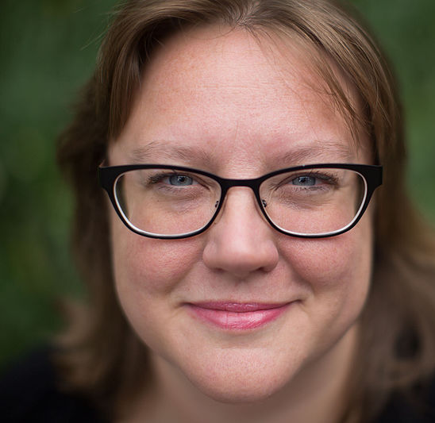
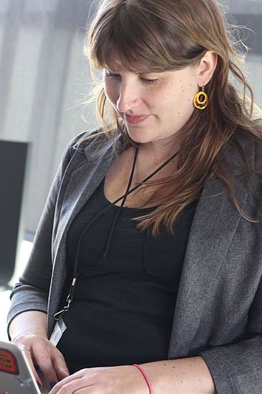
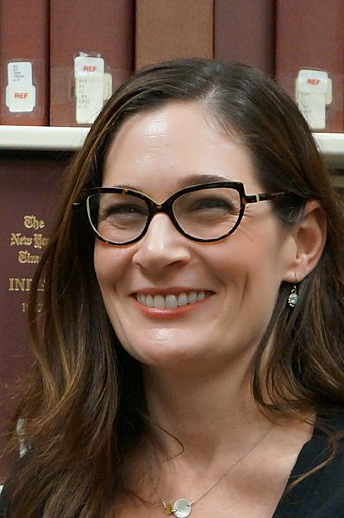
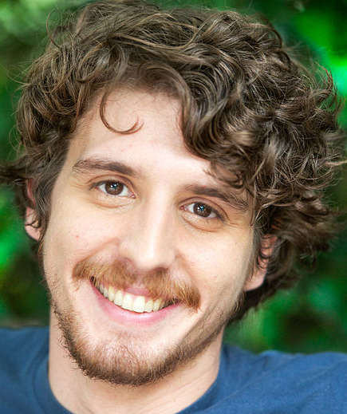
Librarians
Who
Wikipedia
Notes:
During the course we were able to draw on the practices of librarians who Wikipedia, and we have a series of interviews that focus on librarians who have already found ways to incorporate Wikipedia into some form of their work. I’d like to introduce some of these Wikibrarians to you.

Slide 13
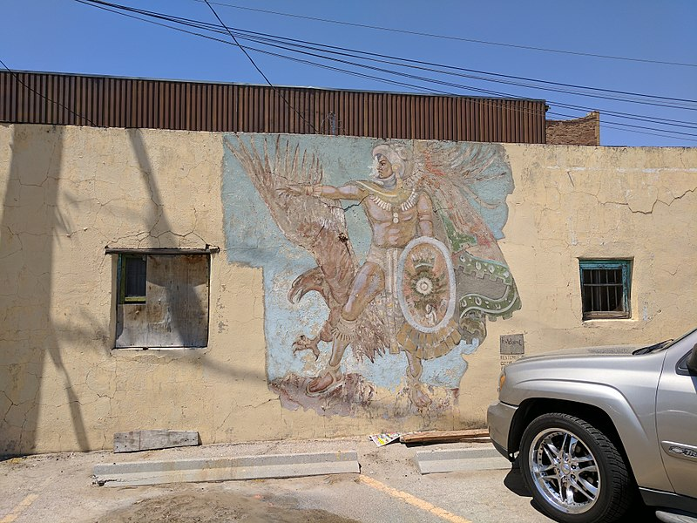
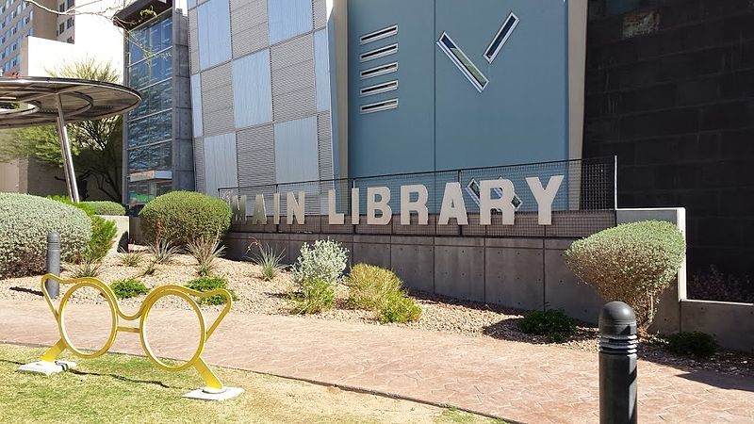
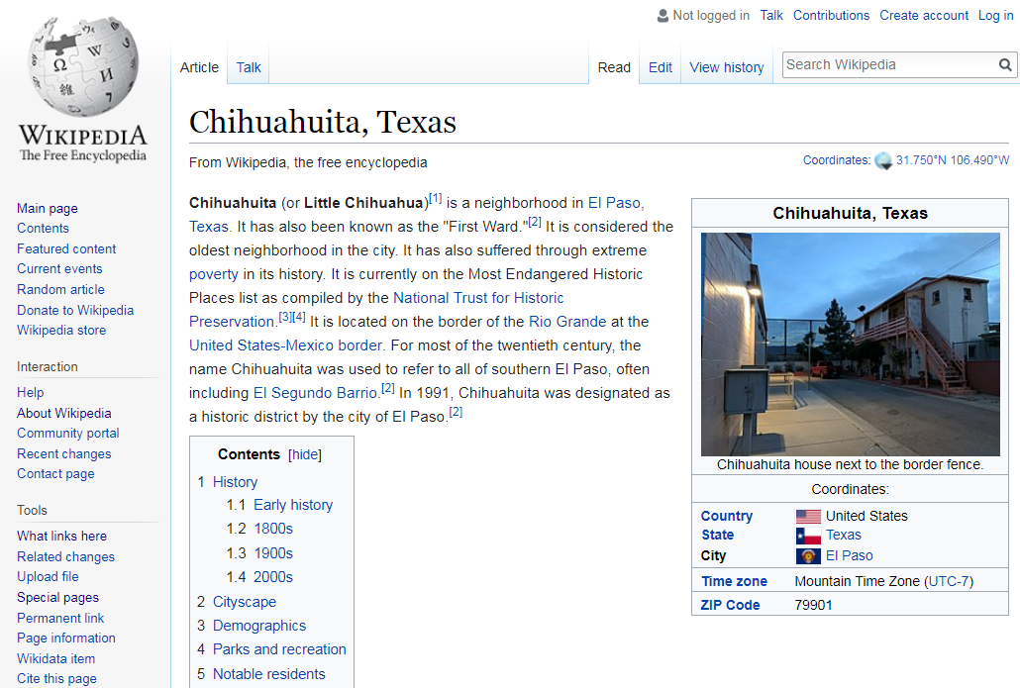
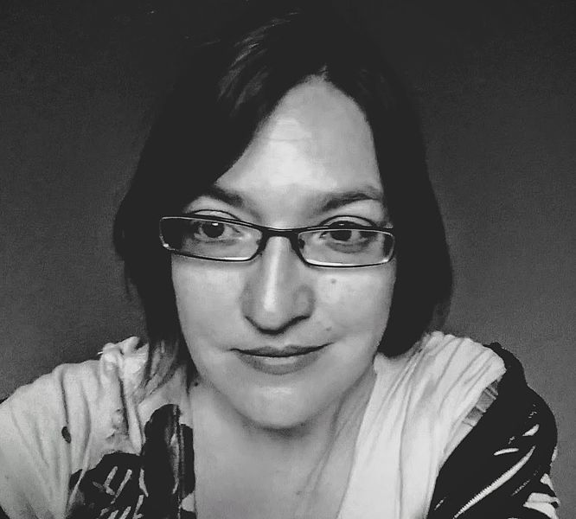
Images by Susan Barnum CC BY-SA 4.0
Notes:
Meet Susan Barnum – she works at the El Paso Public Library.
A few years ago, someone from her local history museum asked for reference materials about Chihuahuita, a historic neighborhood in El Paso. This is a neighborhood that is one of the oldest parts of El Paso and sits directly on the US Mexico Boarder on the banks of the Rio Grande. It is one of the poorest neighborhoods in El Paso and also on the List of Endangered places compiled by the US National Trust for Historic Preservation.
Susan could have done what a lot of us might have done – complied a list of references and shipped them off to the museum colleague. But Sue, who is an active Wikipedia editor as well as a Wikipedian noted that here was no Wikipedia article on it. So she created the article and shared that with her colleagues.

Slide 14
The reference librarian
“…writing the Wikipedia article makes this information available to everyone; it has longevity and visibility.
Notes:
To Susan, this made sense. It made the information available to everyone.

Slide 15
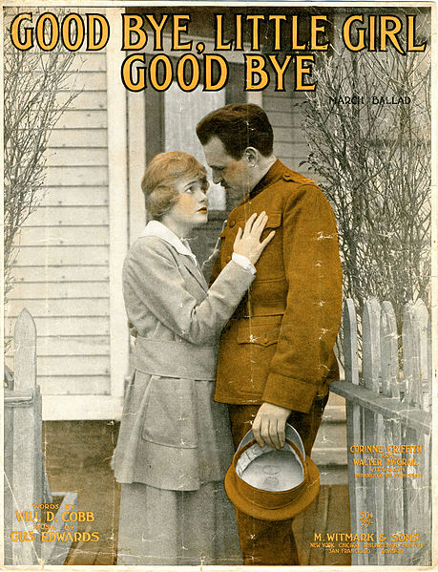
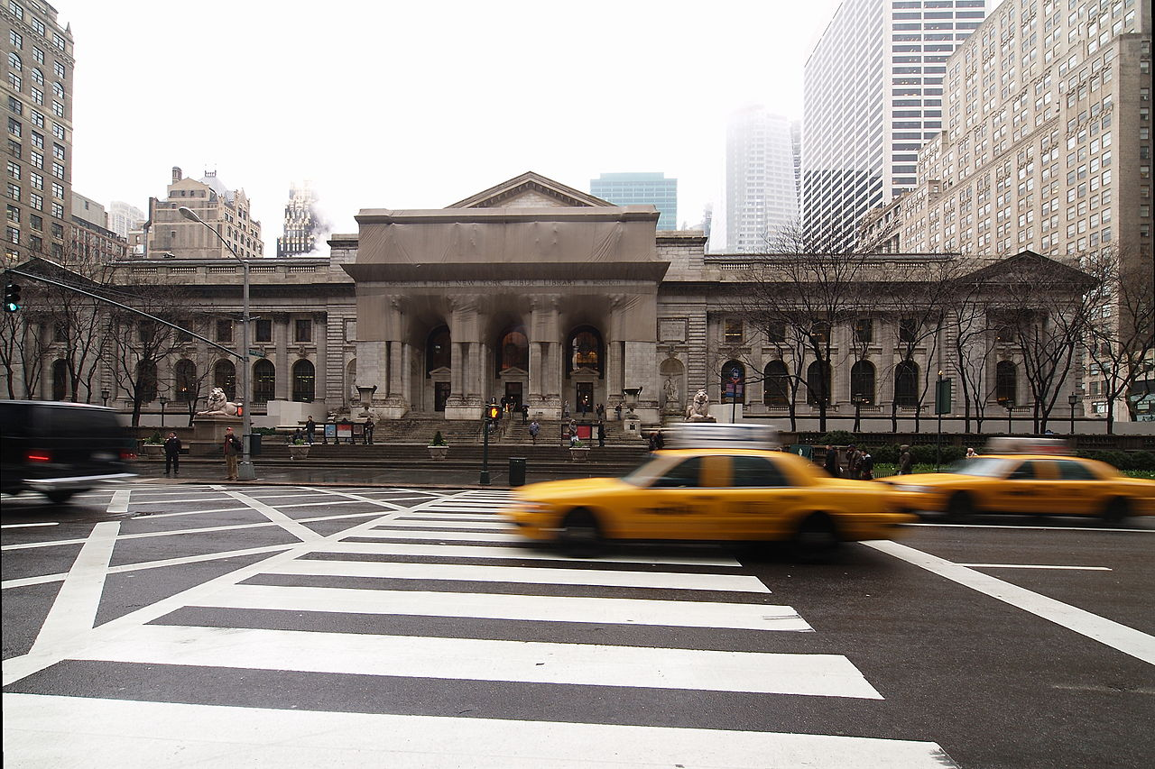
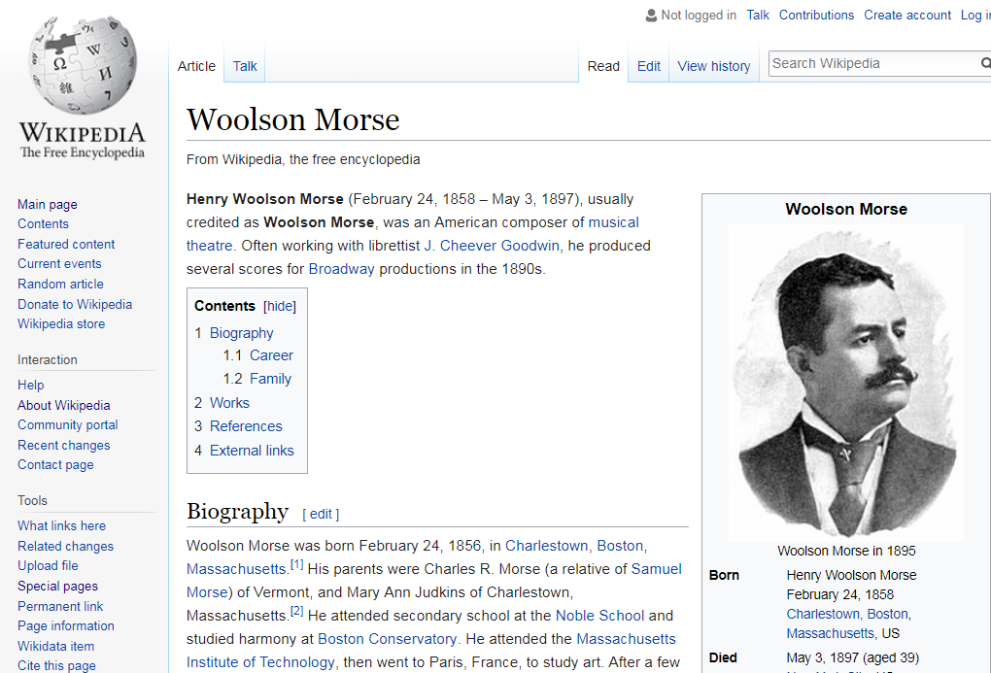
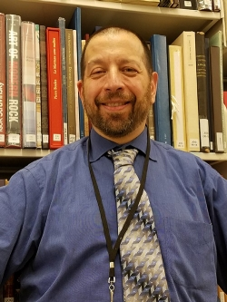
Arnoldius cc-by-SA 4.0
Notes:
Meet Bob Kosovsky. We works as a curator in the New York public library where he works with music collections.
By New York : Witmark, publisher. [Public domain], via Wikimedia Commons
Exterior of the New York Public Library main building Arnolduis cc-by-SA
Bob began to edit Wikipedia in 2009 when he was working on a project with turn-of-the-century sheet music and could find no reference information for the materials.
In his work one composer, Woolson Morse, kept coming up. There wasn’t any biographical information on him, so I began researching him.
I dug up all this information from all these different places, and I decided to make it into a biographical article. And now that article on Woolson Morse is the most comprehensive reference source for information about him. When I did that article, other editors made some alterations; but no one deleted it, they made it better.
And I thought, “Wow, that is what one can do with Wikipedia.”

Slide 16
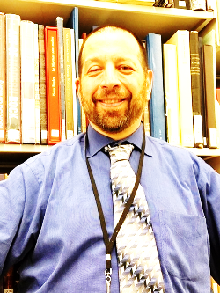
The subject specialist / curator
“…I was coming across all of these musicals with no reference information. It would have helped me greatly to have some reference material to contextualize the music. I started to make my own lists, then it hit me: why not do this in Wikipedia so that it will help other people, too?
Notes:
Bob was doing something similar to what Susan did, except he was adding information in his capacity as a curator – he was unable to easily find information on the collections and creators of collections so he put the information he compiled in a place where others could benefit from it.

Slide 17

Librarians rocked the course!
By the numbers*
The 236 active participant editors
made over 5900 edits
and 369 Commons (photo) uploads
to improve 799 articles
and create 6 new articles!
Since the start of the course, there have been 36.1m views of improved articles
*as of 13 February 2018
Notes:
***baseline: 70% of participants had never edited Wikipedia prior to joining the course!
One of the main goals of course participants was to develop engagement plans for their librarys, and
Plus 86 engagement plans

Slide 18
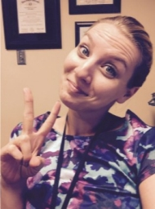
Connecting to other institutions
“This is a tremendous opportunity here to make [Wikipedia] a very robust resource for everybody….
I dare you not to get excited.
Notes:
Kim Gile, is a community reference manager at the Kansas City Public Library, where jazz is a deep part of the history and culture of the city. She notices that articles related to notable musicians, artists and women are missing from Wikipedia. This represents an opportunity for Kim, her fellow library staff and the African American community her library serves to raise the visibility of the city's rich musical cultural heritage. She is planning a series of editing events in conjunction with the American Jazz Museum which is also in Kansas City.
She wants to help her fellow librarians see that Wikipedia is a resource worthy of engagement.
"We've been told not to use it, and never to tell patrons to use it," she explained. "I used to think the same thing, but I'm glad to say that my mind is completely changed.
"I dare you not to get excited,”

Slide 19
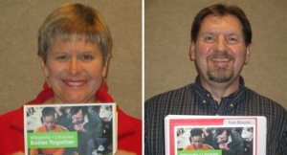
Information literacy
“…I, too, used to poo-poo Wikipedia. Now I consider myself a convert. I am pushing its value to help students be critical consumers of information.
Notes:
Denise Davis and Tom Boeche are librarians at the Morton-James Public Library. The course helped them rethink their approach to teaching research skills.
Every year, students in Nebraska City, Nebraska, come into the library to prepare for National History Day, a nationwide historical writing competition.
After getting the go-ahead from the class teacher, Denise used the 8th graders’ list of research topics to find complementary Wikipedia articles.
Denise used skills acquired in the course to explain to the students how to understand a Wikipedia article, and where to go next. She said this process was helpful for them to understand how to be critical consumers of information.
The students then met with Tom for the next steps in the research process, a walkthrough of library catalogs and the stacks.
In the end, “the teacher was very pleased,”. So pleased that she asked the librarians to speak with the school about the value of the online encyclopedia—the platform is currently blocked for students.

Slide 20
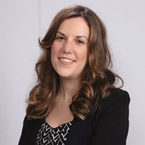
The campus connector
“…Think beyond the edit-a-thon. What we are developing [is] an ongoing Wikipedia project here—with the library as the center of it all.”
Notes:
Samantha Dodd, a Special Collections Archivist at the University of Texas at Arlington Libraries was asked to organize an edit-a-thon in October. Dodd had just enrolled in the course and had never edited Wikipedia. Rather than organizing an edit-a-thon, which would have been ambitious, she instead proposed two events to introduce Wikipedia and convene scholarly conversations about it for the library and the broader university community.
The first event, featured a presentation by a Wikipedian with 11 years of editing experience. His insights on Wikipedia in her words, “blew everyone away,” The second event was a panel conversation with presenters from multiple disciplines discussing the benefits and drawbacks of using Wikipedia in the classroom.
The events drew large crowds of university and community attendees, and gained a lot of socal media attention.
In the days that followed, Samantha found her library at the center of additional Wikipedia initiatives, including plans for a presentation at the state library association meeting.
She’s also been contacted by three faculty members in the Women’s and Gender Studies program for support in incorporating Wikipedia assignments into their classrooms. And it just keeps going – the library and campus now have many plans for more engagement.
Building from these early conversations is paying off. In this case, Samantha went for the biggest impact, which was not just an editathon but a continued campuswise discussion on the information ecology.

Slide 21
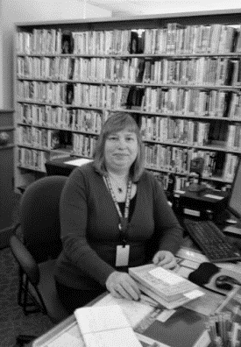
The individual contributor
“…I like that I can add sources that are credible and I am able to find information using my databases that others don’t have immediate access to.
Notes:
Finally, meet Jean King, an adult reference librarian at West Hempstead Public Library
Her post-course plan was to continue to edit from the reference desk.
As an individual contributor Jean is making a difference with her edits and this is great. Not everyone needs to have an engagement plan. Small is good!

Slide 22
Survey questions | Pre-course | Post-course
I understand how Wikipedia works and can explain to others | 18% | 77%
I do not know how to edit Wikipedia | 61% | 2%
I do not know how to organize an engagement program involving Wikipedia | 69% | 4%
I have helped patrons evaluate information on Wikipedia | 22% | 61%
I have helped a colleague with Wikipedia | 12% | 48%

Slide 23
“
As I have been talking with my colleagues about this class, almost EVERY person has said, 'but we tell people not to use Wikipedia!’ I … thought the same thing…my mind has been completely changed…I can all but guarantee we are steering people away from a good place to start their research.
“

Slide 24
“
I really liked the foundational information at the beginning, talking about the structure and layers of work going on with Wikipedia. I really had no idea that there were so many checks and balances on the articles.
“

Slide 25
“
I was one of 99% of users who think of Wikipedia as a less reliable source. I must say that this course was an eye opener …
I am a changed librarian now. A librarian who feels the worth of Wikipedia, crowdsourcing and contributing to the larger community.
“

Slide 26
Librarians have the power to make Wikipedia better and more reliable.
BE BOLD

Slide 27
oc.lc/oclc-wikilib
Merrilee Proffitt
OCLC Research
proffitm@oclc.org
@merrileeIam

