Slide 1
The OCLC Research Library Partnership provides a unique transnational
collaborative network of peers to address common issues as well
as the opportunity to engage directly with OCLC Research
Thank you for underwriting and participating in our programs

Slide 2
OCLC Research Library Partnership
Overview of Three Areas of Research by the OCLC Research Library Partnership

Slide 3




Roy Tennant Chela Weber Rebecca Bryant Constance Malpas

Slide 4
23 May 2018
Research & Learning Agenda for Archives, Special, and Distinctive Collections in Research Libraries
Chela Scott Weber, Senior Program Officer, OCLC Research
weberc@oclc.org | @partly_cloudy

Slide 5
Iterative, Participatory Process
Advisory Board
Discussions with Colleagues, April-May 2017
Workshop early draft at RBMS, June 2017
Workshop later stage draft at SAA, July 2017
Open Community Comment, August 2017

Slide 6
Areas of Investigation
Convergence of the Special Collections
& the Research Library

Slide 7
Areas of Investigation
Advocating for Archives
& Special Collections

Slide 8
Areas of Investigation
Next Steps for Born-Digital

Slide 9
Areas of Investigation
Addressing Audio-Visual Collections

Slide 10
Areas of Investigation
Evolving Systems Environments

Slide 11
Areas of Investigation
Stewardship Responsibilities
& Collections Management

Slide 12
Areas of Investigation
Engaging the Challenges
of Diversifying Our Collections

Slide 13
Next Steps
Broader Involvement and Input
Highlight Forward Thinking Work in the Areas of Investigation
Identify Areas for OCLC / RLP Action
Encourage Action From and Collaboration with Allied Organizations and Individuals

Slide 14
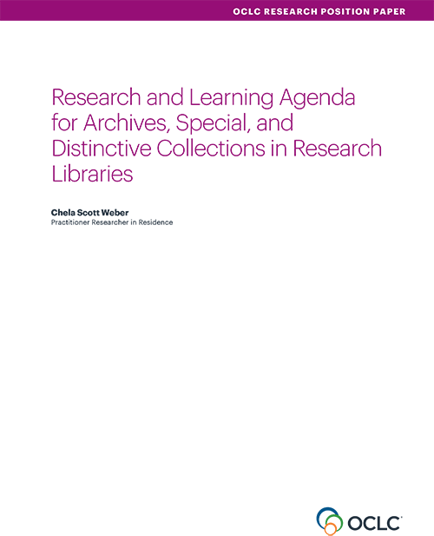
Read the Full Paper
doi:10.25333/C3C34F

Slide 15
23 May 2018
Overview of investigations into Research Information Management (RIM)
Rebecca Bryant, PhD, Senior Program Officer, OCLC Research
bryantr@oclc.org @RebeccaBryant18

Slide 16

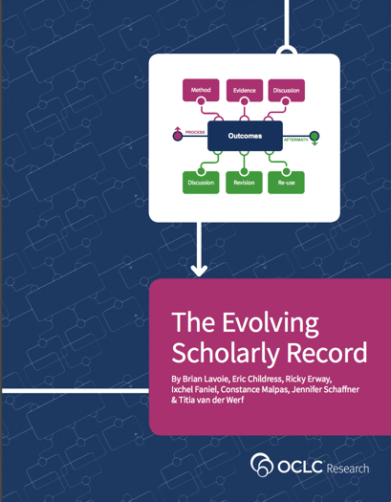
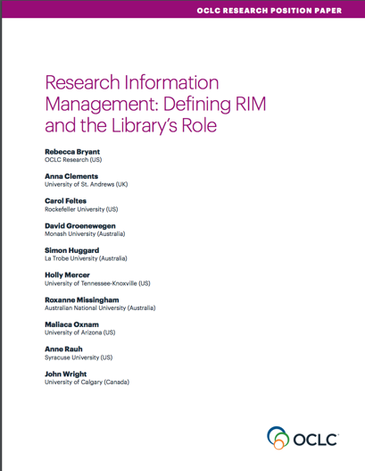
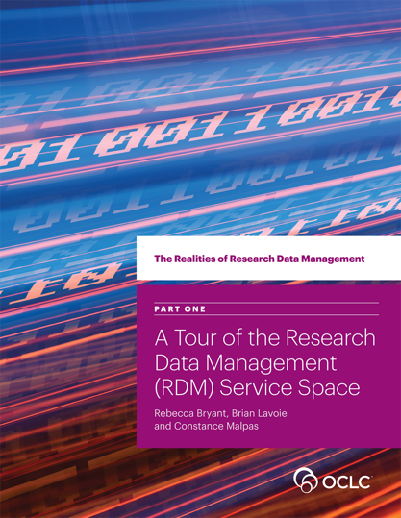
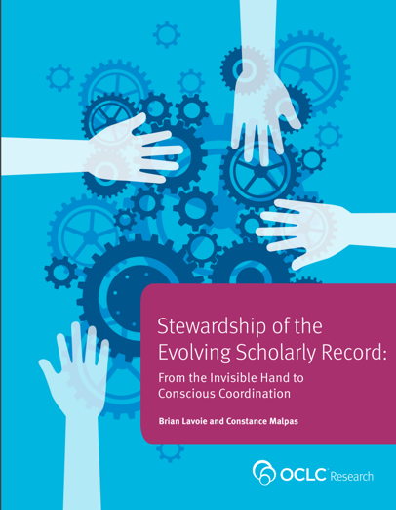
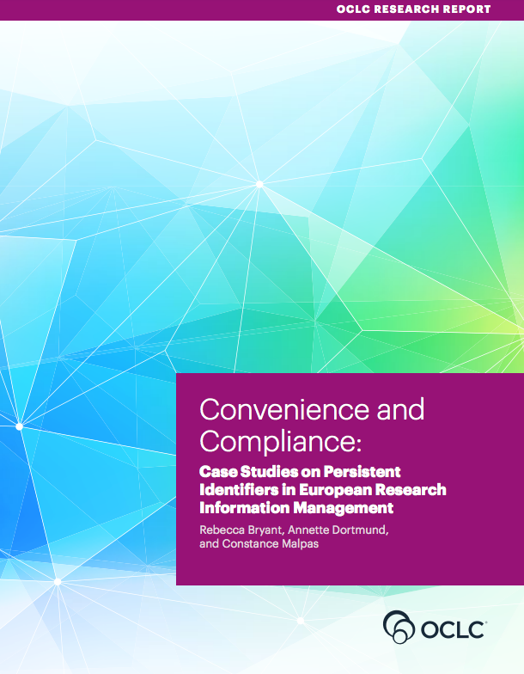
Survey of Research Information Management Practices
(report coming 2018)
oc.lc/esr
oc.lc/rim
Notes:
A few years ago my colleagues Brian Lavoie and Constance Malpas engaged in research on the Evolving Scholarly Record, examining how the traditional print scholarly record is evolving—as it is increasingly digitized and even born digital, with completely new components —things like research data and preprints.

Slide 17



Research Information Management
Survey of Research Information Management Practices
(report coming 2018)
oc.lc/rim
Notes:
An area of recent research for OCLC is research information management, as we recognize this as an important emerging service categories for libraries. We’ve been developing an arc of research to describe, explain, and document international practices in research information management.
In October we released a position paper on research information management, which I’ll talk a bit more about in a minute.
In December we also published a research report, conducted in collaboration with LIBER, documenting case studies in persistent identifiers in research information management.
We have also been collaborating with euroCRIS on an international survey on Research Information Management Practices.

Slide 18
Research Information Management: Defining RIM and the Library’s Role
Provides an international framework for understanding RIM practices
Synthesizes the value proposition of libraries in RIM service provision
Developed in collaboration with RLP member librarians on 3 continents
oc.lc/rim
oc.lc/rim

Slide 19

What is Research Information Management (RIM)?
The aggregation, curation, & utilization of metadata about research activities
Overlapping terms:
  CRIS (Current Research Information System)
  RIS (Research Information System)
  RNS (Research Networking System) RPS (Research Profiling System)
  FAR (Faculty Activity Reporting)
oc.lc/rim
Notes:
In this report, we offered a holistic definition of research information management (RIM) as the aggregation, curation, and utilization of metadata about research activities. One of my goals with this position paper was to provide a model for understanding different practices, as RIM practices vary widely by locale. Our model includes overlapping terms like CRIS and RIS, which are commonly used in Europe, as well as other practices like Research Profiling or Research Networking, which we see more commonly used in the Americas. It also synthesize the value proposition of libraries in RIM service provision.
You can access this report, as well as our other RIM publications, at oc.lc/rim

Slide 20
“RIM Metadata” by OCLC Research, from Research Information Management: Defining RIM and the Library’s Role (doi.org/10.25333/C3NK88), CC BY 4.0
Notes:
Needs DOI
Can put up on Landing Page

Slide 21
“RIM Uses” by OCLC Research, from Research Information Management: Defining RIM and the Library’s Role (doi.org/10.25333/C3NK88), CC BY 4.0
Notes:
Needs DOI
Can put up on Landing Page

Slide 22
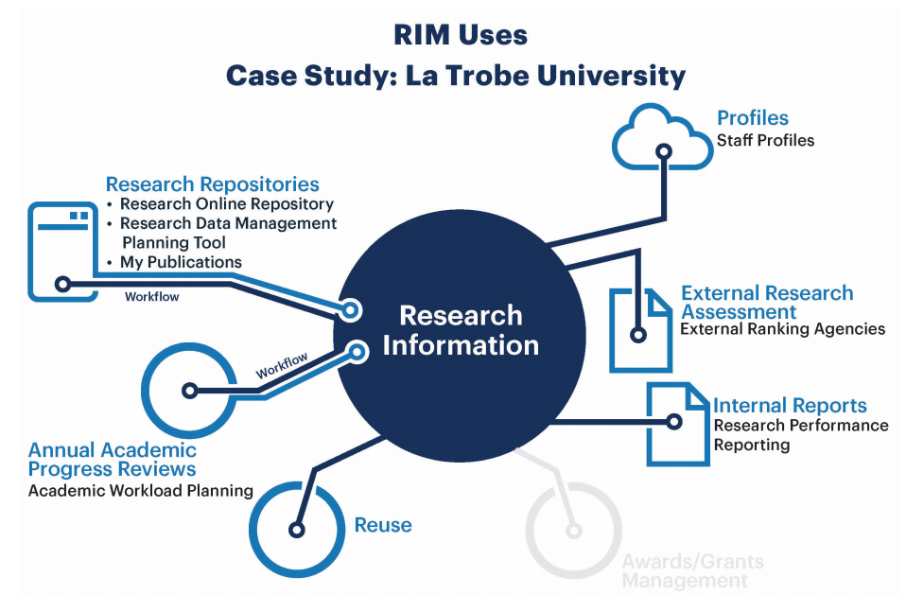

Slide 23
Survey of Research Information Management Practices
  Joint project between
Survey Goals
  To collect data about RIM practices worldwide, in order to identify national and regional practices
  To gather evidence on the increasing role played by research libraries in RIM practices
  To inform the research community about the goals, purposes, and scope of RIM practices
  To examine and report on the institutional stakeholders, workflows, interoperability, and standards in use.
  To serve as a foundation for future research.
Report expected later in 2018
oc.lc/rim
Notes:
This year euroCRIS and OCLC Research, along with RLP library partners, have been working to survey international practices, which builds upon previous euroCRIS/EUNIS research. Together we developed a survey which ran from October 2017 to January 2018, and we heard back from 381 respondents in 44 countries. We are synthesizing the findings and will publish our findings as an OCLC Research Report later this year. Today you will be getting a sneak peak at our findings. There’s a great deal of data for us to dig through, and we’re early in this process, but we want to share with EARMA some of the findings we think will be of interest to you.
Our goals with this survey are broad, foundational. [discuss general goals, limitations, etc.]
- While comprehensive, the survey cannot (and does not intend to) reveal all the nuances of specific geographic environments. Results strongly suggest that follow-up national- or regional-level surveys or scoping exercises could be the logic consequence of this v general insight into global trends

Slide 24
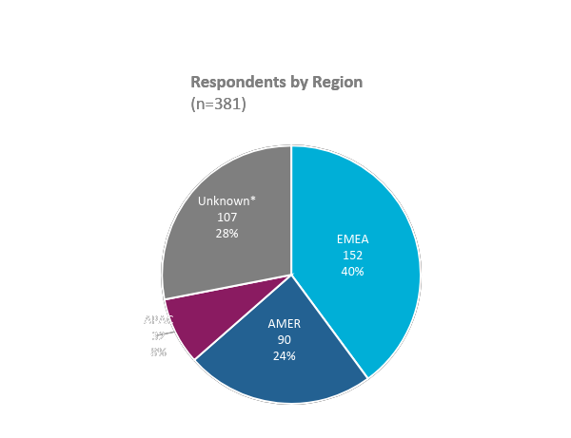
RIM Survey responses: geographic overview
381 survey respondents from 44 countries
Country | # Resp. | Country | # Resp.
United Kingdom | 39 (10%) | Canada | 4 (1%)
United States | 39 (10%) | South Africa | 4 (1%)
Peru | 39 (10%) | Andorra | 3 (1%)
Italy | 28 (7%) | Colombia | 3 (1%)
Australia | 24 (6%) | Finland | 3 (1%)
Germany | 14 (4%) | India | 3 (1%)
Netherlands | 10 (3%) | Japan | 3 (1%)
Portugal | 7 (2%) | Austria | 2 (0.5%)
Poland | 6 (2%) | Bahrain | 2 (0.5%)
Spain | 6 (2%) | China | 2 (0.5%)
Belgium | 5 (2%) | Denmark | 2 (0.5%)
Ireland | 5 (2%) | New Zealand | 2 (0.5%)
1 respondent from each of the following countries: Afghanistan, Albania, Azerbaijan, Barbados, Belize, Brazil, Hungary, Lebanon, Mexico, Namibia, Russia, Saudi Arabia, Slovakia, Sri Lanka, Sweden, Trinidad and Tobago, Turkey, Uganda, United Arab Emirates and Uruguay
by OCLC Research CC BY 4.0
Research Information Management (RIM) Systems: International Survey of Libraries, preliminary results (2018)

Slide 25
Limitations and strengths
Inherent difficulties of evaluating RIM practices internationally—with differences in practices, terminology, maturity, and local or national scope
Large, but fairly heterogeneous sample
  Some resulting sub-samples may be too small for significance
Widest insight ever on the degree of RIM practice implementation
Reveals that RIM is practised worldwide, with European representation by far the strongest
Notes:
- Survey (methodological) shortcomings to be mentioned: there is a certain skew in the results due to quite tailored promotion effort (both for specific commercial stakeholders and national threads -- Norway missing is really significant in this sense considering it topped the previous EUNIS/euroCRIS survey in Europe)

Slide 26
Research Information Management Systems
Well over half (58%) have a live RIM System
*Note: 29 respondents did not provide their RIM system
by OCLC Research CC BY 4.0
Research Information Management (RIM) Systems: International Survey of Libraries, preliminary results (2018)
Notes:
More than half (58%) of respondents indicate their institution has a live RIM system they’ve implemented, and another tenth (13%) are in the process of implementing one.
Of those with a live RIM, just under half are in EMEA, a little over a tenth are in the Americas or Asia Pacific. A sizable portion of them did not indicate their country.
The RIM system most in use among the live institutions (used by nearly a third of them (30%)) is Pure, an offering of Elsevier.

Slide 27
Reporting and compliance drive RIM adoption
by OCLC Research CC BY 4.0
Research Information Management (RIM) Systems: International Survey of Libraries, preliminary results (2018)
Notes:
Respondents were provided a list of six reasons for pursuing RIM activities and were asked the importance of those reasons for their institution. The reasons most indicated as being “extremely important” include managing annual academic activity reporting and supporting institutional compliance such as funder mandates or national assessment exercises.

Slide 28
Other summary findings
Libraries are playing a larger role in RIM, as it increasingly intersects with areas of library expertise:
  Open access
  Author rights
  Publications metadata management & validation
  Training & support for researchers
Congruent with a recent position paper by OCLC
oc.lc/rim

Slide 29
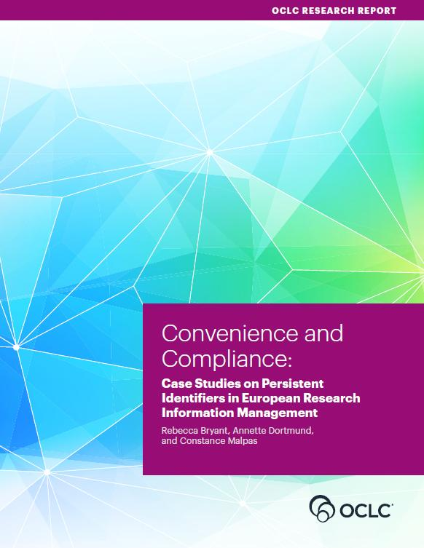
Other summary findings
Congruent with our qualitative Convenience and Compliance findings
Strong adoption of person identifiers
  ORCID becoming a de facto standard in scholarly literature, but other identifiers also needed and used
Organizational identifiers largely unused
oc.lc/rim

Slide 30
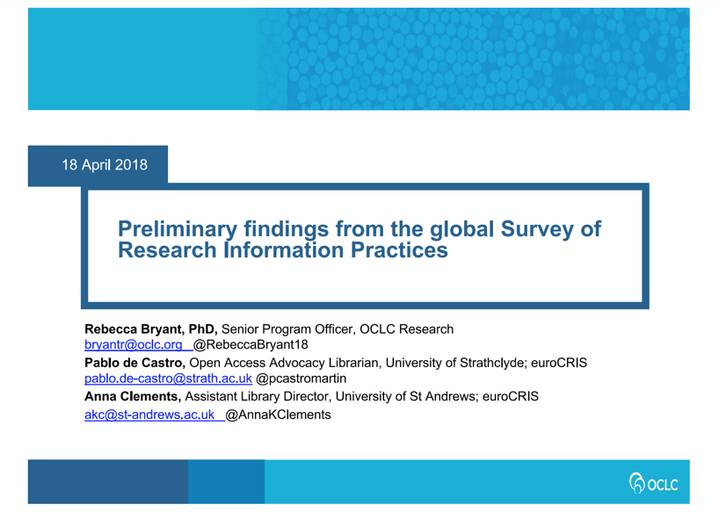
Learn more
oc.lc/rim
Slides available with more details from April 2018 presentation delivered at 24th EARMA Conference in Brussels
http://doi.org/10.5281/zenodo.1218067
Report forthcoming later in 2018

Slide 31
References
Bryant, Rebecca, Anna Clements, Carol Feltes, David Groenewegen, Simon Huggard, Holly Mercer, Roxanne Missingham, Maliaca Oxnam, Anne Rauh and John Wright. 2017. Research Information Management: Defining RIM and the Library’s Role. Dublin, OH: OCLC Research. doi:10.25333/C3NK88
Bryant, Rebecca, Annette Dortmund, and Constance Malpas. 2017.
Convenience and Compliance: Case Studies on Persistent Identifiers in European Research Information. Dublin, Ohio: OCLC Research. doi:10.25333/C32K7M
euroCRIS & OCLC Research. International Survey on Research Information Management Practices. Publication of results as an OCLC Research report expected in 2018
Ribeiro, Lígia, Pablo De Castro, and Michele Mennielli. “EUNIS-EuroCRIS Joint Survey on CRIS and IR,” 2016. http://www.eurocris.org/news/cris-ir-survey-report.

Slide 32
23 May 2018
University Futures, Library Futures: institutional differentiation and the organization of academic libraries
Constance Malpas
Strategic Intelligence Manager and Research Scientist
malpasc@oclc.org | @ConstanceM

Slide 33
University Futures, Library Futures
OCLC Research and Ithaka S+R collaboration with support from Andrew W. Mellon Foundation
Examining impact of increasing differentiation of US higher education on the organization of academic libraries
Shift from collection-centric model of excellence to engagement-oriented model supporting distinctive needs of parent institution; teaching, learning, research workflows
More information: oc.lc/libfutures
Final report anticipated Summer 2018

Slide 34
Why focus on US higher education?
Large, heterogeneous system of >4000 institutions
Comprehensive national statistical reporting
Rapid transformation of sector driven by
  Reductions in state-level funding (ROI of HE)
  Demographic change: growth of New Traditional
  Disruption in digital environment (LMS, online ed, analytics, RIM, etc.)
Model can be extended to other geographies and statistical sources

Slide 35


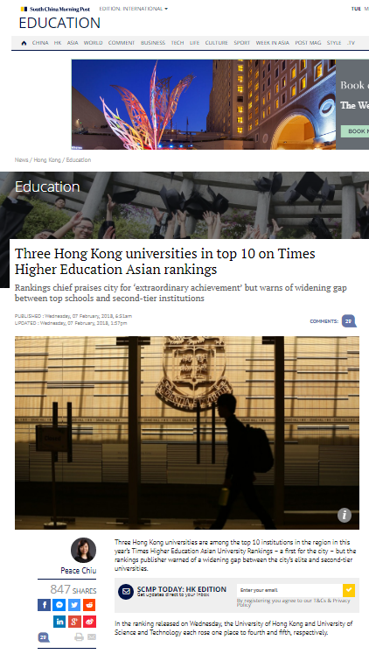
Notes:
Sources:
https://info.microsoft.com/Harvard-Business-Review-EducationWhitePaper-MGC0001281.html?wt.mc_id=636001_SL_SCL_Linkedin_EDU_HBR_RayFlemingBlog
http://qswownews.com/transition-japanese-higher-education/
http://www.scmp.com/news/hong-kong/education/article/2132308/smart-city-three-hong-kong-universities-top-10-times-higher

Slide 36
Key questions
Can we move beyond Carnegie Classification to explore institutional differentiation in terms of universities’ investments and enrollment profiles?
  Literature review
  Institution typology and index
Is a shared view emerging of what an academic library should look like in different institution types?
  Survey
  Focus Groups

Slide 37
Institution Typology
Population: 1506 US higher education institutions (HEI) comprising four-year public and private non-profit degree-granting colleges and universities
Unit of analysis: institution as defined by IPEDS unit ID
Institutional profiles derived from 2015 IPEDS survey data:
  What colleges and universities do (research, liberal education, career preparation)
  How/for whom they do it (traditional vs. ‘new traditional’)
Literature review, details on model and scoring formula: oc.lc/libfutures

Slide 38
University directions

Slide 39



Most four-year institutions exhibit multiple tendencies; they have several ‘lines of business’
primary focus on doctoral research and scholarship
Research
primary focus on preparation for career professions
primary focus on interdisciplinary baccalaureate education
Career
Liberal Education

Slide 40
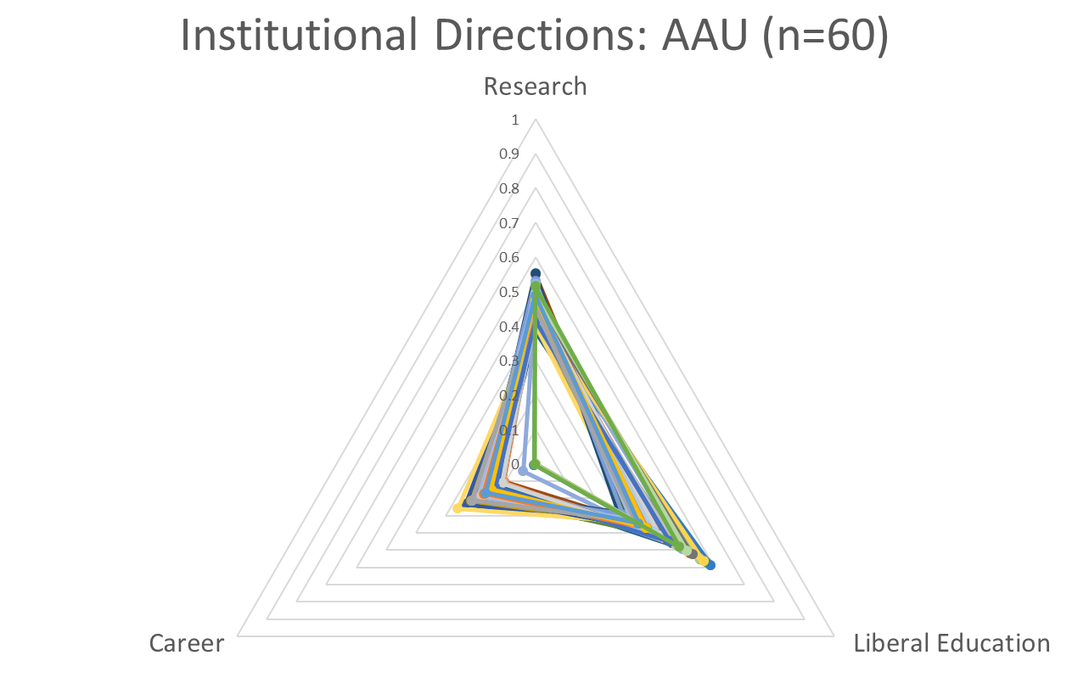
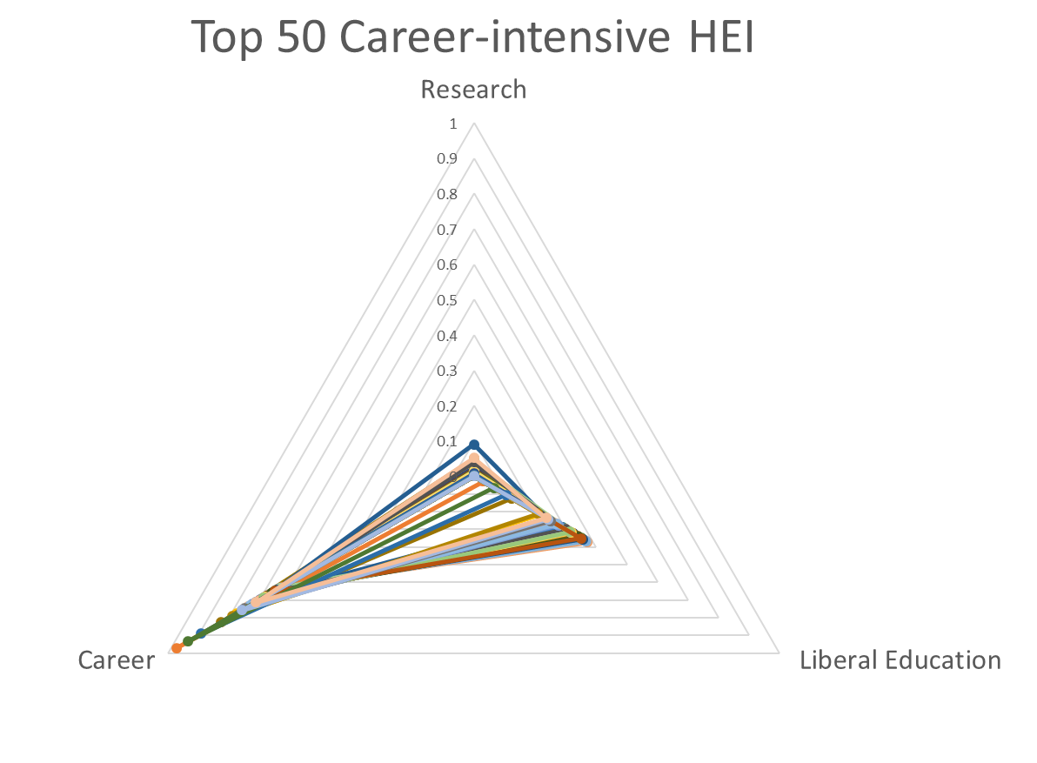
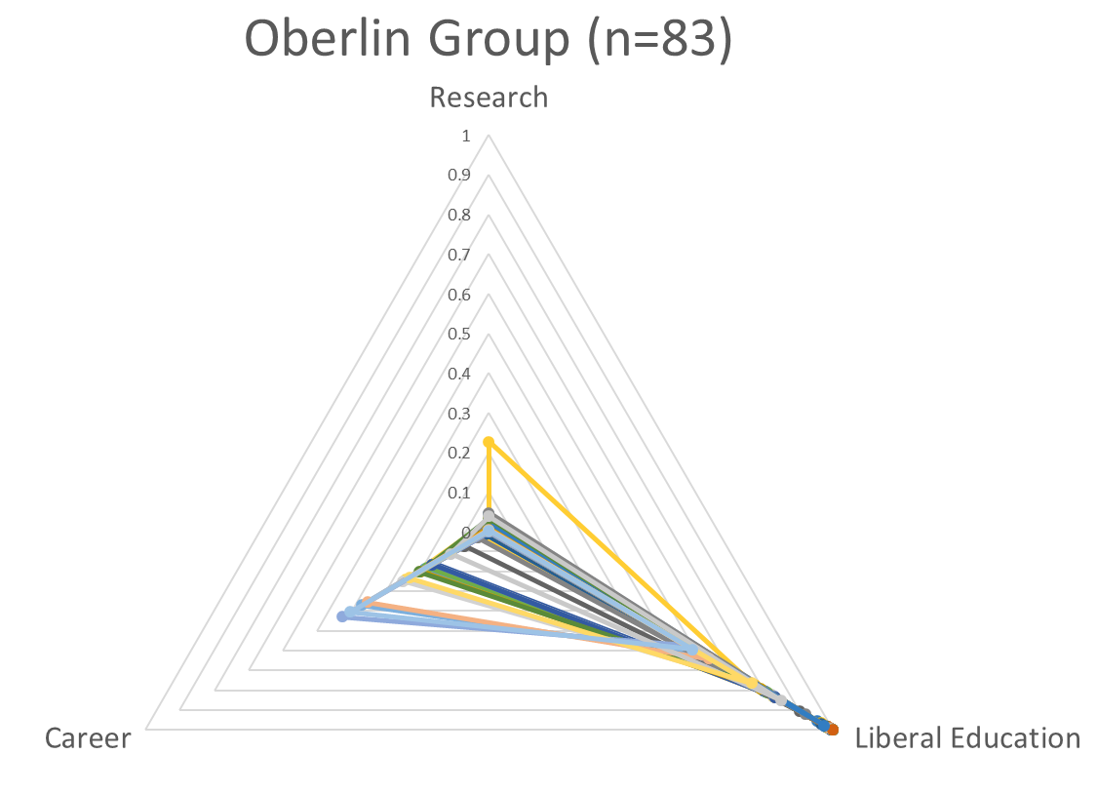
Model can be used to examine groups of institutions for conformance to type (institutional isomorphism)

Slide 42
…little to suggest that ARL directions should be normative for academic libraries in general

Slide 43
library directions

Slide 45
Confidence?
Complacency?

Slide 46



Library service directions
Research Data Management
GIS, visualization services
Library as publisher
Research information management
Collective collections, shared print
…
Research
Instructional design, LMS
Digital humanities
Digital, data literacy training
Makerspace, Fab-lab
Special collections in the classroom
…
Skills-building, test prep resources
Program-level resource guides
E-portfolios
Career
Liberal Education

Slide 48
Ideally, investments in student success would meet or exceed investments in information access

Slide 49
More investment: “inside-out” activities
Reduce costs: “outside-in” operations
+
Engagement agenda
Workflow support
Reputation management
…
-
Collections agenda
Physical inventory
Space management
…

Slide 50
OCLC Research Library Partnership
Programs and research that improve library alignment with institutional priorities of research universities
  RIM: library roles in managing institutional reputation
  RDM: support for emerging research workflows
  Shared Print: operationalizing collective collections
Opportunities to shape and lead community change
  Case studies, implementation partners
  Scaling learning with works-in-progress webinars, events

Slide 51

Thank you!
Your questions?
©2018 OCLC. This work is licensed under a Creative Commons Attribution 4.0 International License.

Slide 52
The OCLC Research Library Partnership provides a unique transnational
collaborative network of peers to address common issues as well
as the opportunity to engage directly with OCLC Research
Thank you for underwriting and participating in our programs

