Slide 1
The Realities of RDM:
Understanding Institutional RDM Services
Brian Lavoie
Rebecca Bryant
OCLC Research
Realities of RDM Webinar Series: Part 1
October 2, 2018

Slide 2
The Realities of RDM: Webinar Series
Webinar #1
Understanding Institutional Research Data Management Services
2 October 2018
11:00 am EDT (UTC -4)
Webinar #2
Identifying and Acting on Incentives When Planning RDM Services
13 November 2018
11:00 am EST (UTC -5)
Webinar #3
Acquiring RDM Services for Your Institution
4 December 2018
11 am EST (UTC -5)

Slide 3
~130 partnership institutions worldwide
Facilitates connections between OCLC Research and research libraries
Supports transnational sharing and peer to peer collaborative learning
Influences service design and future OCLC research
Devoted to challenges facing libraries and archives since 1978
Community resource for shared Research and Development (R&D)
Engagement with OCLC members and the community around shared concerns
oc.lc/research
Notes:
Just in case you are not familiar with OCLC Research, it has carried out Research with and for librarians and library users since 1978.
50+ people incl. WebJunction and Technical Research

Slide 4
Background

Slide 5
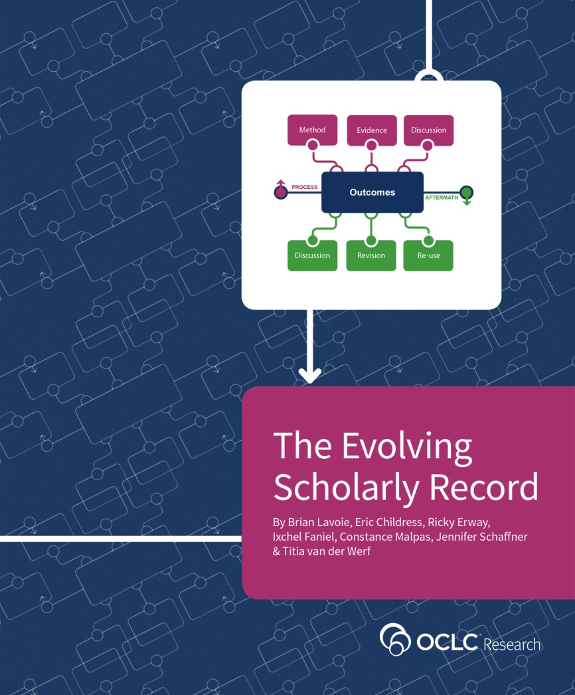
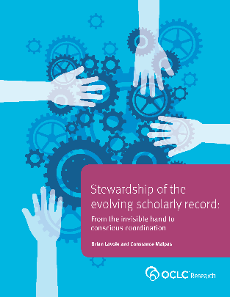
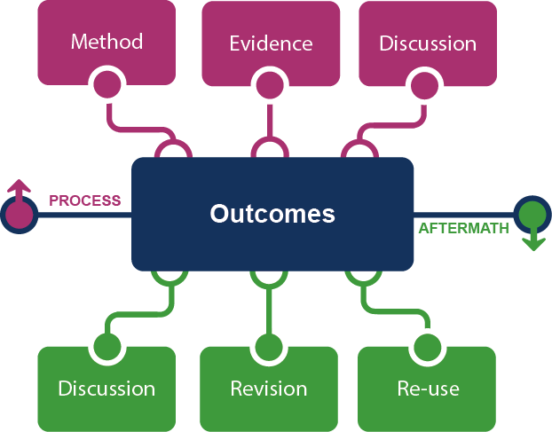
The Evolving Scholarly Record
Research data management
oc.lc/esr

Slide 6
The Realities of Research Data Management
Research data: key part of evolving scholarly record
How universities acquire RDM capacity:
Context, influences, choices
Key decision points:
Deciding: 1) to act 2) what to do 3) how to do it
Case studies:
University of Edinburgh
Wageningen University & Research
University of Illinois - UC
Monash University

Slide 7
OCLC Project Team
Rebecca Bryant, PhD Senior Program Officer
https://orcid.org/
0000-0002-2753-3881
Brian Lavoie, PhD
Research Scientist
https://orcid.org/
0000-0002-7173-8753
Constance Malpas
Research Scientist
https://orcid.org/
0000-0002-9312-8294

Slide 8
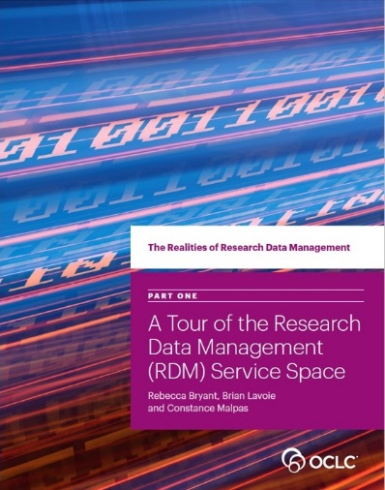
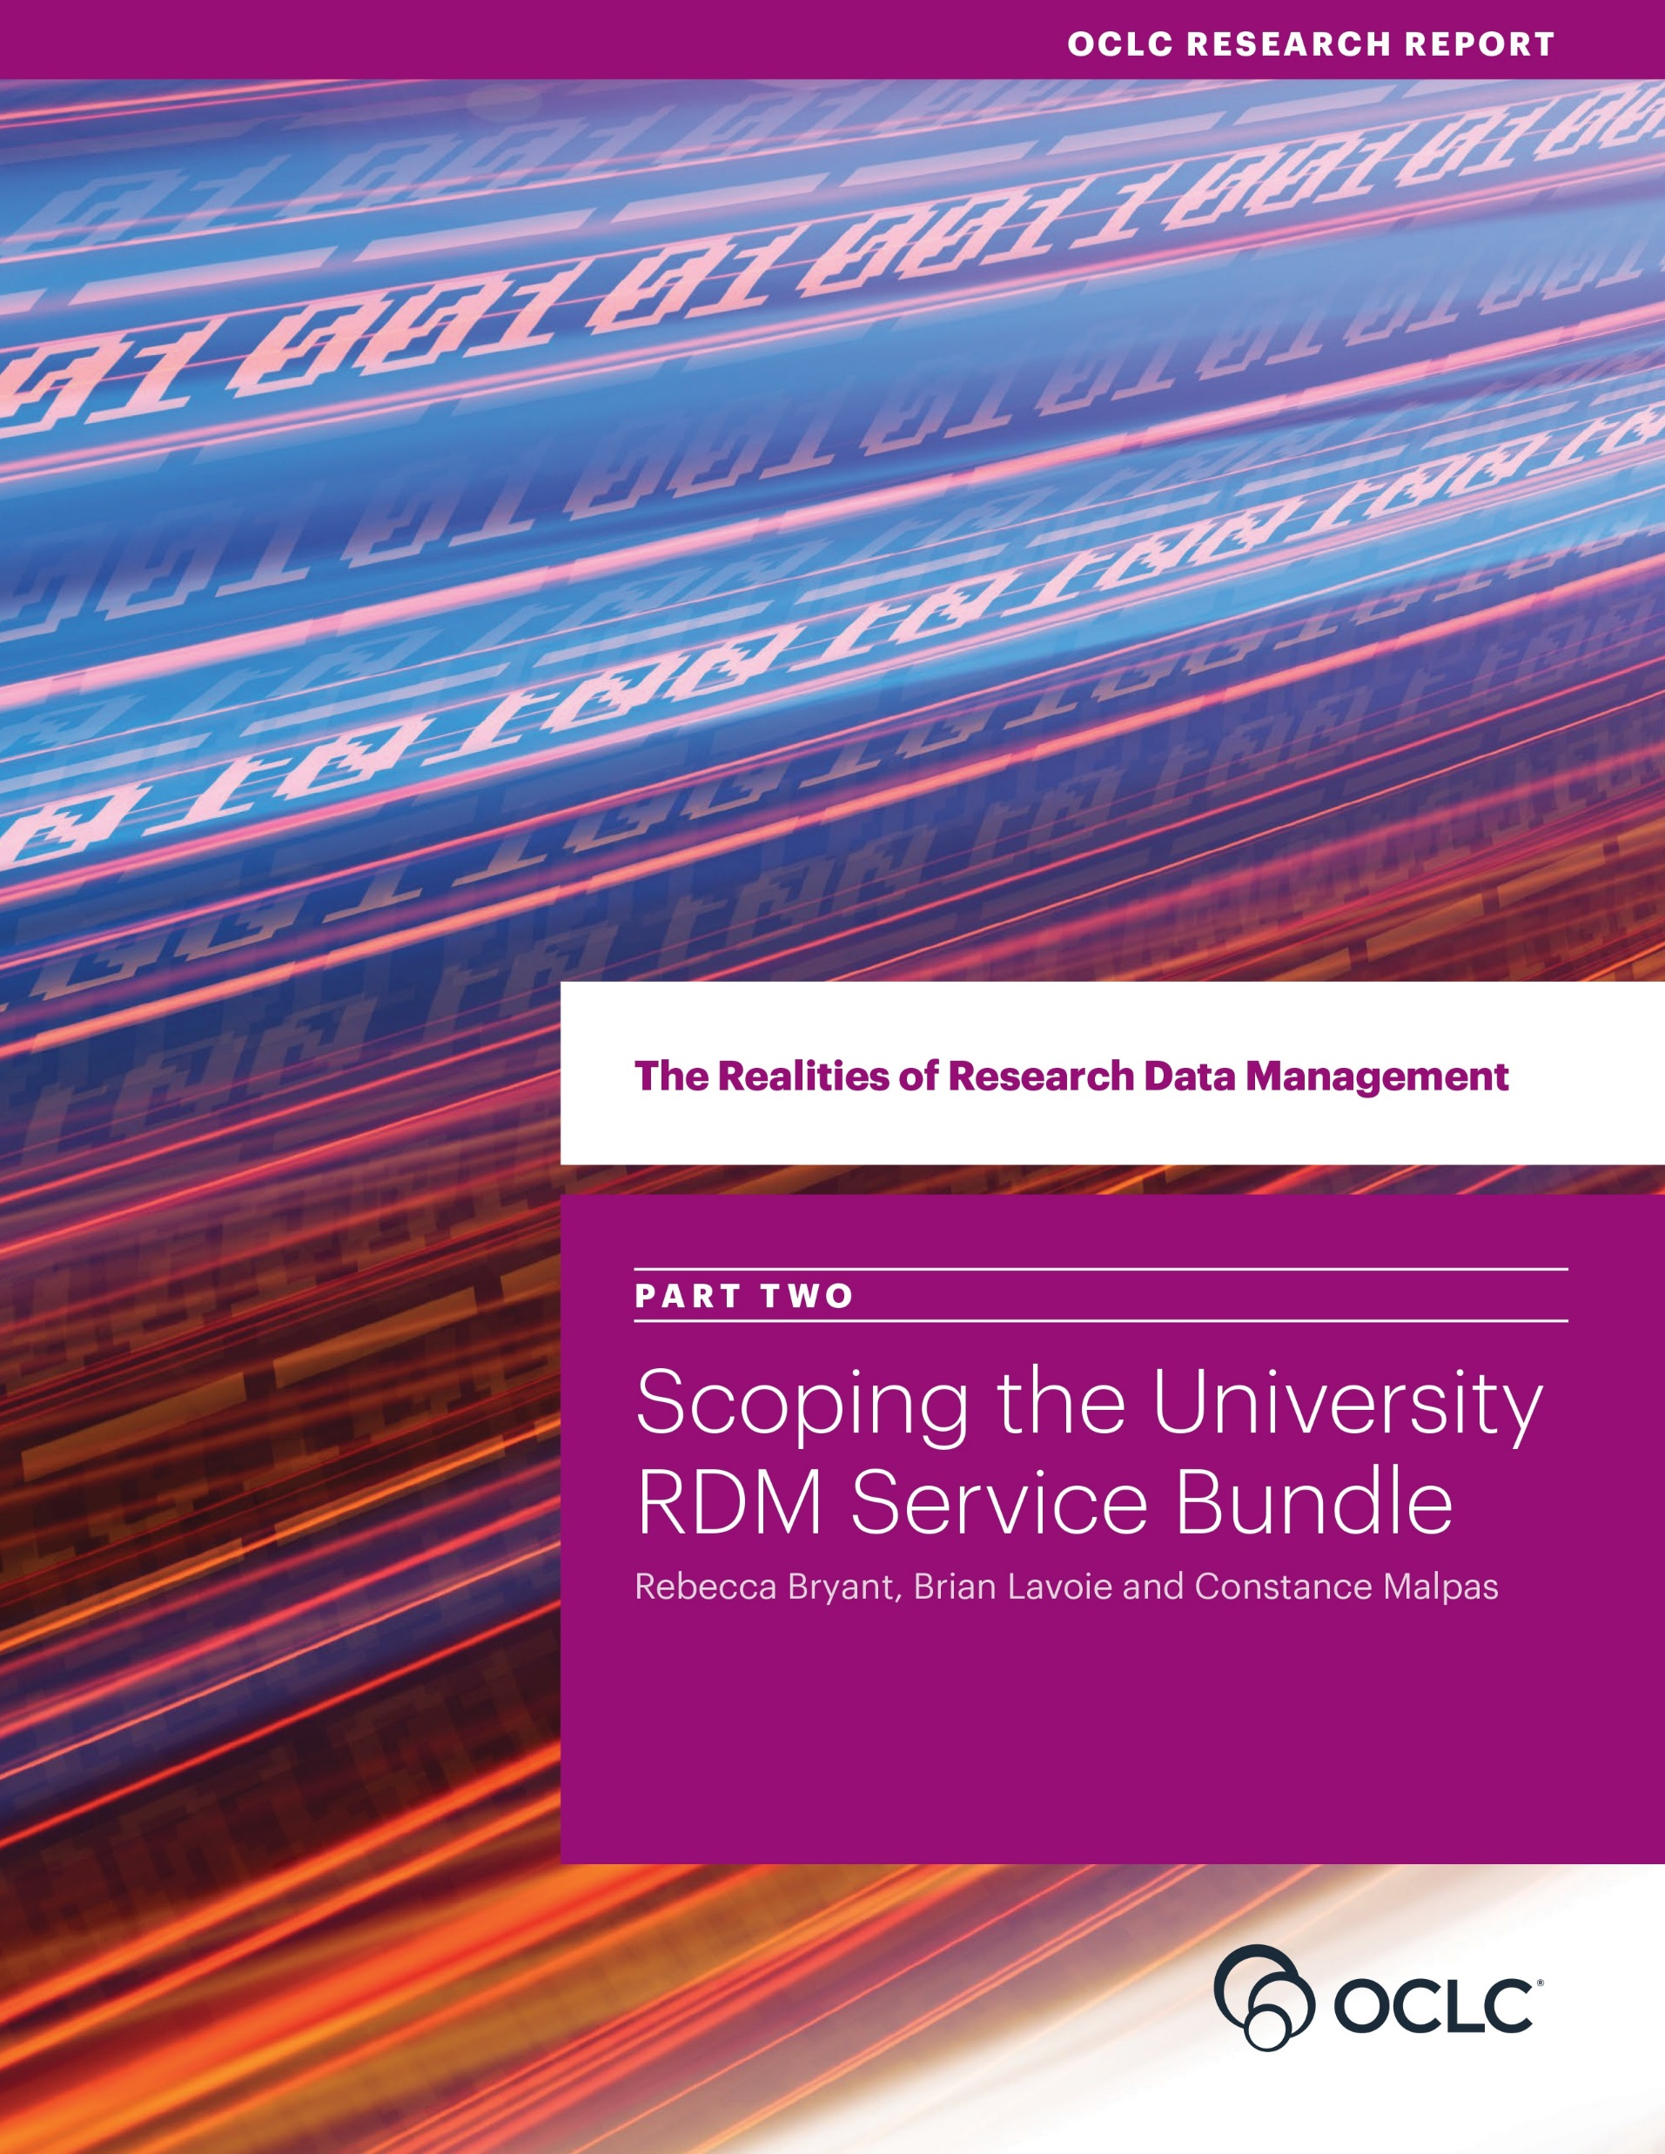
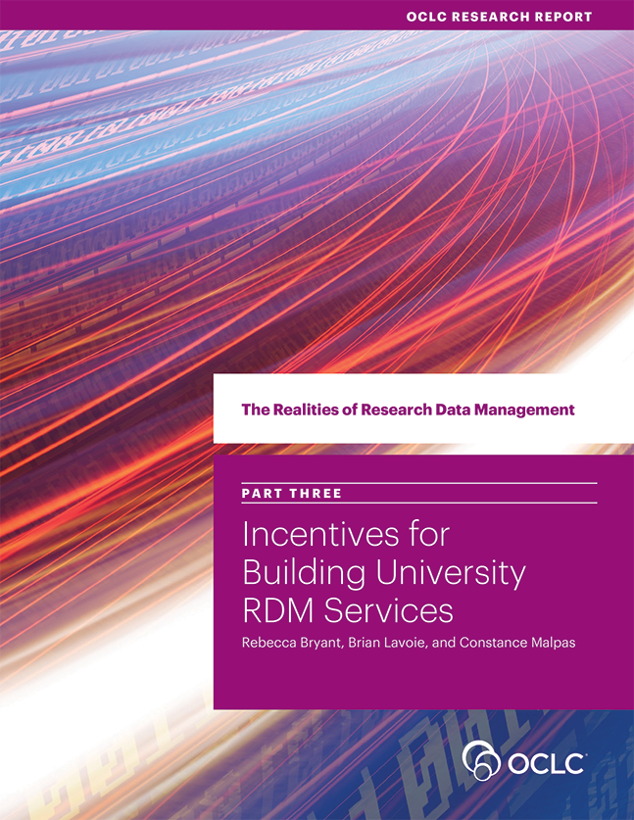
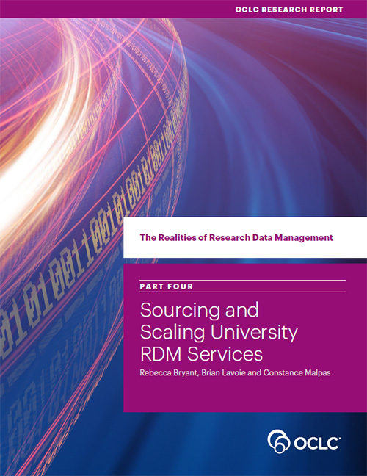
Four Reports
oc.lc/rdm
Scoping the
RDM Service Bundle
Sourcing & Scaling
Choices
Incentives to Acquire
RDM Capacity
RDM Service Space

Slide 9
The RDM Service Space

Slide 10
The RDM Service Space

Slide 11
RDM Services: Examples
“… fast, free, and
confidential feedback
on draft DMPs”
4TU.ResearchData
monash.figshare

Slide 12
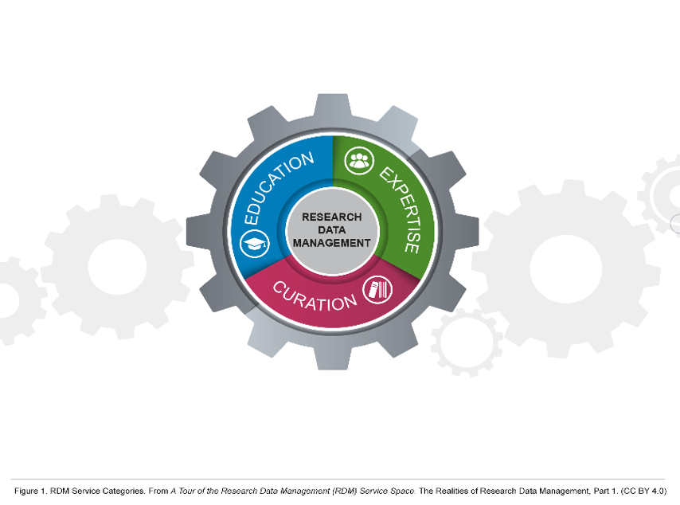
RDM Service Categories
… are both complementary
… and separable

Slide 13
Scoping the RDM Service Bundle

Slide 14
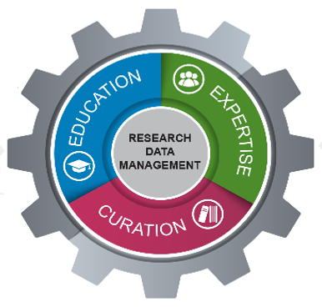
RDM Service Bundle
University
service bundles
… set of RDM services
offered by a university
to its researchers.
Includes not just local
but also external services

Slide 15
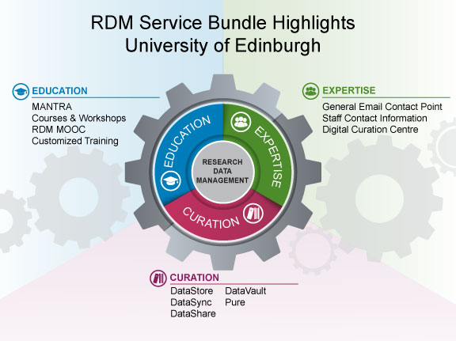
“RDM Service Bundle Highlights: University of Edinburgh” by OCLC Research, from The Realities of Research Data Management Part Two: Scoping the University RDM Service Bundle (https://doi.org/10.25333/C3PG8J), CC BY 4.0
Notes:
LOCALLY BUILT CURATION SERVICES AS 1st CHOICE FOR RESEARCHERS.
EARLY ADOPTER – NO EXTERNAL SERVICES AVAILABLE.
GLOBAL CENTER OF EXCELLENCE.
Edinburgh has invested quite intensively in a suite of locally-built services, especially in Curation. They see themselves as a global center of excellence in RDM, and scope their RDM capacity accordingly.
Edinburgh’s RDM service bundle was shaped by a strong—and early—university commitment to data management, coupled with an external context that mandated responsible data management and sharing. Edinburgh would like its locally deployed RDM services to be seen as the best choice for local researchers to meet their RDM needs, rather than as a last resort when external options are not available.
But Edinburgh also sees itself as a global leader in the RDM service space, with a role in supporting external stakeholders beyond the local university community.
Edinburgh’s RDM service bundle is seen not as a self- contained resource serving local researchers exclusively, but instead as a “center of excellence” in a broader network of RDM services and resources.

Slide 16
“RDM Service Bundle Highlights: University of Illinois at Urbana-Champaign” by OCLC Research, from The Realities of Research Data Management Part Two: Scoping the University RDM Service Bundle (https://doi.org/10.25333/C3PG8J), CC BY 4.0
Notes:
LOCAL REPO ONE OF MANY. FOCUSSED ON OUTREACH.
INTERESTED IN GROUP SCALE SOURCING. DATA CURATION NETWORK TO GROUP SCALE EXPERTISE.
Like Edinburgh, Illinois has built an internally sourced data repository, but unlike Edinburgh, it does not see this repository as a first choice for its researchers, but rather as just one repository among many, to be used when external options do not exist or are otherwise not suitable.
The emphasis on outreach to researchers is a distinctive feature of the Education services in the Illinois RDM service bundle, based on a recognition that data management can be an afterthought for many researchers; therefore, outreach is a key ingredient for ensuring that Education services are highly visible to those that would benefit from them.
You might also recognize a strong focus on DMP in both education and expertise.

Slide 17
“RDM Service Bundle Highlights: Wageningen University & Research” by OCLC Research, from The Realities of Research Data Management Part Two: Scoping the University RDM Service Bundle (https://doi.org/10.25333/C3PG8J), CC BY 4.0
Notes:
CURATION RATHER RECENT, ABLE TO USE NETWORK SCALE SERVICES.
STRONG FOCUS ON EXPERTISE.
In contrast, Wageningen rely on externally-provided curation services. Researchers are encouraged to utilize discipline-focused repositories as a first choice, or, alternatively, to deposit their data into the national-scale DANS-EASY archive or the consortial-scale 4TU.ResearchData repository.
Expertise becomes a big aspect of their RDM service bundle, focusing on helping local researchers navigate the eco-system of RDM services to solve particular RDM problems. Answering questions, advising in the choice of external repository options, assisting in data documentation and deposit.
Researchers are repeatedly encouraged to engage directly with Data Management Support staff. Open ended in scope

Slide 18
“RDM Service Bundle Highlights: Monash University” by OCLC Research, The Realities of Research Data Management Part Two: Scoping the University RDM Service Bundle (https://doi.org/10.25333/C3PG8J), CC BY 4.0
Notes:
Monash’s RDM service bundle is distinctive in its emphasis on Education services tailored specifically for graduate students as an important aspect of academic training, and also in how their Expertise services are diffused over many campus units.
Monash relies heavily on an externally focused approach. Curatorial capacity is drawn from a number of externally sourced platforms: principally figshare, but also LabArchives, Google Drive, VicNode and various services provided through ANDS.
Monash has played a leading role in developing several “above the institution” RDM resources and solutions, including the ANDS service (Australian Nat Data Service)

Slide 19
All together …

Slide 20
Scoping the RDM Service Bundle
“ … RDM is not a monolithic set of services duplicated across universities …”
“… it is a customized solution …”
“… shaped by a range of internal and external
factors …”
Scoping an RDM service bundle does not necessarily mean implementing the full range of services within the RDM service space.

Slide 21
Scoping the RDM Service Bundle:
Other Findings
One size does NOT fit all ...
Even institutions that scope their RDM service bundles to include services in all
three RDM service categories can differ in the emphasis placed on each category.
Ongoing fluidity and uncertainty in the RDM service space remains a challenge in
scoping RDM service bundles.
Thinking locally ...
RDM is an institutional issue. Cross-unit responsibility for the RDM service
bundle is common.
Many research institutions choose to offer RDM Curation services in parallel with,
rather than subsumed in, the institutional repository.
Research Information Management (RIM) systems can be an important
component of the RDM service bundle.

Slide 22
Scoping the RDM Service Bundle:
Other Findings (continued)
Thinking externally ...
An RDM service bundle includes not just what is built and deployed locally, but
the full range of services, sourced locally and externally, that the institution
manages, or to which it brokers access.
Local RDM curatorial services don’t need to be positioned as a preferred or first
choice solution for local researchers.
No RDM service bundle is an island—all are connected, to a greater or lesser
degree, to the broader, external RDM service ecosystem.

Slide 23
Takeaways, etc.

Slide 24
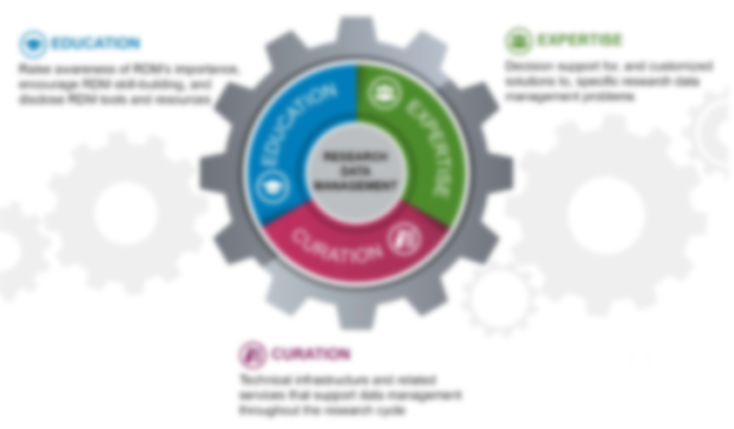
Summary
The RDM service space can be broadly divided into three service categories: Education, Expertise, and Curation.
Education, Expertise, and Curation services are both mutually reinforcing and separable.
RDM is not a monolithic set of services duplicated across universities, but a customized solution shaped by a range of internal and external factors.

Slide 25
Takeaway Questions
Does your institution offer an RDM service bundle - OR - Is an RDM service bundle being planned/in development?
YES: How are the services distributed across the Education-Expertise-Curation (E-E-C) spectrum?
NO: Is this a strategic decision? Resourcing issue? Uncertainty? Other?
What are the core/essential services your institution needs to support RDM needs on campus?
What organizations & units (inside and outside of your institution) are providing RDM services?
Are researchers using services beyond those provided by your institution?
Do you have all of the information you need to answer these questions?
Notes:
We will be focusing on these questions in the interest group.

Slide 26
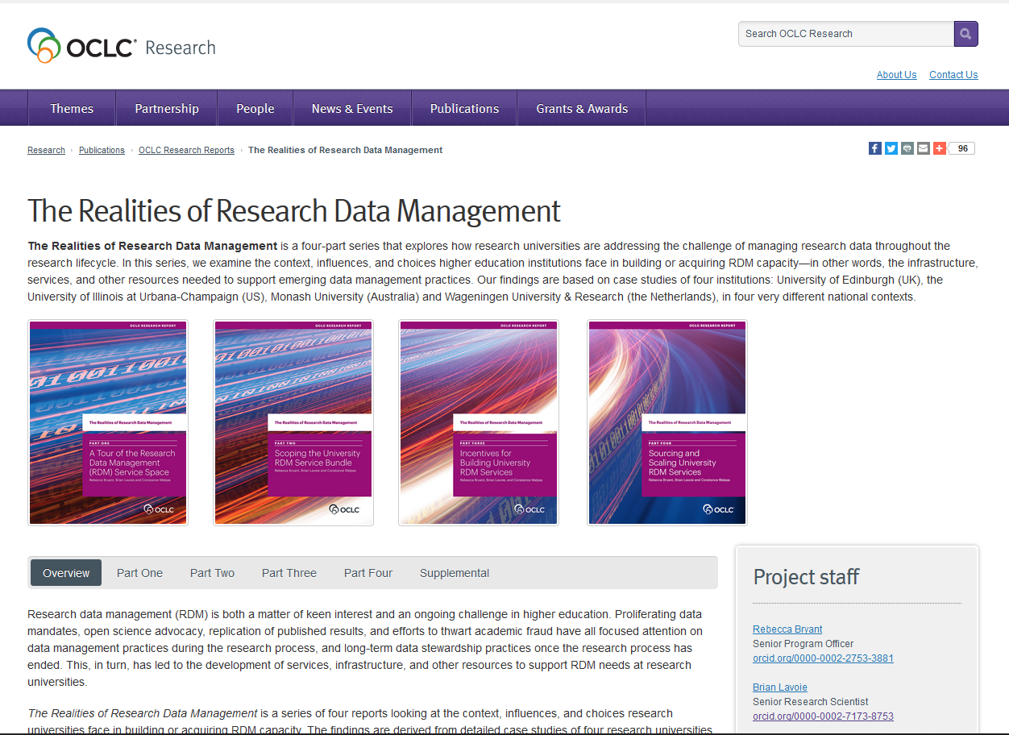
oc.lc/rdm
Webinar recording: Policy Realities of RDM

Slide 27
More Realities of RDM!
Attend …
Webinar #2
Identifying and Acting on Incentives When Planning RDM Services
13 November 2018, 11:00 am EST (UTC -5)
Webinar #3
Acquiring RDM Services for Your Institution
4 December 2018, 11 am EST (UTC -5)
Join …
ORLP RDM Interest Group: oc.lc/rdm-ig
You will be added to the Interest Group listserv

Slide 28
Thank you!
The Realities of Research Data
Management
oc.lc/rdm
Brian Lavoie
lavoie@oclc.org
Rebecca Bryant
bryantr@oclc.org
©2018 OCLC. This work is licensed under a Creative Commons Attribution 4.0 International License. Suggested attribution: “This work uses content from ‘The Realities of RDM: Understanding Institutional RDM Services’ © OCLC, used under a Creative Commons Attribution 4.0 International License: http://creativecommons.org/licenses/by/4.0/.”

