Slide 1
Better together
Effective Partnerships for Libraries Archives and Museums
Jennifer Gunter King, Hampshire College @jgunterking
Merrilee Proffitt, OCLC Research @merrileeIam

Slide 2
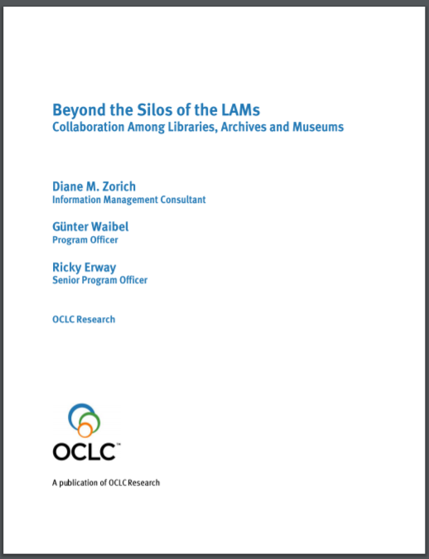
Library, Archive Museum Collaboration
An evergreen topic
Robert S. Martin and Margaret Hedstrom
2006 RBMS preconference
Silos of the LAMs (2008)

Slide 3
Recent developments
Academic Art Museum and Library Summit at University of Miami (2016)
Kress+DLF GLAM Cross-Pollinator Awards (2017)
2nd Academic Art Museum and Library Summit at Oberlin College (2018)

Slide 4
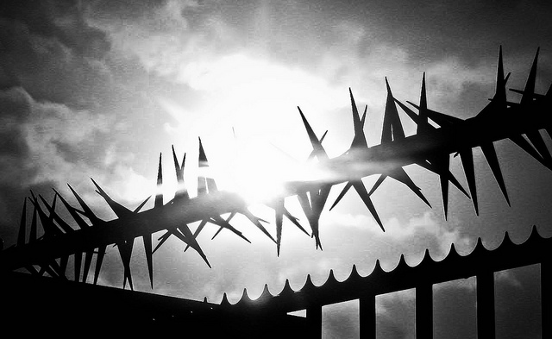
Barriers to collaboration
Significant differences
Training / degree programs
descriptive practice
systems and standards
separate administrative structures
Niels Kliim Wall spikes fence cc-by 2.0

Slide 5
Ingredients for success
Deep sharing
staff
money
Shared administrative structures
Rod Waddington Breaking eggs cc-by-sa 2.0

Slide 6
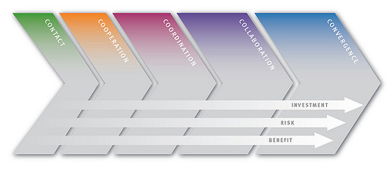
Contact: groups meet, enter dialog and explore common activities and needs
Cooperation: informal activity with small but tangible benefit
Coordination: beyond ac hoc; calendars, meeting reports, share to-do lists and timelines
Collaboration: process of working together creates something that would not be possible with just a single partner
Convergence: organizations are entwined. You are in one another’s budgets and on each other’s org charts.
Making the leap from coordination to collaboration is difficult.
The Collaboration Continuum. Zorich, Diane, Gunter Waible, Ricky Erway. 2009. Beyond the Silos of the LAMs: Collaboration Among Libraries, Archives and Museums. Dublin, OH: OCLC Research

Slide 7
Advice from the trenches
Don’t worry about metadata mapping
“indexing data is no longer a problem”
“the web has shaped behaviors”
Open source software and IIIF help (“cross community collectives”)
Focus on opportunities with particular disciplines
“Have coffee with your colleagues” (regular scheduled meeting help, too)
Ride on the coattails of curators who have responsibility for faculty engagement
New library or museum staff hires as an opportunity for a reset
Change agents can’t be polarizing forces

Slide 8
Advice for archivists
What are mission drivers for GLAM collaboration?
Shared storage needs?
Serving research needs?
Serving teaching needs?
What are administrative structures?
Are the library and the museum under the same provost?
Establish standing committee around shared goals
Who are potential change agents?
Can you leverage staff that are new to the organization?

Slide 9
Particular opportunities for library-archive collaboration?
“CONVERGENCE OF SPECIAL COLLECTIONS AND THE RESEARCH LIBRARY Research libraries are increasingly recognizing a convergence of collections, services, goals, and skill sets across both general and special collections. In the last several years, the intersection of the growth of computational scholarly research methodologies and outputs, growing collections of research data sets, and an increased interest in collecting ephemeral and grey literature, have shifted collecting such that many recent additions to library collections look much more like special collections. They are often contextually situated objects coming in through nontraditional channels or in digital formats that have urgent preservation needs.”
Weber, Chela Scott. 2017. Research and Learning Agenda for Archives, Special, and Distinctive Collections in Research Libraries. Dublin, OH: OCLC Research. doi:10.25333/C3C34F.

Slide 10
A case study of collaboration - Five Colleges (FC) & Museums 10 (M10)
The Five Colleges, formally established in 1965 as a consortium, includes -
Amherst College, Mount Holyoke College, Smith College, the University of Massachusetts Amherst, and later Hampshire College
Museums10 is a collaboration of seven campus museums and three campus-affiliated museums -
Beneski Museum of Natural History, Amherst College; Emily Dickinson Museum; The Eric Carle Museum of Picture Book Art; Hampshire College Art Gallery; Historic Deerfield; Mead Art Museum at Amherst College; Mount Holyoke College Art Museum; Smith College Museum of Art; University Museum of Contemporary Art; Yiddish Book Center
Notes:
The Five College Consortium comprises four liberal arts colleges and one university in the Connecticut River Pioneer Valley of Western Massachusetts.^{[1]} totaling approximately 38,000 students. They are geographically close to one another and are linked by frequent bus service which operates between the campuses during the school year.^{[2]}
The consortium was formally established in 1965, but its roots lay in cooperative efforts between the oldest four members of the consortium dating back to 1914.^{[3]} The consortium is composed of Amherst College, Hampshire College, Mount Holyoke College, Smith College, and the University of Massachusetts Amherst.
[Definition of Consortium: an agreement, combination, or group (as of companies) formed to undertake an enterprise beyond the resources of any one member]
Broadening the collaborative potential for the Five College libraries is Museums 10, an allied museum collaborative the includes the Beneski Museum of Natural History (Amherst College), Emily Dickinson Museum, The Eric Carle Museum of Picture Book Art, Hampshire College Art Gallery, Historic Deerfield, Mead Art Museum at Amherst College, Mount Holyoke College Art Museum, Smith College Museum of Art, University Museum of Contemporary Art, and the Yiddish Book Center.
Using the Framework of the Collaboration Continuum, the Five College Libraries, Archives and Museums have had significant success along the continuum.

Slide 11
Five College Library Consortium
Museums 10
Making the leap from coordination to collaboration is difficult…. and benefits from experience, shared goals and mission, and the belief that working together gets us further than working on our own.
The Collaboration Continuum. Zorich, Diane, Gunter Waible, Ricky Erway. 2009. Beyond the Silos of the LAMs: Collaboration Among Libraries, Archives and Museums. Dublin, OH: OCLC Research
Notes:
Museums 10 and Five College Library collaborations, given the history of the consortia, related missions, and length of time working together, span Cooperation, Coordination, Collaboration, and have some successful convergence.

Slide 12
FC & M10 coordination
Library Committees
Access, Discovery, Innovative Learning, User Experience, Archives and Special Collections, Digital Stewardship, along with working groups
With general charges to share best practices, be forward thinking
Products:
Digital Preservation: A Planning Guide for the Five Colleges
Annual Five College Libraries All Staff – professional development
Museum Committees
Education, Curators, MIMSY, Diversity
Products:
Annual Museums 10 Professional Development Event
Sharing/Developing Best Practices
Notes:
Library Committees (Access, Discovery, Innovative Learning, User Experience, Archives and Special Collections, Digital Stewardship, Librarians Council)
Share best practices, be forward thinking, “Seek to ensure that major investments made by each campus are undertaken from the earliest point of exploration with advice and consultation with colleagues from the other campuses, enhancing the possibility of other campuses joining in any major endeavor either immediately or at a later date.”
Identify, develop and seek funding for collaborative initiatives that directly support the FCLC strategic priorities;
Collaborate within the five colleges, with committees both in the library consortium and outside of the libraries, on special initiatives that advance the consortium;
In consultation with FCLC create task forces and working groups as needed (such as the Depository Task Force within Access) and FCLC may create cross-committee task forces and working groups as well;
Serve as a resource to other Five College committees and task forces;
Sponsor conversations with other committees and across peer groups in the Five Colleges;
Identify professional development areas that foster skill development in areas supporting the FCLC strategic priorities;
Partner with the Professional Development Committee to develop opportunities for Five College library staff; and
Play a key leadership role by providing recommendations and developing policy in areas pertaining to the committee’s charge and expertise.

Slide 13
FC & M10 collaboration
FC library collaborations (not an exhaustive list)
Five College Annex and Depository: storage for print monographs and journals
EAST Eastern Academic Scholars Trust - shared print archive retention agreements
The Five College Archives Digital Access Project digitized collections relating to women's history and education
Five College Finding Aids Project - a searchable database of finding aids for archives and manuscript collections.
Museum collaborations
Collaborative Programming that expands beyond Museums to include Libraries, Archives and Special Collections
Go Dutch
Books to Blogs and Back, 2007
Food

Slide 14
FC & M10 convergence
Shared Integrated Library Service
Triple III
Aleph
FOLIO
Shared Museum Collections Management & Discovery Software
MIMSY/MOBIUS
Notes:
The Five College Libraries share an integrated library service, and its implementation is overseen by a shared Five College manager; and the infrastructure is an integral core of all of the libraries collections services;
Museums 10 was possibly the nation’s first customize Collections Management Software and has been a model to museums, requiring a shared funding model and staffing
Shared Integrated Library Service –
Triple I
Aleph
FOLIO
Shared Museum Collections Management & Discovery Software
MIMSY/MOBIUS

Slide 15
Advice to archivists
Explore perceived differences across professions
Collaboration in traditional realms in the Five Colleges has been easier than pursuing collaboration in new and emerging realms
Frameworks for Distributed Responsibility
If responsibility for born-digital collections is to be truly and appropriately distributed across our programs, it is important to consider what skills and roles might be needed to operationalize shared responsibility, how to create networks and support systems for positions expected to be change-agents, and what ongoing leadership support is required to effect programmatic change.
Weber, Chela Scott. 2017. Research and Learning Agenda for Archives, Special, and Distinctive Collections in Research Libraries. Dublin, OH: OCLC Research. doi:10.25333/C3C34F.
Notes:
Explore perceived differences across professions
1. Archivists often work across collections. It is rare to find an archive that does not contain museum objects or art, manuscripts, books, or journals. Archivists are therefore some of the most powerful advocates for inter-institutional collaboration.
3. It is in the modern era that the distinction between Archives, Libraries and Museums is firmly established, and archivists, curators and librarians occupy divergent (though related) professional identities. Before the turn of the century, the materials that make up our libraries, archives and museums were often found together in Cabinets of Curiosities, Athenaeums, or Reliquaries.
The sheer volume of print at the turn of the last century necessitated the divergence of our professions. But, we are no longer in a print world.
Collaboration in traditional realms in the Five Colleges has been easier than pursuing collaboration in new and emerging realms
1. The Five Colleges is an example of a consortium that initially attempted to emulate traditional workflows and practices. It took strong leadership and vision from the youngest of the Colleges (Hampshire) to agitate for the NEW possibilities available with the development of machine-readable library catalogs – but the battle was an uphill one, and *eventually*, the value of collective adoption of an integrated library system prevailed. Today no one in the Five Colleges can imagine a world where they did not share a library catalog – we boast of the ability for each campus to access the resources of all the campuses.
Frameworks for Distributed Responsibility
In the 21st C. the work at hand is to establish digital infrastructures, but should they mirror the bricks and mortar and stacks and galleries we inherited? Should the organizational charts of libraries archives and museums include new programs and positions to develop the “digital” or should the org charts include elements that, working together, establish a forward-looking framework for the digital versions of our Libraries, Archives and Museums.

Slide 16
Future developments
Five College Libraries, Museums and Collections Summit (October, 2018)
Notes:
Five Colleges and Museums 10 are hosting a Five College Libraries, Museums and Collections Summit in October, 2018 summit in October to explore the opportunity, and responsibility, to collaborate. The day will be dedicated to exploring how the consortium perceives the possibilities, and to broaden the understanding of the possibilities, in order to inspire collaborations that can converge. What do we have to lose?
https://sites.hampshire.edu/fivecollege-museums10-summit/

