Slide 1


The Realities of RDM:
Identifying and Acting on Incentives When Planning RDM Services
Rebecca Bryant
Ixchel M. Faniel
OCLC Research
Realities of RDM Webinar Series: Part 2
13 November 2018
Notes:
today’s webinar is on Identifying and acting on Incentives When Planning RDM Services.
My name is Rebecca Bryant, and I will be co-presenting with fellow OCLC Researcher Ixchel Faniel, as we examine the incentives driving RDM service development.
Our previous webinar, on October 2, focused on the “what” in RDM services—what services might be included in an institutional RDM service bundle. But today’s presentation will focus on the complementary internal and external incentives that influence decision making, priorities, and services offered, with a particular focus on researcher needs. In other words, we'll be discussing the "Why."

Slide 2
Goals
Build relationships across the partnership
Use OCLC Research to support a 3-month, community exploration of RDM practices
Inform us at OCLC Research, helping to direct us to next research topics that will support our partners
Plan service offerings
Understand practices of other research institutions
Explore local conditions
Notes:
Our goal with this three-part webinar series is to offer a framework and community for institutions to examine their own current and future RDM service bundles.
It also provides a setting for us at OCLC Research to learn from our community, particularly the partners in the OCLC Research Library partnership.

Slide 3

Devoted to challenges facing libraries and archives since 1978
Community resource for shared Research and Development (R&D)
Engagement with OCLC members and the community around shared concerns
oc.lc/research
~130 partnership institutions worldwide
Facilitates connections between OCLC Research and research libraries
Supports transnational sharing and peer to peer collaborative learning
Influences service design and future OCLC research
Notes:
Likely, if you are attending this webinar, you are already familiar with OCLC Research, which is a sub-unit of OCLC, dedicated to research and prototype development for the library community for over 40 years.
This webinar series and the associated interest group is made available exclusively for the transnational community of Research Library Partnership members, and allows us to engage directly with you as we collectively learn, influence, and lead future OCLC Research and library services.

Slide 4
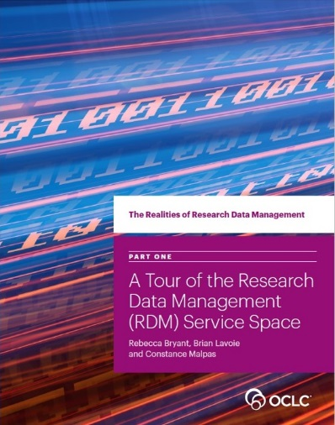
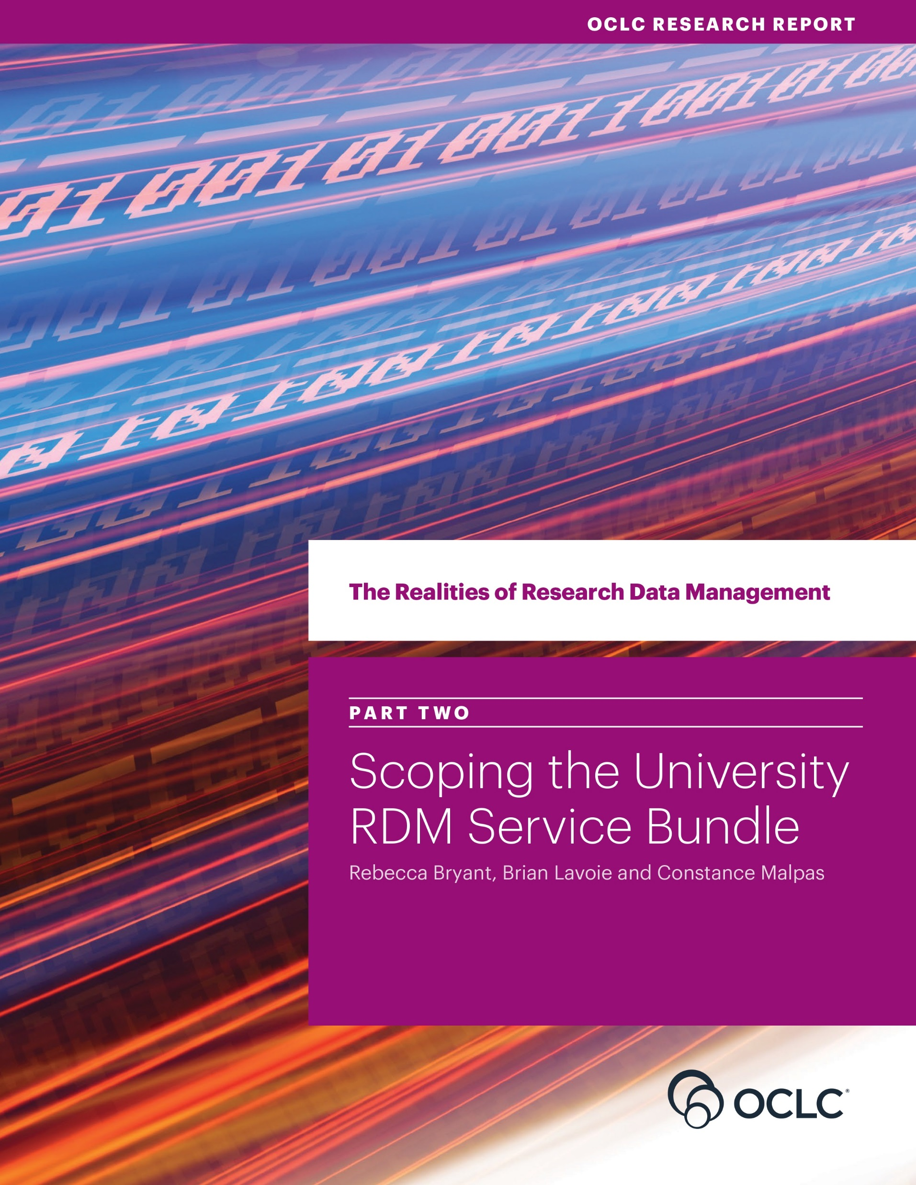
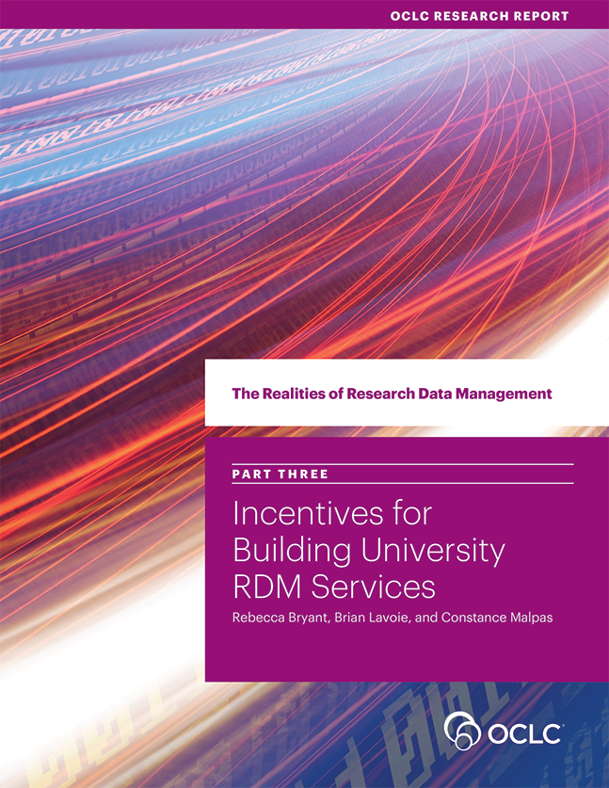
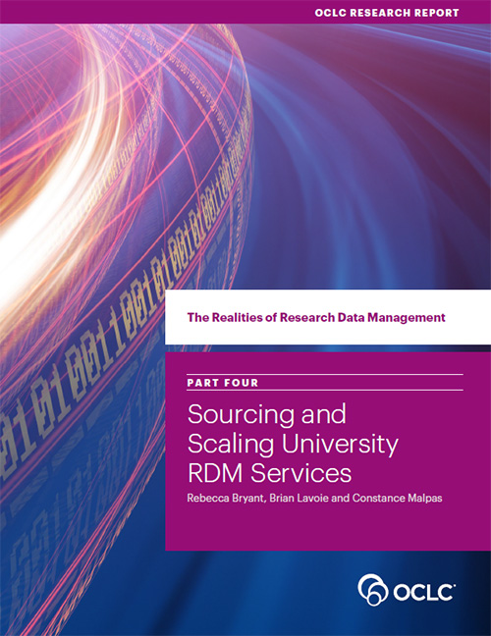
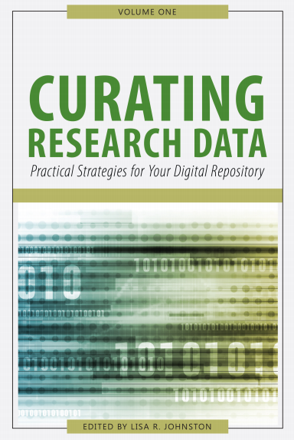
www.oclc.org/research/themes/research-collections/rdm
Notes:
This webinar will focus on two separate but complementary lines of research here at OCLC, related to research Data Management.
The first is the Realities of Research Data Management Series, in which Brian Lavoie and myself have contributed, and which focuses on the what, how, and why of institutional RDM service development at research institutions worldwide.
The second is research focused on user and researcher behaviors, particularly focused on social science researchers, including data sharing and reuse practices. This is work led by my college and co-presenter Dr. Ixchel Faniel.

Slide 5
Incentives to Acquire Institutional RDM Capacity
Scoping the
RDM Service Bundle
Sourcing & Scaling
Choices
Incentives to Acquire
RDM Capacity
RDM Service Space
oc.lc/rdm
Notes:
So I'm going to kick our webinar content off by re-introducing you to the Realities of Research Data Management report series, available at oc.lc/rdm. Today we're going to focus on content from the third report from this four-part series, in which we explored the incentives driving the development university RDM services.

Slide 6



OCLC Project Team
Rebecca Bryant, PhD Senior Program Officer
https://orcid.org/
0000-0002-2753-3881
Brian Lavoie, PhD
Research Scientist
https://orcid.org/
0000-0002-7173-8753
Constance Malpas
Research Scientist
https://orcid.org/
0000-0002-9312-8294
Notes:
This work was a collaborative effort by three OCLC researchers: myself, Brian Lavoie, and Constance Malpas, and

Slide 7
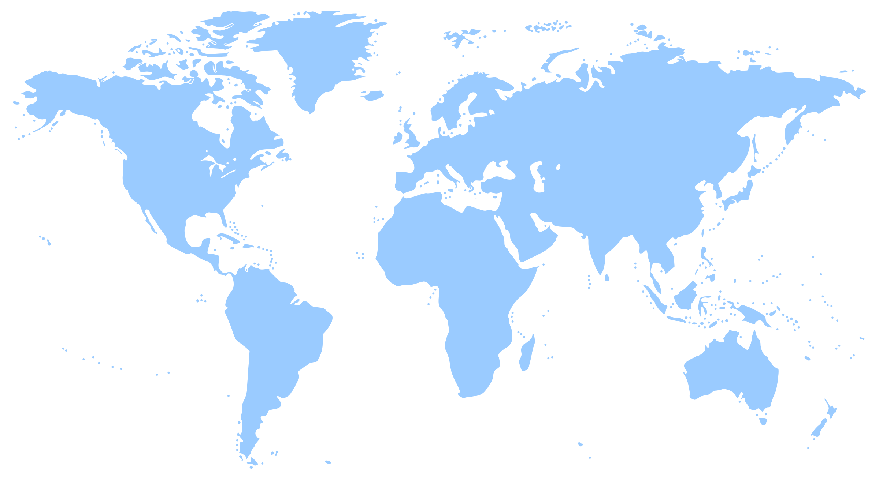
The Realities of Research Data Management
Research data: key part of evolving scholarly record
How universities acquire RDM capacity:
Context, influences, choices
Key decision points:
Deciding: 1) to act 2) what to do 3) how to do it
Case studies:
University of Edinburgh
Wageningen University & Research
University of Illinois - UC
Monash University
Notes:
is a qualitative case study of four institutions in four different national environments: the University of Illinois at Urbana-Champaign in the United States; University of Edinburgh in the UK; Wageningen University and Research, in the Netherlands, and Monash University in Australia.
We examined their processes and decision making processes for deciding to act, and then what and how.

Slide 8
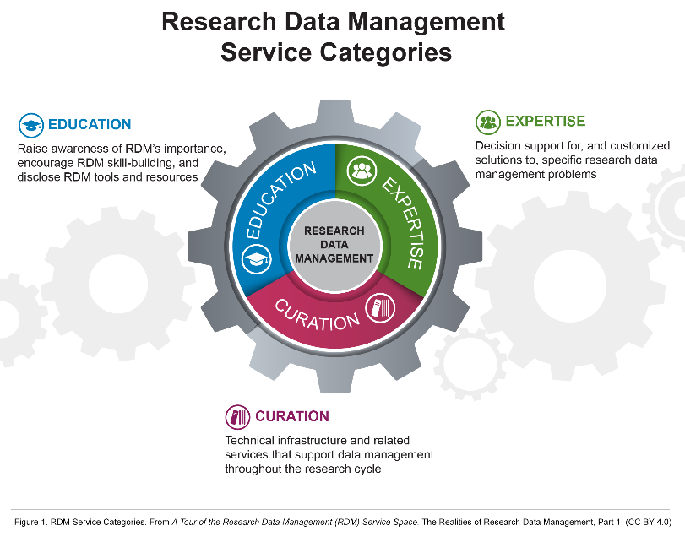
The RDM Service Space
Notes:
The first two reports, and our last webinar, provided an overview of the RDM service space. In particular, we offered this model for understanding three components of an institution’s “service bundle.”
Our model describes three types of service categories that institutions may develop and offer services:
Education
Expertise
Curation
I will be referring back to this throughout my presentation.

Slide 9
“Incentives to Acquire RDM Capacity” by OCLC Research, from The Realities of Research Data Management Part Three: Incentives for Building University RDM Services (https://doi.org/10.25333/C3S62F), CC BY 4.0
Notes:
In our third report, which I’ll be talking about for the rest of my time, we focused on the incentives for institutions to acquire RDM capacity.
In other words, WHY are institutions developing RDM services? How do these drivers shape each institution's service bundle?
While incentives are multi-faceted, we have organized these incentives into four broad categories:
Compliance
Evolving scholarly norms
Institutional Strategy
Researcher demand
I’ll describe these in the next few slides, and I’ll also offer you some examples and “takeaways” for further consideration of your own unique institutional situation.

Slide 10

Data management mandates (or guidelines) from funders, journals, national agencies, and other external stakeholders are one important driver of RDM services
Differences in external mandates mean that institutions may prioritize different RDM services
Mandates may require different things
Data Management Plans (DMPs) in grant proposals
Open data sharing
National policies may define or recommend the length of data preservation
Mandates are also an important driver for continued provision of RDM services
Notes:
Differences in external mandates mean that institutions may prioritize different RDM services.
We tend to think of data retention mandates monolithically, but in fact they tend to vary widely in their specifics from country to country. For example, in the Netherlands, the Code of Conduct for Scientific Practice mandates that research data sets are to be preserved for a minimum of ten years, which amplifies the importance of reliable long-term data preservation solutions. In the US, the National Science Foundation’s data management plan (DMP) requirements for grant funding motivated Illinois’ focus on developing DMP preparation support for their researchers. We saw this at the University of Illinois, which played an active role in the development of the DMPTool.
DMP requirements (so far) as less important in Australia, and we saw less emphasis on these at Monash.

Slide 11
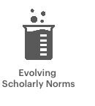
Rapid changes in scholarly communications technology and networks, as well as open science advocacy, are reshaping scholarly practices, increasing interest in data sharing and re-use.
Changes in scholarly norms are not uniform: evolving practices different across disciplines.
Incentives are dynamic and can manifest differently within institutions and disciplines, so you can’t look at researchers or norms monolithically—it’s important to look at individual and disciplinary behaviors.
Institutions may seek to codify RDM and sharing practices through policy development.
Notes:
Scholarly norms are changing and are enacting pressures on data management practices. But changes and pressures are not uniform: evolving practices may differ across the research community.
Just as there is diversity across research data mandates, there is also diversity in the scholarly practices which have started to coalesce around data management. The data practices of one part of the research community may differ from those of another, and this can create challenges for university data curators who are trying to serve researchers across multiple disciplines and research specialties.
The research institutions in our study seek to codify research data management and sharing practices through policy.
There is still a lot of uncertainty and fluidity in terms of external data mandates and guidelines, and also with evolving scholarly practices around research data. The universities in our study have attempted to clarify some of this through institutional RDM policies that help articulate goals, strategic directions, and specific protocols for affiliated researchers. All of the universities in our study have institutional data policies with the exception of Illinois, and Illinois is addressing some of these issues through the development of policies for its Illinois Data bank repository service.

Slide 12
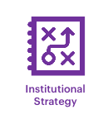
The development of RDM services may become an important institutional strategy for some universities.
University investment in RDM infrastructure, services, or personnel is motivated by locally relevant incentives, which may include:
Institutional reputation management
Internal tracking of research, investments, and outputs
Improved process and performance management
In particular, developing RDM expertise may be key to a strategic agenda to increase library support for research workflows, while shifting away from traditional back-office activities.
Notes:
University investment in research data management infrastructure, services, or personnel is motivated by locally relevant incentives.
Universities tend to share the view that RDM is important, but the mix of incentives or motivations that drive them to act in the RDM space, to develop an RDM service bundle, tend to differ from university to university. Some might be responding mainly to internal interests, such as maximizing grant funding, enhancing their research reputation, or building distinctive capacities. Others could be driven more by external motivations, like policy mandates, scientific norms, and evolving research workflows. Of course, all of these things typically play a role to some degree in university decision-making around RDM, but the relative mix and emphasis will vary according to local circumstances.
Developing RDM expertise is key to a strategic agenda to increase library support for research workflows, while shifting away from traditional back-office activities.
Many academic libraries are shifting attention away from a collection-centric view of their services to one which emphasizes direct engagement with researchers over the course of the research lifecycle. So in this sense, library involvement in the provision of RDM solutions may be a response to dual incentives: on one level, advancing the university’s interest in data management, while at the same time, advancing the library’s interest in expanding their support of researcher workflows.

Slide 13

Researcher demand can be far more important in shaping and sustaining RDM service bundles, rather than incentivizing their creation
Instead, RDM staff prioritize engagement with researchers to educate them on the importance of good RDM practices, and therefore Education services have emerged as an important component of the RDM service bundle.
Active data management is one aspect of the RDM service space where bottom-up demand by researchers is particularly relevant
It’s important for institutions to understand how researchers are managing and sharing their data
Notes:
This has been one of the most interesting parts of our study, particularly when working with Brian Lavoie, who is trained as an economist. Basic economics suggests that a key motivator for developing an RDM service bundle would be an expression of need on the part of university researchers. In other words, universities would develop and supply RDM services because researchers demand them. But we these incentives seem to play a relatively minor role in our four case studies, and those institutions’ decisions to act. In fact, Researcher demand appeared to play a minor role in development of an RDM service bundle at the institutions we studied.
However, there's a lot more to say about researchers' behaviors, and we’ll be momentarily be looking to Ixchel’s expertise on researcher data sharing and reuse practices to help inform us as we think about RDM service development.

Slide 14
RDM service development at the University of Illinois
ARL eScience Institute
Director hired & RDS established
INSTITUTIONAL STRATEGY
eResearch Task Force
Illinois Data Bank launch
3 FTE staff hired
RDS in campus strategic plan
2011
2012
2013
2014
2015
2016
Year of Data Stewardship (campus committee & engagement)
Active Data Storage (ADS) launch
COMPLIANCE
Development of policies for Illinois Data Bank
Data management outreach begins
NSF begins requiring DMPs
RESEARCHER DEMAND
OSTP Memo
RESEARCHER DEMAND
Notes:
I want to share a couple of examples from our case studies. This one is from the University of Illinois.
COMPLIANCE
Beginning in January 2011, the NSF began requiring supplemental DMPs in NSF grant proposals. These DMPs were expected to describe how investigators would responsibly manage and share the results and data from NSF-supported research. Illinois, as the top recipient of NSF funds in the US, quickly responded, working with other institutions to develop the DMPTool, to help researchers comply with the new DMP mandate.
However, this NSF requirement predated the 2013 OSTP (White House Office of Science and Technology Policy) memo directing federal agencies supporting research to develop a plan to support increasing public access to publicly supported research. This memo called for the public availability of federally funded research outputs, directing each federal agency to develop its own public access plan. A complex landscape of different requirements, timelines, and systems has emerged, and researchers are expected to comply.
Part of Illinois’s service bundle is to provide track federal requirements and provide expertise to Illinois researchers.
INSTITUTIONAL STRATEGY
RESEARCH DEMAND
Notice that Illinois responded to the need for active data storage AFTER it had already developed educational, outreach, and curation services. It was responding to researcher needs it uncovered in the course of developing those other services.

Slide 15
RDM service development at Wageningen University & Research (WUR)
Horizon 2020 funding program launches RDM/DMP pilot
VSNU Code of Conduct for Academic Practice revised to include RDM guidelines
SURF National Coordination Point for RDM established
Horizon 2020 and NWO require RDM section in all grant applications
2011
2012
2013
2014
2015
2016
Director hired, WUR Digital Production Centre launched; RDM planning begins
WUR Library launches RDM outreach to faculty
WUR joins 3TU Federation
RESEARCHER DEMAND
WUR Graduate school RDM policy announced
INSTITUTIONAL STRATEGY / EVOLVING SCHOLARLY NORMS
WUR Data Management Support Hub launched
Notes:
RESEARCHER DEMAND
Like Illinois, the WUR Library launched RDM outreach programming, to help educate researchers on the importance of RDM, and to help increase research demand for developing services.
INSTITUTIONAL STRATEGY / EVOLVING SCHOARLY NORMS
WUR, like Edinburgh and Monash, have implemented institutional RDM policies that articulate goals, strategic directions, and specific protocols for researchers. For instance, WUR announced its RDM policy in 2014 requiring all PhD students and university chairs to have a DMP, a policy that was expanded in 2017 with additional requirements for responsible active data management as well as long term preservation.

Slide 16
“Incentives to Acquire RDM Capacity” by OCLC Research, from The Realities of Research Data Management Part Three: Incentives for Building University RDM Services (https://doi.org/10.25333/C3S62F), CC BY 4.0
Notes:
So that’s an overview

Slide 17
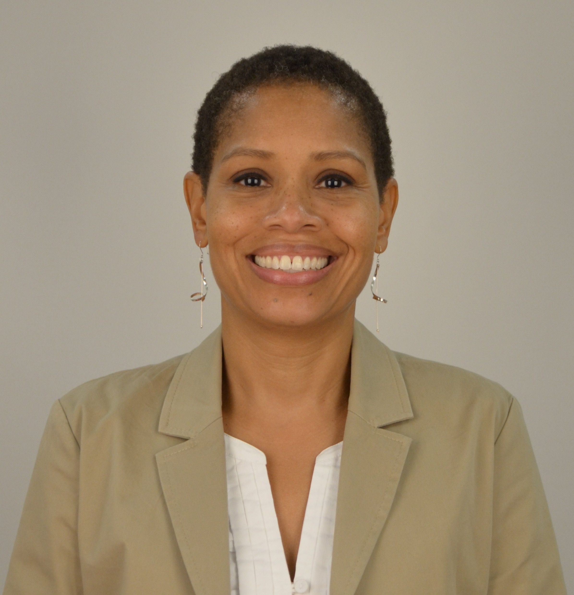
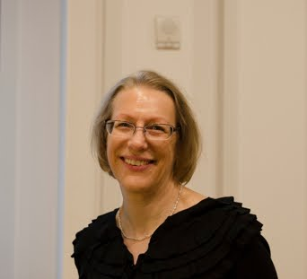
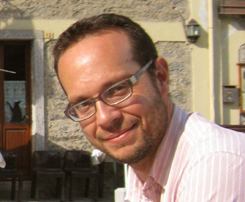

Key Collaborators
Ixchel M. Faniel
OCLC Research
Principal Investigator, DIPIR
Co-investigator, SLO-data
Elizabeth Yakel
University of Michigan
Co-Principal Investigator, DIPIR
Eric Kansa
Alexandra Archive, Open Context
Technology Director and
Co-investigator, SLO-data
Sarah Whitcher Kansa
Alexandria Archive, Open Context
Project Director, SLO-data

Slide 18
Additional Project Members
DIPIR Project and EOL/NEH Project
Partners: Nancy McGovern (MIT), Eric Kansa (Alexandria Archive, Open Context), William Fink (University of Michigan Museum of Zoology), Sarah Whitcher Kansa (Alexandria Archive, Open Context)
Faculty: Ji-Hyun Kim (Ewha Womans University)
Researcher: Christopher Cyr (OCLC)
OCLC Fellow: Julianna Barrera-Gomez
Doctoral Students: Rebecca Frank, Adam Kriesberg, Morgan Daniels, Ayoung Yoon, Anthea Josias
Master’s Students: Alexa Hagen, Jessica Schaengold, Gavin Strassel, Michele DeLia, Kathleen Fear, Mallory Hood, Annelise Doll, Monique Lowe, Pearl Ko, Daniel Delmanaco, Zachary Maiorana
Undergraduates: Molly Haig
SLO-data Project
Senior Personnel: Ran Boytner (Institute for Field Research)
Consultant: Elizabeth Yakel (University of Michigan)
Postdoctoral Researcher: Anne Austin (University of Missouri - St. Louis)
Independent Researcher: Jennifer Jacobs
Doctoral Student: Phoebe France (University of Hawaiʻi at Mānoa)

Slide 19
RDM Research Program
3. SLO-data Project, Grant #PR-234235-16, oc.lc/slo-data
Data production
Data reuse
1. DIPIR Project
IMLS Grant,
#LG-06-10-0140-10
oc.lc/dipir
Data sharing
Data curation
2. 2012 EOL Computable Data Challenge, http://eol.org/info/345 and NEH Grant #HK-50037-12

Slide 20
Twelve context types DIPIR participants mentioned needing or wanting during reuse
Data collection
Prior reuse
Research objectives
Specimen and Artifact
Terms of use
Data production information
Data reuse information
Missing data
Data producer
Advice on Reuse
Data analysis
Provenance
Repository information
Reputation and History
Curation and Digitization
Faniel, I.M., Frank, R. D., and Yakel, E. Paper under review.

Slide 21
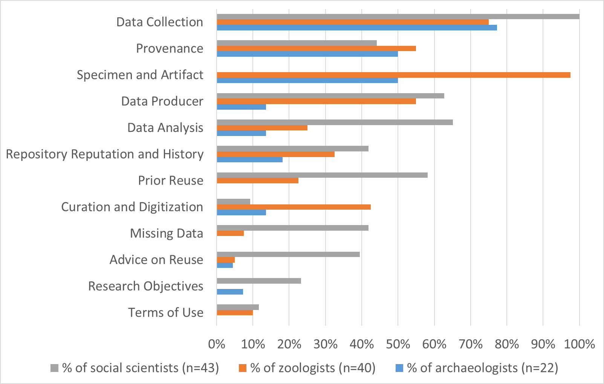
Context types by discipline
Faniel, I.M., Frank, R. D., and Yakel, E. Paper under review.

Slide 22
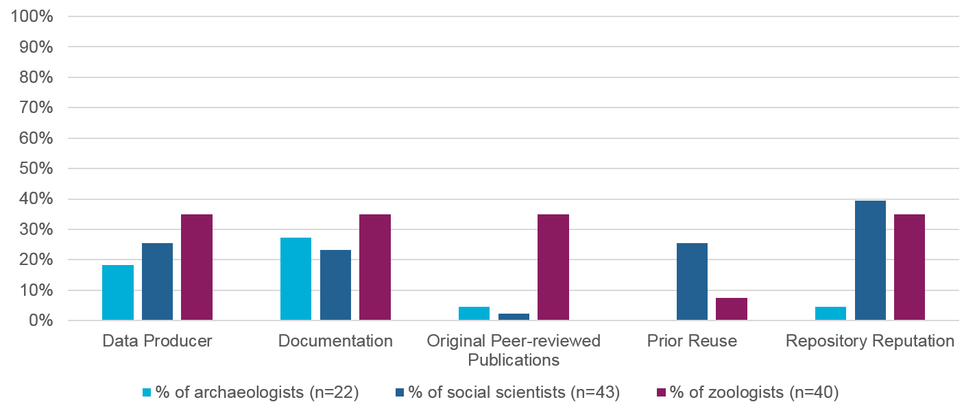
Five trust markers DIPIR participants
considered when assessing trust in data
Faniel, I.M., & Yakel, E. (2017). Practices do not make perfect: Disciplinary data sharing and reuse practices and their implications for repository data curation. College & Research Libraries. In Curating Research Data, Volume One: Practical Strategies for Your Digital Repository, 103–126. Chicago, Illinois: Association of College and Research Libraries

Slide 23
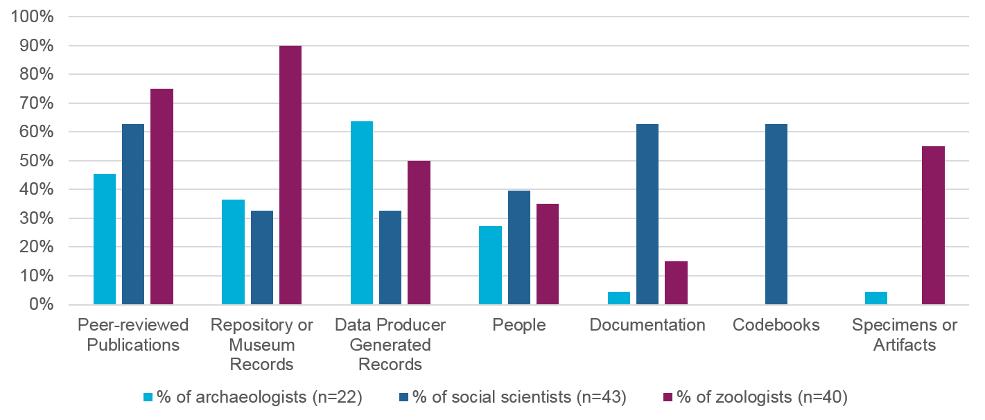
Seven key sources of contextual information DIPIR participants employed during reuse
Faniel, I.M., & Yakel, E. (2017). Practices do not make perfect: Disciplinary data sharing and reuse practices and their implications for repository data curation. College & Research Libraries. In Curating Research Data, Volume One: Practical Strategies for Your Digital Repository, 103–126. Chicago, Illinois: Association of College and Research Libraries

Slide 24
RDM Research Program
3. SLO-data Project, Grant #PR-234235-16, oc.lc/slo-data
Data production
Data reuse
1. DIPIR Project
IMLS Grant,
#LG-06-10-0140-10
oc.lc/dipir
Data sharing
Data curation
2. 2012 EOL Computable Data Challenge, http://eol.org/info/345 and NEH Grant #HK-50037-12

Slide 25
What data lifecycle stages impact each other?
All stages influenced one another, except for curation, which only impacted reuse.
Production impacted the other
stages most frequently and
most impacts were negative.
Sharing impacted curation the most, followed by reuse.
Most curation impacts on reuse were positive.
Reuse impacted the other stages the least frequently,
but all impacts were positive.
Yakel, E., Faniel, I.M., and Maiorana, Z. Paper under review.

Slide 26
RDM Research Program
3. SLO-data Project, Grant #PR-234235-16, oc.lc/slo-data
Data production
Data reuse
1. DIPIR Project
IMLS Grant,
#LG-06-10-0140-10
oc.lc/dipir
Data sharing
Data curation
2. 2012 EOL Computable Data Challenge, http://eol.org/info/345 and NEH Grant #HK-50037-12

Slide 27
What is happening at the point of data creation to negatively impact later lifecycle stages? How can we intervene?
The current instruction and guidelines developed to document archaeological excavations do not sufficiently support team members, given the documentation they are expected to produce.
Data silos were being created within and outside of the
database, which made discovering and accessing data difficult.
Faniel, I.M., Austin, A., Kansa, E., Whitcher Kansa, S., France, P., Jacobs, J., Boytner, R., Yakel, E. (2018). Beyond the archive: Bridging data creation and reuse in archaeology. Advances in Archeological Practice, 6(2), 105-116. doi: 10.1017/aap.2018.2

Slide 28
Implications
How have data reuse needs (e.g. context types, trust makers, sources of context information) influenced your work to support researcher demand at the point of data deposit and dissemination?
How do you engage researchers during the data production process to get what you and reusers need without overwhelming your resources or those of the data producer?
How do you enable more effective flow of data throughout the lifecycle when dealing with competing needs?

Slide 29
Discussion Questions
What are the most influential incentives in your local environment? How do you think this will shape your RDM service bundle?
How does the development of your RDM service bundle need to reflect a broader institutional strategy?
How do you manage the challenges of tracking guidelines and mandates and determine how this informs your service bundle?
How do you know what your researchers need?
How do you engage researchers during the data production process to get what you and reusers need without overwhelming your resources or those of the data producer?
Notes:
We will be focusing on these questions in the interest group.

Slide 30

CALENDAR
October
Webinar: Understanding Institutional Research Data Management Services
Interest group meetings led by Rebecca & Brian
November
Webinar: Identifying and Acting on Incentives When Planning RDM Services
Interest group meetings led by Rebecca & Ixchel
December
Webinar: Acquiring RDM Services for Your Institution
Interest group meetings led by Rebecca & Brian

Slide 31
More Realities of RDM!
Attend …
Webinar #3
Acquiring RDM Services for Your Institution
4 December 2018, 11 am EST (UTC -5)

Slide 32
The Realities of RDM:
Identifying and Acting on Incentives when Planning RDM Services
DISCUSSION
Rebecca Bryant
Ixchel M. Faniel
OCLC Research
Realities of RDM Webinar Series: Part 2
13 November 2018

