Slide 1
OCLC Research Library Partnership:
Amplifying community efforts to drive improvement & innovation
Rachel L. Frick
September 20, 2018
Executive Director, OCLC Research Library Partnership

Slide 2
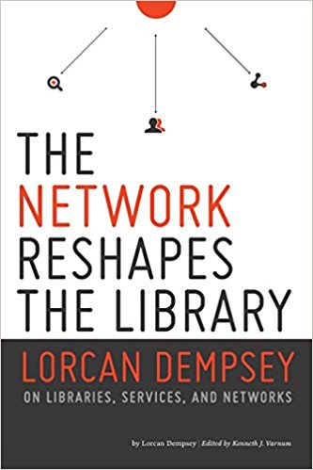

Slide 3
OCLC Research Library Partnership:
A network to scale learning and innovation
People are connections to knowledge
Peer to Peer collaborative learning
Strategic thinking to practical application
Influence service design and future research
Shared understanding for faster innovation

Slide 4
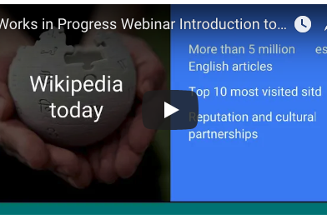
Online Learning:
inform and connect
Partner Work
OCLC Research Initiatives
Technology Deep Dives
Interest / Groups

Slide 5
OCLC Research Library Partnership:
Areas of Focus
Research support and information management
Special collections and archives
Resource Sharing / Collective Collections
Metadata

Slide 6
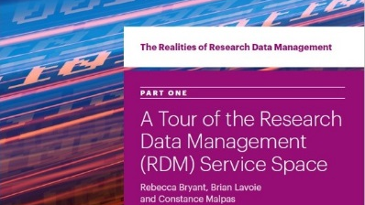
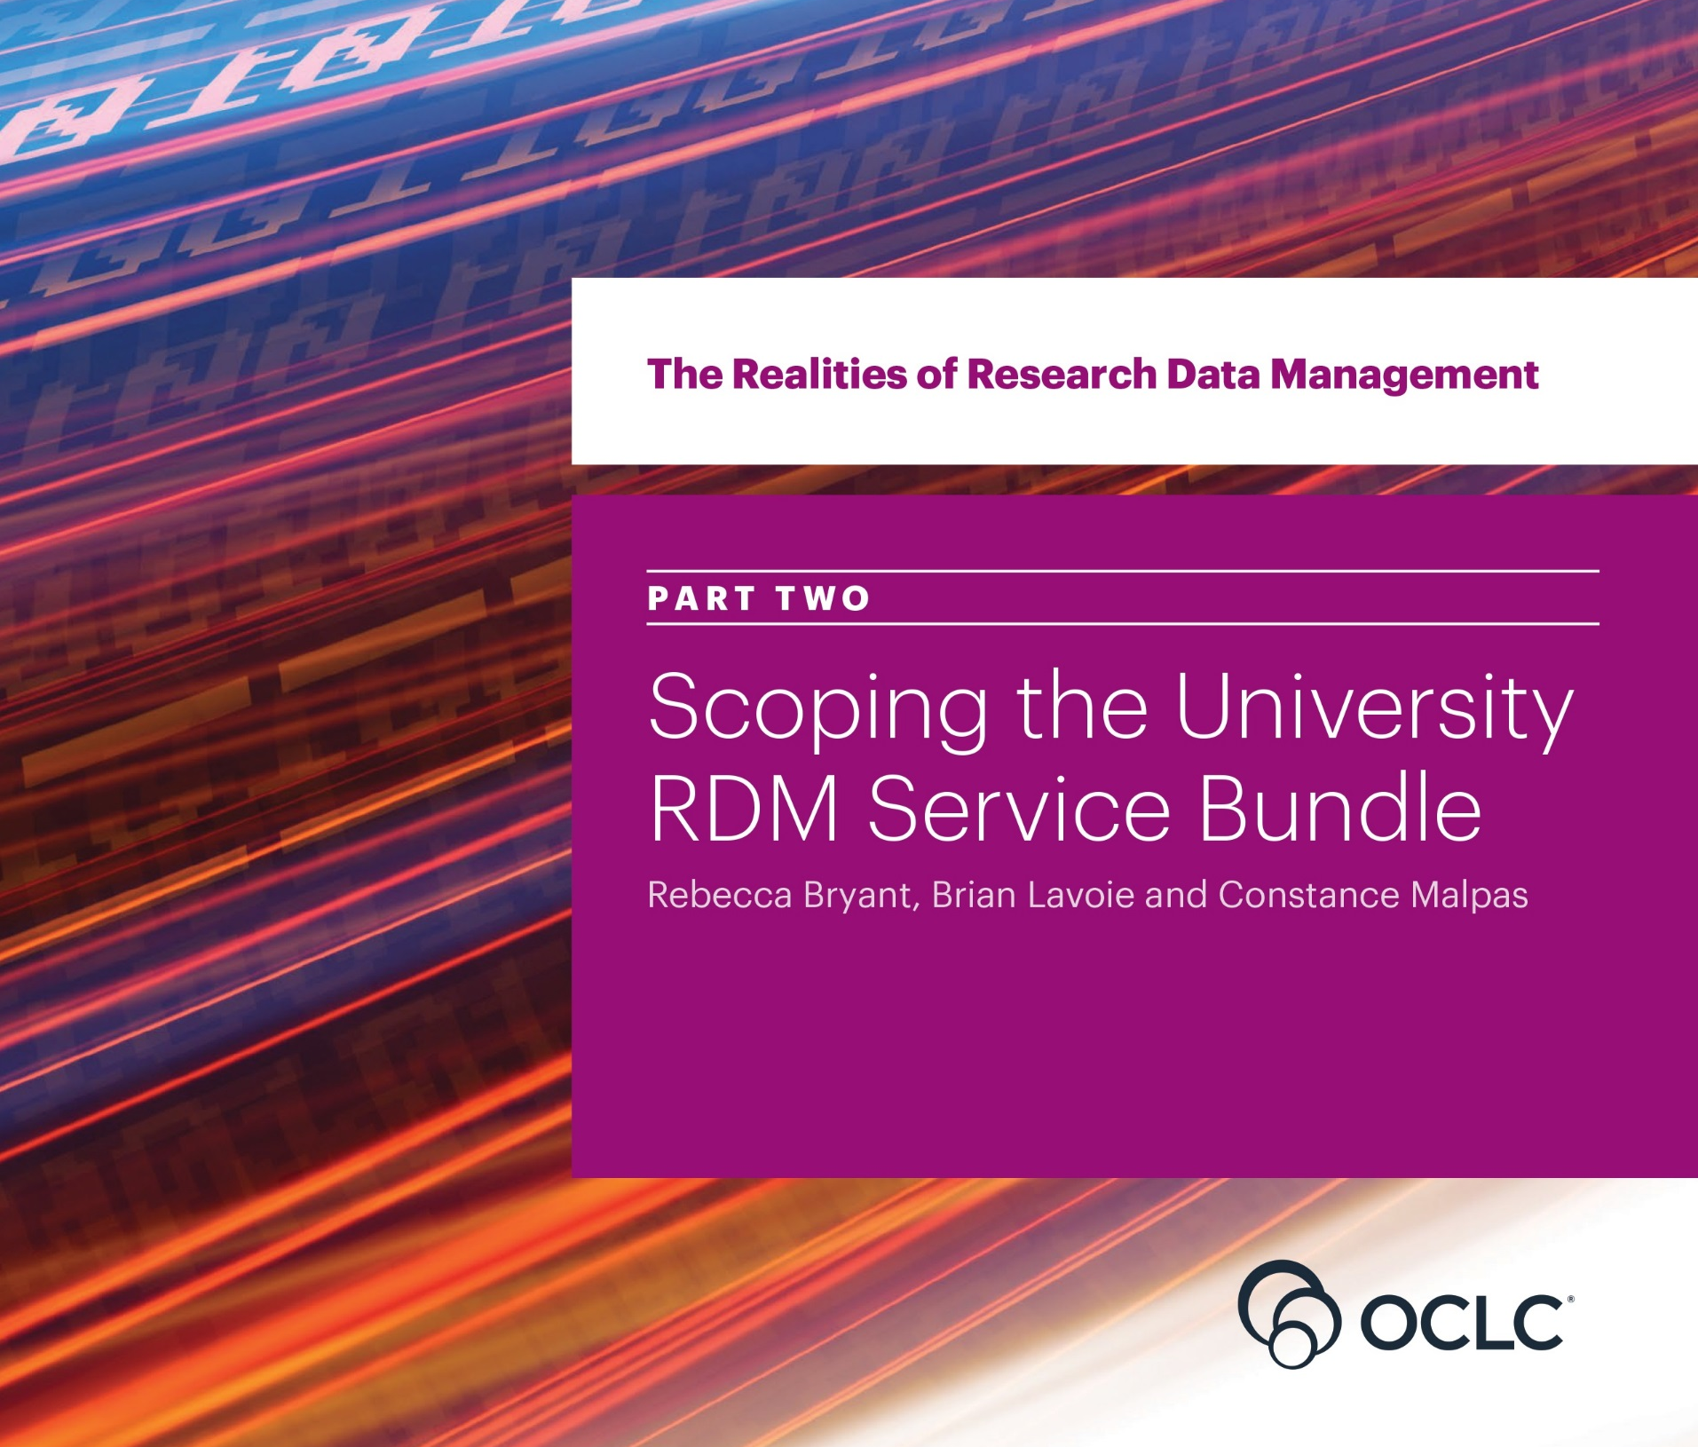
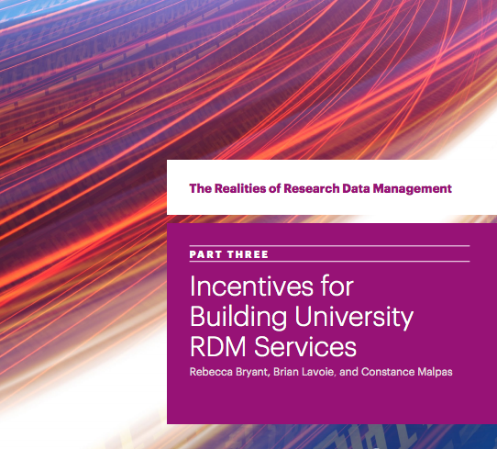
Research Data Management :
From Report to Action
three-part Realities of Research Data Management webinar series exclusively for RLP members.
companion RDM Interest Group to further explore the issues raised in the research reports with OCLC staff and peers.

Slide 7
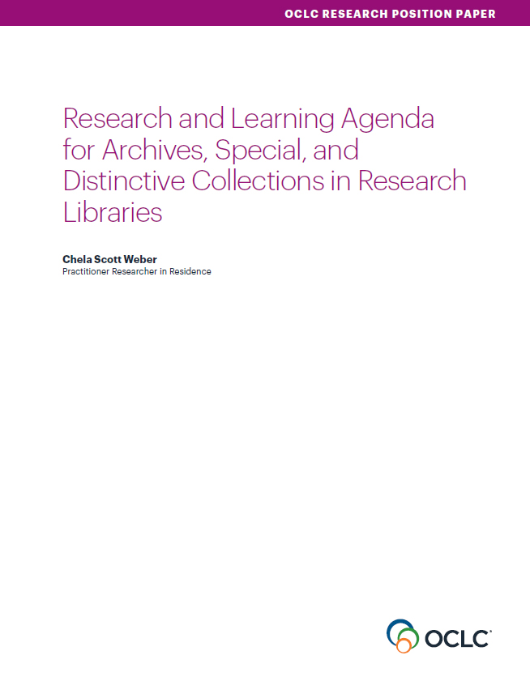
Special Collections & Archives:

Slide 8
Resource Sharing
SHARES Policy Rethink
Sharing Special Collections
ILL Patron User Studies

Slide 9
Leverage the Investment of Open Access
Global Council Survey: October
Lead Investigator: Titia Van Der Werf
Interest group forth coming

Slide 10
Metadata and Beyond
Metadata Managers Focus Group
2018 Linked Data Implementers Survey
Metadata for A/V
Libraries and Wikidata

Slide 11
Prototype to Production and back again

Slide 12
Commitment to Equity Diversity and Inclusion

Slide 13
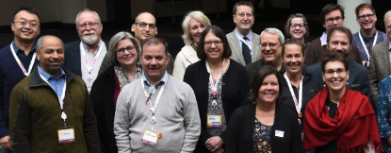
The Value is the Network
Collaborative learning to establish a shared understanding
Facilitate opportunities for creative problem solving
Platform to dig into the research and environmental trends
Connect to the information and expertise you need, when you need it.

Slide 14
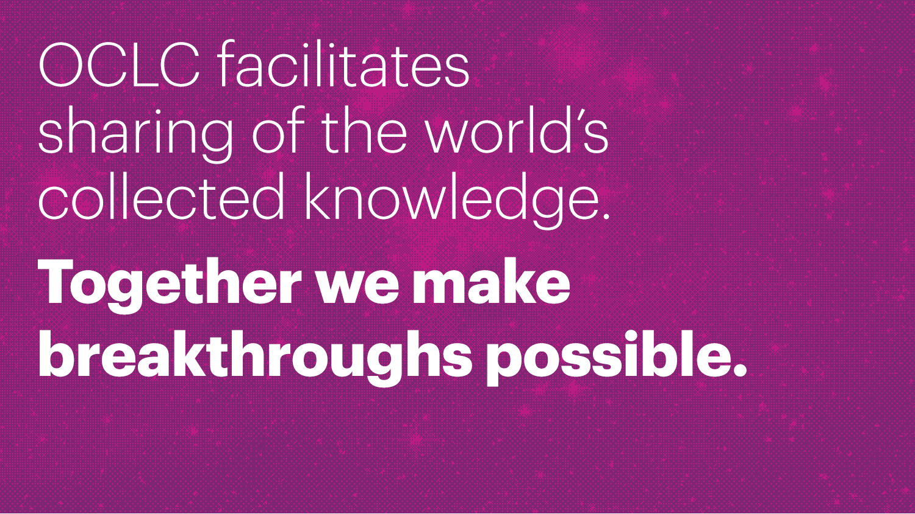

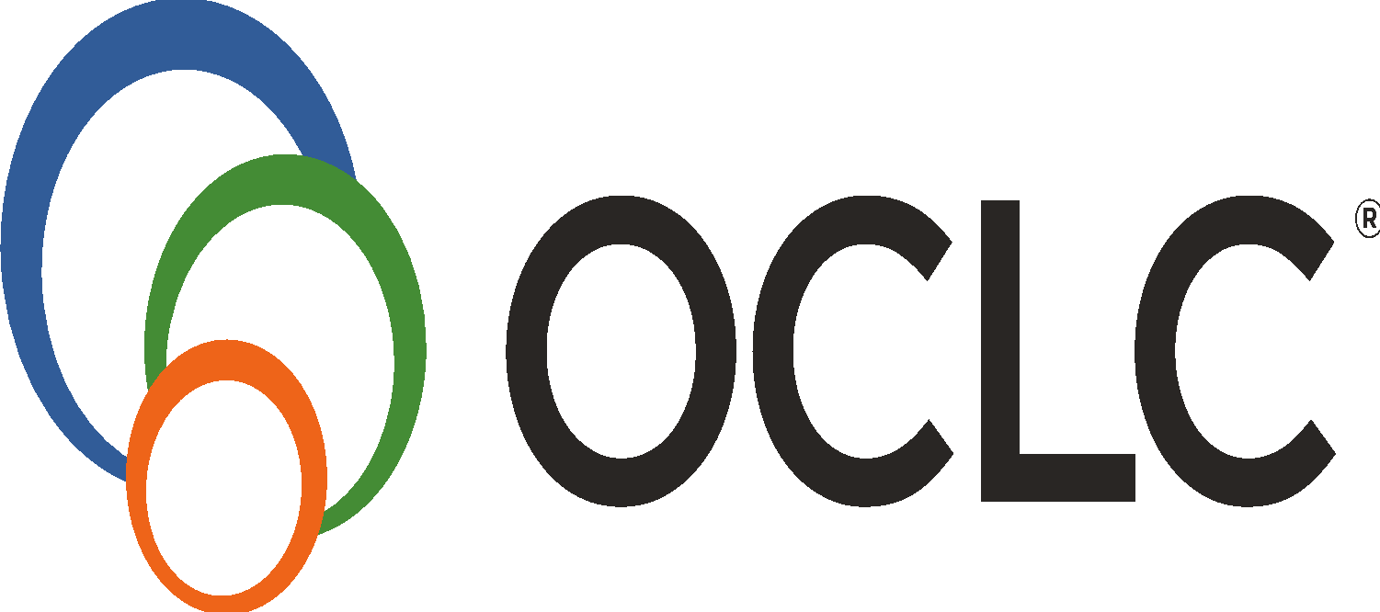
©2018 OCLC. This work is licensed under a Creative Commons Attribution 4.0 International License. Suggested attribution: ”This work uses content from ‘OCLC Research Library Partnership: Amplifying community efforts to drive improvement & innovation’” © Rachel L. Frick used under a Creative Commons Attribution 4.0 International License: https://creativecommons.org/licenses/by/4.0/

