Slide 1
OCLC Mini-Symposium on Research Data Management
20 April 2018, Leiden
The Realities of Research Data Management
Rebecca Bryant, PhD, Senior Program Officer, OCLC Research
bryantr@oclc.org @RebeccaBryant18
Notes:
I’d like to talk about The Realities of Research Data Management project my colleagues in OCLC Research have been working on.
This project explores how research universities have been acquiring RDM capacity, and in particular the REALITIES influencing decision-making.

Slide 2


OCLC Project Team
Rebecca Bryant, PhD,
Senior Program Officer
https://orcid.org/0000-0002-2753-3881
Brian Lavoie, PhD, Research Scientist
https://orcid.org/0000-0002-7173-8753
Constance Malpas, Research Scientist
https://orcid.org/0000-0002-9312-8294

Slide 3
Devoted to challenges facing libraries and archives since 1978
Community resource for shared Research and Development (R&D)
Engagement with OCLC members and the community around shared concerns
oc.lc/research
Notes:
Just in case you are not familiar with OCLC Research, it has carried out Research with and for librarians and library users since 1978.
50+ people incl. WebJunction and Technical Research

Slide 4

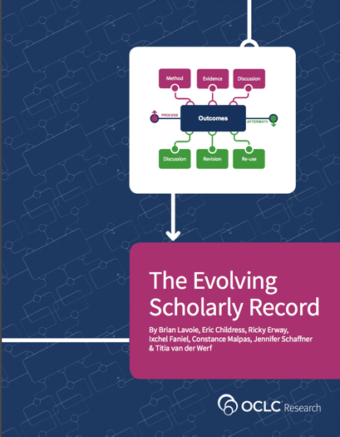
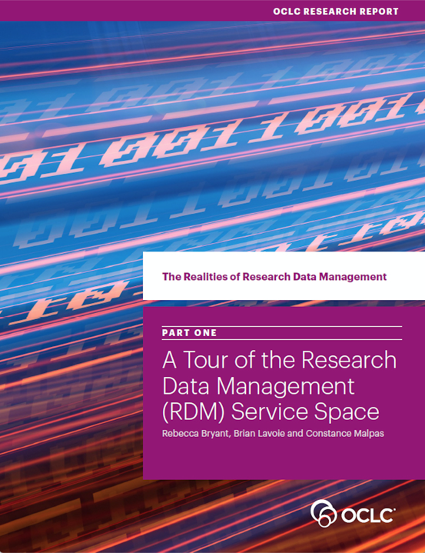
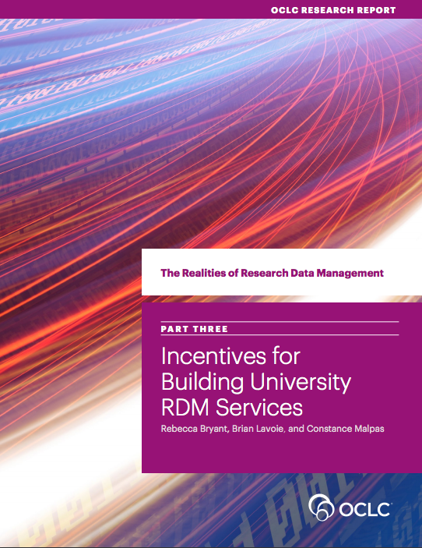
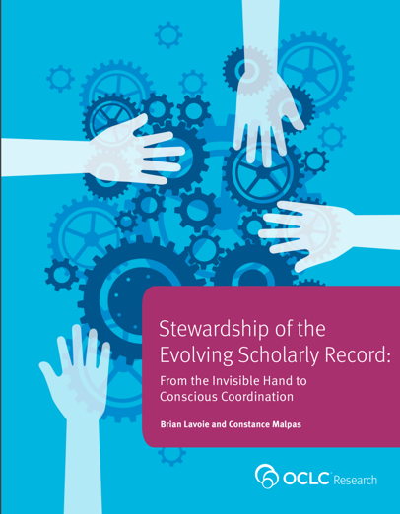
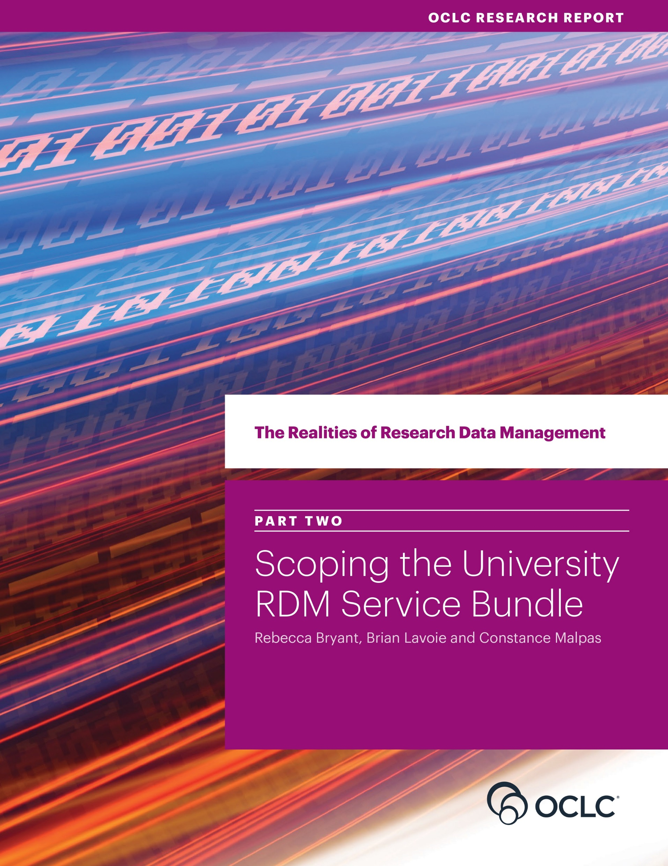
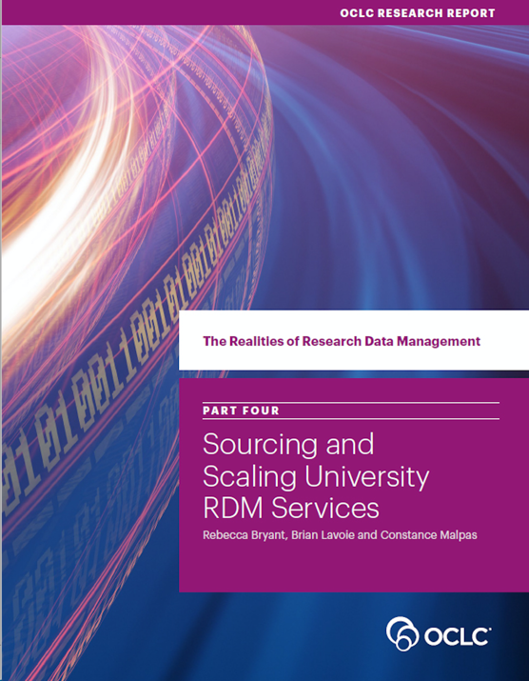
The Realities of Research Data Management
oc.lc/esr
oc.lc/rdm
Notes:
A few years ago my colleagues Brian Lavoie and Constance Malpas engaged in research on the Evolving Scholarly Record, examining how the traditional print scholarly record is evolving—as it is increasingly digitized and even born digital, with completely new components —things like research data and preprints.
For universities, this development has led to efforts to build or acquire capacity to support emerging RDM needs.
The Realities of Research Data Management is an OCLC Research project looking at the context, influences and choices research universities face in building or acquiring RDM capacity.
WHAT – WHY - HOW
Note we are looking at this as an institutional issue, not just from the library perspective. The academic library is certainly an important campus player in RDM, but not the only one. Focusing on libraries only would give an incomplete picture of the current state of RDM on many campuses.

Slide 5

Case Studies
Desk research followed by semi-structured interviews
Selected four institutions with mature RDM offerings in four distinctive national environments
University of Edinburgh
Wageningen University & Research
University of Illinois
Monash University
oc.lc/rdm
Notes:
In The Realities of Research Data Management study, we took an international approach; we have conducted in-depth case studies and interviews with these four research universities in four very different national contexts.
We chose these four institutions because they offered:
A diversity of national environments
Diversity of practices, services, and sourcing decisions
And because they are each institutions that are leading service providers with fairly mature service offerings within their national environments

Slide 6

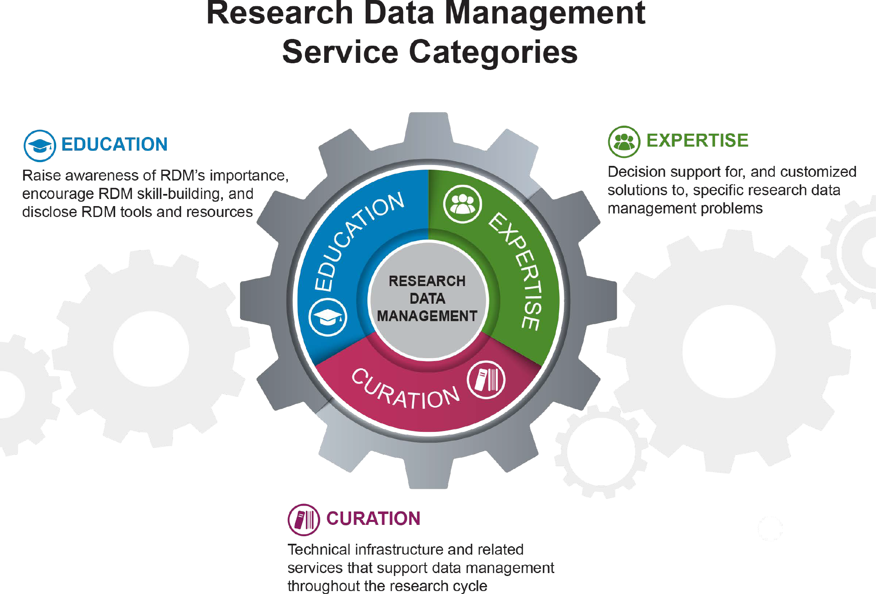
Report 4: Sourcing & scaling
Report 3: Incentives
Report 2:
Scope
Build or buy? Local or external?
Institution scale or scaled above the institution?
Institutional problem to be solved
Internal and external incentives
Scope of the RDM capacity in each of the four universities
Specific services in each cluster
Report 1:
Introduction & Framework
Notes:
The primary deliverables from the project are four reports.
The first provides an overview of the RDM service space, and the remaining three deal with three major decision points universities face in acquiring RDM capacity:
deciding to act (incentives to build/acquire RDM capacity);
deciding what to do (scoping out a bundle of RDM services);
and deciding how to do it (for example, deciding which services will be built locally, or externalized to an outside provider)
The first three reports have been published; the fourth reports is to follow in April this year.
In the rest of the talk, I’d like to touch on some of the key messages from the first three reports; and then preview some of our thinking in regard to the fourth report..

Slide 7
The Framework
Notes:
Acquiring RDM capacity involves making choices about the services needed to support local data management needs. In other words, a key decision point in the RDM capacity acquisition process is to scope the local RDM service bundle.
While general discussions of RDM and its importance to research universities may reference RDM conceptually as one monolithic block of services, moving from concept to practice requires much more precision and customization.

Slide 8
“RDM Service Categories” by OCLC Research, from The Realities of Research Data Management. Part One: A Tour of the Research Data Management (RDM) Service Space (https://doi.org/10.25333/C3PG8J), CC BY 4.0
Notes:
In our first report, we identified three categories of RDM service types that manifested with some regularity across institutions, although not all institutions deployed services in all categories, and the specific services offered within categories varied from institution to institution. We distinguishing between Education, Expertise, and Curation.
Education services: Educational RDM services raise awareness of the importance of (and incentives for) good data management, teach basic data management practices and skills. This may include online resources, training and workshops, and services like the DMP Tool.
Expertise services: provide decision support and customized solutions for researchers working through specific RDM problems. Expertise-related services deploy the specialized knowledge of data librarians, technologists and other support staff to ensure that individual RDM needs and requirements are met.
Curation services: are the technical infrastructure and other services that support data management throughout the research lifecycle. This includes active data management as well as long-term data stewardship.
We also want to emphasize that an RDM service bundle includes not just what is built and deployed locally, but the full range of services, sourced locally and externally—so it may include the long-term curation of datasets in an external repository.
This framework is intended to help circumscribe the kinds of services universities are looking to build or acquire in the RDM space, and it’s also a helpful frame for organizing our discussion in the three reports to follow. But it can also serve to guide or structure discussions you may have. We are actually using it to continue our discussions with universities when talking about their RDM service bundles.

Slide 9
Scope
Notes:
So with this view of the RDM service space in hand, we can think about how our four case study partners scoped their RDM service bundles within this space.
By RDM service bundle, we mean the set of RDM services offered by a university to its researchers. This includes not only what is built and deployed locally, but also external services to which the university brokers access.

Slide 10
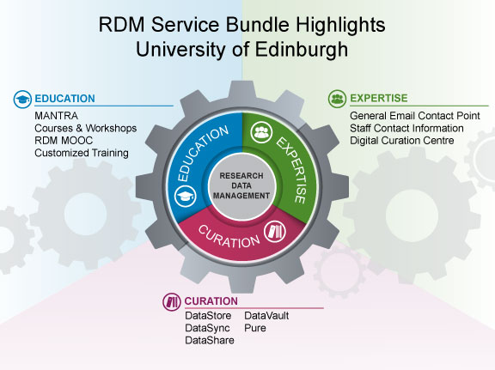
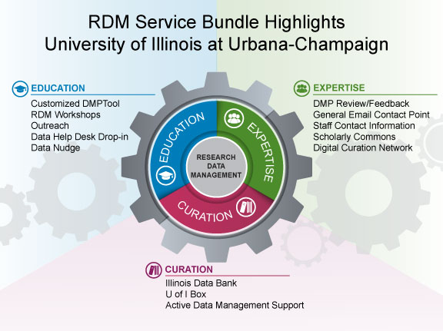
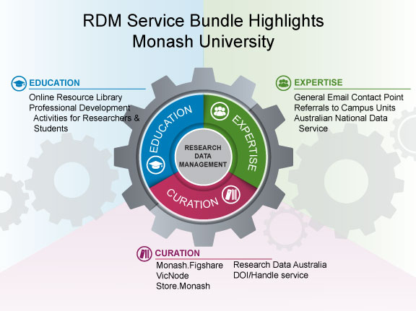
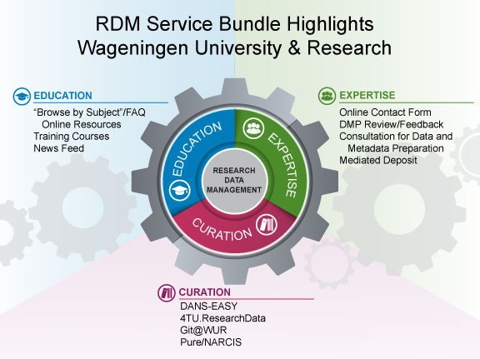
“RDM Service Bundle Highlights” by OCLC Research, from The Realities of Research Data Management Part Two: Scoping the University RDM Service Bundle (https://doi.org/10.25333/C3PG8J), CC BY 4.0
Notes:
These pictures illustrate the highlights from the RDM service bundles of our four case study partners. I’m not going to go through each of these in detail, but I wanted to throw out a few observations that come to mind when we consider all of these service bundles together:
- Each university offers some services in each category, although not always the same ones.
Each university has acquired separate data curation capacity that operates in parallel with, rather than as part of, the institutional repository; three of the four universities are using their RIM system to register locally-produced data sets.
- But if you looked within the service categories, you would see some differences both in emphasis and the character of the services provided.
And I will talk you through some of these next.

Slide 11
“RDM Service Bundle Highlights: Wageningen University & Research” by OCLC Research, from The Realities of Research Data Management Part Two: Scoping the University RDM Service Bundle (https://doi.org/10.25333/C3PG8J), CC BY 4.0
Notes:
CURATION RATHER RECENT, ABLE TO USE NETWORK SCALE SERVICES.
STRONG FOCUS ON EXPERTISE.
In contrast, Wageningen rely on externally-provided curation services. Researchers are encouraged to utilize discipline-focused repositories as a first choice, or, alternatively, to deposit their data into the national-scale DANS-EASY archive or the consortial-scale 4TU.ResearchData repository.
Expertise becomes a big aspect of their RDM service bundle, focusing on helping local researchers navigate the eco-system of RDM services to solve particular RDM problems. Answering questions, advising in the choice of external repository options, assisting in data documentation and deposit.
Researchers are repeatedly encouraged to engage directly with Data Management Support staff. Open ended in scope

Slide 12
“RDM Service Bundle Highlights: University of Edinburgh” by OCLC Research, from The Realities of Research Data Management Part Two: Scoping the University RDM Service Bundle (https://doi.org/10.25333/C3PG8J), CC BY 4.0
Notes:
LOCALLY BUILT CURATION SERVICES AS 1st CHOICE FOR RESEARCHERS.
EARLY ADOPTER – NO EXTERNAL SERVICES AVAILABLE.
GLOBAL CENTER OF EXCELLENCE.
Edinburgh has invested quite intensively in a suite of locally-built services, especially in Curation. They see themselves as a global center of excellence in RDM, and scope their RDM capacity accordingly.
Edinburgh’s RDM service bundle was shaped by a strong—and early—university commitment to data management, coupled with an external context that mandated responsible data management and sharing. Edinburgh would like its locally deployed RDM services to be seen as the best choice for local researchers to meet their RDM needs, rather than as a last resort when external options are not available.
But Edinburgh also sees itself as a global leader in the RDM service space, with a role in supporting external stakeholders beyond the local university community.
Edinburgh’s RDM service bundle is seen not as a self- contained resource serving local researchers exclusively, but instead as a “center of excellence” in a broader network of RDM services and resources.

Slide 13
“RDM Service Bundle Highlights: University of Illinois at Urbana-Champaign” by OCLC Research, from The Realities of Research Data Management Part Two: Scoping the University RDM Service Bundle (https://doi.org/10.25333/C3PG8J), CC BY 4.0
Notes:
LOCAL REPO ONE OF MANY. FOCUSSED ON OUTREACH.
INTERESTED IN GROUP SCALE SOURCING. DATA CURATION NETWORK TO GROUP SCALE EXPERTISE.
Like Edinburgh, Illinois has built an internally sourced data repository, but unlike Edinburgh, it does not see this repository as a first choice for its researchers, but rather as just one repository among many, to be used when external options do not exist or are otherwise not suitable.
The emphasis on outreach to researchers is a distinctive feature of the Education services in the Illinois RDM service bundle, based on a recognition that data management can be an afterthought for many researchers; therefore, outreach is a key ingredient for ensuring that Education services are highly visible to those that would benefit from them.
You might also recognize a strong focus on DMP in both education and expertise.

Slide 14
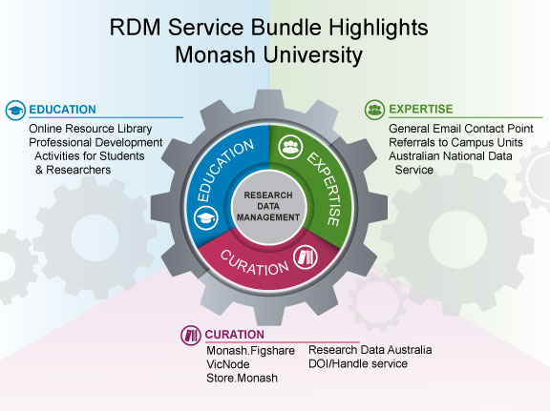
“RDM Service Bundle Highlights: Monash University” by OCLC Research, The Realities of Research Data Management Part Two: Scoping the University RDM Service Bundle (https://doi.org/10.25333/C3PG8J), CC BY 4.0
Notes:
Monash’s RDM service bundle is distinctive in its emphasis on Education services tailored specifically for graduate students as an important aspect of academic training, and also in how their Expertise services are diffused over many campus units.
Monash relies heavily on an externally focused approach. Curatorial capacity is drawn from a number of externally sourced platforms: principally figshare, but also LabArchives, Google Drive, VicNode and various services provided through ANDS.
Monash has played a leading role in developing several “above the institution” RDM resources and solutions, including the ANDS service (Australian Nat Data Service)

Slide 15
“RDM is not a monolithic set of services duplicated across universities;
it is a customized solution shaped by a range of internal and external factors operating on local decision-making.”
Notes:
The key point is that the four RDM service bundles we looked at differed considerably in the ways they were scoped, and these differences could usually be traced back to the local context in which the RDM service bundle is deployed.
Universities don’t necessarily need to implement the full range of services within the RDM service space. Optimizing the RDM service bundle to suit local circumstances often involves being selective of the services offered, rather than comprehensive.

Slide 16
Incentives

Slide 17
Compliance with external policies is a strong driver in some locales
Evolving scholarly norms are not uniform, disciplinary diversity is also a challenge
Institutions built services in anticipation of rather than response to researcher demands
Developing RDM expertise may be part of an institutional strategy to increase library support for research workflows
“Incentives to Acquire RDM Capacity” by OCLC Research, from The Realities of Research Data Management Part Three: Incentives for Building University RDM Services (https://doi.org/10.25333/C3S62F), CC BY 4.0
oc.lc/rdm
Notes:
In our third report, we documented the incentives for building RDM services. This is where taking an international approach was perhaps most interesting, as I think it’s essential for understanding similarities and differences.
Some of our key findings include:
Compliance with external mandates is a strong driver in some locales.
While evolving scholarly practices are driving RDM service development, it is also a challenge, as there are significant disciplinary differences, which researchers expect RDM support services to address
RDM service bundles were developed in anticipation of rather than in direct response to researcher demand. Prioritizing education and outreach is important to institutions to cultivate use.
Bottom-up demand signals seem to be far more important in re-shaping and sustaining RDM service bundles, rather than incentivizing their creation. For example, we saw in several of the case studies that the RDM service bundle evolved to incorporate active data management services, in response to expressions from researchers that this was something they really needed and valued.
The development of RDM services may also be part of an institutional strategy to increase library support and engagement with research workflows. In Europe and Australia, this need also intersects with the adoption and need for integration with commercial RIM systems to track research productivity.
One big message that seems apparent is that RDM is driven by real incentives that are driving university decision-making in this space. But these incentives manifest differently in different university contexts, and they can change or evolve over time. RDM services will only be sustainable and valued to the degree they can respond to these evolving incentives.

Slide 18
Sourcing & Scaling Choices
Coming April 2018

Slide 19
“An RDM service bundle includes not just what is built and deployed locally, but the full range of services, sourced locally and externally, that the institution manages, or to which it brokers access.”

Slide 20
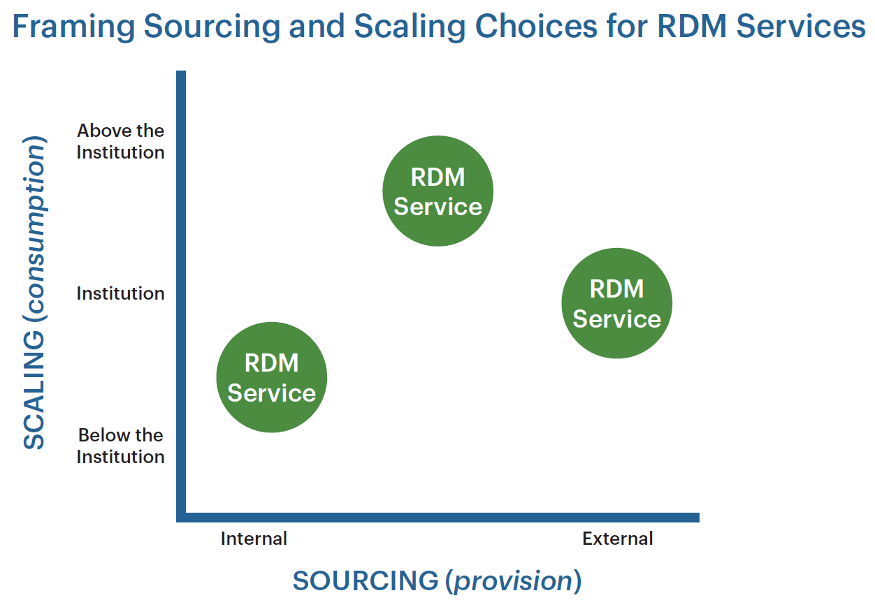
RDM
Service
Data Curation Network
RDM
Service
Customized DMPTool
RDM
Service
Illinois Data Bank

Slide 21
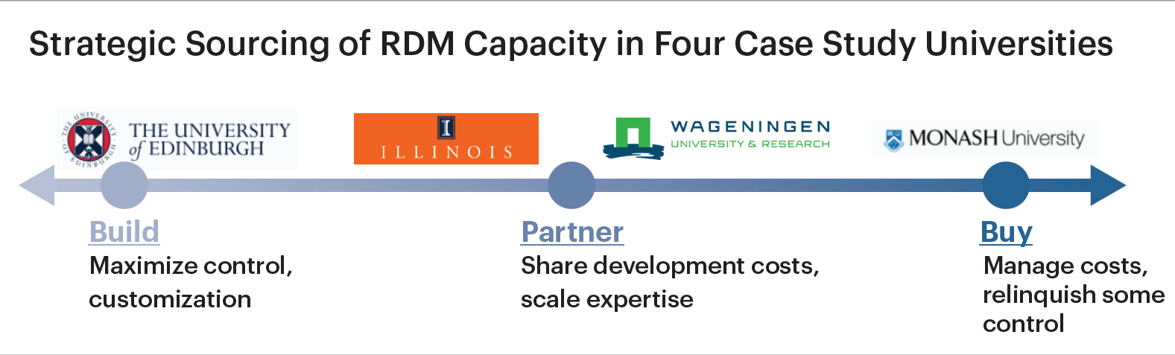
Notes:
Edinburgh favors home-built, locally sourced solutions. They see themselves as a pioneer in this space, in terms of building a fairly comprehensive RDM suite of services from the ground up.
Illinois has also adopted this strategy, but is seeking opportunities for “above the institution” solutions
Wageningen has outsourced much of its data Curation capacity to existing consortial and national scale solutions, while internalizing Education and especially Expertise services
Monash has adopted an externally-focused approach incorporating regional and national-scale solutions, as well as a commercial provider, and provides local Education and Expertise through distributed local services
So four different universities, and four different perspectives on sourcing and scaling RDM service offerings. The point where each university locates itself in this framework is determined by a mix of internal and external factors, which is a topic we examine in our fourth report.

Slide 22
“It would be a mistake to imagine
that there is a single, best model
of RDM service capacity,
or a simple roadmap to acquiring it.”
Notes:
Every service bundle is unique, and not only in the sense that some are more deficient than others.
They are unique because institutions have different needs, react to differing external and local circumstances, and make different strategic choices.
The fact that something is not built locally does not mean it is not part of the service bundle.
And a “minimalist” approach to local RDM service provision is no worse (or better) than a “maximalist” approach, provided it aligns with institutional needs.
I think this is an important statement to take into this session on measurement and assessment, and also to take back to your institutions for further discussion.

Slide 23
Summary
oc.lc/rdm
Notes:
So we’ll leave it there. Please visit the project web site for all the reports and some additional materials.

Slide 24
Questions for discussion
What is a „good“ RDM service bundle?
Is there a notion you have to „tick all the boxes“ to be a credible RDM player? Is the strategic absence of certain services a „gap“?
Do you dare partner or source externally?
Do you dare make strategic choices to NOT do certain things, to free up resources to focus on what is most relevant or impactful in your circumstances?

Slide 25


Thank you.
Rebecca Bryant, PhD,
Senior Program Officer
https://orcid.org/0000-0002-2753-3881

