Slide 1
The OCLC Research Library Partnership provides a unique transnational
collaborative network of peers to address common issues as well
as the opportunity to engage directly with OCLC Research
Thank you for underwriting and participating in our programs

Slide 2
May 2018
Outcomes from the OCLC Research Library Partnership Web Archiving Metadata Working Group
Jackie Dooley, OCLC Research (retired)
Rebecca Guenther, Metadata Standards Consultant
Claudia Horning, University of California, Los Angeles
Mary Samouelian, Harvard Business School

Slide 3
Why did we do this work?
Absence of shared practices for descriptive metadata was the most widely-shared web archiving challenge identified in two surveys:
OCLC Research Library Partnership (2015)
Weber/Graham study of users of archived website (2016)
Library and archival standards are in use for this work, but websites often lack standard data elements and are not amenable to transcription.

Slide 4
Objectives
Make recommendations for descriptive metadata for archived websites that are community-neutral and that address user needs
Identify the most relevant data elements and provide guidance on formulating content
Bridge bibliographic and archival practices
Address the differing characteristics of item- and collection-level descriptions

Slide 5
Background research
Metadata: analyzed relevant standards and nine sets of local guidelines for web archiving metadata; also studied numerous existing records
User needs: abstracted and synthesized 60 readings on users of web archives and their metadata-related issues
Harvesting tools: studied eleven tools for their potential for automated metadata creation

Slide 6
Potential user groups
Practitioners who use standards but want guidance on formulating descriptive content for archived single sites and collections
Dublin Core (used by Archive-It) is a structure standard, not a content standard
Some archivists want web-specific guidance to supplement DACS
RDA (library content standard) focuses on transcription of live single sites
Libraries and archives using a digital asset management system (DAMS), eschewing descriptive standards; brief records, scalable approach
Individuals lacking metadata experience who build or contribute to web archives

Slide 7
WAM data elements
Collector | Extent | Source of Description
Contributor * | Genre/Form | Subject *
Creator * | Language * | Title *
Date * | Relation * | URL
Description * | Rights *
* = 9 of 14 element names/meanings match Dublin Core

Slide 8
Data element inclusion criteria
We aimed for a lean set of elements that could be crosswalked to existing standards.
Includes common elements used for identification and discovery of all types of resource (e.g., Creator, Date, Subject, Title)
Other elements must have clear applicability to archived websites (e.g. Rights, Description, URL)
Elements excluded that rarely (if ever) appear in guidelines and/or extant metadata records and have no web-specific meaning (e.g. audience, publisher, statement of responsibility)

Slide 9
Title (single sites)
Definition: The name by which an archived website or collection is known.
Single sites
The title of a single site usually is transcribed from the head of the home page.
100,000 Poets
California Proposition 29 imposes additional taxes on cigarettes for cancer research
Aliza Sherman rants and raves
Snowden's father plans to visit son in Russia “very soon”

Slide 10
Title (collections)
Collection titles are usually devised. If the collection consists solely of sites harvested from a single institution’s domain, include the institution’s name.
Harvard University Faculty of Arts and Sciences departmental websites
If a collection is centered on a topic or event (or a place, person, etc.), devise a title that briefly articulates the collection’s scope.
Human Rights web archive
#blacklivesmatter web archive
Generally, append to the title a phrase such as “archived websites” or “web archives.”
Trinity University Student Organizations Website Archive
Grateful Dead web archive

Slide 11
Title: Crosswalks
Crosswalks
Dublin Core | Title
EAD | <unittitle>
MARC 21 | 245, 246, 730, 740
MODS | <titleInfo><title>

Slide 12
Source of description
Definition: Information about the gathering or creation of the metadata itself, such as sources of data or the date on which source data was obtained.
Source of Information is used to identify the source of all or some of the metadata, particularly for descriptions of single sites. Basic aspects of a website (creator name, title, etc.) may change significantly, but the responsible institution is unlikely to have the resources to become aware of changes, let alone update the metadata. Include the date on which the site was examined and the location from which the information was taken.

Slide 13
Source of description: Examples
Description based on archived web page captured Sept. 22, 2016; title from title screen (viewed Oct. 27, 2016)
Title from home page last updated June 21, 2012 (viewed June 22, 2012)
Title from home page (viewed on Oct. 11, 2007)
Title from HTML header (viewed Feb. 16, 2006)

Slide 14
Source of Description: Crosswalks
Crosswalks
Dublin Core | Source of Description
EAD | <processinfo>
MARC 21 | 588
MODS | <note>

Slide 15
Collector
Definition: The organization responsible for curation and stewardship of an archived website or collection.
Use Collector for the organization that selects the web content for archiving, creates metadata and performs other activities associated with “ownership” of a resource. Stated another way, this is the organization that has taken responsibility for the archived content, although the digital files are not necessarily stored and maintained by this organization (collections harvested using Archive-It are a prominent example).

Slide 16
Collector: Lifecycle activities
Institutions involved in web archiving engage in a variety of activities during the lifecycle of archiving web content. We identified four activities performed by the institution that assumes responsibility for archiving web content:
Selecting websites for archiving
Harvesting the content of the designated seed URLs
Creating and maintaining metadata to describe the content
Making decisions about other aspects of collections management, including how the harvested files will be preserved and how will access be provided.

Slide 17
Collector: Examples
Creator: Seattle (Wash.)
Title: City of Seattle Harvested Websites
Collector: Seattle Municipal Archives
Title: Globalchange.gov
Contributor: U.S. Global Change Research Program
Collector: Federal Depository Library Program
Creator: Association for Research into Crimes Against Art
Title: ARCAblog : promoting the study and research of art crime and cultural heritage protection
Collector: New York Art Resources Consortium

Slide 18
Collector: Crosswalks
Crosswalks
Dublin Core | Contributor
EAD | <repository>
MARC | 583 subfield h 710 852 subfield a 852 subfield b
MODS | <location>
schema.org | Schema:ownershipInfo

Slide 19
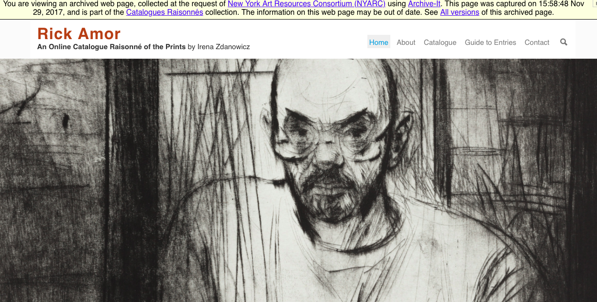
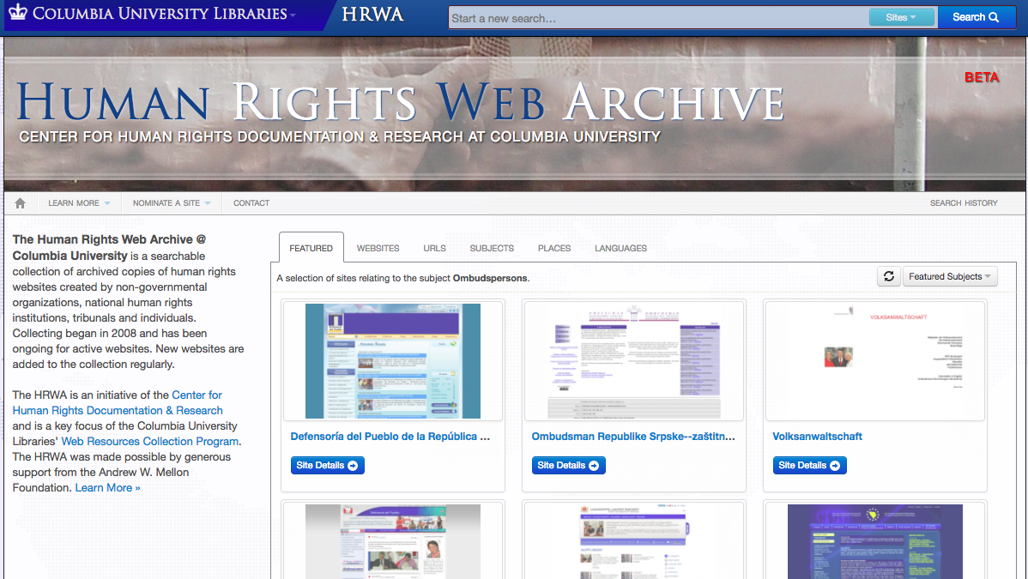
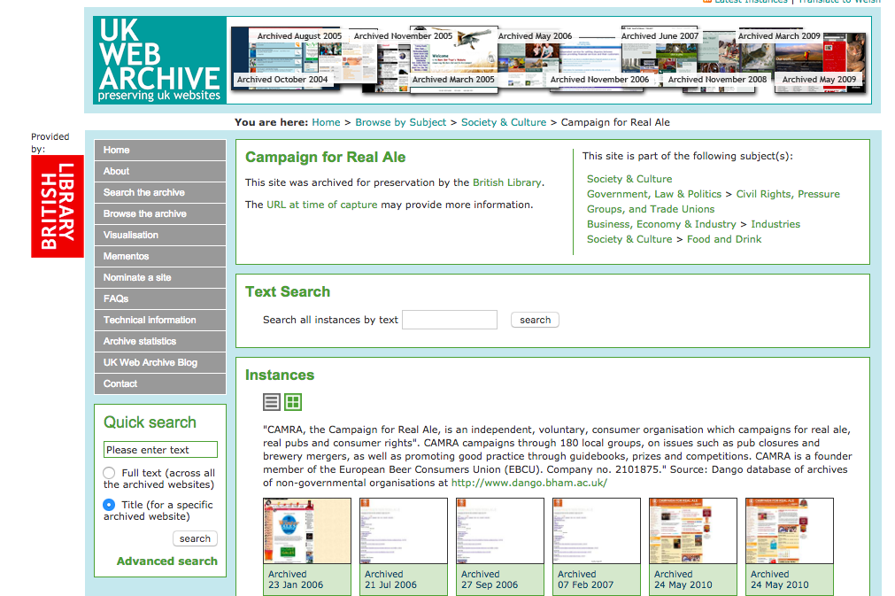
Describing Archived Websites OCLC WAM Webinar, May 2, 2018
Rebecca Guenther, Consultant
rguenther52@gmail.com

Slide 20
Challenges in describing archived web sites
Issues of scalability
How much is being collected?
Cataloging resources
Available tools
Archival or bibliographic description
What is the purpose of web archiving?
What kinds of resources?
Collection vs. Individual sites?

Slide 21
Challenges
Lack of common vocabularies
Web site vs. Website vs. Web archive
Collector vs. Repository
Capture vs. archive
How will they be discovered?
ArchiveIt only
Library catalog
Archival finding aids
Discovery platforms
All of the above

Slide 22
Challenges in developing description guidelines
Variety of environments and practices
Flexibility vs. specificity
Implementation neutral
How to apply to specific implementations
Need for local adaptations
Fitting into the workflow

Slide 23
Using descriptive metadata standards for archived web sites
Descriptive standards and rules not always well adapted to born digital materials
Issue of describing live vs. archive site
Metadata schemes that have been used
Dublin Core
MARC
MODS
EAD

Slide 24
Describing Archived Web Sites at the UCLA Library Using MARC/RDA
Claudia Horning
May 2, 2018

Slide 25
Current standards & practices
Resource Description and Access (RDA)
Integrating Resources: A Cataloging Manual
Appendix A to the BIBCO Participants’ Manual and
Module 35 of the CONSER Cataloging Manual
Provider-Neutral E-Resource MARC Record Guide (August 30, 2017 revision)
OCLC Bibliographic Formats and Standards, 4th edition
See: Special Formats, Electronic Resources

Slide 26
Web Archiving History
Began archiving CA Campaign Literature web sites in 1998
Currently over 1,000 web sites archived
Initially used California Digital Library’s Web Archiving Service (WAS)
Transitioned to Archive-It in 2015
2013 Pilot Project to catalog a small subset
Exported Dublin Core metadata from WAS
Used MarcEdit + CDLWAS to MARC Crosswalk
Generated MARC records in OCLC & UCLA’s ILS

Slide 27
History (cont.)
Describing archived web resources
Note (500): Archived by the UCLA Online Campaign Literature Web Archive
Note (588): Description based on online resource; title from view of archived page (viewed April 22, 2014).
Data source (786): Archived version of http://www.bettersaferschools.com/
URL note (856 $z): Connect to this archived website online.

Slide 28
Joining WAM Working Group
Opportunity to develop best practices and standards for archives, libraries, etc.
Learn more about the web archiving landscape
Help users to discover, understand, and make use of these valuable resources

Slide 29
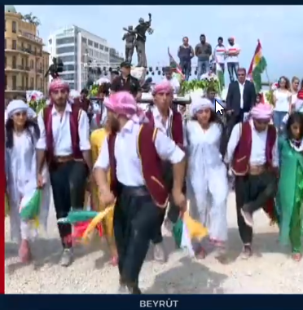
UCLA Library Today
Archiving collections of sites
Focus on ephemeral online content
“A collection of news and social media from the lead-up to the Referendum for Independence from the Iraqi state held in the Kurdish region of Iraq on September 25, 2017. The collection captures the websites of news outlets … representing the various political parties and social media account of individuals prominent in discussions of the referendum.”

Slide 30
Challenges
Embracing collection-level description
Introducing catalogers to concepts of provenance and appraisal
Recording information about restrictions on access, intellectual property rights, etc.

Slide 31
What Comes Next?
Consulting with stakeholders
Developing local best practices and guidelines
Working with Library’s User Engagement teams
Creating workflows
Assessment
Notes:
UCLA Library Advisory Committee on Cataloging & Metadata would develop and document our recommended practices and guidelines
Updating workflows to include process for description of archived web content
Finally, working with the Library’s Assessment team to look at metrics for use of this content and to look for ways to promote better discoverability

Slide 32
Our Archived Web Content
In Archive-It:
https://archive-it.org/organizations/877
Records created during pilot project:
https://ucla.in/2Kmhcfr
Record cataloged using WAM guidelines:
https://ucla.in/2KrCkBh

Slide 33
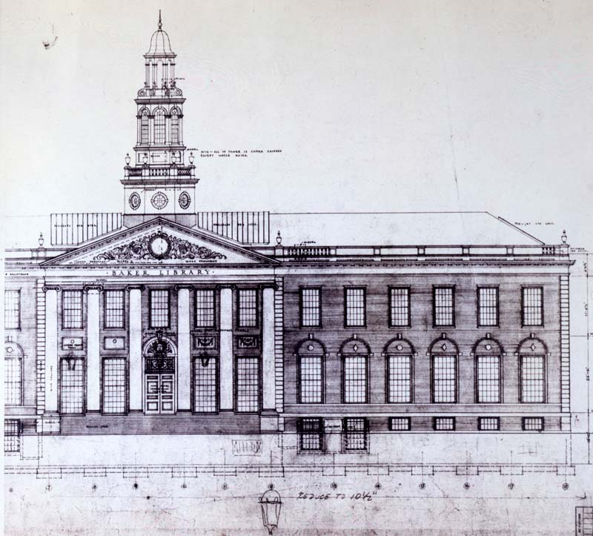
Descriptive Metadata for Archived Web Content at Baker Library Special Collections
Mary Samouelian
May 2, 2018
Notes:
Introduction – who you are and what you are responsible for.

Slide 34
Background
Web archiving program launched in 2013.
Since inception, Archive-It has been our web archiving service.
To date:
45 collections
1,500 active seeds
16,629,292 documents archived
1.2 TB of data
Notes:
We build and curate pre-eminent collections of business practice and management theory, ensuring that the collections are accessible and preserved to the highest standard regardless of format. We also serve as the trusted authority of the School’s history.
To that end, we primarily collect web content created by Harvard Business School (which we consider to be the official records of the school), web content associated with specific contemporary business collections in our holdings, and more recently in 2017 began collecting web content thematic in nature (e.g., the American Manufacturing Council (Trump Administration) as many HBS alumni served on this council, news articles related to one of our donating organizations).
We have one staff member (processing archivist) who is a “lead” for our web archiving program, meaning that this is just part of his job (about 25% of his time) and he is responsible for scoping and setting up the the crawls, performing post-crawl QA’ing, and creating metadata for all the collections.

Slide 35
Background
Current descriptive practices:
Create DublinCore descriptive metadata through Archive-It at collection level.
Add archival object in ArchivesSpace resource record where archived web content belongs “intellectually.”
Basic description of extent and location in collection catalog record: physical description (300); electronic location and access (856).
Notes:
We have taken an archival approach to descriptive metadata because we are a special collections repository and we primarily describe our content using archival descriptive practices.
Note that there is one collection (not publically available yet) where we are describing the content at the seed level (news articles) per our donor agreement. Currently this is a very manual process and is not sustainable for other collections at this time.

Slide 36
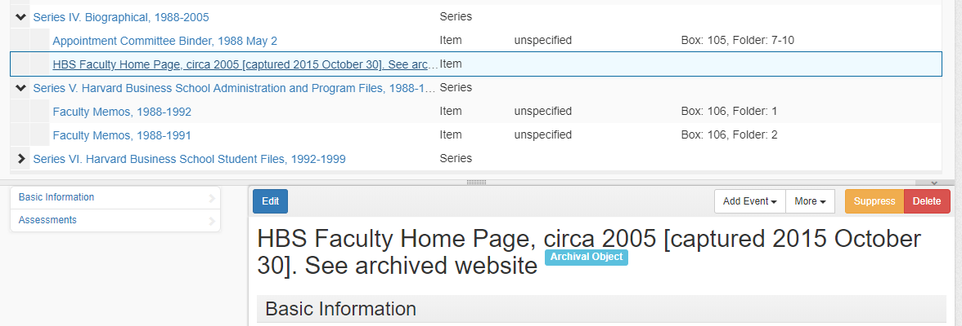
Background
Notes:
This is one of our faculty collections and the professor maintained a faculty home page. You’ll see that the archived page is grouped with the biographical papers created by the professor.

Slide 37
Background

Slide 38
Wam Working Group
Why join WAM?
Understand which metadata elements were relevant for the discovery of archived web content.
Gain deeper understanding of describing web content using bibliographic approach.
Be part of a community effort to address and propose standards.
Ultimately increase discoverability and usability of archived web content.
Notes:
At Baker Library we’ve taken an archival approach and I wanted to understand the differences between the an archival approach versus a bibliographic approach. Are there advantages of using one over the other and if yes, what are those advantages? I wouldn’t say that cataloging is one of my strongest skills so how would we begin describing this content using a bibliographic approach?

Slide 39
Current Efforts
Reviewed and revamped our scoping rules for harvesting web content.
Analyzed 14 recommended elements in WAM report to determine which elements were most relevant/useful for the discovery of our archived web content.
Developed standard language for elements that will likely be identical for each collection.
Revised metadata for several collections in Archive-It; reviewed process and are currently updating all collections.
Notes:
Describe as a “pre-step”. First bullet is important because we wanted to truly understand what content we were capturing and why. This is critical in determining how to optimally describe our content.
Second bullet point – understanding your users – do you know who they are? We are still struggling with this as we don’t have good metrics to measure use, but we do have good idea of who our internal users are.

Slide 40
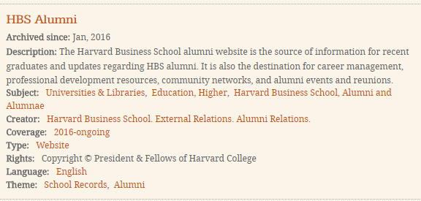
Current Efforts
Current metadata record in Archive-It
Notes:
9 fairly basic metadata elements.
“Archived since” is automatically generated by Archive-It
The description metadata element solely describes the content of the website and not that this is an archived website.
The metadata element “theme” is a custom field we added to group our collections into broader themes such as school records, student experience and social media.
We felt our strengths were:
Metadata was consistent, meaning we used the same 9 metadata elements.
We standardized language for each element.
By adding a theme we felt our users would be able to find “like” collections more easily (including our HBS Archivist and HBS departments who use these collections the most).

Slide 41
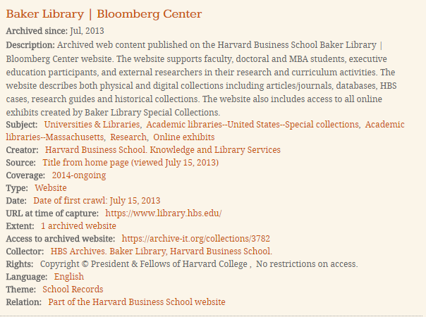
Current Efforts
Enhanced metadata record in Archive-It
Notes:
15 metadata elements
“Archived since” is automatically generated by Archive-It
We now believe that the description makes it clear that this is archived web content and that users will understand the purpose for collecting the content.
Added source element to indicate the source for the title of the collection
We added the date element which now indicates when the content was first crawled. We decided to maintain the coverage element instead of combining it with the date element. First we didn’t want to edit all the fields and secondly we liked that this information was called out in its own element.
Retained type
Added URL at the time of capture
Added extent primarily because a collection can consist of many archived websites and we want to make sure users understood this.
Added access statement
Added Baker Library as the collector (standard across collections)
Rights – retained copyright statement but also added if there were any restrictions.
Our theme maps to “genre/form”
Relation was added – in this case the HBS is so big that we could not have archived the entire site in one crawl so we crawled it based on administrative units, programs and events. This ensures that researchers know that this collection is merely a part of a bigger website.
Only metadata element missing is contributor, which we will use when applicable

Slide 42
Next Steps
Complete enhancing DublinCore collection level metadata in Archive-It.
Explore enhancing seed level metadata where appropriate.
Create a collection level finding aid using recommended metadata elements in WAM report.
Create individual collection level catalog records.
Add a digital collection for archived web content to our Discovery Platform, with the goal of repurposing metadata from Archive-It.

Slide 43
Next Steps
Update policies and procedures to reflect web archiving metadata efforts.
Meet with Public Services staff about archived web content to ensure they know how to communicate these resources to researchers.
Develop metrics to track discoverability and use of archived web content.

Slide 44
Challenges
This is a big effort!
Is this the right approach?
Manual process.
Coordinating effort with other Harvard repositories.
Notes:
Big effort that we’re hoping will pay off. Metadata currently is created manually and we have quite a few collections that need to be described.
If you notice in in Archive-It each Dublin Core element added is automatically linked in the faceted searching on the left and it is becoming a bit “messy” with all of the search possibilities.
We only have part of a person to do this work, so the manual part of it is painfully obvious. We need to find ways to automate this work.
To my knowledge, we’re the first repository at Harvard to roll out this effort. What are others at Harvard doing? Have they interpreted the report the same way? Will we have similar metadata to make discoverability across the university the same?

Slide 45
Want to learn more?
Archive-It: https://archive-it.org/organizations/719

Slide 46
Influence of WAM guidelines
How might they change current practice?
Use of same DC element for information that are more specifically tagged in other standards
Will others reevaluate their practices or will the guidelines verify existing ones?
Will they mainly help institutions new at describing web archives?
Example: revisions to NYARC profile to map to WAM elements (coming soon) http://www.nyarc.org/sites/default/files/web-archiving-profile.pdf
What does it mean to comply with the WAM guidelines?

Slide 47
What comes next?
What additional guidance is needed?
Use cases for specific environments and workflows
Variety of options in WAM need fleshing out
Use of controlled vocabularies?
Availability of tools
For metadata creation and automatic generation of metadata
For discovery
For repurposing metadata among systems and environments

Slide 48
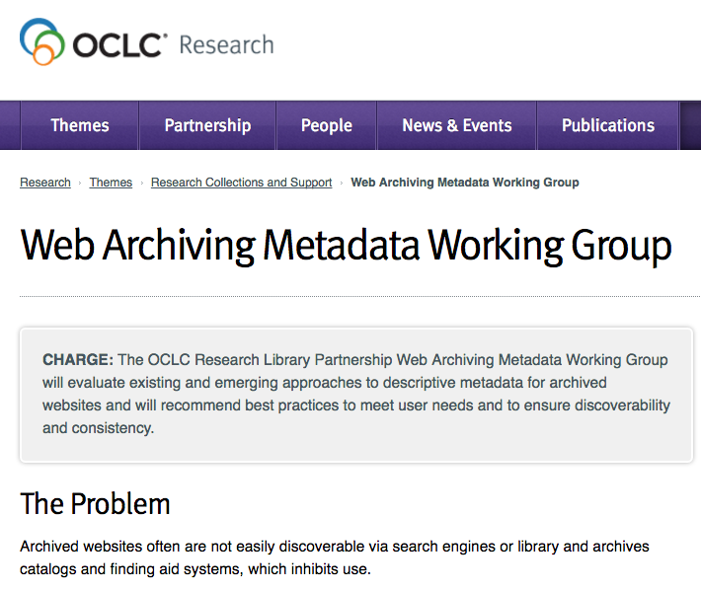
Thank you!
Your questions?
Jackie Dooley
Rebecca Guenther rguenther52@gmail.com
Claudia Horning chorning@library.ucla.edu
Mary Samouelian msamouelian@hbs.edu
©2018 OCLC. This work is licensed under a Creative Commons Attribution 4.0 International License.

Slide 49
The OCLC Research Library Partnership provides a unique transnational
collaborative network of peers to address common issues as well
as the opportunity to engage directly with OCLC Research
Thank you for underwriting and participating in our programs

