Slide 1
The Realities of RDM:
Acquiring RDM Services for Your Institution
Brian Lavoie
Rebecca Bryant
OCLC Research
Realities of RDM Webinar Series: Part 3
December 4, 2018

Slide 2
The Realities of RDM: Webinar Series
Webinar #1
Understanding Institutional Research Data Management Services
2 October 2018
11:00 am EDT (UTC -4)
Webinar #2
Identifying and Acting on Incentives When Planning RDM Services
13 November 2018
11:00 am EST (UTC -5)
Webinar #3
Acquiring RDM Services for Your Institution
4 December 2018
11 am EST (UTC -5)

Slide 3
~130 partnership institutions worldwide
Facilitates connections between OCLC Research and research libraries
Supports transnational sharing and peer to peer collaborative learning
Influences service design and future OCLC research
Devoted to challenges facing libraries and archives since 1978
Community resource for shared Research and Development (R&D)
Engagement with OCLC members and the community around shared concerns
oc.lc/research

Slide 4
Background

Slide 5
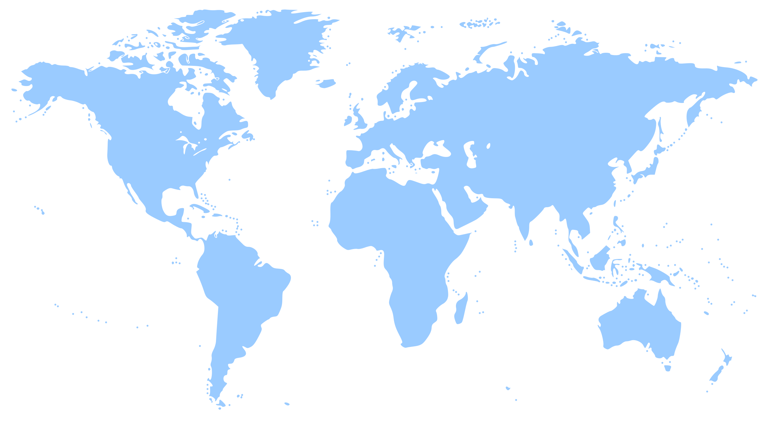
The Realities of Research Data Management
Research data: key part of evolving scholarly record
How universities acquire RDM capacity:
Context, influences, choices
Key decision points:
Deciding: 1) to act 2) what to do 3) how to do it
Case studies:
University of Edinburgh
Wageningen University & Research
University of Illinois - UC
Monash University

Slide 6
OCLC Project Team
Rebecca Bryant, PhD Senior Program Officer
https://orcid.org/
0000-0002-2753-3881
Brian Lavoie, PhD
Research Scientist
https://orcid.org/
0000-0002-7173-8753
Constance Malpas
Research Scientist
https://orcid.org/
0000-0002-9312-8294

Slide 7
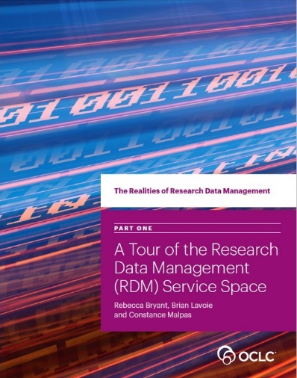
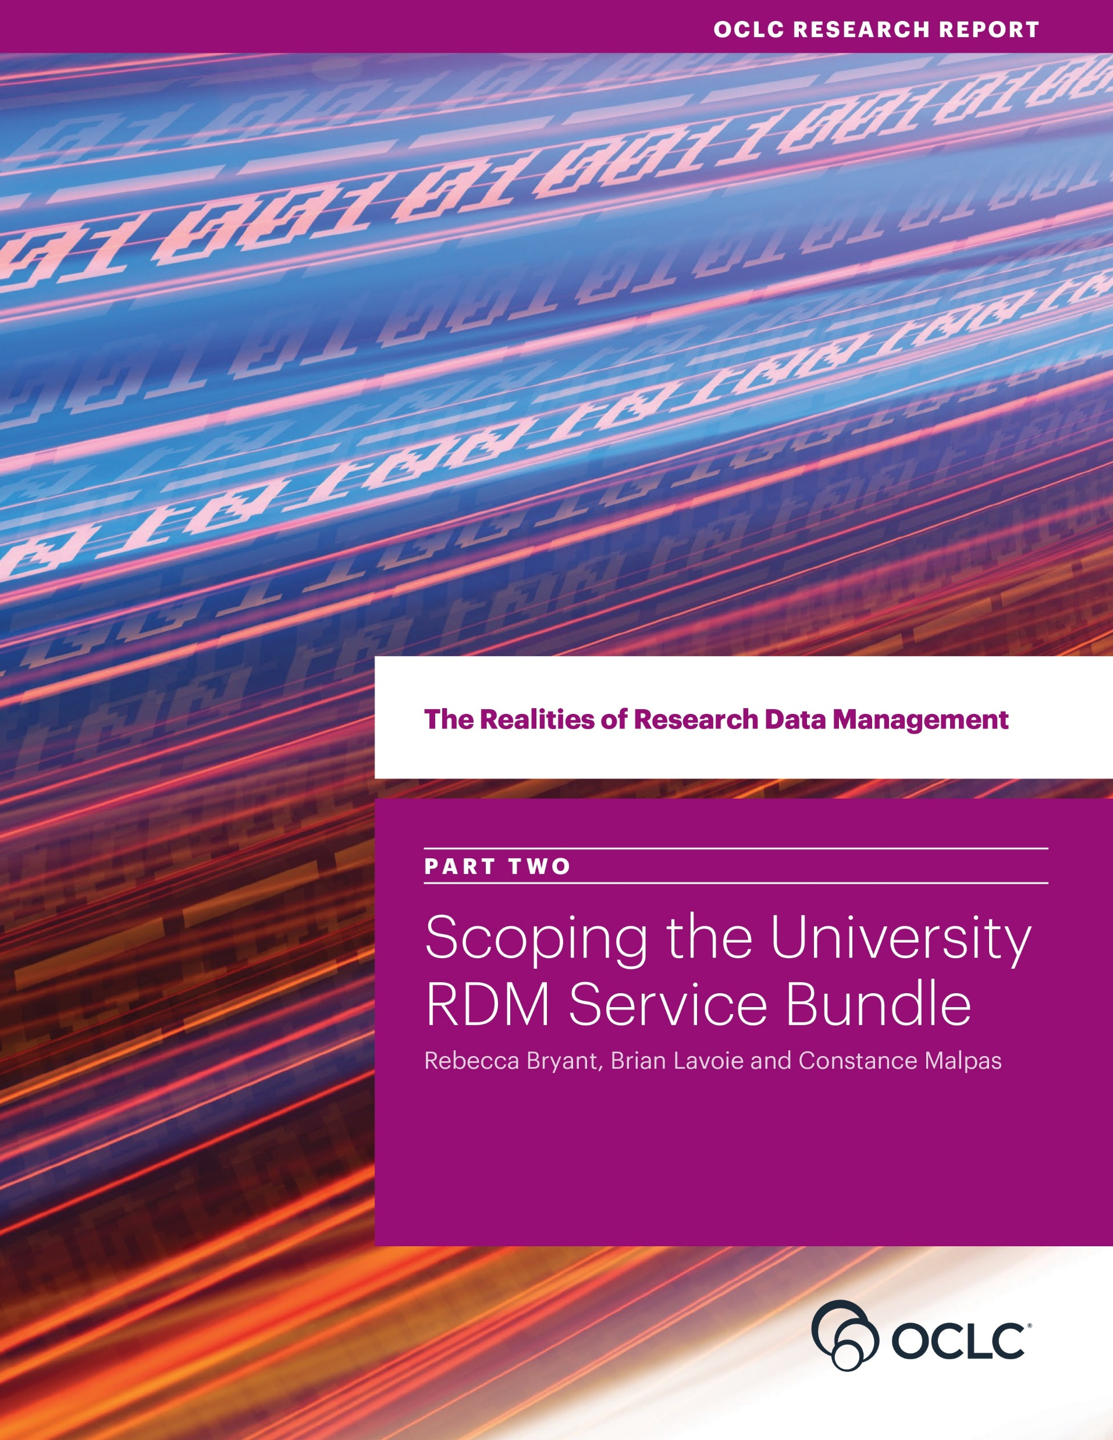
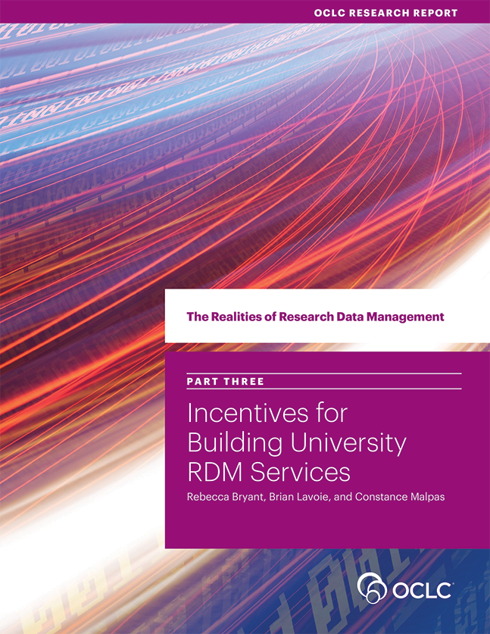
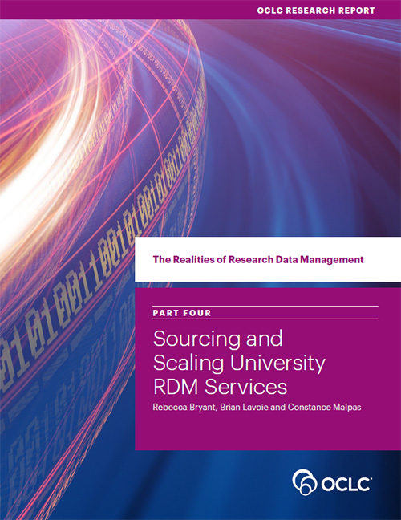
Four Reports
oc.lc/rdm
Scoping the
RDM Service Bundle
Sourcing & Scaling
Choices
Incentives to Acquire
RDM Capacity
RDM Service Space

Slide 8
The RDM Service Space & RDM Service Bundles

Slide 9
The RDM Service Space

Slide 10
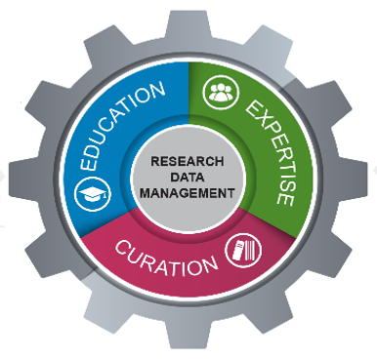
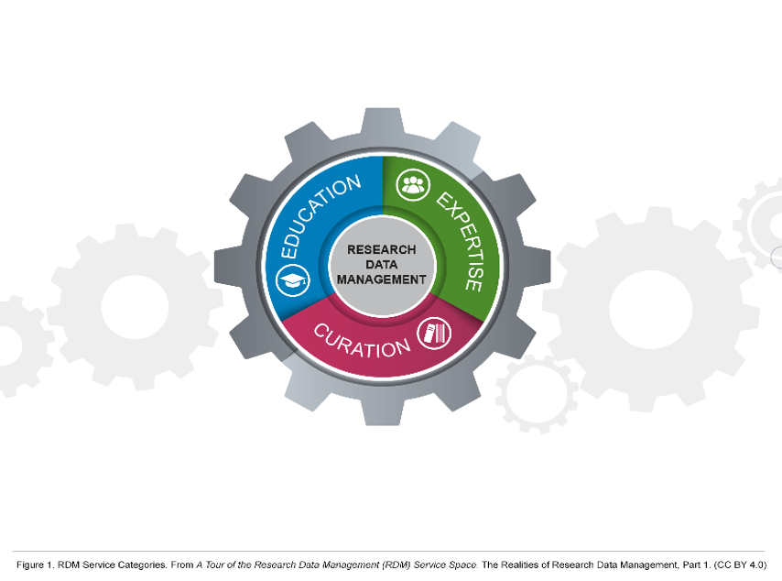
RDM Service Bundle
University
service bundles
… set of RDM services
offered by a university
to its researchers.
Includes not just local
but also external services

Slide 11
Sourcing RDM Services

Slide 12
Sourcing
Will an RDM service be developed and deployed internally,
or will it be externalized to an outside provider?
Internal sourcing: built, customized, or adapted – and then
deployed, maintained, and evolved – primarily through
local effort and resources
External sourcing: can be achieved through different types
of providers.
Choice of internal v. external sourcing applies to individual
RDM services, not the service bundle as a whole

Slide 13
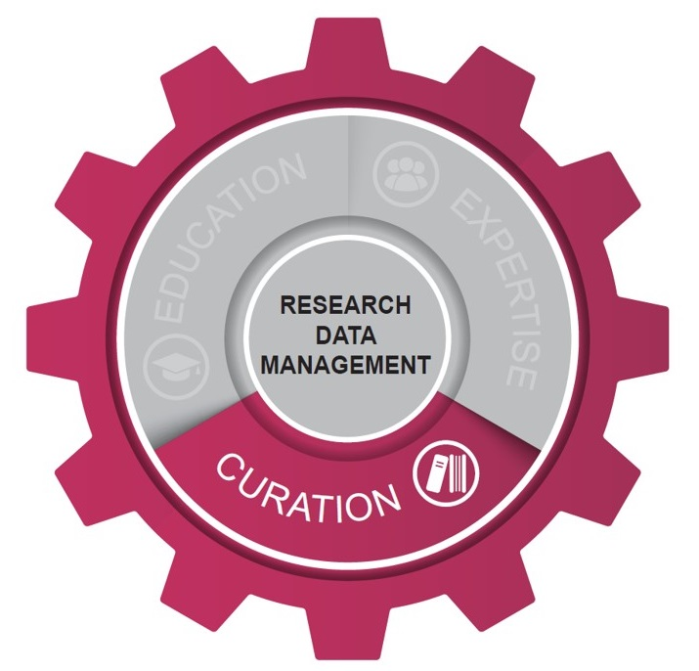
Sourcing choices: Curation
4 different universities, 4 different approaches to sourcing Curation services.
Choices impacted by internal & external context.

Slide 14
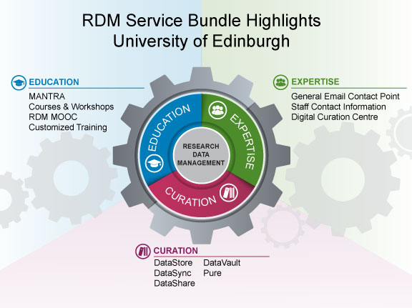
“RDM Service Bundle Highlights: University of Edinburgh” by OCLC Research, from The Realities of Research Data Management Part Two: Scoping the University RDM Service Bundle (https://doi.org/10.25333/C3PG8J), CC BY 4.0

Slide 15
“RDM Service Bundle Highlights: Wageningen University & Research” by OCLC Research, from The Realities of Research Data Management Part Two: Scoping the University RDM Service Bundle (https://doi.org/10.25333/C3PG8J), CC BY 4.0

Slide 16
Sourcing: Observations
Curation services are the most likely to be externalized
Availability of reliable national/consortial RDM infrastructure
Example: Wageningen: 4TU & DANS
Local RDM curation services often focus on data lacking another home
Example: Illinois Data Bank
Existing researcher workflows key factor in externalizing curation capacity
Education & Expertise services usually sourced internally … so far
Human-intensive nature of services favors local provision
Some local services may be needed to establish “RDM credibility”
Potential for growth in externalized Education/Expertise services
Example: Data Curation Network

Slide 17
Scaling RDM Services

Slide 18
Scaling … the user community
Who will the RDM service support?
Above the Campus
Campus
Below the Campus

Slide 19
Scaling … examples
Who will the RDM service support?
Above the Campus
MANTRA
Data Curation Network
4TU.ResearchData
Campus
RDM LibGuides
DMP Consultation
U of E DataStore
Wageningen: Grad Student/
Post Doc RDM Training
U of I: Subject specialists
Below the Campus
Monash: Protein Crystallography

Slide 20
Scaling … observations
Thinking about university RDM capacity may start “below the campus”
“Below campus”-scale services can catalyze higher-scale deployments
Example: Protein crystallography at Monash
Example: DMP support at Wageningen
“Generic” vs. specialized RDM services
Specialized services require specialized expertise
Example: Store.Monash
Positioning of local RDM services
Do local RDM services compete with or complement external services?
Example: Edinburgh and Illinois

Slide 21
The Interoperability Imperative

Slide 22
“No RDM service bundle is an island …”
“ … all are connected, to a greater
or lesser degree, to the broader,
external RDM service ecosystem.”
… and often deployed at a
variety of scales

Slide 23
Sourcing & scaling:
The interoperability imperative

Slide 24
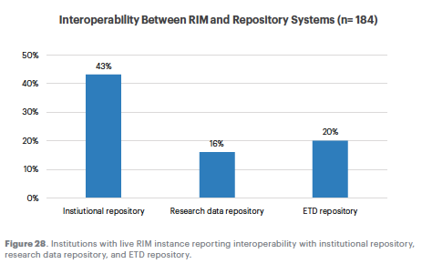
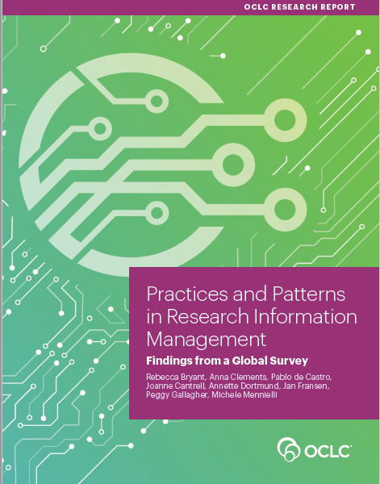
Notes:
Figure 28. Institutions with live RIM instance reporting interoperability with institutional repository, research data repository, and ETD repository

Slide 25
Takeaways, etc.

Slide 26
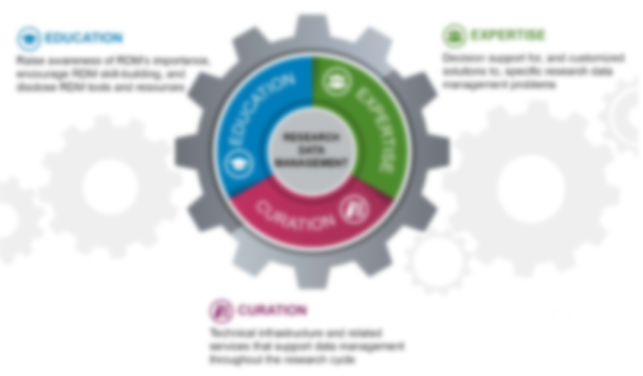
Summary
Sourcing and scaling are important choice variables in developing an RDM service bundle.
Curation services are the most likely to be externalized; Education and Expertise most likely to be internalized.
RDM services can be deployed to support user communities at campus-scale, as well as scales below campus and above campus.
Maintaining interoperability across RDM services is an important aspect of managing the RDM service bundle.

Slide 27
Takeaway Questions
What is the mix of internally & externally sourced services in your university RDM service bundle?
Differences in internal/external mix across Education, Expertise, Curation services?
Does your RDM service bundle include services that are scaled:
Below campus?
Above campus?
What are the interoperability bottlenecks in your RDM services?
Technical obstacles?
Relationship obstacles?
Do you have all of the information you need to answer these questions?

Slide 28
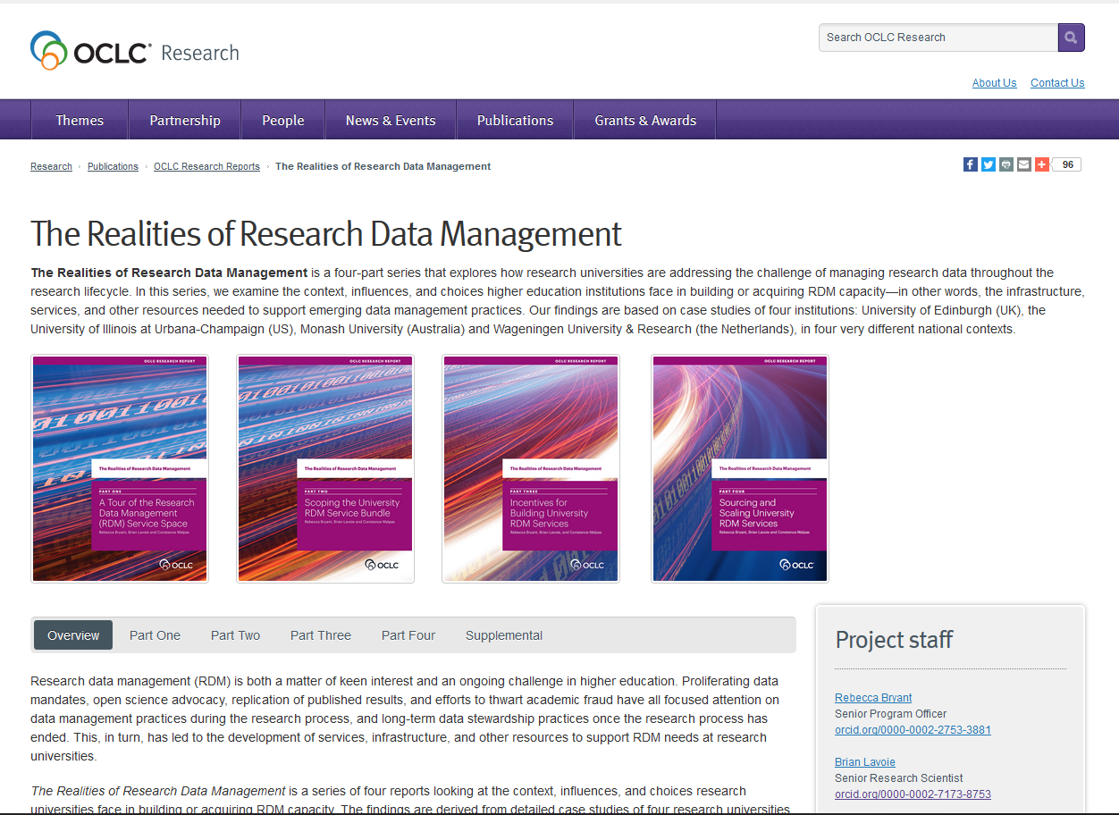
oc.lc/rdm

Slide 29
More Realities of RDM!
Join …
ORLP RDM Interest Group: oc.lc/rdm-ig
You will be added to the Interest Group listserv
Watch:
Webinar recordings on the OCLC Research YouTube channel:
https://www.youtube.com/user/OCLCResearch
Read …
Summary of Interest Group discussions:
First webinar: http://hangingtogether.org/?p=6823
Second webinar: forthcoming!
Third webinar: forthcoming!

Slide 30
Thank you!
The Realities of Research Data
Management
oc.lc/rdm
Brian Lavoie
lavoie@oclc.org
Rebecca Bryant
bryantr@oclc.org

