Slide 1
Works in Progress Webinar
Lessons Learned from a Linked Data Prototype for Managing Bibliographic Data

Slide 2
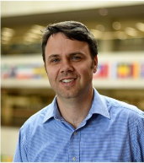
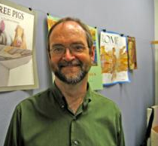
John Chapman, OCLC
Marc McGee, Harvard University
Bruce Washburn, OCLC
Stephen Hearn, University of Minnesota

Slide 3
OCLC, Linked Data and Wiki
Linked Data production
VIAF (2009)
FAST (2011)
WorldCat.org (2014)
Wikidata & Wikipedia
VIAFbot, etc (2012)
VIAF links - expansion of non-English (2015)
CiteTool integration (2017)
Wikipedia+Libraries: Better Together
OCLC community projects
Person Entity Lookup Pilot (2015)
Metadata Refinery Prototype (2015)
IIIF support in CONTENTdm (2017)
Notes:
This project didn’t start in a vacuum.
OCLC has been working with libraries and wikipedians and users to expand usage of library data in Wikipedia and wikidata.
VIAFBot project wrote more than 400K library authority links into Wikidata, following similar work on English and other language Wikipedias. http://journal.code4lib.org/articles/8964
Wikipedia + Libraries: Better Together provided free online training for 236 librarians looking to increase their Wikipedia skills and design Wikipedia related training for the communities they serve.
For this project, Our research team identified that the wikibase software would be an ideal way to get us where we wanted to go, and quickly.
What would it take to create an easy-to-use system that allowed users not just to search on and refer to, but to edit?
How would that work in a wiki environment?

Slide 4
New ways of working together
Collaboration
Discussion of use cases
Listserv, Community Center
Office Hours, Partner Meetings
Reconciliation
Auto-suggest search interface
SPARQL Endpoint
Explorer UI
Editing
Wikibase UI
Retriever
Notes:
Designed as partnership.
collaborate with our library partners on problem statements and provide tools to address those issues. Collaboration occurred through a variety of means
The project started by spinning up our own instance of Wikibase. The features provided by this out-of-the-box solution, such as auto-suggest and editing, allowed OCLC staff to focus our energies on what our partners needed most (beyond that initial set of capabilities) as the project evolved.

Slide 5
A TOUR OF THE PILOT SYSTEM

Slide 6
Disambiguating Wiki*
Wikipedia -- a multilingual web-based free-content encyclopedia
Wikidata.org -- a collaboratively edited structured dataset used by Wikimedia sister projects and others

Slide 7
Disambiguating Wiki*
Wikipedia -- a multilingual web-based free-content encyclopedia
MediaWiki -- free and open-source wiki software
Wikidata.org -- a collaboratively edited structured dataset used by Wikimedia sister projects and others
Wikibase -- a MediaWiki extension to store and manage structured data

Slide 8
MediaWiki Features
Search, Autosuggest, and APIs
Multilingual User Interface
Wikitext editor
Change history
Discussion pages
Users and rights
Watchlists
Maintenance reports
Etc.

Slide 9
MediaWiki + Wikibase Features
Search, Autosuggest, APIs, Linked Data, and SPARQL
Multilingual User Interface
Structured data editor
Change history
Discussion pages
Users and rights
Watchlists
Maintenance reports
Etc.

Slide 10
Wikibase out-of-the-box advantages
Open source
An all-purpose data model that takes knowledge diversity, sources, and multilingual usage seriously
Collaborative – can be read and edited by both humans and machines
User-defined properties
Statement-level references and qualifiers
Version history

Slide 11
Use Case: Manual Data Entry
Notes:
The Wikibase UI supports data entry. It has a powerful and well-tested set of features that speed the data entry process and assist with quality control and data integrity.

Slide 12
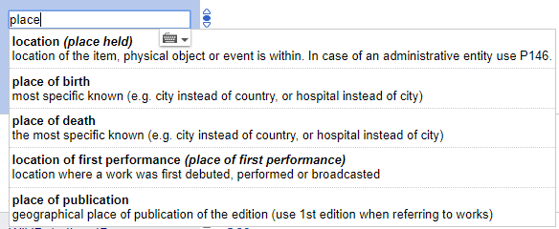
Use Case: Autosuggest
Notes:
Searching for entities as you type is supported by the Mediawiki API. This feature is found in both the Wikibase UI when selecting properties and objects for statements, when searching, and when constructing SPARQL queries in the SPARQL Query Service UI.

Slide 13
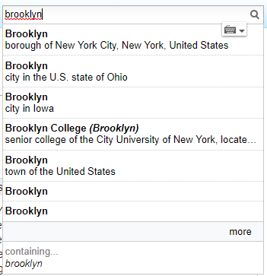
Use Case: Autosuggest
Notes:
Searching for entities as you type is supported by the Mediawiki API. This feature is found in both the Wikibase UI when selecting properties and objects for statements, when searching, and when constructing SPARQL queries in the SPARQL Query Service UI.

Slide 14
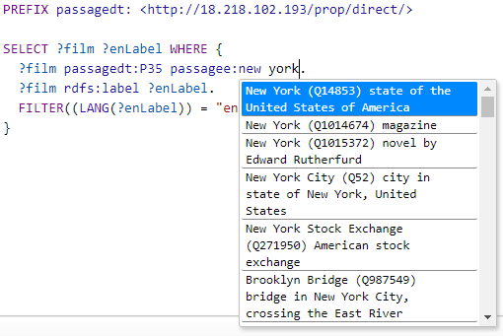
Use Case: Autosuggest
Notes:
Searching for entities as you type is supported by the Mediawiki API. This feature is found in both the Wikibase UI when selecting properties and objects for statements, when searching, and when constructing SPARQL queries in the SPARQL Query Service UI.

Slide 15
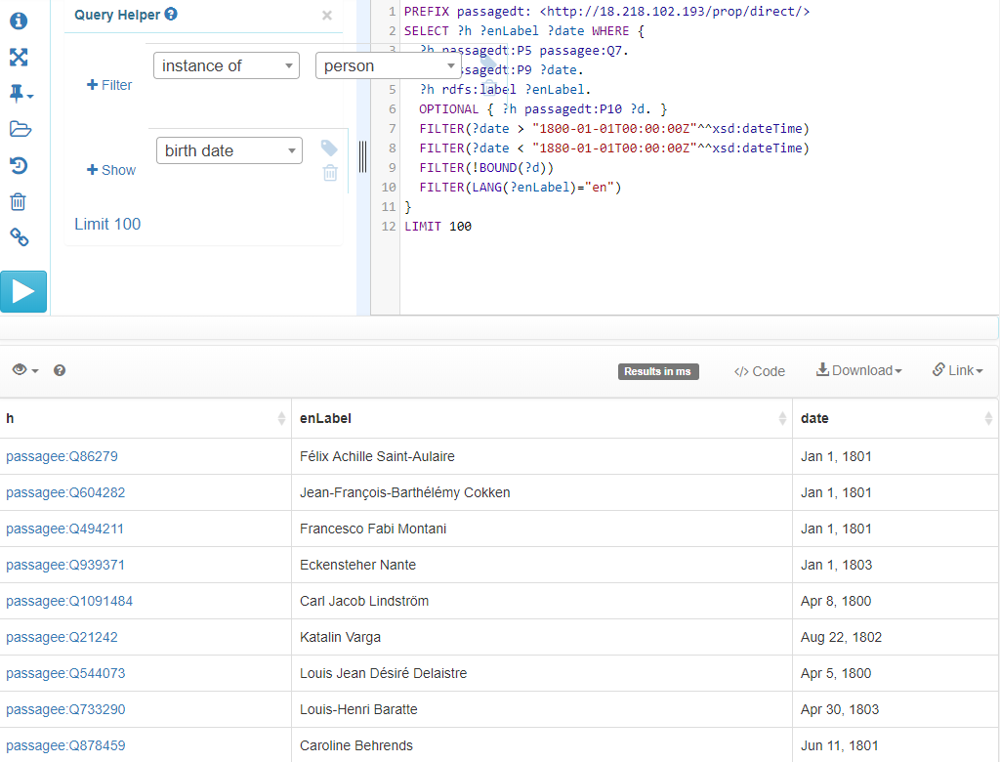
Use Case: Complex Queries
Notes:
SPARQL is a semantic query language for databases.
The ecosystem includes a SPARQL endpoint and a user-friendly interface for constructing queries.
In this example SPARQL query, items describing people born between 1800 and 1880, but without a specified death date, are listed.

Slide 16
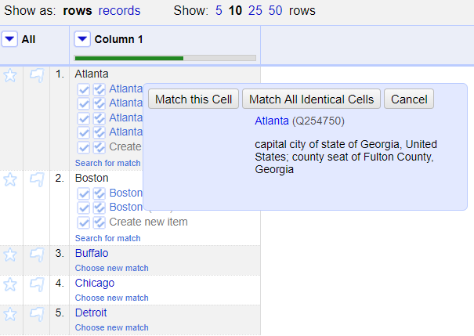
Use Case: Reconciliation
Notes:
Reconciling strings to a ranked list of potential entities is a key use case to be supported.
We used an OpenRefine-optimized Reconciliation API endpoint for this use case.
The Reconciliation API uses the ecosystem’s Mediawiki API and SPARQL endpoint in a hybrid tandem to find and rank matches.

Slide 17
Use Case: Batch loading
GATHER DATA
TRANSFORM
LOAD
Our sources included WorldCat, VIAF, FAST, and Wikidata
Detect duplicates, add identifiers for strings, format for Pywikibot.
Create entities and add statements in Wikibase.
1
2
3
Notes:
For batch loading new items and properties, and subsequent batch updates and deletions, OCLC staff use Pywikibot.
It is a Python library and collection of scripts that automate work on MediaWiki sites. Originally designed for Wikipedia, it is now used throughout the Wikimedia Foundation's projects and on many other wikis.
Wikidata Quickstatements is an interesting alternative.

Slide 18
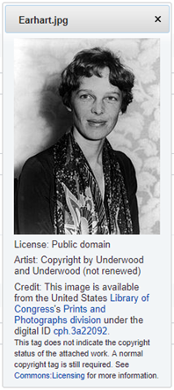
Extending the Entity Ecosystem: Gadgets
Notes:
The Wikibase UI can be extended by writing little “Gadgets” … basically small Javascript applications that can be invoked from Wikibase pages.
For example, we created a gadget that would make gather thumbnail images and metadata for statements associated a MediaWiki Commons image with an entity.

Slide 19
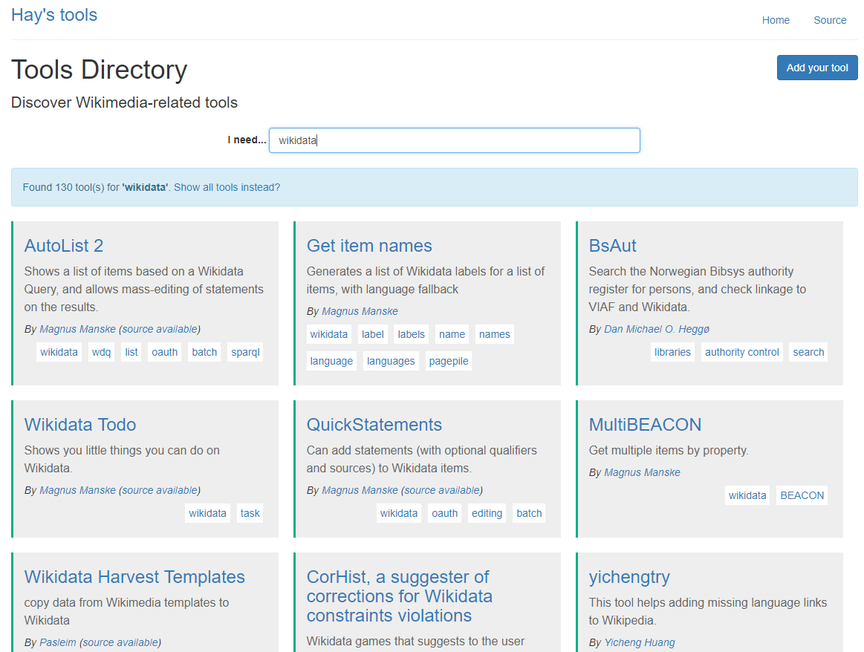
Extending the Entity Ecosystem: Toolforge
https://tools.wmflabs.org/hay/directory/
Notes:
The MediaWiki and Wikidata Community is extensive and active, and the MediaWiki Toolforge site provides access to a wide range of open source applications that are built on that software foundation. We made use of that community extension for an OpenRefine-compatible API endpoint.
The Toolforge is supported by Wikimedia Foundation staff and volunteers, and provides access to and information about additional services, including many that improve and empower Wikibase.

Slide 20
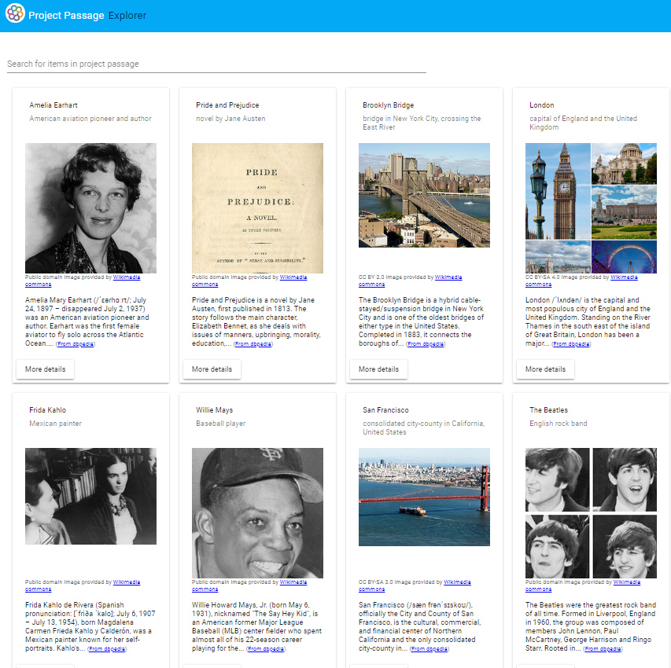
Extending the Entity Ecosystem: Explorer
Notes:
We created our own fit-for-purpose extensions, including an “Explorer” for browsing through our entities which utilized the MediaWiki Search API as well as the SPARQL Query API to gather data, with other sources like DBpedia providing additional context.

Slide 21
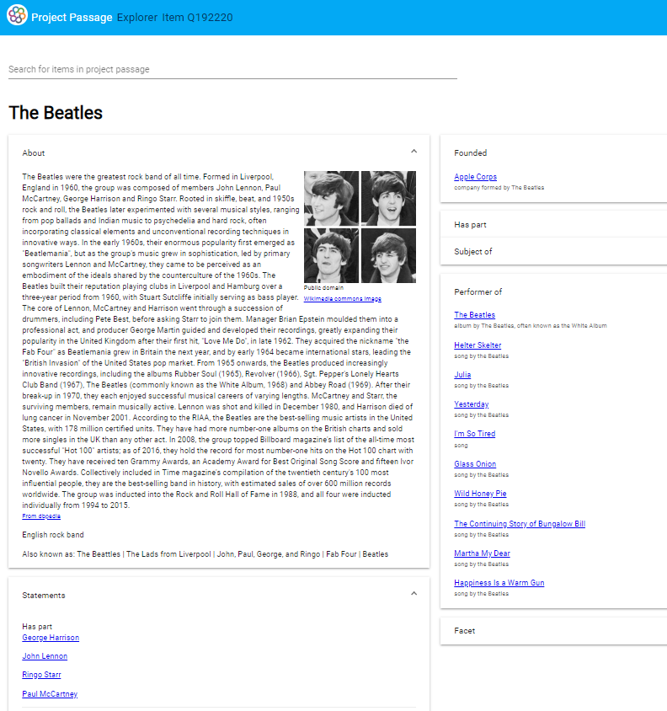
Extending the Entity Ecosystem: Explorer
Notes:
We created our own fit-for-purpose extensions, including an “Explorer” for browsing through our entities which utilized the MediaWiki Search API as well as the SPARQL Query API to gather data, with other sources like DBpedia providing additional context.

Slide 22
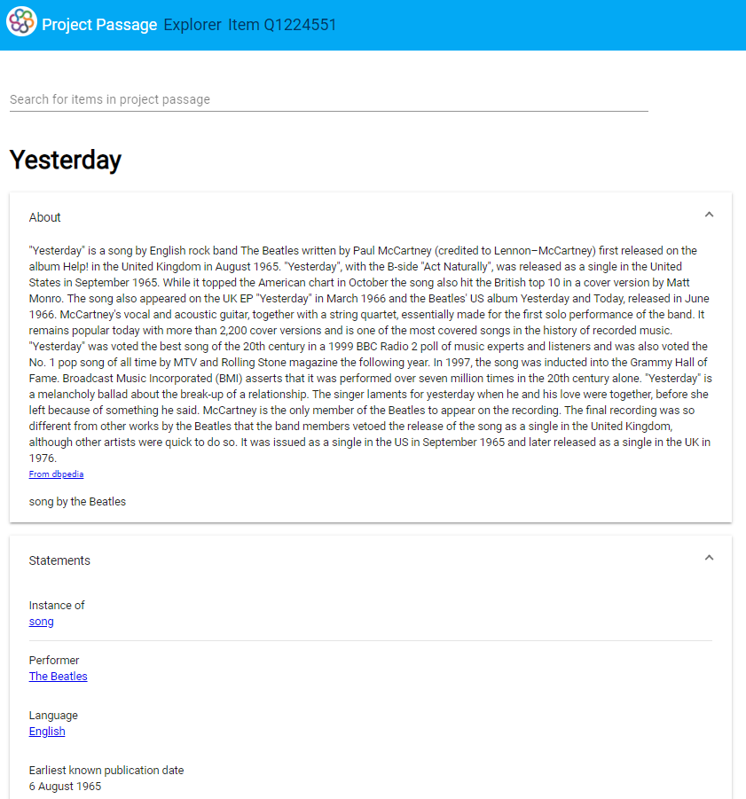
Extending the Entity Ecosystem: Explorer
Notes:
We created our own fit-for-purpose extensions, including an “Explorer” for browsing through our entities which utilized the MediaWiki Search API as well as the SPARQL Query API to gather data, with other sources like DBpedia providing additional context.

Slide 23
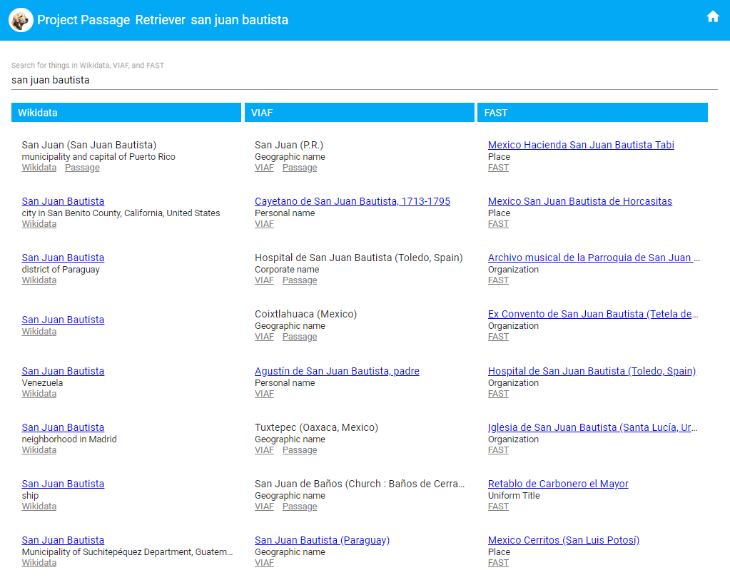
Extending the Entity Ecosystem: Retriever
Notes:
Our “Retriever” extension was built in response to, and guided by, pilot participant feedback, as a way to fill in some of the “entity gaps” in the system.
A simple keyword search interfaces uses the Wikidata, VIAF, and FAST APIs to return possible matches. Selecting one of the matches fills in data in a simple form for double-checking data quality and supplementing descriptions, with a one-click button to create a new entity description in the pilot system Wikibase.

Slide 24
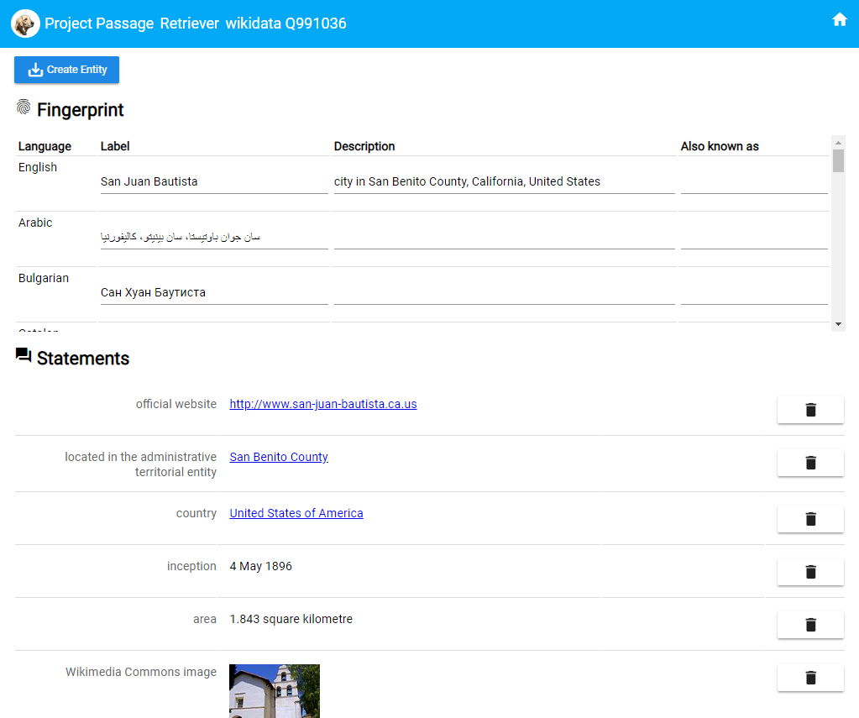
Extending the Entity Ecosystem: Retriever
Notes:
Our “Retriever” extension was built in response to, and guided by, pilot participant feedback, as a way to fill in some of the “entity gaps” in the system.
A simple keyword search interfaces uses the Wikidata, VIAF, and FAST APIs to return possible matches. Selecting one of the matches fills in data in a simple form for double-checking data quality and supplementing descriptions, with a one-click button to create a new entity description in the pilot system Wikibase.

Slide 25
HARVARD LIBRARY

Slide 26
Harvard Library - Motivations
Explore alternatives to MARC & BIBFRAME to describe entities and their relationships
Gain experience with metadata input, vocabularies, etc. within the Wikidata structure
Learn more about Wikibase as cataloging UI
Opportunity to participate in shared learning experience
Interest in understanding and potentially influencing OCLC direction for linked data use/creation
Notes:
**Include a digression about importance of Wikidata
-51 million entities, growing rapidly
-tie in to open web and resource exposure
-library data under-represented (both bibliographic and embedded entities)
-connection points with domain expert user communities

Slide 27
Harvard Library - Successes
Collaboration
Community Center
Office Hours - focused topics
Rapid, iterative prototyping - ontology and tooling
Wikibase and related tools
SPARQL Query Service
Retriever - entity integration across sources
Explorer - results of work in user-facing system
Notes:
Explorer
-

Slide 28
Harvard Library - Lessons Learned
Great value to working in functional Linked Data editing ecosystem
Wikibase - intuitive and robust
Exposing the questions
Property definitions and constraints
Need for community decisions, documentation with examples
When to say ‘when’ on entity/relationship creation?
Notes:
Wikibase as UI
-largely positive experience, very easy to connect theory and practice
-~10 metadata creation/metadata management staff
-explored various entity and material types / breadth over depth
-internal study group sharing sessions
-easy to jump in and start creating
-production assistance tools/gadget options are robust; only just began to explore
Wikidata considers itself an ‘emergent’ vocabulary. Somewhat different than traditional library descriptive standards. Prescriptive and bounded usage of properties and classes would seem to be harder to control. Evolving vocabulary more difficult to keep track of. Working directly in a functional ecosystem allowed the appropriate questions to emerge.
Specifically, property definitions ...
When to say when?
Entity creation - rabbit hole / MARC we have a sense of when something is done… you can read it; with entity relationships it’s more difficult to make that evaluation. Model allows for more relationships than we’re used to asserting. Flexibility is great for special collections; setting guidelines will be helpful

Slide 29
Harvard Library - Use Cases
Sharing library digital content more broadly
Home for traditionally “local” authority management?
Standards of notability
Entities or concepts not well represented in available library vocabularies
Enhancing library data with non-library domain expert knowledge
Notes:
Connection between wikidata and wikimedia commons and wikipedia brings library data a step toward broader web exposure and resource re-use

Slide 30
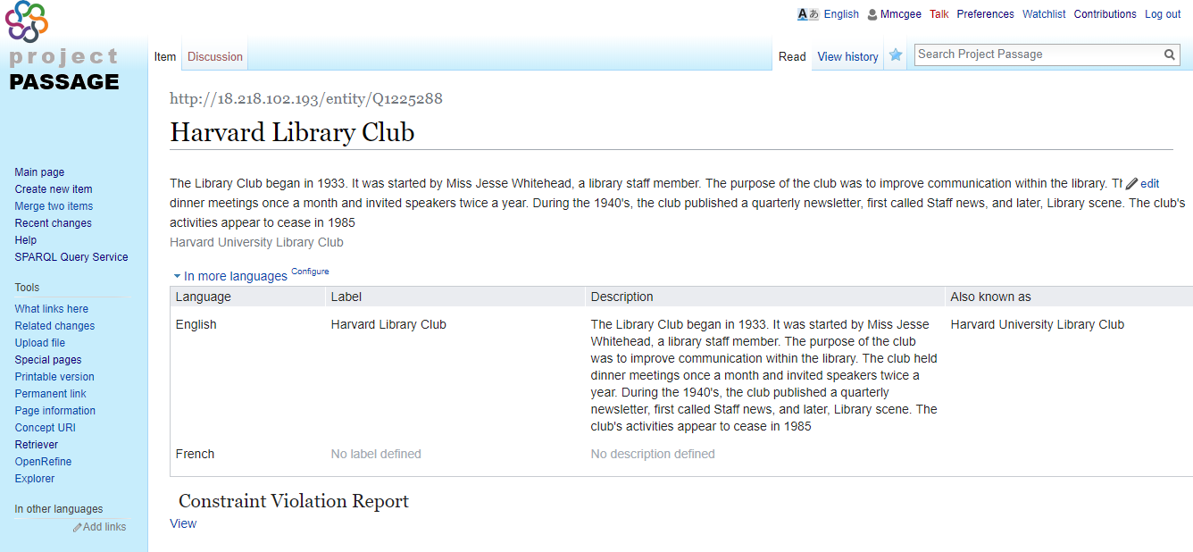
Harvard Library Club, 1933-1985

Slide 31
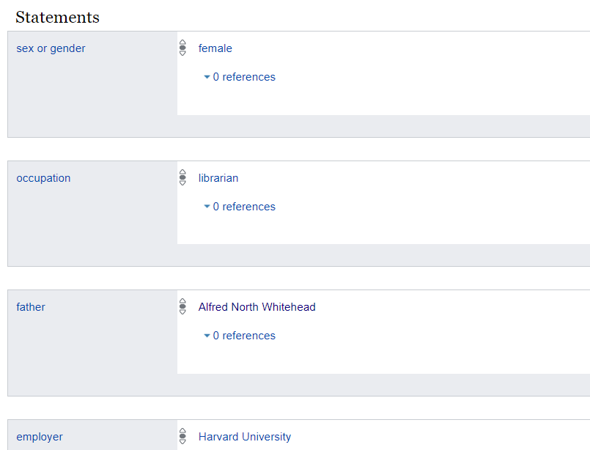

Slide 32
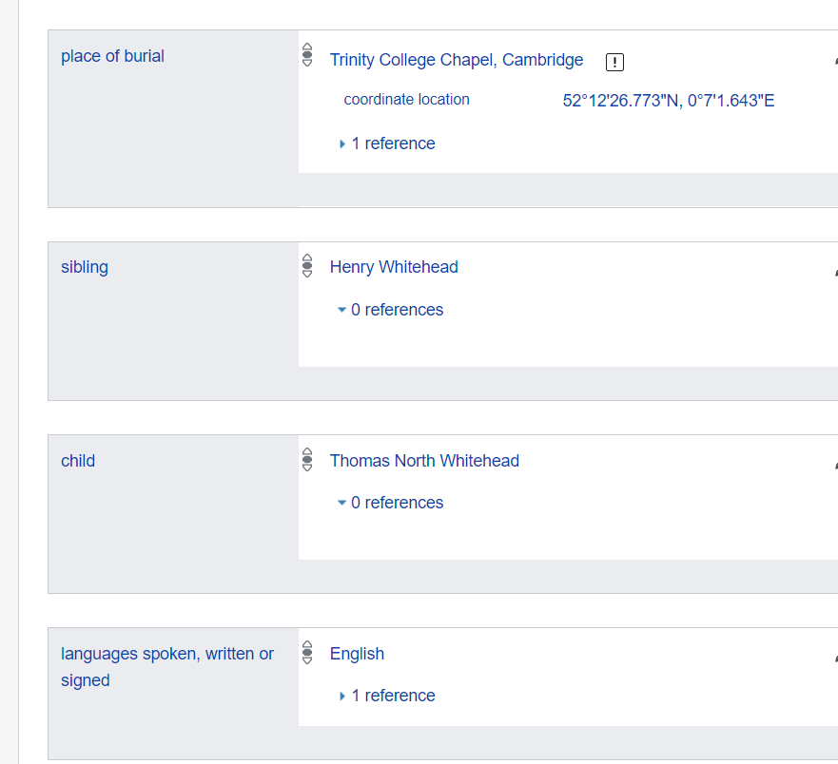

Slide 33
Harvard will…
Explore linked data for metadata production
Lead initiatives for shared identifiers and identity management
Continue collaboration with OCLC, LD4, and other partners to create workflows that aspire to the timeliness, scale, and flexibility that modern scholarly output requires
Notes:
From Google doc (because I really liked it!):
Harvard Library has a reputation for going it alone, unsustainable going forward, need to foreground collaboration with new and existing partners to get things done at the scale and timeliness that modern scholarly output requires
Flexible, extensible

Slide 34
UNIVERSITY OF MINNESOTA LIBRARIES

Slide 35
University of Minnesota Libraries -- Motivations
Initial hands-on experience with linked data for some of us
Agree with Harvard Library’s observations
Passage system was relatively easy to adapt to and improved as we used it
Notes:
We have done some local experimentation with linked data models and have been tracking community developments, but Passage was the first opportunity for group hands-on work. We had 4-5 people participating in the project locally.
Our experience was similar to Harvard’s--we found Passage fairly easy to learn and use, and it got better over the course of the project. We really appreciated the regular contacts with developers and project managers at OCLC and the level of agreement and understanding about project goals and methods. We also really liked the interactions with metadata folks at other institutions and being involved in a community effort.

Slide 36
Minnesota -- Positive experiences
Passage encourages us to think about entities in relationship
Ability to describe and relate multiple entity types
Ability to draw on web sources for entity descriptions
Connections
Notes:
Passage isn’t just a system for describing traditional bibliographic objects. The linked data model encourages us to see our work of description as building a web of relationships among a population of described entities of various types, and to think about how each of those is most appropriately described in general and in relation to our focus object. In this regard, the ready access to Wikidata descriptions of an encyclopedic range of entities was very valuable. Still, it was also essential to be able to add to that population of entities within the Passage Wikibase.
In addition to the positive connections with OCLC staff and project participants, we also liked being able to emphasize connections as two-way navigable relationships. For example, the creator name isn’t just a way of finding the object as it often is in traditional library catalogs--it’s also a way of exploring the creator and the creator’s other relationships. This is a model which is always latent in library authority control, but is not often foregrounded and elaborated the way it is in Passage.

Slide 37
Minnesota -- Open questions
Granularity?
Scalability?
Search engine optimization factors?
Place in the metadata ecosystem?
Navigation of defined relationships?
Constraints?
User community?
Notes:
The Passage Project did raise a number of open questions for us:
Library holdings can be described at a very granular level, including details about each library’s copy of a work. In a context like Passage, how much of that granularity is appropriate? Is there still a need for a local system to manage inventory, access, and condition metadata separate from the description which needs to be widely shared?
Even above the question of item-level granularity, there are scalability questions. Is there an intuitive hierarchy which users would expect which would see some objects as being more useful (in Wikimedia terms, “notable”) and should justify the effort of description? Should we describe everything and let any sort of scaling for usefulness be left to end user activity to sort out?
If we are doing this work in part to make library holdings and services more visible on the web, what kinds of search engine optimization should we be focusing on when doing description?
Given that we are working to integrate our metadata into the web, what place should libraries have in that larger ecosystem? Are there kinds of description which we should cede to other communities, or which would entail our participation in other communities outside libraries?
Relationships are profoundly fluid and subtle. Linked data has an impulse to define relationships in precise terms, but that opens up an endless range of possibilities for greater and greater refinement. How can this process of defining relationships be efficiently managed? (We noted that the limited categorization and navigability of defined relationships in Passage is one area that still needs work.)
Logical constraints are an available feature of linked data predicates which have the potential to increase the ability of computers to use set-based reasoning as well as string matching to determine result sets. To achieve this, constraints also require some degree of technical understanding and adherence on the part of metadata creators. Can we find a good balance between a system that could enable a more open participant pool for doing metadata creation and a set of embedded practices which could enhance the computability of the metadata?
Which leads to the question of what user community Passage is aimed at as a tool for metadata creation? The cataloging community? The GLAM (galleries, libraries, archives, museums) community generally? Focused expert communities? The general internet user community? Does Passage have roles to offer for all of these groups?

Slide 38
Minnesota will ...
Continue to participate in linked data projects
Contribute to discussions of best practices for linked data
Advocate for greater integration of library services into web environment and of web-based entity management into library metadata
Notes:
Minnesota plans to continue its exploration of linked data through participation as one of the cohort of institutions now being added to the LD4P project, through work with our Ex Libris Alma and Primo systems and their linked data functionality developments, through membership in PCC committees and task groups related to linked data, and as members of the ongoing Passage advisory committee. Personally I hope to contribute particularly to the discussion of the conceptual, social, and organizational aspects of linked data as a community development effort. The technical aspects of linked data may not be the most difficult aspects to sort out for wider community adoption and effective implementation. The implications of understanding libraries’ role as nodes in a web environment which they both draw from and contribute to need a lot more discussion. The Passage Project has done a commendable job of developing a functioning system and practicing community through which some of these issues can be more knowledgeably raised and addressed.

Slide 39
FROM PROTOTYPE TO PRODUCT

Slide 40
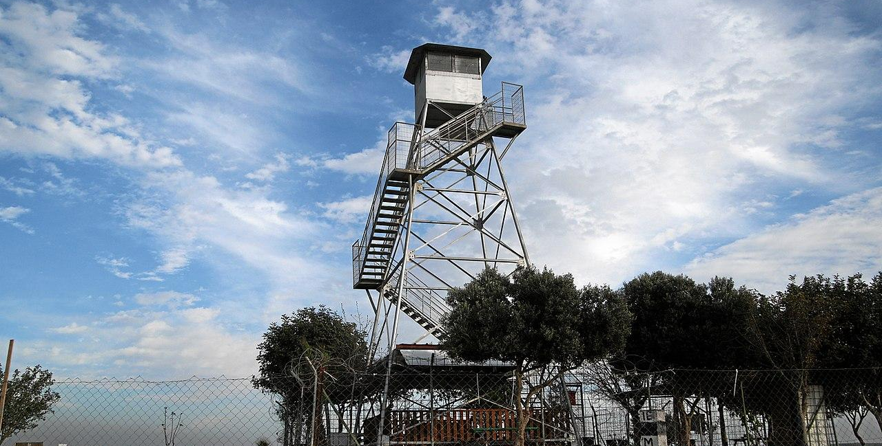
High-level observations
Notes:
- distinguishing data for different purposes that has been mixed in the MARC record
A new vantage point on a vast area… hard to see the patterns when you are in the system, useful to step out of it
Keeping with the forest theme, in orienteering you have destinations that you can get a rough idea of by studying map and compass . handrails (parallel to travel), backstops (you have gone too far)
IMAGE CREDIT:
https://commons.wikimedia.org/wiki/File:Ruhama-fire-lookout-tower.jpg
CC-BY-SA-4.0
Description
English: Ruhama Forest: Fire Watchtower
Date 8 March 2016, 16:34:14
Source Own work
Author Mboesch

Slide 41
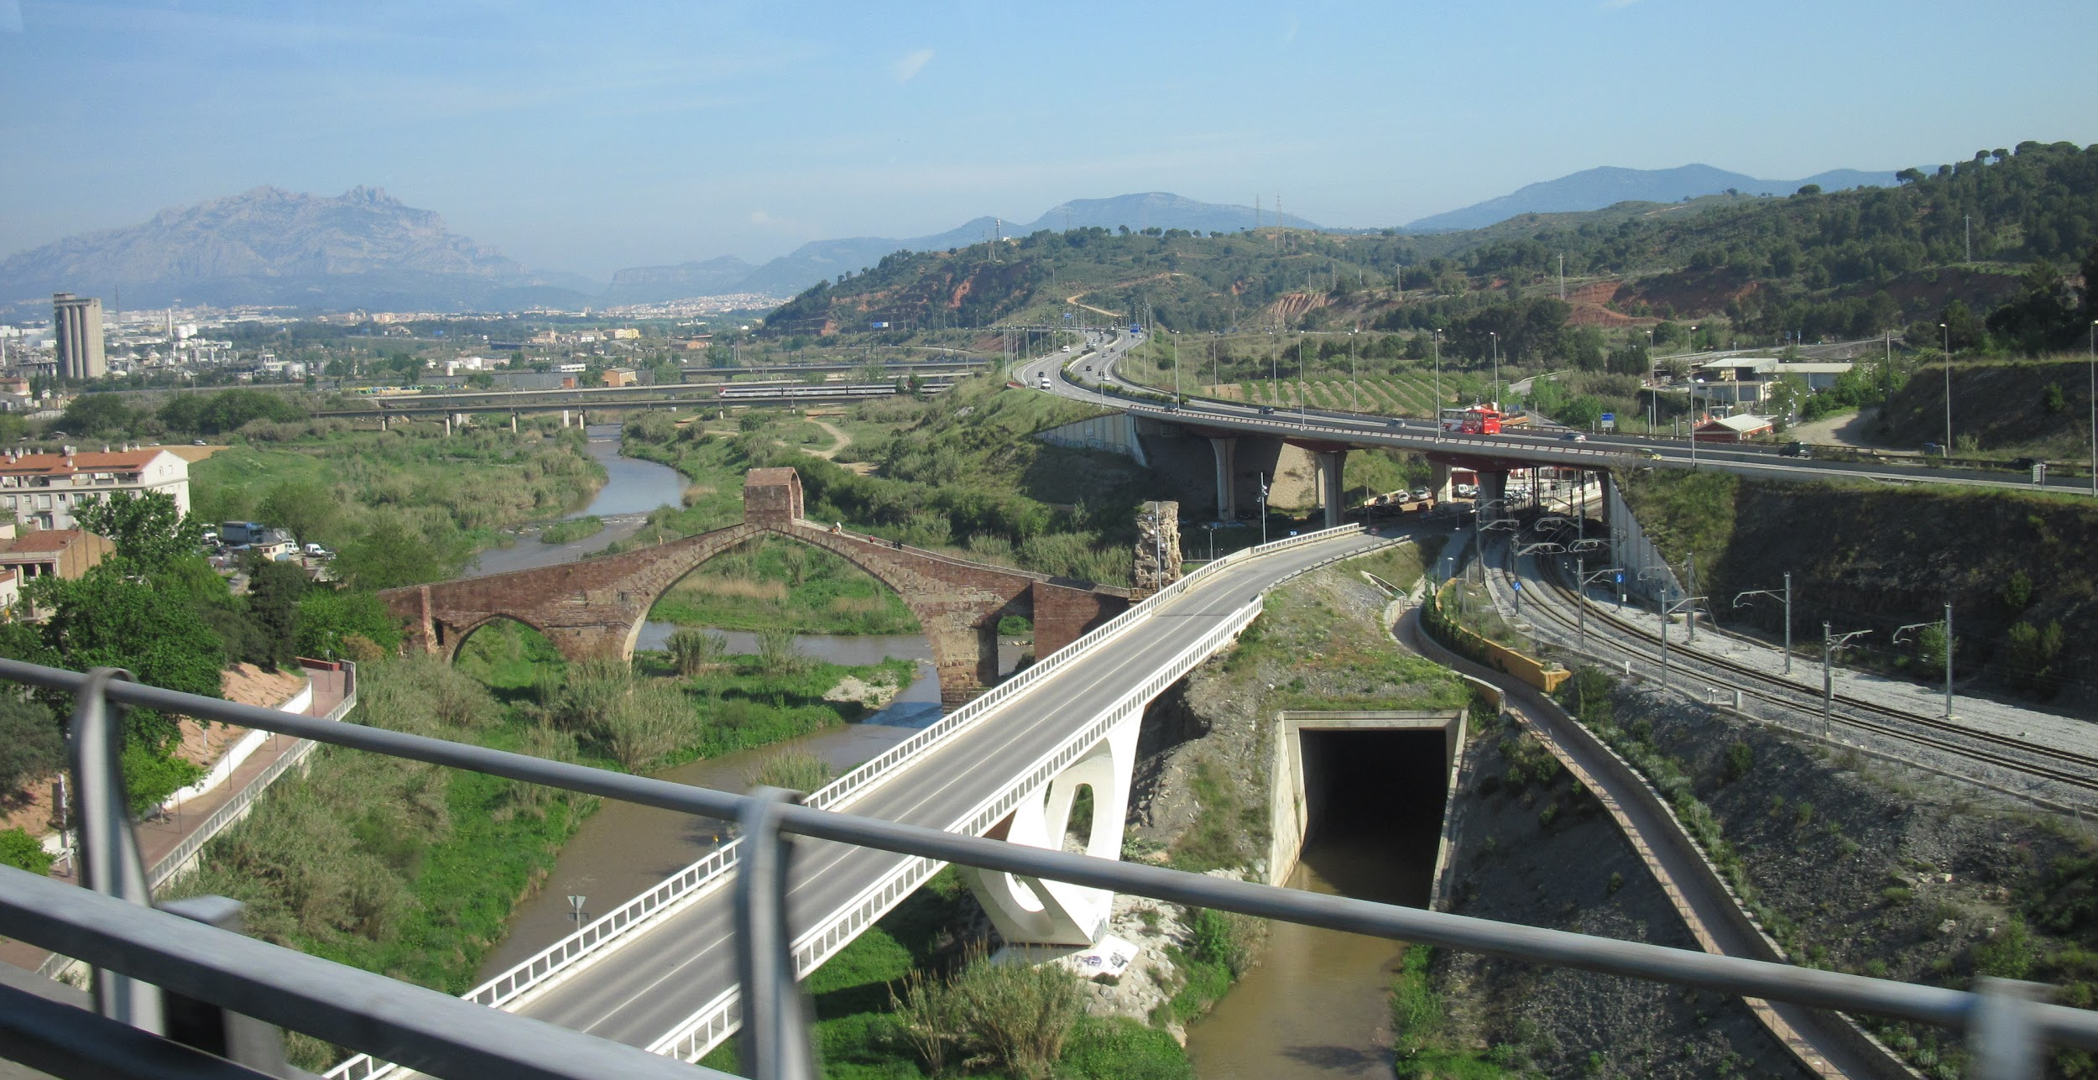
High-level observations
Notes:
Why are handrails/backstops important? time is of the essence. It’s not a race but we do feel a sense of urgency to put shape to this and provide value.
we were able to leverage automation to populate the database, but had to consider what that also suggested in terms of the best use of people’s time. This intersects with the classic “notability” issue.
What’s the best use of a hub? What’s the best use of local systems? If our goal is finding, and our aim is increasing efficiency across the network, what does that recommend?
The indexing of the data, and where one goes to find it, and where it is stored, have big implications
IMAGE CREDIT
https://commons.wikimedia.org/wiki/File:Overpasses_in_Spain.JPG
CC0
Description English: Overpasses in Spain
Date 25 April 2010
Source Own work
Author Владимир Шеляпин

Slide 42
Lessons learned
Notes:
We believe the mixed MARC-Bibframe environment will continue for a while
Need to leverage OCLC's scale and structure to create high-quality entity descriptions
AND stand behind their URIs for the long term – infrastructure provider
Need to deal with even more heterogeneous input/output
Need to build services to allow 3rd-party/library-built to engage with EE
Why do all of this – get discovered!!
IMAGE CREDIT
https://commons.wikimedia.org/wiki/File:Small_Island_in_Lower_Saranac_Lake.jpg
CC-ASA 3.0
Description
Island of Lower Saranac Lake, Adirondack Mountains, New York state, USA
Date 18 October 2007
Source en:Image:Small Island in Lower Saranac Lake.jpg (photographer: en:User:Mwanner)
Author en:User:Mwanner

Slide 43
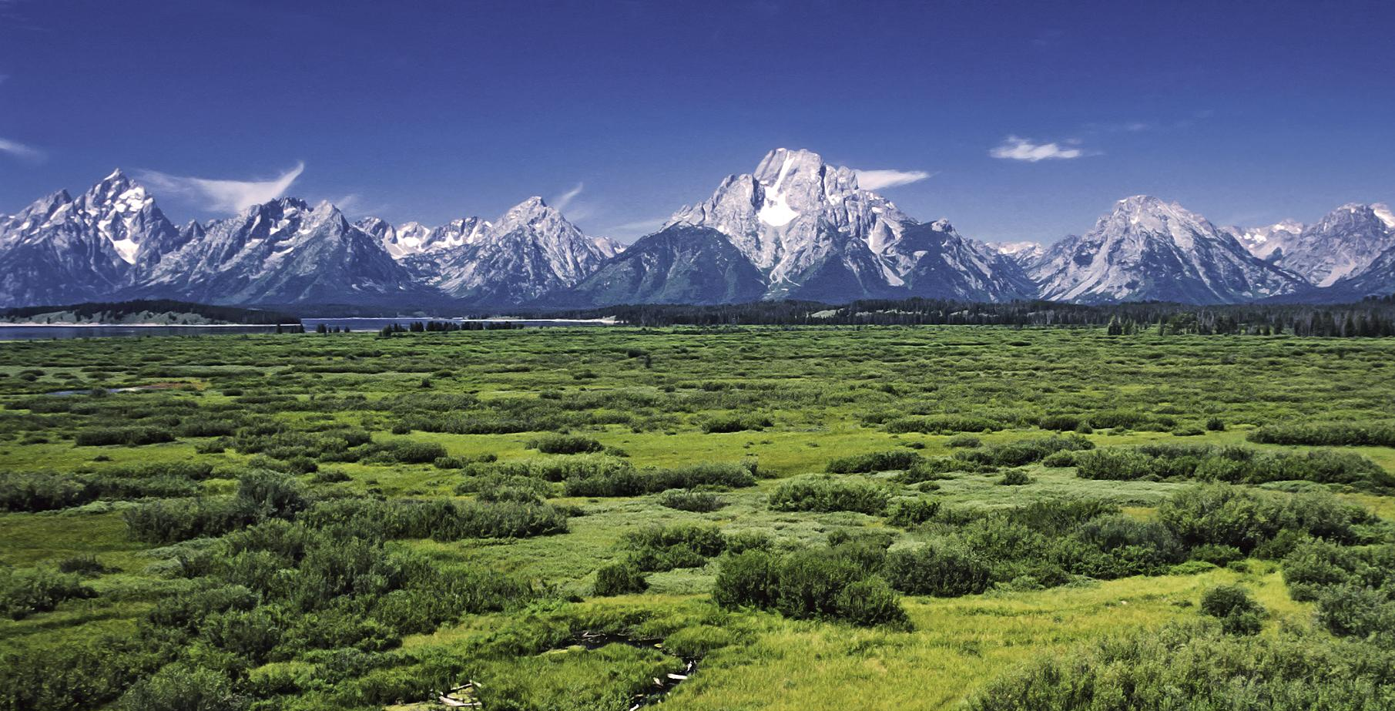
What's next for OCLC products/services?
Notes:
Even before the pilot ended, we engaged with our technical and development teams on how we could put this into broad use.
This work continues and we have milestones this fall.
Can't really announce details but the initial priorities are around building the entity ecosystem, including services for working with it
We will continue to work on interface design
IMAGE CREDIT
https://commons.wikimedia.org/wiki/File:Willow_Flats_area_and_Teton_Range_in_Grand_Teton_National_Park.jpg
CC BY-SA 3.0
Description
English: Jackson Lake Lodge outlook in the Grand Teton National Park, Wyoming, United States. View over the Willow Flats area to the Teton Range with the Mount Moran and his Skillet Glacier (12605 ft) in the middle.
Deutsch: Blick von der Jackson Lake Lodge über das Feuchtgebiet Willow Flats area zu den Gipfeln des Teton Range Gebirges im Grand Teton National Park, Wyoming, USA.
Français : Paysage du parc national de Grand Teton, dans le Wyoming. Le mont Moran est au centre.
Date July 1980
Source Own work
Author Michael Gäbler

