Slide 1
April 2018
The OCLC Mini-Symposium: Research Data Management
Rachel Frick
Executive Director, Research Library Partnership
OCLC Research

Slide 2
Agenda
Welcome And Research Update
The realities of RDM: findings from comparative case studies
Hilde van ZeelandScientific Information Specialist at the Wageningen Data Competence Centre. and
Rebecca Bryant, OCLC Senior Program Officer
The state of RDM at UC San Diego
David Minor, Program Director Research Data Curation University of California, San Diego

Slide 3
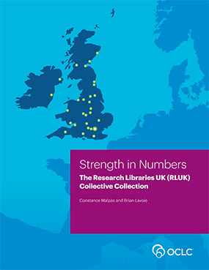
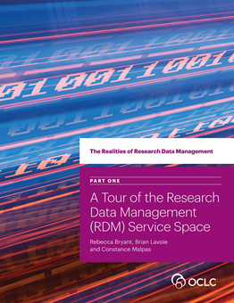
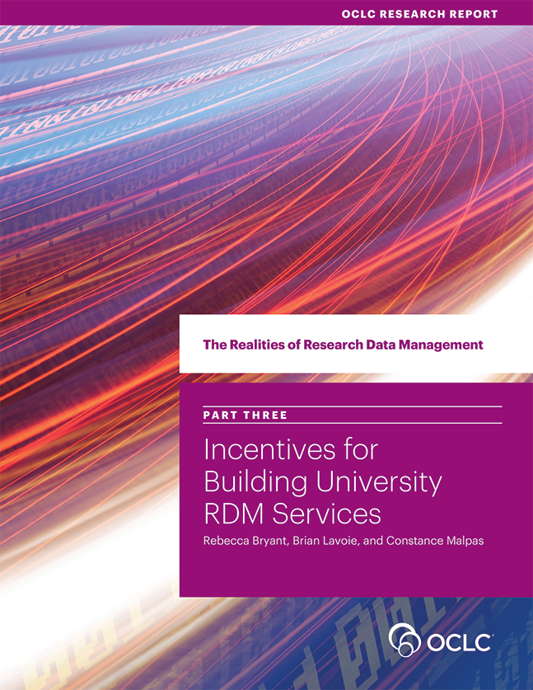
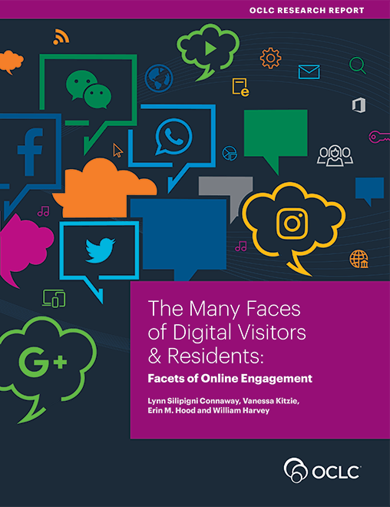
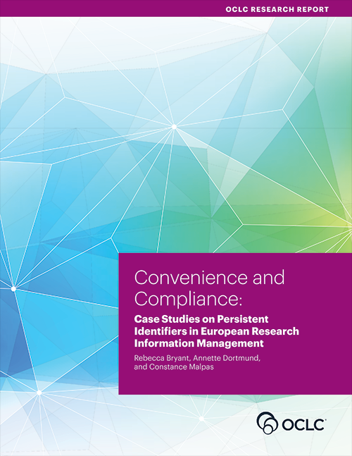
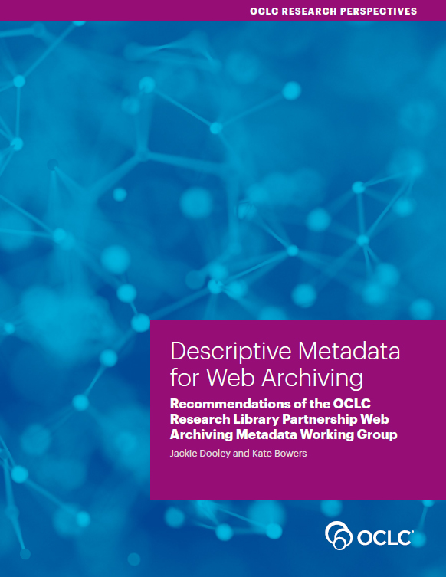
OCLC Research
Scaling and accelerating library learning and innovation.
Notes:
To get started, let me say a few words about OCLC Research. Our purpose is to scale and accelerate learning and innovation. We do this by exploring a range of areas that affect libraries and librarianship, including the aggregation, mining, expansion, and description of bibliographic data, managing and leveraging the collective collection, resource sharing, user studies and the library in the life of the digital user, research data management and research information management, public libraries as community catalysts, online learning networks, and more…The unifying factor among all of those research areas is libraries operating in a networked environment. And we are particularly interested in the sharing and cooperation that can happen through networks, which are not coincidently also the founding principles of OCLC.

Slide 4
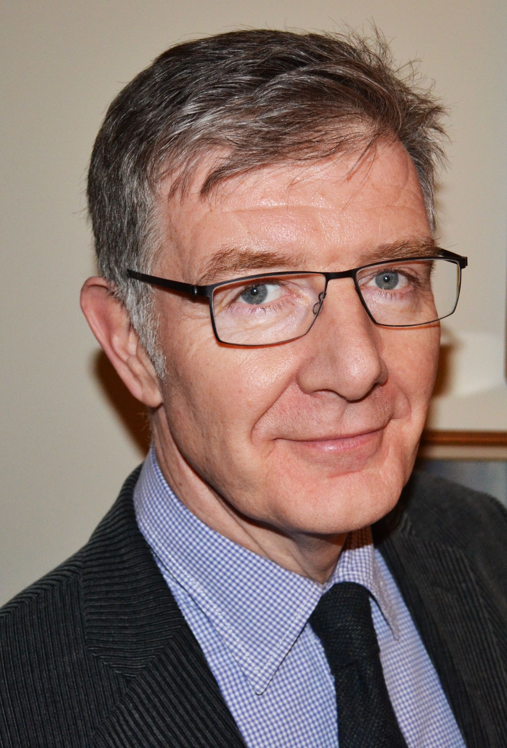
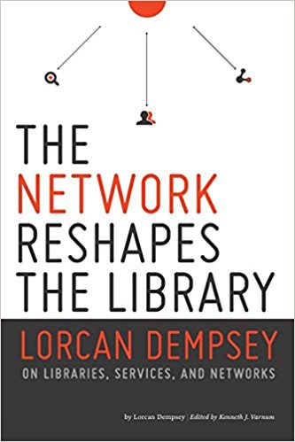
Lorcan Dempsey, VP Research, Chief Strategist

Slide 5
Three trends
Inside out
Facilitated
Collective

Slide 6
Reconfiguration of research work by network/digital environment.
Inside out collection

Slide 7
Reconfiguration of the information space by network/digital environment.
Facilitated
Collection

Slide 8
The specialized collection
Reconfiguration of the information space by network/digital environment.
Facilitated
Collection
The facilitated collection

Slide 9
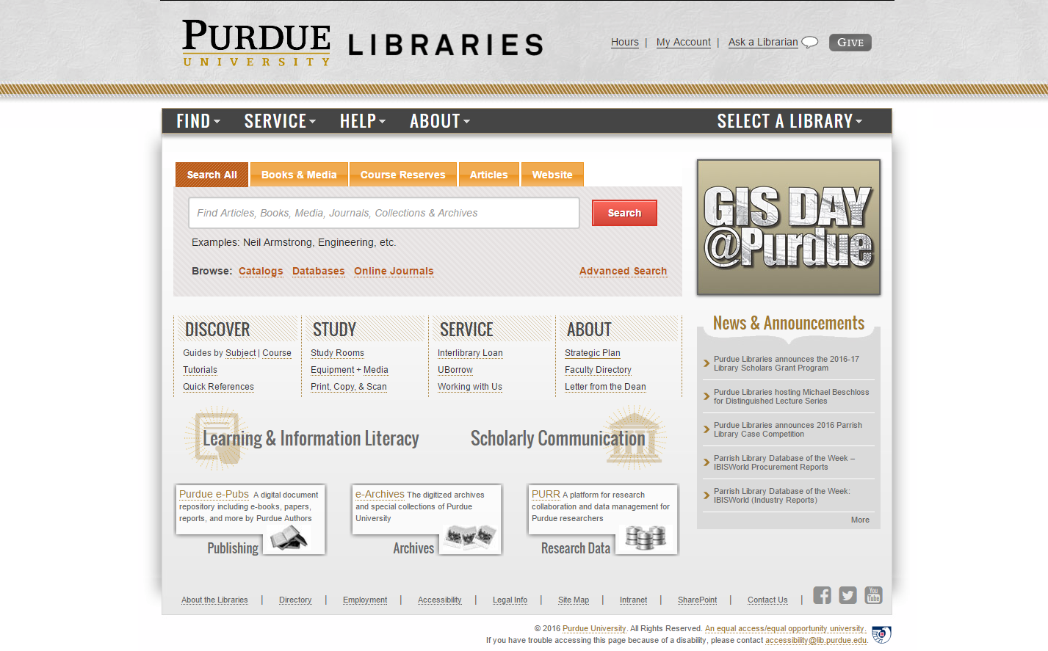
Outside in
Facilitated
Collective
Inside out

Slide 10
The ‘external’ collection:
Pointing researchers at Google Scholar;
Including freely available ebooks in the catalog;
Creating resource guides for web resources.
The ‘borrowed’ collection
The ‘shared print’ collection
The ‘shared digital’ collection
The evolving scholarly record
A collections spectrum
The ‘owned’ collection
The ‘licensed’ collection
The ‘demand-driven’ collection
The ‘facilitated’ collection
Note: Libraries have variable
Investments across the entire
spectrum
Purchased and physically stored
Meet research and
learning needs in best way
@lorcand

Slide 11
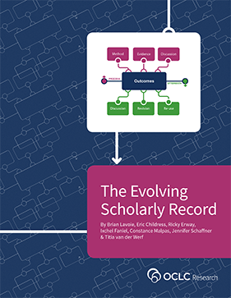
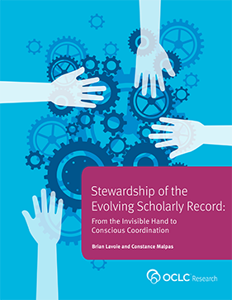
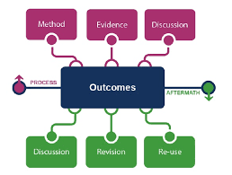
Supporting the creative process: the emerging scholarly record
Increasing volume of content
Increasing diversity and complexity of content
Increasing distribution of custodial responsibility

Slide 12
Creation, management and disclosure:
Vice president for research
R- infra-structure
Medical center
Tech Transfer Office
CIO
News Bureau
Institutional Reporting
Research Data Management
Advancement & corporate relations
Provost
Data Warehouse
RIM/Profiling system
Digital scholarship
LIBRARY
Colleges & depts
Institutional Repository
User education & training
Disciplines & departments
Graduate school
Office of undergraduate research
Researcher
Research manager
Research support
Campus center for teaching & learning

Slide 13
Challenges for Libraries
Better understanding of researcher needs
Advocating the Library role
Interoperability of services and data

Slide 14
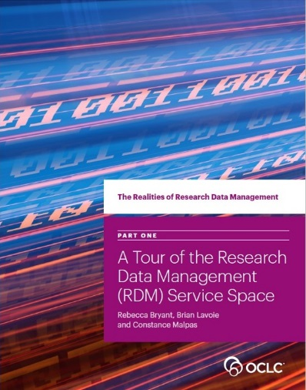
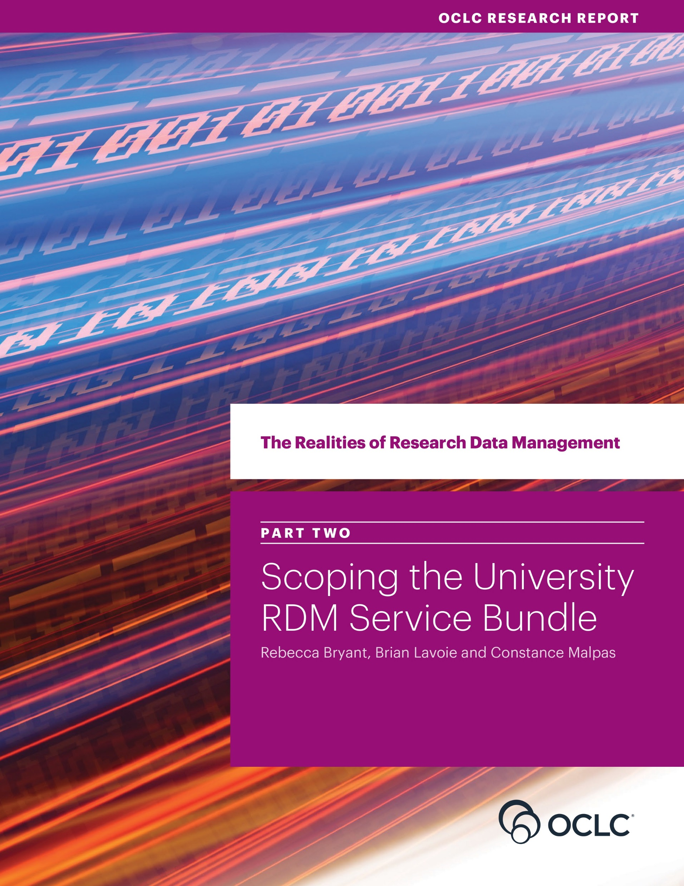
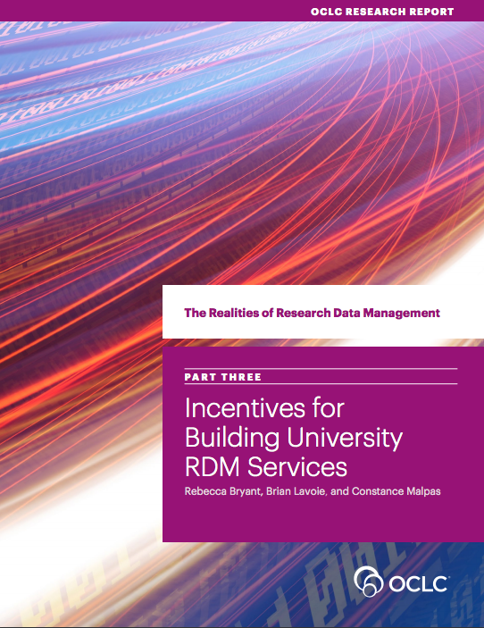

The Realities of Research Data Management
4-part series closely examining the RDM service development at 4 universities:
Edinburgh (UK)
Illinois (US)
Wagenigen (NL)
Monash (AUS)
oc.lc/rdm

Slide 15
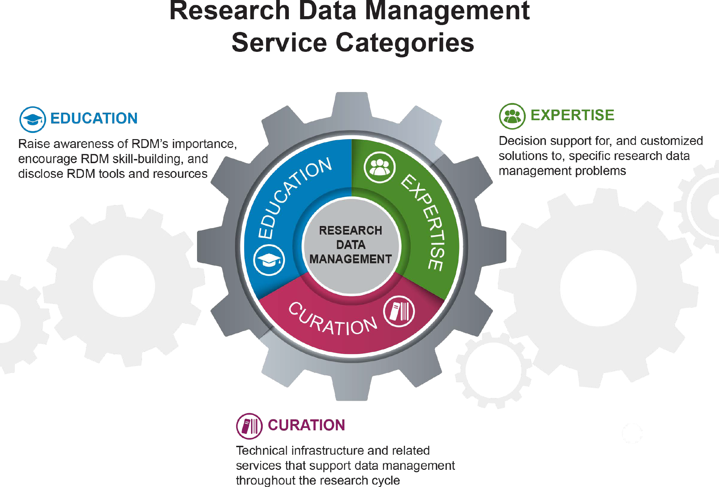
The Realities of Research Data Management
Presents a framework for understanding & discussing the RDM service categories research institutions may choose to offer.
“RDM Service Categories” by OCLC Research, from The Realities of Research Data Management. Part One: A Tour of the Research Data Management (RDM) Service Space (https://doi.org/10.25333/C3PG8J), CC BY 4.0
oc.lc/rdm

Slide 16
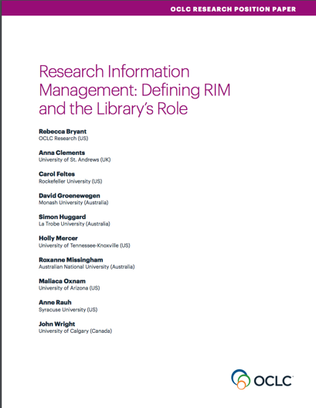
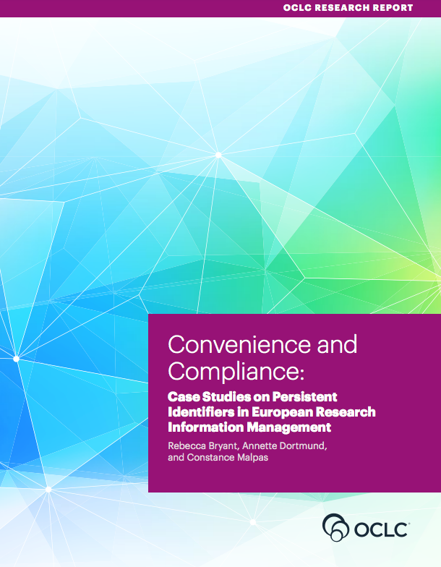

Research Information Management (RIM)
Research Information Management
Survey of Research Information Management Practices
(report coming summer 2018)
oc.lc/rim
Notes:
Recognizing that research information management is of increasing importance for libraries, OCLC Research has been developing a program of research around RIM.
The position paper was developed with an RLP working group comprised of librarians from 3 continents.
The research report on the status of RIM adoption and persistent person and organizational identifiers was research conducted by OCLC Research in collaboration with LIBER.
The Survey on research Information Management Practices is a joint research effort between OCLC Research/RLP librarians and euroCRIS.

Slide 17
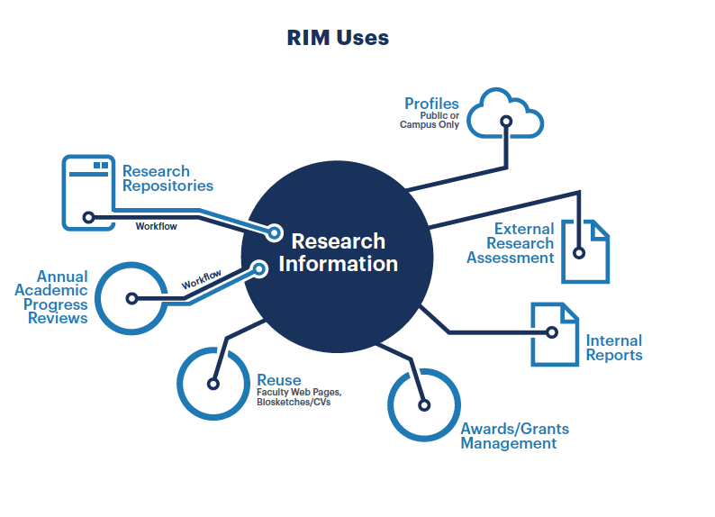
Framework for understanding RIM
Presents a framework for understanding different uses—which vary widely by locale—as part of research information management practice.
oc.lc/rim

Slide 18
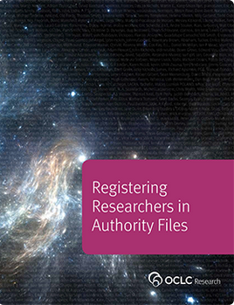
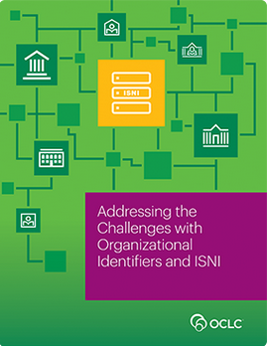
Persistent identifiers
Discusses the value of PIDs in library workflows
Describes challenges and uses for organizational identifiers
Examines the current status of PIDs in European RIM practice
Notes:
University libraries increasingly register the researchers affiliated with their own university and the outputs they produce.
We are working with OCLC Research Library Partners and others to explore new modes of tracking and registering researcher identifiers and compiling their scholarly output.
Registering researchers in some type of authority file or identifier system is becoming more important. The report presents functional requirements and recommendations for different stakeholders (researchers, funders, university administrators, librarians, publishers, etc.). It also provides an overview of the researcher identifier landscape, changes in the field, emerging trends, and opportunities. It is written in collaboration with 14 experts from the field, including your own Melanie Wacker.
More recently, we have looked at organisational identifiers that are needed to validate the affiliation of researchers and that can help disambiguate researchers’ names. The Partner Task froup on Representing Organizations in ISNI identifier also documented the overall challenges in assigning identifiers to organizations; the modeling done can be adapted by others
As a result of OCLC Research’s work in this area and also in the area of linked data, OCLC as an enterprise has gained better insight in the needs of libraries for person reconciliation services.
My colleagues Rebecca Bryant, Constance Malpas and Annette Dormond have been working with LIBER on the adoption and integration of persistent identifiers in European Research Information Management, including interviews with institutions in Finland, German and The Netherlands. That report will be out soon.

Slide 19
Key to Interoperability: Persistent Identifiers
Identifiers are key to research infrastructure inoperability and openness
Identifiers allow for effective/efficient collection, curation and reuse
Use unique, persistent (ideally actionable) identifiers when possible.
Globally unique is good, but if you only have local – that’s ok
Know the role of the identifier in the research workflow – and get involved with the organizations that run them

Slide 20
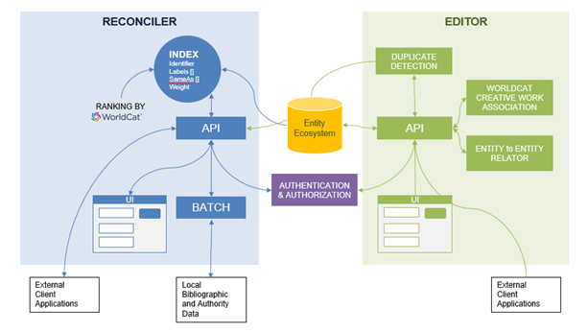
Linked Data Gets Real
Prototype 3 services
reconcile legacy bibliographic information with linked data entities
create and edit new linked data entity descriptions
view relationships between entities
Phase One Complete
1M name entities loaded
WikiBase platform demo
Notes:
Linked Data. In the latter part of 2017, we launched a pilot to demonstrate the production value of linked data services. We have been working with initial partners Cornell University, Montana State Library, and University of California, Davis. The pilot consists of developing an experimental prototype that includes three main linked data services:
a reconciliation service to connect legacy bibliographic information with linked data entities;
a service to create and edit new linked data entity descriptions; and
a service to create and edit relationships between entities.
What we hope to achieve from this pilot is to
Understand the feasibility and scalability of the WikiBase technology, and gain insights into the partnership with the WikiBase community
Complete an analysis of the improved reconciliation of legacy bibliographic data to linked data entities
Discuss the efficacy and efficiency of introducing linked data tools in metadata management workflows; and
Develop use cases to support implementation of the tools into production environments
We have completed Phase 1 of the project, which involved loading 1 million name entities from VIAF, FAST, and WikiData into a centralized data store; and conducting a WikiBase platform demonstration.

Slide 21
Linked Data Gets Real
Phase 2 underway
Launch an entity editor
American University, Brigham Young University, Cleveland Public Library , Gale Cengage
Harvard University, Michigan State University, National Library of Medicine,
North Carolina State University, Northwestern University, Princeton University
Smithsonian Library, Temple University, University of Minnesota,
University of New Hampshire, Yale University, UC-Davis, Cornell
Linked Data Implementers Survey:
About: http://hangingtogether.org/?p=6689
Survey: https://www.surveymonkey.com/r/LinkedDataSurvey2018
Deadline: 25 May
oc.lc/linkeddatasummary
Notes:
We have completed Phase 1 of the project, which involved loading 1 million name entities from VIAF, FAST, and WikiData into a centralized data store; and conducting a WikiBase platform demonstration.
And have begun Phase 2, which entails launch of an entity editor,
New Partners:

Slide 23
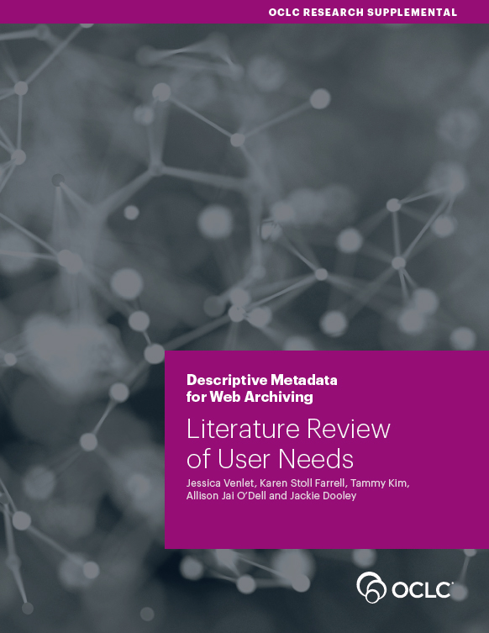
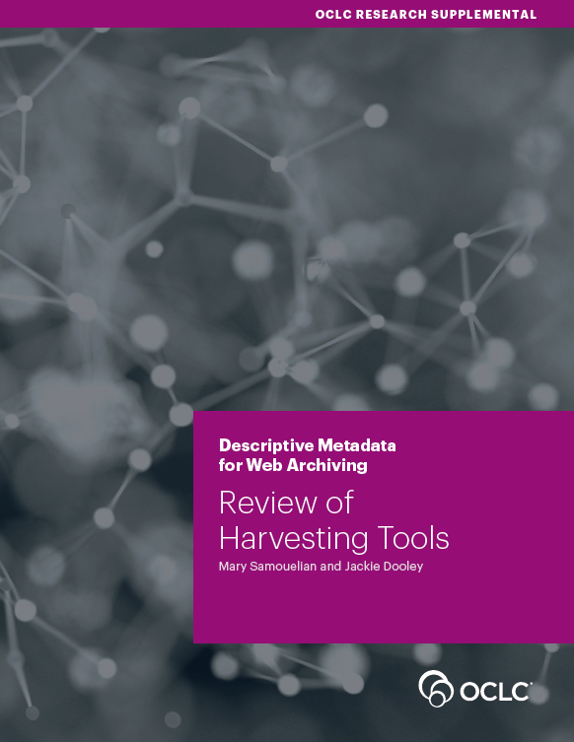
Descriptive Metadata for Web Archiving
Recommendations for descriptive metadata
User needs, with annotated bibliography
Tools analysis, with evaluation grid
oc.lc/wam

Slide 24
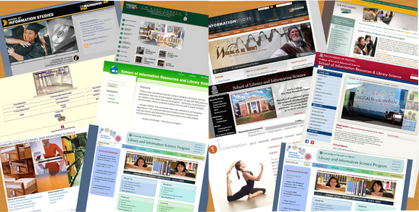
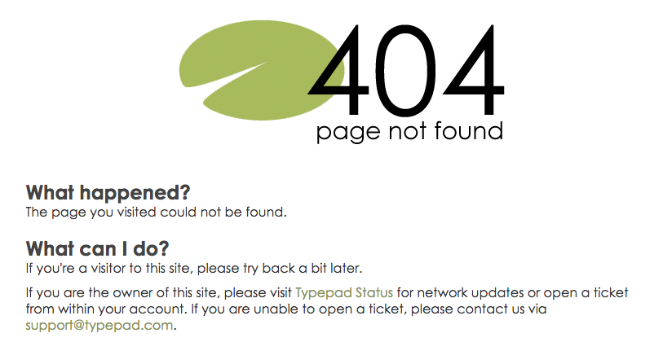
Web Archiving Metadata Working Group 2016-2017
Evaluate approaches to descriptive metadata
Synthesize user needs and behaviors
Recommend community- and output-neutral best practices for metadata that meet user needs
Develop data dictionary
Evaluate available tools
Notes:
““Web archiving operates at the frontier of capturing and preserving our cultural and historical record.” – British Library web archive blog, 2016-09-14
A 2015 survey of members of the OCLC Research Library Partnership revealed the lack of descriptive metadata guidelines as the biggest challenge related to website archiving among this cohort. The second most-cited challenge is to learn about the needs of users who seek to use website content in their work.
The Working Group conducted two literature reviews: identified and gathered about 33 (user needs) and 23 (metadata) articles, reports, blog posts, conference presentations, and social media exchanges that were related to user needs and/or metadata issues for web archives.
From abstracts they created synthesis of findings based on some main topics that emerged from readings.
Studying users’ needs is a necessary prelude to developing metadata best practices. Noted that users are not often aware that libraries harvest and archive web content. Working Group focused on who uses web archives, how and why do they use them, and what can libraries do to support users’ needs. Users of web archives are – academic researchers, legal researchers, digital humanists, data analysts, web and computer scientists. They have different uses and needs of web archives: reading specific web pages/sites; data and text mining; technology development.
The recommended best practices for web archiving metadata also need to ensure discoverability and consistency. The working group is developing a data dictionary – a set of data elements with the scope of each defined.

Slide 25
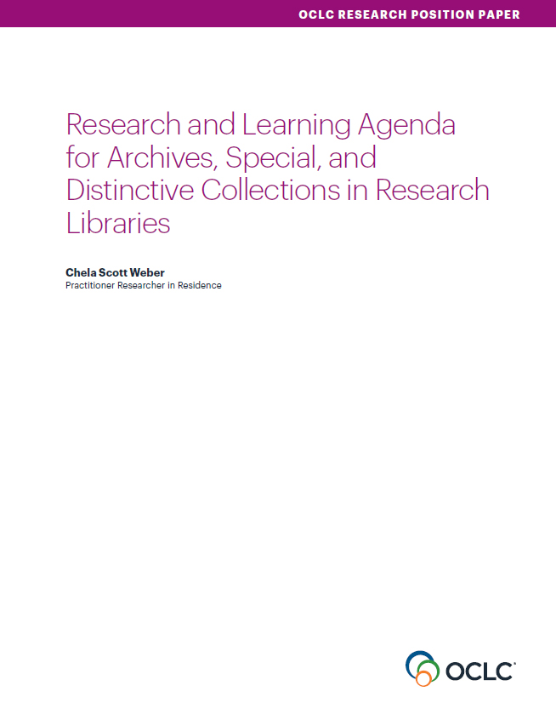
Areas of Investigation
Convergence of Special Collections and the Research Library
Advocating for Archives and Special Collections
Next Steps for Born Digital
Access Needs
Evolving Systems Environments
Stewardship and Collection Development
Engaging the Challenge of Diversifying Collections
https://www.oclc.org/research/publications/2017/oclcresearch-research-and-learning-agenda.html

Slide 26
Types of Work
In-depth Research
helps establish or define current status, or illuminate an ill-defined area of need, such as surveys or other intensive data gathering activities, with analysis and synthesis of that data
Community Exploration
convening to examine specific issues, facilitating an ongoing discussion group to connect practitioners around evolving area of work, or gathering case studies that can point to shared issues or best practices
Practical Advice
practical guidance for on-the-ground practice, highlighting current projects that employ smart tactics
Notes:
The types of work to be undertaken vary across the agenda, as appropriate to the current understanding of each problem space and level of community interest. Some issues are in need of in-depth exploration before further work can be identified, while others are already well defined and will be best addressed by practical guidance.

Slide 27
Contributions from the RLP network
Sharon E. Farb, UCLA Tom Hyry, Harvard University Athena Jackson, Pennsylvania State University Michelle Light, University of Nevada, Las Vegas Erin O’Meara, University of Arizona Hillel Arnold, Rockefeller Archive Center Elvia Arroyo-Ramirez, Princeton University Paul Constantine, University of Washington Jarrett Drake, Princeton University Audra Eagle Yun, University of California, Irvine Max Eckard, University of Michigan Patrick Galligan, Rockefeller Archive Center Bonnie Gordon, Rockefeller Archive Center Bergis Jules, University of California, Riverside Elizabeth Kaplan, George Washington University Mark Matienzo, Stanford University Megan McShea, Smithsonian Institution Don Mennerich, New York University Courtney Mumma, Texas Digital Library Christie Peterson, George Washington University Dallas Pillen, University of Michigan Anne Sauer, Cornell University Sibyl Schaefer, University of California, San Diego Michael Shallcross, University of Michigan Steven Villereal, University of Virginia Bethany Anderson, University of Illinois Martin Antonetti, Northwestern University Alexis Antracoli, Princeton University Lisa Carter, The Ohio State University Martha Conway, University of Michigan Jillian Cuellar, UCLA Andra Darlington, Getty Research Institute Timothy DiLauro, Johns Hopkins University Mark Dimunation, Library of Congress Maria Estorino, University of North Carolina, Chapel Hill Meredith Evans, Jimmy Carter Presidential Library and Museum Valerie Gillispie, Duke University Ben Goldman, Pennsylvania State University Carrie Hintz, Emory University Polina Ilieva, University of California, San Francisco Petrina Jackson, Iowa State University Jennifer Jones, Minnesota Historical Society Kris Kiesling, University of Minnesota Bill Landis, Yale University Francesca Marini, Texas A&M University Jennifer Meehan, Emory University Corey Nimer, Brigham Young University Meg Phillips, National Archives and Records Administration Lynn Ransom, University of Pennsylvania Janice Ruth, Library of Congress T-Kay Sangwand, UCLA Dan Santamaria, Tufts University Matthew Sheehy, Brandeis University Cyndi Shein, University of Nevada, Las Vegas Jordon Steele, Johns Hopkins University William Stingone, New York Public Library Cherry Williams, University of California, Riverside

Slide 28
Get Involved!

Slide 29
OCLC Research Library Partnership
The OCLC Research Library Partnership provides a unique transnational
collaborative network of peers to address common issues as well
as the opportunity to engage directly with OCLC Research

Slide 30
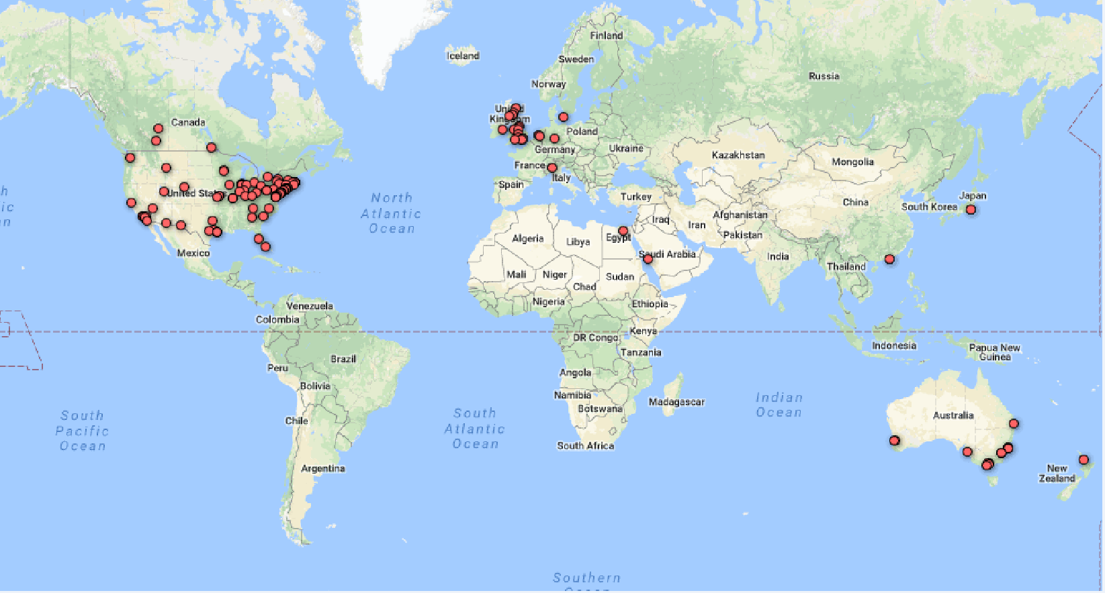
The Partnership Network
25 of top 30 universities in Times Higher Education Ranking
Notes:
Of the 150 or so institutions affiliated with the OCLC Research Library Partnership, one-third are located outside the United States.

Slide 31
Our focus
Unique and distinctive collections
Serving the research mission: Research information management / research data management
Shared collections: resource sharing and the future of shared print
Making metadata work harder
Equity, diversity, and inclusion

Slide 32
Methods
Outputs:
Publications
Webinars (recorded)
Presentations
Working Groups
Webinars, WebEx discussions
“Works in Progress” Webinars featuring Partners
Face-to-face meetings
Prototypes
Notes:
The OCLC Research Library Partnership is part of the “Membership and Research” division at OCLC. I am focusing today on the work program officers do in collaboration with working groups drawn from the OCLC Research Library Partnership.

Slide 33
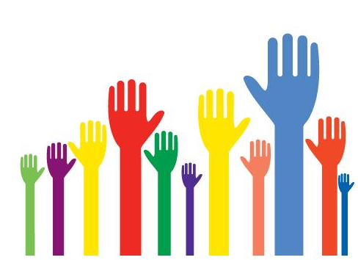
Engagement opportunities
Contribute to standing Partner groups of your peers:
SHARES
Metadata Managers Focus Group
Watch for new working groups soliciting members on the OCLCRLP-ANNOUNCE-L list
Participate in Partners-only Webinars and events
Share your own “Work in Progress” in a Webinar
Join a Partner email list
Guest blog on HangingTogether.org
Want a consultant? Contact your liaison, Karen Smith-Yoshimura

Slide 34






Channels for keeping current
http://www.oclc.org/research
https://twitter.com/OCLC/lists/oclc-research
https://www.facebook.com/OCLCResearch
http://www.slideshare.net/oclcr
http://hangingtogether.org/
http://youtube.com/oclcresearch

Slide 35
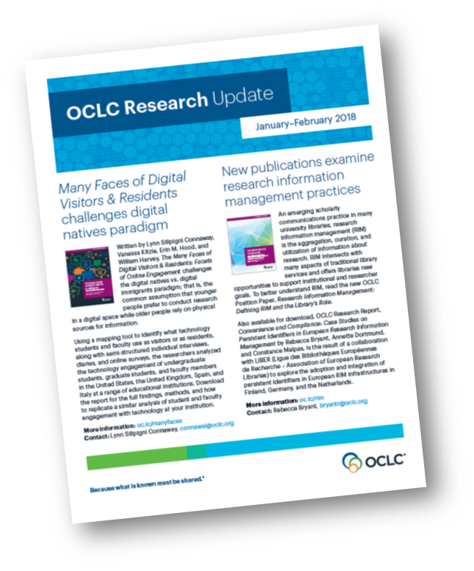

Thank you!
©2018 OCLC. This work is licensed under a Creative Commons Attribution 4.0 International License. Suggested attribution: “This work uses content from “Data Designed for Discovery” © OCLC, used under a Creative Commons Attribution 4.0 International License: http://creativecommons.org/licenses/by/4.0/.”

