Slide 1
Lynn Wexler
Reference Librarian
Hirsch Library, Museum of Fine Arts, Houston

Slide 2
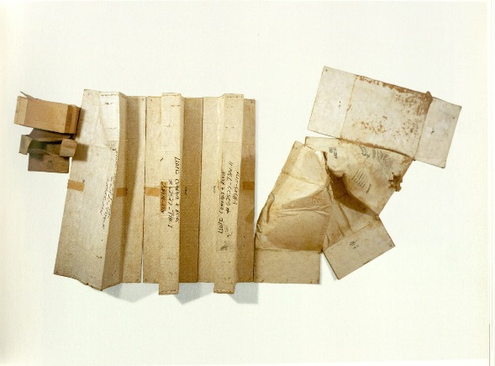
USPS Free Tracking: Is it worth the risk?
Maybe. Maybe not.
Cat. 29. Rauschenberg, Robert (1971) Baton Blanche, cardboard. From Robert, Rauschenberg: Cardboards and Related Pieces (pg. 57), by Yve-Alain Bois et al., 2007, New Haven: Yale University Press.

Slide 3
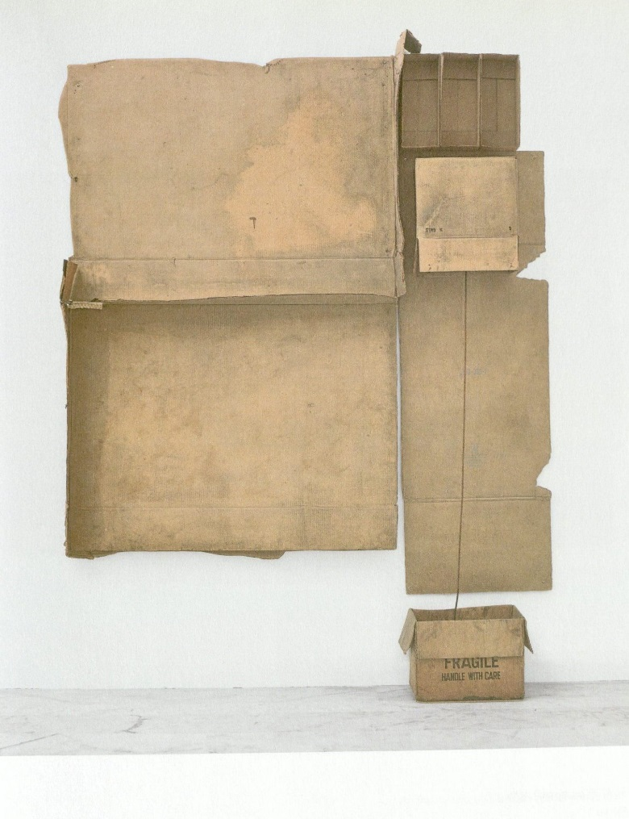
USPS Free Tracking Experience
Tracking information ambiguous
Tracking service unreliable
Cat. 10. Rauschenberg, Robert (1971) 1/2 Gals. / AAPCO, cardboard. From Robert, Rauschenberg: Cardboards and Related Pieces (pg. 38), by Yve-Alain Bois et al., 2007, New Haven: Yale University Press.

Slide 4
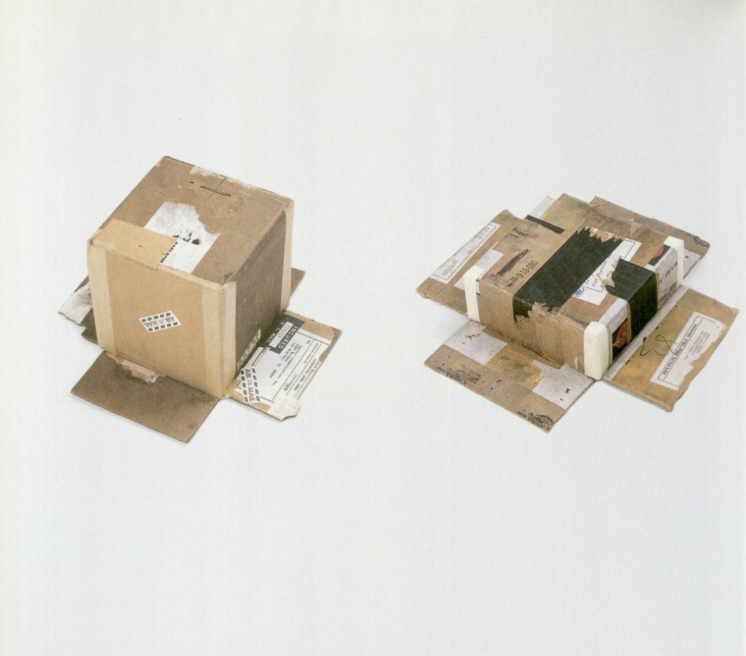
Happy Ending
ILL item found in stacks
Cat. 45 and 46. Rauschenberg, Robert (1971) Cardbird Box I and Cardbird Box II, cardboard. From Robert, Rauschenberg: Cardboards and Related Pieces (pg. 64), by Yve-Alain Bois et al., 2007, New Haven: Yale University Press.

Slide 5
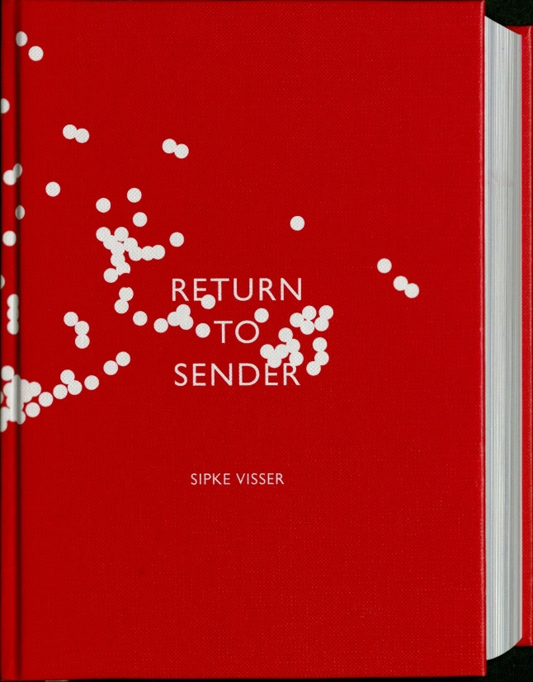
Lesson Learned
Is it worth the risk?
Maybe it is.
Maybe not.
You decide.
Cover. From Return to Sender by Sipke Visser, 2013, London: S. Visser.

