Slide 1

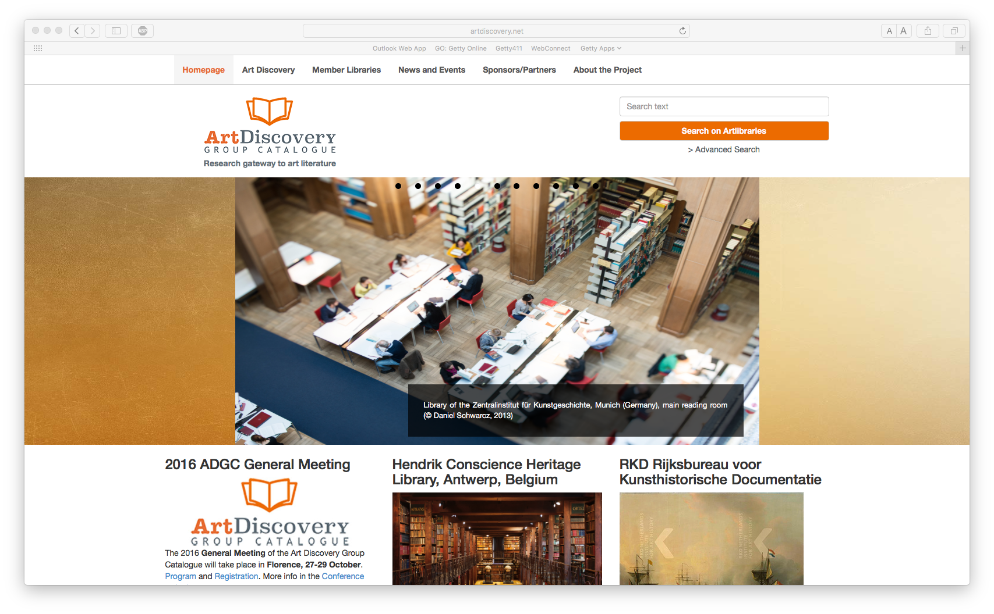
http://artdiscovery.net
Art Discovery Group Catalogue
Update ARLIS/NA 2017
Notes:
Replaced artlibraries.net as union catalog for the international art library community…with added value of other resources
Came out of the FAB project
Product of OCLC EMEA
Free resource for the community, with fees for participation, depending on if is an OCLC member or not

Slide 2
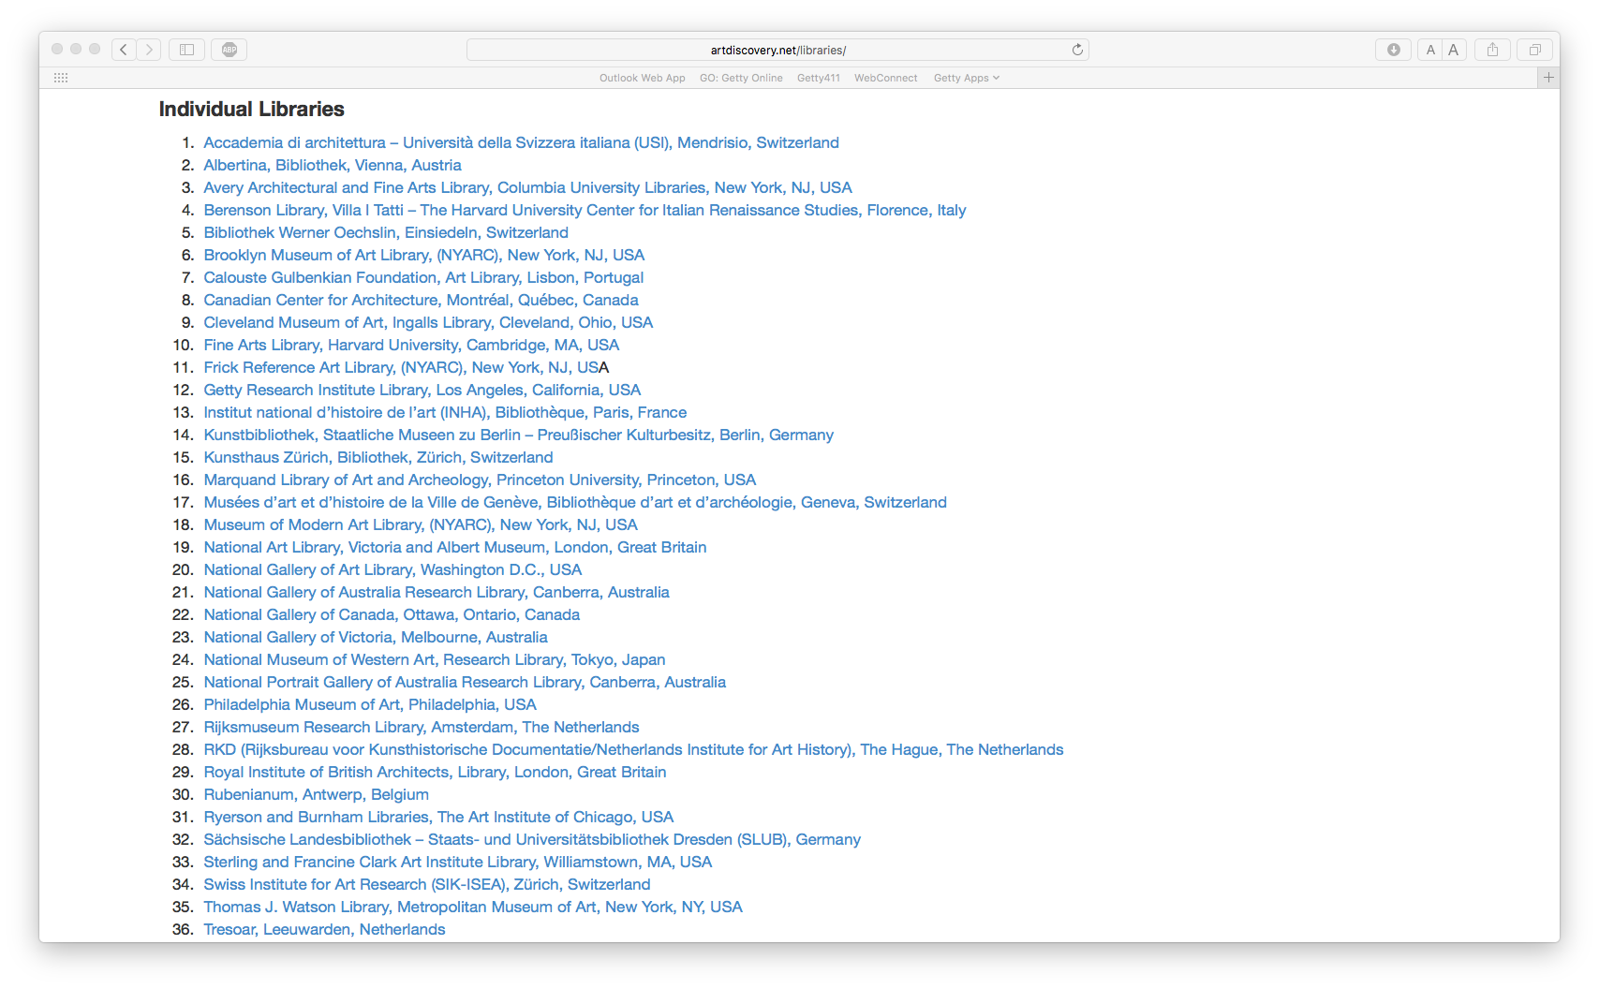
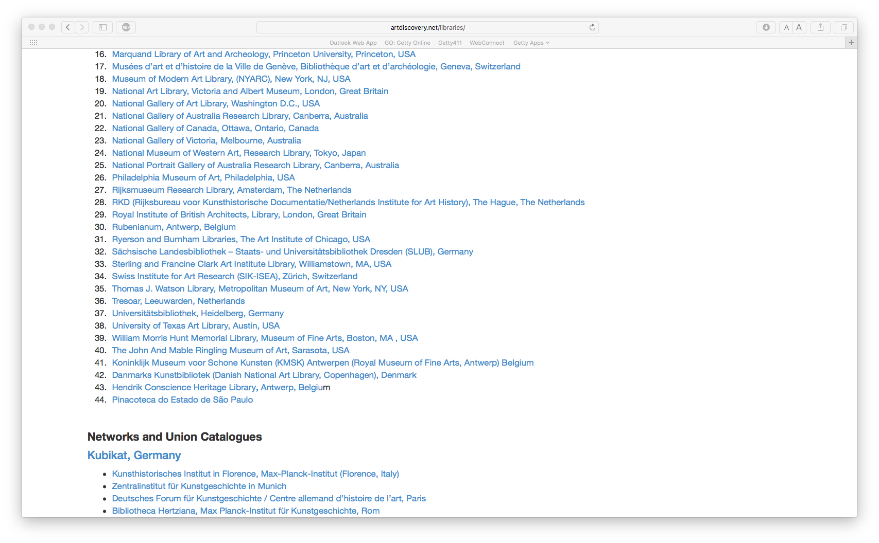
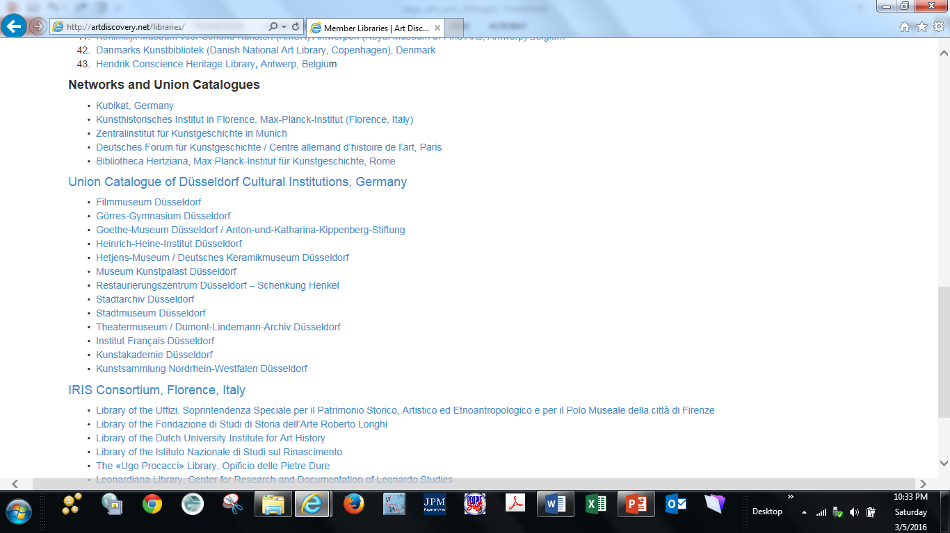
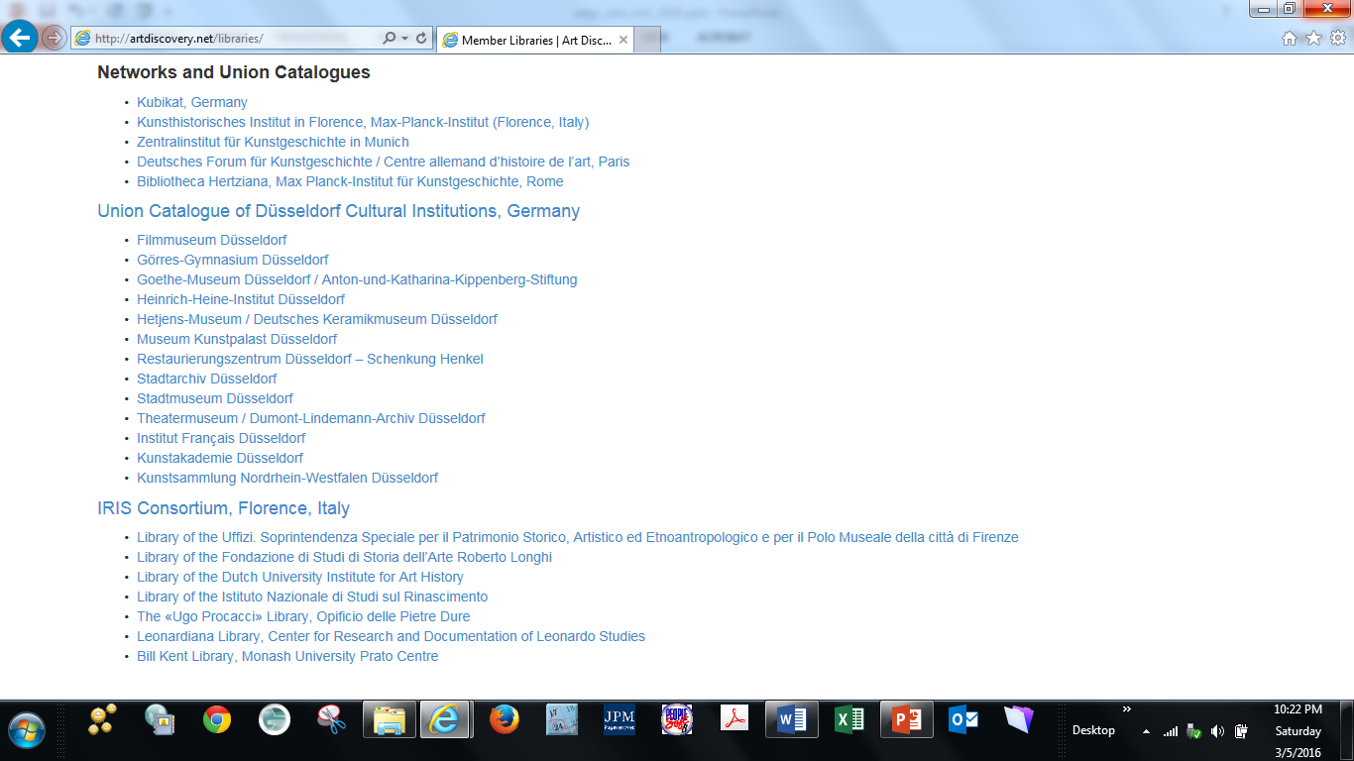
Notes:
Current libraries, including those seven and IRIS consortium added by Kress grant

Slide 3
New and pending members
  Pinacoteca di Sao Paolo, Brazil
  Polimoda International Institute of Fashion Design and Marketing, Florence
  Danish National Art Library
  RKD-Netherlands Institute for Art History, The Hague
  Royal Museum of Fine Arts, Antwerp
  Hendrik Conscience Heritage Library, Antwerp
  Bibliothèque du Musée des Arts Décoratifs, Paris
  Polish Academy of Sciences Art Institute in Warsaw, Poland
  Warburg Institute, London
Notes:
New members are always welcome
Pricing ranges from $370 to $927 annually for libraries already in OCLC depending on size
Cost is more for those needing to load records into OCLC

Slide 4
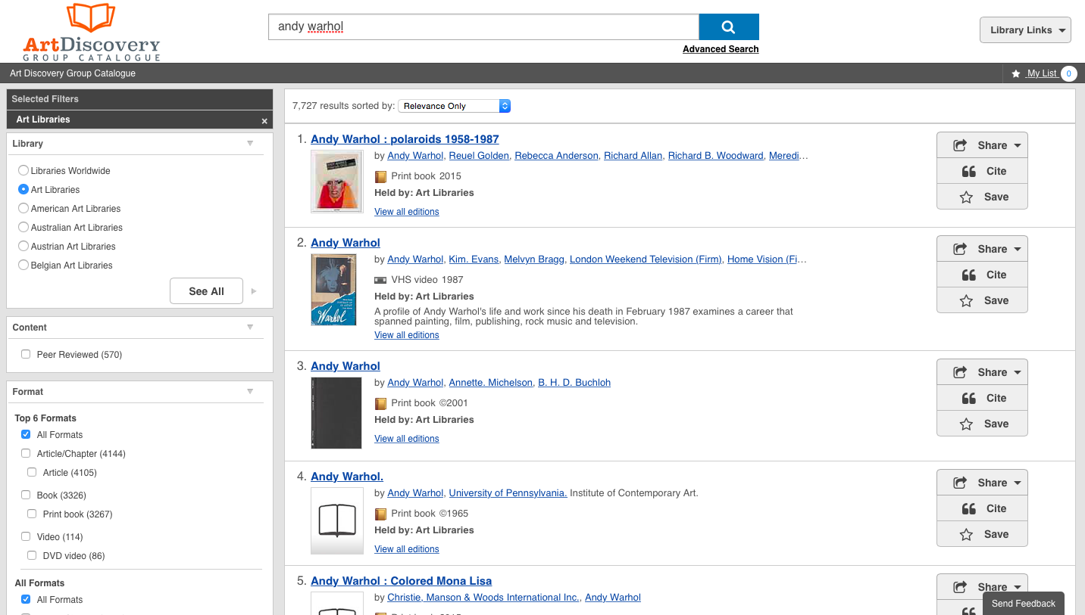
Features (SB)
Notes:
Art-scoped view of WorldCat
Filtering based on holdings of participating art libraries—those items more likely to be of interest to art researchers
Wide variety of materials included—books, films, websites, images, etc.
Narrow to a subset of art libraries—e.g., by country or by art libraries NOT in universities
Narrow on various other facets, e.g., format, language, peer reviewed
Broaden results to Libraries Worldwide to compare with a general WorldCat search

Slide 5
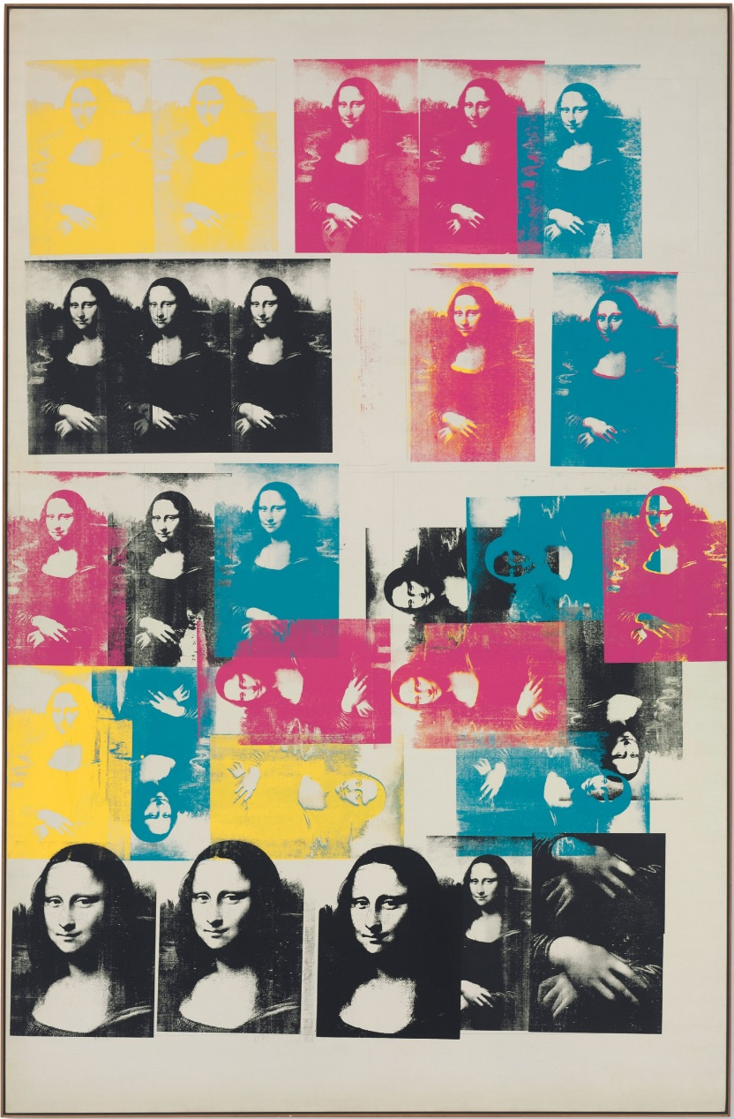
Features (SB)
Notes:
New content is being added to OCLC through the ADGC project
Many premier art libraries that were never in OCLC
SCIPIO database, e.g., result no. 5 is an individual auction record in the Scipio database

Slide 6
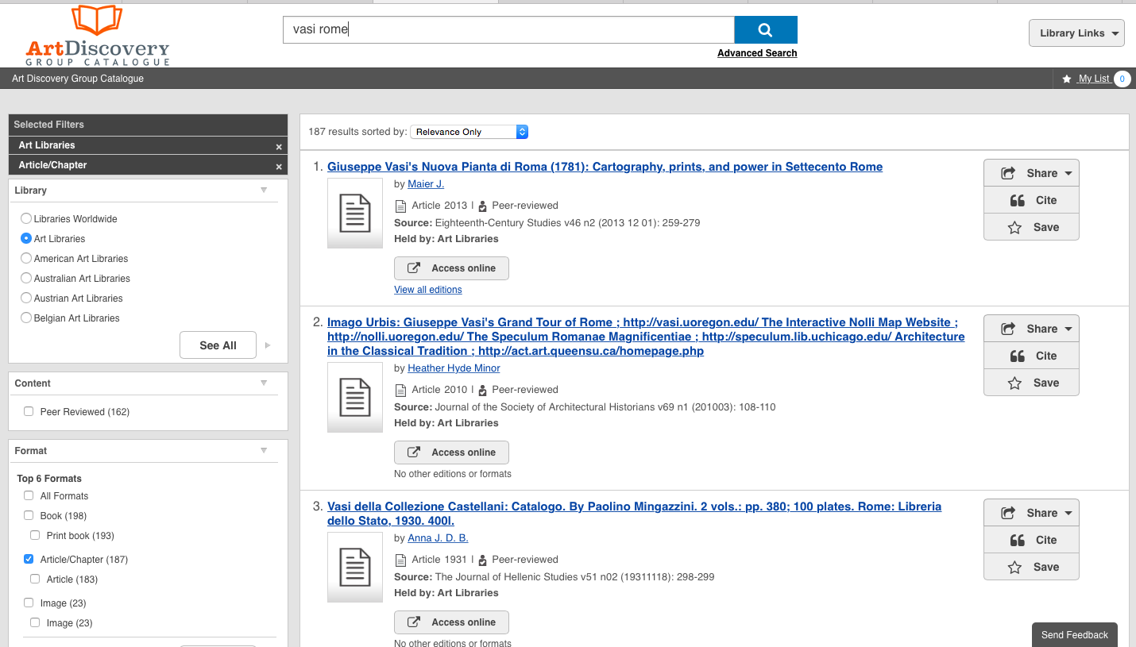
Features (SB)
Notes:
Search base includes metadata for millions of records in OCLC’s vast Central Index
Analytic records appear if a member library has holdings for the journal or at the analytic level—sometimes this is a “false drop”. Have added a menu option at the bottom of the list that excludes universities but need your feedback on if this is effective.
KUBIKAT another resource added through ADGC project—rich and growing database of art journal analytic records, including current and legacy journals not in Art Index or IBA
Tool for discovery and research
Tool for collection development and management

Slide 7
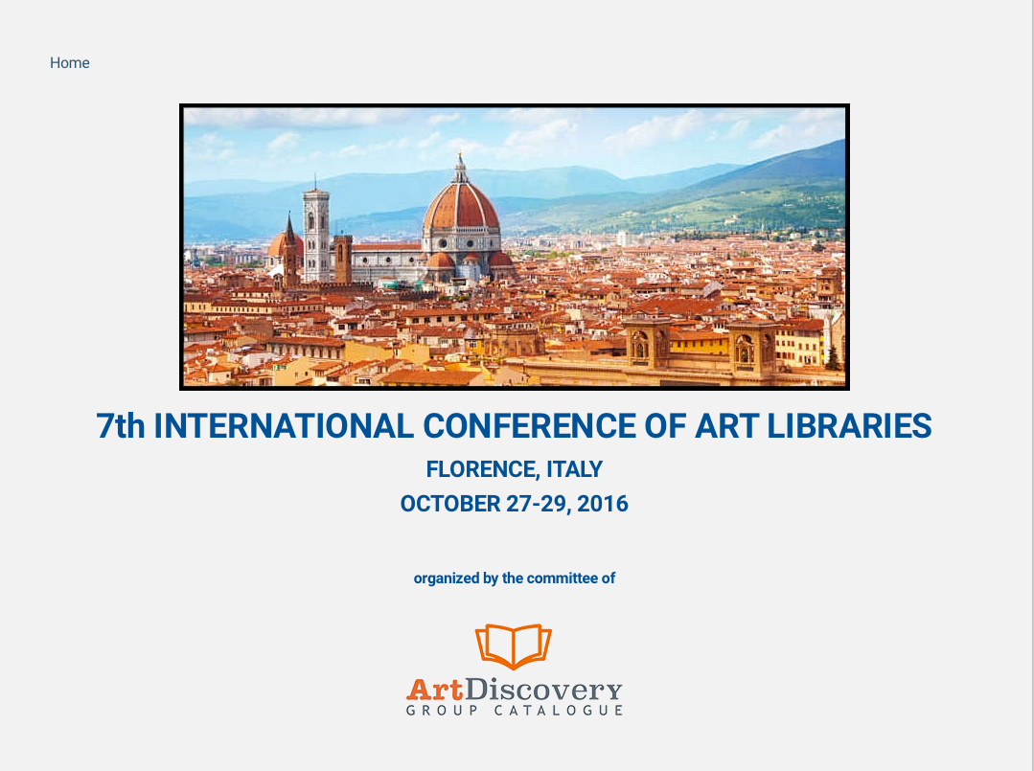
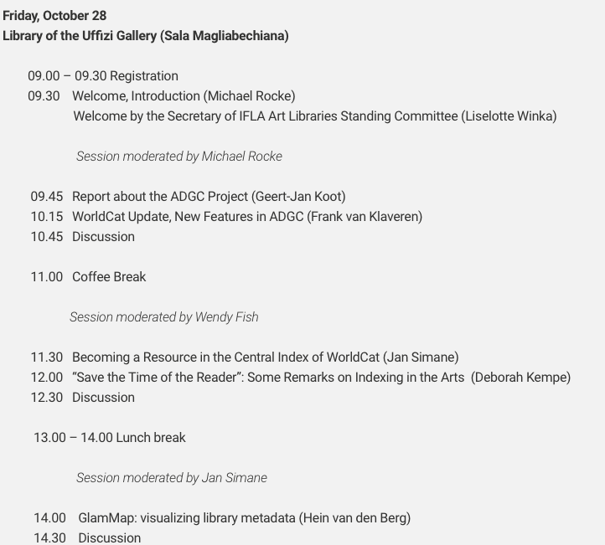
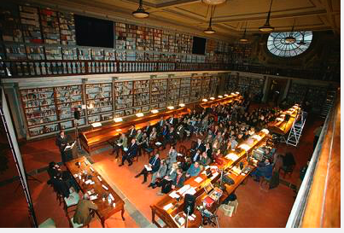
Notes:
Florence conference last fall
Opportunity to assess progress since 2013

Slide 8
Post-ADGC conference survey results: feedback
…an extraordinarily important project in which all relevant art libraries must be represented
…It has succeeded in being a focal point for bringing together art librarians together to discuss our profession and the future of art bibliography in general.
…a great and outstanding project but still not completely mature in its development.
It feels like something that only the 'big boys', ie. large academic, research and/or national museums can contribute to because of the lack of resources in many smaller, European libraries.
Notes:
Affirmed the project’s potential
Also that it is very much a WORK IN PROGRESS

Slide 9
Post-ADGC conference survey results: needs improvement
…too much noise in the result lists.
…more important databases should be added (BHA, RILA, ASCO, etc.)
…the website should be updated more frequently.
…it should be more advertised
…have the interface and webpages available in other languages
...need more non-european and non-american libraries, whose holdings would clearly enrich the catalogue. This might help to raise the attraction of the catalogue, by not only acquiring new data but also new users.
Notes:
OCLC EMEA is committed to the project
Can see that in Europe LOADING the libraries in OCLC is still unusual and there are some resource concerns
Still, many in the US and abroad are Interested in innnovative developments, e.g., a CatVIS project for mining the ADGC dataset
With visual display of results for non-traditional queries, e.g., the geographic distribution of literature in a particular field of art history
Feedback from YOU and YOUR PATRONS is what the project most needs
Interested in innnovative developments, e.g., a CatVIS project for mining the ADGC dataset
With visual display of results for non-traditional queries, e.g., the geographic distribution of literature in a particular field of art history
Feedback from YOU and YOUR PATRONS is what the project most needs

Slide 10
Next steps and future plans
Develop and conduct usability study and user survey to share with community
Add non-European and non-American art libraries
Add more unique content, such as BHA, ASCO, Arkyves
Work with OCLC EMEA on improvements to interface

Slide 11
  Questions?
  ADGC committee members in New Orleans this week:
  Sandra Brooke (sbrooke@Princeton.edu)
  Deborah Kempe (kempe@frick.org)
  Kathleen Salomon (ksalomon@getty.edu)

