Slide 1
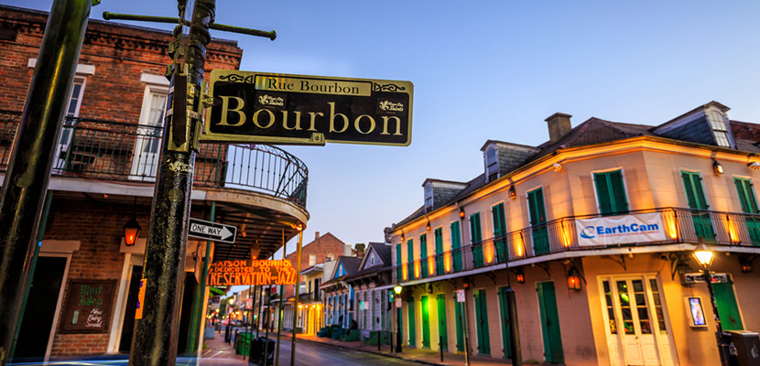
2017 OCLC Round Robin Round-Up

Slide 2
Who responded?
8 total; 7 museums and the Getty

Slide 3
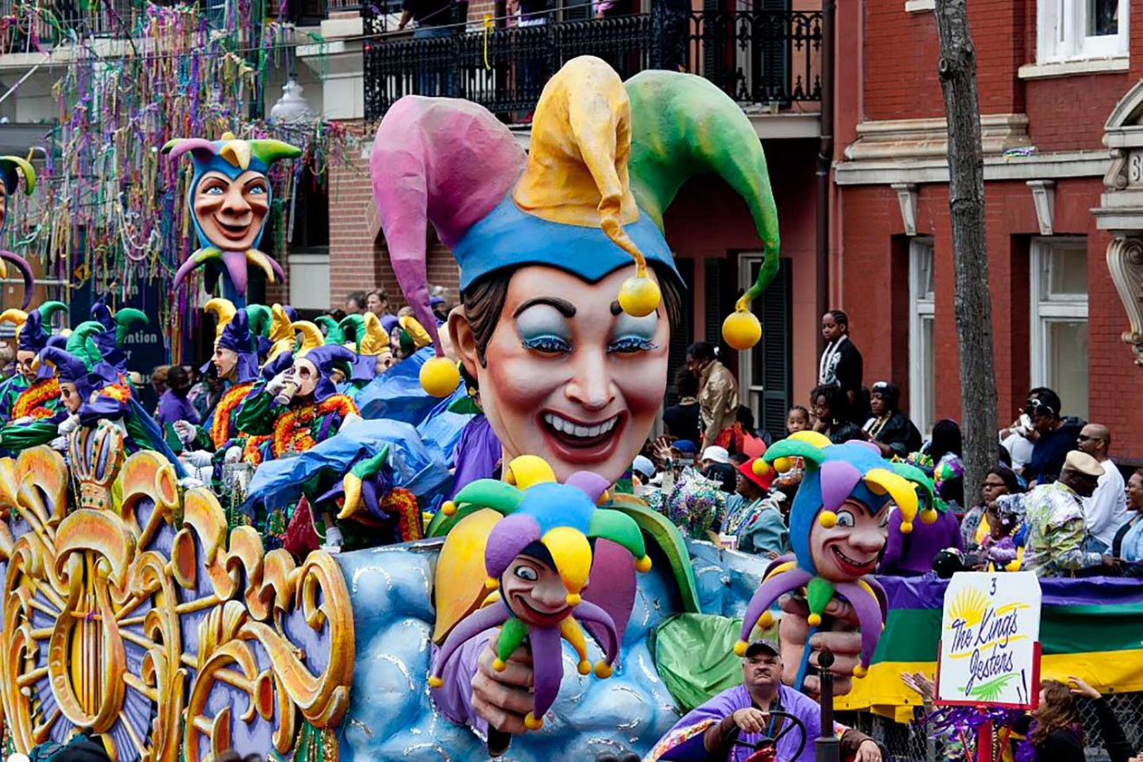
Major changes this past year?
Staff changes in 8 of 8
More digital stuff in 6 of 8
Facilities:
3 minor
1 major
1 being planned (it’s going to be big!)

Slide 4
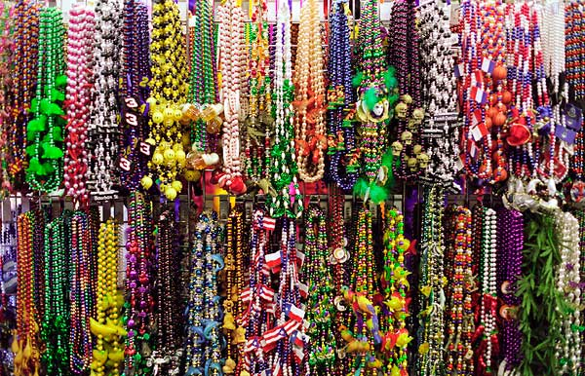
What about that funding?
2
3
Grants/gifts: 5

Slide 5
Stay tuned for 2018

