Slide 1
Using OCLC Work IDs for Discovery ***** OCLC Works in Progress Webinar December 12, 2017
Jim LeBlanc Frances Webb
Director, Library Technical Services Digital Library Applications Programmer
Cornell University Cornell University
JDL8@cornell.edu frances.webb@cornell.edu

Slide 2
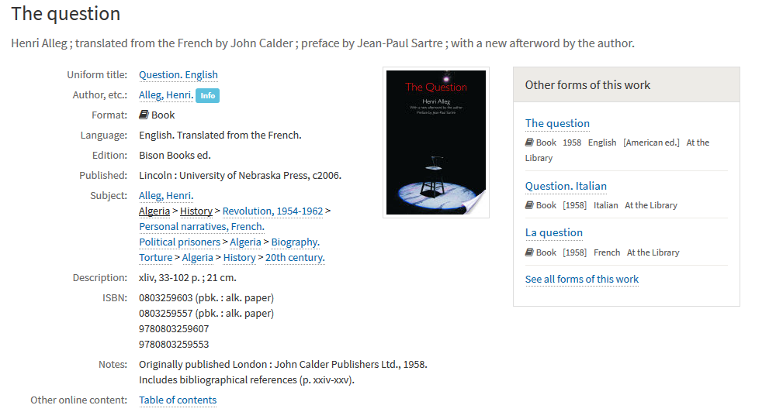
Notes:
Before acquiring the OCLC work ID compendium, we had wanted to link between catalog records for the same work, but our initial research showed this to be a very significant undertaking. Connecting our records based on bibliographic description risked many false matches unless applied strictly, and missed too many matches even when applied loosely. The OCLC numbers in our records were too granular for the kind of record connections we wanted.
In this example, a recent edition of a book is connected, in the “other forms of this work” box on the right hand, with an earlier English edition, an Italian translation, and the original French. The titles don’t quite match, and all four have different OCLC numbers. The connections here are a product of our inclusion of the OCLC works.

Slide 3
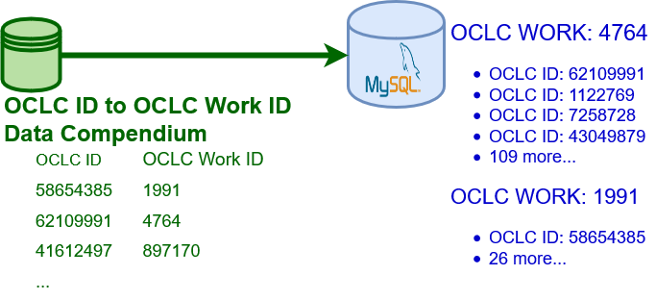
Notes:
The OCLC work compendium, (and we’re currently using a copy of the compendium from the fall of 2015,) was delivered to us as a 365 million line text file, each line connecting OCLC record ID’s, to OCLC works. Importing the data was as simple as loading it all into a database with indexing by *both* numbers for quick cross-referencing. In the example data shown on the right, the work 4764 represents “The Question” from the previous slide. The four OCLC record ID’s beneath it represent the four editions of the title we have, while the compendium associates 109 other OCLC record ID’s with the work which are not present in our catalog records.

Slide 4
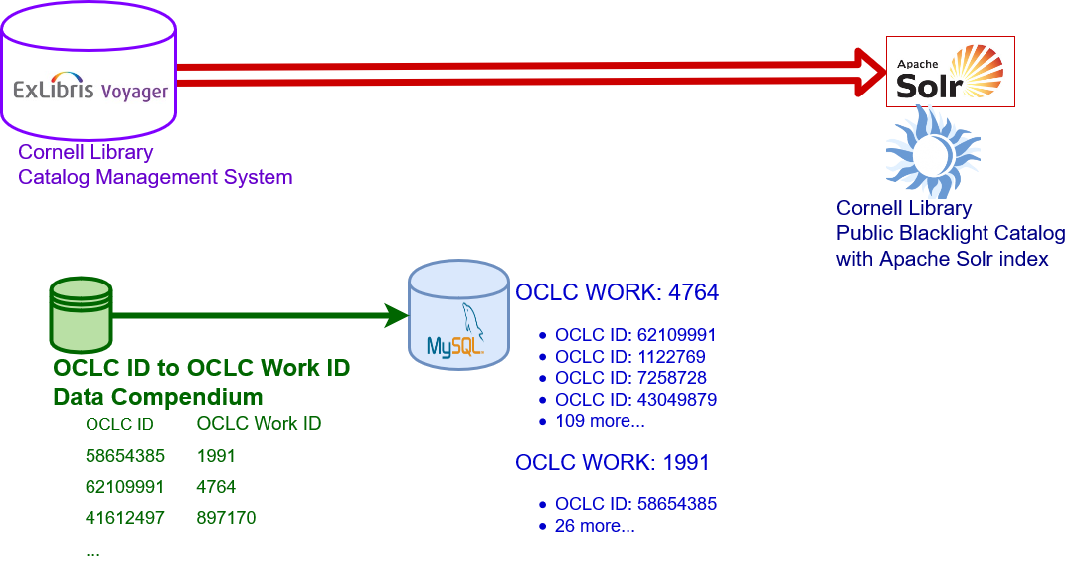
Notes:
Our library catalog is in an ExLibris Voyager system, and our public catalog interface uses a Blacklight UI, which depends on a Solr search engine. Before adding OCLC works to the mix, we had a process that pulled our records from Voyager, and processed them into the Solr search index. To integrate what we could about works, we incorporated the new data into the existing indexing process.

Slide 5
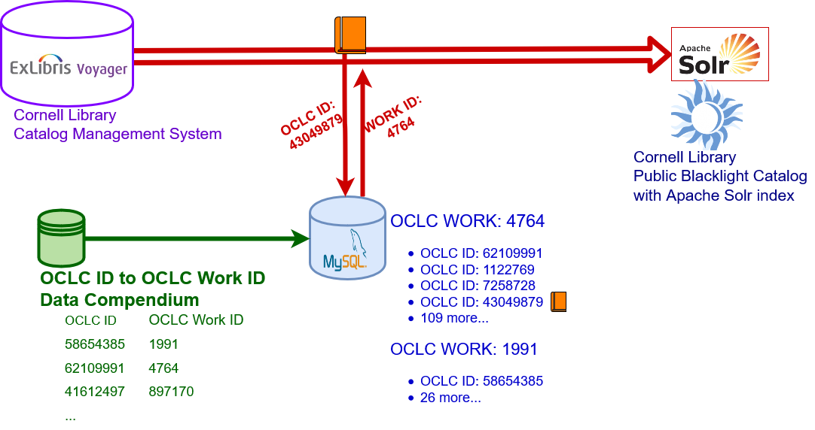
Notes:
As each record is processed into the search index, the OCLC record id from our record is now used to identify that record’s work number. In addition, our database of works also retains the association of the OCLC record ID with the particular local record, as represented here by the little orange book.

Slide 6
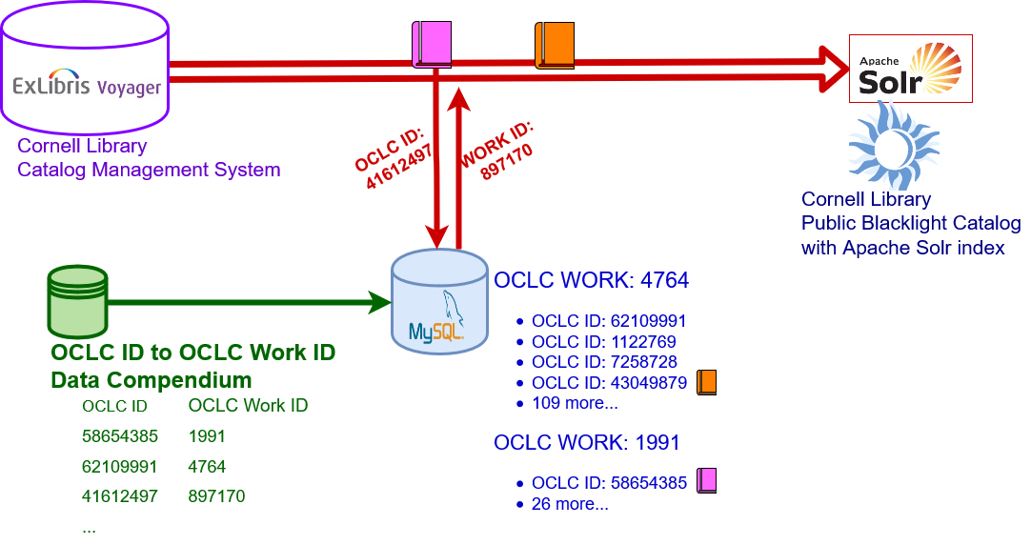
Notes:
As this process continues, our database associating works with oclc record ids, then with our own records, grows. Our local records have their own record numbers, but I’m using color-coding to separate one from another so to avoid a third set of numerical identifiers in the illustration.

Slide 7
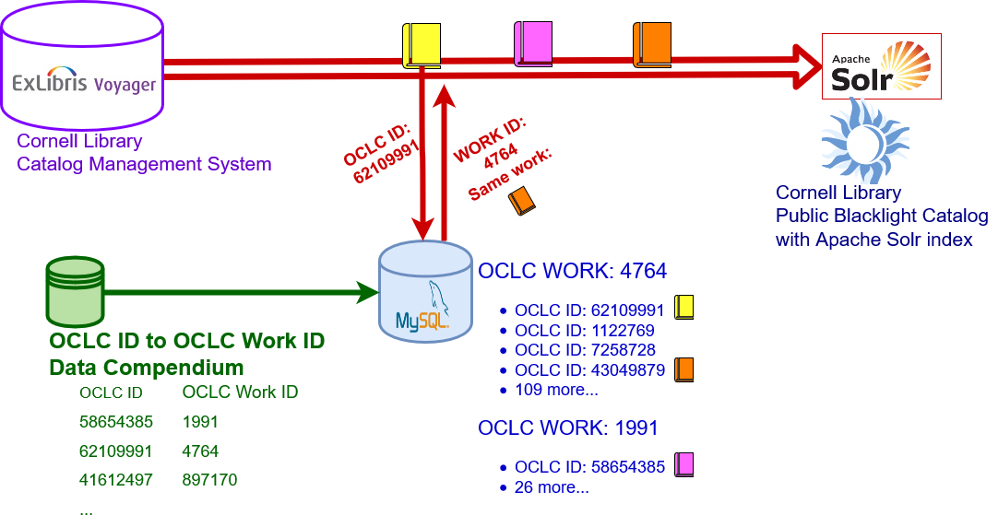
Notes:
When we see a record whose OCLC ID is associated with the same work as another record, then that information can also be supplied to the Solr search engine. That allows the public interface to have immediate access to information about connected records.

Slide 8
Notes:
Some of the time, we will find multiple local records with the same OCLC record ID. While we treat these connections between records the same way regardless, these are connections that we could have made using the OCLC numbers alone, and without the Work ID compendium. There are approximately 100 thousand such connections between pairs of records we could make using OCLC record ID’s, while the addition of the works compendium allows us to make nearly a million more, meaning that 91% of the “other forms” links we’re able to display are directly a result of our use of the work ID’s.
As this process continues, we end up with a detailed database associating our records with OCLC records and works. Maintaining this database as our records are created, modified, and deleted becomes a vital component to keeping our “other forms of this work” links reliable.

Slide 9
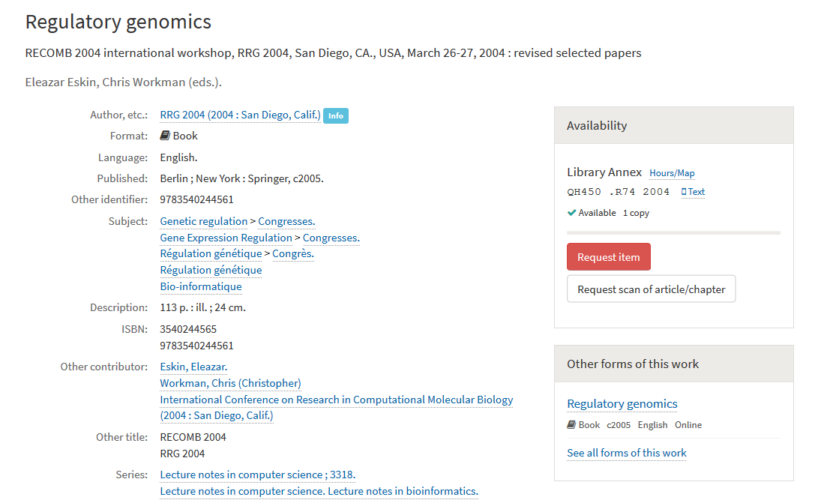
Notes:
This example shows a major use case for “other form” linking.
When finding a record for a print title, patrons want to see if we have an online copy. This is a good example, as the print copy is located in our library annex and will not be available the same day, but the online edition can likely be accessed immediately.

Slide 10
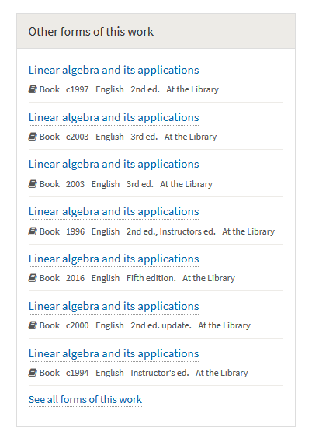
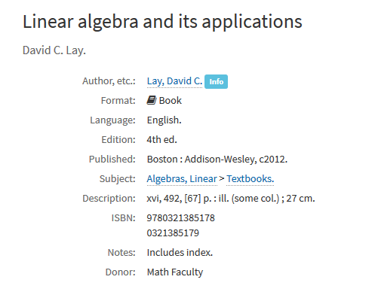
Notes:
Connecting editions is another important use, as when finding a record for the 4th edition of this text book, a patron can see that the library holds several editions including two instructor’s editions and one more recent edition.

Slide 11
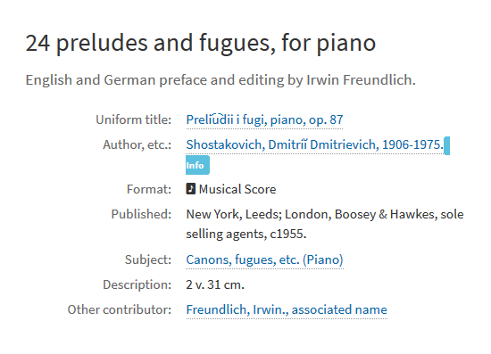
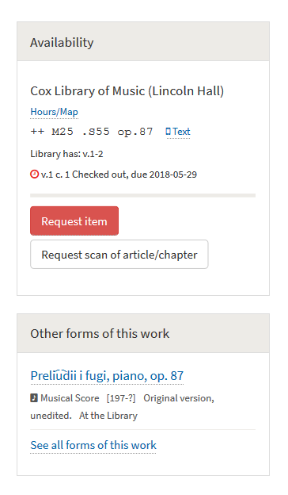
Notes:
This musical score is checked out, and the “other forms of this work” feature may help a patron find an available copy without having to resort to attempting to recall the copy associated with the record they first found.

Slide 12
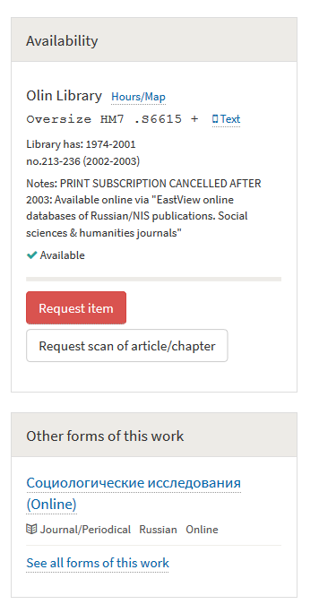
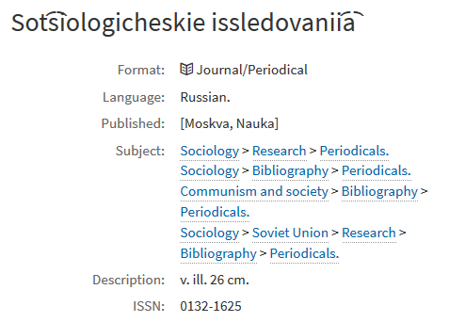
Notes:
One of the uses in most heavy demand, from faculty in particular, is the ability to connect print with online journal holdings. This example is a good one, because looking here at the record for Cornell’s print holdings of the journal you can see a note in the “availability” box on the top right that our print subscription was cancelled in 2003 in favor of online-only subscription. Conversely, a patron looking at the record of online holdings linked to in the “Other forms of this work” box might find themselves tracking back to print holdings as the online holdings don’t go back further than 2000.
I haven’t drawn attention to it yet, but at the bottom of every “Other forms of this work” box, you can see a link labelled, “See all forms of this work”. This isn’t very important when we only have two records for a work, but when we have dozens or hundreds of records, this is important as it performs a catalog search for the OCLC work.

Slide 13
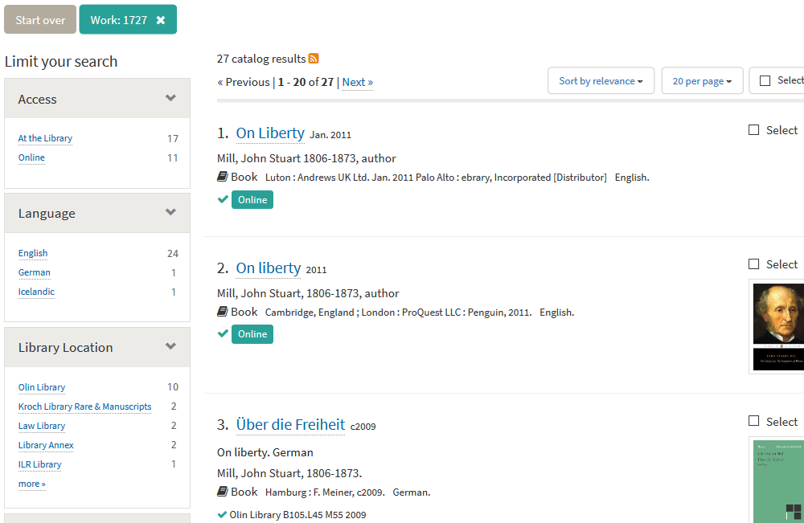
Notes:
Clicking that link brings us back into our standard search result panel. I’m showing a different example work here, looking at a work for which the library has enough different copies to make an itemized list in the “Other forms of this work” box unwieldy. Instead, by going back to a search result screen, the various copies can be filtered using the search facets on the left, as applicable. Do I want a copy in a particular language? One in print or online? If I’d prefer to read a print book, this can be a good way to find one at a library location nearby, or to learn more about the copies that have been stored in rare and manuscript collections.
The Cornell Library Discovery & Access team is engaged in ongoing development of features of our public catalog. As the OCLC Works service grows and evolves, we are eager to see how we can incorporate any new capabilities into what is already a very import record linking feature in our catalog.

Slide 14
OCLC Work IDs: additional use cases and ideas for further development

Slide 15
OCLC Work IDs: additional use cases and ideas for further development
Discovery of other editions/formats at other institutions (e.g. within resource sharing consortia)

Slide 16
OCLC Work IDs: additional use cases and ideas for further development
Discovery of other editions/formats at other institutions (e.g. within resource sharing consortia)
Discovery of digital editions in HathiTrust

Slide 17
Additional use cases and ideas for further development – contd.
Propagation of work-level data from the work ID to expressions and manifestations (in place of cataloger-created work authority records)

Slide 18
Additional use cases and ideas for further development – contd.
Propagation of work-level data from the work ID to expressions and manifestations (in place of cataloger-created work authority records)
Support for MARC-to-RDF linked data conversion

Slide 19
Additional use cases and ideas for further development – contd.
Integration of Work IDs into OCLC production services

Slide 20
Additional use cases and ideas for further development – contd.
Integration of Work IDs into OCLC production services
Embed Work IDs, whenever available, in a standard MARC field – see MARC Proposal 2017-09, “Defining Field 758 (Resource Identifier)”

Slide 21
Additional use cases and ideas for further development – contd.
Integration of Work IDs into OCLC production services
Embed Work IDs, whenever available, in a standard MARC field – see MARC Proposal 2017-09, “Defining Field 758 (Resource Identifier)”
Refresh Work IDs in WorldCat to incorporate new and changed data

Slide 22
Additional use cases and ideas for further development – contd.
Integration of Work IDs into OCLC production services
Embed Work IDs, whenever available, in a standard MARC field – see MARC Proposal 2017-09, “Defining Field 758 (Resource Identifier)”
Refresh Work IDs in WorldCat to incorporate new and changed data
Allow member libraries to request changes or edit work entity data directly

Slide 23
Questions? Comments?

Slide 24
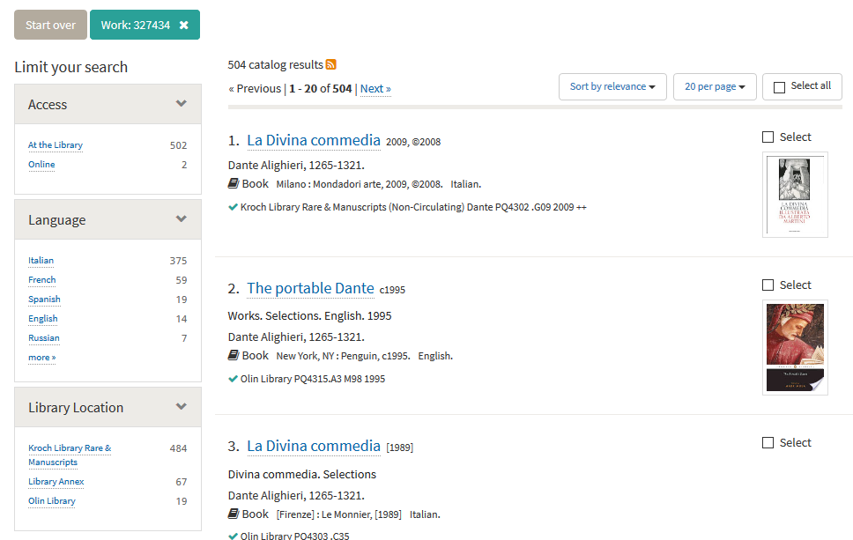

Slide 25
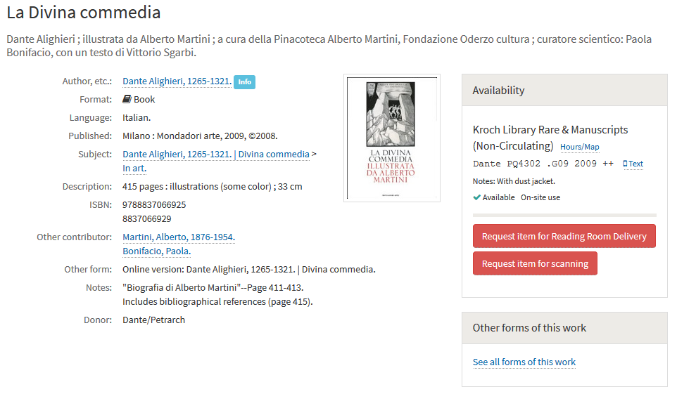

Slide 26
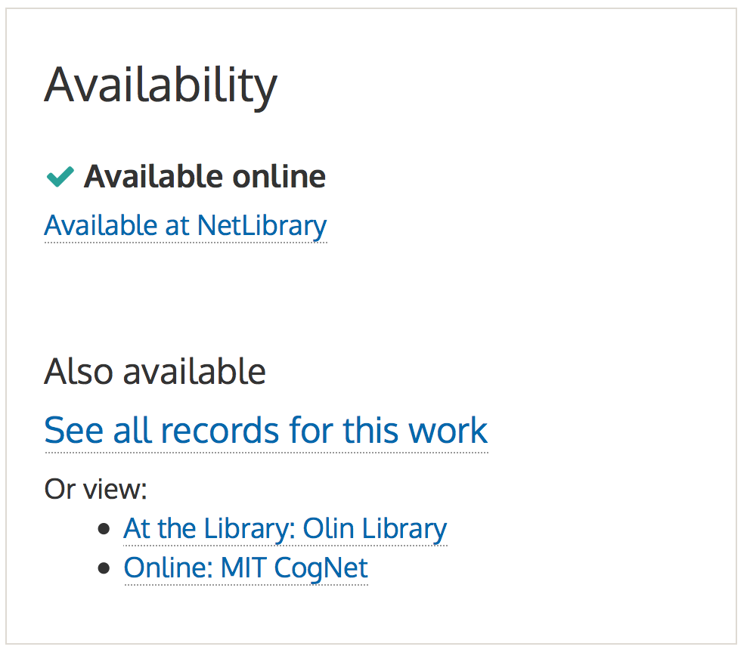
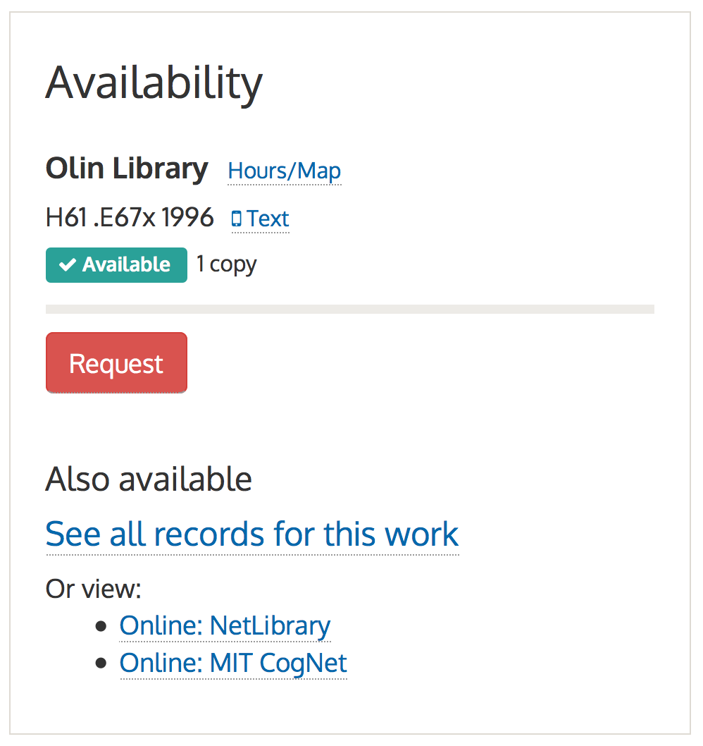
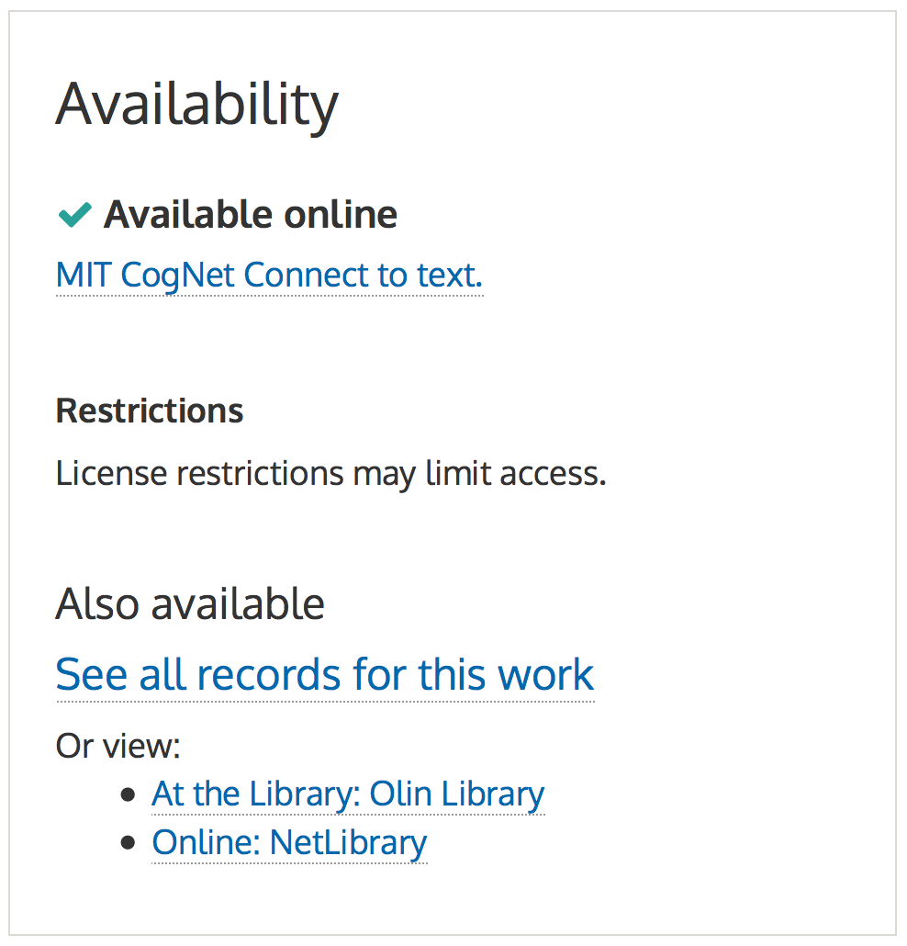
Early Prototype

Slide 27
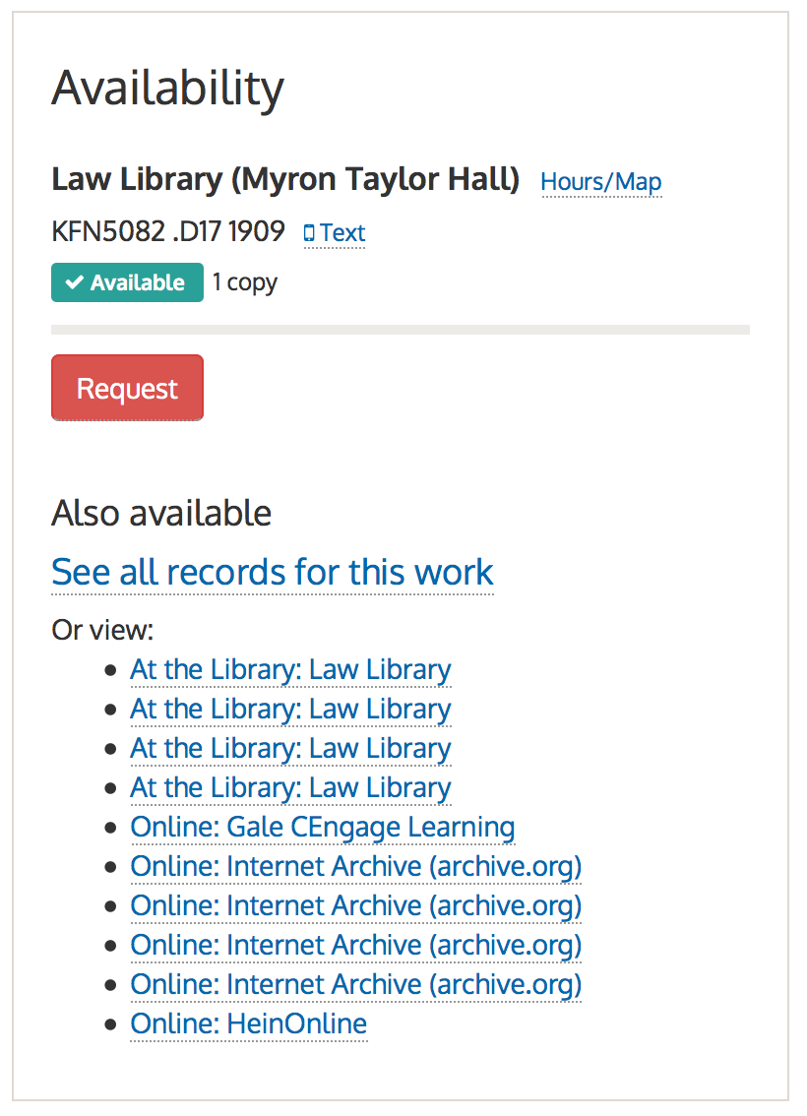
Early Prototype
In early attempts, the focus when linking between records for a work was on the access locations for the other records, and details like language and edition were not noted.
1905
1904
1911
1907
1911
1905
1911
1907
1909
1904

Slide 28
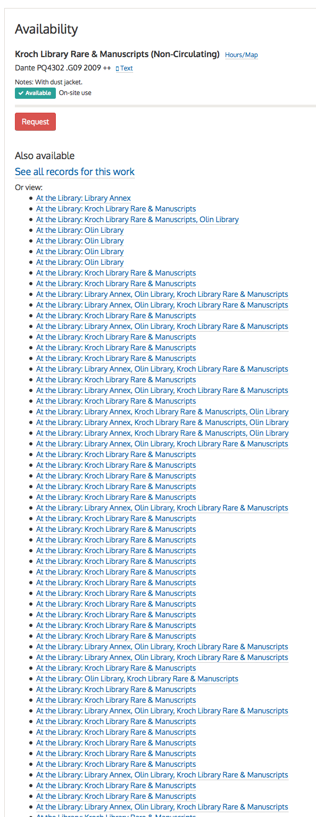
Early Prototype
Initially, cross links to other records were listed even when hundreds were present. The uselessness of this type of listing lead to hiding the detailed list behind a search link when more than a dozen are present.

