Slide 1
Listening to Sermons from Mystical Germans Who Preach from Ten to Four
Zack Lane
Head of Delivery Services
Columbia University Libraries
October 20, 2017
Delivery Services
Columbia University

Slide 2
…or, Letting the Punishment Fit the Crime
Zack Lane
Head of Delivery Services
Columbia University Libraries
October 20, 2017
Delivery Services
Columbia University

Slide 3
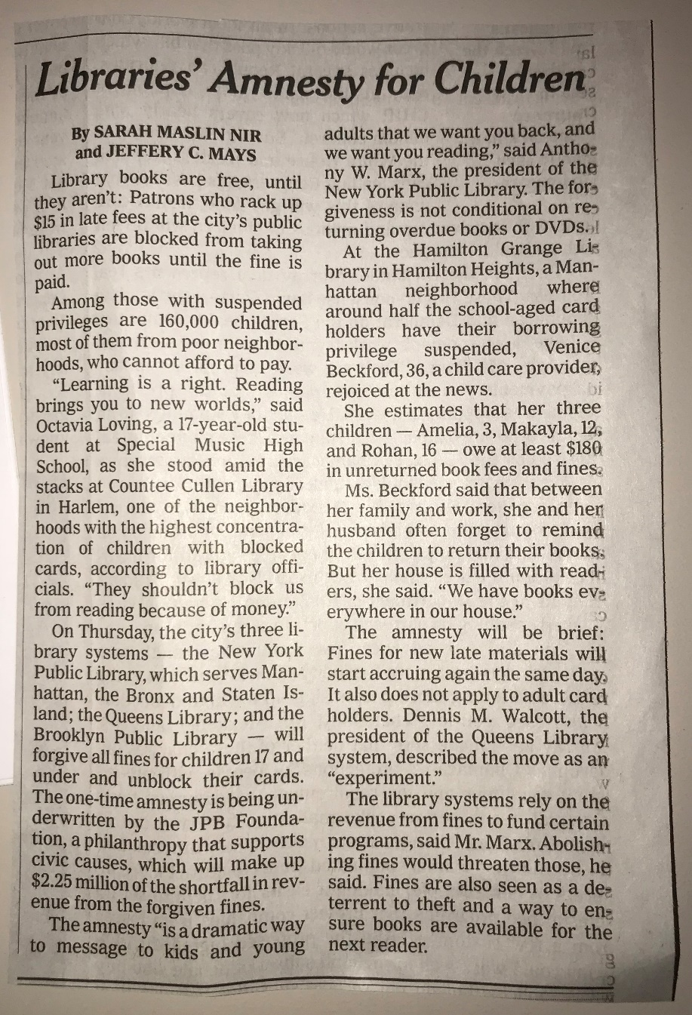
Make News Good Again
Hooray for Children
Hooray for Reading
Boo Budgets
“Hello Ideas, Have you met Reality?”
Complex vs Complicated
Effecting Change in Context
Is … Can … Should
Delivery Services
Columbia University

Slide 4
What’s this about?
Columbia’s paradigm shift about patrolling shared resource for benefit of RTL
Zack was annoyed with invoices
Removing mis-applied fines is the worst
Data again
Show & tell about how data analysis can shift thinking on library policies and actual policies
Scrutiny on legacy practice
Celebrating the 16-week ILL loan period – reflection on how Columbia wants to Borrow
Delivery Services
Columbia University

Slide 5
Columbia University Libraries will no longer assign staff to send invoices for long overdue books lent via Borrow Direct as part of routine operation. Columbia staff may opt to recall long overdue books or contact partner library staff directly to facilitate return. Columbia may opt to invoice for long overdue books. Long overdue books will otherwise be reviewed and charged as Missing to put them into the replacement queue. Review of long overdue items will take place quarterly according to the procedure outlined below.
Columbia may opt to recall items from partner institutions at any time. It is our expectation that the recall request does not need explanation and will be honored.
Columbia may opt to issue invoices to Borrow Direct partner libraries if books are reported lost, damaged, etc. Pursuit of all invoices and acceptance of replacement copies are at the discretion of Head of Delivery Services.

Slide 6
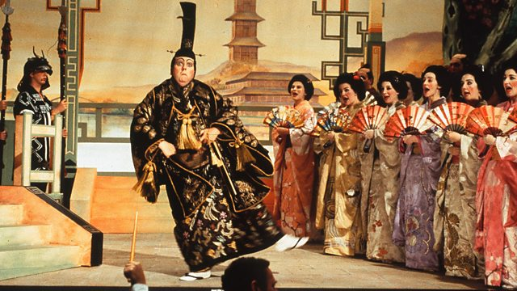
Delivery Services
Columbia University

Slide 7
Lost, Damaged & Long Overdue
The goal of Columbia’s invoicing policy is to balance maximizing patron return rate and minimizing staff time spent on invoicing.
The resultant philosophy focuses on being a sympathetic, trusting and well-patrolled borrower rather than a mindful, assiduous lender.
The return of the book is always preferred to invoicing.
Delivery Services
Columbia University

Slide 8
Quarterly Reports
Run automatically everything 3 months
Defined, adjustable parameters
Immediately actionable by department
Goal : Reduce BS
All publicly accessible until recently
ILL QR#1 – Borrow Direct Fine Report
ILL QR#2 – Overdue Borrow Direct Lending Report
ILL QR#3 – Overdue Borrow Direct Borrowing Report
ILL QR#4 – Morningside to HSL Report
ILL QR#5 – ILL Missing Status Patron Report
ILL QR#6 – Overdue ILL Lending Report
ILL QR#7 – Borrow Direct In Transit Report
ILL QR#8 – Temp Loc Report
Delivery Services
Columbia University

Slide 9
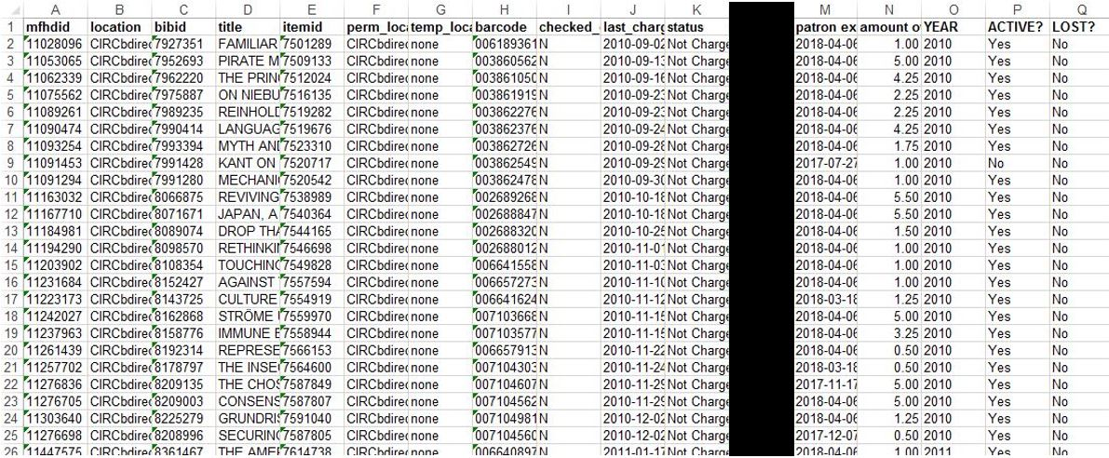
ILL QR#1 – Insight into Borrowers
Make it stop
The details are important
Delivery Services
Columbia University

Slide 10
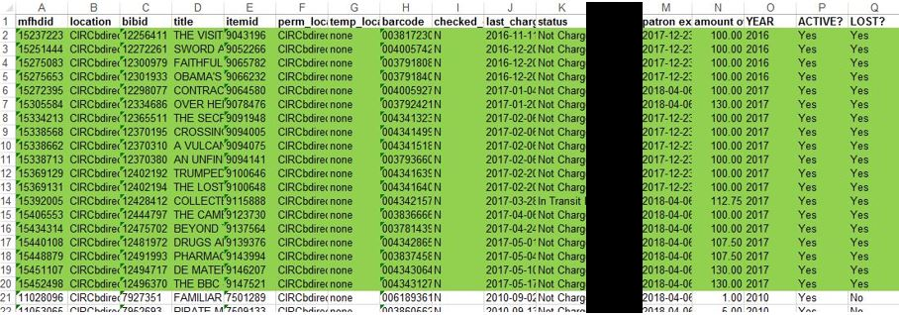
Bad for patrons
Liability for staff
Delivery Services
Columbia University

Slide 11
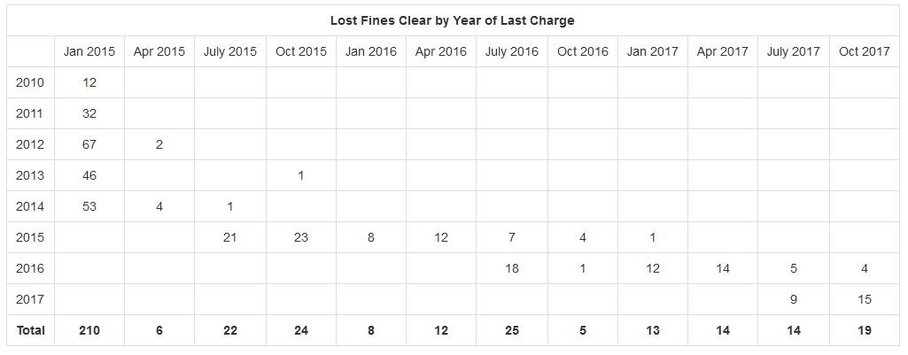
Keep the river running
Standing water breeds creatures
Delivery Services
Columbia University

Slide 12
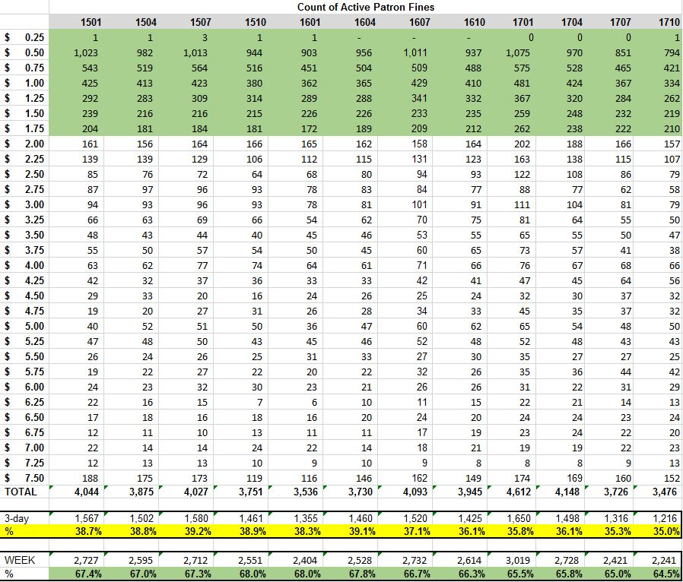
Delivery Services
Columbia University

Slide 13
What We Did
Desire to extend loan period from 12- to 16-weeks
Eliminate Columbia’s renewal
Extend grace period from 1 to 3 days
Tightened time to Lost & block from 45 to 30 days
Empower service desk staff
Extend loan periods 1-2 weeks or negotiate
Place mediated request on patron’s behalf
Routinely clear fines from Inactive accounts
Strongly consider eliminating “casual” fines entirely
“We care about the book not the money”
Think about how ILL Borrowing can mimic BD
Delivery Services
Columbia University

Slide 14
Borrow Direct
Consortial borrowing & lending activity among the Ivies Plus partners
Collections added in recent years:
Univ of Chicago
Duke
Johns Hopkins
Stanford
Everybody loves Borrow Direct
Predictable & Consistent User Experience
Delivery Services
Columbia University

Slide 15
Delivery Services
Columbia University

Slide 16
Delivery Services
Columbia University

Slide 17
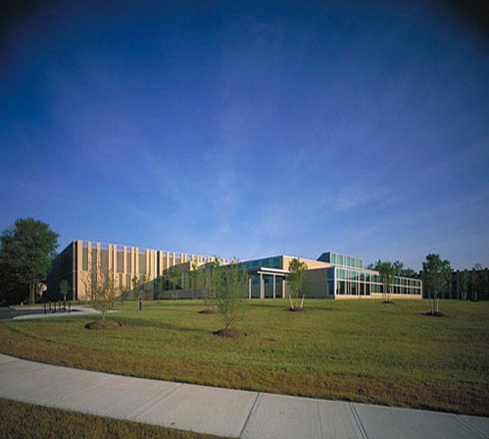
Circulation Data
Zack are you really going to make us look at Circ Data?
Yes
Borrow Direct activity in context of print usage
Scale is important
This will be fast, it’s ok
Delivery Services
Columbia University

Slide 18
Delivery Services
Columbia University

Slide 19
Delivery Services
Columbia University

Slide 20
Delivery Services
Columbia University

Slide 21
Delivery Services
Columbia University

Slide 22
Delivery Services
Columbia University

Slide 23
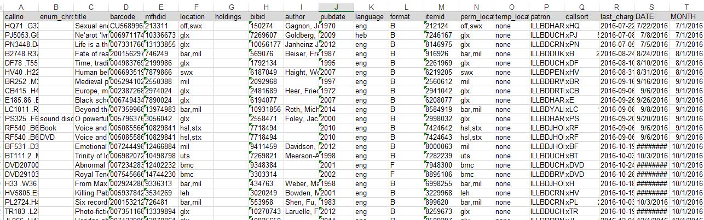
ILL QR#2 – Insight into Lending
More Excel data
The details are important
Delivery Services
Columbia University

Slide 24
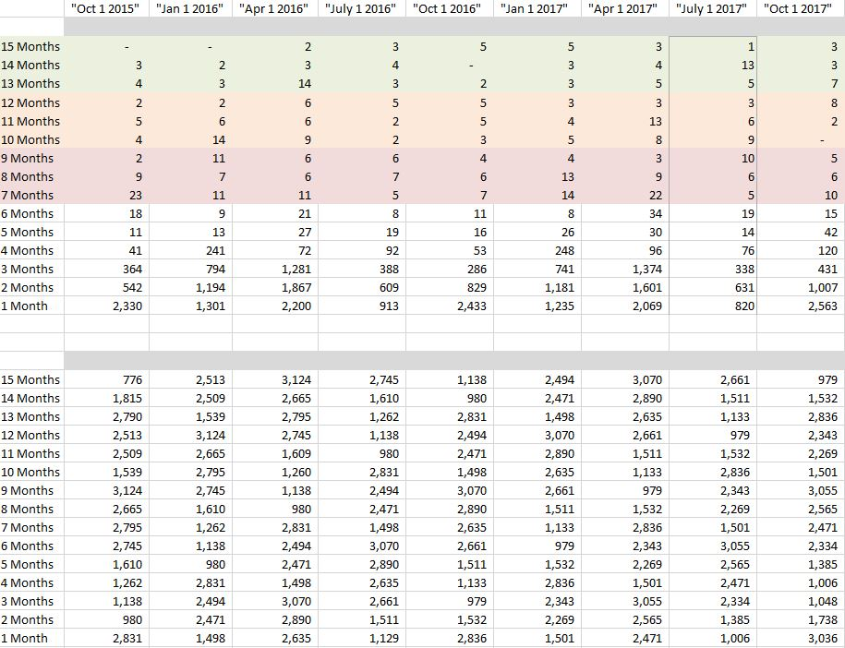
Delivery Services
Columbia University

Slide 25
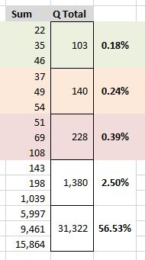
Delivery Services
Columbia University

Slide 26
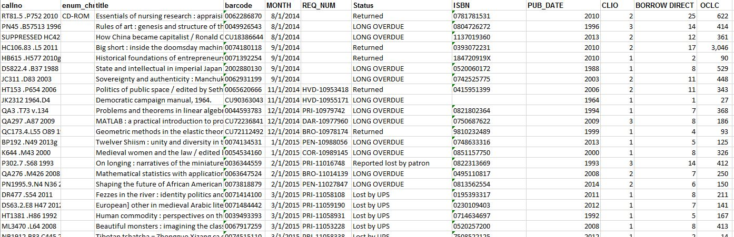
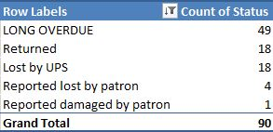
Average # of holdings in Worldcat = 404
6 titles with under 20 holdings in Worldcat
Average other copies in Borrow Direct = 6
8 titles with no other Borrow Direct holdings
Delivery Services
Columbia University

Slide 27
What We Did
Consortium-wide comfort increasing loan period from 12- to 16-weeks
BD Policy Group decision to chill on invoicing
Rationalized local loan periods during shift to ReCAP Shared Collection (big deal)
Columbia changed ILL loan period from 6-weeks (perpetual renewals) to 16-weeks no renewal
Shift footing from renewal footstooling to the integrity of recall
Planned integration of acquisition routines
Delivery Services
Columbia University

Slide 28
Thank you for your patience
There’s more where that came from
Delivery Services
Columbia University

