Slide 1
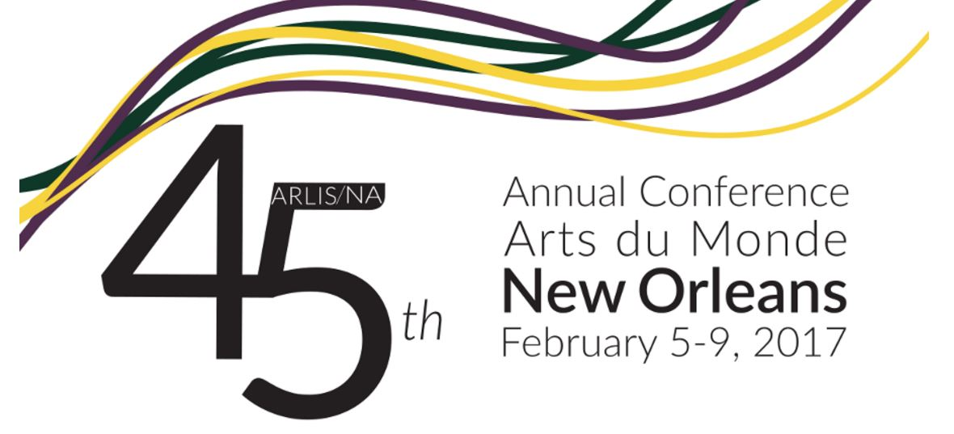
Web Archiving Metadata Guidelines Working Group
Report at OCLCRLP Update, ARLIS/NA Annual Conference, New Orleans, February 8, 2017
Deborah Kempe, WAM WG member

Slide 2
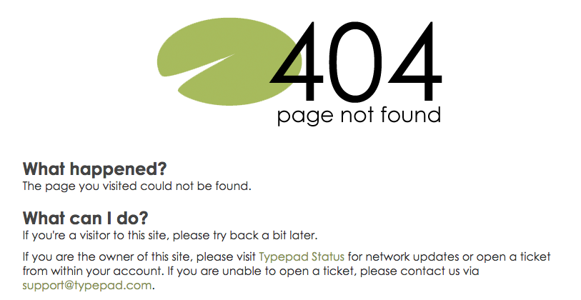
THE IMPERATIVE

Slide 3
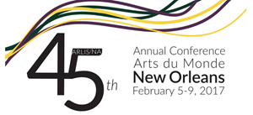
“It is far easier to find an example of a film from 1924 than a website from 1994.”
--M.S. Ankerson. “Writing web histories with
an eye on the analog past”
2012

Slide 4
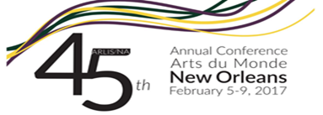
“In the past few years, we have noticed a significant uptick in the use of web archives in mainstream media.”
--Web Sciences and Digital Libraries Research Group
11 September 2016

Slide 5
“Web archiving operates at the frontier of capturing and preserving our cultural and historical record.”
--The British Library web archive blog
14 September 2016
Notes:
While it is fun and exciting to be part of the Wild West in the frontier of web archiving described earlier in the British Library quote, the library community has a long and proven tradition to band together to tame the broncos and develop efficient metadata practices. And who better to help us than OCLC, the product of decades of shared cataloging. As web archiving slowly spreads as an integral component of collection development for Research Library Partners, the growing band of practitioners in the frontier acknowledged the need for community development of core metadata practices and reached out to RLP for help in doing so.

Slide 6
Archived websites often are not easily discoverable via search engines or library and archives catalogs and finding aid systems, which inhibits use.
Absence of community best practices for descriptive metadata was the most widely-shared web archiving challenging identified in two surveys:
OCLC Research Library Partnership (2015)
Rutgers/Weber study of users of archived website (2016)

Slide 7
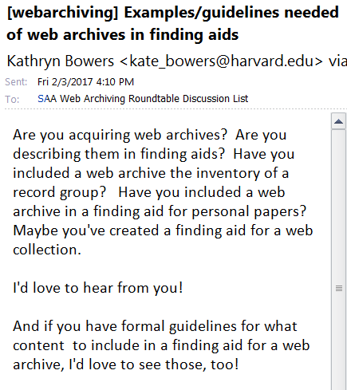

Slide 8
THE OBJECTIVE
Develop best practices for web archiving metadata that are community-neutral and output-neutral.
Publish a set of data elements with the scope of each defined (i.e., a data dictionary).

Slide 9
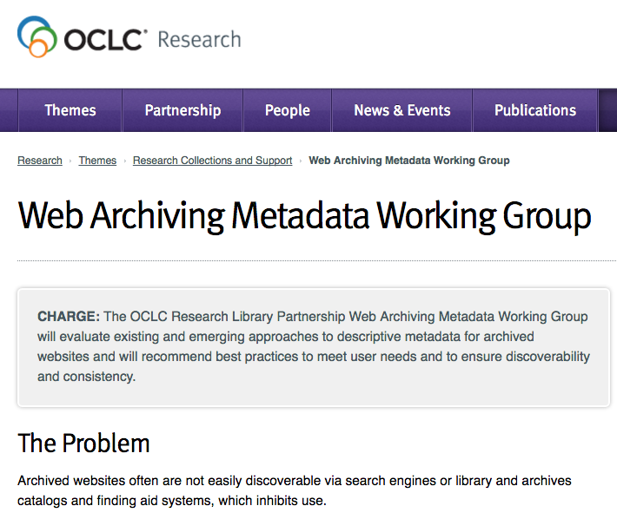
OCLC RESEARCH LIBRARY PARTNERSHIP
WEB ARCHIVING METADATA WORKING GROUP

Slide 10
Working Group charge
The OCLC Research Library Partnership Web Archiving Metadata Working Group will evaluate existing and emerging approaches to descriptive metadata for archived websites and will recommend best practices to meet user needs and to ensure discoverability and consistency.

Slide 11
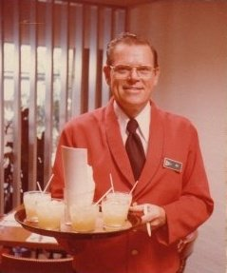
Working Group Members:
25 individuals from diverse community of libraries and archives

Slide 12
Planned outputs
A report on user needs and behaviors will inform community-wide understanding of documented needs and behaviors as evidence to underlie the metadata best practices.
A report evaluating selected open-source web archiving tools will describe metadata-related functionalities.
Best practices guidelines for descriptive metadata will address aspects of bibliographic and archival approaches.

Slide 13
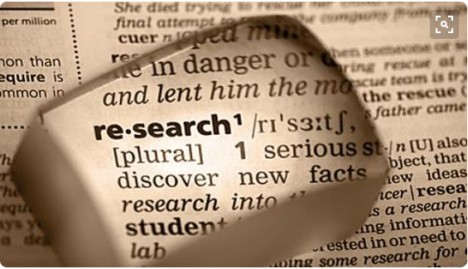
LITERATURE REVIEWS
Notes:
Decided to create a report on user needs - started with lit review to see what existing research shows.
Purpose of report is to inform community-wide understanding of document user needs and behaviors. This will serve as evidence to determine best practice guidelines for web archiving metadata.

Slide 14
Methodology
Two literature reviews: user needs and metadata
Selectively gathered published literature, conference reports and notes, social media, etc.
Abstracted each item
Synthesized our findings
Notes:
We identified and gathered about 33 (user needs) and 23 (metadata) articles, reports, blog posts, conference presentations, and social media exchanges that were related to user needs and/or metadata issues for web archives.
From abstracts we created synthesis of findings based on some main topics that emerged from readings.

Slide 15
Why study users’ needs?
A necessary prelude to development of metadata best practices
We want to recommend an approach based on real user needs & behaviors
Users don’t necessarily utilize the usual discovery tools to locate archived websites
Lack of awareness that libraries harvest and archive web content
Notes:
Users of web archives are diverse - they have different uses and needs of web archives:

Slide 16
We focused on three questions
Who uses web archives?
How and why do they use them?
What can we do to support their needs?

Slide 17
Types of users identified in readings
Academic researchers (social sciences, history)
Legal researchers
Digital humanists and data analysts
Web and computer scientists
Note: We did not find sources that address other types of users.
Notes:
Taken from Rutgers study of users of archived websites; not yet published.
Academic researchers in history and social sciences - may be looking at the actual content of web pages - looking for information
Digital humanists and data analysts - using web archives for data and text mining
Web and computer scientists - technology development, systems

Slide 18
Types of use
Reading specific web pages/sites
Data and text mining
Technology development
Notes:
Academic researchers in history and social sciences - may be looking at the actual content of web pages - looking for information
Digital humanists and data analysts - using web archives for data and text mining
Web and computer scientists - technology development, systems

Slide 19
What we learned about user needs
Formatting and organization of data is an issue
Lack of discovery tools make access challenging
“Provenance” information is a critical missing piece
Libraries and archives need to actively engage in outreach to users
Notes:
Provenance from users’ perspectives: why and when a website was created and collected
How can libraries and archives support users? Teach them how to find and use web archives, how to use available tools

Slide 20
What we learned about metadata issues
Confirmed that no appropriate set of best practices exists
Data formats used include MARC, Dublin Core, MODS, EAD Finding aids
Metadata elements used vary widely, and the same element may have different meanings
Level of description varies as well: Single site, collection of sites, seed URLs …
Creating metadata at scale is … impossible?
Notes:
Much of this was confirmed by our review of institution-specific metadata guidelines.

Slide 21
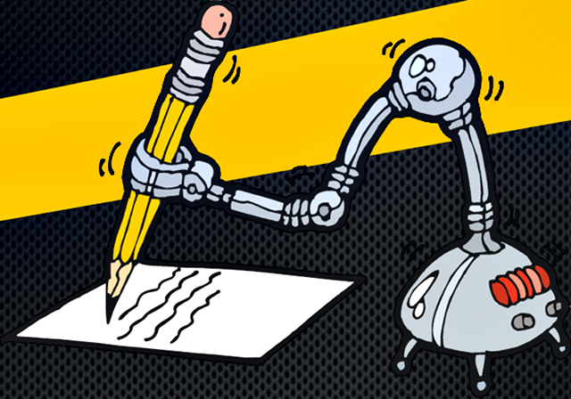
CAN WE AUTOMATE METADATA CREATION?

Slide 22
The community longs for the magic bullet: automatic generation of metadata from the tools used to crawl websites.

Slide 23
So we evaluated open-source tools
Archive-It
Heritrix
HTTrack
Memento
NetArchiveSuite
NutchWax
Site Story
Social Feed Manager
Web Archive Discovery
Wayback
webrecorder.io
WebCurator

Slide 24
Evaluation criteria
Basic purpose of the tool
Which objects/files can it take in and generate?
Which metadata profiles does it record in?
Which descriptive elements are automatically generated?
Which descriptive elements can be exported?
What relation does it have to other tools?

Slide 25
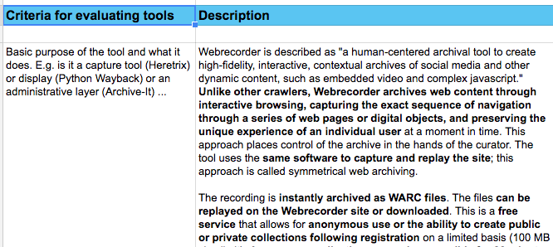
Evaluation grid for webrecorder
Etc.

Slide 26
What we learned
Websites generally have poor metadata (e.g., title is “home page”)
Tools have few or no metadata-related features
Extractable data usually limited to title, crawl date ….
Most tools capture only the site (usually in WARC format), so metadata must be created manually/externally
A few tools enable manual input of metadata within WARC file
Ergo: no magic bullet (big sigh)

Slide 27
DEVELOPING METADATA BEST PRACTICES

Slide 28
Why study existing practices?
A necessary prelude to development of metadata best practices
We want to evaluate them in light of user needs
We want to borrow their best features
We want to understand how existing rules and guidelines are reflected in current practice

Slide 29
Methodology
Analyze descriptive metadata standards & local guidelines
Evaluate existing records “in the wild”
Differentiate bibliographic & archival approaches
Identify issues specific to web archiving
Incorporate findings from literature reviews

Slide 30
Descriptive standards under review
Describing Archives: A Content Standard (SAA)
Integrating Resources: A Cataloging Manual (Program for Cooperative Cataloging, based on RDA)
Dublin Core
Notes:
Working group includes both catalogers and archivists, and we looked at national standards from both communities, with the full acknowledgment that none of them could fully address the specific qualities of archived born digital resources.

Slide 31
Local guidelines under review
Archive-It
Columbia
Government Printing Office
Harvard
Library of Congress
New York Art Resources Consortium (NYARC)
University of Michigan
University of Texas
Notes:
Eight sets of existing and widely varying guidelines were considered by the group. Some were quite explicit, others not so.

Slide 32
Most common elements in local guidelines
Collection title
*Creator/contributor
Date of capture
Date of content
*Description
Genre
Language
Publisher
Rights/Access conditions
Subject
*Title
URL
* Only three elements that appear in all standards and local guidelines.
Some RDA elements that are not often used: Extent, Place of Publication, Publisher, Source of Description, Statement of Responsibility.
Notes:
That said, by putting them all onto a handy grid developed by Jackie, we were able to identify the most commonly shared elements of metadata description.
You don’t have to be a metadata specialist to guess that the three shared by all were that of loosely defined fields for TITLE, CREATOR or CONTRIBUTOR, and DESCRIPTION. So far, so good.
It did get thornier as we tried to categorize other elements, but basically, we agreed that these 12 elements appear most often. Suprisingly--or maybe not--if you are a web archivist, some elements considered essential for traditional cataloging are not so present, like publisher, place of publication, extent, and statement of responsibility.

Slide 33
Analysis of data elements
Definitions?
Most frequently used?
Core?
Same concept, different elements?
Same element, different concepts?
Notes:
As i mentioned, it has not been easy to fully define or agree what some elements are describing. This is part of the dilemma of “making the black hole grey,” which was the title of NYARC’s web archiving grant from the Mellon Foundation. Web archiving challenges our ingrained understanding of what web-based resources are or represent. It’s a sometimes frustrating but always interesting set of thought exercises.

Slide 34
Analysis of existing records
Data sources
WorldCat
ArchiveGrid
Archive-It
Types of record
Bibliographic: MARC, Dublin Core, MODS …
Archival: MARC, finding aids
Notes:
As mentioned in the earlier slide, we agreed it was imperative to look at records “in the wild,” to see what actual practice is looking like in the big aggregations. So we set about finding examples, and found that it wasn’t so easy. Which brings home the fact that we clearly need some agreement, when even librarians and archivists have trouble finding records.

Slide 35
Bibliographic vs. archival description
Bibliographic: description of a single site
Based on RDA or Dublin Core
Includes standard bibliographic data elements
Usually does not provide context
Archival: description of a collection of sites
Based on DACS or Dublin Core
Includes narrative description, e.g. of creator, content ...
Includes context of creation and use
Notes:
As evidenced by our investigations, there remains a basic division in organizational and descriptive approaches to web archives, and both are valid and therefore need to be supported. The choice of which to use depends on a variety of factors, including intent of purpose for collecting, staffing expertise, and administrative organization. Web archives are a bit slippery, neither fish nor fowl, and therefore both approaches are totally valid depending on circumstances. And indeed some institutions may choose to use both.

Slide 36
DILEMMAS SPECIFIC TO WEB CONTENT
Notes:
As I mentioned, web archives are difficult to categorize. And here are some examples of those tricky dilemmas we faced.

Slide 37
Is the website creator/owner the … publisher? author? subject? all three?
Should the title be … transcribed verbatim from the head of the site? Edited to clarify the nature/scope of the site? Should it begin with "Website of the …"
Which dates are both important and feasible? Beginning/end of the site's existence? Date(s) of capture by the repository? Date of the content? Copyright?
How should extent be expressed? “1 archived website”? "1 online resource"? "6.25 Gb"? "circa 300 websites"?
Notes:
Variety of practices:
some institutions required the same content in the Creator/Publisher elements

Slide 38
Is the institution that harvests and hosts the site the … repository? creator? publisher? selector?
Does provenance refer to …the site owner? the repository that harvests and hosts the site? ways in which the site evolved?
Does appraisal mean …the reason the site warrants being archived? a collection of sites named by the repository? the parts of the site that were harvested?
Is it important to be clear that the resource is a website? If so, how to do so? In the extent? title? description?
Which URLs should be included? Seed? access? landing page?
Notes:
for most institutions the publisher was optional; for others it was mandatory.
And hey, what does “place of publication” mean on the web?

Slide 39
A sample finding aid note
Physical Characteristics and Technical Requirements note:
"The web collection documents the publicly available content of the web page, it does not archive material that is password protected or blocked due to robot txt exclusions.
Although [institution] attempts to archive the entirety of a website, certain file types will not be captured dependent on how they are embedded in the site.
This can include videos (Youtube, Vimeo, or otherwise), pdfs (including Scribd or another pdf reader), rss feeds/plug-ins (including twitter), commenting platforms (disqus, facebook), presi, images, or anything that is not native to the site."
Source: New York University
Notes:
Here a sample from one record. NYU’s finding aids attempt to describe what is in--and just as importantly--what’s not in the collection. The group agreed this was a good practice, but NYU seems to be an outlier here, as we did not readily find other examples. Perhaps this will be incorporated into our recommended best practices.

Slide 40
MARC21 record types
When coded in the MARC 21 format, should a website be considered a …
Continuing resource?
Integrating resource?
Electronic resource?
Textual publication?
Mixed material?
Manuscript?
Notes:
Another dilemma. For archival records, we found that mixed materials was predominant and for bib records, integrating or continuing resources was most used. At NYARC we use Integrating resource, which is a subset of continuing resource.
So this just gives you a quick overview of the sort of discussions we’ve been having, preliminary to our task of reporting. I’ll turn it back over to Jackie to take us to that final step.

Slide 41
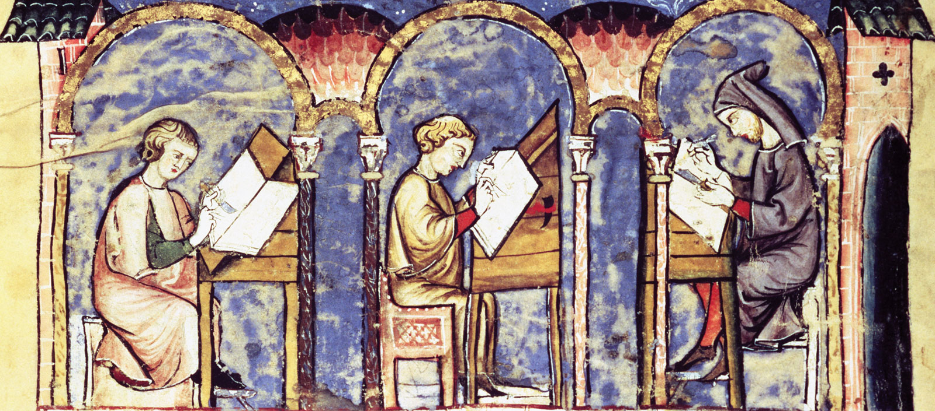
FORTHCOMING REPORTS

Slide 42
Estimated publication dates
Tools evaluation (February/March 2017)
With evaluation grids
User needs (February/March 2017)
With annotated bibliography
Best practices guidelines (April/May 2017)
With annotated bibliography and local guidelines evaluation grid

Slide 43
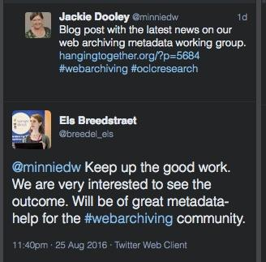
DISCUSS!!
http://www.oclc.org/research/themes/research-collections/wam.html

