Slide 1
The HathiTrust Shared Print Program: Implementation and Next Steps
Lizanne Payne
Shared Print Program Officer
elpayne@hathitrust.org
October 3, 2017

Slide 2
Background of the HathiTrust Shared Print Program
2011: Constitutional Convention “Distributed Print Monographs Archive Initiative” approved
2014: HathiTrust Print Monographs Archive Planning Task Force begins work
2015: Task Force planning report issued (March) and approved by Board (June)
2016: Shared Print Program Officer hired
Big changes in governance and leadership

Slide 3
Goals of the HathiTrust Shared Print Program
From the final report of the HathiTrust Print Monographs Archive Planning Task Force (March 2015)
Link the preservation of HathiTrust digital and corresponding print collections through library retention commitments
Reduce overall costs of collection management for HathiTrust members
Catalyze national/continental collective management of collections

Slide 4
Key Attributes of the HathiTrust Shared Print Program
From the final report of the HathiTrust Print Monographs Archive Planning Task Force (March 2015)
Secure retention commitments for print holdings that mirror book titles in the HathiTrust digital collection
Maintain a lendable print collection distributed among HathiTrust member collections
Reflect support by and provide benefits to all HathiTrust members (not a subset)
Build on existing shared print and resource-sharing arrangements, avoid disturbing members’ other affiliations

Slide 5
HathiTrust Shared Print Program Phases
Finalize policies & MOU
Identify initial retentions
Phase 2: Infra-structure
Adopt tools for collection analysis, collection management, resource-sharing
Plan next priorities and services (e.g. digitization)
Phase 1: Quick Launch
Build momentum
Build infrastructure
2016-2017
2018--

Slide 6
Overview of
HathiTrust Shared Print Phase 1
June – December 2016
January – June 2017
July – September 2017
HT Shared Print retentionsconfirmed
Finalize policies, funding principles, & MOU
Libraries agree to MOU
Board approved MOU
Identify proposed retention commitments
The Phase 1 libraries are not expected to make binding retention commitments until they have had a chance to agree to the final policies and MOU.

Slide 7
HathiTrust Shared Print Retention Libraries
Arizona State University Brandeis University Brown University Bryn Mawr College Claremont Colleges Colby College Columbia University Duke University Emory University Georgia Tech University Getty Research Institute Harvard University Indiana University Iowa State University Johns Hopkins University Lafayette College Massachusetts Institute of Technology McGill University | New York Public Library Northwestern University Ohio State University Princeton University Swarthmore College Syracuse University Tufts University University of Alberta University of Calgary University of California, Merced University of California, San Diego University of California, Santa Cruz University of California Northern Regional Library Facility (NRLF) University of California Southern Regional Library Facility (SRLF) University of Chicago University of Delaware | University of Florida University of Illinois, Urbana-Champaign University of Iowa University of Michigan University of Minnesota University of Missouri University of Notre Dame University of Pennsylvania University of Queensland University of Texas at Austin University of Virginia University of Washington University of Wisconsin-Madison Washington University in St. Louis Yale University
49 libraries!
45 in U.S.
3 in Canada
1 in Australia
Blue = OCLC RLP libraries (33)

Slide 8
HathiTrust Shared Print Agreement
Agreement (MOU)
Separate document to be signed by Retention Libraries
Includes general fundamental terms that are not likely to change over time
Goal was to sign only once
Operating Policies and Guidelines
Separate from MOU, posted on website
Policies are more detailed operating requirements that may change over time
Guidelines are detailed specifications for certain policies, e.g. preferred environmental conditions

Slide 9
Key Features of HathiTrust Shared Print Agreement (MOU)
Retention Libraries agree to retain volumes through fixed date 12/31/2042 (25 years from 2017)
HathiTrust agrees to maintain a Shared Print Registry and support the program through the established HathiTrust budget process
Libraries that need to withdraw must transfer volumes OR responsibility for volumes OR secure confirmation from HathiTrust that transfer is not required
HathiTrust and Retention Libraries will review the Program no later than December 31, 2040 to determine if it will expire or be extended.

Slide 10
Major HathiTrust Shared Print Operating Policies
Scope: Monographs from circulating general collections that correspond to items in the HathiTrust Digital Library
Retention Period: Fixed date 12/31/2042 (25 years from 2017), also used for future commitments
Environment: Storage facility preferred, campus shelving acceptable
Validation: Verification of holdings and condition encouraged but not required (desirable but not feasible at scale, consider future sampling)
Disclosure: Record retention commitments in HathiTrust registry and local system; planning for OCLC shared print registration but not currently required
Access: Loan retained volumes to other HathiTrust members; may use local ILL policies including fees

Slide 11
HathiTrust Shared Print Funding Principles
Program management
Local metadata updates and lending
Costs paid by HathiTrust
Shared by all members
Part of HathiTrust member fee
Costs absorbed by Retention Libraries
Systems
Long-term shelving of physical volumes

Slide 12
HathiTrust Shared Print Commitments
145 million print monographs in Retention Library collections
58 million of those match HathiTrust
4.8 million distinct OCLC numbers proposed for retention
256 million print monographs in HathiTrust member collections
16 million print monographs proposed for retention
49 Retention Libraries proposed over 16 million commitments
As of October 2017

Slide 13
Key Points about Phase 1 Retention Proposals
Light-weight analysis and library-volunteered commitments
Required: Lendable monographs that match HathiTrust
Encouraged:
In a storage facility
Unique or rare holdings among HathiTrust libraries
Already committed to another shared print program
No efforts to predefine desired number of copies nor to prevent duplication
No minimum commitment for libraries

Slide 14
Light-Weight Process to Identify
HathiTrust Retention Commitments
Libraries review
Libraries export proposed commitments
HathiTrust ingests, updates Shared Print Registry
HathiTrust provided
Print Holdings Review File
Used holdings data provided annually by HT members
Monographs matching HT
Overlap count within Retention Libraries and within HT
Library provides
Shared Print Commitments File
Some libraries provided existing commitments (EAST)

Slide 15
Shared Print Proposals by Consortium/Group
Consortium/Group | Volumes Committed
OCLC Research Library Partners (33 of 150 Members) | 12,300,000
Big Ten Academic Alliance (8 of 14 members) | 6,300,000
Ivy Plus (10 of 13 members) | 4,400,000
ReCAP (all 4 members, 3 of them also in Ivy Plus) | 3,000,000
University of California system (RLFs + 3 campus libraries) | 1,800,000
ASERL (6 of 38 members) | 700,000
GWLA (7 of 36 members) | 485,000
EAST (6 of 40 members in Cohort 1) | 300,000
Overlapping memberships, not deduplicated

Slide 16
Some Characteristics of HathiTrust Shared Print Proposals
Committed to Other Shared Print Programs
By Shelving Type
16.4 million committed volumes

Slide 17
Redundancy Across HathiTrust Shared Print Proposals
No efforts to predefine desired number of copies nor to prevent duplication
Total 4.8 million titles/OCNs
committed by any of 49 Retention Libraries

Slide 18
Commitments for Rare vs Common Holdings Across HathiTrust Member Collections
4.8 million committed titles/OCNs
held by 1 to 120 HathiTrust members

Slide 19
Questions so far?

Slide 20
Phase 2
Infrastructure and Growth
Secure retention commitments for additional volumes
Identify and prioritize print holdings matching HathiTrust digital holdings NOT covered by Phase 1 commitments
Encourage participation by additional Retention Libraries
Develop tools to make use of Shared Print Registry data
Search Shared Print Registry
Compare HathiTrust library collections to Shared Print Registry
Search/display shared print commitments in HathiTrust Catalog
Report volumes lost or damaged, seek replacements
Consider options for resource-sharing
Coordinate shared print commitments with other efforts:
Other shared print programs
HathiTrust Federal Documents program
New digital content in HathiTrust

Slide 21
Potential Impact of the HathiTrust Shared Print Program
Stewardship of print holdings that match HathiTrust may affect other programs’ retention decisions
Significant holdings concentrated in storage facilities may support a future national network of archival and/or service copies
Focused collection analysis of HathiTrust member print collections could enhance development of the HathiTrust digital collection
HathiTrust program may play important role in development of global shared print ecosystem

Slide 22
Global Shared Print Ecosystem: What Would it Look Like?
Discoverable holdings
Coordinated preservation priorities
Feasible validation
Integrated resource-sharing
Specialized services

Slide 23
Discoverable Holdings: Shared Print Disclosure in OCLC WorldCat
Make shared print commitments visible to other libraries to support global shared print decisions, deselection, and resource-sharing
OCLC Shared Print Registration Service being developed
Library uploads minimal identifying data
OCLC generates shared print LHRs in WorldCat AND exports records for local ILS update
Expected Fall 2017
No additional cost for OCLC cataloging subscribers
WorldCat
Shared print commitments
Library
Catalog updates

Slide 24
Coordinated Preservation Priorities
What to retain/preserve next?
How many copies do we need?
Across what geographic area?
In what environmental conditions?
Who makes decisions or recommendations?

Slide 25
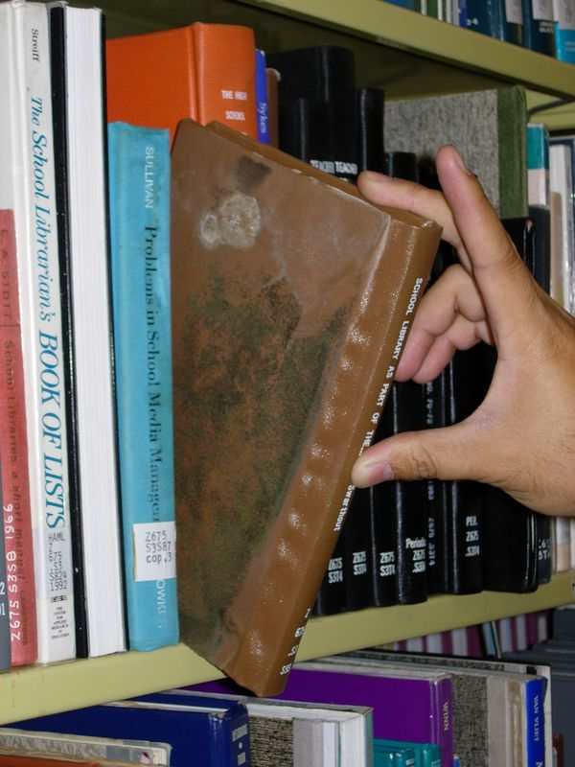
Feasible Validation
How do we know retained holdings exist and are in good-enough condition?
Physical review to confirm presence and condition is rare because of expense
Programs usually compensate for lack of validation by planned redundancy

Slide 26
EAST validation sampling study Spring 2016
40 libraries tested a random sample of 6,000 monograph volumes each
Avg=97%
Highest=99.7%
Lowest=91%
http://eastlibraries.org/validation

Slide 27
Integrated Resource-Sharing: Seamless Integration and Specialized Services
Lend service copies
Scan delivery
Print-on-demand
Digitize
Resource-sharing for shared print best served by:
Disclose retentions in WorldCat
Enhance resource-sharing systems to prefer shared-print copy, know about special services
“Responsibility for archiving of print monographs is best shared at the mega-regional or national level, while responsibility for servicing low-use print monographs is best shared at the micro-regional or local level.”
… Rick Lugg, Sustainable Collections Services (SCS), Sample & Hold blog post, January 16, 2014

Slide 28
Obstacles
Worry
Misaligned
Cost-Benefit
Lack of Infrastructure
Free riders may benefit but not pay
Faculty may object
Retaining libraries incur costs but others benefit
No common registry
No common resource-sharing
No common organization

Slide 29
How can OCLC Research Library Partners Help?
Treat shared print agreements as increasingly standard tools for collection management, in your dealings with administrators and faculty
Use your leverage to encourage OCLC to develop infrastructure to support shared print functionality

Slide 30
Selected Background Information
HathiTrust Shared Print Program https://hathitrust.org/shared_print_program
Dempsey, Lorcan, Brian Lavoie, Constance Malpas, Lynn Silipigni Connaway, Roger C. Schonfeld, JD Shipengrover, and Günter Waibel. 2013. Understanding the Collective Collection: Towards a System-wide Perspective on Library Print Collections. Dublin, Ohio: OCLC Research http://www.oclc.org/content/dam/research/publications/library/2013/2013-09.pdf.
Hale, Dawn, editor. Shared Collections, Collaborative Stewardship. Chicago: Association for Library Collections and Technical Services, American Library Association, 2016.
Lugg, Rick. “Shared Print Monographs: The Question of Scale”. Blog post January 16, 2014. http://sampleandhold-r2.blogspot.com/2014/01/shared-print-monographs-question-of.html
Stambaugh, Emily. “Curating Collective Collections: Reinventing Shared Print.” Presentation to OCLC's Collective Insight Series event October 15, 2013. https://www.youtube.com/watch?v=UjocSImazTc

Slide 31
Questions? Thank you!

