Slide 1
Baltimore, MD - 1 November 2017 * #oclcrlp
The interoperability imperative for libraries: supporting scholarly services and workflows
Rebecca Bryant
Roy Tennant
Senior Program Officer
@rebeccabryant18
orcid.org/0000-0002-0725-6493
Senior Program Officer
@rtennant
orcid.org/0000-0002-0725-6493

Slide 2
Today’s goals
Share with and learn from fellow RLP institutions
Do so within the context of recent OCLC Research & CNI research on scholarly communications topics
Consider past, present, and future needs—and interoperability
To inform future research directions & priorities for OCLC Research

Slide 3
PLAN FOR THE DAY
1. Discuss your current practices & OCLC Research into
  Research Data Management
  Research Information Management
  Institutional Repositories
Discuss the interoperability imperative
  Local interoperability/scaling
  Group scale activities between institutions/groups

Slide 4
PLAN FOR THE DAY
9:00 - 9:30 | Event begins, introductory comments
9:30 - 10:00 | Groups convene. Introduction & goals
10:00 - 10:45 | RDM discussion & exercise
10:45 -11:00 | BREAK
11:00-11:30 | RIM discussion & exercise
11:30-12:00 | IR discussion & exercise
Noon – 1:00 | LUNCH
1:00 -1:30 | Stitching costs (local interoperability)
1:30 - 2:00 | Group scale interoperability
2:00 – 2:30 | Collectively formulating key conclusions/goals for reporting out
3:30 - end | Entire conference reconvenes/reports

Slide 5
INTRODUCTION
Scope
Literature

Slide 6
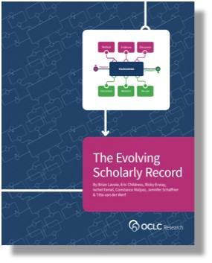
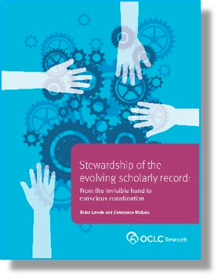
Assumptions
Changes to the evolving scholarly record are being driven by evolutions in technology
Interoperability is becoming a key priority
  Efforts to improve workflows for researchers & reduce admin burden
  RDM growing in importance
  North American institutions are increasingly adopting RIM
Adams Becker, S., M. Cummins, A. Davis, A. Freeman, C. Giesinger Hall, V. Ananthanarayanan, K. Langley, and N Wolfson. Horizon Report: 2017 Library Edition. Austin, TX: The New Media Consortium, 2017. http://cdn.nmc.org/media/2017-nmc-horizon-report-library-EN.pdf.
Lavoie, Brian, Eric Childress, Ricky Erway, Ixchel Faniel, Constance Malpas, Jennifer Schaffner, and Titia van der Werf. 2014. The Evolving Scholarly Record. Dublin, Ohio: OCLC Research.http://www.oclc.org/content/dam/research/publications/library/2014/oclcresearch-evolving-scholarly-record-2014.pdf.

Slide 7
Vice president for research
Medical center
Tech Transfer Office
CIO
News Bureau
Institutional Reporting
Research Data Management
Advancement & corporate relations
Provost
Data Warehouse
RIM/Profiling system
Digital scholarship
LIBRARY
Colleges & depts
Institutional Repository
User education & training
Disciplines & departments
Graduate school
Office of undergraduate research
Campus center for teaching & learning

Slide 8

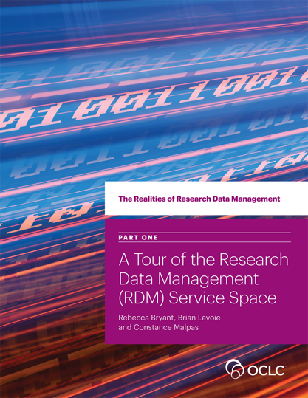
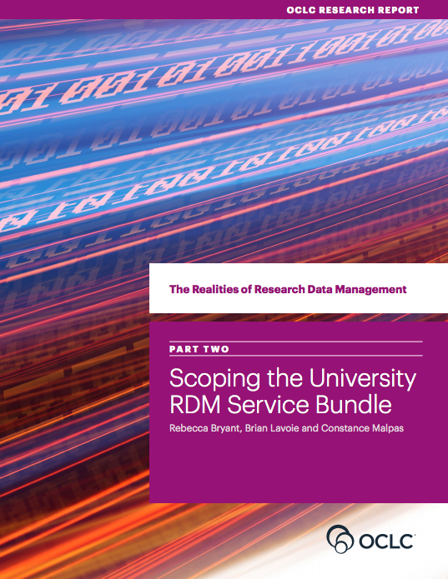
The Realities of Research Data Management
4-part series examining how research universities are developing RDM support services
4 institutional case studies
  University of Edinburgh (UK)
  University of Illinois at Urbana-Champaign (US)
  Monash University (Australia)
  Wageningen University & Research (the Netherlands)
oc.lc/rdm
Notes:
OCLC Research

Slide 9
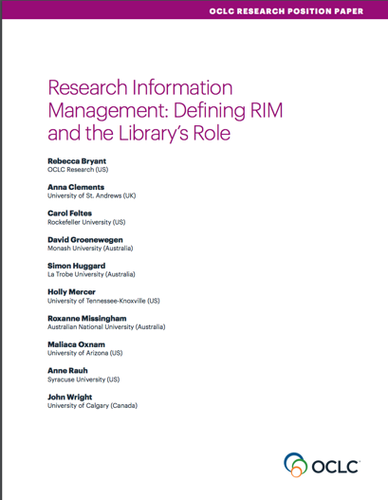
Defining Research Information Management & the Library’s Role
Persistent identifiers in a shifting landscape:
Case studies in European research information management
(forthcoming Nov 2017)
Survey of Research Information Management Practices
(take the survey!)
oc.lc/rim
Notes:
OCLC Research

Slide 10
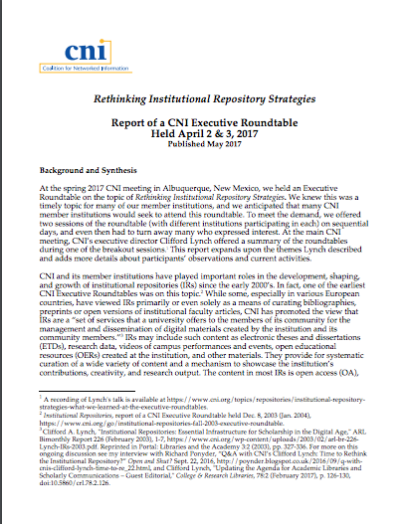
Rethinking Institutional Repository Strategies
How does the IR relate (or not) to other systems? RIM, RDM, repositories of digitized content?
Is it possible to have one system fulfill a variety of roles?
What next steps are you contemplating?
https://www.cni.org/wp-content/uploads/2017/05/CNI-rethinking-irs-exec-rndtbl.report.S17.v1.pdf

Slide 11
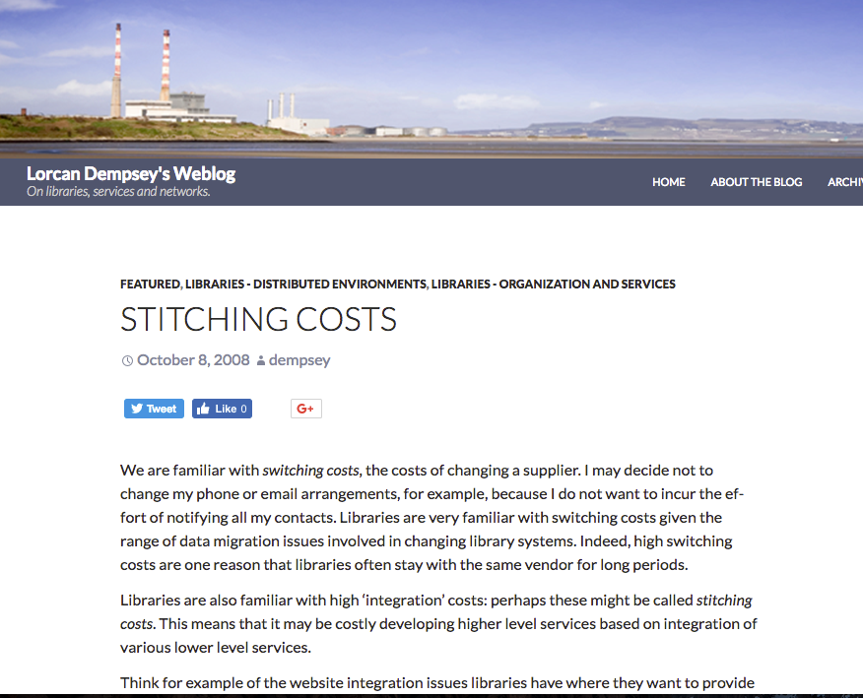
“Stitching costs”
Integration costs
Increased need for interoperable &/or integration between these 3 service categories
Institutional scale
Drivers include:
  > researcher workflows
  > metadata harvesting at scale
  > OA mandates/tracking needed
Dempsey, Lorcan. “Stitching Costs.” Lorcan Dempsey’s Weblog. October 8, 2008. http://orweblog.oclc.org/stitching-costs/.

Slide 12
Exercise 1
Vice president for research
What campus units do you CURRENTLY collaborate with?
Medical center
Tech Transfer Office
CIO
Institutional Reporting
News Bureau
Research Data Management
Advancement & corporate relations
Provost
Data Warehouse
RIM/Profiling system
Digital scholarship
LIBRARY
Colleges & depts
Institutional Repository
User education & training
Disciplines & departments
Graduate school
Office of undergraduate research
Campus center for teaching & learning

Slide 13
Group scale/integration
Are there benefits of working across institutions?
Can we increase efficiency? Reduce redundant efforts?
What problems can we solve by working at group scale?

Slide 14
The Realities of Research Data Management
Explores how research universities are addressing the challenge of managing research data throughout the research lifecycle
Case studies of four institutions
Offers model for RIM adoption
oc.lc/rdm

Slide 15
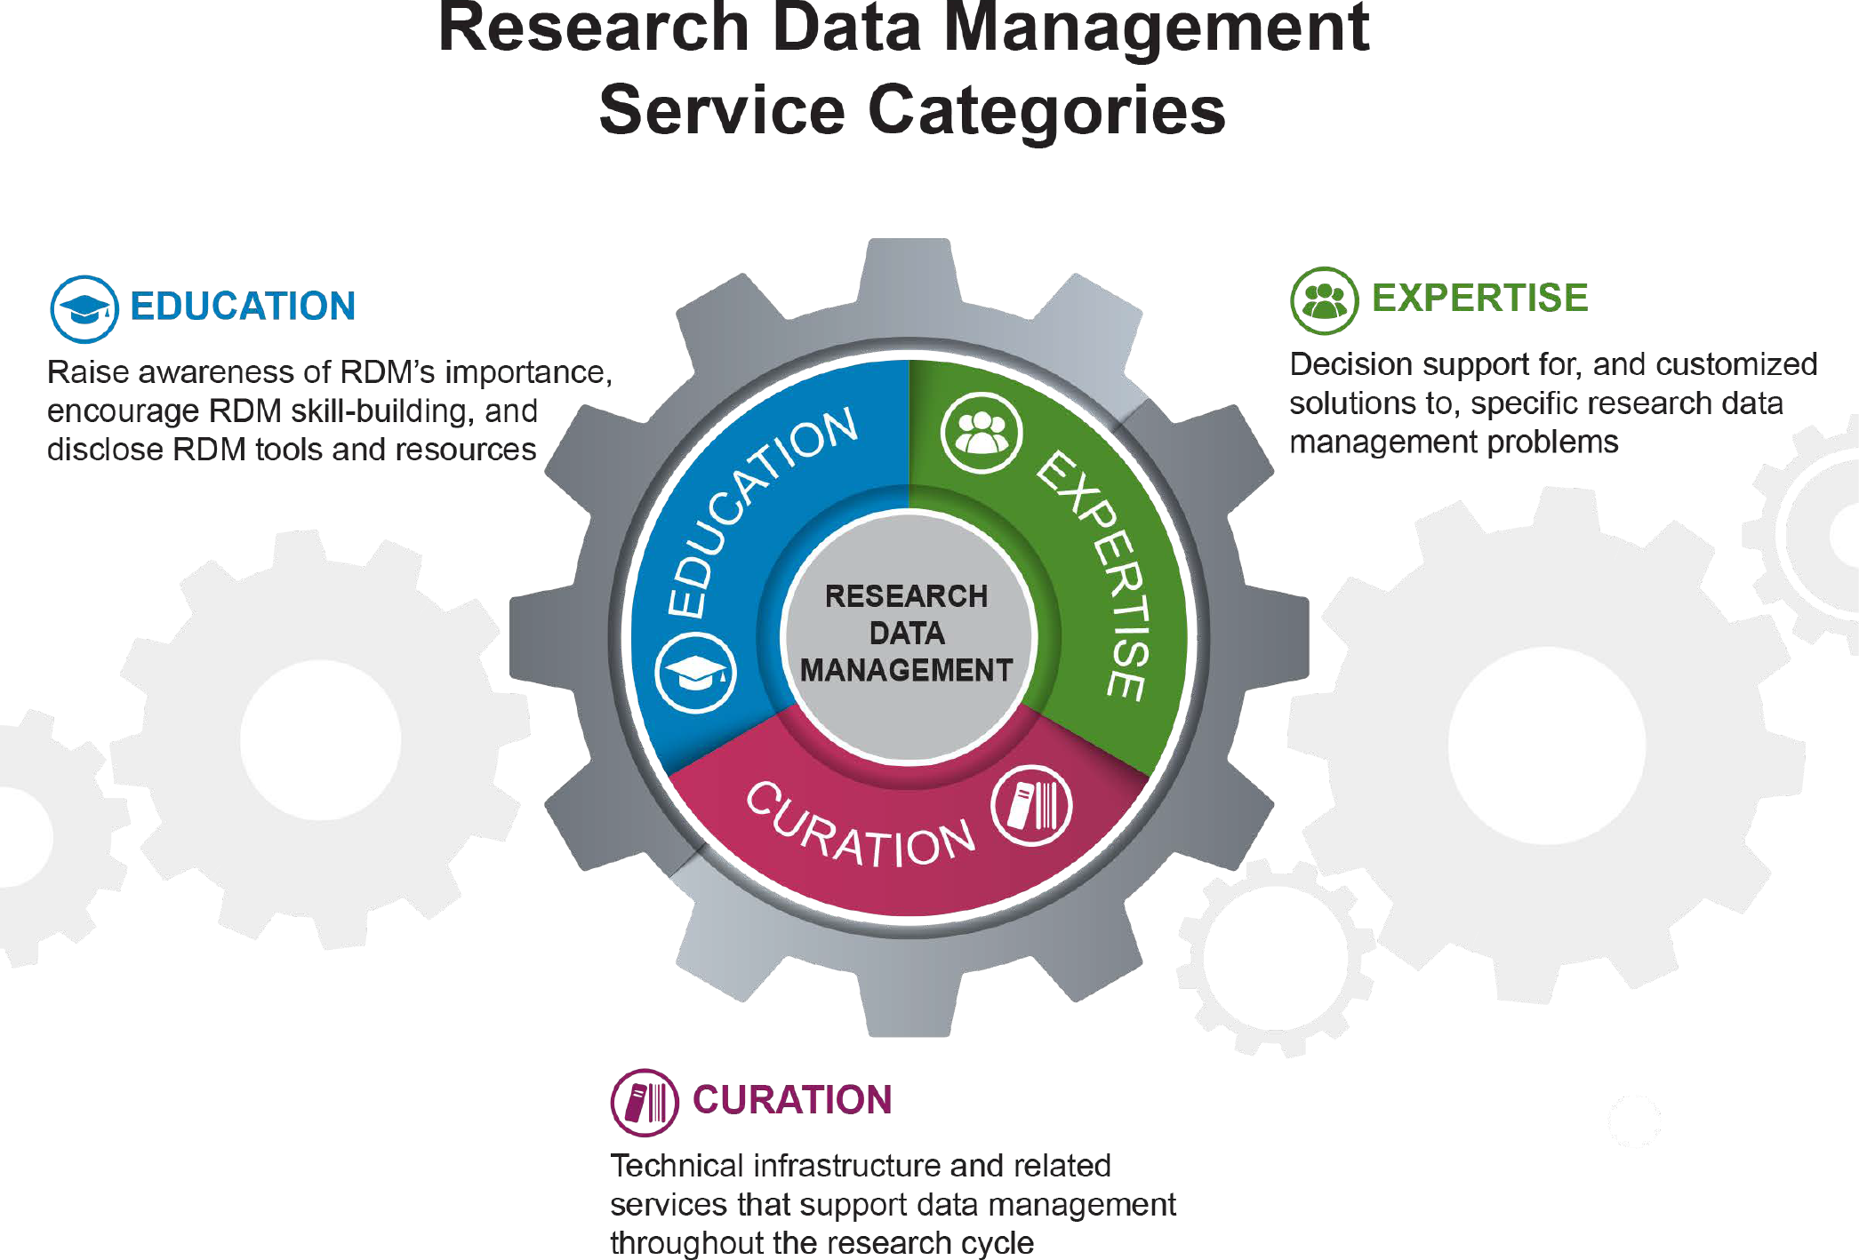
“RDM Service Categories” by OCLC Research, from The Realities of Research Data Management. Part One: A Tour of the Research Data Management (RDM) Service Space (https://doi.org/10.25333/C3PG8J), CC BY 4.0

Slide 16
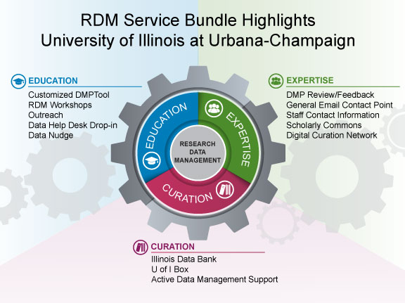
“RDM Service Bundle Highlights: University of Illinois at Urbana-Champaign” by OCLC Research, from The Realities of Research Data Management Part Two: Scoping the University RDM Service Bundle (https://doi.org/10.25333/C3Z039), CC BY 4.0

Slide 17
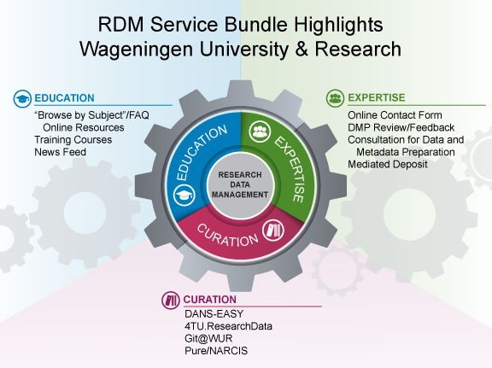
“RDM Service Bundle Highlights: Wageningen University & Research” by OCLC Research, from The Realities of Research Data Management Part Two: Scoping the University RDM Service Bundle (https://doi.org/10.25333/C3Z039), CC BY 4.0

Slide 18
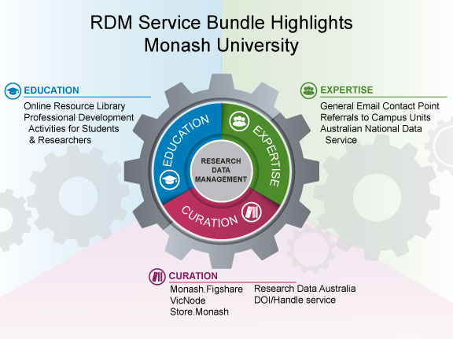
“RDM Service Bundle Highlights: Monash University” by OCLC Research, The Realities of Research Data Management Part Two: Scoping the University RDM Service Bundle (https://doi.org/10.25333/C3Z039), CC BY 4.0

Slide 19
Key findings for your reflection
Each institution’s offer is unique & shaped by local AND external factors
It may not be necessary for an institution to implement the full range of possible services
The RDM service bundle is NOT just local offerings, but also the external offerings researchers may use
  External data centers are important supplements
RDM curation services may or may not be subsumed in the IR

Slide 20
Exercise 2
Use this model to articulate the RDM service bundle at YOUR institution
      Current
      Planned
      Thinking about?
Discuss & share
Aggregate for group
“RDM Service Categories” by OCLC Research, from The Realities of Research Data Management. Part One: A Tour of the Research Data Management (RDM) Service Space (https://doi.org/10.25333/C3PG8J), CC BY 4.0

Slide 21
Education:
Expertise:
Curation:
“RDM Service Categories” by OCLC Research, from The Realities of Research Data Management. Part One: A Tour of the Research Data Management (RDM) Service Space (https://doi.org/10.25333/C3PG8J), CC BY 4.0

Slide 22
More OCLC Research on RDM
http://www.oclc.org/research/themes/research-collections/rdm.html
  If You Build It, Will They Fund? Making Research Data Management Sustainable, 2016.
  Building Blocks: Laying the Foundation for a Research Data Management Program, 2016.
  Starting the Conversation: University-wide Research Data Management Policy, 2013.
Webinar, Policy Realities in Research Data Management, featuring the University of Illinois and Wageningen University. http://www.oclc.org/research/events/2017/07-25.html

Slide 23
BREAK

Slide 24
Research Information Management: Defining RIM and the Library’s Role
Provides an international framework for understanding RIM practices
Synthesizes the value proposition of libraries in RIM service provision
Developed in collaboration with RLP member librarians on 3 continents
oc.lc/rim

Slide 25


What is Research Information Management (RIM)?
The aggregation, curation, & utilization of metadata about research activities
    Overlapping terms:
    CRIS (Current Research Information System)
    RIS (Research Information System)
    RNS (Research Networking System)
    RPS (Research Profiling System)
    FAR (Faculty Activity Reporting)
    RIMs ≠ social networking platforms like ResearchGate or Academia.edu
    RIM ≠ Research Data Management (RDM)

Slide 26
“RIM Metadata” by OCLC Research, from Research Information Management: Defining RIM and the Library’s Role (doi.org/10.25333/C3NK88), CC BY 4.0

Slide 27
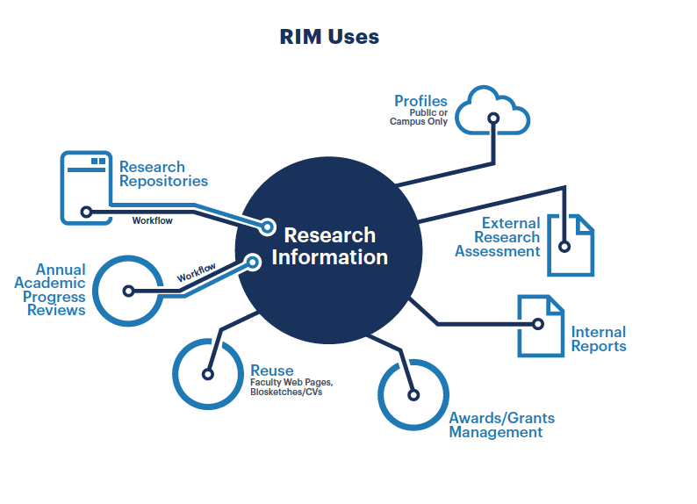


Slide 28
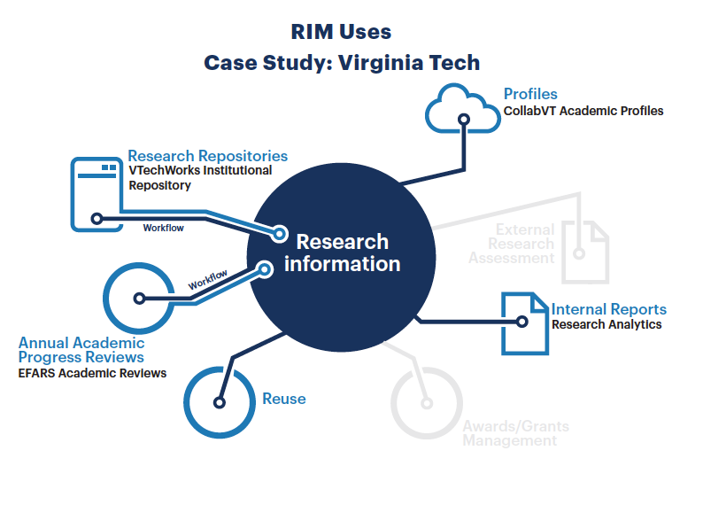

Slide 29
Exercise 3
Identify the RIM uses at YOUR institution
    Current
    Planned
Discuss & share
Aggregate for group

Slide 30
“RIM Uses” by OCLC Research, from Research Information Management: Defining RIM and the Library’s Role (doi.org/10.25333/C3NK88), CC BY 4.0

Slide 31


Survey on Research Information Management Practices
oc.lc/rim
PLEASE participate
Survey closes January 2018
Jointly developed by
Global survey to learn about RIM activities, drivers, & practices
Survey findings and data will be published CC-BY in 2018

Slide 32
Rethinking IR Strategies
Many institutions have had an IR for 5-15 years​; time for assessment?
What were our goals? Are we meeting them?
Can what the IR supports be done better by something else?
https://www.cni.org/wp-content/uploads/2017/05/CNI-rethinking-irs-exec-rndtbl.report.S17.v1.pdf

Slide 33
Discussion/synthesis of report
Spotty adoption by campus faculty
Shifting systems ecology
Appropriate role(s) for the IR?
Potential multiple systems providing similar services
Aging infrastructure
Lack of unified discovery

Slide 34
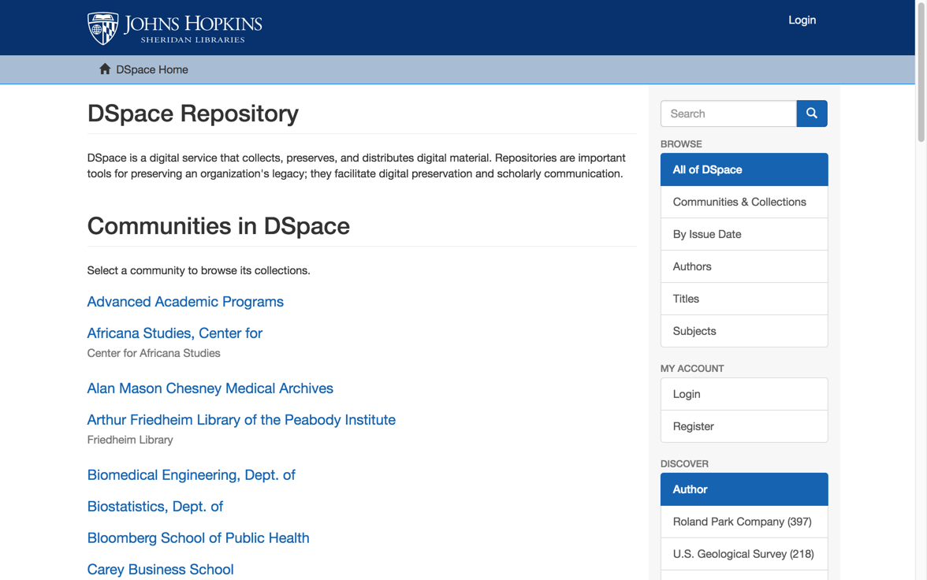
Exercise 4
Discuss the role of your institutional repository, both now and what you see for the future
Aggregate for the group

Slide 35
LUNCH

Slide 36
PART 4: Stitching costs
We’re seeing transformations in this landscape, particularly outside the US
Examples
Where do you think your systems are going—where do you want to be in 5 years?

Slide 37
IR-RIM-RDM at Monash University
ARROW IR
Institution-scale
Group-scale
Grey literature, working papers, data & media files
Theses
Private or public (useful for active data management & collaboration)
decommissioned
Theses & data sets migrated
Research Data Australia
Monash.figshare
Publications
migrated
Discovery
Goal:
interoperability
Research Data Services/ VicNode
MyResearch
RIM
Integrated RIM/IR approach
Complete campus bibliography with metadata on all publications
Stores & provides links to OA publications
Elsevier Pure product
Preservation
https://www.monash.edu/library/about/initiatives/repository

Slide 38
Discussion
Do library problems intersect with other institutional problems? Are there other stakeholders to collaborate with?
What do you think you will need to offer your institution & researchers in 5 years?
Do you think new technologies, products, and service categories may emerge or blend together?
How can OCLC Research investigations help inform these questions?
How many systems does your researcher have to sign into to report on their activities, share their research, and promote their professional identity?
How do your systems interoperate today? Do they need to? What problems are you trying to solve?
What about their:
    Ease of workflows for researchers?
    Functionality?
    Scalability? Age?
    Support institutional AND library goals?

Slide 39
Exercise 5
Vice president for research
To get to where you think you need to go, who do you NEED to develop relationships with?
Medical center
Tech Transfer Office
CIO
Institutional Reporting
News Bureau
Research Data Management
Advancement & corporate relations
Provost
Data Warehouse
RIM/Profiling system
Digital scholarship
LIBRARY
Colleges & depts
Institutional Repository
User education & training
Disciplines & departments
Graduate school
Office of undergraduate research
Campus center for teaching & learning

Slide 40
“Libraries in Research Information Management” by OCLC Research, from Research Information Management: Defining RIM and the Library’s Role (doi.org/10.25333/C3NK88), CC BY 4.0

Slide 41
PART 5: Group scaling/integration
We’re seeing transformations in this landscape, particularly outside the US
Where do you think your systems are going—where do you want to be in 5 years?
Distributed vs centralized?

Slide 42



Group scale efforts in the Netherlands
Group-scale data curation
Group-scale aggregation: combined IR/RIM/RDM
DANS-EASY RDM
4TU RDM
RIM/IR
RIM/IR
RIM
IR
https://www.narcis.nl/
Notes:
CRIS aggregation in the Netherlands

Slide 43

United States
Data centers, preprint repositories
IR
RIM/IR
IR
RIM
RDM
Notes:
SHARE has 165 aggregated sources as of Oct 24, 2017

Slide 44
Canada
?
National- & group-scale data centers
IR
RDM
IR
RIM
IR
RDM

Slide 45
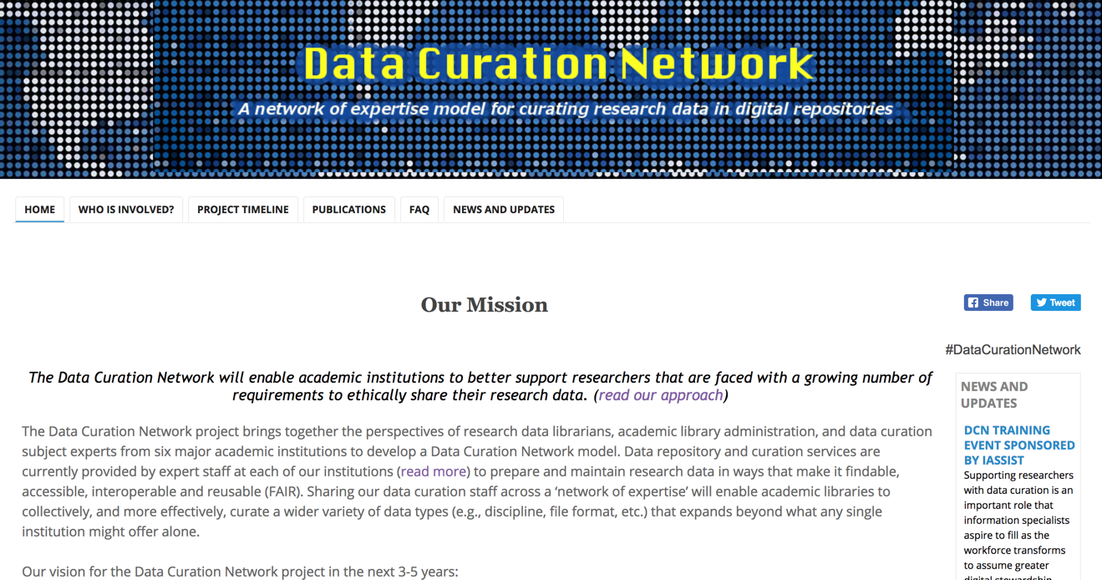
Group scale RDM expertise: Data Curation Network
https://sites.google.com/site/datacurationnetwork/

Slide 46
Discussion
What do you need that you can’t do on your own? Or that you don’t want to do on your own?
How are you working across institutions?
What scale would you naturally turn to? Consortium?
Data curation expertise?
Improved aggregation? Of RIM? Of IRs? Of data? Of all 3?
How can OCLC Research investigations help inform these questions?

Slide 47
What’s Next?
Notes will be synthesized and result in a Hanging Together blog post
We’d like to repeat this conversation with partners in EMEA, AUS/NZ in future
This conversation informs a nascent program of research at OCLC Research about interoperability and its role in supporting the evolving scholarly record
Continued engagement with RLP as that research developments—let us know if & how you want to remain engaged

Slide 48
What’s Next?
Contribute your institutional experiences to the Survey on Research Information Management Practices
  oc.lc/rim
Consider sharing your institutional successes, leadership, & collaborations in a Works in Progress webinar
Future opportunities for RLP collaborations, conversations
What do you take back to your institution? How will you do this? What is your messaging to other stakeholders at your institution?

Slide 49
Key takeaways

Slide 50
RECONVENE as large group

