Slide 1
Libraries and the University Research Enterprise: An International Perspective
Rebecca Bryant, PhD
Simon Huggard
Anne Rauh
OCLC Research, USA
La Trobe University Library, Australia
Syracuse University Libraries, USA
orcid.org/0000-0002-2753-3881
bryantr@oclc.org
@rebeccabryant18
orcid.org/0000-0002-0365-112X
s.huggard@latrobe.edu.au
@simonhuggard
orcid.org/0000-0001-8323-2314
aerauh@syr.edu
@AnnieRauh

Slide 2
OCLC: A global network of libraries
EMEA
3,734 members in 69 countries
Americas
Asia Pacific
10,817 members in 27 countries
1,580 members in 24 countries
Notes:
OCLC is a global library cooperative that provides shared technology services, original research and community programs for its membership and the library community at large.
OCLC libraries are part of an active and engaged global network of libraries with more than 16,000 members across 120 countries.
Global network provides unparalleled access to the world’s collected knowledge in ways that cannot be achieved independently
Ability to address shared challenges at scale
Together, we connect people to the information they need to achieve their goals

Slide 3
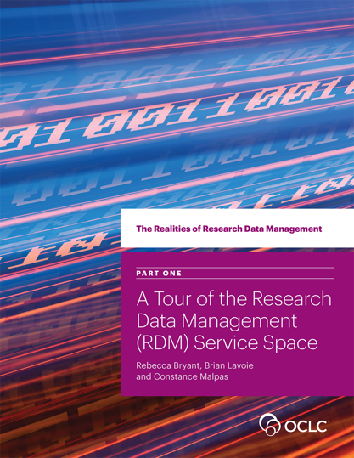
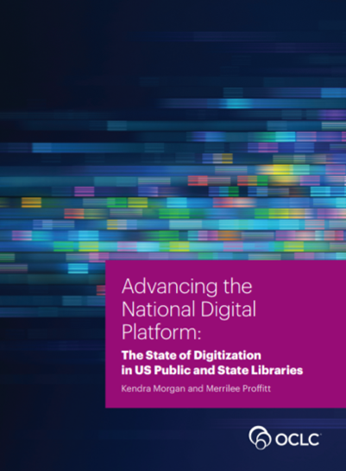
OCLC Research
Division of OCLC
Devoted to challenges facing libraries and archives since 1978
Community resource for shared Research and Development (R&D)
Engagement with OCLC members and the community around shared concerns
oc.lc/rdm
oc.lc/NatlDigitalPlatform
Notes:
OCLC Research
Sample reports published by OCLC Research on topics such as Digitization and Research Data Management

Slide 4
OCLC Research Library Partnership (RLP)
~150 research libraries worldwide
Facilitates collaboration, research, & sharing across member institutions & with OCLC Research
  Working groups
  Research reports
  Webinars
  Consultations & events
www.oclc.org/research/partnership.html

Slide 5
Research Information Management:
Defining RIM and the Library’s Role
Position paper published 10/19/17
Rebecca Bryant, OCLC Research
Anna Clements, University of St Andrews
Carol Feltes, Rockefeller University
David Groenewegen, Monash University
Simon Huggard, La Trobe University
Holly Mercer, University of Tennessee, Knoxville
Roxanne Missingham, Australian National University
Maliaca Oxnam, University of Arizona
Anne Rauh, Syracuse University
John Wright, University of Calgary
More information at:
oc.lc/rim
Notes:
Provides an international framework for understanding RIM practices
Synthesizes the value proposition of libraries in RIM service provision
oc.lc/rim

Slide 6
Report Description
The goal of this report is to help libraries and other institutional stakeholders understand developing research information management practices—and particularly the value add that libraries can offer in this complex ecosystem.
  It offers a definition of RIM practices and nomenclature, offering models to explain the metadata sources, uses, and institutional stakeholders.
  It also provides examples and models of library engagement in RIM.

Slide 7

What is Research Information Management?
The aggregation, curation, & utilization of metadata about research activities
    RIMs are not:
      Social networking platforms
      Research Data Management
Notes:
An ecosystem, not a single system or platform
Increasingly more than the most “current” information
Our interest is in how institutions are managing research information, not how information is being managed in social media platforms like Research Gate outside the institution.

Slide 8

Why call it Research Information Management?
An ecosystem, not a single system or platform
Increasingly more than the most “current” information
        Overlapping terms:
          CRIS (Current Research Information System)
          RIS (Research Information System)
          RNS (Research Networking System)
          RPS (Research Profiling System)
          FAR (Faculty Activity Reporting)

Slide 9
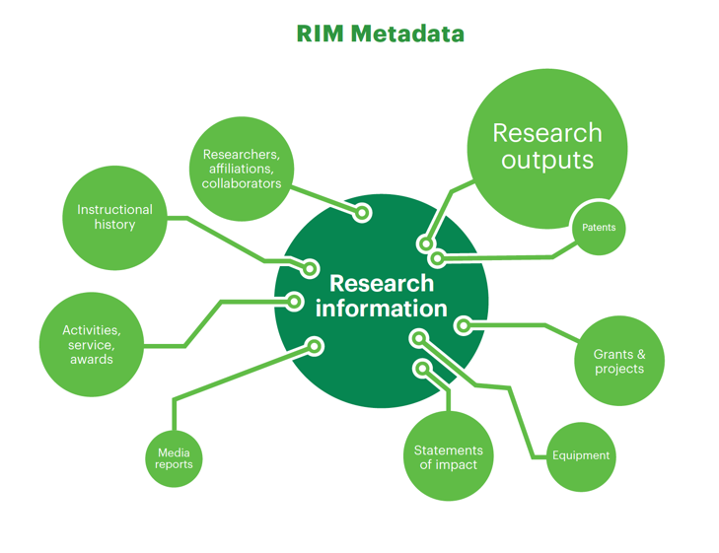
RIM Metadata

Slide 10
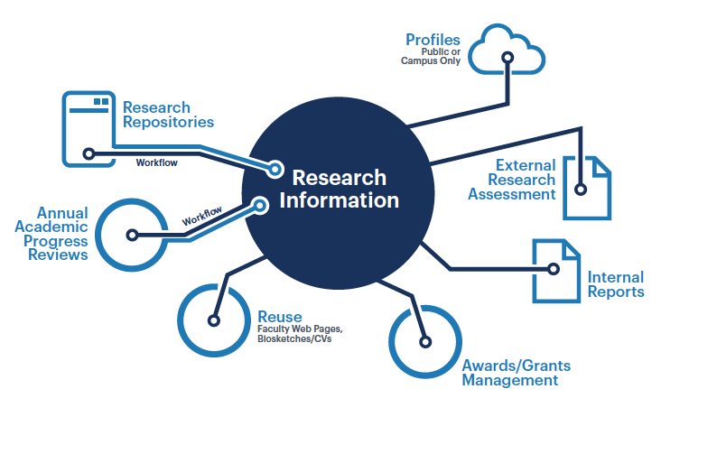
RIM Uses

Slide 11
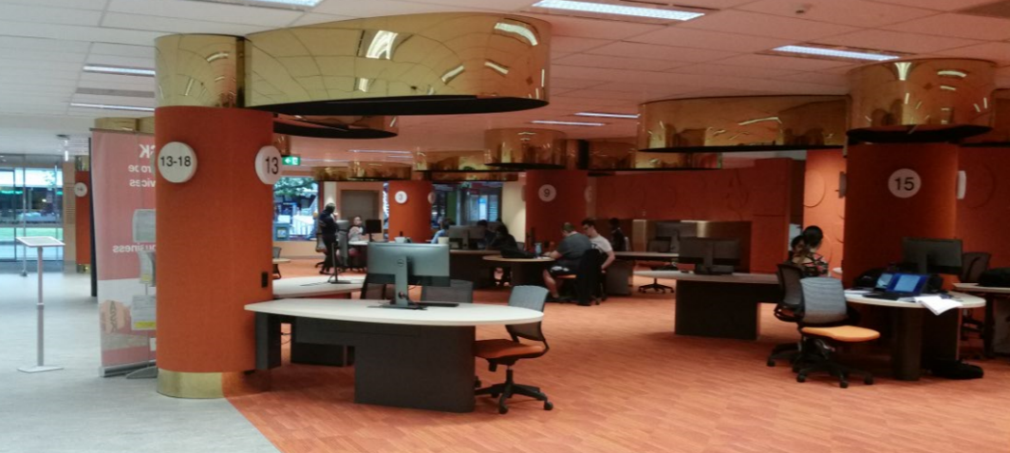
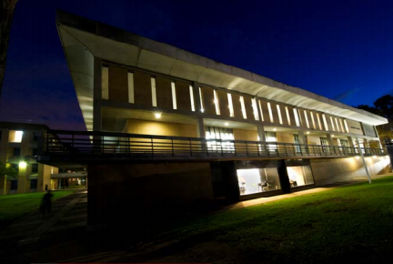
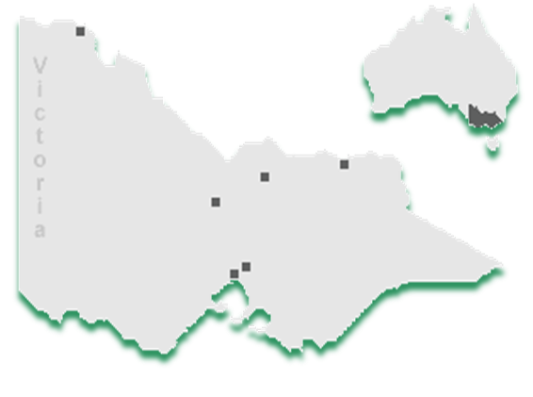

La Trobe University (Victoria, Australia)
Established in 1964
More than 36,000 students (27, 971 full-time equivalent)
20% are graduate students (6,847) ; 1,636 Research students
23% are international (8451) ; 1,488 Faculty academic staff
Main campus in Melbourne; 4 regional campuses in the state of Victoria
$26m Library budget (AUD); $14m Information Resources budget

Slide 12
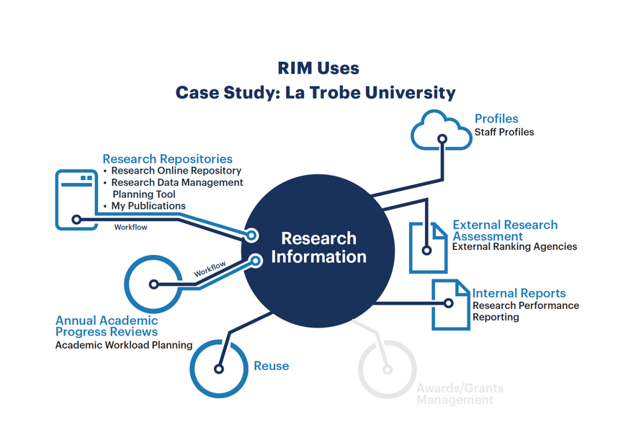
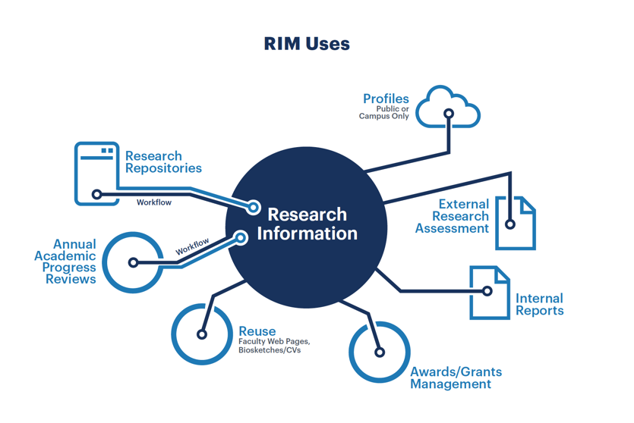

Slide 13
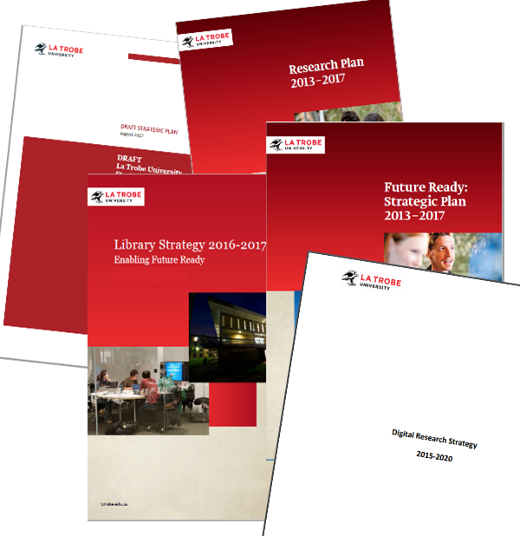
La Trobe University Strategic Goals and Plans
Improve research quality and impact
Support excellent research
Investment in state of the art IT and
e-Research infrastructure
Improve La Trobe’s international
ranking by promoting research
Increase research quantity and quality
Notes:
University Future Ready Strategic Plan 2013-2017; Research Plan 2013-2017 ; Library Strategy 2016-2017; Digital Research Strategy 2015-2020.

Slide 14
Initiatives and projects
Library-led research data management initiative 2015-
Digital Research Strategy 2015-2018
Enterprise Research Data Management Systems (ERDMS) Project 2016-2018
Project for Research Information Management Enablement (PRIME) 2017-2019
Projects will unify researchers’ digital presence and simplify their research workflows

Slide 15





Australian Research Information
Management Landscape
Government reporting
Funder mandates
Changing policies
Australian Code for the Responsible Conduct of Research

Slide 17

Syracuse University (Syracuse, NY, USA)
Private research university
In the 2015 Carnegie Classification of Institutions of Higher Education, moved from R2 to R1
15,000 undergraduates
5,000 graduate students
Located in Central NY
Notes:
Stu

Slide 18

Syracuse University Rim Goals
Find Expertise
Grow Collaboration
Propel Research
Notes:
Stu
Discuss background of selection process
Who was consulted
When were stakeholders identified
Discuss Syracuse ‘Team Approach’
To our audience assess your readiness, staffing and project goals to ensure success.

Slide 19
Challenge 1: Identifying Expertise
No systematic way to identify which faculty do what research
No expertise database
No way to see interdepartmental or cross-college collaborations
Notes:
We had a series of challenges to solve
We can tell the story of Peter being a new VPR and not having a tool to look at research holistically

Slide 20
Challenge 2: Matching Funding
No systematic way to align funding opportunities with researchers
University’s other funding search mechanisms require significant researcher effort
Notes:
Stu

Slide 21
Challenge 3: Reduce Burden
Reduce duplicate efforts to maintain publication records and grant information across campus
Reduce faculty time spent keeping multiple profiles up to date
Facilitate outsiders to quickly find experts or potential collaborators
Potential for simplifying data collection and reporting for internal and external requests
Notes:
Stu

Slide 22
Who?
Enterprise-wide collaboration and the role of the library

Slide 23
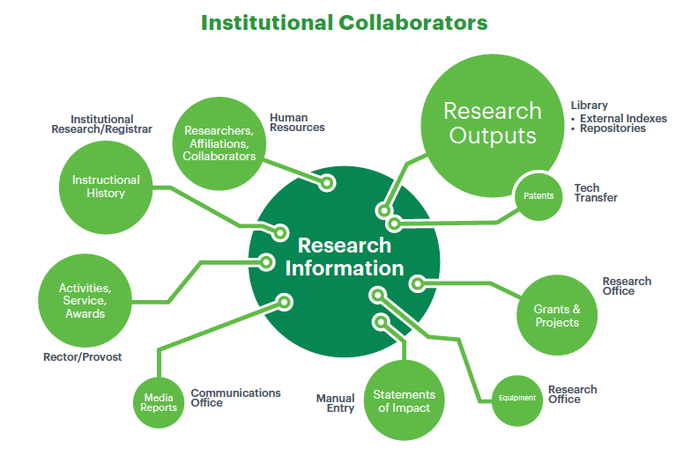
Institutional Collaborators
Notes:
Opportunities to leverage through collaborations to address other institutional challenges
Opportunities to better address local goals by understanding the problems others at the institution are trying to solve.
Provost & institutional research
Research Office
Campus communications
Library
Researchers!

Slide 24
Doing More. Together.
Opportunities to leverage through collaborations to address other institutional challenges
Opportunities to better address local goals by understanding the problems others at the institution are trying to solve.
  Provost & institutional research
  Research Office
  Campus communications
  Library
  Researchers!

Slide 25
Syracuse University Division of Responsibilities
Office of Research
Office of Sponsored Programs
Libraries
Understanding of research infrastructure
Queries from HR tables for profile updates
Master profile list maintenance
Data hierarchy structures
Understanding of funding landscape
Data feeds from Sponsored Programs
Promote the usage of the Funding Discovery module
Promote networking to facilitate research growth
Understanding of scholarly publishing
XML support
Hands-on training
Scopus expertise
API integration of other data sources (WorldCat, Web of Science, etc.)
Notes:
Annie

Slide 26
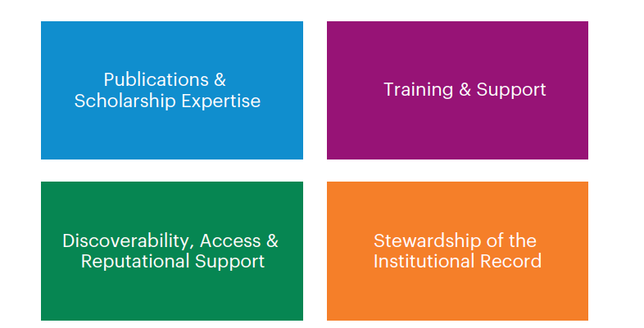
Libraries in Research Information Management

Slide 27
Why Libraries?

Slide 28
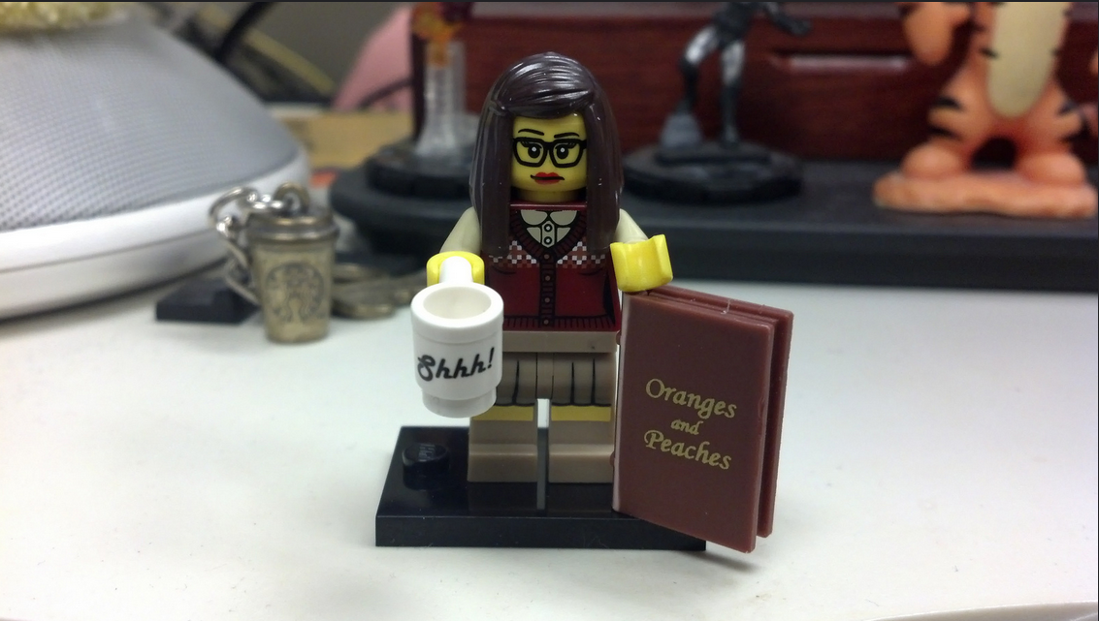
Librarian Skills
Notes:
Skills that librarians bring are essential to making these tools work
Libraries understand subtle challenges of using aggregated data, distinctions amongst disciplines, challenges with interpreting journal or book based metrics, etc.
Xml story at SU

Slide 29



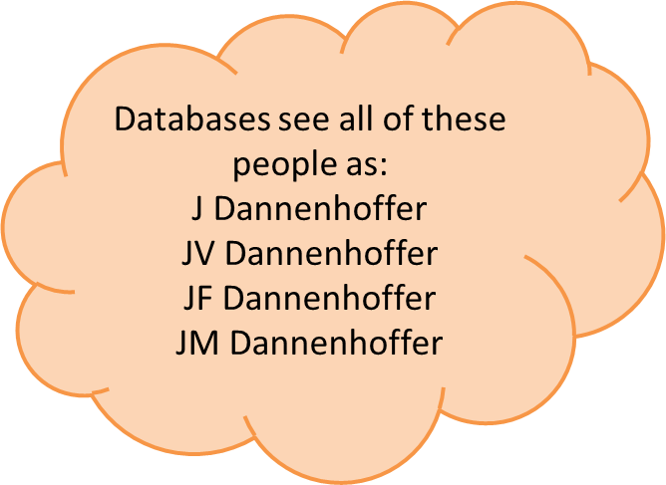


Author Disambiguation in Publications
(spouses)
(siblings)
Joan V. Dannenhoffer
Syracuse University
John F. Dannenhoffer III
Syracuse University
Joanne M. Dannenhoffer
Central Michigan University
(siblings)
Joanne V. Dannenhoffer
M.D. May 2013
John F. Dannenhoffer IV
Engineer, Pratt & Miller
Notes:
Annie
Nephew – Thomas Dannenhoffer-Lafage is a chemistry PhD candidate at University of Chicago
John’s brother – Dr. Robert Dannenhoffer, Roseburg Oregon MD
John’s cousin – Ray Dannenhoffer is professor at University of Buffalo Med school
You may be able to distinguish your own publications, others cannot
The data is good, it isn’t always perfect. Librarians can help untangle issues in Pure and Scopus data about your faculty and their work.

Slide 30


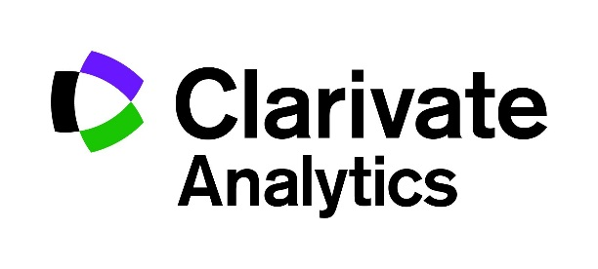











Information Market
Notes:
Annie
Many of these tools come from companies libraries already work we have an understanding of their relationships
Every time we’ve shown this tool to a group, we get asked, why isn’t Web of Science data included instead of Scopus

Slide 31
Survey on Global RIM Practices
Rebecca Bryant, OCLC Research
Pablo de Castro, University of Strathclyde & euroCRIS
Anna Clements, University of St Andrews & euroCRIS
Jan Fransen, University of Minnesota, Twin Cities
Constance Malpas, OCLC Research
Michele Mennielli, DuraSpace & euroCRIS
Rachael Samberg, University of California, Berkeley
More information at:
oc.lc/rim
Notes:
Open until January
Results published in 2018
Survey data will be published CC-BY
Survey seeks input from institutions at all stages of RIM adoption
This survey will help us understand and report on the state of RIM activities worldwide, and it seeks answers to the following questions:
Why?
We want to identify the different drivers for RIM adoption worldwide
How?
We want to understand how institutions are USING RIM functionality
What?
Processes, systems, interoperability & scope – other systems, which campus populations?
Who?
Stakeholders & collaborators – how much staffing, from where on campus
ONE SURVEY per institution

Slide 32
What?
Processes, systems, interoperability & scope
System(s) in use & when implemented
Interoperability with internal & external systems
Sources of publications metadata
Use of persistent identifiers & vocabularies
Which campus populations are included in the RIM?
All disciplines?
How many researchers are included?

Slide 33
Who?
Stakeholders & collaborators
Who are the institutional stakeholders involved in RIM adoption?
What’s the specific role of the library?
Staff resources?
Outreach & education activities?
Measures of success?

Slide 34
Who Should Participate?
Universities, research institutes, and other organizations supporting research and research management
Institutions should participate regardless of the status of RIM implementation
  In production
  In process of implementation
  Exploring RIM options
Only one survey per institution

Slide 35
Survey Timeline
Survey launched October 18
  Spanish language coming November, thanks to CONCYTEC
  Closes mid-January
Survey results will be published in 2018 as an OCLC Research report and made openly available to the community.
Survey data will be published CC-BY
More information at:
oc.lc/rim

Slide 36
Questions?
Rebecca Bryant, PhD
Simon Huggard
Anne Rauh
OCLC Research, USA
La Trobe University Library, Australia
Syracuse University Libraries, USA
orcid.org/0000-0002-2753-3881
bryantr@oclc.org
@rebeccabryant18
orcid.org/0000-0002-0365-112X
s.huggard@latrobe.edu.au
@simonhuggard
orcid.org/0000-0001-8323-2314
aerauh@syr.edu
@AnnieRauh

