Slide 1
IIPC, London Web Archiving Week
16 June 2017
Best Practices for Descriptive Metadata
Recommendations of the OCLC Research Library Partnership
Web Archiving Metadata Working Group
Alexis Antracoli, Karen Stoll Farrell, Jackie Dooley
oc.lc/wam

Slide 2
THE PROBLEM

Slide 3
Archived websites often are not easily discoverable via search engines or library and archives catalogs and finding aid systems, which inhibits use.
Absence of community best practices for descriptive metadata was the most widely-shared web archiving challenge identified in two surveys:
OCLC Research Library Partnership (2015)
Weber/Chapman study of users of archived website (2016)

Slide 4
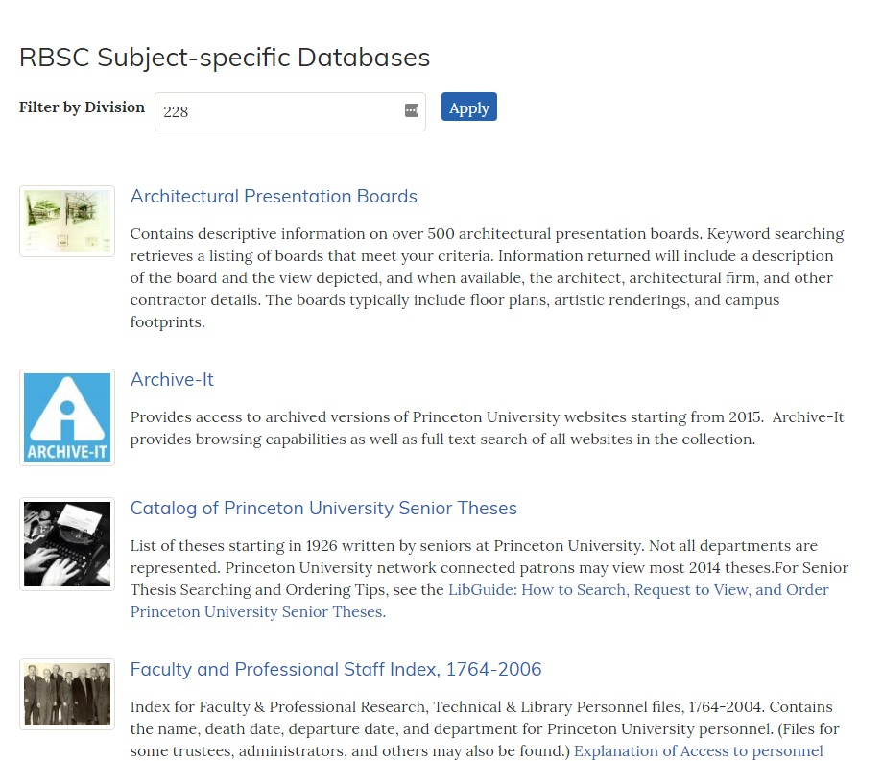
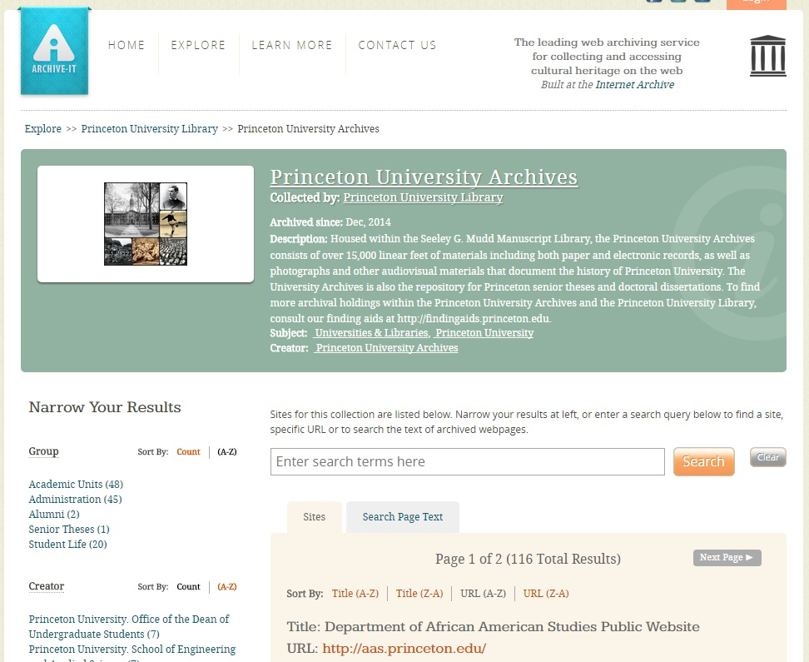

Slide 5
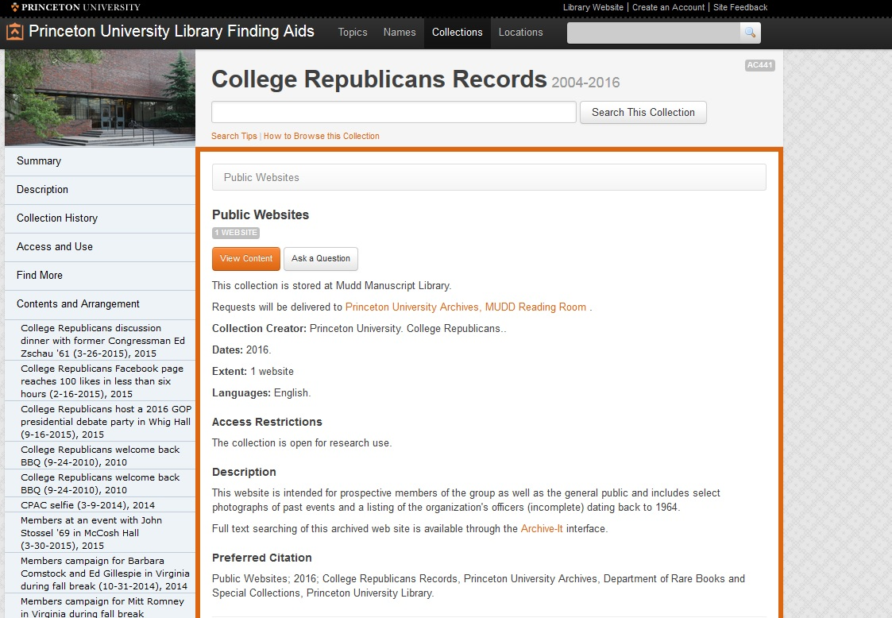

Slide 6
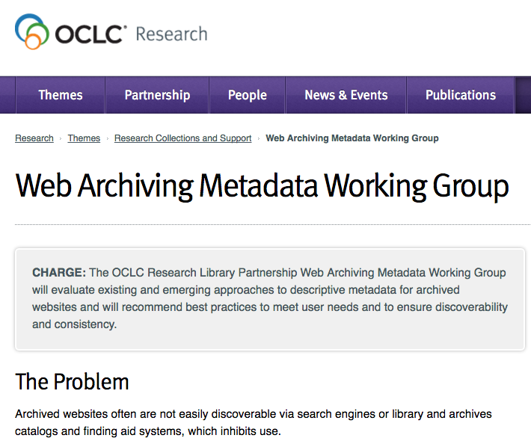
OCLC RESEARCH LIBRARY PARTNERSHIP
WEB ARCHIVING METADATA WORKING GROUP

Slide 7
Objective
Recommend best practices for web archiving descriptive metadata that are community-neutral and standards-neutral
A set of defined data elements (i.e., a data dictionary)

Slide 8
Outputs (July 2017)
Literature review to inform our understanding of documented user needs and behaviors
Best practices for descriptive metadata address both single-site and collection approaches
Analysis of descriptive metadata functionalities of eleven harvesting tools [not covered in today’s session]

Slide 9
LITERATURE REVIEWS
Bailey et al. Ben-David & Huurdeman Bernstein Bragg & Hanna Costa Costa & Gomes Costa & Silva Cruz & Gomes Dougherty & Meyer Galligan Gatenby Gibbons Goel Goethals Guenther Hartman et al. Hockx-Yu Jackson Jones & Shankar Lavoie & Gartner Leetaru Mannheimer Masanès Milligan Murray & Hsieh Neubert Niu O’Dell Peterson Phillips & Koerbin Pregill Prom & Swain Ras & van Bussel Reynolds Riley & Crookston Stirling et al. Sweetser Taylor Thomas et al. Thurman & O’Hanlon Tillinghast Truman Weber&Graham Webster Wuet al. Zhang et al.
Notes:
Created two literature reviews, one focused on end users needs and the other on metadata practitioners. We recognized at the outset of our work that this was a necessary prelude to defining best practices.
Purpose of report is to inform community-wide understanding of document user needs and behaviors. This will serve as evidence to determine best practice guidelines for web archiving metadata.
We identified and gathered over 60 articles, reports, blog posts, conference presentations, and social media exchanges that were related to in some way to metadata needs for users and practitioners of web archives.
From abstracts we created a synthesis of findings based on main topics that emerged from readings.

Slide 10
Who are the end users of web archives?
Digital humanists
Web scientists
Computer scientists
Data analysts
Journalists
Lawyers
Website owners
Website designers
Government employees
Genealogists
Patent applicants
Instructors
Students
Linguists
Sociologists
Political scientists
Historians
Anthropologists
Notes:
Various topologies in the literature. Primarily focused on academic-ish research. Some national libraries have conducted studies including the general public, but not much detail is known about them.

Slide 11
How are they using web archives?
Read specific web pages/sites
Data and text mining
Technology development
Notes:
Academic researchers in history and social sciences - may be looking at the actual content of web pages - looking for information
Digital humanists and data analysts - using web archives for data and text mining
Web and computer scientists - technology development, systems

Slide 12
What behaviors do they use?
Costa and Silva (2010) classify needs into three behavioral groups; much cited by others.
Navigational
Informational
Transactional
Notes:
Navigational: find a specific website that the user already has in mind
Informational: collect information about a topic from multiple sources
Transactional: perform a web-mediated activity such as downloading a file, which is often a first step to combining large amounts of data across multiple web archives

Slide 13
Takeaways for end-user needs
Flexible Formats
Engagement
Access and re-use/rights statements
Archived vs. live
Subject access
Notes:
raw data presents a high barrier to use by those new to web archiving - user friendly interfaces are desirable with federated searching across archives. On the other hand, researchers want to be able to extract and re-purpose the data - it needs to be flexible.
Meghan Dougherty has talked about the need for more engagement between practitioners and researchers, but that engagement extends further in relation to metadata - researchers want to be able to access and add their own metadata
Users want clarity about access and re-use...at least, as much as we can give them.
Archived vs. live
Adding context (will come up again soon) is highly important. Users want subject and topic information.

Slide 14
“Provenance” metadata
“The critical missing piece”
Provides context
Why was the content archived?
Selection criteria
Scope
Notes:
Provenance from users’ perspectives: why, when and by whom a website was created and collected

Slide 15
Takeaways for metadata practitioners
Archival and bibliographic approaches
RDA, MARC, Dublin Core, MODS, finding aids, DACS
Data elements vary widely
Same element name, different meanings
Level of description
Single site, collection of sites, seed URLs
Scalability and limited resources
Notes:
Much of this was confirmed by our review of institution-specific metadata guidelines.

Slide 16
DEVELOPING DESCRIPTIVE METADATA BEST PRACTICES
Notes:
Websites are messy. No standards for presentation of data elements such as exist for published materials.
How does a metadata practitioner decide which elements of a site are most important to translate into metadata? And then how to formulate the content of each of those elements?

Slide 17
Methodology
Analyze metadata standards & institutional guidelines
RDA (libraries), DACS (archives), Dublin Core (simplified)
Evaluate existing metadata records “in the wild”
WorldCat, ArchiveGrid, Archive-It
Identify dilemmas specific to web archiving
Incorporate findings from literature reviews
Prepare data dictionary and report narrative

Slide 18
WEB-SPECIFIC DILEMMAS

Slide 19
Is the website creator/owner the … publisher? author? subject?
Should the title be … transcribed verbatim from the head of the site? Edited to clarify the nature/scope of the site? Append e.g. "web archive”?
Which dates are important/feasible other than capture dates? Beginning/end of the site's existence? Date of the content? Copyright?
How should extent/size be expressed? 1 archived website? 1 online resource? 6.25 Gb? approximately 300 websites?
Is the host institution that harvests and manages the archived content the repository? creator? publisher? selector?

Slide 20
Is it important to clearly state that the resource is a website? If so, where? In the title? description? extent statement? all of these?
Does provenance refer to …the site owner? the repository that harvests and hosts the site? ways in which the site evolved?
Does appraisal mean …the reason the site warrants being archived? a collection of sites named by the repository? the parts of the site that were harvested?
Which URLs should be included? Seed? access? landing page?
Notes:
for most institutions the publisher was optional; for others it was mandatory.
And hey, what does “place of publication” mean on the web?

Slide 21
RECOMMENDED BEST PRACTICES

Slide 22
Setting the context
Use cases: library, archives, researcher
Comparisons between …
Bibliographic and archival approaches to description
Description of archived and live sites
Collection, site, and document-level descriptions

Slide 23
Data dictionary characteristics
Lean (14 elements); use on its own or with granular library and archives standards
Element names and definitions adopted or adapted from standards
Usage notes explain how to formulate the content of each element
The same element is used for a concept at all levels of description as per multilevel principles expressed in archival standards (DACS and EAD).

Slide 24
Data dictionary inclusion criteria
Includes common elements used for identification and discovery of all types of resource (e.g., Creator, Date, Subject, Title)
Other elements must have clear applicability to archived websites (e.g. Access Conditions, Description, URL)
Elements excluded that rarely (if ever) appear in guidelines and/or extant metadata records and have no web-specific meaning (e.g. audience, publisher, statement of responsibility)

Slide 25
WAM data elements
Access/Rights * | Extent | Title *
Collector | Genre/Form | URL
Contributor * | Language *
Creator * | Relation *
Date * | Source of Description
Description * | Subject *
* = 9 of 14 element names/meanings match Dublin Core

Slide 26
Access Conditions [to be renamed Rights]
Definition: Circumstances that affect the availability [and/or re-use] of an archived website or collection.
Use Access Conditions to record whether or not conditions exist that restrict user access to the archived content. These might include the need to make an appointment for onsite use or a specified period of time during which the content is embargoed. Such conditions may be imposed by an archival repository, donor, other agency, or legal statute.
This content is embargoed from public access until 2025.
Due to Twitter's Terms of Service, this data archive is accessible only to the University of Miami community …
Maps to “Rights” in Dublin Core.

Slide 27
Access Conditions: Crosswalks
Crosswalks
Dublin Core | Rights
EAD | <accessrestrict> <userestrict>
MARC | 506
MODS | <accessCondition>
schema.org | schema:license schema:isAccessiblrForFree

Slide 28
Collector
Definition: The organization responsible for curation and stewardship of an archived website or collection.
Use Collector for the organization that selects the web content for archiving, creates metadata and performs other activities associated with “ownership” of a resource. Stated another way, this is the organization that has taken responsibility for the archived content, although the digital files are not necessarily stored and maintained by this organization (collections harvested using Archive-It are a prominent example).
No equivalent in Dublin Core.

Slide 29
Collector: Lifecycle activities
Institutions involved in web archiving engage in a variety of activities during the lifecycle of archiving web content. We identified four activities performed by the institution that assumes responsibility for archiving web content:
Selecting websites for archiving
Harvesting the content of the designated seed URLs
Creating and maintaining metadata to describe the content
Making decisions about other aspects of collections management, including how the harvested files will be preserved and how will access be provided.

Slide 30
Collector: Examples
Creator: Seattle (Wash.)
Title: City of Seattle Harvested Websites
Collector: Seattle Municipal Archives
-============
Title: Globalchange.gov
Contributor: U.S. Global Change Research Program
Collector: Federal Depository Library Program
============
Creator: Association for Research into Crimes against Art
Title: ARCAblog : promoting the study and research of art crime and cultural heritage protection
Collector: New York Art Resources Consortium

Slide 31
Collector: Crosswalks
Crosswalks
Dublin Core | Contributor
EAD | <repository>
MARC | 524 852 subfield a 852 subfield b
MODS | <location>
schema.org | schema:OwnershipInfo

Slide 32
Source of description
Definition: Information about the gathering or creation of the metadata itself, such as sources of data or the date on which source data was obtained.
Source of Information is used to identify the source of all or some of the metadata, particularly for descriptions of single sites. Basic aspects of a website (creator name, title, etc.) may change significantly, but the responsible institution is unlikely to have the resources to become aware of changes, let alone update the metadata. Include the date on which the site was examined and the location from which the information was taken.
No equivalent in Dublin Core.

Slide 33
Source of description: Examples
Description based on archived web page captured Sept. 22, 2016; title from title screen (viewed Oct. 27, 2016)
Title from home page last updated June 21, 2012 (viewed June 22, 2012)
Title from home page (viewed on Oct. 11, 2007)
Title from HTML header (viewed Feb. 16, 2006)

Slide 34
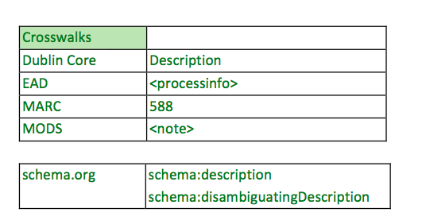
Source of description: Crosswalks

Slide 35
WAM data elements (14)
Access/Rights * | Extent | Title *
Collector | Genre/Form | URL
Contributor * | Language *
Creator * | Relation *
Date * | Source of Description
Description * | Subject *
* = 9 of 14 element names/meanings match Dublin Core

Slide 36
PUBLICATION IN LATE JULY

Slide 37
Three simultaneous reports
Best practices for descriptive metadata
With data dictionary
User needs
With annotated bibliography
Tools
With evaluation grids

Slide 38
Q&A

Slide 39
IIPC, Web Archiving Week
16 June 2017
For more information, please contact:
Jackie Dooley
Program Officer, OCLC Research
oc.lc/wam
dooleyj@oclc.org
@minniedw
©2016 OCLC. This work is licensed under a Creative Commons Attribution 4.0 International License. Suggested attribution: “This work uses content from Developing Best Practices for Web Archiving Metadata to Meet User Needs
© OCLC, used under a Creative Commons Attribution 4.0 International License: http://creativecommons.org/licenses/by/4.0/.”

