Slide 1
SAA Description Section
Portland, 26 July 2017
Best Practices for Descriptive Metadata for Web Archiving
Recommendations of the OCLC Research Library Partnership
Web Archiving Metadata Working Group
oc.lc/wam
Alexis Antracoli, Kate Bowers, Jackie Dooley

Slide 2
THE PROBLEM

Slide 3
Absence of community best practices for descriptive metadata was the most widely-shared web archiving challenge identified in two surveys:
OCLC Research Library Partnership (2015)
Weber/Graham study of users of archived website (2016)

Slide 4
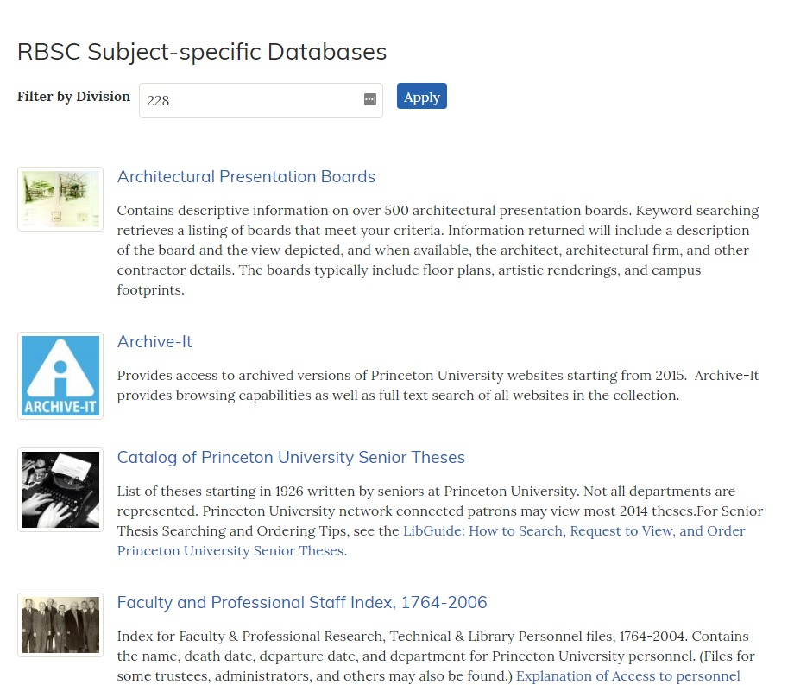
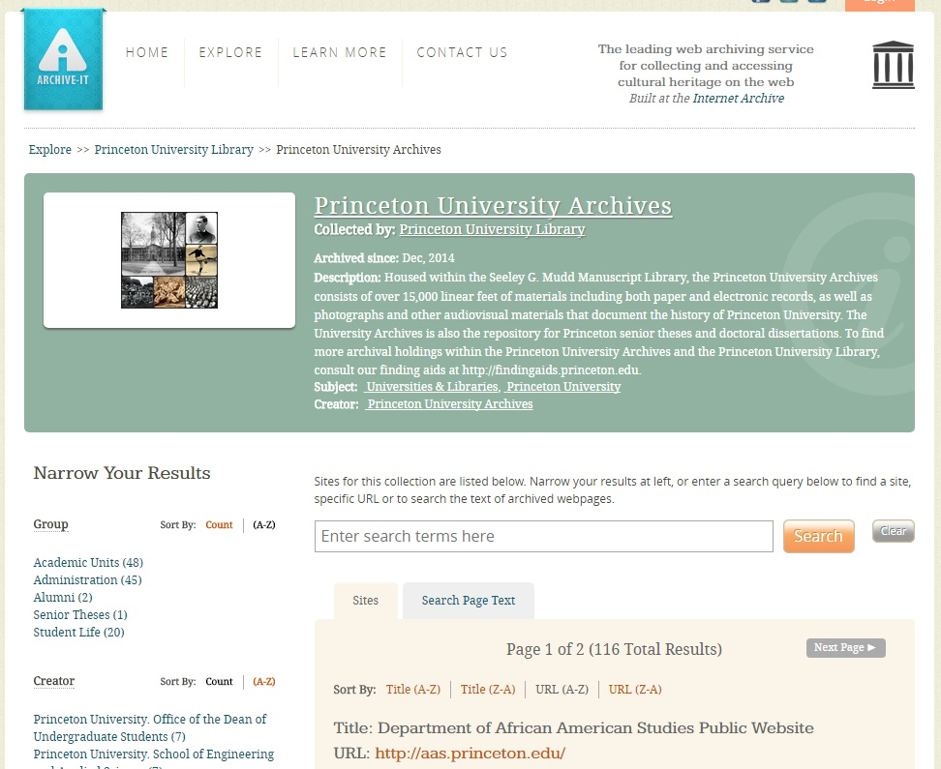

Slide 5
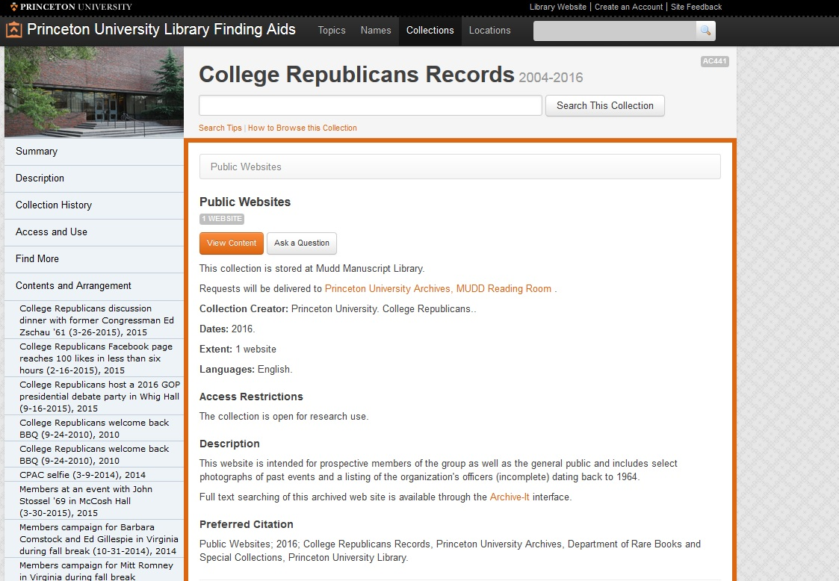

Slide 6
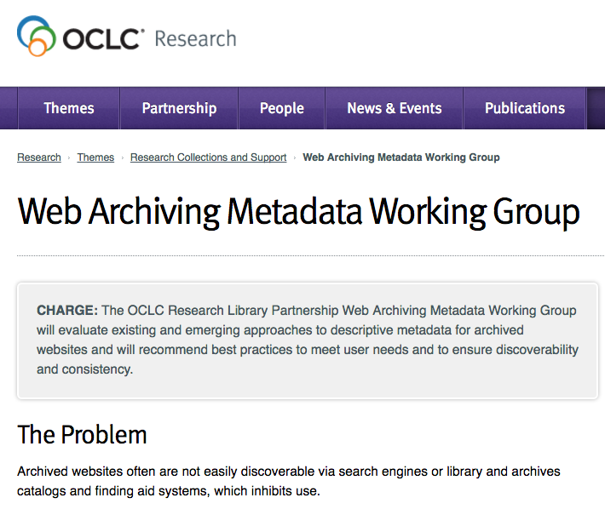
OCLC RESEARCH LIBRARY PARTNERSHIP
WEB ARCHIVING METADATA WORKING GROUP

Slide 7
Objectives
Recommend best practices for descriptive metadata for archived websites that are community-neutral and that address user needs (NOT a standard; displaces no standards)
Identify the most relevant data elements and provide guidance on formulating content
Bridge bibliographic and archival practices
Address the differing characteristics of item- and collection-level descriptions

Slide 8
Potential user groups
Practitioners who use standards but want guidance on formulating content for description of archived single sites and collections
Dublin Core (used by Archive-It) is a structure standard, not a content standard
Some archivists want web-specific guidance to supplement DACS
Those who want to export MARC records to a less granular data structure (such as Archive-It)
RDA (library content standard) focuses on transcription of live single sites, but websites lack standard elements and are not amenable to transcription
Libraries and archives using a digital asset management system (DAMS), eschewing descriptive standards; brief records, scalable approach
Individuals lacking metadata experience who build or contribute to web archives

Slide 9
Feedback received
How much? A lot!
Mostly positive; three negative comments
Positive: premise accepted; suggestions for improvement
Negative: premise rejected, including because …
Archival (two comments, including TS-DACS): recommendations are too bibliographic, don’t conform to DACS
Bibliographic (one comment): recommendations are too archival

Slide 10
LIT REVIEWS & OTHER RESEARCH
Bailey et al. Ben-David & Huurdeman Bernstein Bragg & Hanna Costa Costa & Gomes Costa & Silva Cruz & Gomes Dougherty & Meyer Galligan Gatenby Gibbons Goel Goethals Guenther Hartman et al. Hockx-Yu Jackson Jones & Shankar Lavoie & Gartner Leetaru Mannheimer Masanès Milligan Murray & Hsieh Neubert Niu O’Dell Peterson Phillips & Koerbin Pregill Prom & Swain Ras & van Bussel Reynolds Riley & Crookston Stirling et al. Sweetser Taylor Thomas et al. Thurman & O’Hanlon Tillinghast Truman Weber & Graham Webster Wuet et al. Zhang et al.
Notes:
Created two literature reviews, one focused on end users needs and the other on metadata practitioners. We recognized at the outset of our work that this was a necessary prelude to defining best practices.
Purpose of report is to inform community-wide understanding of document user needs and behaviors. This will serve as evidence to determine best practice guidelines for web archiving metadata.
We identified and gathered over 60 articles, reports, blog posts, conference presentations, and social media exchanges that were related to in some way to metadata needs for users and practitioners of web archives.
From abstracts we created a synthesis of findings based on main topics that emerged from readings.

Slide 11
Who uses web archives?
Digital humanists
Web scientists
Computer scientists
Data analysts
Journalists
Lawyers
Website owners
Website designers
Government employees
Genealogists
Patent applicants
Instructors
Students
Linguists
Sociologists
Political scientists
Historians
Anthropologists
Notes:
Various topologies in the literature. Primarily focused on academic-ish research. Some national libraries have conducted studies including the general public, but not much detail is known about them.

Slide 12
Users need “provenance” metadata
“The critical missing piece”
Provide context
Why was the content archived?
Selection criteria
Scope
Note: WAM focused solely on descriptive metadata, not technical or preservation metadata.
Notes:
Provenance from users’ perspectives: why, when and by whom a website was created and collected

Slide 13
Metadata practitioner needs
Archival and bibliographic approaches
DACS, EAD, MARC, Dublin Core, RDA, MODS
Data elements vary widely
Same element name, multiple meanings
Level of description
Single site, collection of sites, seed URLs
Scalability and limited resources
Notes:
Much of this was confirmed by our review of institution-specific metadata guidelines.

Slide 14
Best practices methodology
Analyze metadata standards & institutional guidelines
RDA (libraries), DACS (archives), Dublin Core (simplified)
Evaluate existing metadata records “in the wild”
ArchiveGrid, Archive-It, WorldCat
Identify dilemmas specific to web archiving
General finding: extreme inconsistencies in existing practice
Incorporate findings from literature reviews
Prepare data dictionary and report narrative

Slide 15
WEB-SPECIFIC DILEMMAS

Slide 16
Is the website creator/owner the … publisher? author? subject?
Should the title be … transcribed verbatim from the head of the site? Edited to clarify the nature/scope of the site? Append e.g. "web archive” for a collection?
Which dates are important/feasible other than capture dates? Beginning/end of the site's existence? Date of the content? Copyright?
How should extent/size be expressed? 6.25 Gb? 300 websites? 1 archived website? 1 online resource?
Is the host institution that harvests and manages the archived content the repository? creator? publisher? selector?

Slide 17
Is it important to clearly state that the resource is a website? If so, where? In the title? description? extent statement? all of these?
Does provenance refer to …the site owner? the repository that harvests and hosts the site? ways in which the site evolved?
Does appraisal mean …the reason the site warrants being archived? a collection of sites named by the repository? the parts of the site that were harvested?
Which URLs should be included? Seed? access? landing page?
Notes:
for most institutions the publisher was optional; for others it was mandatory.
And hey, what does “place of publication” mean on the web?

Slide 18
THE ARCHIVE-IT METADATA INTERFACE

Slide 19
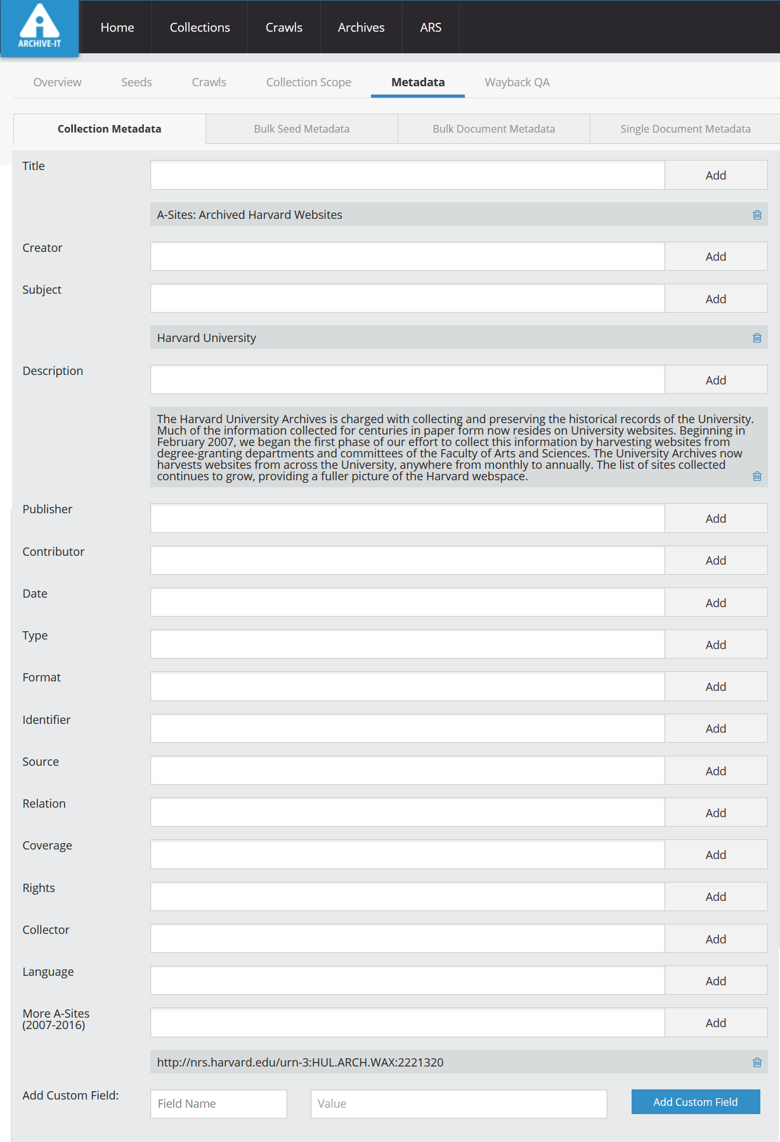
Archive-It, the most widely used web archiving platform, provides for application of DC metadata for collections and seeds

Slide 20
Detail of the Collection-level metadata editing interface

Slide 21
At the seed level, “grab title” can pull a title from HTML
Archive-It has support for non-DC fields

Slide 22
Bulk options include downloading all seed metadata

Slide 23
RECOMMENDED BEST PRACTICES

Slide 24
WAM data elements
* = 9 of 14 element names/meanings match Dublin Core
Collector | Extent | Source of Description
Contributor * | Genre/Form | Subject *
Creator * | Language * | Title *
Date * | Relation * | URL
Description * | Rights *

Slide 25
Data dictionary inclusion criteria
Includes common elements used for identification and discovery of all types of resource (e.g., Creator, Date, Subject, Title)
Other elements must have clear applicability to archived websites (e.g. Rights, Description, URL)
Elements excluded that rarely (if ever) appear in guidelines and/or extant metadata records and have no web-specific meaning (e.g. audience, publisher, statement of responsibility)

Slide 26
Data element features
Element name
Definition
Usage note
Examples
Crosswalk

Slide 27
Collector
Definition: The organization responsible for curation and stewardship of an archived website or collection.
Use Collector for the organization that selects the web content for archiving, creates metadata and performs other activities associated with “ownership” of a resource. Stated another way, this is the organization that has taken responsibility for the archived content, although the digital files are not necessarily stored and maintained by this organization (collections harvested using Archive-It are a prominent example).
No equivalent in Dublin Core.

Slide 28
Collector: Lifecycle activities
Institutions involved in web archiving engage in a variety of activities during the lifecycle of archiving web content. We identified four activities performed by the institution that assumes responsibility for archiving web content:
Selecting websites for archiving
Harvesting the content of the designated seed URLs
Creating and maintaining metadata to describe the content
Making decisions about other aspects of collections management, including how the harvested files will be preserved and how will access be provided.

Slide 29
Collector: Examples
Creator: Seattle (Wash.)
Title: City of Seattle Harvested Websites
Collector: Seattle Municipal Archives
-============
Title: Globalchange.gov
Contributor: U.S. Global Change Research Program
Collector: Federal Depository Library Program
============
Creator: Association for Research into Crimes Against Art
Title: ARCAblog : promoting the study and research of art crime and cultural heritage protection
Collector: New York Art Resources Consortium

Slide 30
Collector: Crosswalks
Crosswalks
Dublin Core | Contributor
EAD | <repository>
MARC | 524 852 subfield a 852 subfield b
MODS | <location>
schema.org | schema:OwnershipInfo

Slide 31
Source of description
Definition: Information about the gathering or creation of the metadata itself, such as sources of data or the date on which source data was obtained.
Source of Information is used to identify the source of all or some of the metadata, particularly for descriptions of single sites. Basic aspects of a website (creator name, title, etc.) may change significantly, but the responsible institution is unlikely to have the resources to become aware of changes, let alone update the metadata. Include the date on which the site was examined and the location from which the information was taken.
No equivalent in Dublin Core.

Slide 32
Source of description: Examples
Description based on archived web page captured Sept. 22, 2016; title from title screen (viewed Oct. 27, 2016)
Title from home page last updated June 21, 2012 (viewed June 22, 2012)
Title from home page (viewed on Oct. 11, 2007)
Title from HTML header (viewed Feb. 16, 2006)

Slide 33
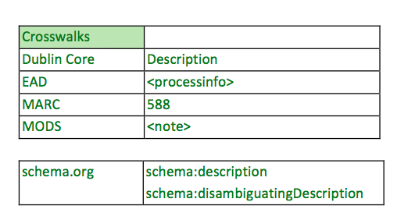
Source of description: Crosswalks

Slide 34
FORTHCOMING PUBLICATIONS

Slide 35
Three simultaneous reports (autumn 2017)
Best practices for descriptive metadata
With data dictionary
User needs
With annotated bibliography
Tools
With evaluation grids
Send comments by August 4th!

Slide 36
Q&A

Slide 37
SAA Description Section
26 July 2017
For more information, please contact:
Jackie Dooley
Program Officer, OCLC Research
oc.lc/wam
dooleyj@oclc.org
@minniedw
©2016 OCLC. This work is licensed under a Creative Commons Attribution 4.0 International License. Suggested attribution: “This work uses content from Developing Best Practices for Web Archiving Metadata to Meet User Needs
© OCLC, used under a Creative Commons Attribution 4.0 International License: http://creativecommons.org/licenses/by/4.0/.”

