Slide 1
Smithsonian Transcription Center Taking Digitization to the Next Level
http://Transcription.si.edu
Ching-hsien Wang
Ching-hsien Wang, Manager
wangch@si.edu
Collections Systems & Digital Assets Division
Office of Chief Information Officer
Smithsonian Institution
July 21, 2016
Notes:
Thank you everyone for having me.
The Smithsonian Transcription Center is a platform that allows us to upload Smithsonian digital images online and We invite the public to help transcribe contents for us.

Slide 2
Smithsonian Transcription Center Taking Digitization to the Next Level
http://Transcription.si.edu
Outline:
Overview of the Transcription Center project,
System functionality and user interface,
Crowdsourcing and statistics
Usage of collected transcribed data
Notes:
Today I plan to cover the following:
An overview of the Transcription Center project,
Brief description of system functionality and user interface,
Some system statistics and
How we use the collected data
Let’s get started.

Slide 3
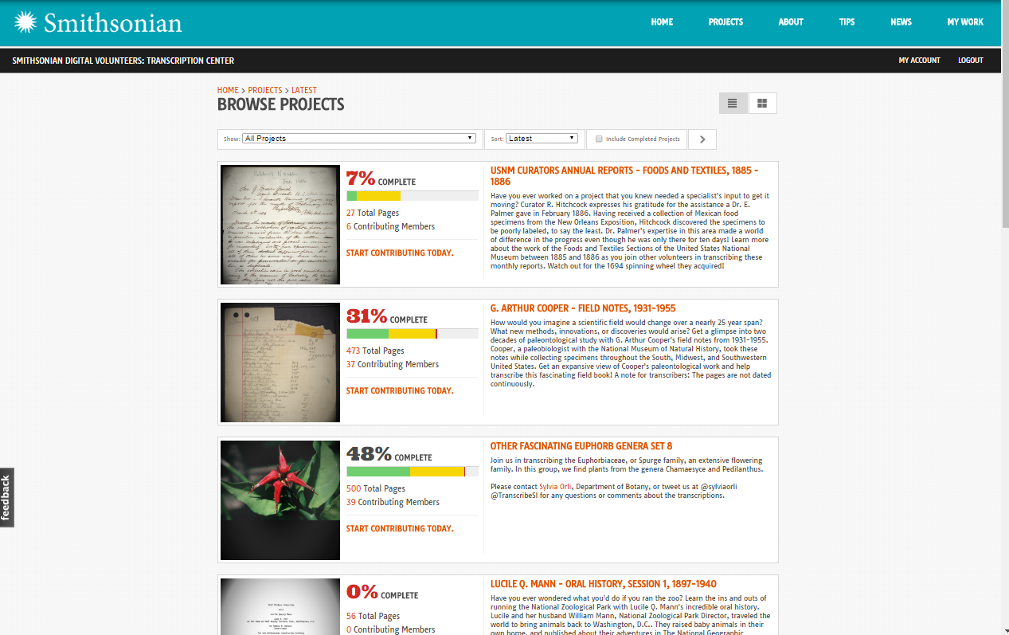
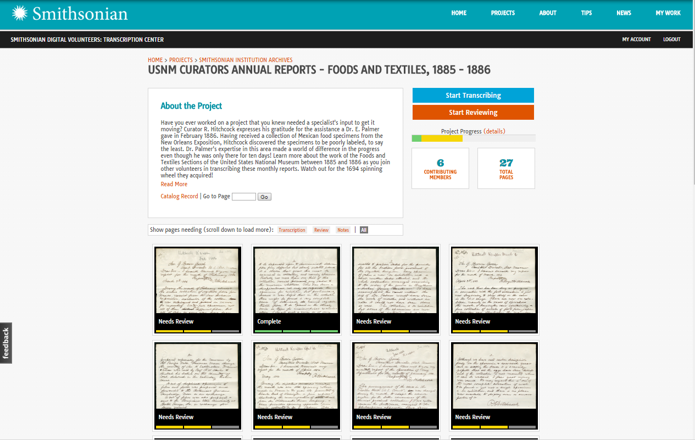
Smithsonian Transcription Center Taking Digitization to the Next Level
Notes:
This project was launched in June 2013 with a just few archives at the Smithsonian. This project has grown into a successful “cross institution collaboration” .
I am the project manager, and I am fortunate to work with a team of talented technical staff and a project coordinator Meghan Ferriter.
15 Smithsonian organizations are part of this project. There are 9 archives, 5 museum departments, and the Smithsonian Libraries. These organizations provided materials to the Transcription Center.

Slide 4
Why Does Transcription Matter?
Discovery: Transcription turns handwritten and typed documents into searchable and machine-readable resources
Humanities Research: Digitized and fully transcribed documents are an incredibly valuable asset for art, history, & literary researchers across the globe.
Scientific Research: Transcription of handwritten collection labels will create millions of specimen data points available to the scientific community for research and discovery.
Education: From high school to graduate studies, transcription allows students to engage with primary source materials – a key part of the learning experience.
Readability: Transcription preserves these historic documents for future generations as practices like cursive handwriting are less emphasized in in school.
http://Transcription.si.edu
Notes:
The Transcription Center was never viewed as a stand alone system or project at the Smithsonian. Our vision was to build a companion system as part of our larger digitization efforts and network of discovery systems. It is also an important tool for public engagement.
We all know that the many digitized written materials are view-able but not easily search-able, many hand written materials are difficult to read and understand. Finally, many collections are not online at all. This limits our ability to support education, research and discovery.
The Transcription Center is designed to address the limitations and to improve the readability and better support discovery and education.

Slide 5
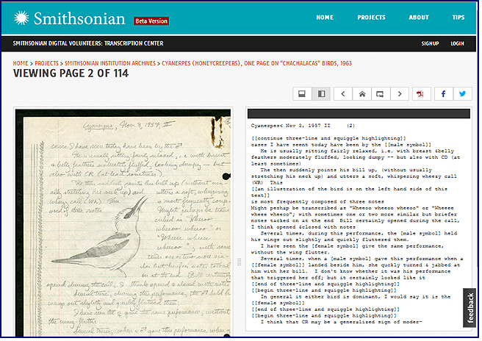
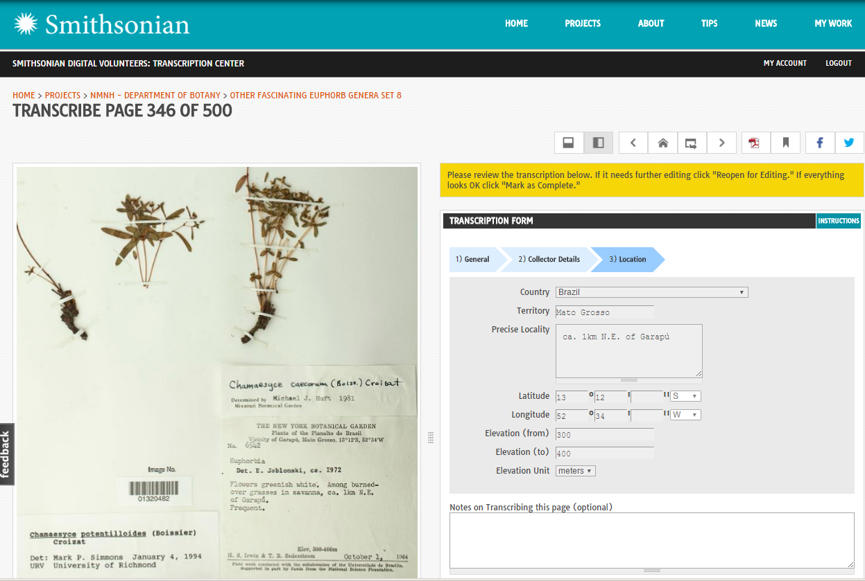
Smithsonian Transcription Center
Transcription Center
199,500+ pages of documents
187,300+ pages are completed
6,655+ active participants
Document types include:
diaries,
field notebooks,
endangered language materials,
letters,
manuscripts,
collection objects ,
specimen labels,
etc.
Notes:
In three years time, We uploaded about 199,000 digital documents, and 187,000 pages are already completed.
We have more than 6000 active participants working with us.
Document types include materials such as diaries, field notebooks, endangered language materials, manuscripts, and museum collection objects.
Each image is displayed on the left side of the page, and the public transcribe the text on the right.

Slide 6
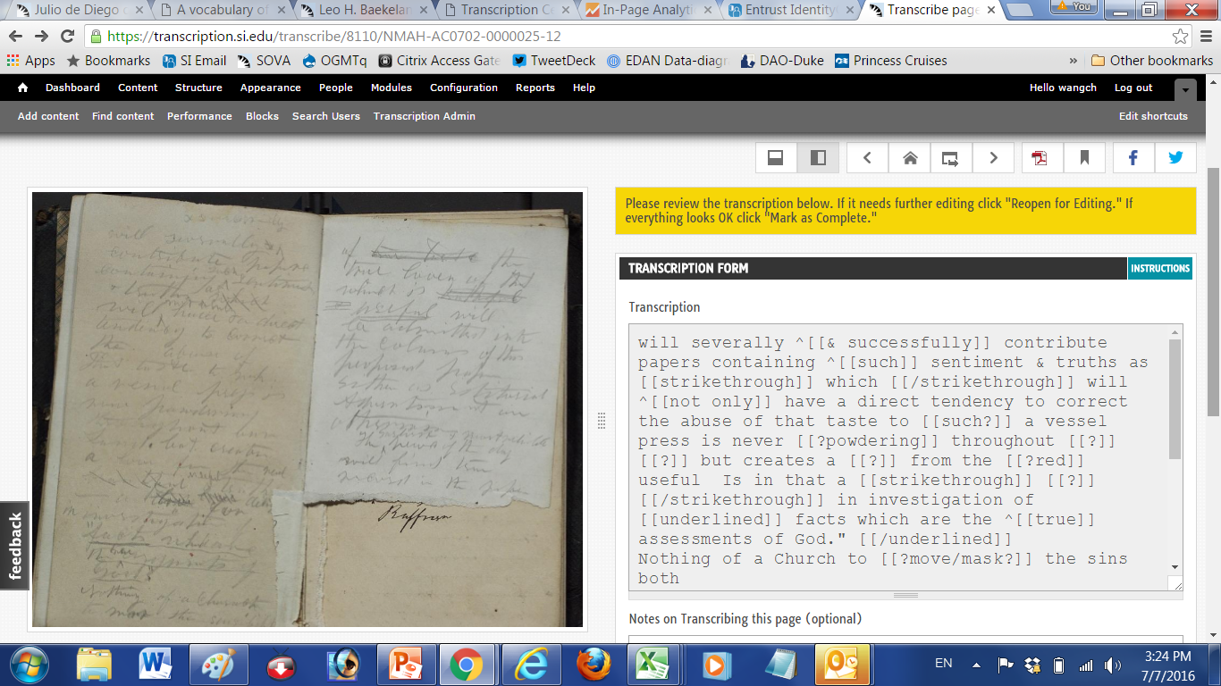
Flexible System Architecture
Template driven,
Support structured and open text formats
Notes:
The transcription Center is template driven and is flexible to support very different transcribing needs. It supports structured and open text formats
For example: open text templates are suitable for diaries, manuscripts, notebooks, and letters.
This example is a diary volume from Charles Francis Hall from the Archives Center at American History museum. The hand written pages are very difficult to read, but the stories and gruesome living conditions it recorded was very valuable to the researchers today.

Slide 7
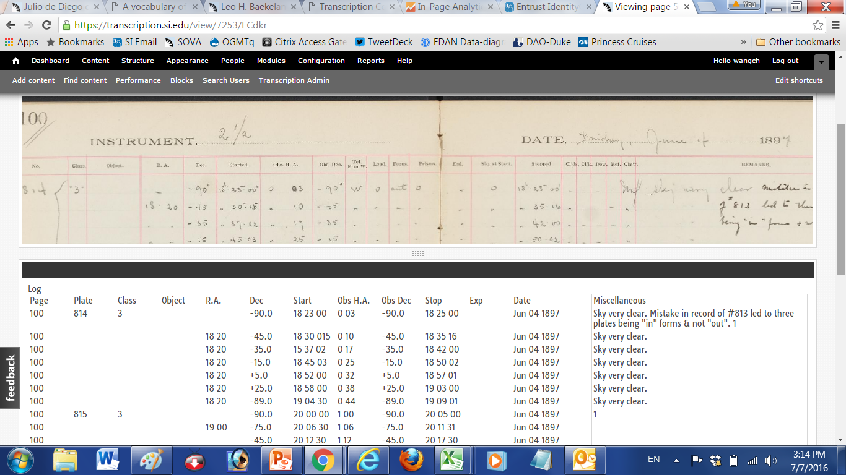
Flexible System Architecture
Template driven,
Support structured and open text formats
Notes:
Structure template supports specific data types. This project is from the Harvard-Smithsonian Center for Astrophysics. This set of 75 logbooks contains information about 500,000 photographic glass plates. The metadata are transcribed in spreadsheet format following the logbook layout.

Slide 8
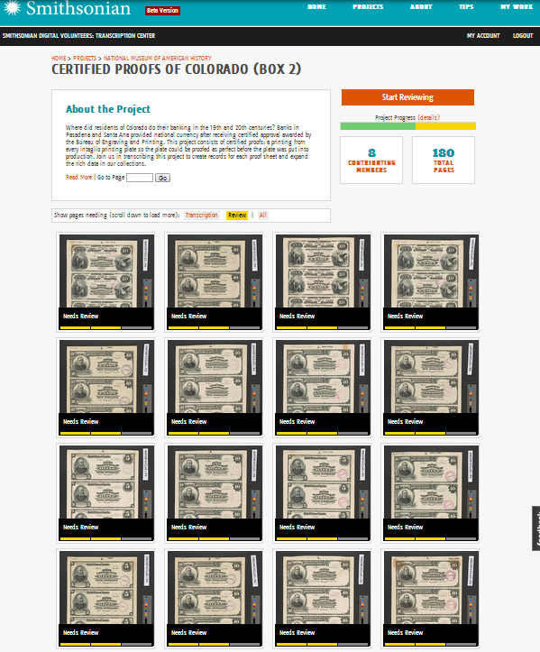
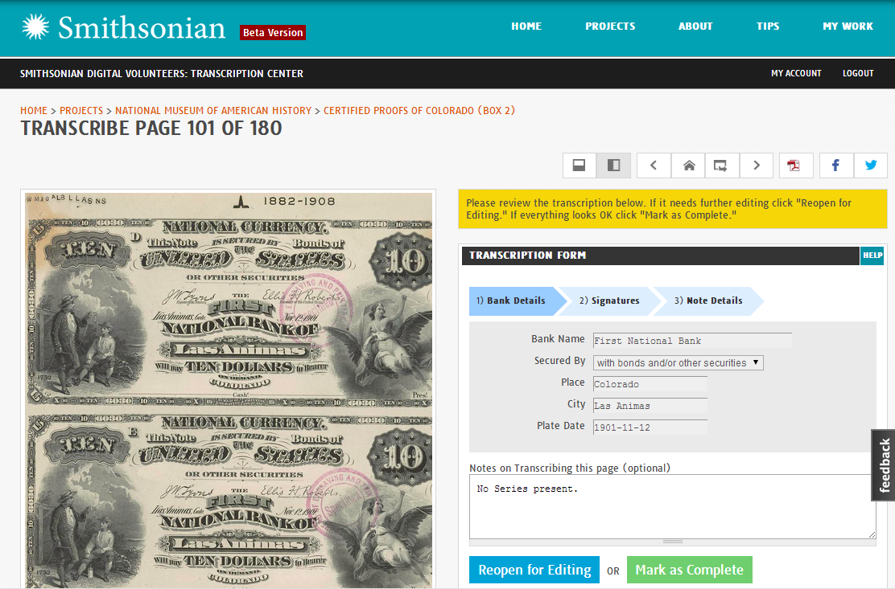
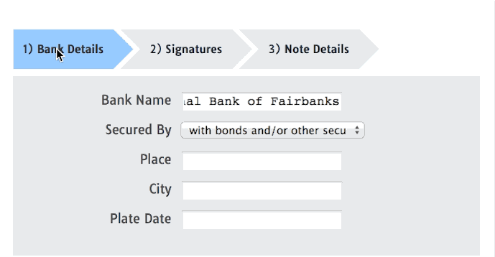
Transcribe to Create Electronic Records
Notes:
One more example where a template contains multiple tabs when too many data fields are being transcribed.
These numismatic proofs sheets were completely hidden before the transcription project. These objects were digitized without any catalog records first, The images were uploaded into the Transcription Center. The structured data is collected from three separate tabs for simplified process.
The Transcription Center supports not only the data entry interface but the data output files with the desired formats so future database or catalog records can be built for better searching.

Slide 9
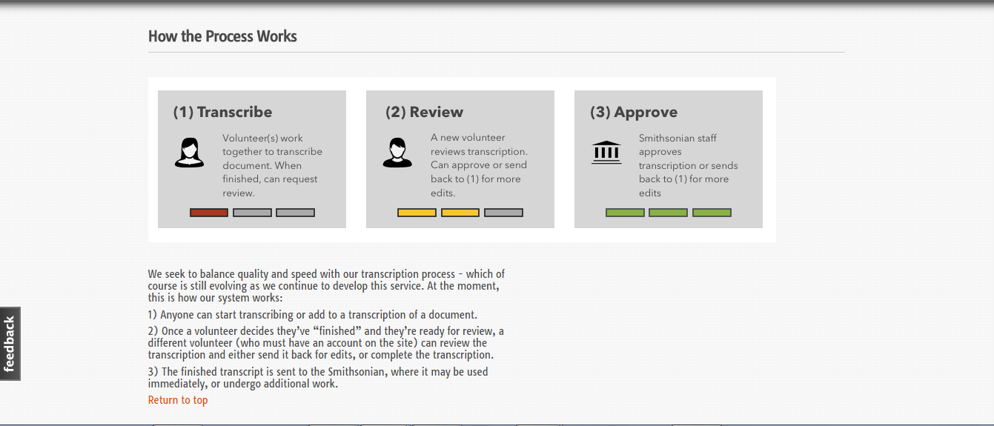
The Process of Transcribing and Reviewing
Notes:
Smithsonian has a unique process that manages the quality control . Here is how it works.
Everyone in the Transcription Center can transcribe a page at any time. After a page is finished, the system will select a different person to review the page. No one can review his own work. The reviewer does not know who has transcribed the page that is being reviewed, but the reviewer must be logged in with a personal account in order to review . A reviewer can chose to edit and complete a page, or he can choose to return the page back to the pool for additional transcription .
After a page has been completed for review, it is considered completed but not approved. Smithsonian staff have the option to go through the final approval process. This process ensures necessary quality control and provide flexibility at the same time.

Slide 10
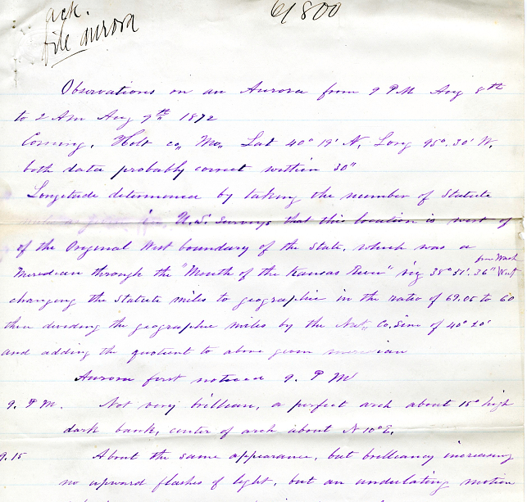
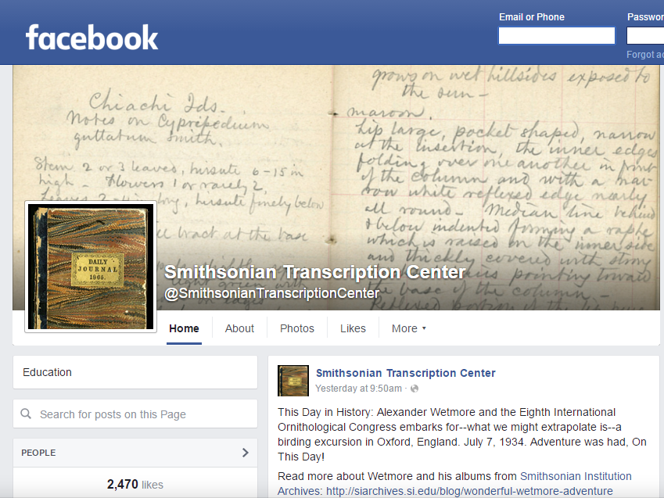
Engaging the Public
Tradition of building a strong volunteer community
1846-1870 working with a network of 352 volunteer observers
Tracking and reporting weather conditions, Aurora Borealis, and Tornados via telegraphs
Secretary Baird cultivated relationships with the volunteers by writing 3500-5000 letters per year
Transcription Project carries on the tradition and cultivate a new network of volunteers
6655 active volunteers to date
Social media platform for affective communication
Google hangout sessions for rewards
Organized campaigns for targeted projects
Notes:
The Smithsonian has a long tradition of working with the volunteers on large projects. Started in 1846, The Smithsonian’s new Secretary Baird started a meteorological observation program. The volunteers from across the country sent in observations on the weather and natural history specimens of their region. Secretary Baird cultivated these relationships by writing up to 5000 letters per year. When the Smithsonian Meteorological Project ended in 1870, it led to the founding of the National Weather Service.
Today, the Transcription Center Project is pleased to work our online volunteers. We have a dedicated project coordinator (Meghan Ferriter) to communicate with our volunteers via email, Facebook, twitter, and other social media platforms. The communications address direct question and answers ,, providing technical guidance on how to solve a problem, and running organized campaigns to tackle difficult projects. Meghan also host Google Hangout sessions to reward volunteers by giving behind the scenes tours that are related to the relevant transcription projects.

Slide 11
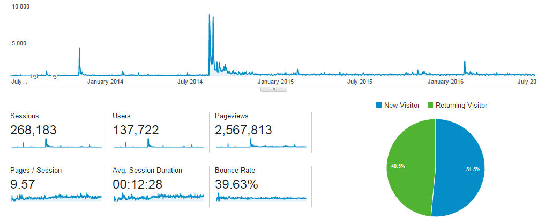
Overview Statistics
During June 2013 – June 2016
191,000+ pages are avalable in Transcription Center
188,000+ pages are completed
6,655 active users
Averaging 140 users per week working on the site
51+% of the users are returned users on the site
Supper Users spent average of 28 pages on each visit to the site
Notes:
In three years time,
Our volunteers have pushed the projects forward very fast, and we try hard to keep up with them by uploading more and more documents online.
Among our volunteers, on average, there are about 140 volunteers per week work on the site,
51% of the users are returned users on the site.
Our Supper volunteers spent on average of 28 pages on each visit .

Slide 12
TC User Activity
Active Volunteers
 | Actions (each) | Group total | % of total
anonymous | 55481 | 55,481 | 5.5%
super user | 2057-77352 | 597,524 | 59.4%
top user | 32-2041 | 310,653 | 30.9%
mid-range | 11-31 | 27,573 | 2.7%
median | 10 | 1,530 | 0.2%
moderate | 1-9 | 11,622 | 1.2%
one-off | 1 | 755 | 0.1%
 |  | 1,005,138 | 100.0%
Notes:
This is a chart that shows the wide range of volunteers and their contribution activities. Everyone has a personal account except those who are labeled as anonymous. Anonymous volunteers did not login when they transcribed. Anyone who has done at least one transcribe or review action is loosely considered as an active volunteer.
The vertical axel shows the number of contribution activity counts. The activities level is as high as 77,352 contribution actions per person. That is supper high.
The horizontal axel are the 6000+ individual volunteers .
As far as the contribution level goes, we have broken down the Volunteers into Supper users, Top users, Mid-range Users, Moderate and one-off users.
The Super users are our top 1% of total active users, but they contribute 59% of all activities. We have two supper users who contributed more then 77,300 activities each, the rest of the supper users range from 4000 to 2100 activities each!
Our anonymous user group took 55,480 actions collectively. Even though we don’t know who they are, they have contributed 5.5% of the activities.

Slide 13
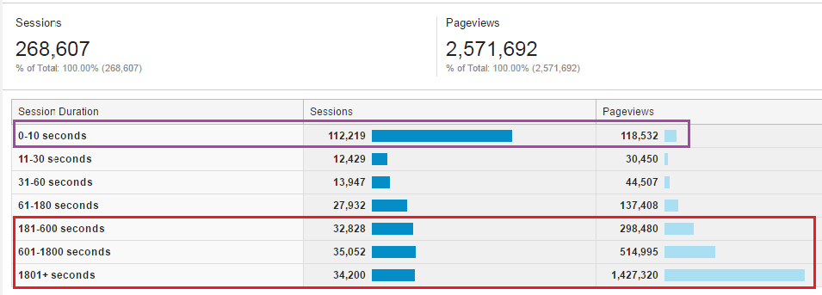
Volunteer Group Tiers June 2013 through June 2016
Significant number of users spent less then 10 seconds on the system and bounced out, but
102,000 sessions of volunteers spent 10, 20, 30 minutes or more on the system, and viewed 1.5 million pages.
The most work is being completed by volunteers in the last group.
Notes:
Similarly, from Google Analytics Report, it shows that many sessions lasted shorter than 10 seconds.
But this chart also shows that 102,000 sessions lasted at least 10 minutes, 20, minutes, 30 minutes or more per session.
In the red highlighted section, you can see the huge number of page viewed by this dedicated group. These are the sessions that have done the bulk of the transcription and review work on the system.
We can’t thank them enough!

Slide 14
More about our Volunteers
Quality of the work is excellent.
In a sample collected on our system showed the error rate was much lower comparing to OCR error rate.
Volunteers responded very well when we reached out by
Providing Feedback buttons on home page,
Including note field on every page,
Staying active in social media platforms,
Organizing special campaigns to direct volunteers
Notes:
Our volunteers produced very high quality of the work.
A sample taken on the system showed that our volunteer’s error rate was 0.0013 comparing to average OCR error rates as 0.20.
From the beginning we knew that communication with our volunteers was very important. We
provided a Feedback button in a promenade location on the home page,
we included a note field on every page,
we are active in social media platforms, and
we organize special campaigns to direct volunteers.
The volunteers really responded very positively to our approaches.

Slide 15
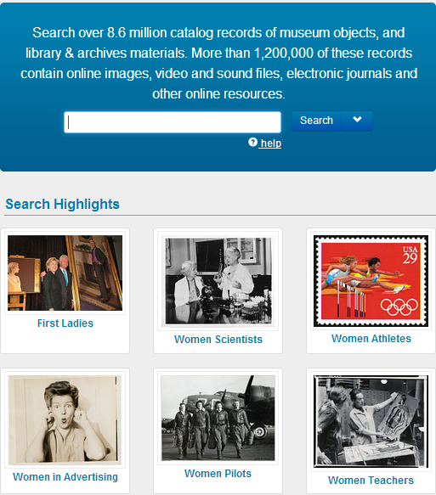
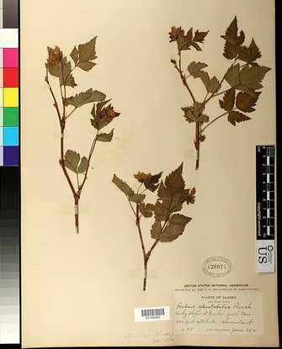
Sharing the Finished Product
What to do about the 188,300 pages of collected data?
PDF Download Online Searching Create Catalog Record
Notes:
As we promised, we want to increase our ability to discover and access the hidden contents.
We made sure that the public can download our transcribed files, we indexed all contents in the Smithsonian central Enterprise Digital Asset Network for use by all software application, including search engines. Finally, we took transcribed data and created structured catalog records.

Slide 16
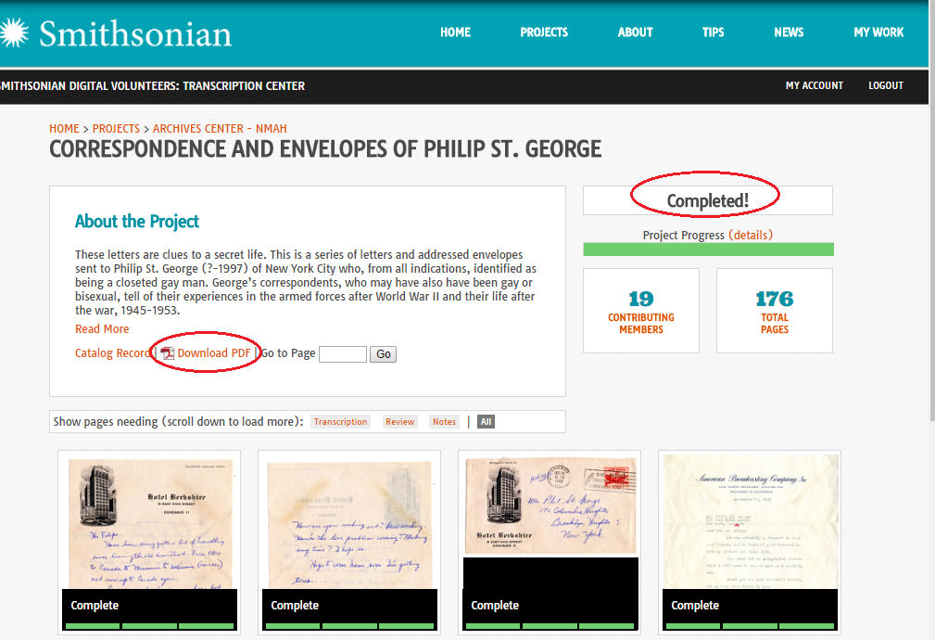
Downloadable PDF Files Usage
https://transcription.si.edu/pdf_files/7624.pdf
Notes:
For every project that has been completed, the Transcription Center offers a downloading button on display so the users can take the PDF file for their own use.

Slide 17
Downloadable PDF Files Usage
https://transcription.si.edu/pdf_files/7624.pdf
PDF statistics Jan. 2014-Jun 2016
Total PDF files downloaded 340,910
The usage demand sharply increased since Aug. 2015
Notes:
In 1 ½ years, the total downloaded files is near 341,000 times.
From this chart we can see that the demands for these files sharply increased in the past 12 months.

Slide 18
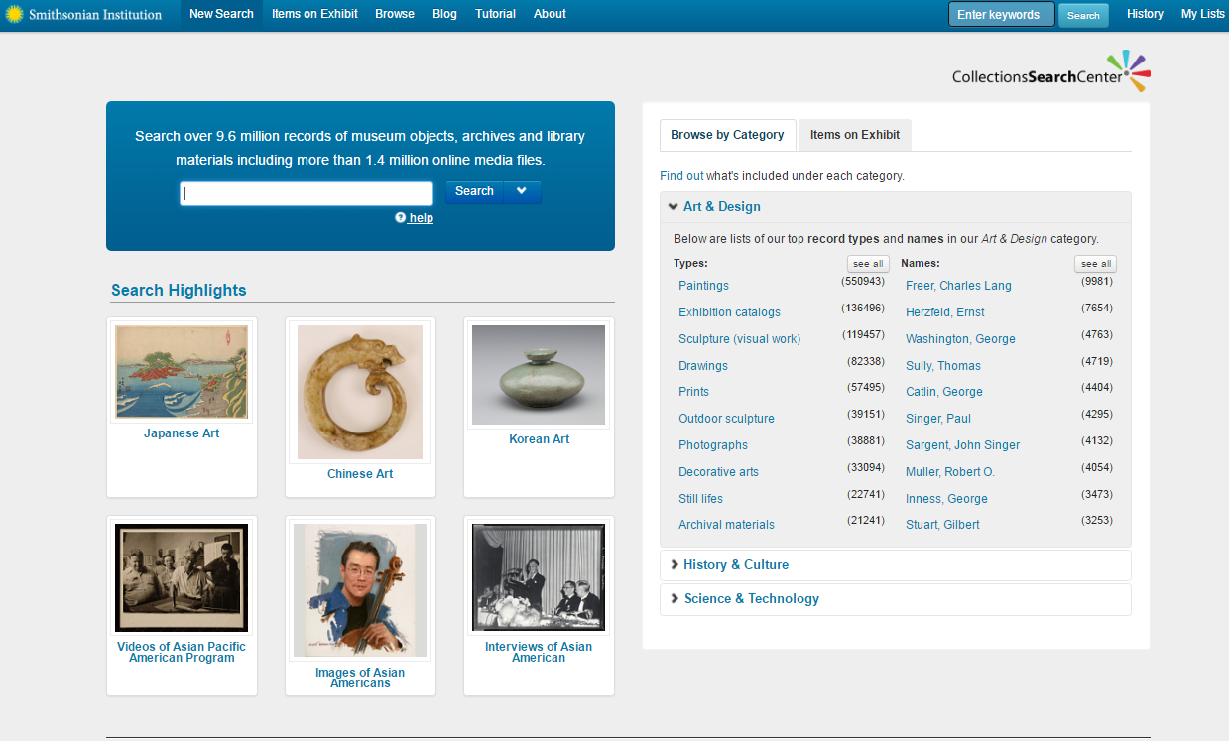
Integrate Transcription Searching in Smithsonian Collections Search Center
Search for “belly feather”, we found four fieldbook and one museum object records online
Notes:
We made sure that all data from the Transcription Center is instantly indexed and searchable in the central Smithsonian Enterprise Digital Asset Network.
This is the Smithsonian Collections Search Center that is the discovery platform for the more than 9 million Smithsonian collections from our libraries, archives and museums.

Slide 19
Integrate Transcription Searching in Smithsonian Collections Search Center
Search for “belly feather”, we found four fieldbook and one museum object records online
Notes:
In this example, we search for “belly feather”, and we found multiple records.

Slide 20
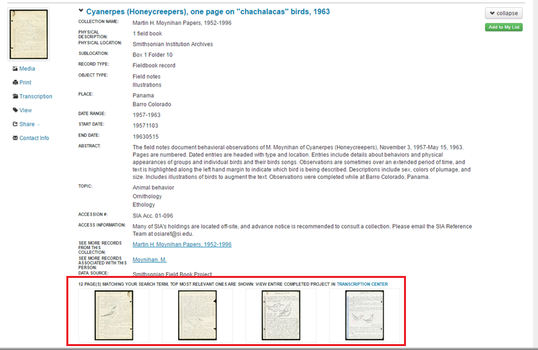
Integrate Transcription Searching in Smithsonian Collections Search Center
Search for “belly feather”, we found four fieldbook and one museum object records online
Notes:
One of the record is a field book in 1963 on Cyanerpes Honeycreepers. There are multiple pages in this field book containing the matching search term. The matching pages are on display as part of the catalog record. Clicking on a thumbnail,

Slide 21
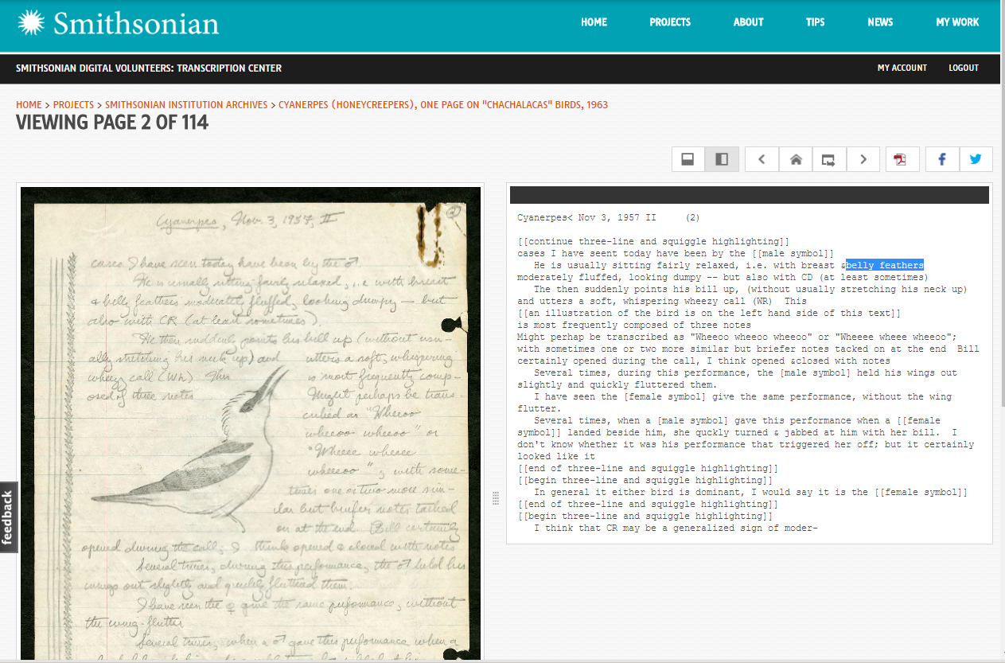
Integrate Transcription Searching in Smithsonian Collections Search Center
Search for “belly feather”, we found four fieldbook and one museum object records online
Notes:
You will be sent to the corresponding page in Transcription Center.

Slide 22
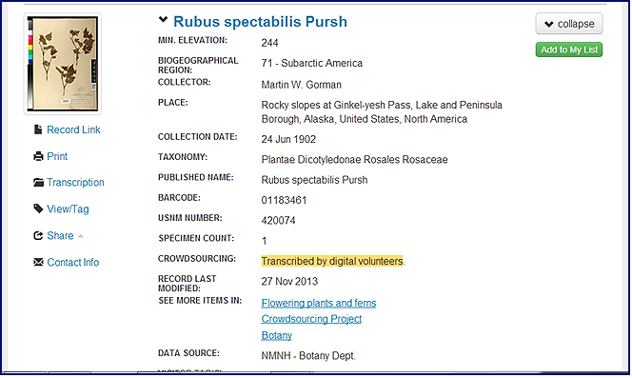
Create Catalog Records with collected structured data
Create 128,500 Catalog Records!
Botany records: 27280 Entomology records: 44100
Numismatic records: 39500 Smithsonian Astrophysics records: 17600
Notes:
We created lots of catalog records. These records uncover our hidden collections. This is one example record from Natural History Museum Botany Department with lots very detailed information, you will notice the record includes a note that reads: “Transcribed by digital volunteers”.
We credit our volunteers for the work they have done for us.

Slide 23
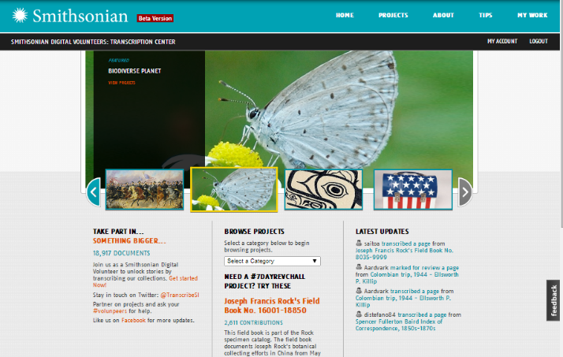
Smithsonian Transcription Center
In Summary, planning for a successful crowdsourcing transcription project:
Consider transcription as an extension of existing digitization efforts,
Dedicated resources to manage and interact with the volunteers,
Dedicated staff to maintain sufficient available pages in the system,
Create a plan to fully utilize the transcribed data to improve the discovery and access to hidden collections.
Ching-hsien Wang, Manager
wangch@si.edu
Collections Systems & Digital Assets Division
Office of Chief Information Officer
http://Transcription.si.edu
Notes:
The final take away from this presentation would be the following:
If you are considering doing a project similar to this,
Consider transcription as an extension of exist digitization efforts,
Allocate dedicated resources to manage and interact with the volunteers,
Allocate dedicated staff to maintain available pages in the system,
Create a plan to fully utilize the transcribed data to improve the discovery and access to hidden collections.
That is all I have today. Thank you!

