Slide 1
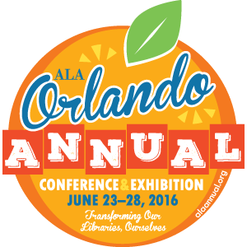


10:30-11:30 OCCC Room S320 A-C
OCLC Research Update
Please Note:
This session will
be videotaped
#ALAAC16
21 June 2016

Slide 2
OCLC Research Update
10:30-11:30
Orlando, Florida, USA

Slide 3
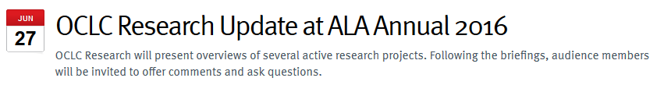




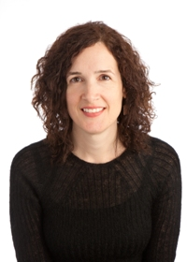
Eric
Childress
Highlights
Jackie
Dooley
Web Archiving: Developing Best Practices to Meet User Needs
Dennis
Massie
ILL Cost Calculator: The Very Latest
Karen
Smith-Yoshimura
Linked Data Implementations
Sharon
Streams
Scaling Supercharged Storytimes

Slide 4
OCLC Research: Highlights
Eric Childress
Consulting Project Manager

Slide 5
OCLC Membership & Research
Research
WebJunction
Membership & Governance
Research Library Partnership
Community Center
Notes:
“OCLC Research is part of the larger Membership and Research division which also includes our group that looks after membership and governance, and the community center. Some of the work that will be presented here today includes work from the OCLC Research Library Partnership and Web Junction. These programs of OCLC Research these bring library voices in to inform our work.”

Slide 6


Membership and Governance
OCLC Global & Regional Councils
Register at oc.lc/memberforums
Just announced:
14 OCLC Member Forums in the Americas, U.K. & Europe
Special Research Library Partnership programs in Chicago, Philadelphia and Los Angeles
Americas / EMEA / Asia Pacific
48 member-elected delegates who work to strengthen the connection between OCLC member institutions and OCLC.

Slide 7
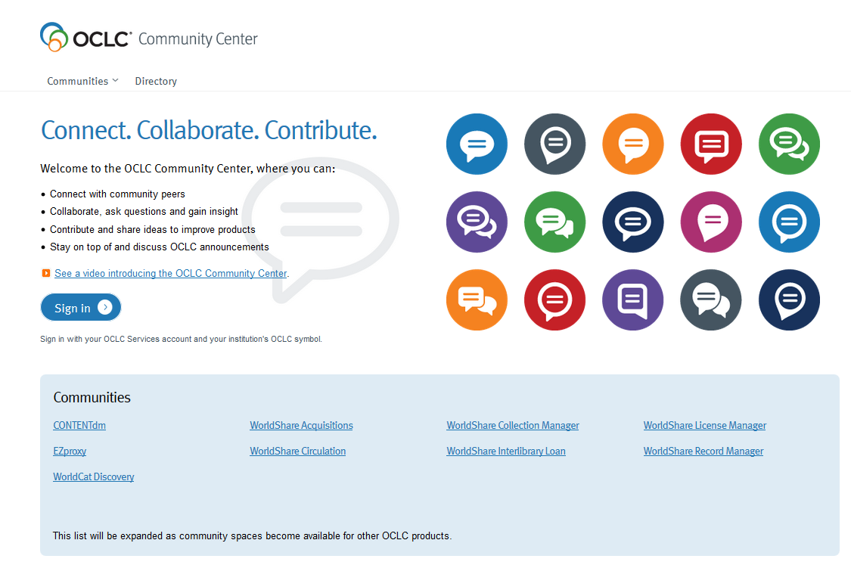
Community Center
Product/service collaborative space
Face-to-face time at ALA
Rapid growth in enrollment and activity in the last year…

Slide 8
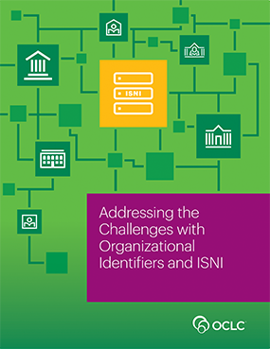


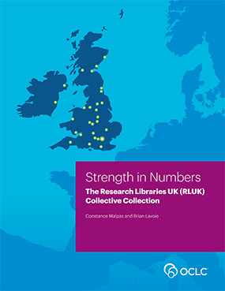


Strength in Numbers: The Research Libraries UK (RLUK) Collective Collection
Detailed characterization of the collective collection of the RLUK membership, with special emphasis on print books
Compares RLUK to ARL collective collection
Addressing the Challenges with Organizational Identifiers and ISNI
Why organizational identifiers are important
Benefits of ISNI membership
The Library in the Life of the User Annotated Bibliography
Builds on the Library in the Life of the User report & a related symposium
Annotated list of resources to help leaders advocate for, plan, and execute user-centered library services

Slide 9
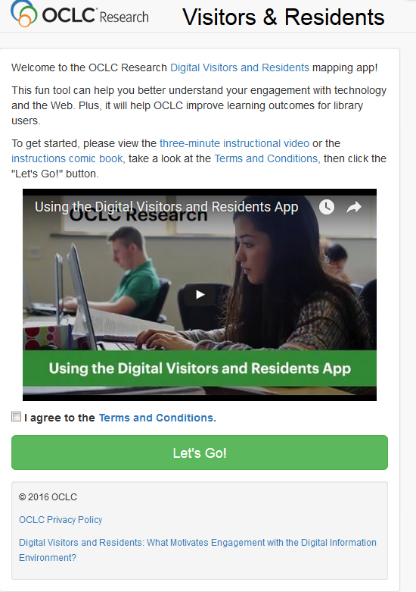
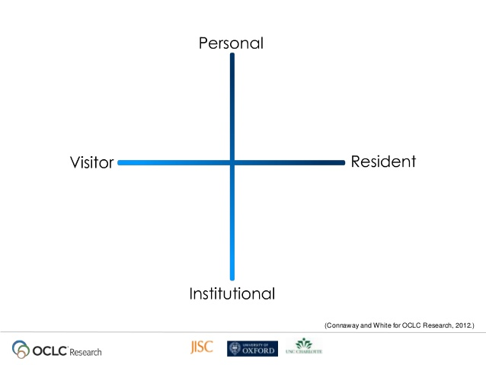

An application designed to help people map out where they fall on the Visitors and Residents spectrum in the use of various services and applications
Visitors and Residents app
http://experimental.worldcat.org/vandrmapping/signIn

Slide 10
Developing Best Practices to Meet User Needs
The OCLC Research Library Partnership Web Archiving Metadata Working Group
Jackie Dooley
Program Officer

Slide 11
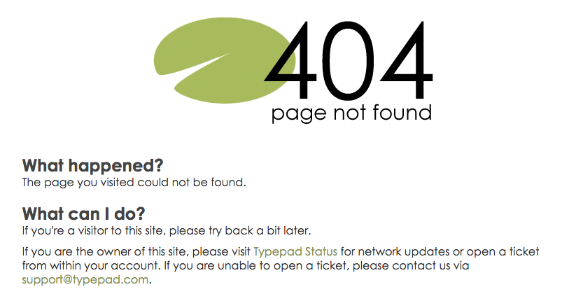
The problem

Slide 12
Archived websites often are not easily discoverable via search engines or library and archives catalogs and finding aid systems, which inhibits use.
Absence of community best practices for descriptive metadata was the most widely-shared web archiving challenging identified in a 2015 survey of the OCLC Research Library Partnership.

Slide 13
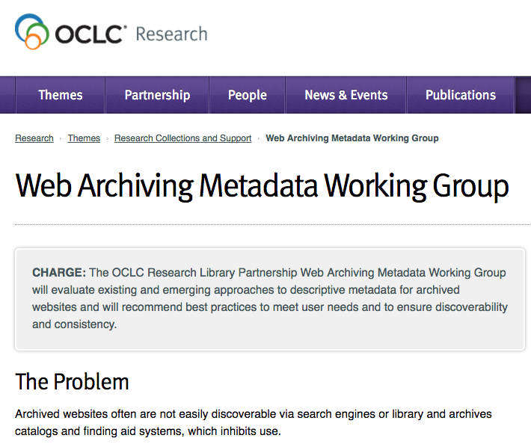
Our approach

Slide 14
Working Group Charge
The OCLC Research Library Partnership Web Archiving Metadata Working Group will evaluate existing and emerging approaches to descriptive metadata for archived websites and will recommend best practices to meet user needs and to ensure discoverability and consistency.
http://www.oclc.org/research/themes/research-collections/wam.html

Slide 15
Projected Outcomes
Best practices for descriptive metadata that bridge existing approaches (bibliographic and archival).
A report on user needs will inform community-wide understanding of documented needs and behaviors as evidence to underlie the metadata best practices.

Slide 16
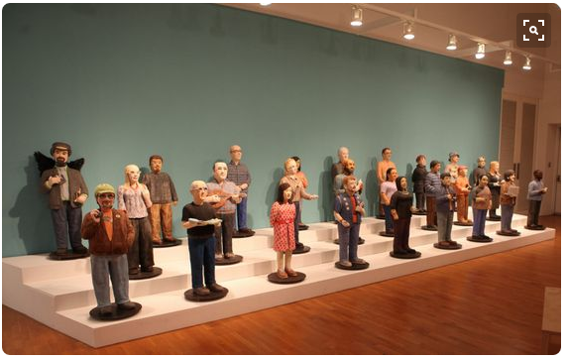
working group members

Slide 17
Trevor Alvord, Brigham Young University
Alexis Antracoli, Princeton University
Penny Baker, Clark Art Institute
Kate Bowers, Harvard University
Lori Dedeyan, UC Berkeley
Evan Echols, University of Delaware
Karen Stoll Farrell, Indiana University
Rick Fitzgerald, Library of Congress
Ben Goldman, Penn State University
Rebecca Guenther, consultant
Claudia Horning, UCLA
Chad Hutchens, University of Wyoming
Deborah Kempe, Frick Museum
Tammi Kim, University of Nevada Las Vegas
Jason Kovari, Cornell University
Rosalie Lack, California Digital Library
Eilidh MacGlone, National Library of Scotland
Matthew McKinley, UC Irvine
Allison O’Dell, University of Florida
Joy Panigabutra-Roberts, University of Cairo
Dallas Pillen, University of Michigan
Lily Pregill, Frick Museum
Mary Samouelian, Harvard Business School
Aislinn Sotello, UC San Diego
Alex Thurman, Columbia University
Jessica Venlet, MIT
Olga Virakhovskaya, University of Michigan
Jackie Dooley & Dennis Massie, OCLC Research

Slide 18
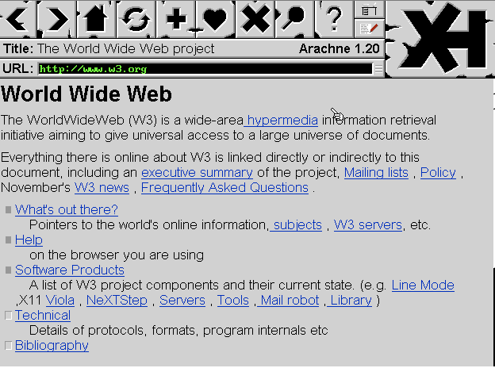
timeline

Slide 19
Call for volunteers, November 2015
WAM launched, January 2016
2016
Desk research
Study existing practices
Obtain ongoing community input
2017
Publish!

Slide 20
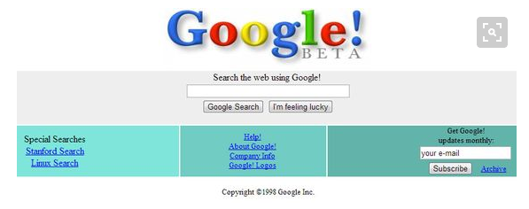
Desk research

Slide 21
Literature review
User needs
Metadata needs from user & library/archives perspectives
Tools with metadata components

Slide 22

Study user needs

Slide 23
Why bother?
A necessary prelude to development of metadata best practices
Take an approach based in reality of user needs and behaviors
Users don’t necessarily utilize the usual discovery tools to locate archived websites
Many users don’t realize that libraries & archives do web archiving for user access

Slide 24
Methodology
Read
Abstract
Synthesize
Write
[Rinse and repeat for metadata]

Slide 25
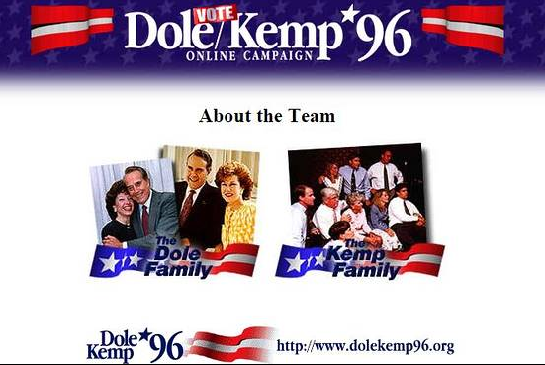
Study metadata needs

Slide 26
Descriptive standards under review
Describing Archives: A Content Standard (SAA)
Ultra-archival
Integrating Resources: A Cataloging Manual (Program for Cooperative Cataloging)
Ultra-bibliographic

Slide 27
Local guidelines under review
Archive-It
Harvard
Library of Congress
New York Art Resources Consortium (NYARC)
University of Illinois
University of Michigan
University of Texas
Send us yours!!

Slide 28
Methodology
Analyze descriptive metadata standards & local guidelines
Evaluate existing records “in the wild”
Compare data elements
Differentiate bibliographic & archival approaches
Identify issues specific to web archiving
Incorporate findings from user needs and metadata literature reviews
Prepare best practices document

Slide 29
Analysis of local guidelines
Data elements
Definitions?
Most common?
Core?
Same concept, different elements?
Same element, different concepts?
Associated structure & content standards
Presence/absence of elements specified in descriptive standards

Slide 30
Analysis of existing records
Data sources
WorldCat
ArchiveGrid
Archive-It
Types of record
Bibliographic: MARC, Dublin Core, etc.
Archival: MARC, finding aids, local
Identify patterns and inconsistencies in local practice

Slide 31
Sample web-specific issue #1
Institution responsible for the crawl is variably tagged as …
Creator/contributor
Repository
Publisher
Selector
Statement of responsibility

Slide 32
Sample web-specific issue #2
Is the site owner the …
Publisher?
Creator/Author?
P.S. Are websites published?

Slide 33
Sample web-specific issue #3
Useful dates?
Capture
Beginning/end of site’s existence
Changes to site
Content
Copyright

Slide 34
What are your web-specific descriptive issues?

Slide 35
Community awareness & input
Discussion with constituencies
Presentations
Published article in Journal of Western Archives
Listservs
…

Slide 36
Produce the two outputs
Report on user needs
Best practices for descriptive metadata
Aiming for early 2017

Slide 37
ILL Cost Calculator: The Very Latest
Dennis Massie
Program Officer, OCLC Research

Slide 38
What

Slide 39
Our aspirations for the calculator
Provide fresh data about current models
Help establish best practices
Facilitate comparison to anonymized peers
Support evidence-based decision-making

Slide 40
Use Cases
Users want to know:
Their resource sharing unit costs
How those costs evolve over time
How their costs compare with peers
Users would like to project:
The financial impact of joining a consortium
Of buying a certain piece of equipment
Of implementing a new service

Slide 41
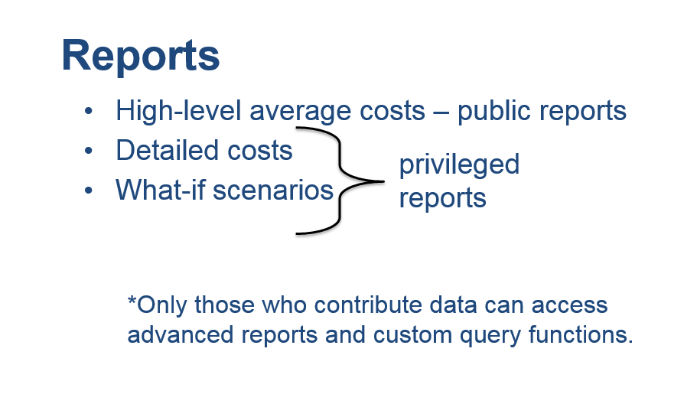

Slide 42
Some guiding principles
Make data entry simple and easy
Minimize collection of confidential or sensitive data
Aggregate and anonymize data in reports
Use existing functionality where possible
Aim to produce actionable intelligence, not satisfy curiosity

Slide 43
Why

Slide 44
Where is the fresh ILL cost data?

Slide 45

Where is the fresh ILL cost data?

Slide 46
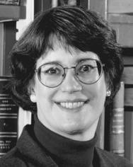
Where is the fresh ILL cost data?

Slide 47

Where is the fresh ILL cost data?

Slide 48
Where is the fresh ILL cost data?
$17.50/$9.27

Slide 49

Where is the fresh ILL cost data?
$17.50/$9.27

Slide 50
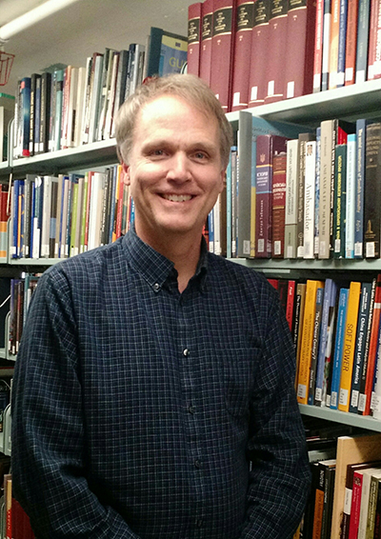
Where is the fresh ILL cost data?
$17.50/$9.27

Slide 51

Where is the fresh ILL cost data?
$17.50/$9.27

Slide 52
Where is the fresh ILL cost data?
$9.62/$3.93
$17.50/$9.27

Slide 53
Where is the fresh ILL cost data?
$9.62/$3.93
$17.50/$9.27
(72 responses)

Slide 54
Where is the fresh ILL cost data?
$9.62/$3.93
(23 responses)
$17.50/$9.27
(72 responses)

Slide 55
Old Apples vs New Oranges
2002
Filled requests only
Selective tracking of unmediated methods
2011
Filled and unfilled
No tracking of mediated vs unmediated
Meanwhile:
Libraries are now lending from electronic holdings
Print items are being loaned directly from offsite storage
Many new methods, models, and technologies have emerged

Slide 56
WHO

Slide 57
ILL Cost Calculator Working Group – 2013-now
Megan Gaffney, University of Delaware
Justin Hill, Temple University
Ralph LeVan, OCLC Research
Margarita Moreno, National Library of Australia
Moi!
Notes:
.

Slide 58
Beta Testers – October 2015-present
Megan Gaffney, University of Delaware
Justin Hill, Temple University
Margarita Moreno, National Library of Australia
Lars Leon, University of Kansas
Brian Miller, The Ohio State University
David Larsen, University of Chicago
Jenny Lee, University of California, Los Angeles
Ronald Figueroa, Syracuse University
Matthew Sheehy, Brandeis University
Josh Steans, University of Wisconsin-Stout
Don Pawl, University of Colorado at Colorado Springs

Slide 59
How

Slide 60
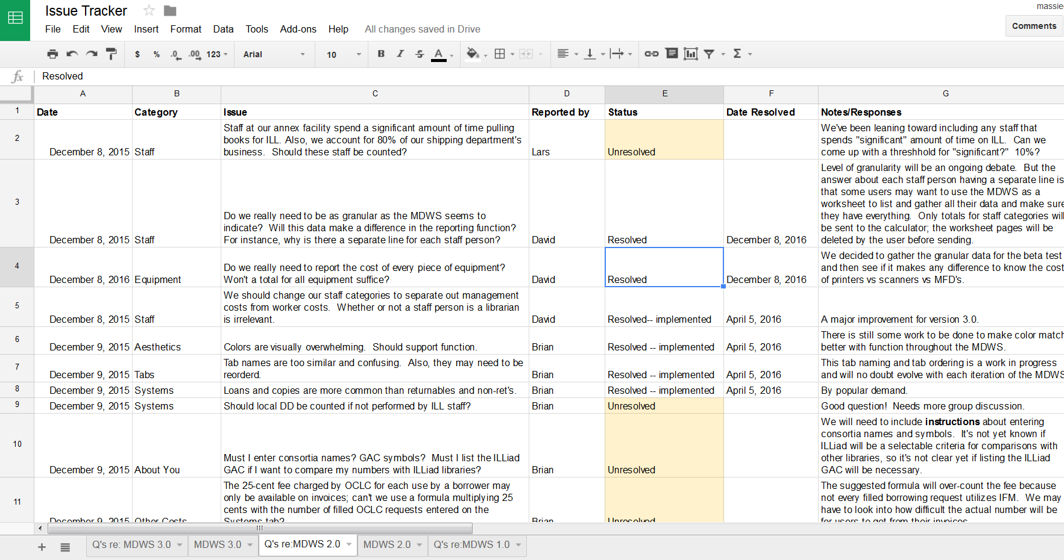

Slide 61
Recent issues tackled by the Betas

Slide 62
Recent issues tackled by the Betas
Which staff should we include?
Circ? Offsite storage? Mail room? Work study?

Slide 63
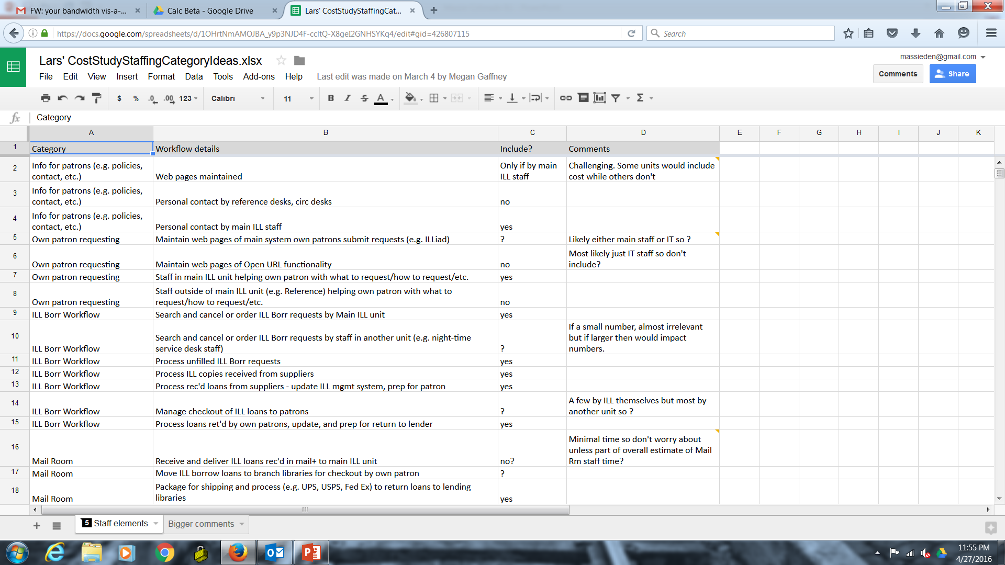

Slide 64
Recent issues tackled by the Betas
Which staff should we include?
Circ? Offsite storage? Mail room? Work study?
What equipment should be counted? Amortized?
High-end scanners? PC’s? Printers? MFD’s?

Slide 65
Recent issues tackled by the Betas
Which staff should we include?
Circ? Offsite storage? Mail room? Work study?
What equipment should be counted? Amortized?
High-end scanners? PC’s? Printers? MFD’s?
How should we define an unfilled request?
From the patron’s POV? The ILL system’s?

Slide 66
Recent issues tackled by the Betas
Which staff should we include?
Circ? Offsite storage? Mail room? Work study?
What equipment should be counted? Amortized?
High-end scanners? PC’s? Printers? MFD’s?
How should we define an unfilled request?
From the patron’s POV? The ILL system’s?
Should we count delivering own stuff to own patrons?

Slide 67
Recent issues tackled by the Betas
Which staff should we include?
Circ? Offsite storage? Mail room? Work study?
What equipment should be counted? Amortized?
High-end scanners? PC’s? Printers? MFD’s?
How should we define an unfilled request?
From the patron’s POV? The ILL system’s?
Should we count delivering own stuff to own patrons?
What about costs covered by confidentiality agreements?
What about costs that we simply can’t come up with?

Slide 68
when

Slide 69
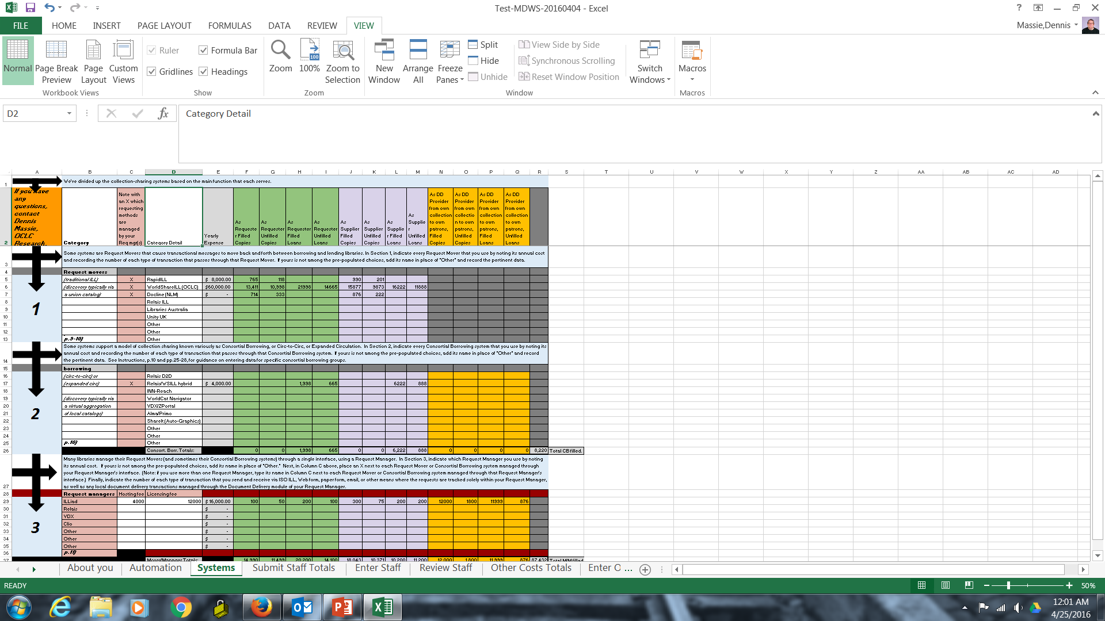
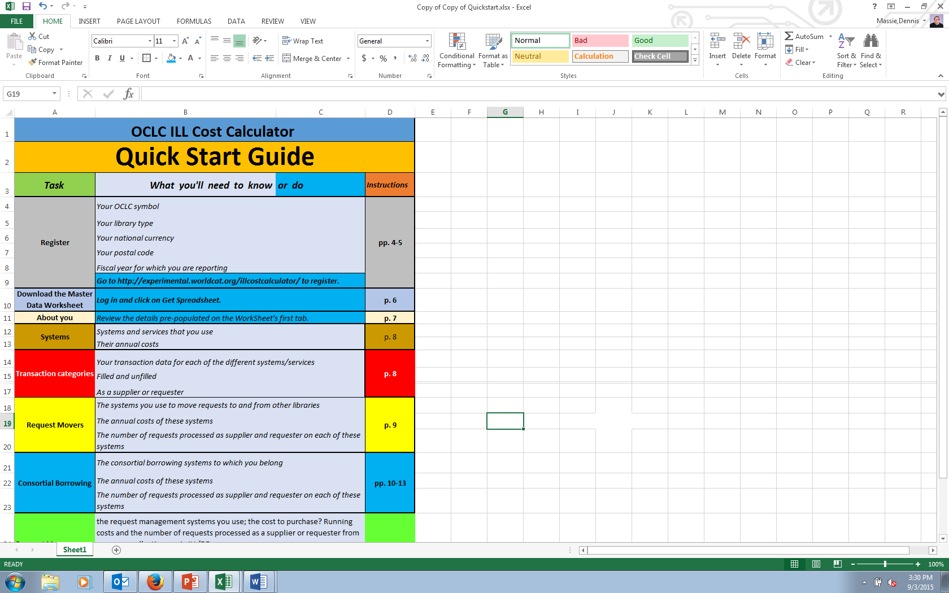
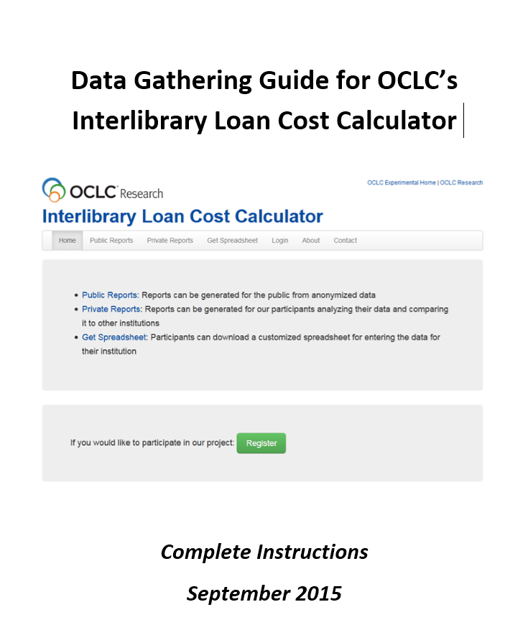
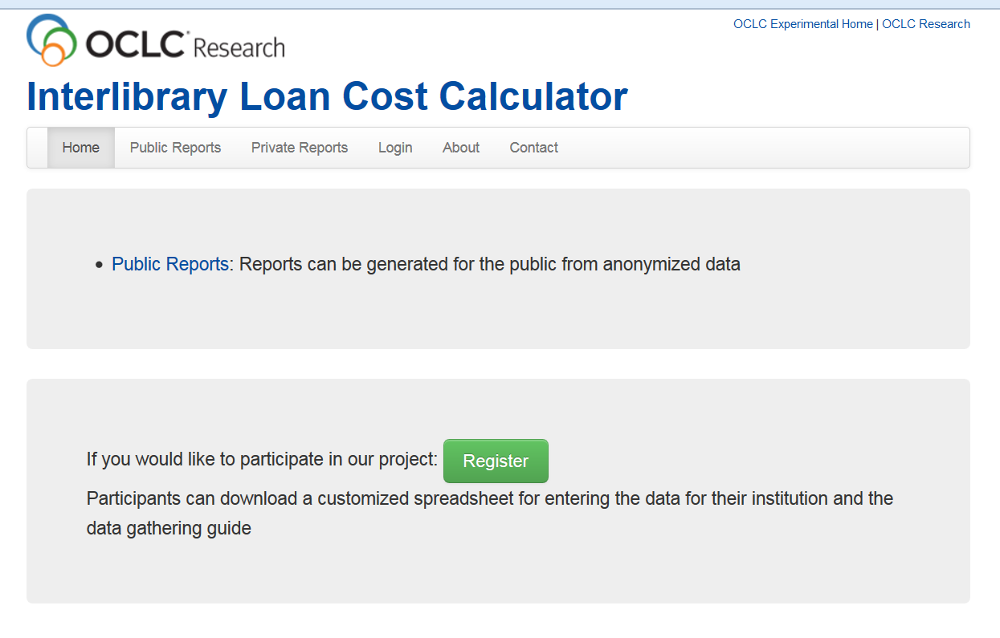
Now in Beta Testing

Slide 70
Birthing an ILL Cost Calculator
Next 4 months:
Beta testers will gather and submit their data
OCLC software engineer will build database and reporting functions
Beta testers will test reports
Next 6 months:
“Early interest” folks will be invited to submit data
Eventually
We’ll open it up to everyone
We’ll work with various groups and organizations to encourage use
Google OCLC ILL Calculator for more information.

Slide 71
Linked Data Implementations
Karen Smith-Yoshimura
Senior Program Officer

Slide 72

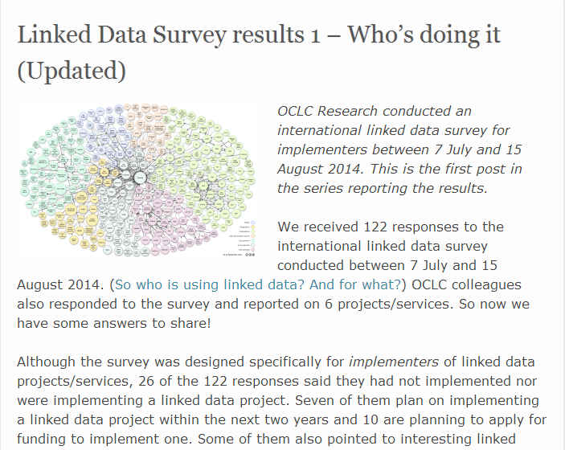
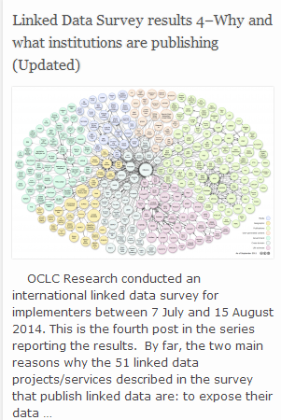
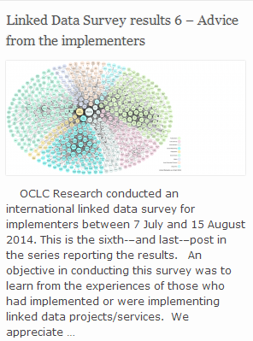
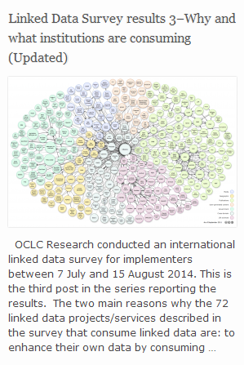
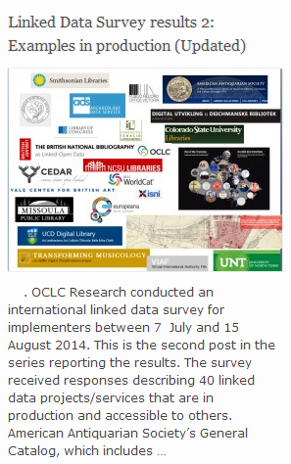
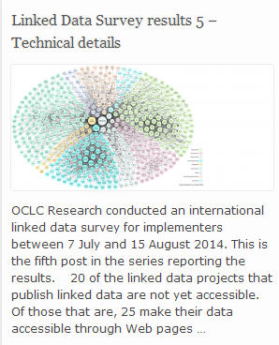
International Linked Data Surveys for Implementers
Notes:
The impetus for an “International Linked Data Survey for Implementers” were discussions with OCLC Research Library Partner metadata managers who were aware of a number of linked data projects or services but felt there must be more “out there”. In consultation with a number of colleagues and after some beta testing with a group of linked data implementers with the survey instrument, we conducted an initial survey in July – August 2014. The target audience were those who had already implemented a linked data project or service, or were in the process of doing so. Questions were asked both about publishing linked data and consuming linked data.
I published the results in a series of posts on our HangingTogether blog.
One of the first criticisms we received were that the results did not include some leading linked data implementers such as the national libraries of France and Germany. So we repeated the survey between 1 June and 31 July 2015.

Slide 73
International Linked Data Surveys for Implementers
2014
48
2015
71
Both
29
Number of institutional responses
Notes:
These are the number of institutions reporting one or more linked data project or service, either ones publishing linked data, consuming linked data, or both.

Slide 74
Geographic breakdown of 90 responding institutions
20 countries
represented
Notes:
These are the countries represented by the 90 institutions which have implemented or are implementing at least one linked data project or service. US respondents numbered 39, or 43% of the total.
Spain: 10 (11%)
UK: 9 (10%)
Netherlands: 6 (7%)

Slide 75
2015 responding institutions by type
Notes:
This is how I categorized the responding institutions, but others may do it differently.
National Libraries which responded (14): Biblioteca. Real Academia Nacional de Medicina, Bibliotheque nationale de France, British Library, German National Library, Koninklijke Bibliotheek, Library of Congress, National Diet Library, National Library of Malaysia, National Library of Medicine, National Library of Portugal, National Library of Spain, National Library of Sweden, National Library of Wales, National Széchényi Library [Hungary]
Categorized as “network” (10): ABES, BIBSYS, Consorci de Serveis Universitaris de Catalunya, Digital Public Library of America, Europeana Foundation, Haute école de gestion de Genève (SwissBib), North Rhine-Westphalian Library Service Center, OCLC, RERO - Library Network of Western Switzerland, and The European Library.
Government (7): Agencia Española de Cooperación Internacional para el Desarrollo (AECID). Biblioteca della Camera dei deputati (Italy), Biblioteca Valenciana Nicolau Primitiu, Biblioteca Virtual de Derecho Aragonés, Consejería de Educación, Cultura y Deportes Gobierno de Castilla-La Mancha, España, Diputación de Málaga. Cultura y Deportes. Biblioteca Cánovas del Castillo, Ministry of Defense (Spain)
Scholarly (based at one institution but multi-institutional on a theme/discipline) (6): Big Data Institute [Muninn Project, Canadian Writing Research Collaboratory]; Colorado State [datasets from the NSF-funded Shortgrass Steppe-Long-Term Ecological Research station in northern Colorado, for researchers in natural sciences]; Fundacción Ignacio Larramendi (Spain); Pratt Institute [Linked jazz]; University of Alberta Libraries [Canadiana, partners with Pan-Canadian Documentary Heritage Network]; University of Applied Sciences St. Poelten [encyclopedic music data for music magazines, legal information for publishers and semantic tagging/indexing for video files at community TV network.]
Public library/libraries (5): Anythink Libraries, Arapahoe Library District, Evansville Vanderburgh Public Library, New York Public Library, Oslo Public Library
Museum (3): British Museum, J. Paul Getty Trust, Smithsonian
Other: 1 publisher (Springer) and 3 societies (American Numismatic Society, Chemical Heritage Foundation, Minnesota Historical Society)

Slide 76
How long linked data project or service in production
 | 2015 | 2014
Not yet in production | 37 | 27
Less than one year | 19 | 13
More than one year, less than two years | 10 | 12
More than two years | 46 | 24
Total
112
76
Notes:
The 71 institutions responding to the 2015 survey reported a total of 168 linked data projects/services, of which 112 were described. Two-thirds of these linked data projects/services are in production, of which 61% have been in production for more than two years. It’s almost double the number of projects/services in production for over two years reported in 2014.

Slide 77
How linked data is used
 | 2015 | 2014
Consume linked data | 38 | 25
Publish linked data | 10 | 4
Both consume & publish | 64 | 47
Notes:
In both the 2014 and 2015 surveys, most projects/services both consume and publish linked data. Relatively few only publish linked data.

Slide 78
Reasons for publishing linked data | 2015 | 2014
Expose to larger audience on the Web | 67 | 45
Demonstrate what could be done with datasets as linked data | 59 | 41
Heard about linked data and wanted to try it out by exposing our data as linked data. | 43 | 21
See if publishing linked data would improve our Search Engine Optimization (SEO.) | 29 | 9
Notes:
Although the number of respondents between the two surveys differ, the ranking of the reasons given for publishing linked data are the same.

Slide 79
Types of data published as linked data
Notes:
Given the relatively large representation of libraries among respondents, no surprise that bibliographic and authority data are the most common types of data published, with descriptive metadata a close third.
Other: 5 of the 11 “other” were about organizational data; 2 were data about people (researchers, library staff). 1 about performance works (e.g., shows).

Slide 80
Reasons for consuming linked data | 2015 | 2014
Provide our users with a richer experience. | 51 | 35
Enhance our own data by consuming linked data from other sources. | 50 | 37
More effective internal metadata management. | 32 | 16
Greater accuracy and scope in our search results | 27 | 12
See if consuming linked data would improve our Search Engine Optimization (SEO). | 19 | 12
Experiment with combining different types of data into a single triple store. | 17 | 15
Heard about linked data and wanted to try it out by using linked data sources. | 17 | 13
Notes:
Again, the ranking of the reasons given for consuming linked data are almost the same among respondents in the 2014 and 2015 surveys.

Slide 81
Some examples In production
Notes:
I’ve selected a few examples from the 75 linked data projects or services described that are in production. Not so easy, as they are meant for machines to read, not a human like me. This is just a sampling.

Slide 82
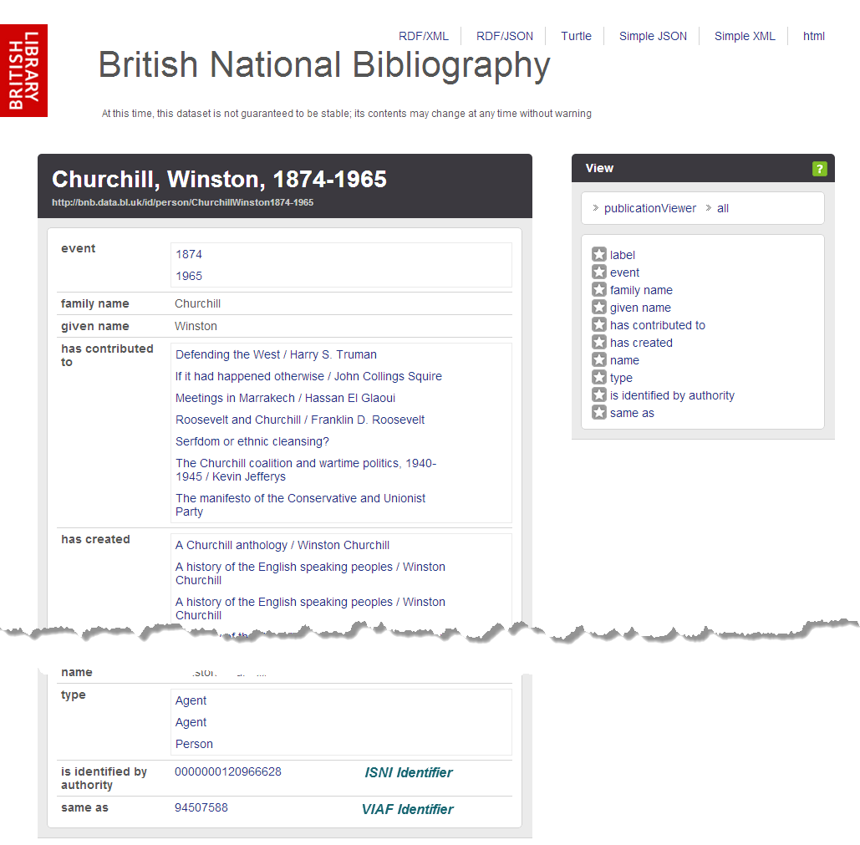
http://bnb.data.bl.uk
Notes:
The British Library was one of the first to make its national bibliography available as linked open data, exposing it in bulk. It is considered successful as it has been selected for the UK National Information Infrastructure and its data model has been influential.
Note that it includes links to both the ISNI and VIAF identifiers for this entity. The end of the page also shows the SPARQL query to retrieve the result that people can modify and re-run.

Slide 83
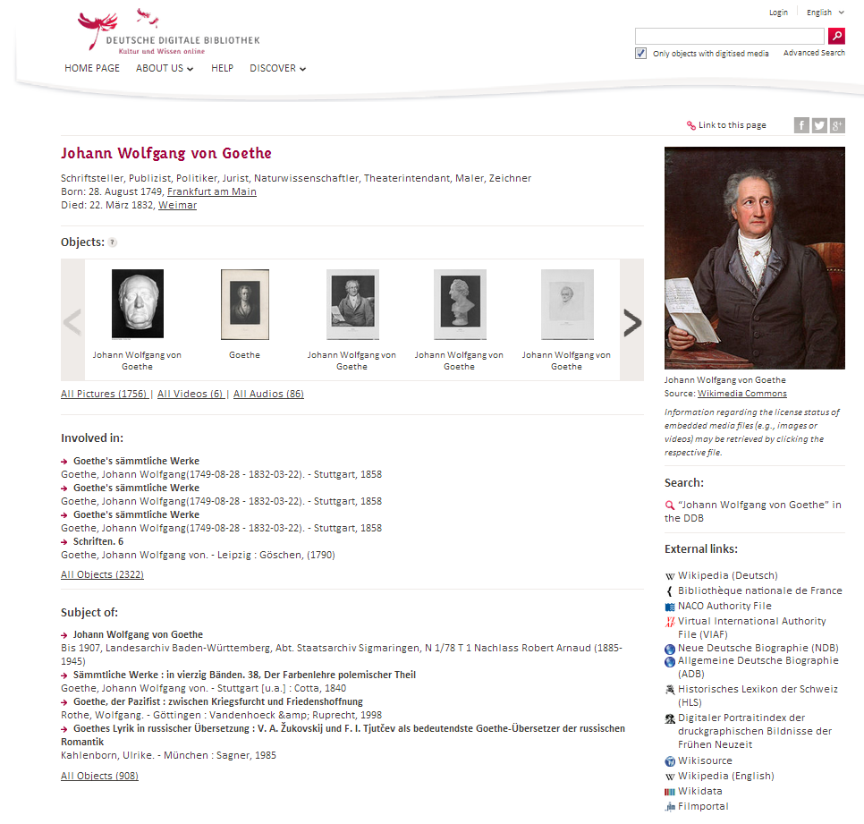
http://www.dnb.de/EN/entityfacts
Notes:
The German National Library described 4 projects that publish linked data: German National Bibliography, German Integrated Authority File (GND), its BIBFRAME prototype, and Entity Facts, shown here. Entity aggregates information about entities from various sources. The information provided is based on the Integrated Authority File (Gemeinsame Normdatei, GND) and merged with other sources such as Wikipedia, VIAF and IMDb. The data model was designed to facilitate reuse by developers without domain knowledge. Its Web interface provides information in German and English

Slide 84
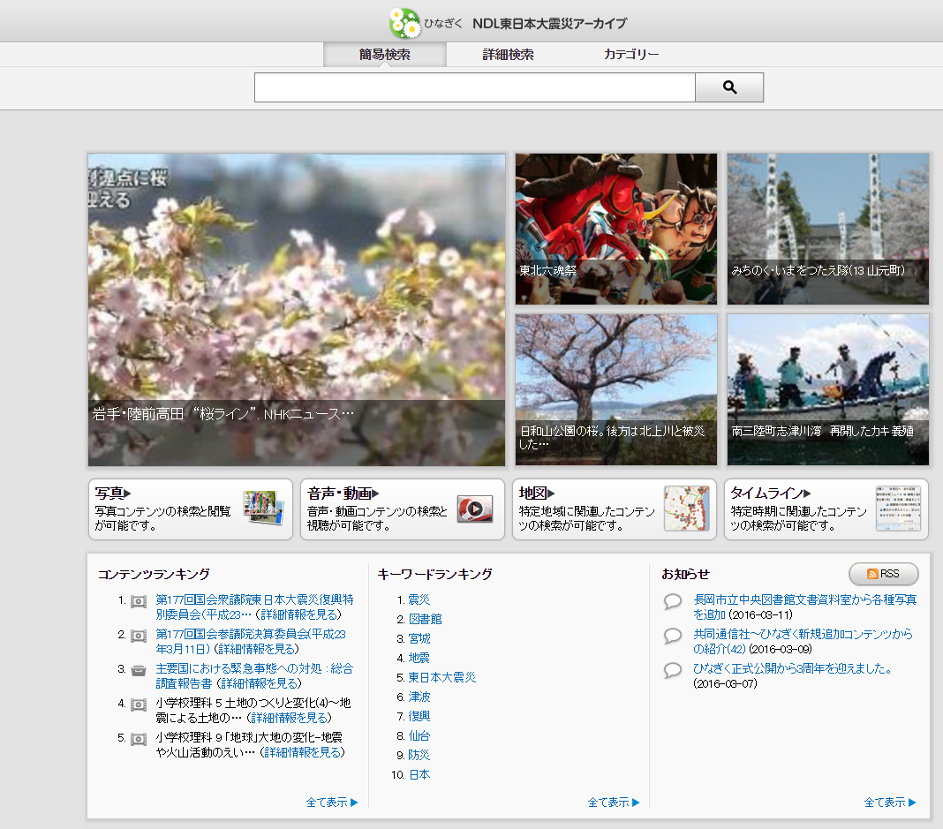
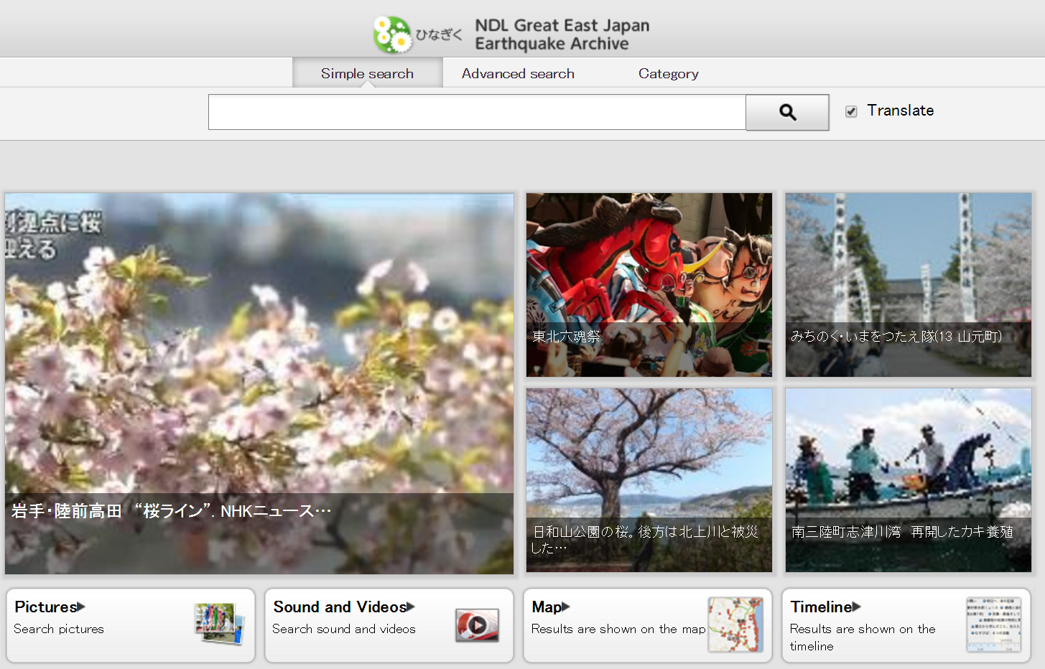
http://kn.ndl.go.jp/
Notes:
The National Diet Library reported on 5 different projects in the 2015 survey. One was for publishing bibliographic data as linked data, another on publishing authority data as linked data. Another: International Standard Identifier for Libraries and Related Organizations (ISIL) for Japan, and one on Nippon Decimal Classification”, the Japanese standard classification system. This one is to enable comprehensive searching of sounds videos, images, web information and other resources related to the Great Kanto earthquake of 2011.
Slide from Jean Godby, OCLC Research

Slide 85
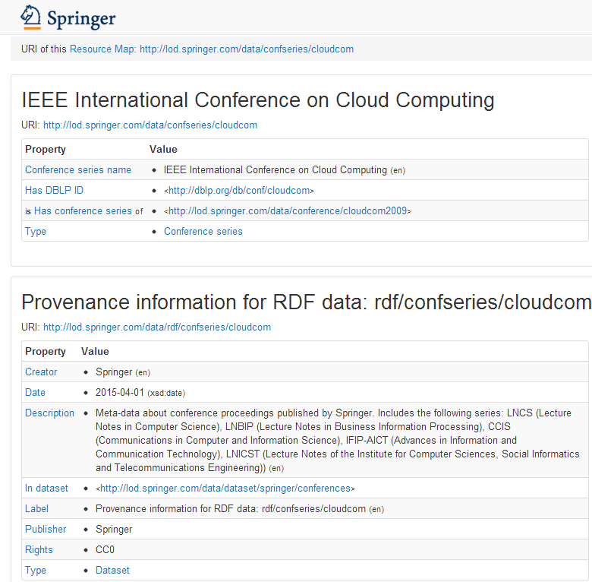
Notes:
Springer is the only publisher to respond to our survey.. It is making data about scientific conferences available as Linked Open Data to make information about publications, authors, topics and conferences easier to explore and to facilitate analysis of the productivity and impact of authors, research institutions and conferences.

Slide 86
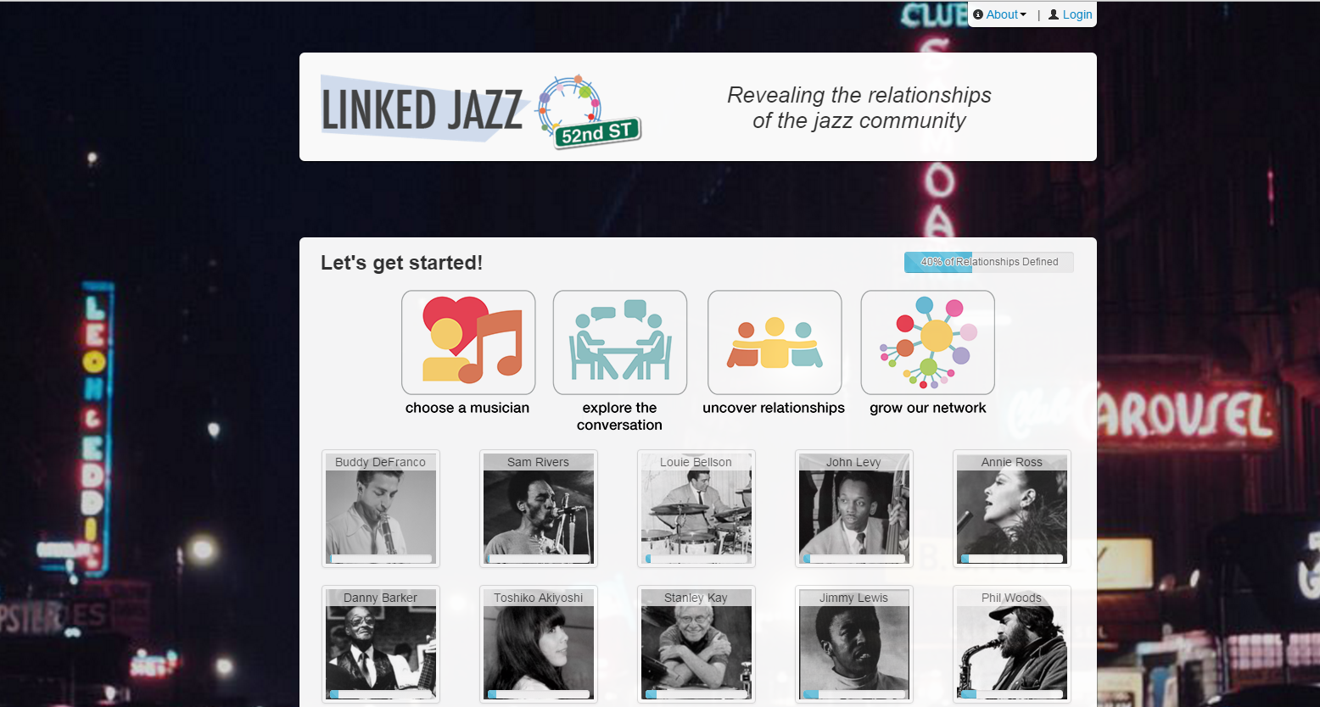
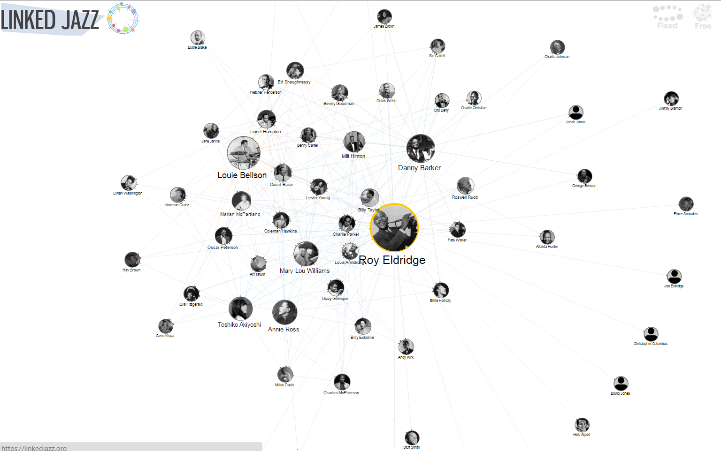
https://linkedjazz.org/
Notes:
The Pratt Institute reported its Linked Jazz project, which applies Linked Open Data technologies to digital heritage materials and explores the implications of linked data in the user experience. It exposes relationships between musicians and enables jazz enthusiasts to make more connections.
It generated new triples from the content of interview transcripts – from the data rather then converting existing metadata. Transcripts came from Rutgers Institute for Jazz Studies Archives, Smithsonian Jazz Oral Histories, the Hamilton College Jazz Archive, UCLA’s Central Avenue Sounds series, and the University of Michigan’s Nathaniel C. Standifer Video Archive of Oral History. The first phase of the project was funded through an OCLC/ALISE Library and Information Science Research grant

Slide 87

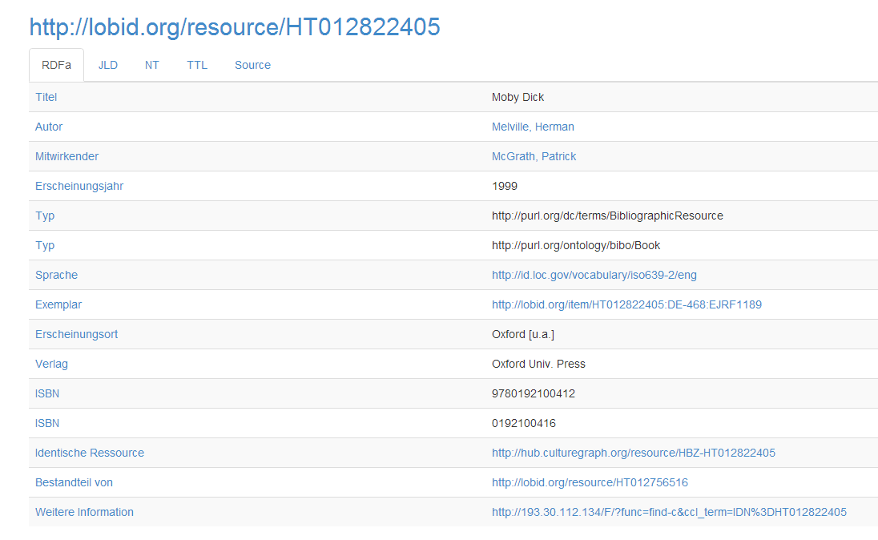
North Rhine-Westphalian Library Service Center
Notes:
The North Rhine-Westphalian Library Service Center (hbz) publishes one of the largest linked data datasets (1-5 billion triples). Its linked open data API provides access to 20 million bibliographic records and 45 million holdings from the hbz union catalog; to authority data from the German Integrated Authority File (GND); and to library address data from the German International Standard Identifier for Libraries and Related Organizations (ISIL) registry.

Slide 88
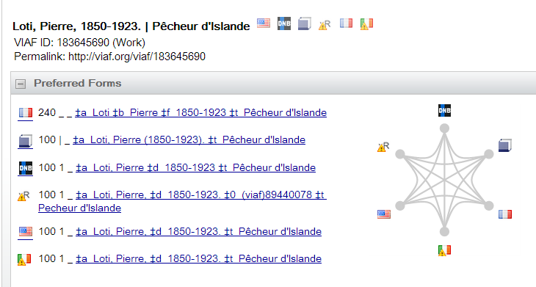
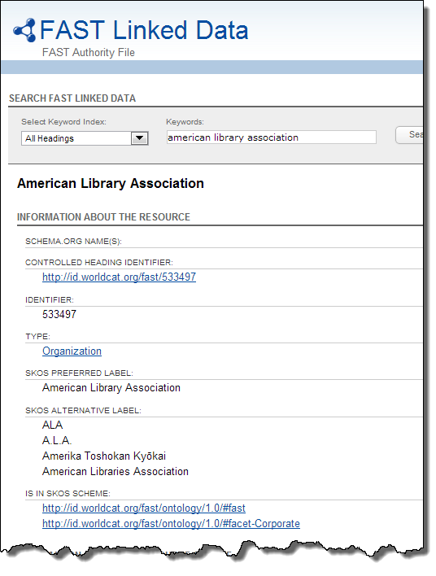

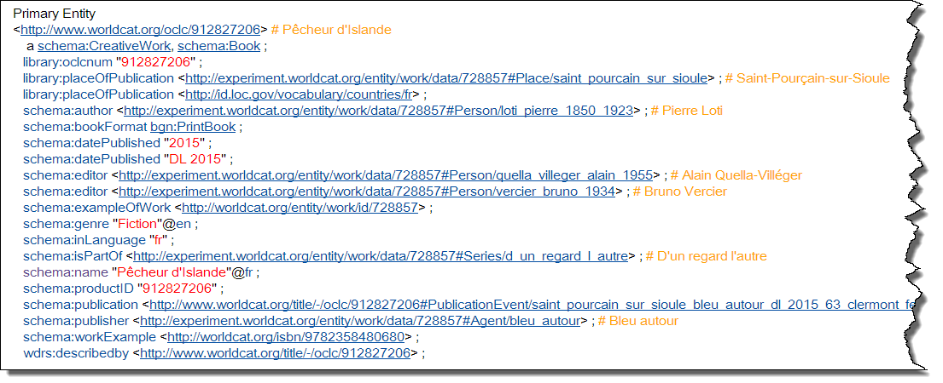
Over 20 billion triples
Notes:
This audience well knows that OCLC has been publishing RDF triples extracted from MARC records and library authority files for several years – records that you OCLC members have contributed over decades.
OCLC also responded to the survey, and these are three of the projects described: VIAF (The Virtual International Authority File), <click> FAST (Faceted Application of Subject Terminology) <click> and WorldCat.org.
All together OCLC has published <click> well over 20 billion RDF triples. This constitutes the largest library aggregation of linked data resources in the world. I chose these three linked data sources because…

Slide 89
2015 linked data sources most consumed | 2015
VIAF (Virtual International Authority File) | 41
DBpedia | 36
GeoNames | 35
id.loc.gov | 35
Resources we convert to linked data ourselves | 17
Getty's AAT | 16
FAST (Faceted Application of Subject Terminology) | 15
WorldCat.org | 15
data.bnf.fr | 12
Deutsche National Bib Linked Data Service | 12
Notes:
… They were among the top 10 linked data sources consumed by the 2015 survey respondents (named by 12 or more of the respondents).
I’ve starred the ones which also responded to the survey. Note that “resources we convert to linked data ourselves” is one of the top linked data sources consumed. One advice from linked data implementers is to first consume the linked data you publish.
These could be considered successful publishers of linked data by the degree to which others consume the data provided.

Slide 90
Advice from the implementers
Focus on what you want to achieve, not technical stuff
Model data that solves your use cases
Add distinctive value: Build on what you have others don’t
Pick a problem you can solve
Have a good understanding of linked data structure, available ontologies and your own data
Consume your own published data
Just do it!

Slide 91
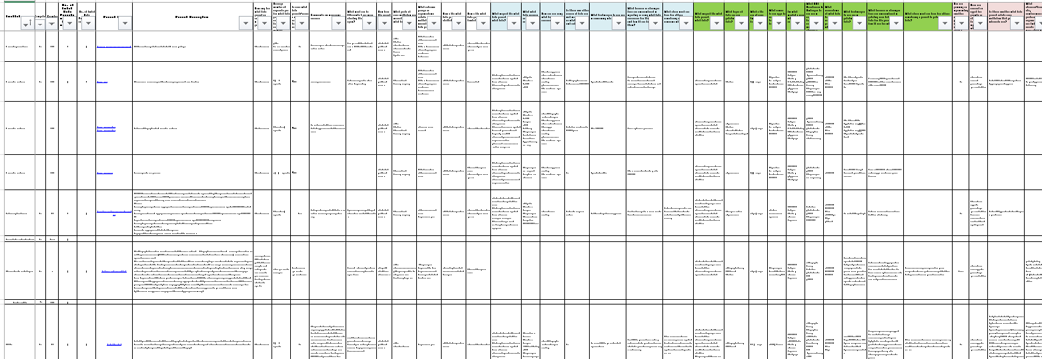
Full details of responses
http://www.oclc.org/content/dam/research/activities/linkeddata/oclc-research-linked-data-implementers-survey-2014.xlsx
Notes:
We plan to add the responses to the 2015 survey to the spreadsheet with the 2014 responses. You’ll be able to make your own comparisons, or focus on the institutions that most resemble yours.

Slide 92
Scaling Supercharged Storytimes
Sharon Streams
Director, WebJunction | OCLC Research

Slide 93

Understand & Identify Needs
Build Capacity:
-Technology
- Space
- Competency
- Materials
Design & Deliver Services
Reach Target Audiences
Evaluate Service Outcomes
Health
Lifelong Learning
Economic Success
etc.
Notes:
A little background before I dig into my update:
WebJunction launched in 2003 with a grant from the Bill & Melinda Gates Foundation to OCLC. Over the past 13 years, WebJunction has served to build the capacity of public libraries to meet evolving community needs. Our focus is on learning, which we believe that – when applied – can lead to transformation. We also think that active, social, online learning makes it more effective at scale.
WebJunction joined with OCLC Research about 18 months ago, and are really excited and energized by this new collaboration.
Our view is that a strong public library knows the needs of its community,
has capacity to serve those needs,
delivers services to meet those needs,
reaches those with the need, and
evaluates the effectiveness of the services addressing those needs.
And the cycle is continuous. This is a tall order, and we try to help by adopting a similar approach to our work. We strive to understand both public library needs and community needs and design learning programs that will have positive outcomes for both audiences.
I am going to use our recent project Supercharged Storytimes as an example of using library research to bolster library practice for the benefit of our youngest patrons.

Slide 94
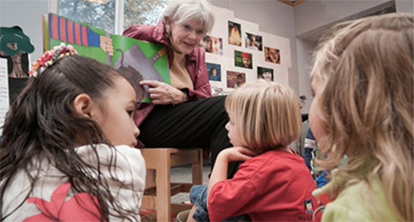
The Need
Young children need to build essential early literacy skills.
Public library staff need to know they are making a difference.
Photo credit: Project VIEWS: http://views2.ischool.uw.edu
Notes:
Research shows there is essential brain development that occurs in young children between birth and age 5. Children who have not developed early literacy skills by the time they enter kindergarten will struggle to catch up. In fact, the lag can compromise their learning success through their entire academic experience. Too many children have been affected by this lag, and so that is the community need to be addressed.
There is also the need within the library to understand whether programs and services are truly making a difference in people’s lives.

Slide 95


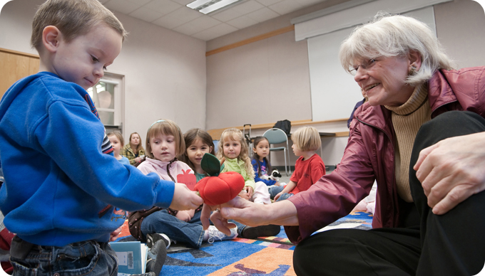
The Research
“Do library storytimes help young children develop early literacy skills?”
Notes:
One of the most popular and longstanding public library program is storytime for young children, so this is where those two needs intersect.
In response, Over the last few years the University of Washington Information School conducted IMLS-funded research to answer the question:
“Do library storytimes help young children develop early literacy skills?”
This research was called Project VIEWS2, and was led by Dr. Eliza Dresang, pictured here. The study was particularly relevant and important for libraries because this was the first study of its kind conducted in a public library setting.

Slide 96
The Research
“A purposeful focus on early literacy concepts in storytimes makes a difference on the program and the children’s early literacy behaviors”
̶ VIEWS2
http://views2.ischool.uw.edu/welcome-directors/
Notes:
Well, what the research found was that
-Animation 1
“A purposeful focus on early literacy concepts in storytimes makes a difference on the program and the children’s early literacy behaviors”
In other words, Storytimes Matter.
VIEWS2 also produced research-based tools that library practitioners can use for storytime planning and reflection.

Slide 97


Research moves to practice
Provide an online orientation and community of practice for storytime practitioners. Scale.
Notes:
After learning about the work of VIEWS2, we sought a IMLS National Leadership Grant to move the research into practice. This project began in the fall of 2014 and ran through this spring. and was conducted in partnership with Washington State Library and Thrive Washington, an early learning organization. Sadly, Dr. Dresang passed away during the grant proposal process, so we have relied on the legacy of her work and her VIEWS2 research team as consultants to the project.
The ensuing program, which we dubbed Supercharged Storytime, has engaged over 500 storytime practitioners across 6 states.

Slide 98





Peer Learning Community
“The online community allows me to share resources with others who may have more experience than me, and not feel intimidated.”
“We learn from our peers best.
They motivate us and provide the "spark" to try new things.”
early literacy concepts and tools
Supercharged Central
online community
Live online sessions
Reflect
Practice
Share
Facilitated instruction + individual practice + peer-to-peer sharing and reflection
Notes:
The program included a blend of Facilitated orientation + individual practice + peer to peer sharing and reflection
Specifically, Over an 8-week period, we conducted a series of live online sessions that introduced the cohort to concepts and tools arising from the Project VIEWS2 work, which we had adapted for this application-based orientation. These lively sessions included a lot of peer-to-peer interaction, which the participants found particularly valuable. There are a couple representative quotes here on the slide.
In between each session, Participants put their learning into practice at their library. They also reinforced their learning through independent study and reflection, and shared their experience with their peers in the discussion space we set up for this program, Supercharged Central.

Slide 99
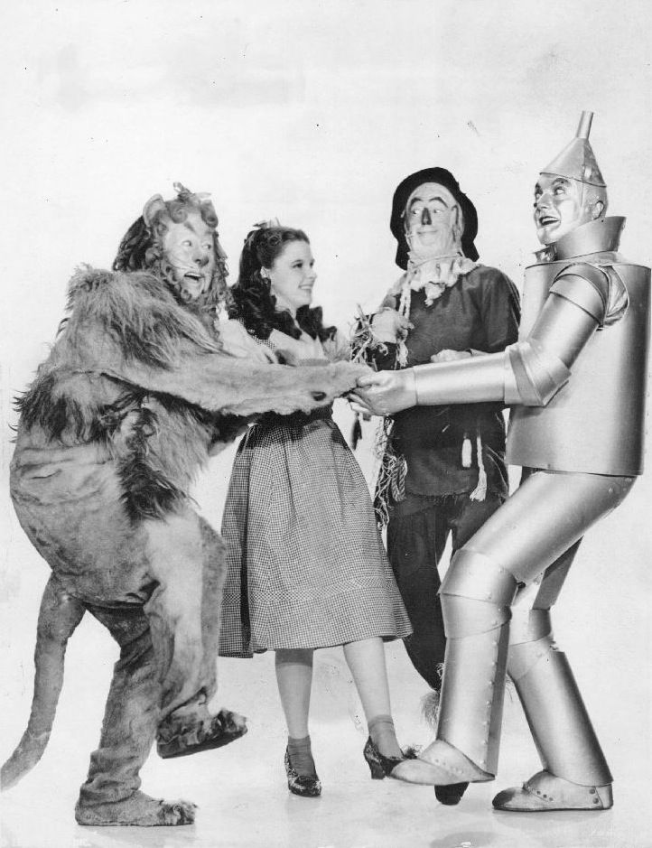
Building Capacity
Knowledge
Awareness
Confidence
Community
Public domain publicity still
Notes:
The project has built library staff capacity on multiple dimensions:
KNOWLEDGE: By connecting their existing techniques to the research, practitioners can be more intentional about incorporating early literacy concepts in their planning and delivery of storytimes.
AWARENESS: spreading the VIEWS2 research raises awareness among administrators, parents and caregivers and other stakeholders that library storytimes matter. It’s “not just a cute thing to do”. They are programs worth building and sustaining to meet an essential learning need.
CONFIDENCE: With this new knowledge and awareness, confidence soars. Like in Wizard of Oz, so much of this project was about library practitioners recognizing the strengths that they had all along. As one participant put it, “I have been doing storytimes for years, but I didn’t know why I was doing the things I was doing. I realized I am so much smarter than I thought!”
COMMUNITY: the 500+ participants shared their experiences with supercharged storytimes with one another, spreading ideas, resources, and support across 6 states.
Together, this CAPACITY stimulates ACTION: storytime programs are being delivered with confidence and renewed intention to support the development of essential early literacy skills.
We have formative and summative project evaluation results that measured outcomes across these areas, and we will share those in a report later this summer.

Slide 100
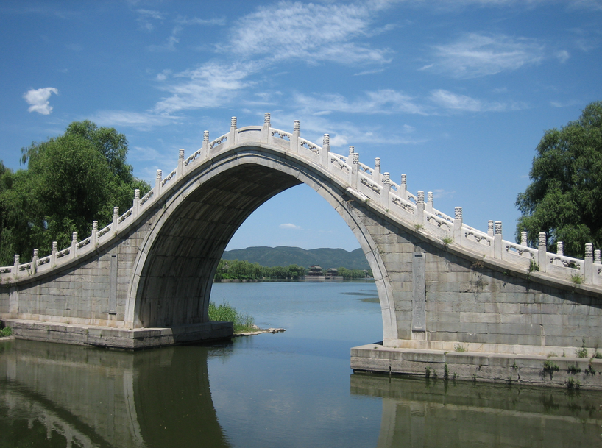
Bridge Research and Practice
Project VIEWS2 Research
Supercharged Storytimes
Library Learning
Notes:
Through the process of bridging research to practice, we’ve learned that Designing programs from a research-base lends legitimacy to the work, both for participants as well as for potential partners. However, it’s not enough to say that the work is “grounded in research.” Practitioners will need to know what that means and why it matters to their library and their community.
Researchers and program providers working together to socialize research must invest time to build a common language and perspective that will resonate with the intended audience. In the case of Supercharged Storytimes, our project team and the VIEWS2 researcher had to hash out context and vocabulary, and identify how to maintain the integrity of the research outputs while creating an engaging learner experience. We even created a glossary to bridge the jargon gap.
-Ultimately, this investment of time was well worth the effort.
-Supercharged Storytimes has demonstrated the power of peer learning; the power of intention in library practice; and the importance of confidence as a facet of library capacity and community-building.
-We’re thrilled that our project has achieved this at the scale that it has. As a learning organization, we’ve love to hear how your institution is bridging research and practice, so that we can learn from you.

Slide 101
Project Resources
Supercharged Library
Orientation Outline
Supercharged Storytime Course
Now available at
www.webjunction.org
Notes:
Project resources, archived recordings and more have been gleaned and curated from Supercharged Storytimes and are available on WebJunction.org.
There is a postcard handout that you can grab that has some details as well.
Thank you!

Slide 102
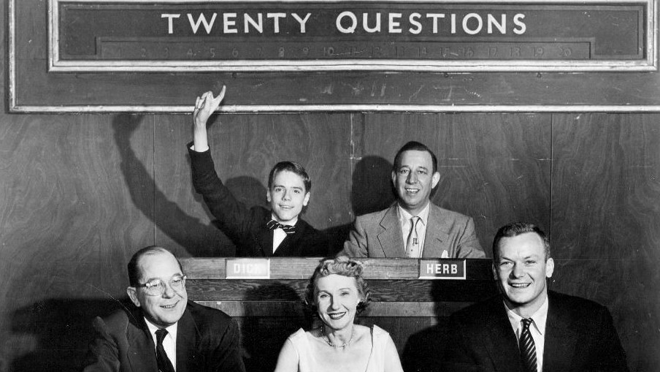
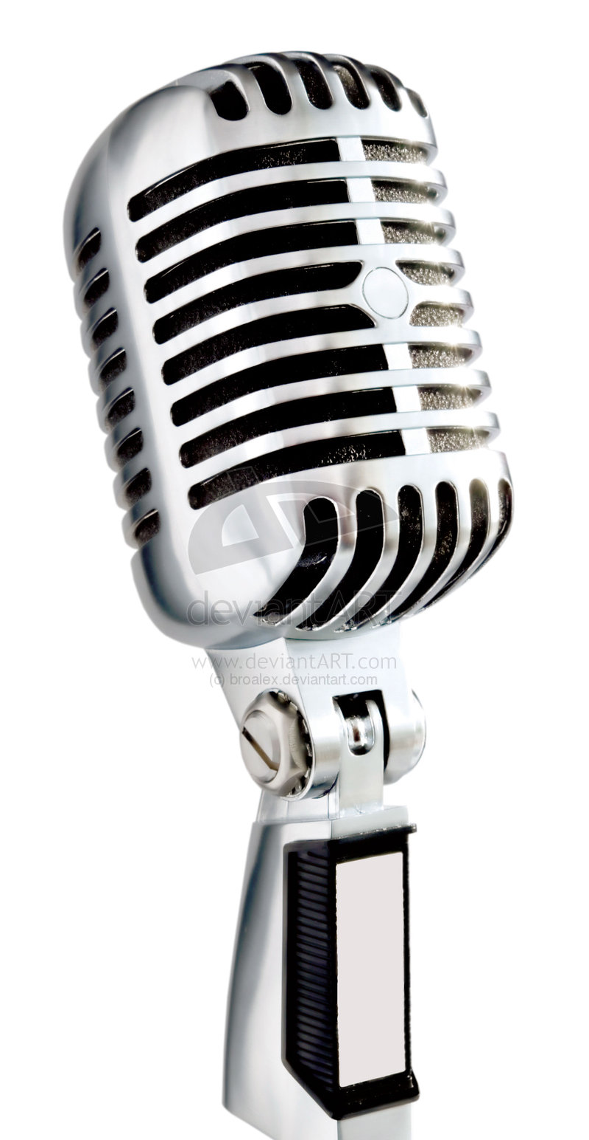
Please use
The microphone
Questions?
Thank
You!
Source: https://upload.wikimedia.org/wikipedia/commons/6/65/20_questions_1954.JPG
Notes:
Photo from DuMont advertising the show, with 14 year-old Dick Harrison, Herb Polesie, Fred Van Deventer, Florence Rinard, and actor Aldo Ray as guest panelist (February 1, 1954)
See: https://en.wikipedia.org/wiki/Twenty_Questions

Slide 103
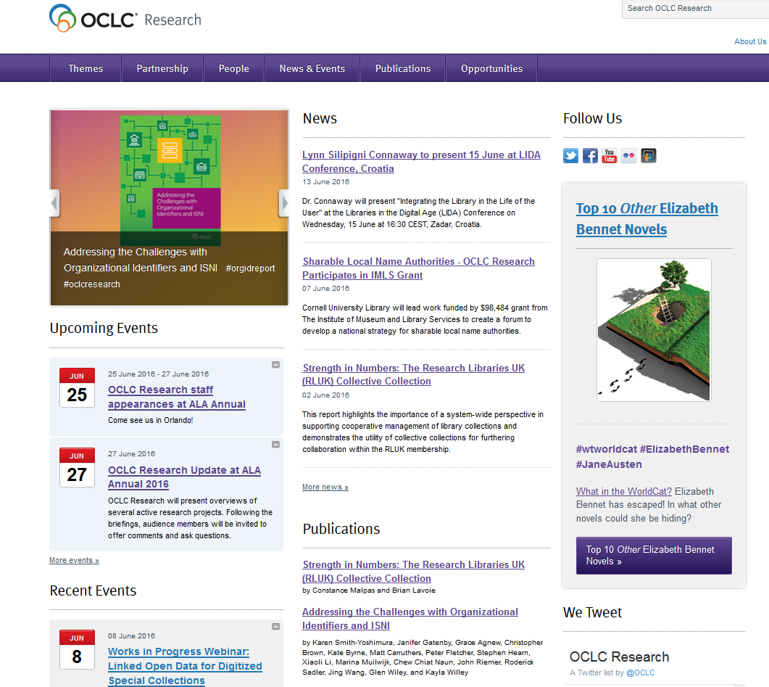
OCLC Research
http://www.oclc.org/research.html

